Slide 1
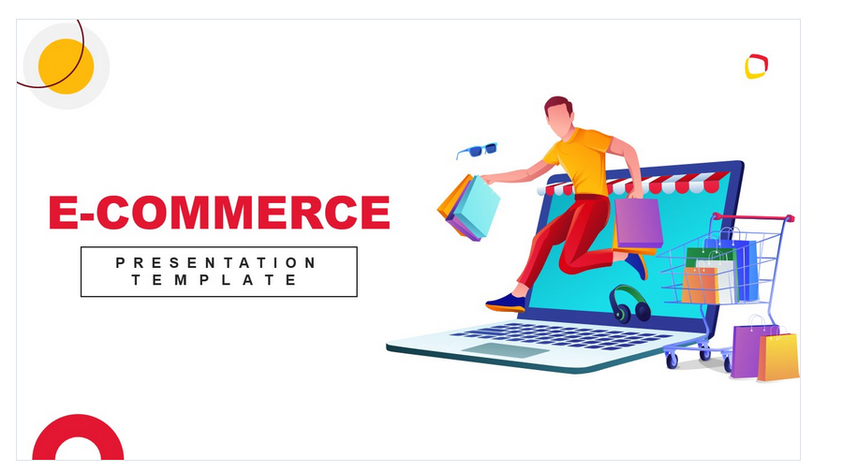
Electronic Shop
Social Media Strategy
Here is where your presentation begins

Slide 2
Table of contents
01
04
02
05
03
06
DATASET
Content plan
EDA and feature engineering
You can describe the topic of the section here
MODEL BUILDING
Budget
Comparison of classification model.
You can describe the topic of the section here
KPI
KPI overview
Metrics to be considered.
You can describe the topic of the section here

Slide 3
Business Probelm
In the rapidly growing landscape of online shopping, one of the major concerns for customers is the reliability of timely delivery of an item. . This problem statement seeks to address the uncertainty surrounding delivery timelines and ensure that customers can trust the timely arrival of their purchases from electronic online stores.

Slide 4
01
Dataset
Let’s discover more about the customer’s database of an ecommerce company.

Slide 5
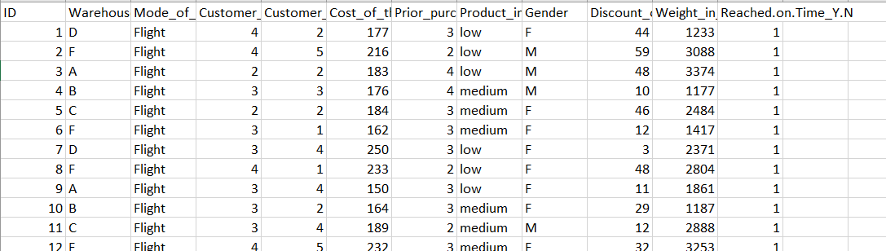
→ E COMMERCE DATASET
1) ID: ID Number of Customers.
2) Warehouse block: The Company have big Warehouse which is divided in to block such as A,B,C,D,E.
3) Mode of shipment:The Company Ships the products in multiple way such as Ship, Flight and Road.
4) Customer care calls: The number of calls made from enquiry for enquiry of the shipment.
5) Customer rating: The company has rated from every customer. 1 is the lowest (Worst), 5 is the highest (Best).
6) Cost of the product: Cost of the Product in US Dollars.
7) Prior purchases: The Number of Prior Purchase.
8) Product importance: The company has categorized the product in the various parameter such as low, medium, high.
9) Gender: Male and Female.
10) Discount offered: Discount offered on that specific product.
11) Weight in gms: It is the weight in grams.
12) Reached on time: It is the target variable, where 1 Indicates that the product has NOT reached on time and 0 indicates it has reached on time.

Slide 6
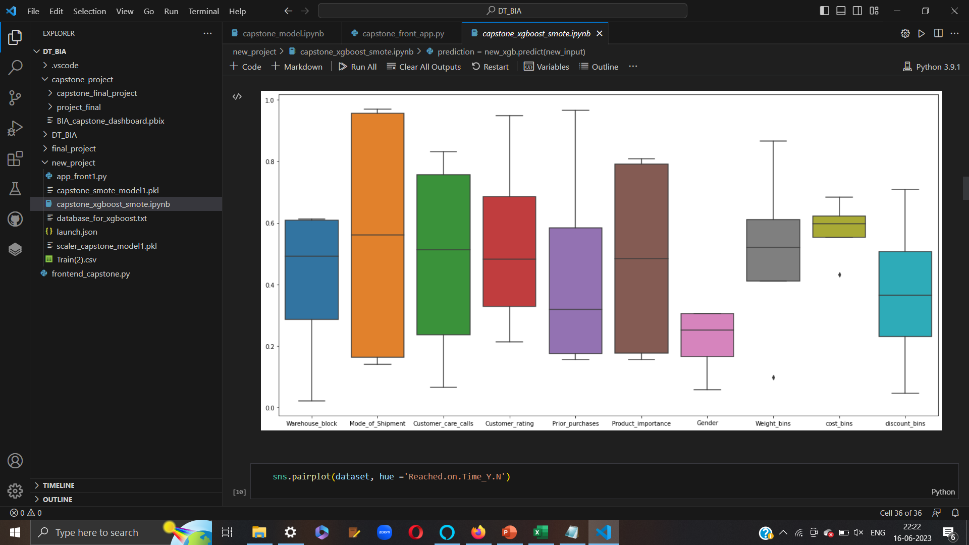
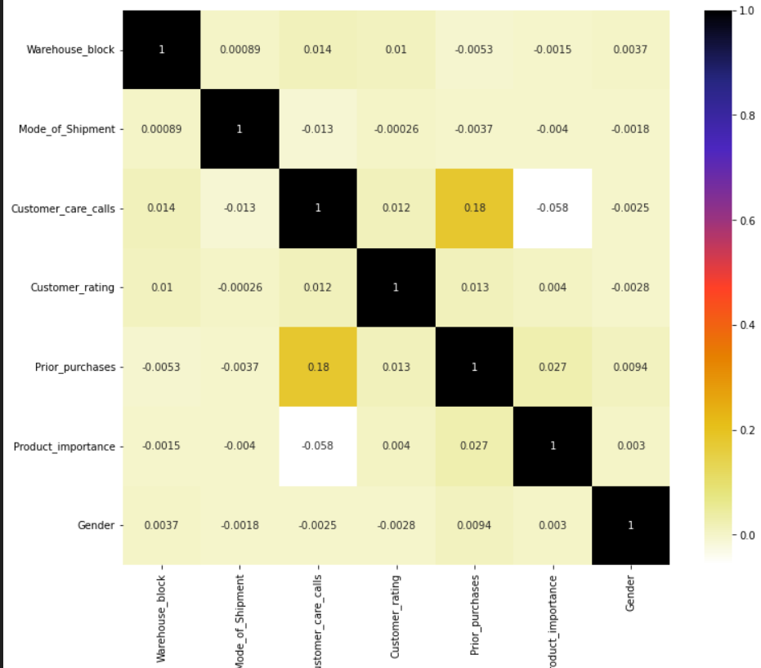
Exploratory Data Analysis
1) outlier detection
2) Heatmap

Slide 7
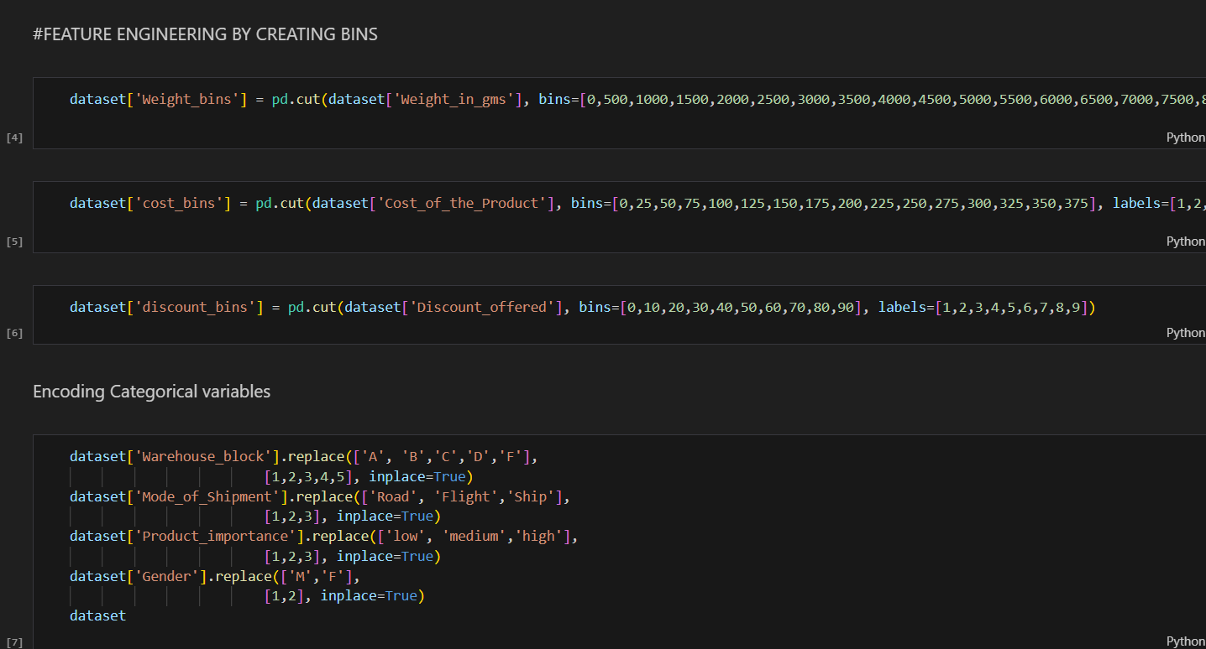
Feature Engineering
1) Weight, Cost and discount Bins and Encoding of categorical variables.

Slide 8
02
MODEL BUILDING
Let’s explore the world of machine Intelligence!

Slide 9
What sets us apart?
Mercury
Mercury is the closest planet to the Sun and the smallest of them all
Venus
Venus has a beautiful name and is the second planet from the Sun
Mars
Despite being red, Mars is actually a cold place. It’s full of iron oxide dust

Slide 10
Classification Model Building
X will have whole dataset except the output variable.
Y will have output variable.
Standardize the data.
Train Test split for cross validation.
Hyperparameter Tuning.
Comparison of different models -

Slide 11

Having 68 % accuracy good or not ?

Slide 12

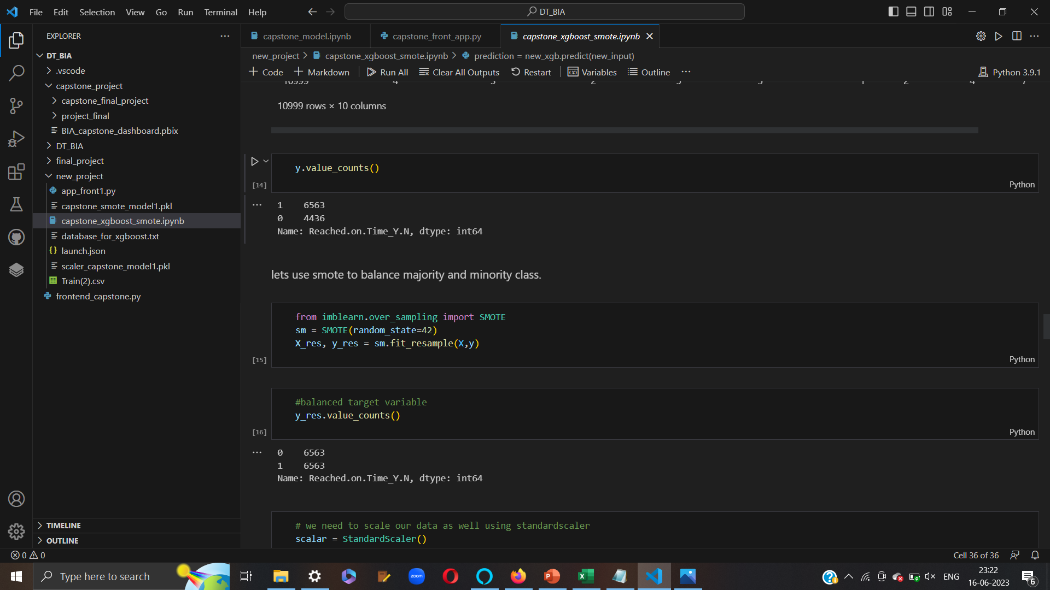
SMOTE

Slide 13

After using smote accuracy of XGBoost model -
0.68
0.74

Slide 14
03
KPI overview
Lets explore what increased items to be delivered on time.

