Slide 1

Naeem Ur Rehman
Mobile Application Developer
at InstaCare

Slide 2
What is Dart?
Dart is a programming language designed for client development, such as for the web and mobile apps.
It is developed by Google and can also be used to build server and desktop applications.
Dart is an object-oriented, class-based, garbage-collected language with C-style syntax.

Slide 3
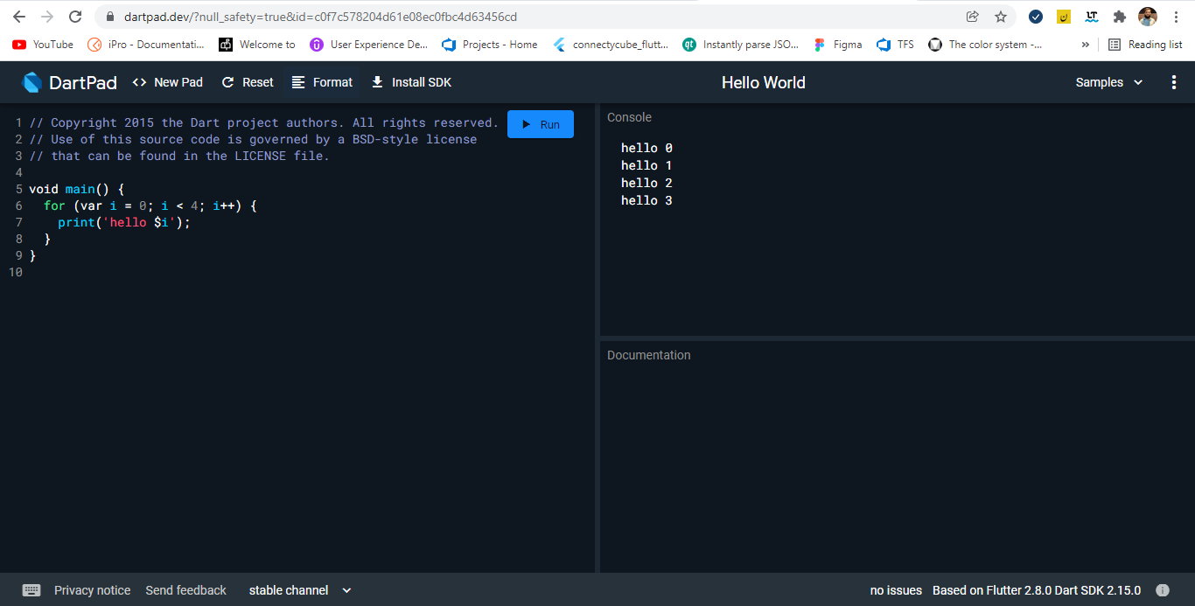
Environment (Executing Script Online with DartPad)
You may test your scripts online by using the online editor at https://dartpad.dartlang.org/

Slide 4
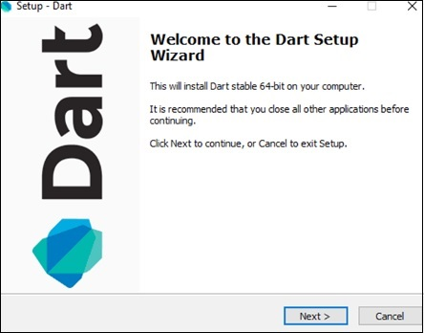
Environment (Setting Up the Local Environment)
The current stable version of Dart is 2.15.0. The dart SDK can be downloaded from − https://dart.dev/get-dart.
On completion of the SDK installation, set the PATH environment variable.
Verifying the Installation > Open cmd and type Dart.
<dart-sdk-path>\bin

Slide 5
Data Types in dart
One of the most fundamental characteristics of a programming language is the set of data types it supports. These are the type of values that can be represented and manipulated in a programming language.
The Dart language supports the following types−
Numbers
Integer
Double
Strings
Booleans
Lists
Maps
Dynamic
Dart is an optionally typed language. If the type of a variable is not explicitly specified, the variable’s type is dynamic. The dynamic keyword can also be used as a type annotation explicitly.

Slide 6
Identifiers in dart
Identifiers are names given to elements in a program like variables, functions etc. The rules for identifiers are:
Identifiers can include both, characters and digits. However, the identifier cannot begin with a digit.
Identifiers cannot include special symbols except for underscore (_) or a dollar sign ($).
Identifiers cannot be keywords.
They must be unique.
Identifiers are case-sensitive.
Identifiers cannot contain spaces.
Valid identifiers | Invalid identifiers
firstName | Var
first_name | first name
num1 | first-name
$result | 1number

Slide 7
Object-Oriented Programming in dart
Dart is an Object-Oriented language. Object Orientation is a software development paradigm that follows real-world modelling. Object Orientation considers a program as a collection of objects that communicate with each other via mechanism called methods.
Object − An object is a real-time representation of any entity.
Class − A class in terms of OOP is a blueprint for creating objects. A class encapsulates data for the object.
Method − Methods facilitate communication between objects.
class TestClass {
void print() {
print("Hello World");
}
}
void main() {
TestClass c = new TestClass();
c.print();
}

Slide 8
Variables in dart
A variable must be declared before it is used. Dart uses the var keyword to achieve the same.
All uninitialized variables have an initial value of null. This is because Dart considers all values as objects.
The dynamic keyword
var name = 'Smith’;
String name = 'Smith’;
int num = 10;
void main() {
dynamic x = "tom";
print(x);
}

Slide 9
Final and Const Variables
The final and const keyword are used to declare constants. Dart prevents modifying the values of a variable declared using the final or const keyword. These keywords can be used in conjunction with the variable’s data type or instead of the var keyword.
The const keyword is used to represent a compile-time constant. Variables declared using the const keyword are implicitly final.
final variable_name;
OR
final data_type variable_name;
const variable_name;
Or
const data_type variable_name;

Slide 10
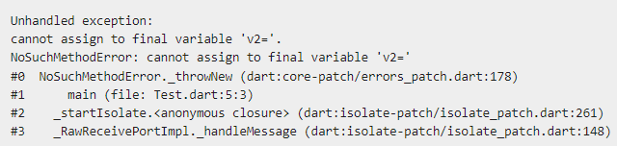
Question!
void main() {
final v1 = 12;
const v2 = 13;
v2 = 12;
}

Slide 11
Dart Operators
An operator is a special symbol that is used to carry out some specific operation on its operand. In Dart, we have rich set of built in operators to carry out different type of operations. In Dart, we have following types of operators available:
Assignment Operators
Arithmetic Operators
Type test Operators
Relational Operators
Logical Operators
Bitwise Operators
Conditional Operators
Casecade notation(..) Operator

Slide 12
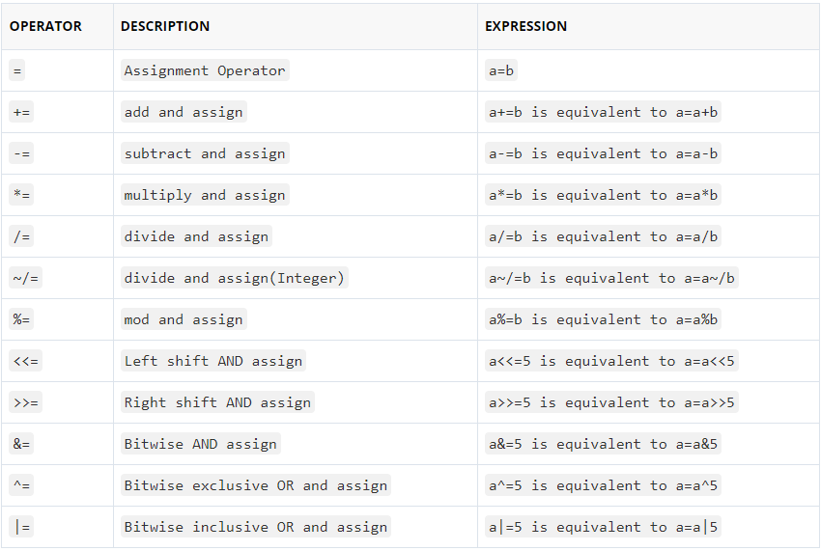
Dart Assignment Operators

Slide 13
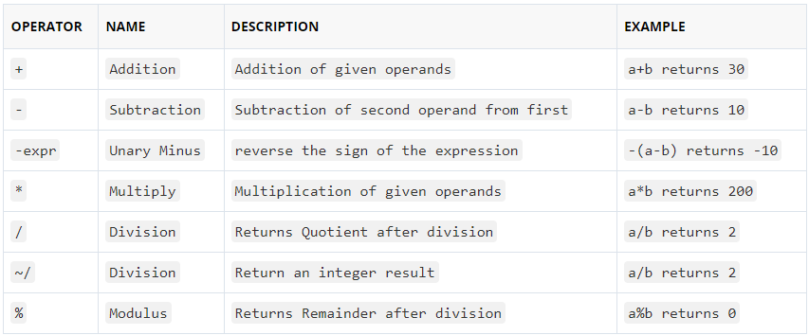
Dart Arithmetic Operators
Let variable a holds 20 and variable b holds 10:

Slide 14
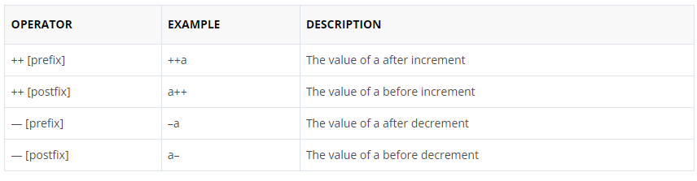
Dart Unary Operators (post and pre)
In Java, ++ and — are know as increment and decrement operators respectively. These are unary operators it means they works on single operand. ++ adds 1 to operand and — subtracts 1 to operand respectively. When ++ is used as prefix(like: ++i), ++i will increment the value of i and then return it but, if ++ is used as postfix(like: i++), operator will return the value of operand first and then only increment it.

Slide 15
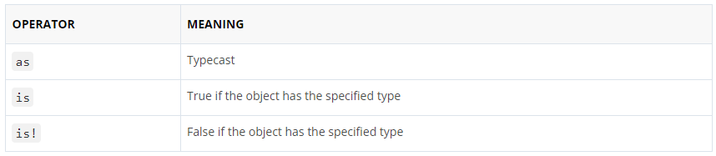
Dart Type test Operators
The Type test operators are used for checking types at runtime.

Slide 16
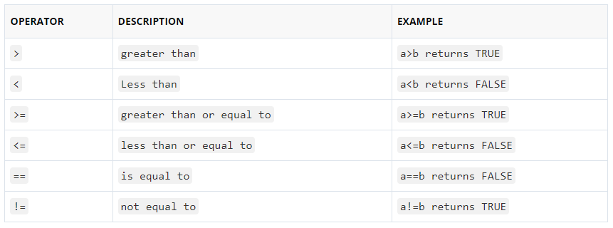
Dart Relational Operators
Let variable a holds 20 and variable b holds 10, then −

Slide 17
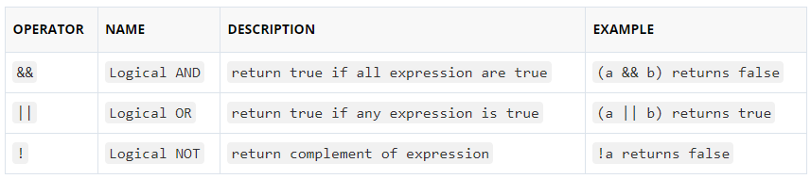
Dart Logical Operators
Let variable a holds true or 1 and variable b holds false or 0, then −

Slide 18
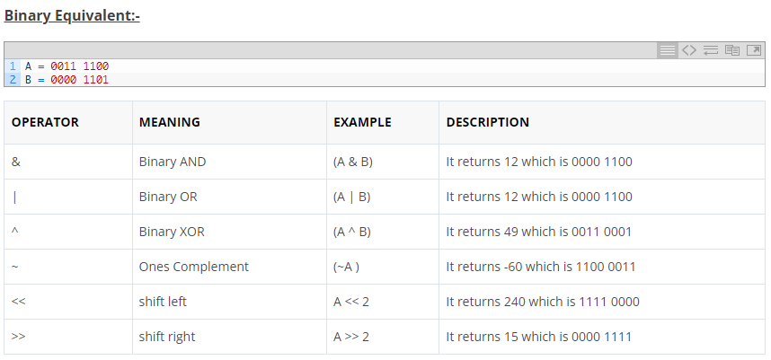
Dart Bitwise Operators
Bitwise operator are used to perform bit level operation over its operand. Let A = 60; and B = 13;

Slide 19
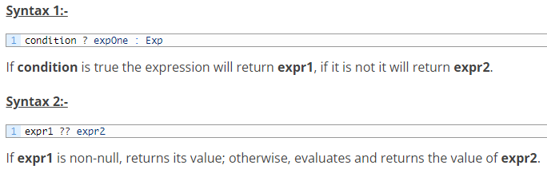
Dart Conditional Operators ( ? : )
The conditional operator is considered as short hand for if-else statement. Conditional operator is also called as “Ternary Operator”.

Slide 20
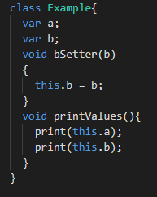
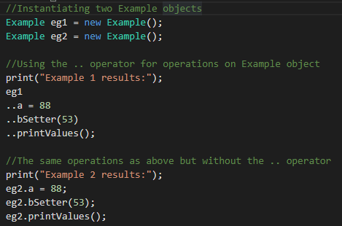
Dart Cascade notation(..) Operator
Cascades (..) allow you to perform a sequence of operations on the same object. The Cascades notation(..) is similar to method chaining that saves you number of steps and need of temporary variable.

Slide 21
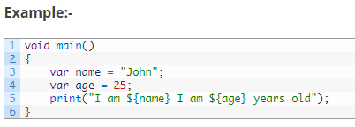

String Interpolation
String interpolation is the process of evaluating a string containing placeholders, variables and interpolated expressions. When an interpolated string is evaluated the placeholders, variables and expressions are replaced with their corresponding values. In Dart, ${expression} is used for string interpolation.

Slide 22
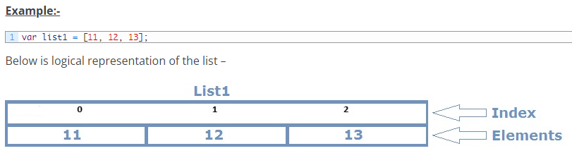
Dart Lists
In Dart, list data type is used to represent a collection of objects. A List is an ordered group of objects. The List data type is actually similar to the concept of an array in other programming languages

Slide 23
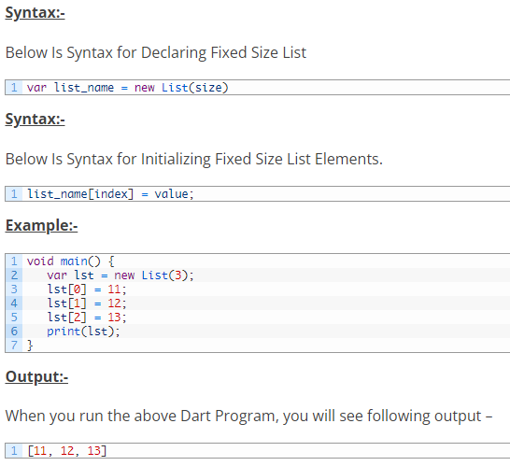
Fixed Length List
A List object declared with size specified cannot be changed runtime.

Slide 24
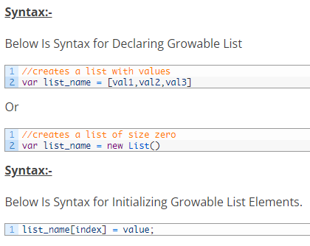
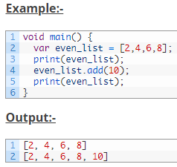
Growable List
A List object declared without size is termed as Growable List. The length of the growable list can changed in runtime.

Slide 25
Dart Map
The Map is an object that is used to represents a set of values as key-value pairs. In Map, both keys and values can be of any type of object, it is not necessary that the keys and values both of the same type.. In Map, each key can only occurs once, but the same value can be used multiple times. In Map, each of the value is associated with a unique key, and this key is used to accessed corresponding Map value. The Map can be defined by using curly braces ({ }) and values can be assigned and accessed using square braces ([]).

Slide 26
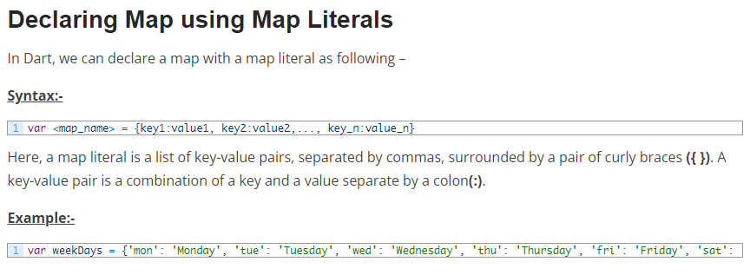
Declaring Map In Dart
In Dart, Maps can be declared in following two ways –
Using Map Literals
Using a Map constructor

Slide 27
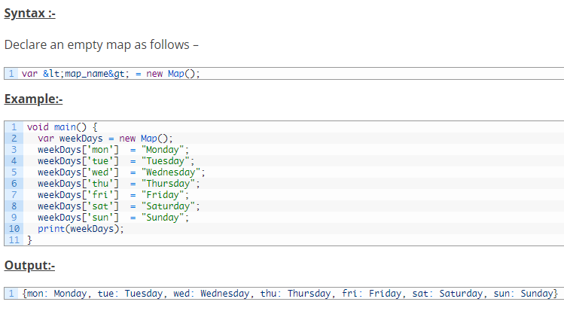
Declaring/Initialize Map using Map Constructor
In Dart, we can declare/initialize a map with a map constructor as following

