Slide 1
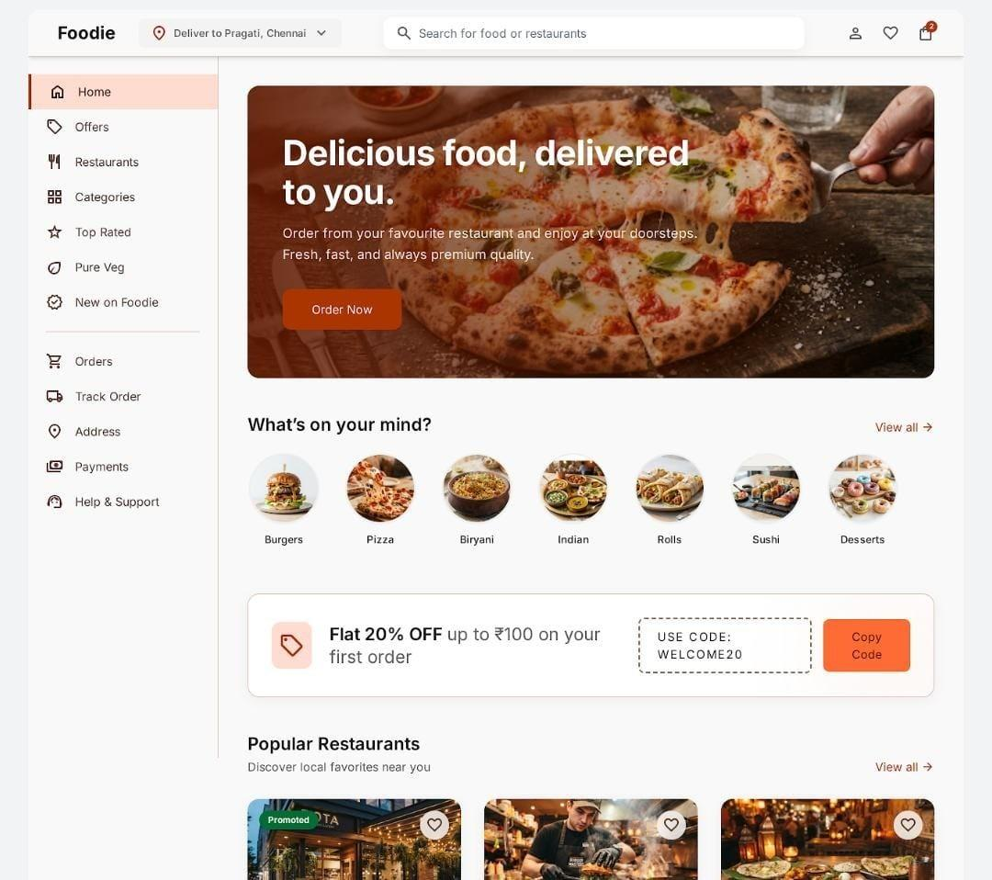
INTERNSHIP REVIEW | IT3711
UI/UX Design of Foodie
Food Delivery Web Application
Safila Farhath A S – 810023205023
B.Tech Information Technology
UCE (BIT Campus), Anna University, Tiruchirappalli
Media Wave Technology, Tiruchirappalli

Slide 2
1
Introduction & Objectives
Introduction
Objectives
UI/UX Design internship at Media Wave Technology, Trichy (15 Jun – 15 Jul 2026)
Project: Foodie – a food delivery web application
Users discover restaurants, search food, order, pay and track delivery
Designed in Figma with a user-centered approach
Scope: UI/UX design of the screens
Understand professional UI/UX workflows
User research and competitor analysis
Personas and user flows
Wireframes and high-fidelity UI in Figma
Reusable design system
Better problem-solving and communication
Foodie – UI/UX Internship | Safila Farhath A S
2

Slide 3
2
Company Profile
Media Wave Technology
Vision
Software company in Tiruchirappalli, Tamil Nadu. Services: Web & Mobile App Development, UI/UX Design, Digital Marketing, Graphic Design, Software Testing, Maintenance.
Leading provider of innovative, reliable, high-quality digital solutions.
Mission
User-friendly design, modern technologies, continuous learning, excellent service.
Organization Structure
Managing Director → Project Manager → Team Lead → UI/UX Designers · Frontend · Backend · QA Engineers → Interns
Foodie – UI/UX Internship | Safila Farhath A S
3

Slide 4
3
Internship Journey – 30 Days
Days 1–6
Days 7–10
Days 11–23
Days 24–30
Research
Wireframes
UI Design
Review & Finalize
Orientation, requirements, competitor analysis, user research, personas, user flow
Low-fidelity wireframes, mentor review, design system
Login, Home, Categories, Restaurants, Offers, Cart, Payment, Tracking, Support, Profile, Wishlist
UI review and refinement, responsive check, final screens, documentation, submission
Foodie – UI/UX Internship | Safila Farhath A S
4

Slide 5
4
Problem & Solution
Existing food delivery apps
Foodie design
✕ Too many screens to place one order
✕ Inconsistent, complicated navigation
✕ Weak search and filters
✕ Long, confusing checkout
✕ Unclear payment options
✕ Unclear order tracking
✓ Simple, consistent navigation
✓ Prominent search and categories
✓ Clear restaurant and food details
✓ Easy cart and checkout
✓ Understandable payment options
✓ Status and delivery in one place
✓ Reusable components
Foodie – UI/UX Internship | Safila Farhath A S
5

Slide 6
5
Design Process
1
2
3
4
5
6
Empathize
Define
Ideate
Wireframe
Visual Design
Review & Refine
Understand users and pain points
Turn findings into design problems
Explore layouts and navigation
Structure and hierarchy
Colour, type, icons, components
Mentor and UI review
Every design decision is linked to user needs and observed pain points.
Foodie – UI/UX Internship | Safila Farhath A S
6

Slide 7
6
User Research & Persona
Research Methods
AK
Arjun Kumar
21 · College Student
User interviews · Competitor analysis
Online surveys · Observing existing apps
Goals Order quickly, find nearby restaurants, track delivery, save favourites
Needs Simple UI, fast checkout, multiple payments
Pain points Complex layouts, slow ordering, difficult restaurant search
Key Findings
Fast, simple navigation
Easy search and secure payment
Real-time order tracking
Foodie – UI/UX Internship | Safila Farhath A S
7

Slide 8
7
User Flow
Open App
›
Login / Sign Up
›
Home
›
Search / Select Restaurant
›
Choose Food
›
Add to Cart
Checkout
›
Payment
›
Order Confirmed
›
Track Order
›
Delivered
Benefits: better navigation, less user effort, clear structure for developers
Foodie – UI/UX Internship | Safila Farhath A S
8

Slide 9
8
Wireframes & Design System
Wireframes
Typography
Components
Login, Home, Categories, Restaurants, Offers, Cart, Payment, Profile
Poppins – Bold headings, Semi Bold sub-headings, Regular body
Buttons, search bar, food and restaurant cards, navigation bar, Material Icons
Colour Palette
Primary – Orange
Background – White
Text – Black
Secondary – Gray
Success – Green
Foodie – UI/UX Internship | Safila Farhath A S
9

Slide 10
9
Tools & Technologies
Figma
Stitch AI
Google Fonts
UI design, wireframes, components, Auto Layout, design system
Rapid exploration of initial layouts
Poppins typography
Material Icons
Design Principles
Consistent iconography across screens
Simplicity, consistency, accessibility, hierarchy, responsive
Foodie – UI/UX Internship | Safila Farhath A S
10

Slide 11
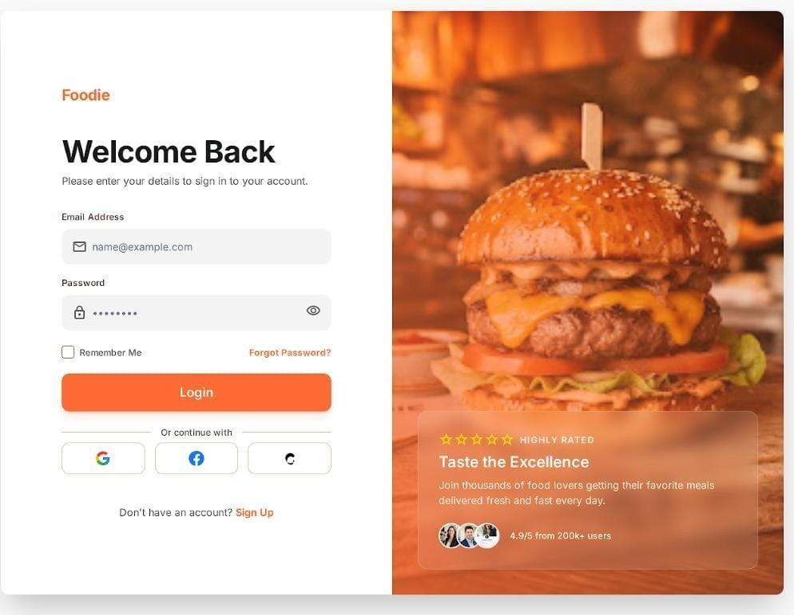
10
Login & Home Pages
Fig 9.1 – Login
Fig 9.2 – Home
Secure sign-in with email and password, remember me, social login and a Sign Up option.
Quick access to categories, offers and popular restaurants with search and side navigation.
Foodie – UI/UX Internship | Safila Farhath A S
11

Slide 12
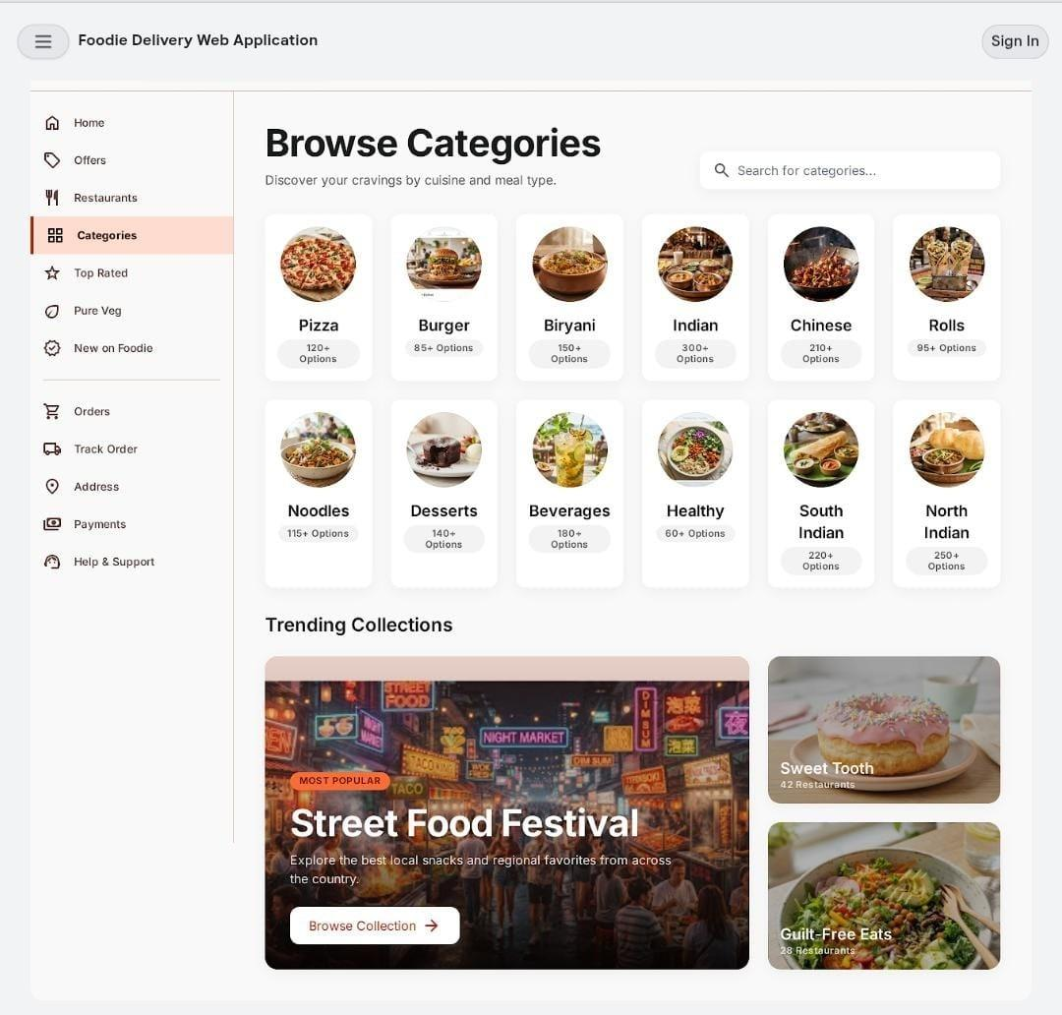
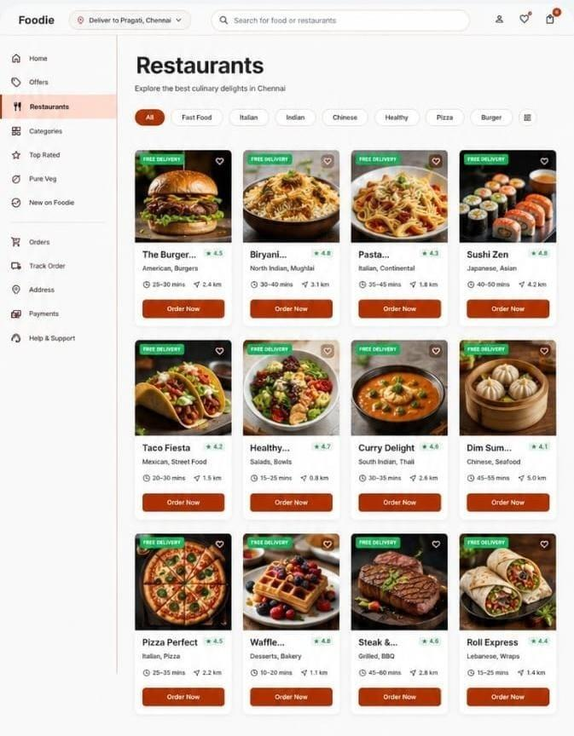
11
Categories & Restaurants
Fig 9.3 – Categories
Fig 9.4 – Restaurants
Browse food categories like Pizza, Burger and Biryani, along with trending collections.
Restaurant cards with rating, delivery time and cuisine, plus filter chips and Order Now.
Foodie – UI/UX Internship | Safila Farhath A S
12

Slide 13
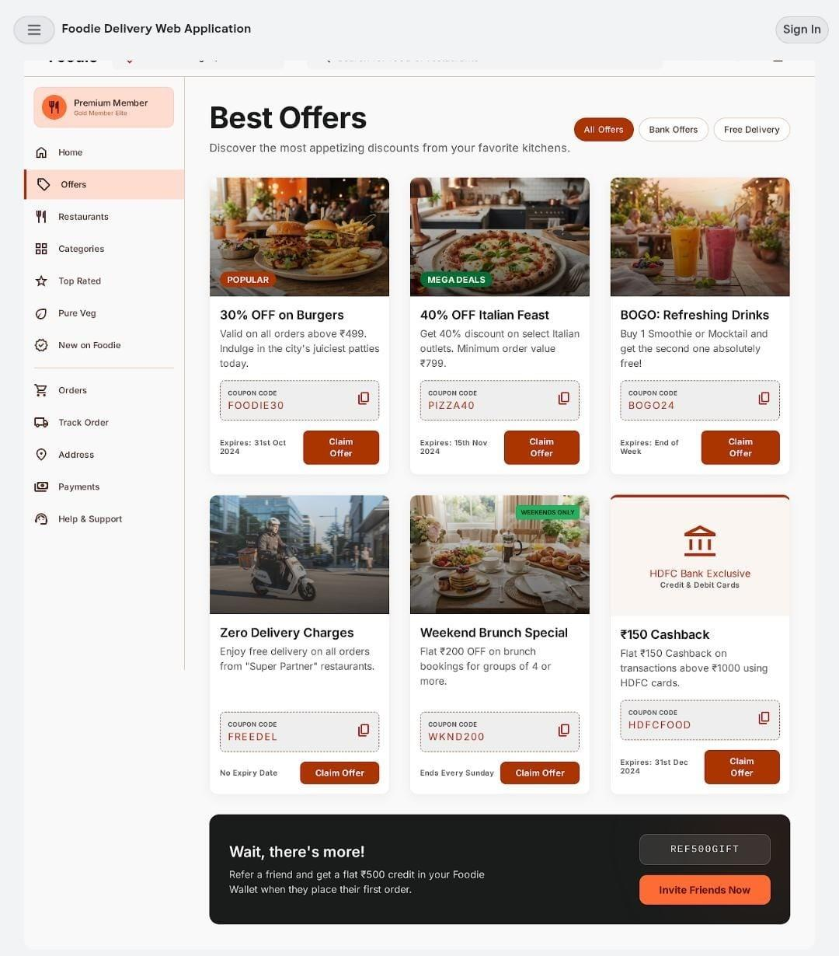
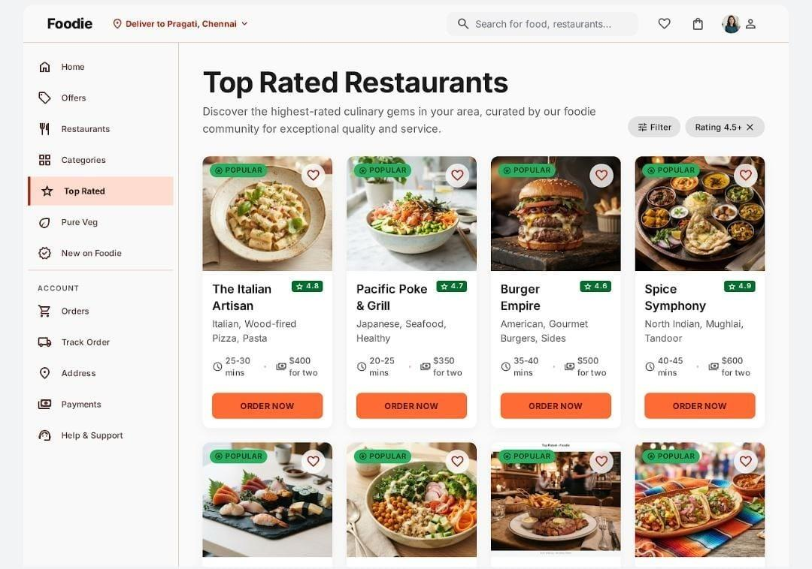
12
Offers & Top Rated
Fig 9.5 – Offers
Fig 9.6 – Top Rated
Discounts, coupon codes and bank offers users can claim, with a refer-a-friend banner.
Highly rated restaurants based on customer reviews, with rating filter and price for two.
Foodie – UI/UX Internship | Safila Farhath A S
13

Slide 14
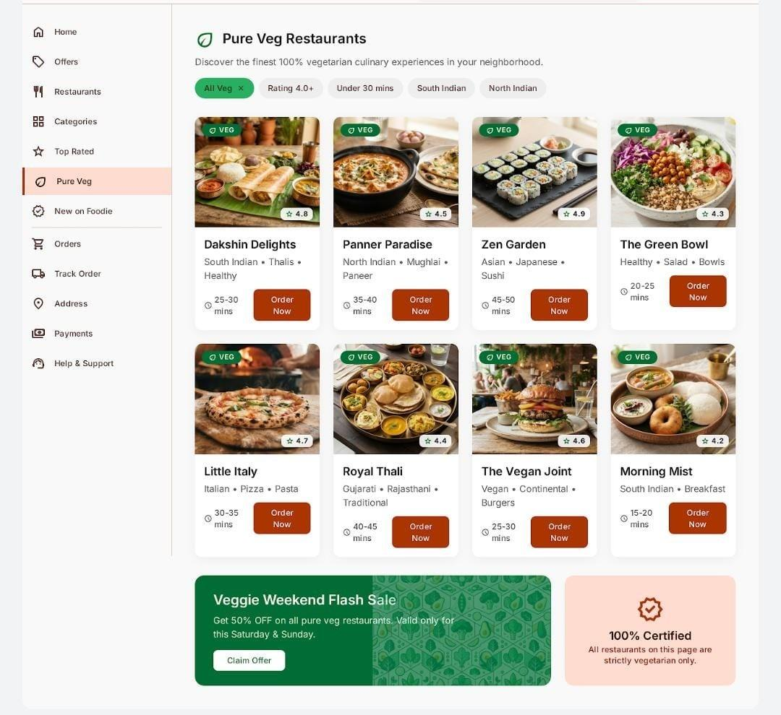
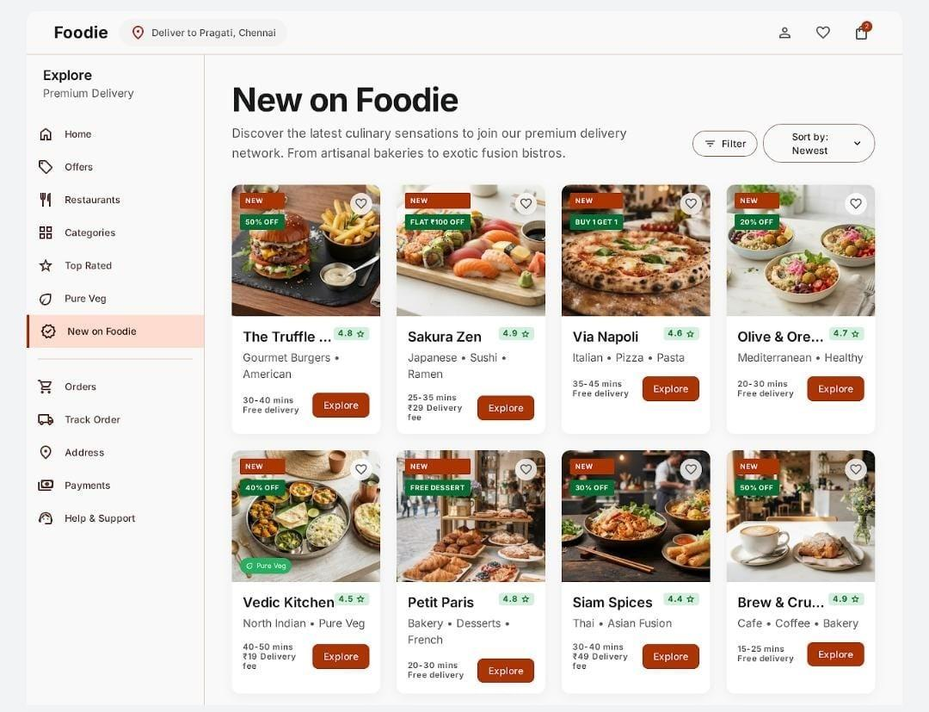
13
Pure Veg & New on Foodie
Fig 9.7 – Pure Veg
Fig 9.8 – New on Foodie
100% vegetarian restaurants with veg badges, delivery time and quick filters.
Newly added restaurants and special offers, with filter and sort-by options.
Foodie – UI/UX Internship | Safila Farhath A S
14

Slide 15
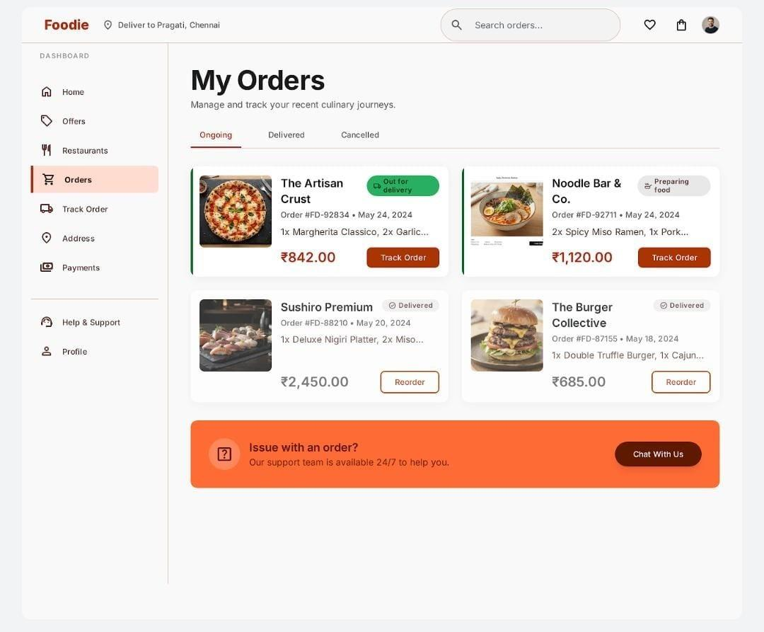
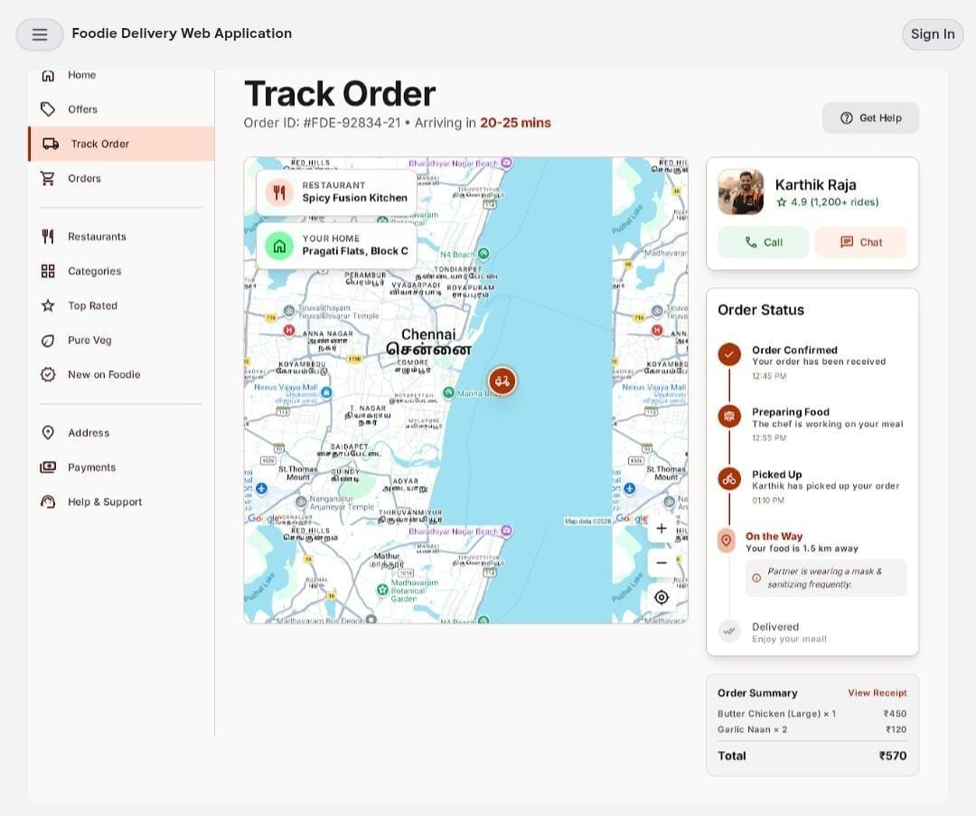
14
Orders & Track Order
Fig 9.9 – Orders
Fig 9.10 – Track Order
Ongoing, delivered and cancelled orders with Track Order, Reorder and chat support.
Live map, delivery partner details and step-by-step order status with ETA.
Foodie – UI/UX Internship | Safila Farhath A S
15

Slide 16
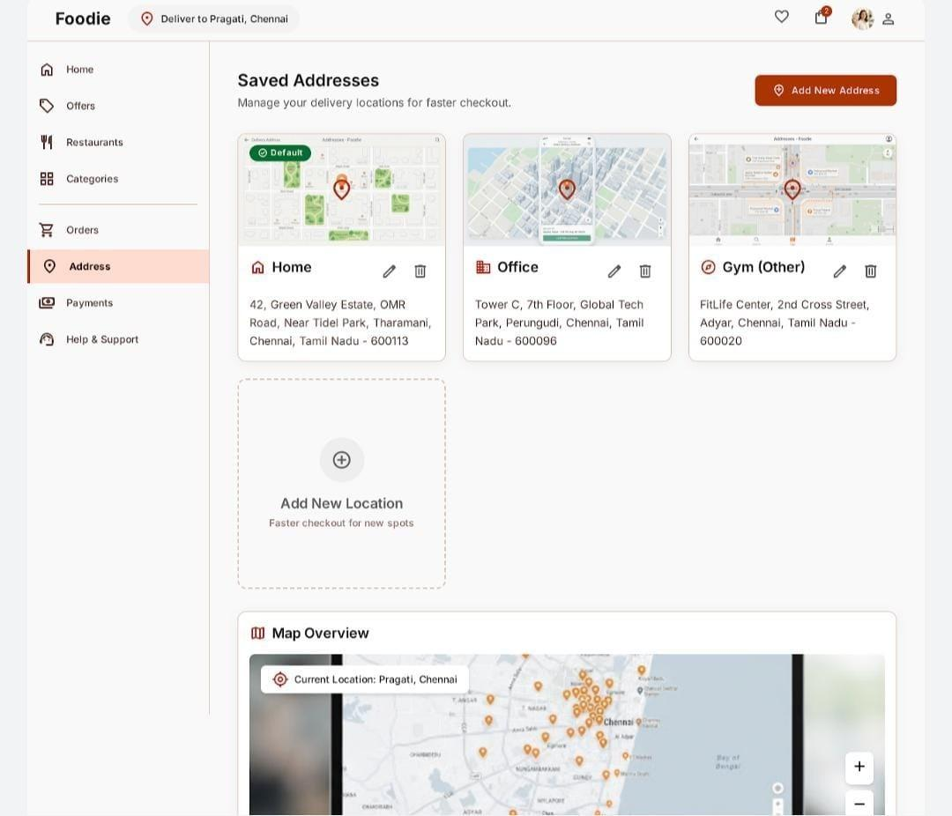
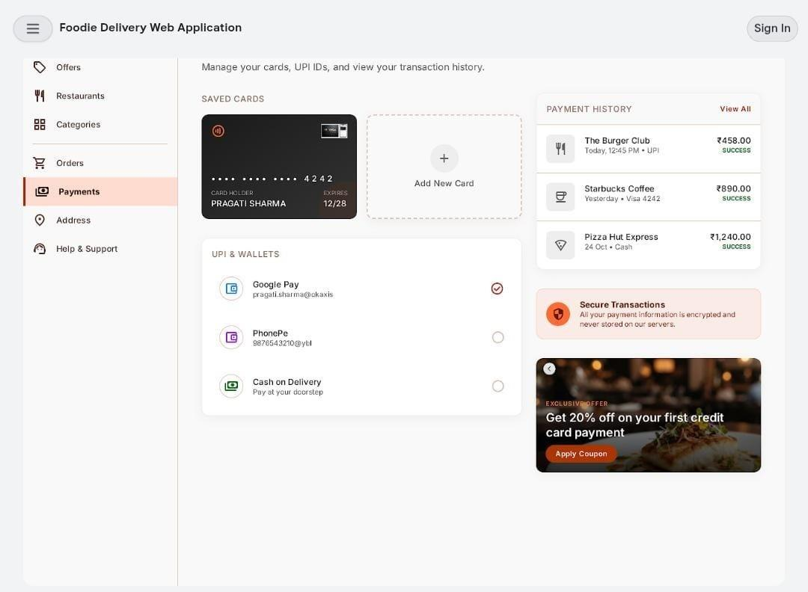
15
Address & Payment
Fig 9.11 – Address
Fig 9.12 – Payment
Add, edit and manage saved delivery addresses, with a default address and map overview.
Saved cards, UPI and wallets, Cash on Delivery and payment history in one place.
Foodie – UI/UX Internship | Safila Farhath A S
16

Slide 17
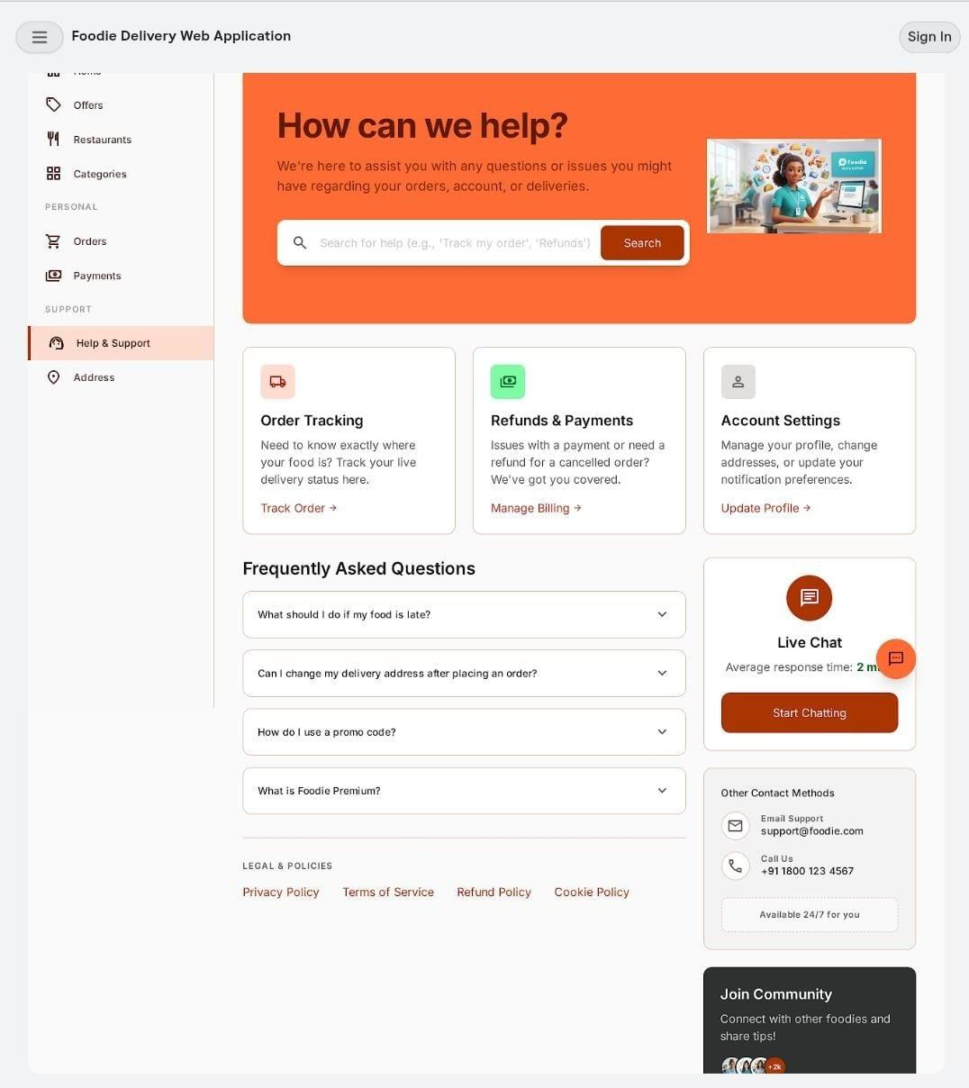
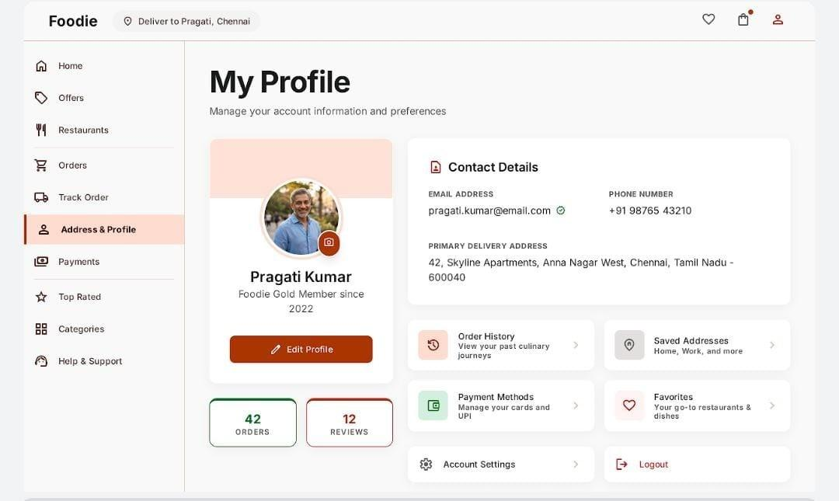
16
Help & Support, Profile
Fig 9.13 – Help & Support
Fig 9.14 – Profile
Search help, FAQs, live chat and contact options for orders, refunds and account issues.
Account details, order history, saved addresses, payment methods and favourites.
Foodie – UI/UX Internship | Safila Farhath A S
17

Slide 18
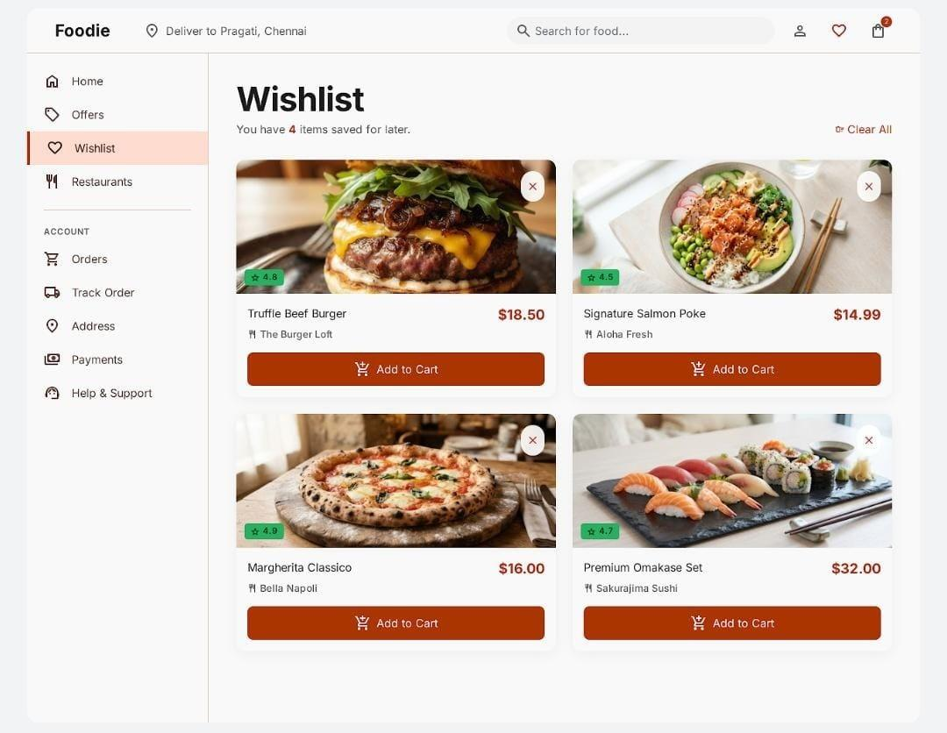
17
Wishlist Page
Save favourite restaurants and dishes
Add saved items straight to cart
Quick reorder
Reachable from navigation and profile
Fig 9.15 – Wishlist
Foodie – UI/UX Internship | Safila Farhath A S
18

Slide 19
18
Learnings, Conclusion & Future Work
Learnings & Conclusion
Future Work
UI/UX principles, user research, wireframing
Design system creation and Figma
Communication and teamwork
Foodie UI designed end to end using user-centered principles
Interactive prototype and usability testing
AI-based food recommendations
Voice-based food search
Personalized offers
Feedback and rating system
Mobile application
Foodie – UI/UX Internship | Safila Farhath A S
19

Slide 20
Thank
You
Questions?
Safila Farhath A S
Media Wave Technology, Tiruchirappalli

