Slide 1

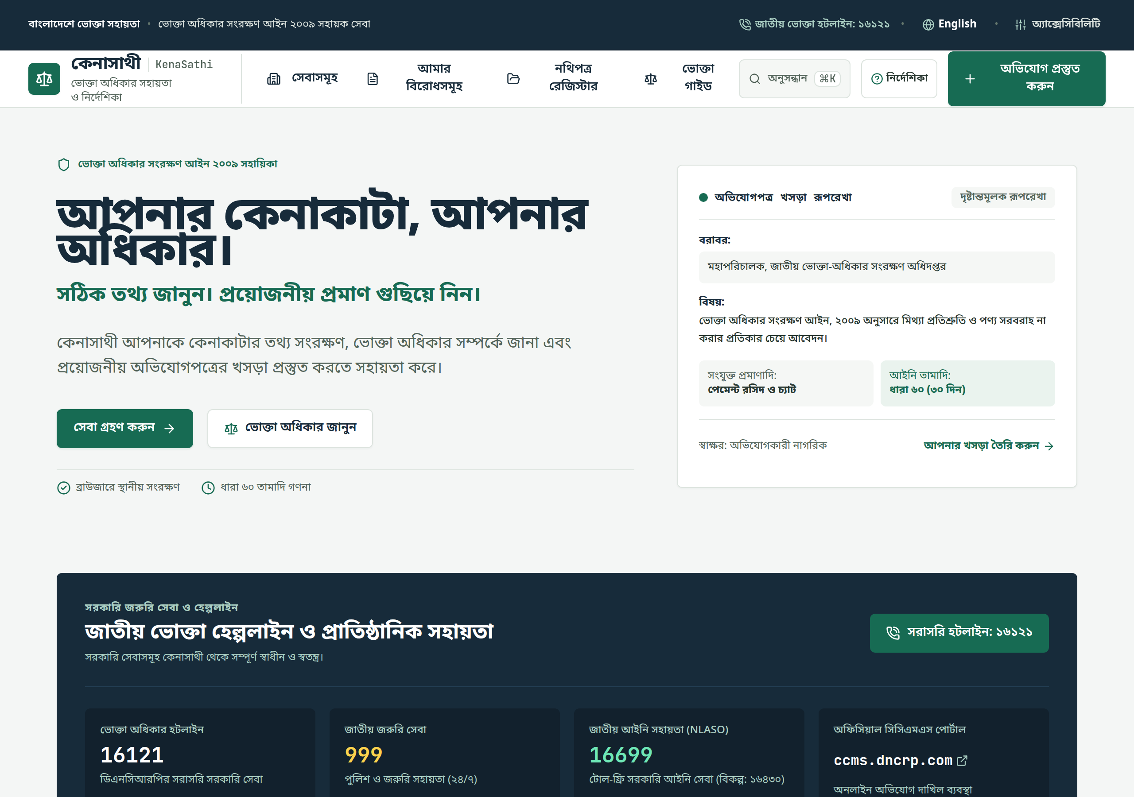
KenaSathi
PROBLEM STATEMENT
Consumer disputes start
with scattered proof
Receipts, seller messages and delivery details often sit in different places. People need a clear way to organize what happened and prepare a draft they can review.
KenaSathi helps Bangladeshi consumers turn purchase records into an evidence-led complaint draft.
Product interface capture. The sample shown is illustrative.
Independent consumer assistance. Users review and submit drafts themselves.
1 / 5
Notes:
The problem statement is a product framing, not a measured survey result. Event requirements: https://yunet-aignite26.devpost.com/rules. Product overview: https://github.com/Safin313-REBORN/KenaSathi.

Slide 2
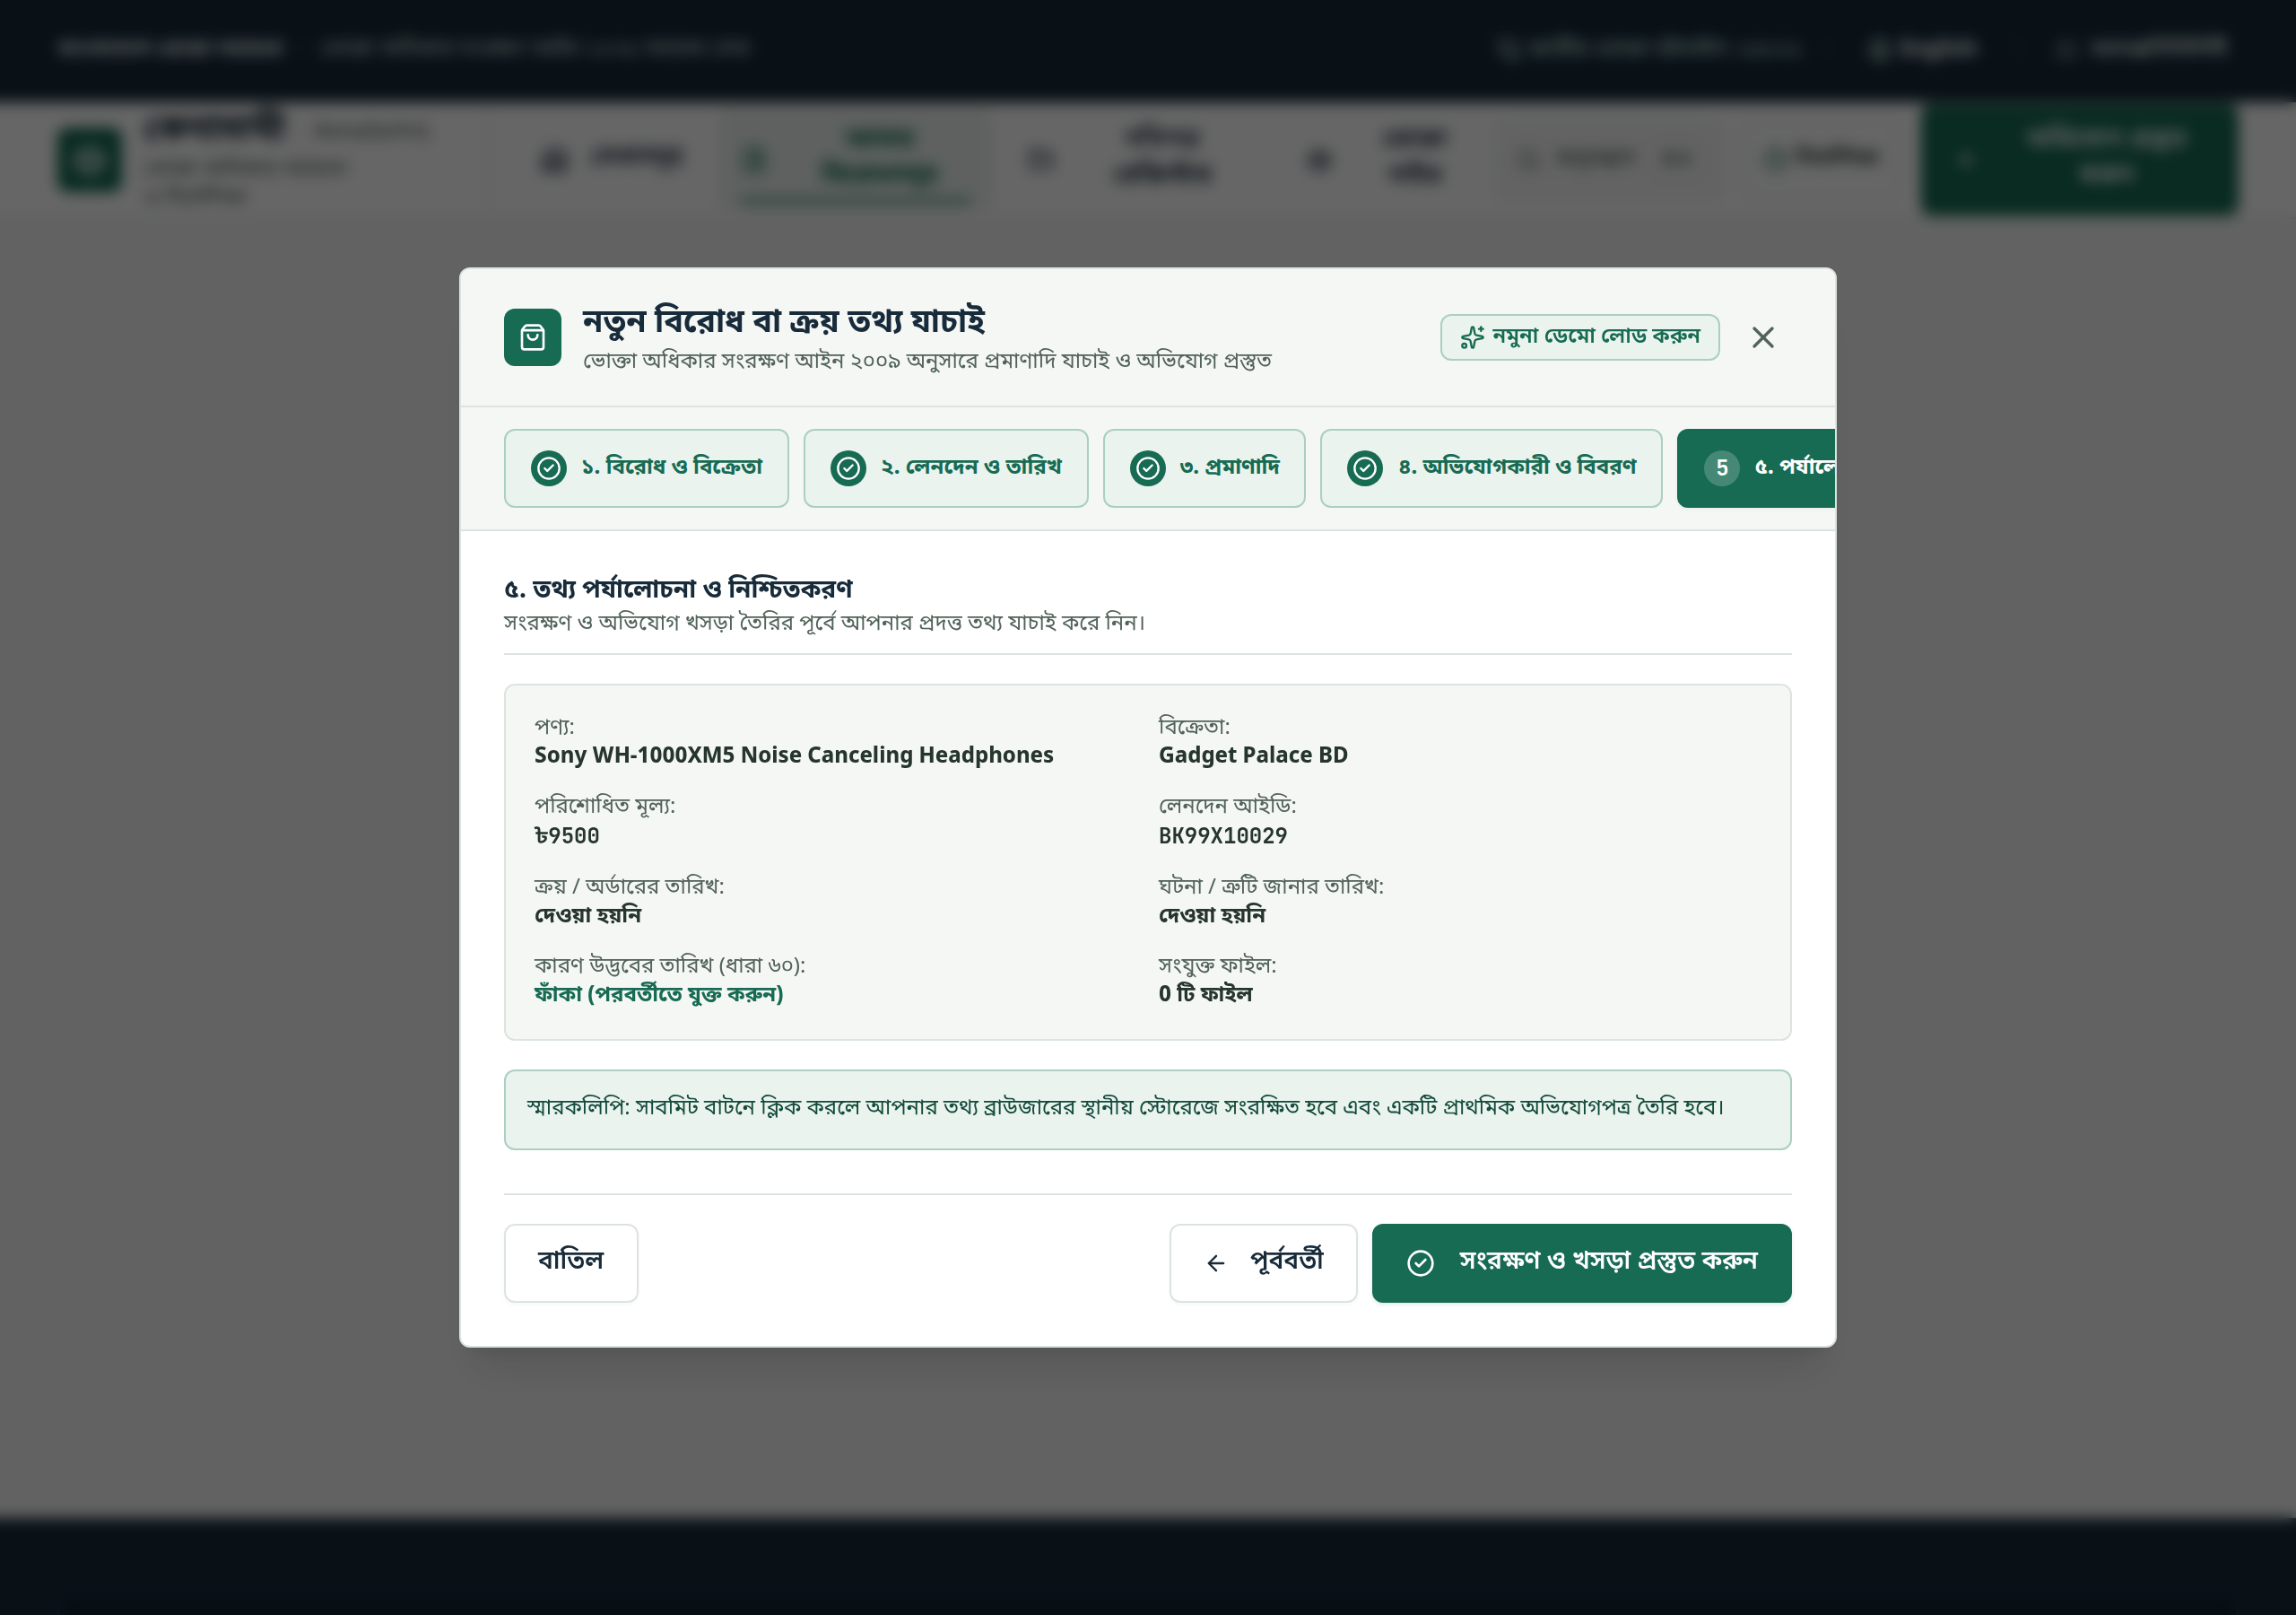
KenaSathi
PROPOSED SOLUTION
A guided space for evidence and next steps
01
Keep records together
Organize seller details, dates, payment references and evidence in one case workspace.
02
Make the timeline clearer
Show a date window from the cause-of-action date the user confirms.
03
Prepare a reviewable draft
Create a structured complaint draft that the user can edit, copy or print.
The intake flow gathers the facts before creating a draft.
KenaSathi is independent. It does not submit complaints or promise an outcome.
Independent consumer assistance. Users review and submit drafts themselves.
2 / 5
Notes:
Product functions and storage boundaries are described in the project README and privacy flow: https://github.com/Safin313-REBORN/KenaSathi and https://github.com/Safin313-REBORN/KenaSathi/blob/main/docs/AI_DATA_FLOW_AND_PRIVACY.md.

Slide 3
KenaSathi
HOW IT WORKS
A workflow that keeps users in control
1
2
3
4
Describe
Organize
Check
Prepare
Enter the seller, product, payment and confirmed event date.
Attach records and review extracted details with their source.
See a date window and candidate guidance. AI suggestions remain unverified.
Edit the draft, then copy or print it for an official channel.
AI assistance is optional. Local patterns and date rules provide a fallback; people verify facts before using the draft.
Independent consumer assistance. Users review and submit drafts themselves.
3 / 5
Notes:
Section 60 date-window guidance is based on a user-confirmed cause-of-action date and should be checked against the facts and official filing guidance. Official law source: https://bdlaws.minlaw.gov.bd/act-print-1014.html. Product AI behavior: https://github.com/Safin313-REBORN/KenaSathi/blob/main/docs/AI_DATA_FLOW_AND_PRIVACY.md.

Slide 4
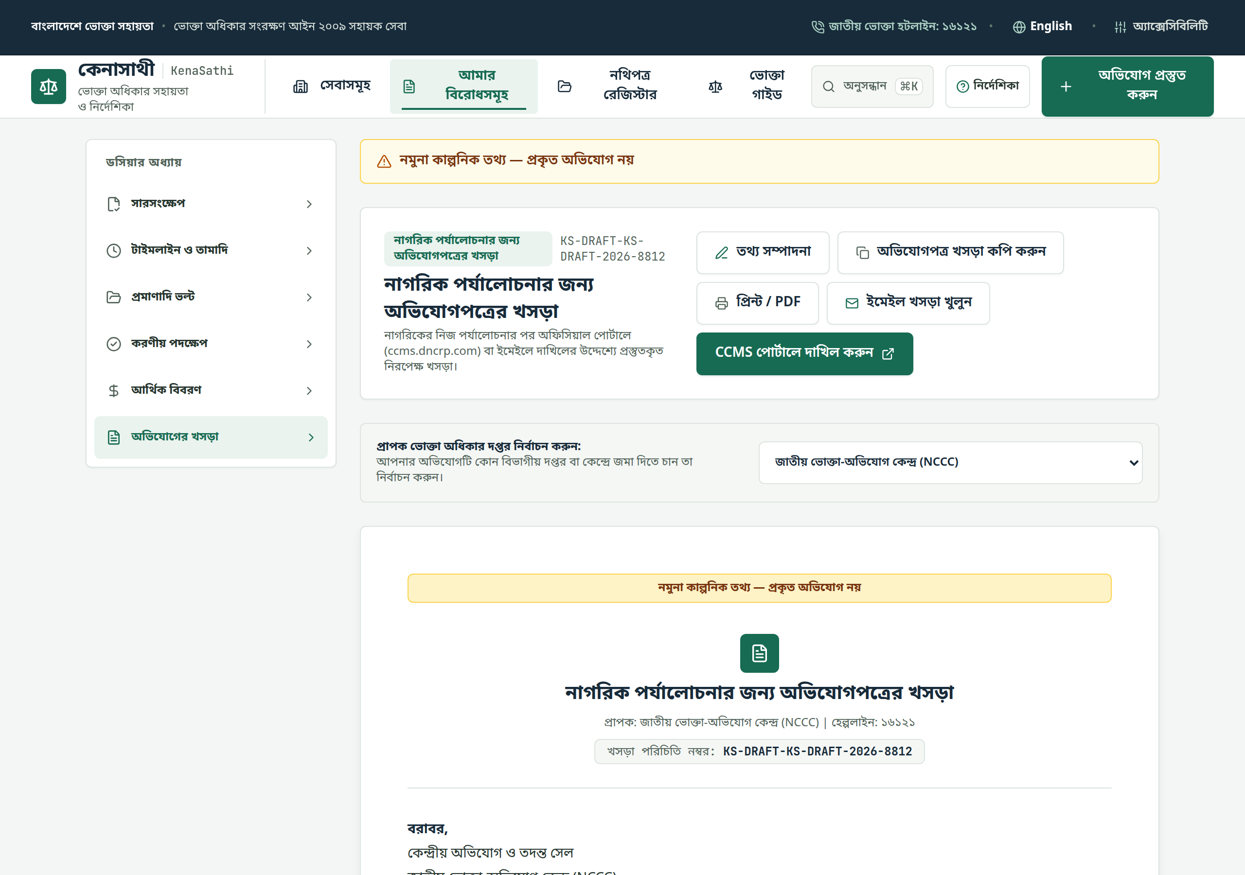
KenaSathi
AI AND TECHNICAL IMPLEMENTATION
AI assists review while the rules stay explicit
Optional AI
A user may enter their own provider key and consent to selected text being sent for summary and fact suggestions.
Local logic
Pattern extraction and the date calculation have local deterministic paths. Suggested facts remain unverified.
Data boundary
Case details and evidence remain in browser storage. SQLite serves help FAQs and matching chat only.
Draft preview with fictional demonstration data.
Independent service. No government affiliation, automatic filing or guaranteed refund.
Independent consumer assistance. Users review and submit drafts themselves.
4 / 5
Notes:
AI is optional and runs directly from the browser to the provider using user-supplied credentials after consent; images may still contain personal details. Case and evidence storage behavior is documented at https://github.com/Safin313-REBORN/KenaSathi/blob/main/docs/AI_DATA_FLOW_AND_PRIVACY.md.

Slide 5
PARTICIPANT
Saharia Hassan Safin
Daffodil International University
BSc in CSE, 2nd year
KenaSathi organizes consumer purchase evidence and prepares a draft people can review before they contact an official service.
LIVE APP
kenasathi-production.up.railway.app
SOURCE CODE
github.com/Safin313-REBORN/KenaSathi
KenaSathi is an independent consumer-assistance product.
Notes:
Participant name, institution and year were provided by Saharia Hassan Safin. Project link: https://kenasathi-production.up.railway.app. Source repository: https://github.com/Safin313-REBORN/KenaSathi. Event requirements and sticker: https://yunet-aignite26.devpost.com/.

