Slide 1

Smart stick for impaired visually people

Slide 2
Prepared By:
Omar nouby mohamed | 20-00637
Ahmed Abdelkarem Hasan Nasr | 20-01122
George Emad | 20-01146
Mena said naiem | 19-01386
Osama rezk | 20-00461
Walid masuod dauod | 20-01337
Karim Khalaf Ibrahim | 19-00160

Slide 3
Supervised By:
Prof.Ahmed hamza- professor of computer and information Technology Egyptian E-learning university
Eng.safinaz alla Eldin
Demonstrator,Department of information Technology Egyptian E-learning university

Slide 4
Introduction
The main aim of this Project is to assist blind persons without human need.
Percentage of impaired people Globally, at least 2.2 billion people have a near or distance vision impairment.
So the With such a large number of visually impaired people, there is a need for such ideas in order to make life easier for them.

Slide 5
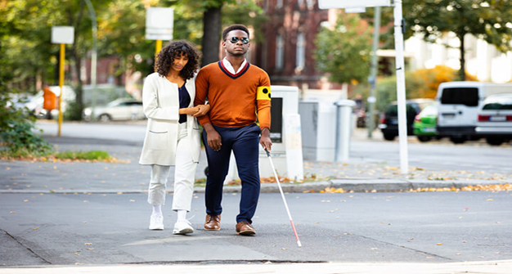
Problem statement:
(Difficulites for impaired people)
Navigational Challenges : The visually impaired face difficulties in moving to their destination
Dependence on Others : Blind people need someone to take care of them while they walk.
Obestical detection : Visually impaired people need to be alerted of moving objects.

Slide 6
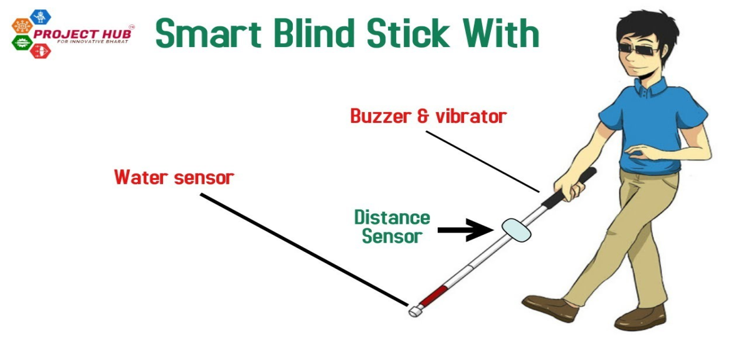
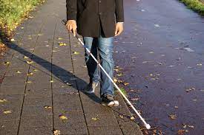
Problem solution
The stick, with the help of a camera, detects the obstacle the blind person is approaching .
The smart blind stick aims at giving the blind person a better understanding of the path he is moving in.

Slide 7
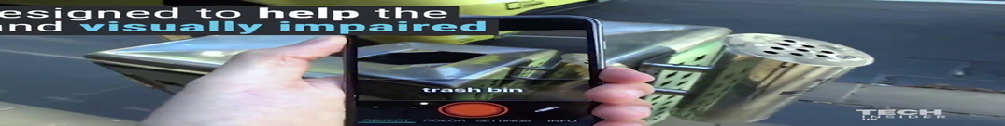
How our project help them
The smart blind stick aims at giving the blind person a better understanding of the path he is moving in.
Smart stick allow people who are blind, or visually impaired, to navigate the world around them safely.
Advantage:
1-Navigtion and mobility
2-object recognition
3-pronouncing the name of object

Slide 8
AI parts
Computer vision
SSD
Efficient Det
yolo
Retina net
Text to speech
gtts
pyttsx3

Slide 9
Advantages of open cv 1-comprehensive library 2-cross-Platform compatibility 3-wide range of algorthims why we used opencv : In order to use the functions provided by this library

Slide 10
YOLO (You Only Look Once)

Slide 11
Why we used it
1-Real-Time Detection : This suits the project because the idea of ​​the project is to open the computer camera to recognize objects
2-good Accuracy : it provides a good accuracy in detecting objects ,it can detect a wide range of object classes in various scenarios
3-Ease of Implementation :the version I used is the latest version of yolo which provides many functions in an easy way to use

Slide 12
The dataset in yolo
The data set which is used in yolo is coca data set ,it is a dataset which contains 80 different types of object
the yolov8 used a pretrained on this data set
We didn’t train a custom dataset because the project idea is to predict all types of objects serrounding the user so it is so not suitable to train a dataset to predict all types of objects in different situations .

Slide 13
Convert text to speech
gtts

Slide 14
Why we didn’t used it
Internet Dependency
It doesn’t pronounce the text directly.
It requires to save the audio first ,we want library to say the name of object directly

Slide 15
Convert text to speech
Pyttsx3

Slide 16
Advantages: -
Offline Operation
Platform Independence
Easy to Use
Adjustable Speed and Volume

Slide 17
Disadvantages
Limited Voices
Less Natural Sounding
Limited Language Support

Slide 18
What we added to the code
Auto alarming system .
Warning the blind of the moving element from right and left.
Warning the blind of the object in front of him .

Slide 19
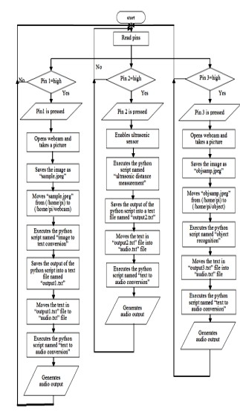
Start
Initialize System of Blind Stick
Connecting Mobile Application
Checking Bluetooth and GPS/GPRS
Detect Connection Type
Bluetooth
GSM/GPRS Antenna
Establishing Connection
Establishing Connection
No
Yes
Process will be Terminated
System Start Reading Data from Sensors (Ultrasonic/IR)
Microcontroller will Execute Data Depending on yolo Algorithm by capturing photos by
After Gathering Processed Data (PNG ,JPEG) there will be a guide audio throw the smart stick for avoiding obstacles

Slide 20
Tools we used
Jupyter note book we used it is so simple and it is interactive computing environment
Python We used python language because it has a large number of libraries used in computer vision ,we used python 3.12 because it the latest version of python and Compatible with the version of yolo from python website https://www.python.org/downloads/
yolov8 model don’t need to be downloaded you just install it by this statement, pip install ultralytics , and then importing it in the environment
Opencv you just need to import it in the environment and you don’t need to install it.
Pyttx3 library you can install it by this state.pip isntall pyttx3,then you need to import it.

Slide 21
advantages of yolo:https://www.datacamp.com/blog/yolo-object-detection-explained disadvantages of yolo:https://www.quora.com/What-are-the-advantages-and-disadvantages-of-YOLO-You-Only-Live-Once advantages and disadvantages of open cv: https://www.linkedin.com/pulse/open-cv-py-package-image-processing-vijayaraj-anbalagan causes of visual impairment: https://www.news-medical.net/health/Causes-of-visual-impairment.aspx precentages of impaired people in the world https://www.who.int/news-room/fact-sheets/detail/blindness-and-visual-impairment

