Slide 1

PhishShield AI
AI-Based Phishing Detection & URL Risk Analysis System
Academic Literature Survey & Final Major Project Presentation

Slide 2
ABSTRACT
Project Overview & Executive Summary
The Cyber Threat Landscape
• Phishing attacks account for over 80% of reported security incidents globally.
• Social engineering exploits human behavior rather than software vulnerabilities.
• Attackers use typosquatting, shorteners, and obfuscation to bypass static firewalls.
• Static blacklists suffer from a 6 to 48-hour delay before new phishing domains are listed.
The PhishShield AI Solution
• Dual Payload Evaluation: Analyzes structured Web URLs & unstructured Email/SMS text.
• Hybrid Engine: Combines Scikit-Learn NLP (TF-IDF + Naive Bayes) with lexical heuristics.
• Brand Protection: Employs difflib SequenceMatcher fuzzy matching for typosquatting.
• Explainable AI: Integrates VirusTotal API v3 & Groq LLM Chatbot (PhishShield AI).
• Actionable Artifacts: Generates instant PDF reports & maintains admin audit trails.

Slide 3
PROBLEM STATEMENT
Real-World Cyber Problems Solved
1. Brand Impersonation & Typosquatting
• Attackers register domains like 'paypaI.com' or 'hdfc-bank-verify.xyz'.
• Solution: Fuzzy string matching cross-references top banking registries (+55 penalty).
2. Social Engineering & SMS Phishing
• Urgent messages like 'KYC update required in 24 hours' induce panic.
• Solution: TF-IDF + Naive Bayes Classifier detects urgency language & phishing intent.
3. URL Shortening & Obfuscation
• Links hidden behind bit.ly, raw IPs, or embedded '@' symbols bypass basic filters.
• Solution: 10-point lexical telemetry checks protocol, shorteners, TLDs & IP hosts.
4. Blacklist Detection Latency
• Public threat lists take up to 48h to index new URLs (Zero-day window).
• Solution: Dynamic structural heuristics evaluate links instantly without static lists.

Slide 4
STATE OF THE ART
Literature Survey & Existing Tools
Platform | Core Mechanism | Primary Strengths | Limitations & Literature Gaps
VirusTotal | 70+ Commercial AV engines | Global database coverage | Slow zero-day detection; no SMS/text analysis
PhishTank | Crowdsourced submissions | Verified community history | High latency in manual reviews; binary output
Google Safe Browsing | Browser lookup API | Fast pre-indexed lookups | Fails against brand-new zero-day URLs
Urlscan.io | DOM & screenshot sandbox | Detailed visual rendering | Complex technical output for non-experts
Key Literature Gaps Identified
• Absence of Unified Scanning: Existing platforms inspect URLs or files separately, lacking unified SMS/email evaluation.
• Technical Barrier for Users: Traditional outputs supply complex JSON responses without explainable guidance.
• Lack of Conversational AI Assistance: Scanners output static verdicts without answering user follow-up questions.

Slide 5
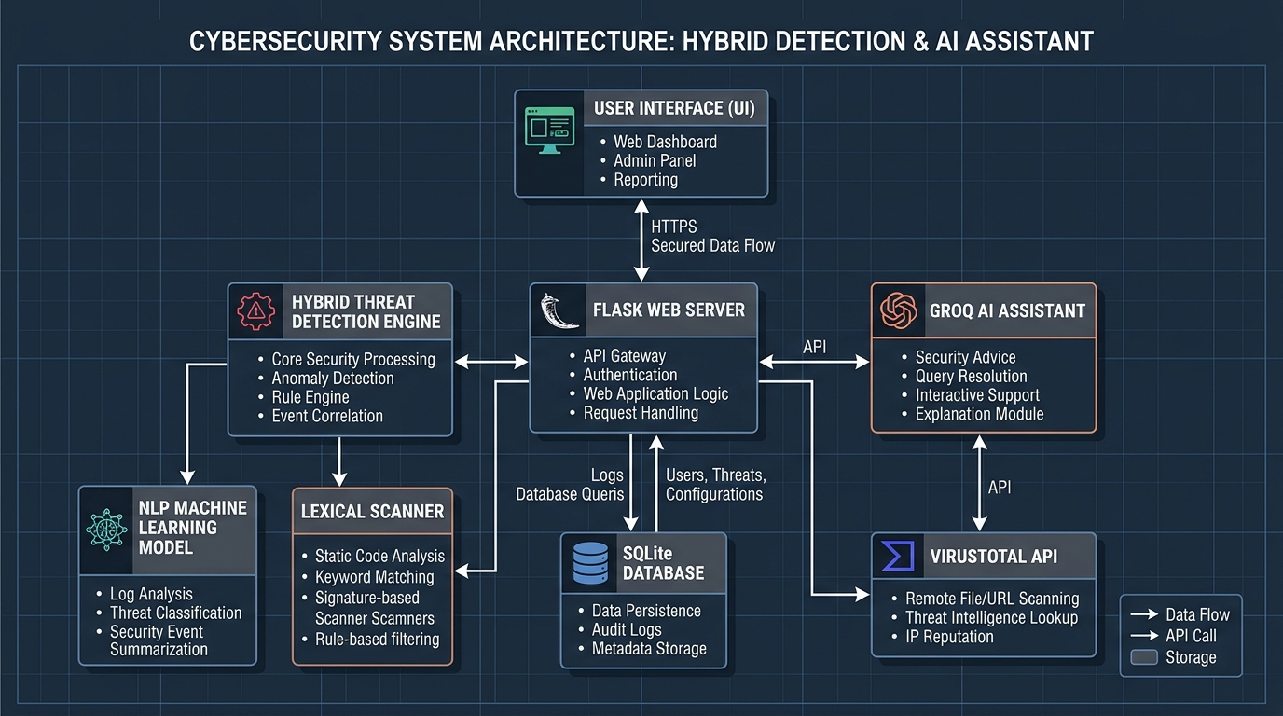
TECHNICAL DESIGN
System Architecture Blueprint
Architectural Highlights
• Flask Web Gateway: Centralized HTTP routing & user authentication.
• Hybrid Threat Engine: Orchestrates NLP ML model and Lexical Telemetry.
• NLP Classifier: Scikit-Learn TF-IDF + Naive Bayes inference.
• External APIs: VirusTotal v3 REST API & Groq LLM Assistant.
• SQLite Persistence: High-speed WAL mode for scan history & audit logs.

Slide 6
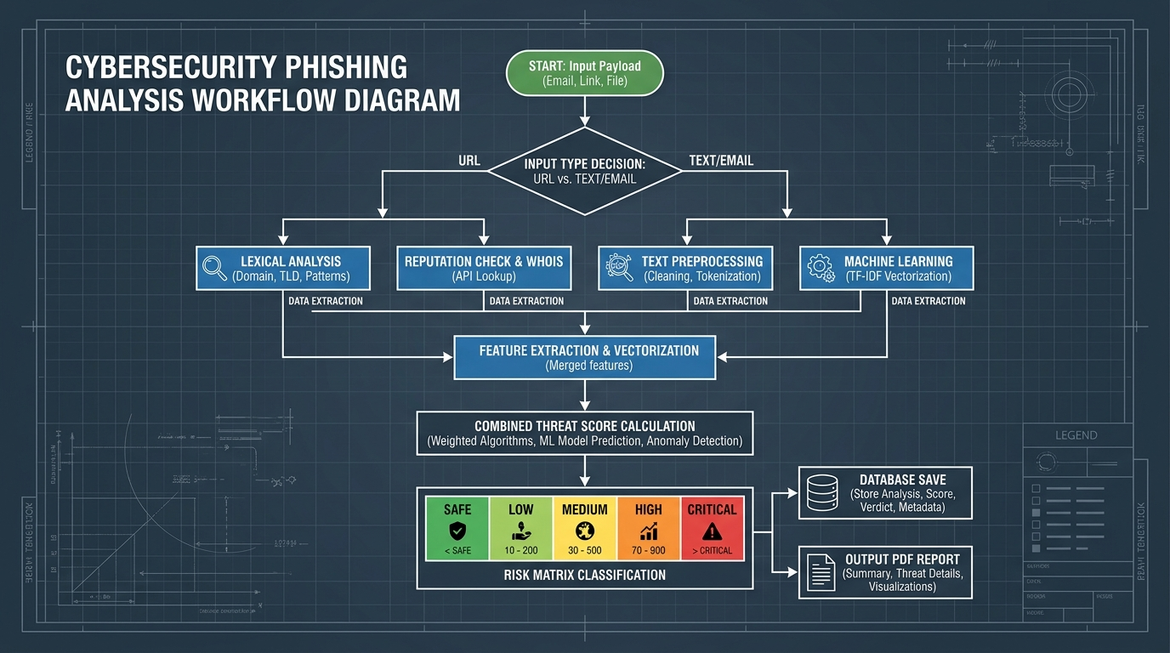
DECISION PIPELINE
Detection Workflow Process Flowchart
Pipeline Decision Steps
• 1. Input Routing: Validates URL vs SMS/Email payload type.
• 2. Parallel Extraction: Lexical Telemetry vs TF-IDF Vectorization.
• 3. Threat Calculation: Merges ML probability, keyword weights & API scores.
• 4. Risk Matrix: Assigns 5-tier classification (Safe to Critical).
• 5. Output Generation: Saves to DB & triggers dynamic PDF report.

Slide 7
METHODOLOGY
Machine Learning & Mathematical Formulation
NLP Machine Learning Pipeline
• Vectorization: TfidfVectorizer with ngram_range=(1, 2), stop_words='english'.
• Model: Multinomial Naive Bayes (alpha=0.1) for high-speed text classification.
• Mathematical Equation:
• P(Phishing | Text) = [ P(Text | Phishing) * P(Phishing) ] / P(Text)
• Combines token frequencies with posterior class probabilities.
Dynamic Risk Scoring Matrix
• Weighted Score Formula:
• S_total = min((S_ML * 0.6) + (S_KW * 0.4) + S_Heuristics + S_Typosquat + S_VT, 100)
• Risk Scale Classifications:
• • Safe (0% - 19%): Legitimate payload indicators.
• • Low Risk (20% - 44%): Minor structural anomalies.
• • Medium Risk (45% - 69%): Multiple suspicious patterns.
• • High Risk (70% - 89%): Strong phishing/spoofing markers.
• • Critical (90% - 100%): Severe threat confirmed.

Slide 8
BENCHMARKING
Comparative Analysis: Why Our Website Is Better
Feature / Capability | VirusTotal | PhishTank | Google Safe Browsing | PhishShield AI (Our System)
URL Lexical Heuristics | Indirect | No | No | Yes (10-Point Telemetry)
Email / SMS ML Scanning | No | No | No | Yes (TF-IDF + Naive Bayes)
Typosquatting Matcher | No | No | No | Yes (SequenceMatcher)
Interactive AI Chatbot | No | No | No | Yes (PhishShield AI Assistant)
PDF Threat Report Export | No | No | No | Yes (ReportLab Generator)
Role-Based Admin Audit Logs | No | No | No | Yes (RBAC System Logs)
5-Tier User Risk Leveling | JSON Stats | Binary | Binary | Yes (Safe to Critical)

Slide 9
SYSTEM MODULES
Core Application Modules & UI Features
1. Interactive Security Dashboard
• Features live threat counters, Chart.js Doughnut charts, scan history table, and custom payload type selector dropdown.
2. PhishShield AI Assistant
• Groq LLM-powered real-time assistant answering security questions and explaining specific scan indicators.
3. PDF Threat Report Generator
• ReportLab Platypus engine producing downloadable PDF reports with detailed threat scores and timestamps.
4. Role-Based Admin Audit Panel
• Privileged dashboard for operator management, account controls, and chronological system event trailing.

Slide 10
IMPLEMENTATION
Technology Stack Breakdown
Backend & Logic
• Python 3.10+
• Flask 3.x Web Server
• Werkzeug Password Hashing
• ReportLab PDF Engine
ML & Intelligence
• Scikit-Learn NLP
• TF-IDF Vectorizer
• Multinomial Naive Bayes
• VirusTotal V3 REST API
• Groq / Grok LLM API
Frontend & DB
• HTML5 & ES6+ JS
• Tailwind CSS Layout
• Chart.js Visualizations
• SQLite3 (WAL Mode)

Slide 11
ROADMAP
Future Scope & Enhancements
1. Browser Extension (Chrome Plugin)
• Manifest V3 extension inspecting web links inside emails and active browser tabs in real-time.
2. Live WHOIS Domain Age Telemetry
• WHOIS protocol integration penalizing newly registered domains (under 30 days old).
3. Deep Learning (BERT Models)
• Fine-tuned DistilBERT / RoBERTa models for advanced spear-phishing contextual analysis.
4. Enterprise REST API Endpoints
• Secure API key endpoints (/api/v1/scan) for batch automated threat analysis in corporate SOCs.

Slide 12
Thank You!
We extend our sincere thanks to our Project Guide, Examiners & Faculty Members.

