Slide 1
Enterprise Canteen
Management System
CS
CanteenSys
Enterprise CMS
POS · Kitchen · Distribution · Balance · Reports
with AI-powered Bangla voice ordering
RFID card checkout at POS
Real-time kitchen & token queue
AI voice assistant (Claude / Gemini / local LLM)
Role-based access & full audit trail
Project presentation · July 2026

Slide 2
OVERVIEW
One platform for the whole canteen operation
CanteenSys runs employee canteen sales end to end — from RFID card scan at the POS, through live kitchen preparation, to token-based pickup — with employee balances, inventory, and analytics in a single Django application.
POS
Kitchen (KDS)
Distribution
Inventory
RFID / touch checkout
Live order queue
Token handover board
Menu & daily stock
Balance & Cards
Reports
AI Voice
Admin & Roles
Advance + credit
Sales analytics
Bangla assistant
Permissions + audit

Slide 3
ARCHITECTURE
Technology stack
Backend
Django (Python) · role-based auth · atomic checkout transactions
Database
Microsoft SQL Server · sequences for order / token / payment numbers
Real-time
Server-Sent Events (SSE) — live kitchen & token pickup boards
Hardware
RFID / NFC employee cards · 80 mm thermal receipt printer
AI layer
Pluggable LLM providers — Claude, Gemini, self-hosted — with failover
Voice I/O
Browser Web Speech (bn-BD) for speech; app-served Bangla TTS audio
Frontend
Server-rendered templates + Bootstrap · touch-first POS UI

Slide 4
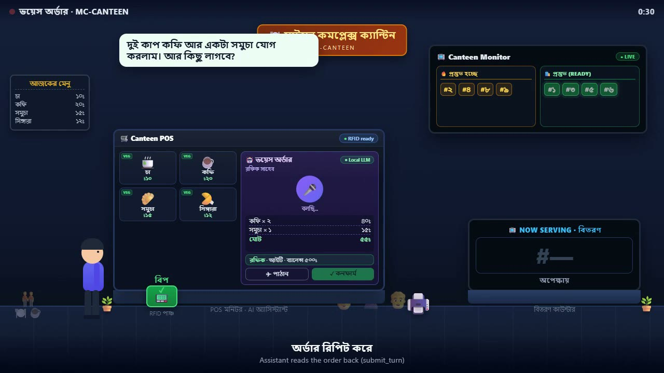
FIRST LOOK
AI voice ordering — animated walkthrough (with sound)
Click ► to play — walk-up · RFID punch · order · confirm · auto-print slip · token on the monitor

Slide 5
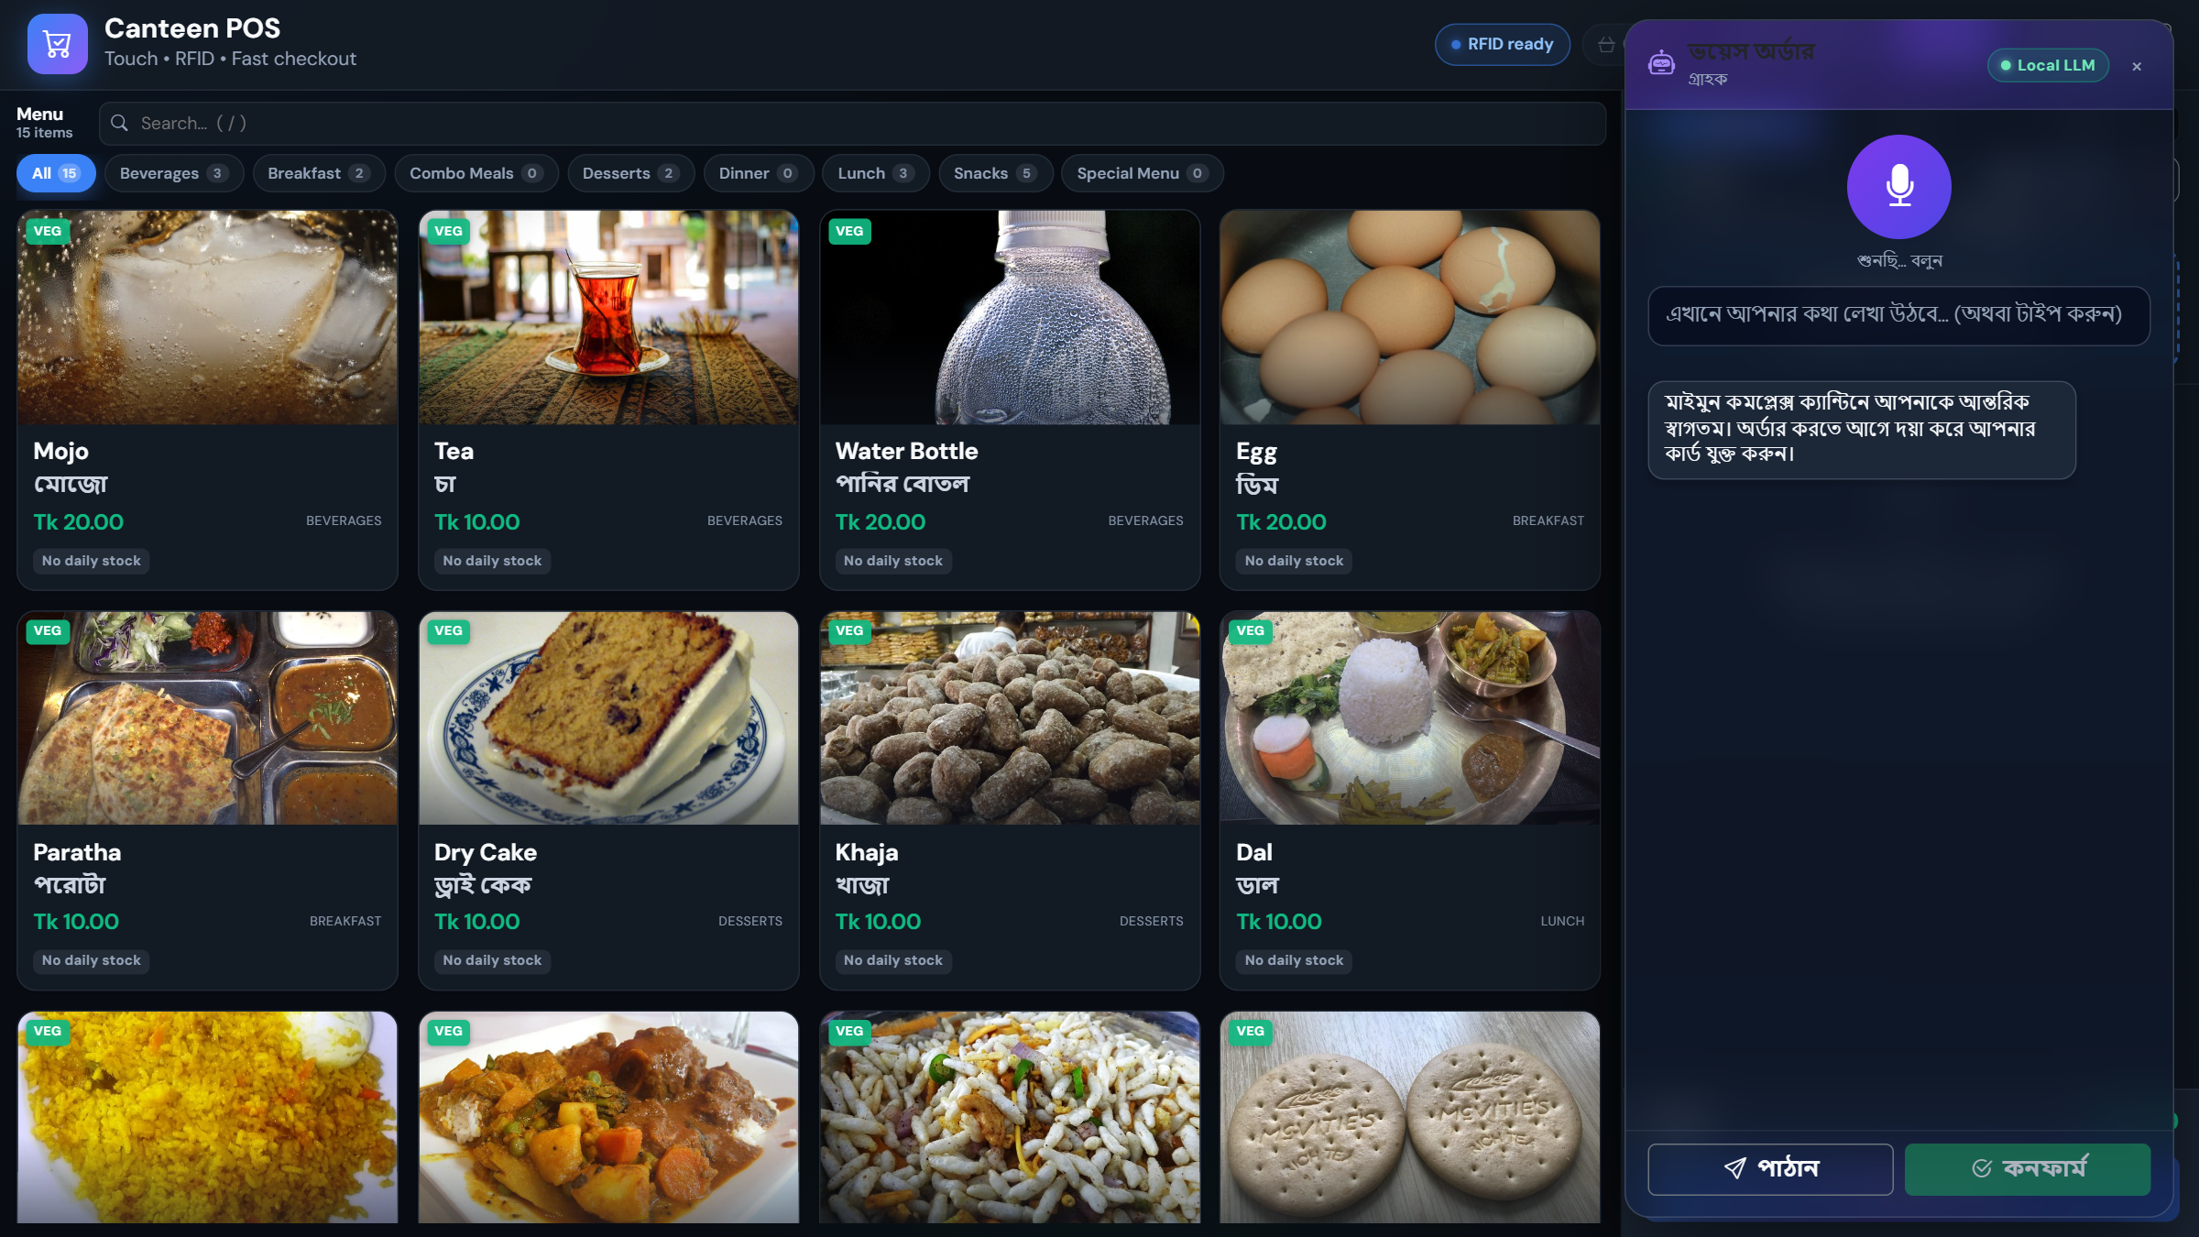
AI VOICE ORDERING
Hands-free ordering in Bangla
1
Customer taps Voice and speaks in Bangla
2
Speech → text (Web Speech, bn-BD)
3
Active LLM returns the order via a submit_turn tool
4
Items validated against live stock; total computed
5
“কনফার্ম” → order committed, token issued
6
Token announced by voice; 80 mm slip auto-prints
POS voice assistant · active provider shown live (Local LLM)

Slide 6
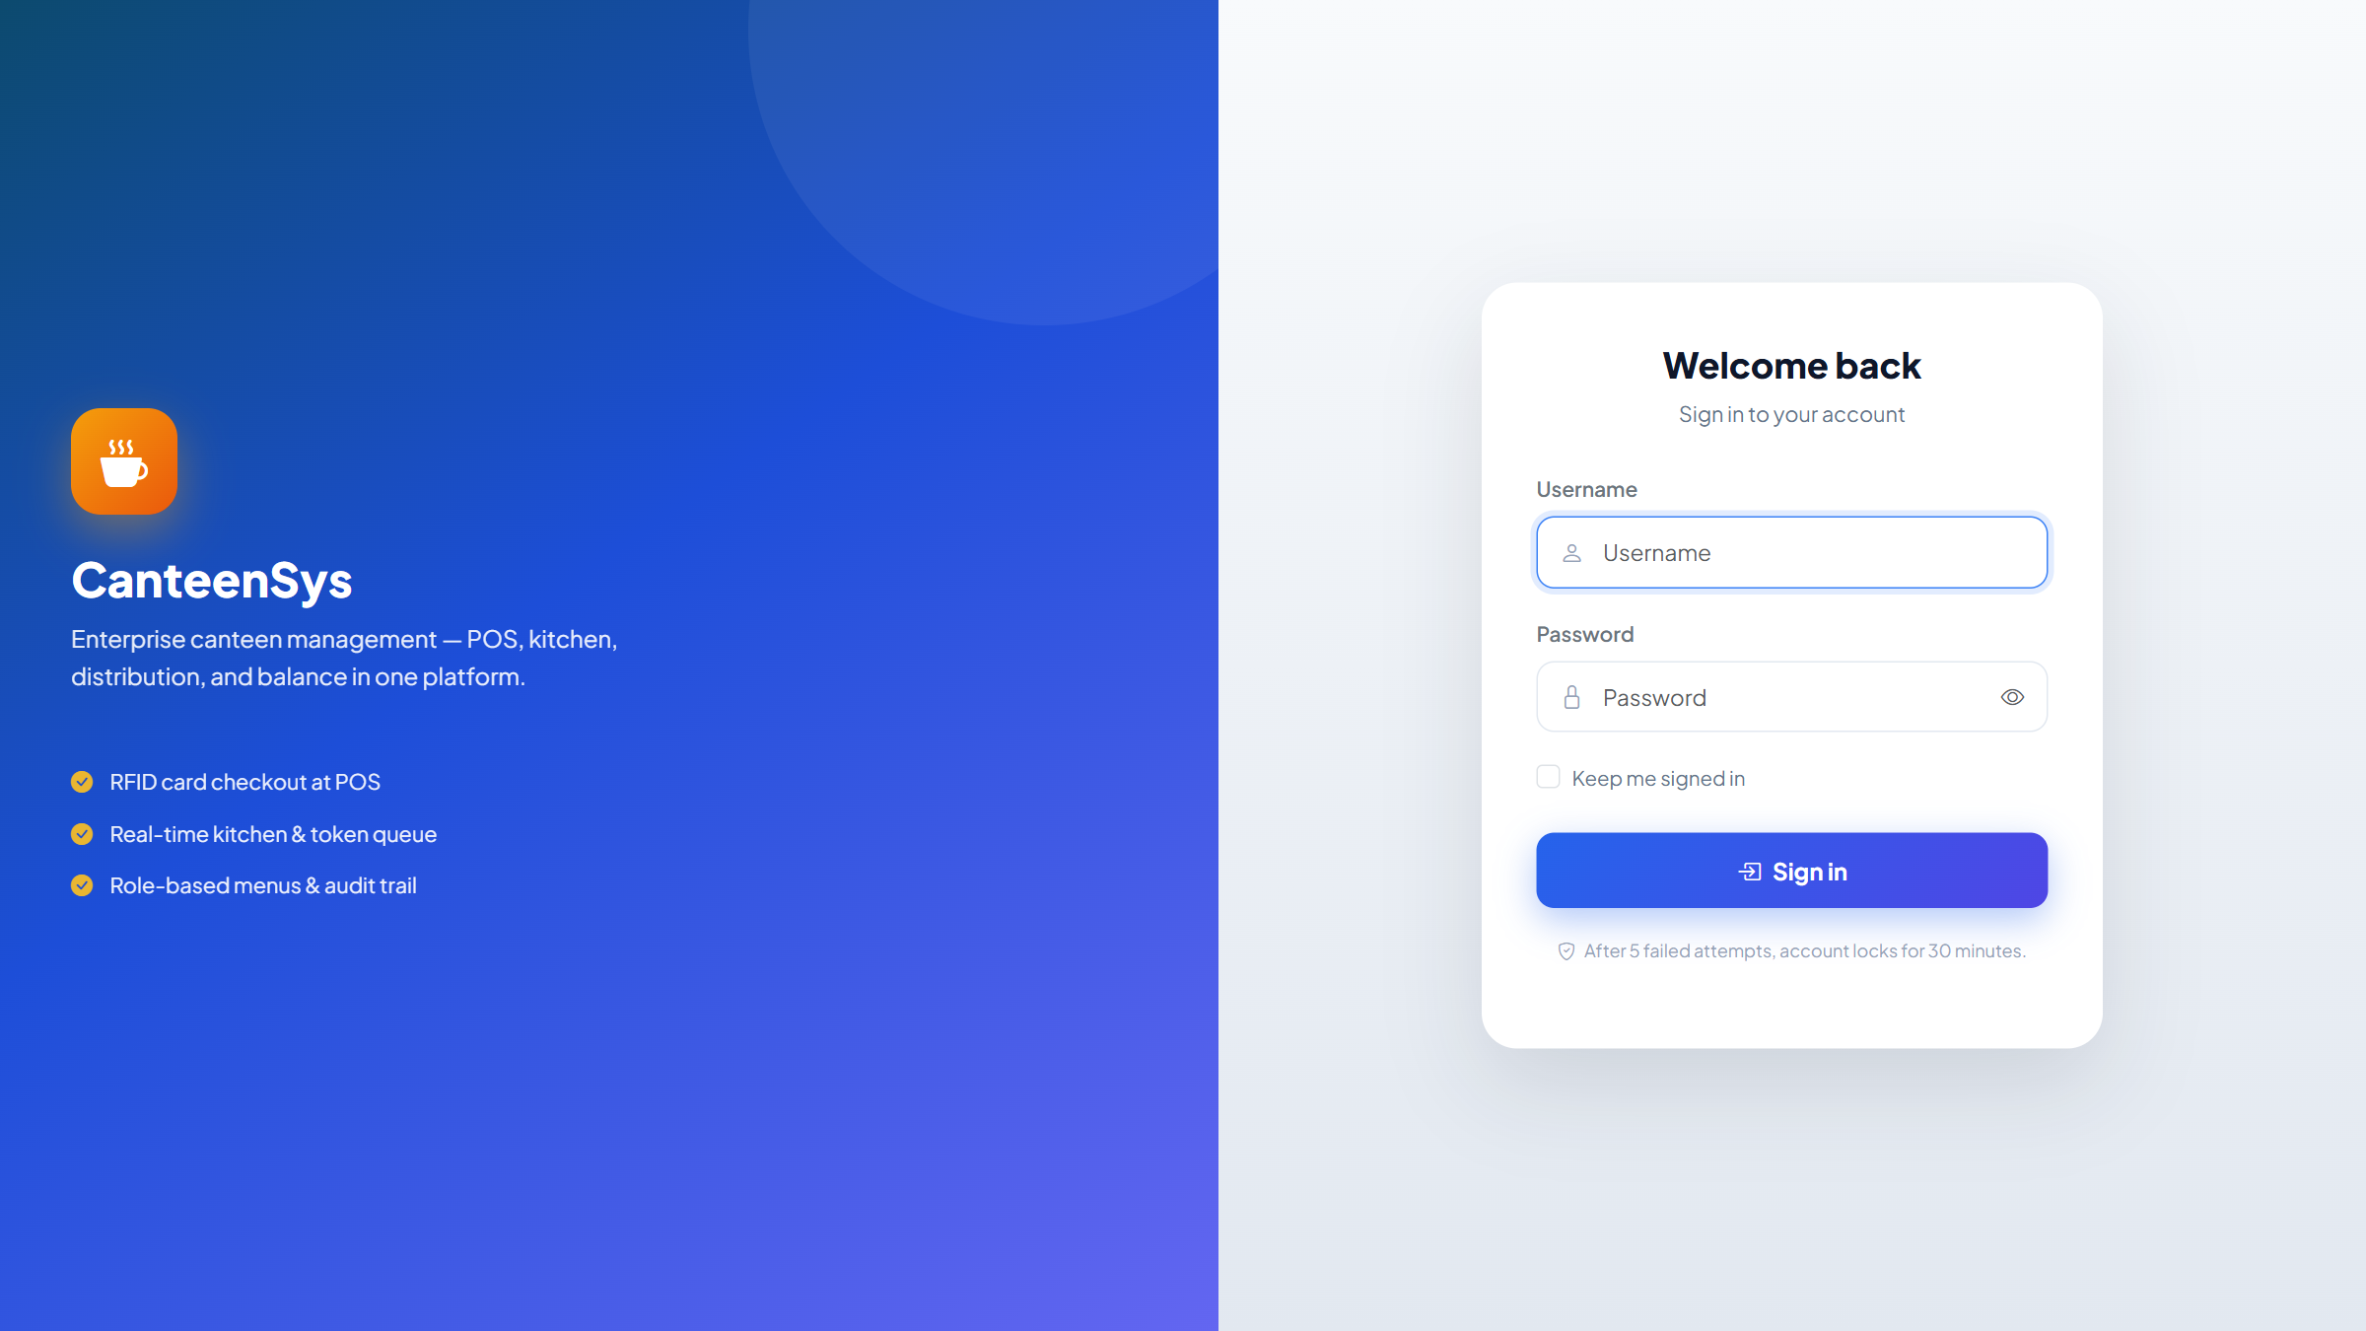
SIGN IN
Secure role-based login
Username + password · account locks for 30 min after 5 failed attempts

Slide 7
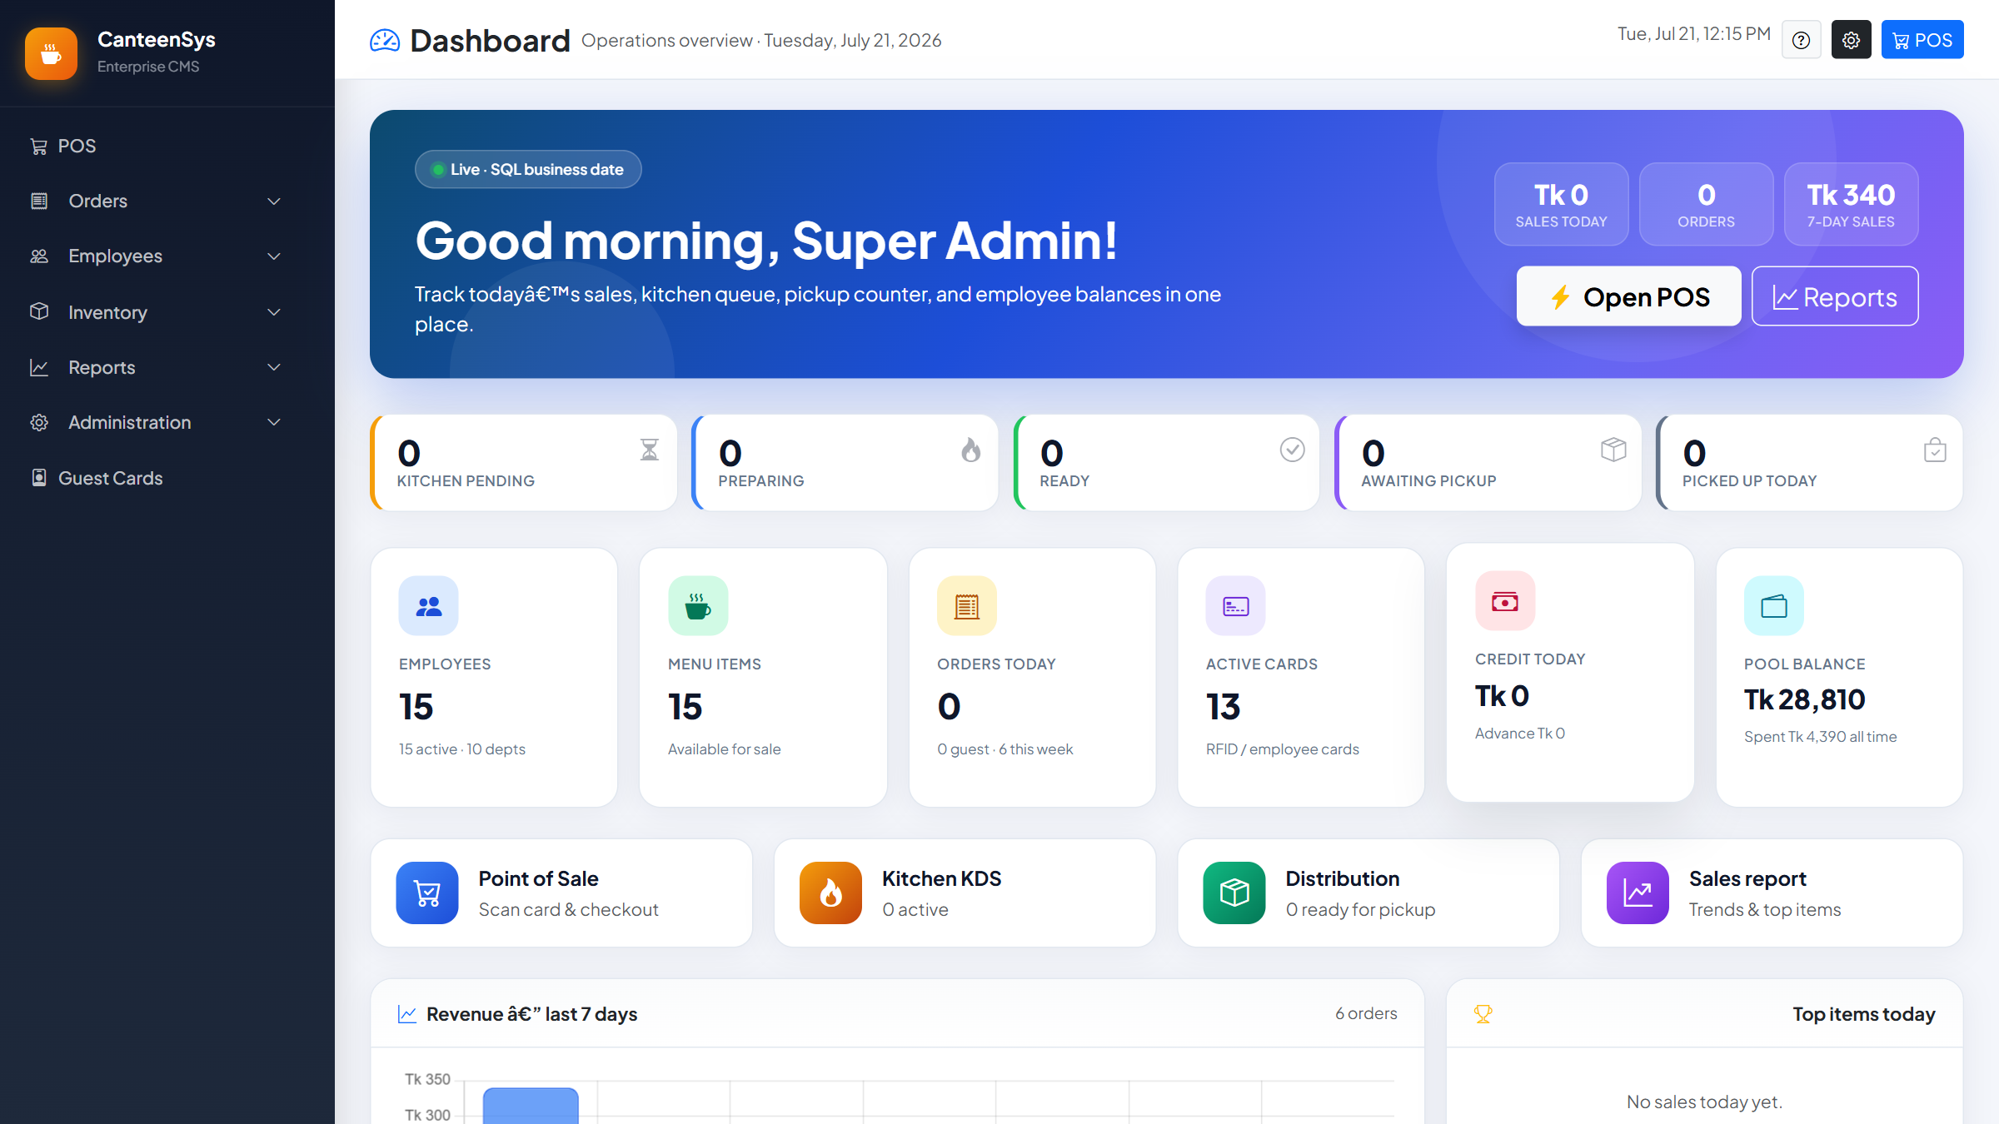
DASHBOARD
Live operations at a glance
Sales, orders, kitchen queue, pickup counters and pool balance — live on the SQL business date

Slide 8
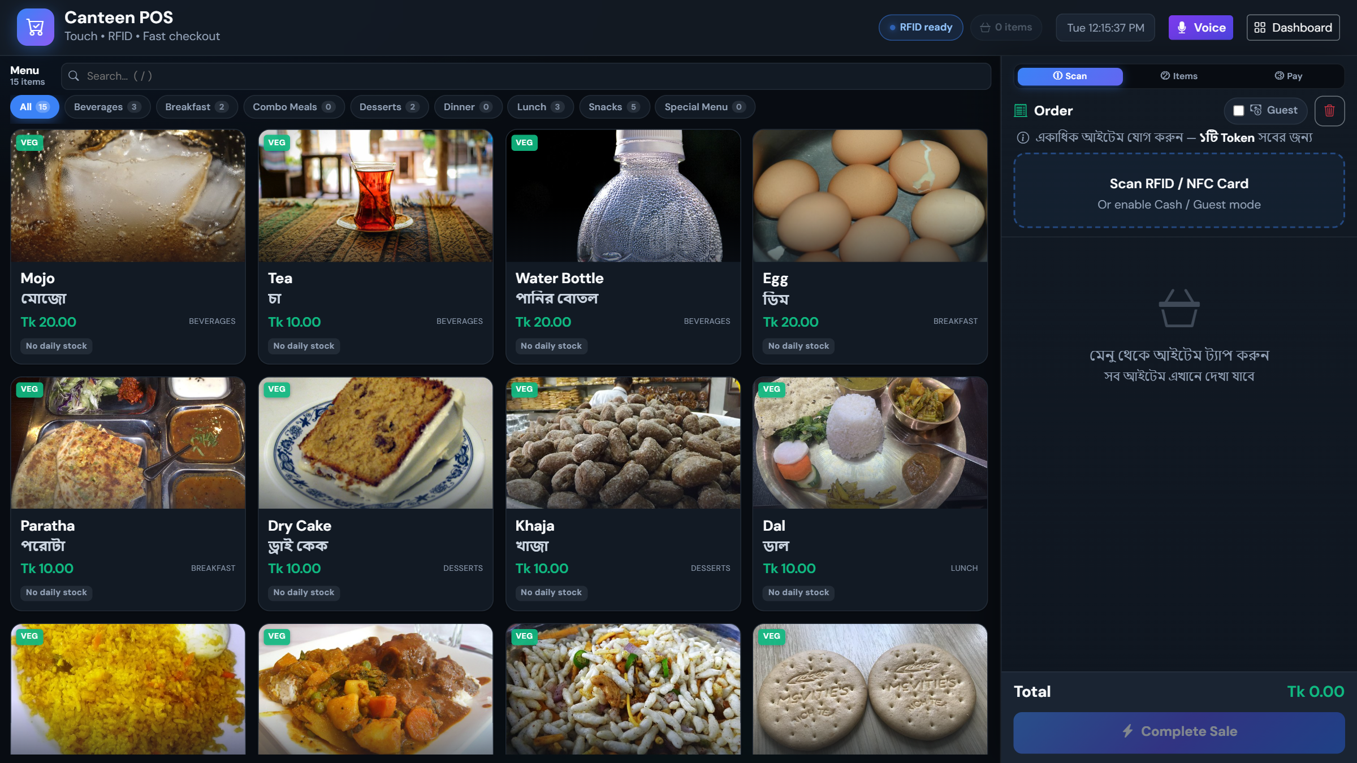
POINT OF SALE
Touch + RFID fast checkout
Category menu, cart, guest/cash mode and one-tap Complete Sale

Slide 9
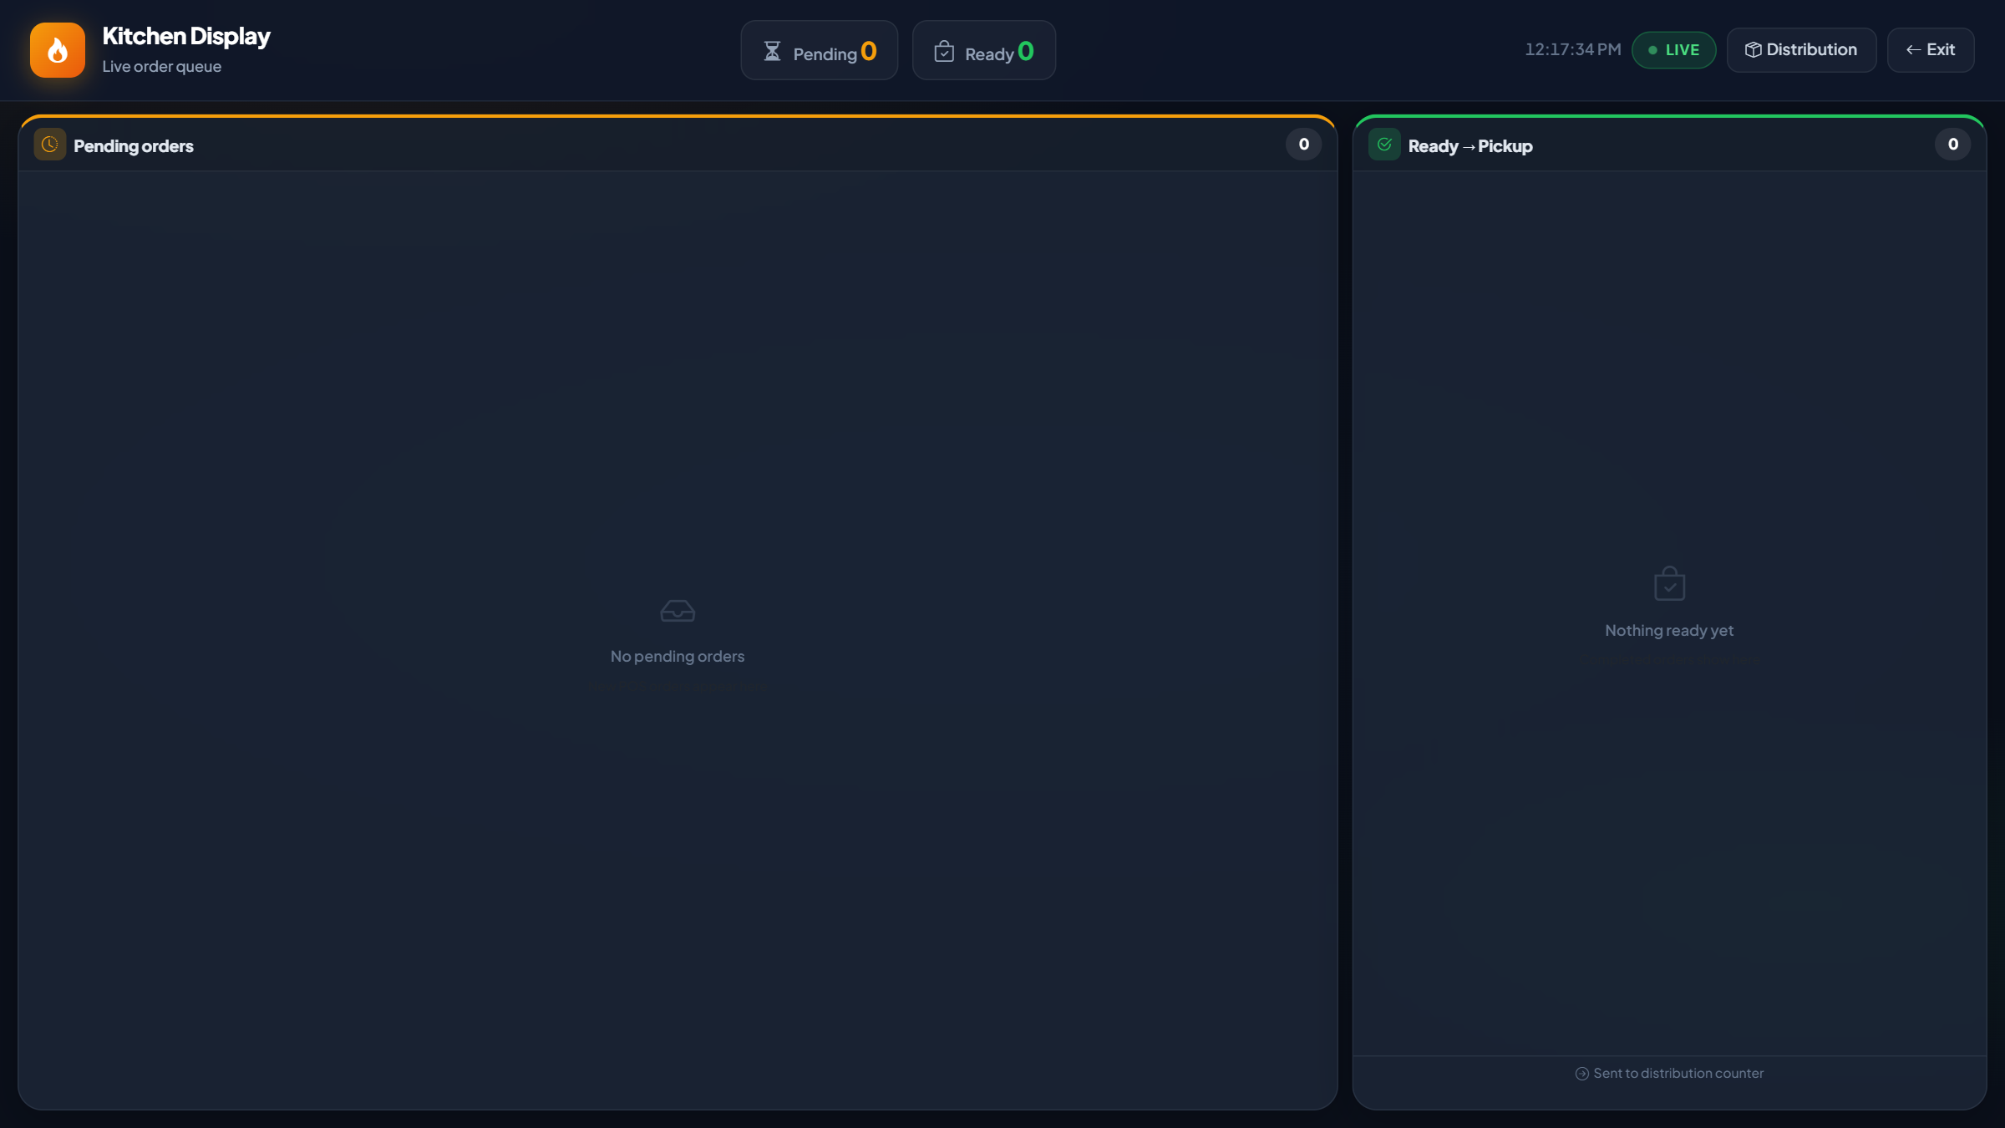
KITCHEN DISPLAY (KDS)
Real-time preparation queue
Preparing → Ready columns update live via SSE

Slide 10
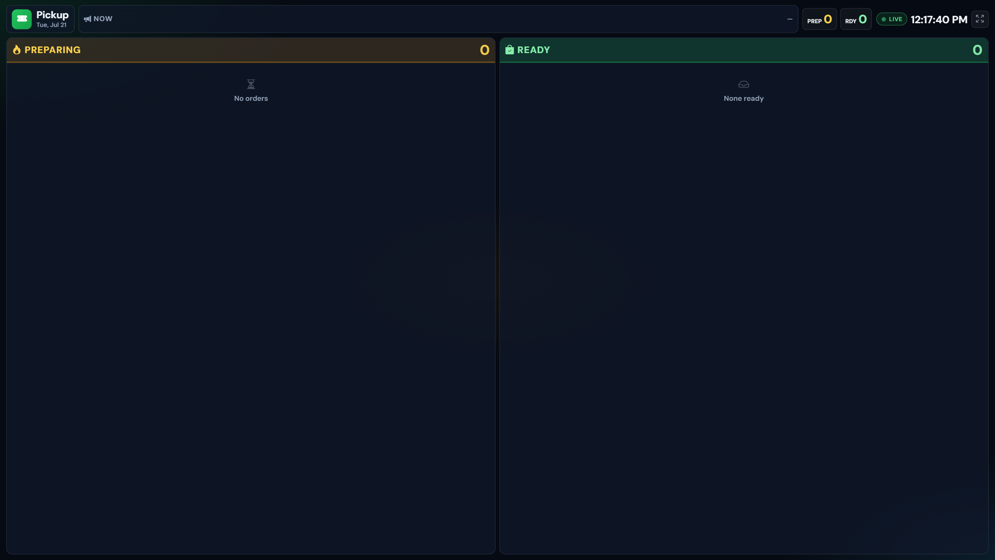
TOKEN PICKUP MONITOR
Customer-facing display
Preparing & Ready token board for the pickup wall screen

Slide 11
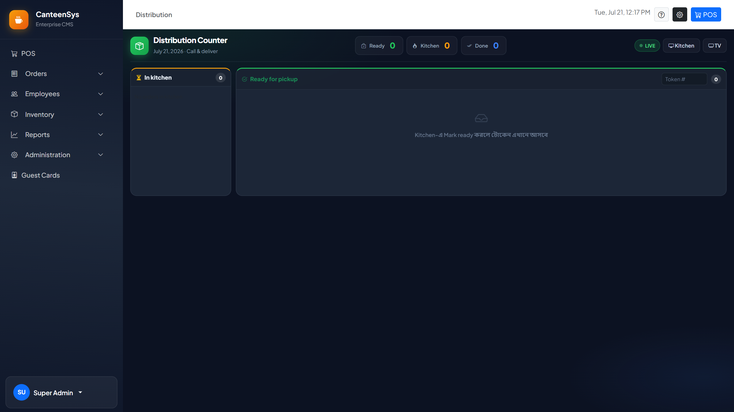
DISTRIBUTION COUNTER
Verified handover
Match token to employee, then mark completed

Slide 12
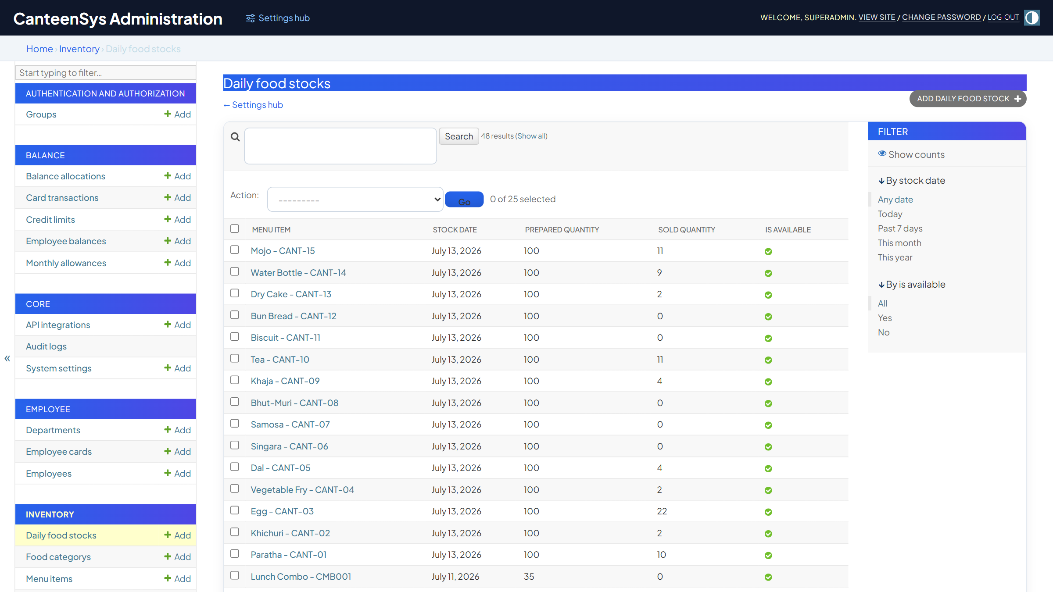
INVENTORY & DAILY STOCK
Per-day stock control
Prepared vs sold quantity per menu item, per business day

Slide 13
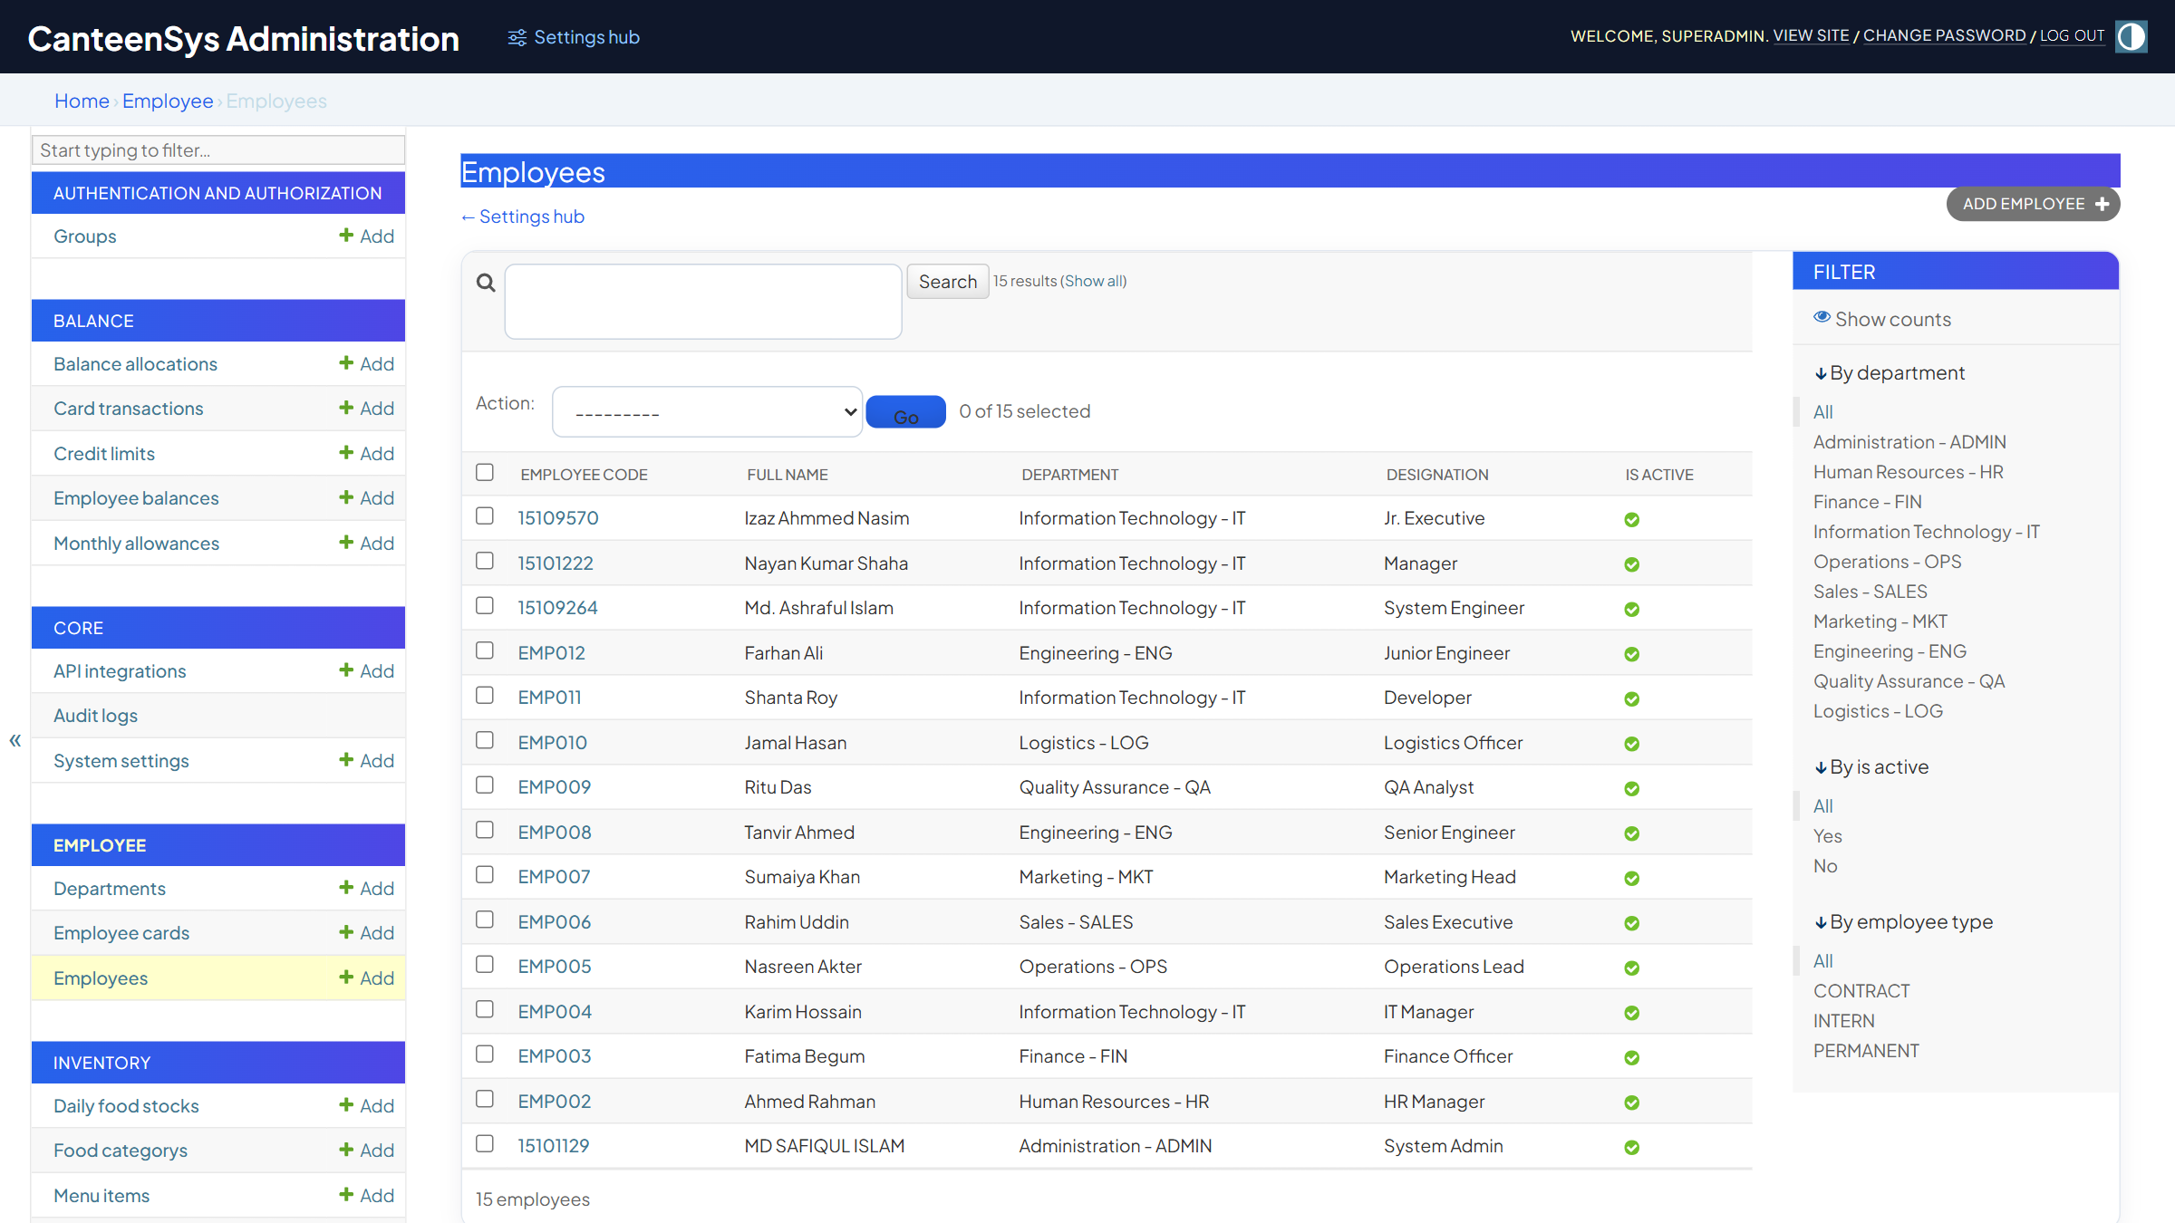
EMPLOYEES & CARDS
People, cards & balances
Departments, RFID cards and advance/credit balances

Slide 14
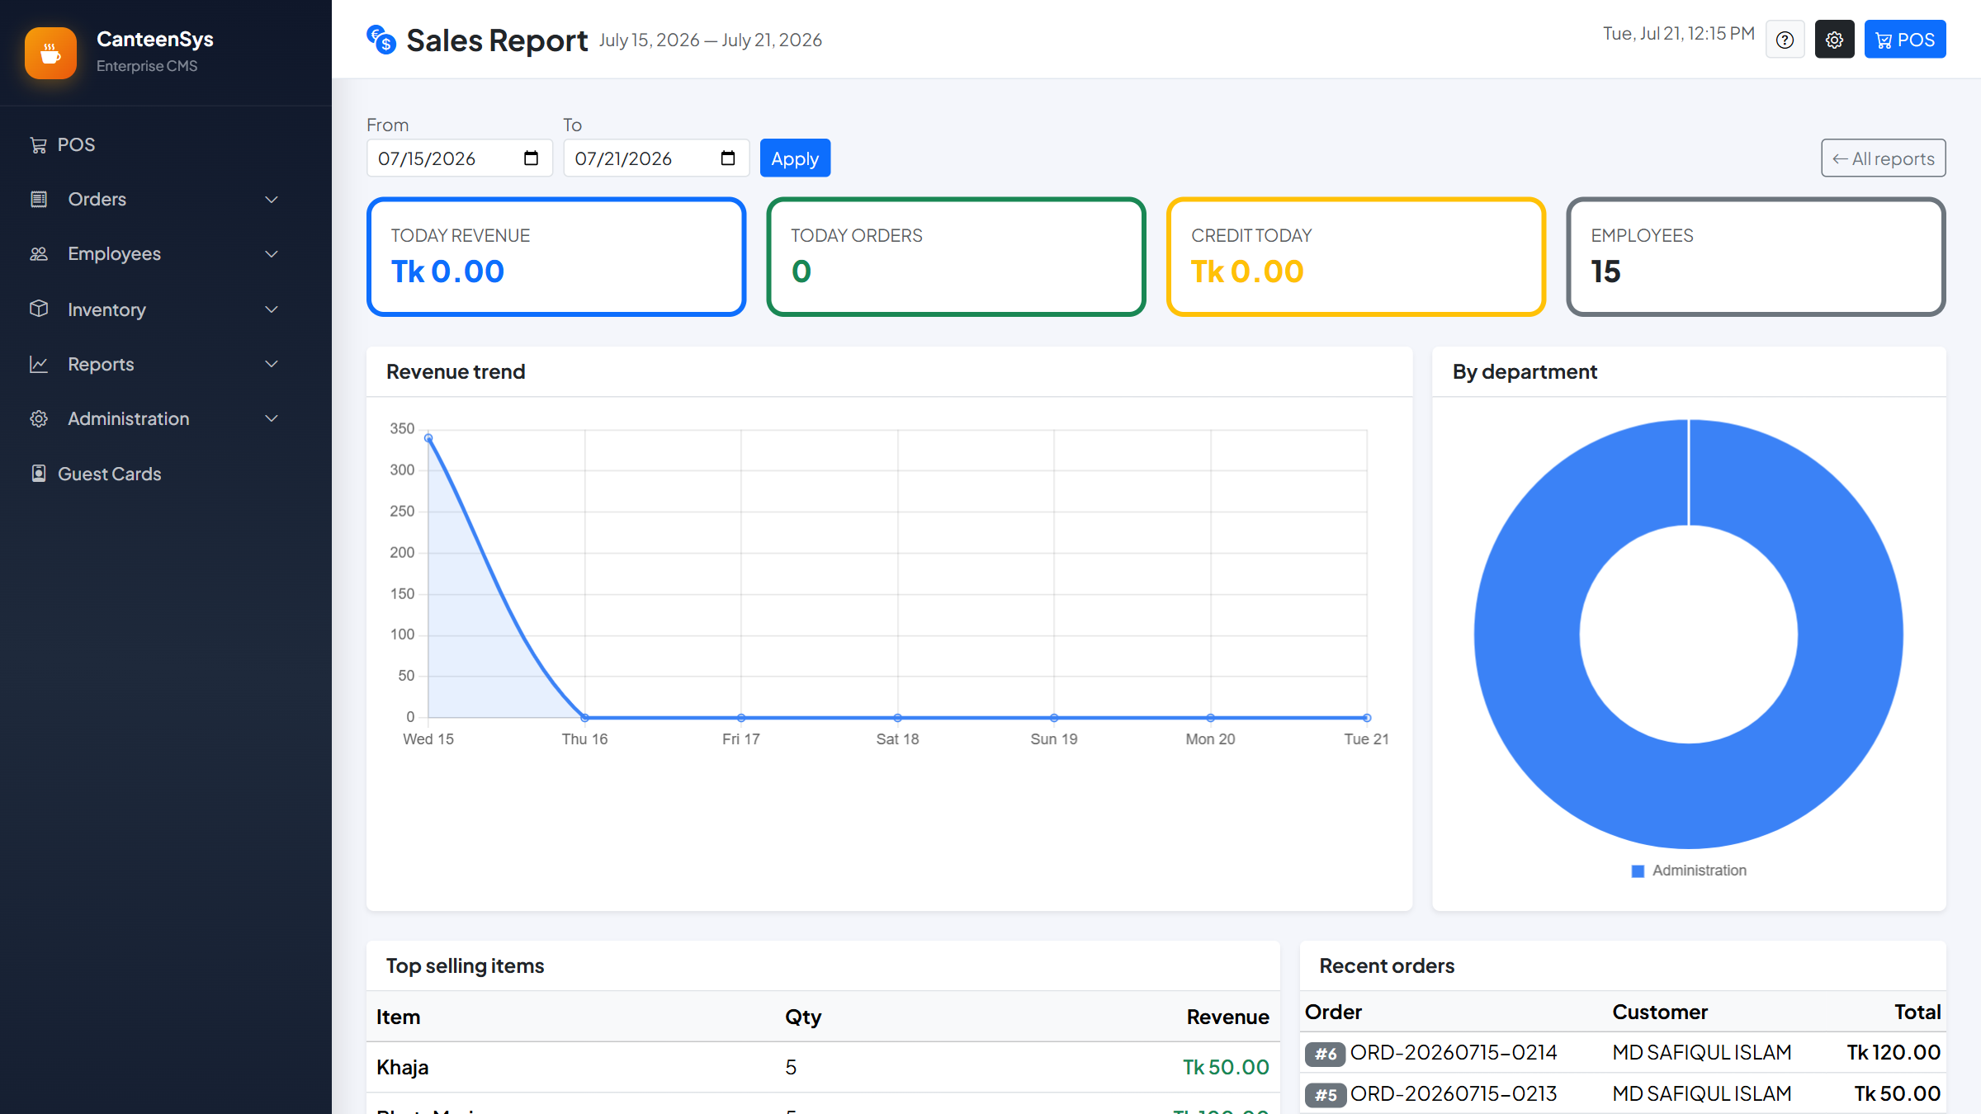
SALES REPORTS
Analytics & trends
Revenue trend and department breakdown with date range

Slide 15
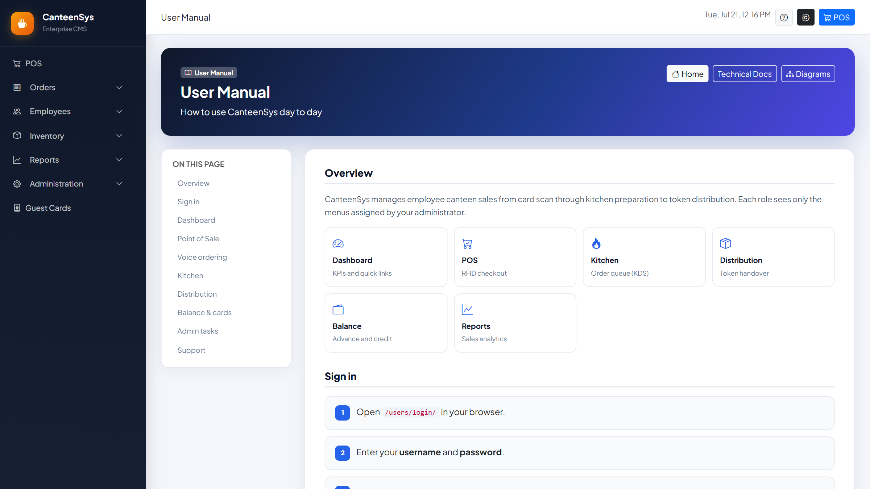
BUILT-IN USER MANUAL
In-app docs + demo video
Role-aware documentation including the AI voice walkthrough video

Slide 16
CanteenSys
Faster service · accurate billing · full traceability — powered by AI
Thank you

