Slide 1
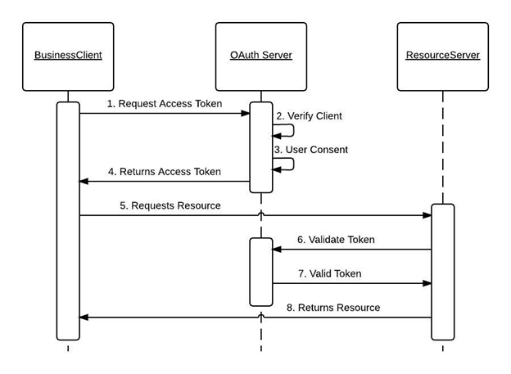
Request Access Token Types
Authorization code flow (Password Window)
Client credentials flow (ClientID)
Resource owner password credentials (Username & password)
Hybrid flow
Device authorization flow
PKCE flow

Slide 2
Request Access Token Types
Authorization code flow (Password Window)
Client credentials flow (ClientID)
Resource owner password credentials (Username & password)
Hybrid flow
Device authorization flow
PKCE flow

Slide 3

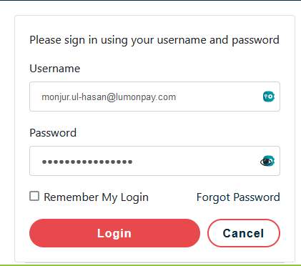

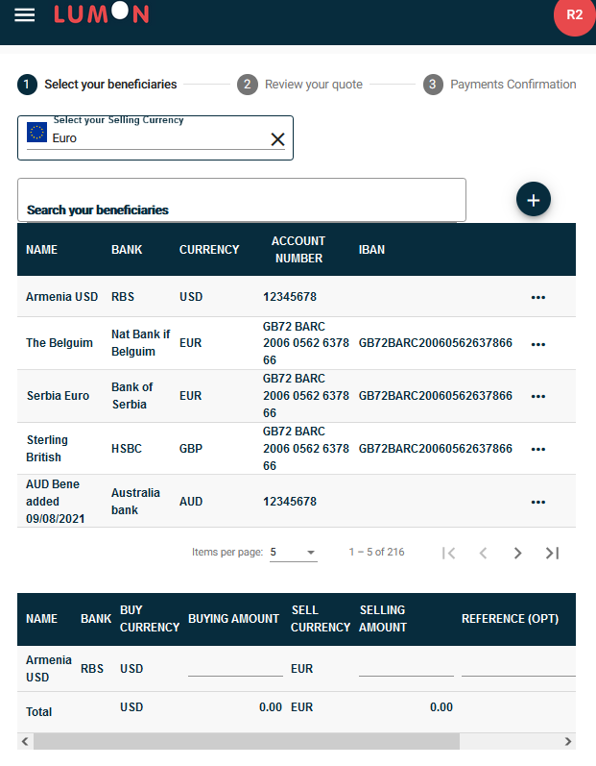
https://identity.mywebsite.com
Identity Server
Identity Server Database - Store Users’ Credential and Scopes
- Stores App Ids, Secrets, and Scopes
1. <Access Token>
10. Token Validation
5. Obtain SMS Access Authorization
8. Obtain GrameenPhone Authorization
2a. Validate Access Tokens
2b. <Authorization Token>
7. Token Validation
9. <GrameenPhone
4. Tokens Validation
Authorization Token>
Payment API
SMS API
GrameenPhone Adapter
3. <Access Token>
6. <SMS
<Authorization Token>
Authorization Token>
11. <GrameenPhone Authorization>
Payment
Password-based Token
Corporate.grameenPhone.com
https://portal.mywebsite.com/payment
Client-Secret Base Token

