Slide 1









Count4U
STOCK & SALES MANAGEMENT
Safiya Abdulkadir Elmi
240500598

Slide 2

Problem & Solution
Problem
  Small shops often manage stock manually.
  Low-stock items can be missed.
  Calculating sales manually takes time.
Solution
  Count4U is a simple stock and sales management system.
  It helps shop owners keep track of products and stock.
  Sales and stock quantities are updated automatically.

Slide 3





Target Users & Features
Target users
  Spaza-shop owners
  Small retail shops
Features
  User login
  Product catalogue
  Sell items
  Automatic sales total
  Automatic stock deduction
  Stock up/restocking
  Low-stock alerts
  Sales dashboard
  Best-selling and slow-selling products

Slide 4


How Count4U Works
Technology Used
  Select product → Add to sale → Checkout → Sale recorded → Stock updated
  For restocking: Select product → Enter quantity → Stock updated
  HTML
  CSS
  Bootstrap
  JavaScript
  PHP
  MySQL
How it works and technology used

Slide 5

Benefits
  Saves time
  Reduces manual calculations
  Makes stock easier to monitor
  Shows important sales information
  Simple interface for small-shop owners
Benefits & Improvements
Future Improvements
  API integration
  Integration with services such as stock/payment providers

Slide 6
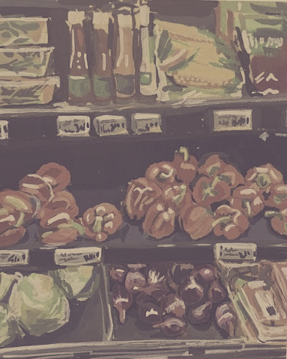
Conclusion
  Count4U provides a simple way to manage stock and sales.
  It reduces manual work for small-shop owners.
  The system keeps important stock and sales information in one place.
WEBSITE LINK
https://count4u.liveblog365.com

