Slide 1

Workshop
Biostatistics &
SPSS Workshop
Clear concepts • correct test choice • practical analysis
Presented by
Safoorah Sabir
Senior Lecturer Statistics

Slide 2

Why this workshop matters
1
From data to answer
3
Use SPSS with confidence
Convert patient records, forms and scores into clear summaries and decisions.
Enter data correctly, select menus and read key output.
2
Avoid wrong tests
4
Report simply
Choose the correct analysis according to variable type and study question.
Write results in a clean format that readers can understand.
Main idea: statistics is not only calculation — it is a way to answer clinical questions responsibly.
INTRODUCTION

Slide 3
Workshop roadmap
1
Variables & data types
2
SPSS data setup
3
Descriptive statistics
4
Sampling & inference
What to know, when to use it.
What to know, when to use it.
What to know, when to use it.
What to know, when to use it.
5
Hypothesis testing
6
Common statistical tests
7
Reporting & practice
What to know, when to use it.
What to know, when to use it.
What to know, when to use it.
The order moves from “What is my data?” to “Which test should I apply?”
INTRODUCTION

Slide 4

Learning outcomes
Identify qualitative, quantitative, continuous and discrete variables.
Set variable names, labels, values and measurement scale in SPSS.
Summarize data using mean, median, mode, variance and standard deviation.
Understand sampling, inference and hypothesis testing in simple words.
Choose between t-tests, ANOVA, chi-square and regression for common questions.
INTRODUCTION

Slide 5
From a question to an answer
Ask
Define
Enter
Analyze
Report
What do I want to know?
Which variables?
Clean SPSS sheet
Choose correct test
Explain result
Example question: Is the average pain score lower after treatment than before treatment?
INTRODUCTION

Slide 6
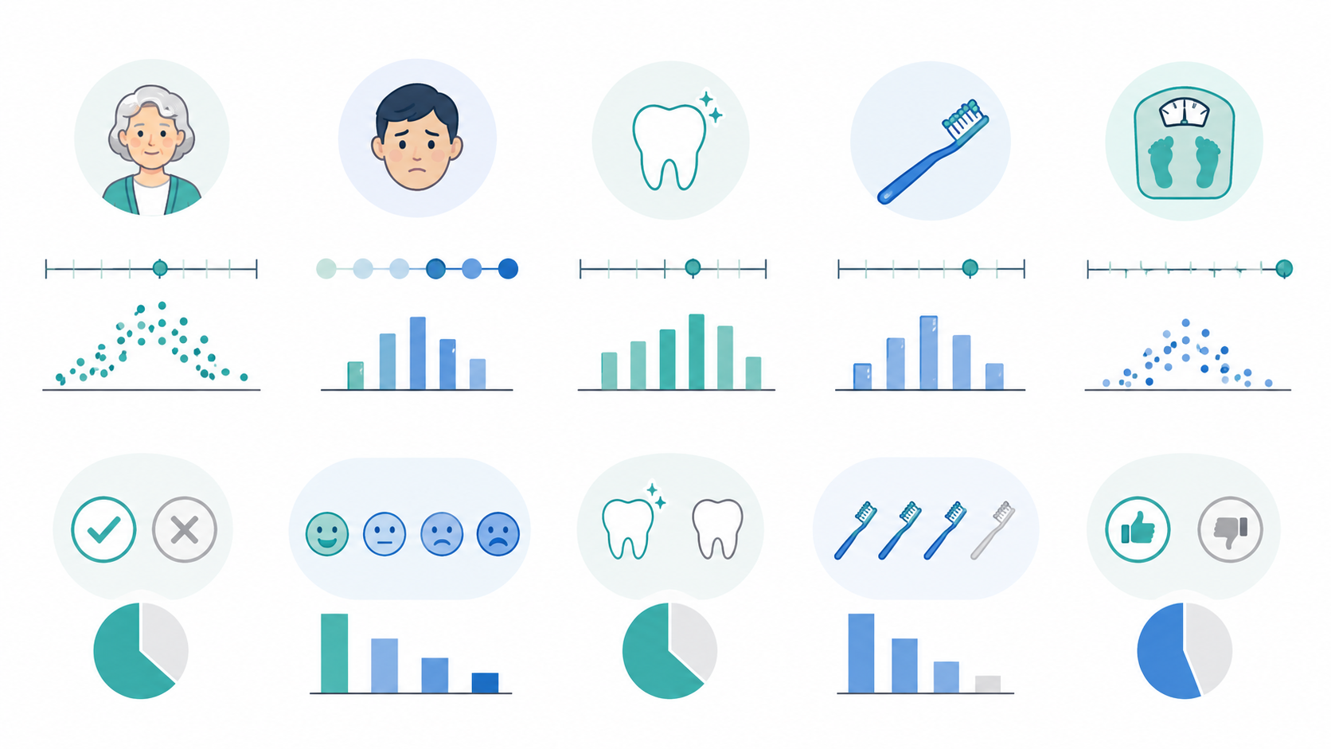
VARIABLES
Part 1
Biostatistics basics
Understand the language of variables before opening SPSS.
Biostatistics & SPSS Workshop

Slide 7
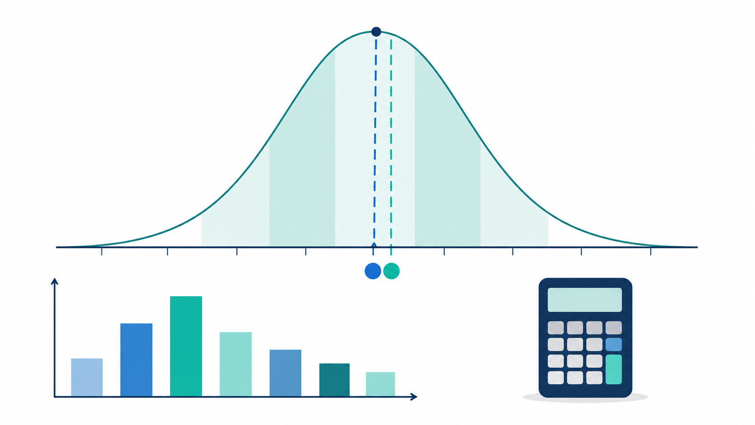
What is biostatistics?
✓
Simple definition
Biostatistics uses numbers, summaries and tests to answer health-related questions from data.
→
In practice
It helps us describe patients, compare groups and study relationships between variables.
VARIABLES

Slide 8
Qualitative vs quantitative variables
A
Qualitative variables
Categories or names.
Examples: gender, blood group, brushing habit, satisfaction level.
#
Quantitative variables
Numbers that can be measured or counted.
Examples: age, pain score, mouth opening in mm, appointment duration.
VARIABLES

Slide 9
Continuous vs discrete variables
∞
Continuous
1
Discrete
Measured on a scale and can have decimals.
Examples: age, weight, time, pocket depth in mm.
Counted as whole numbers.
Examples: number of visits, number of missing teeth, number of medicines.
Quick rule: measured = continuous; counted = discrete
VARIABLES

Slide 10
Dependent vs independent variables
X
Independent variable
Y
Dependent variable
The factor or group that may explain a change.
Examples: treatment type, age group, brushing frequency.
The outcome we measure.
Examples: pain score, plaque score, healing time, satisfaction.
Example: Does mouthwash type change plaque score?
Mouthwash type = independent variable | Plaque score = dependent variable
VARIABLES

Slide 11
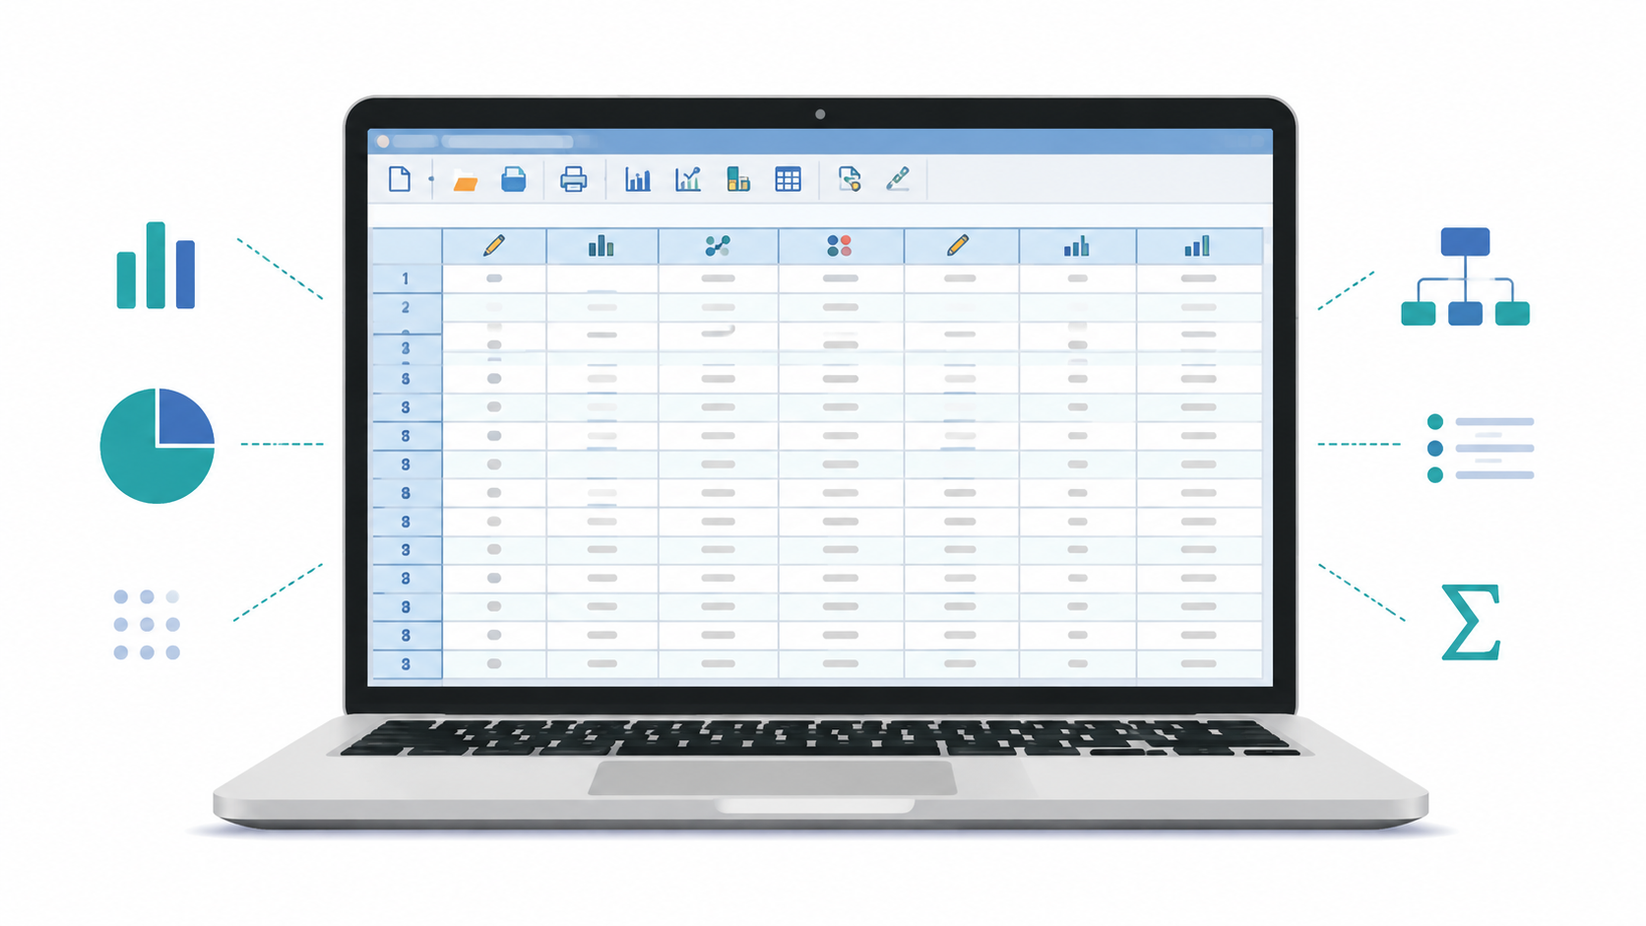
Data types in SPSS
1
Numeric
T
String
Numbers used for analysis: age, pain score, visits.
Text or labels: name, city, remarks. Not ideal for tests.
D
Date
$
Comma / Dollar
Dates of visit, procedure or follow-up.
Special formats; usually not needed for basic analysis.
Tip: use numeric coding for categories whenever possible.
SPSS SETUP

Slide 12
SPSS Variable View: key columns
Question
Groups / Data
Outcome
Test
Name
Short variable name: age, gender, pain_pre
Type
Numeric, string, date
Label
Full explanation of the variable
Values
Coding for categories: 1 = Male, 2 = Female
Measure
Nominal, ordinal or scale
Good setup makes analysis easier and reduces mistakes.
SPSS SETUP

Slide 13
Measurement scale: nominal, ordinal, scale
N
Nominal
O
Ordinal
S
Scale
Categories with no order.
Examples: gender, treatment group, yes/no.
Categories with order.
Examples: mild / moderate / severe, satisfaction level.
Numerical measurement.
Examples: age, pain score, plaque score, time in minutes.
SPSS uses measurement scale to guide summaries and graphs.
SPSS SETUP

Slide 14
How to choose the correct measurement scale
Question
Groups / Data
Outcome
Test
If data are names only
Male/Female, Yes/No, Group A/B
Nominal
Frequencies, chi-square
If data have order
Mild/Moderate/Severe
Ordinal
Median, percentages
If data are measured numbers
Age, pain score, duration
Scale
Mean, SD, t-test, ANOVA
Simple memory: Name = Nominal | Order = Ordinal | Number = Scale
SPSS SETUP

Slide 15
Organizing data correctly
R
One row = one participant
C
One column = one variable
K
Use simple codes
Each participant should appear once in the main data sheet.
Do not mix two variables in one column.
Example: 1 = Yes, 0 = No. Keep a codebook.
M
Avoid empty text
✓
Check before analysis
Use consistent coding for missing data.
Run frequencies and descriptives first.
SPSS SETUP

Slide 16
DESCRIPTIVE STATISTICS
Part 2
Describe the data
Start with simple summaries before doing statistical tests.
Biostatistics & SPSS Workshop

Slide 17
Descriptive statistics: first look at the data
Tells us what the data look like.
Finds the center of values: mean, median, mode.
Finds spread: variance and standard deviation.
Identifies unusual values and skewness.
DESCRIPTIVE STATISTICS

Slide 18
Mean, median and mode
M
Mean
Md
Median
Mo
Mode
Average value.
Example: average pain score after treatment.
Middle value after sorting.
Useful when data are skewed.
Most repeated value.
Useful for categories and common responses.
Example values: 2, 3, 3, 4, 8 → mean = 4, median = 3, mode = 3
DESCRIPTIVE STATISTICS

Slide 19
Variance and standard deviation
V
Variance
SD
Standard deviation
!
Easy meaning
Average squared distance from the mean. It tells how scattered the values are.
Average spread around the mean in the original unit.
Small SD = values are close.
Large SD = values are spread out.
Example: two groups may have the same mean, but different spread.
DESCRIPTIVE STATISTICS

Slide 20
Symmetric distribution
Values are balanced around the center.
Mean, median and mode are close to each other.
Many parametric tests work better when data are roughly symmetric.
Always check histogram or normality before deciding.
DESCRIPTIVE STATISTICS

Slide 21
Skewness: when data are not balanced
+
Positive skew
–
Negative skew
Most values are low, but a few values are very high.
Example: long treatment time for a few complex cases.
Most values are high, but a few values are very low.
Example: high satisfaction with a few low scores.
For skewed data, median can be more meaningful than mean.
DESCRIPTIVE STATISTICS

Slide 22
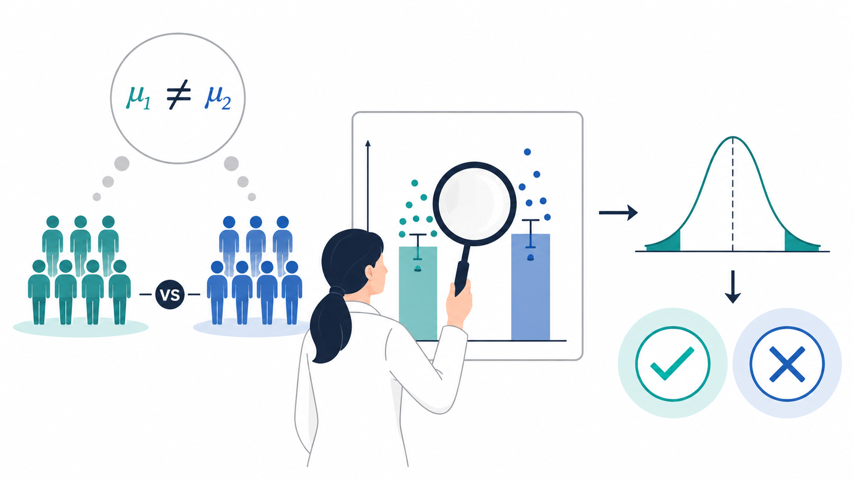
INFERENCE
Part 3
Inference & testing
Move from sample summaries to evidence-based conclusions.
Biostatistics & SPSS Workshop

Slide 23
Sampling: why we do not study everyone
P
Population
S
Sample
I
Inference
All people we want to understand.
A smaller group selected from the population.
Using sample results to make a statement about the population.
Good sample = better confidence in your result.
INFERENCE

Slide 24
Inference in simple words
1
Collect data from a sample.
2
Calculate a statistic: mean, percentage or difference.
3
Estimate what may be true in the larger group.
4
Use a test to judge if the finding is likely real or due to chance.
INFERENCE

Slide 25
Hypothesis testing: easy steps
1
State the question
2
Write H₀ and H₁
3
Choose correct test
4
Check p-value
5
Make conclusion
Use data to decide
H₀ = no difference
H₁ = difference
Use data to decide
Use data to decide
Use data to decide
Hypothesis testing does not prove; it gives evidence.
INFERENCE

Slide 26
P-value and significance
p
P-value
<
Common rule
Probability of getting a result like this if the null hypothesis is true.
If p < 0.05, the result is called statistically significant.
Important: statistical significance is not always clinical importance.
INFERENCE

Slide 27
Which test should I use?
Question
Groups / Data
Outcome
Test
One mean vs fixed value
1 group
Scale
One-sample t-test
Two separate groups
2 independent groups
Scale
Independent t-test
Same participants before/after
2 related readings
Scale
Paired t-test
Three or more groups
3+ independent groups
Scale
ANOVA
Association of categories
Two categorical variables
Nominal/Ordinal
Chi-square
Prediction/relationship
Outcome + predictor
Mostly scale
Regression
STATISTICAL TESTS

Slide 28
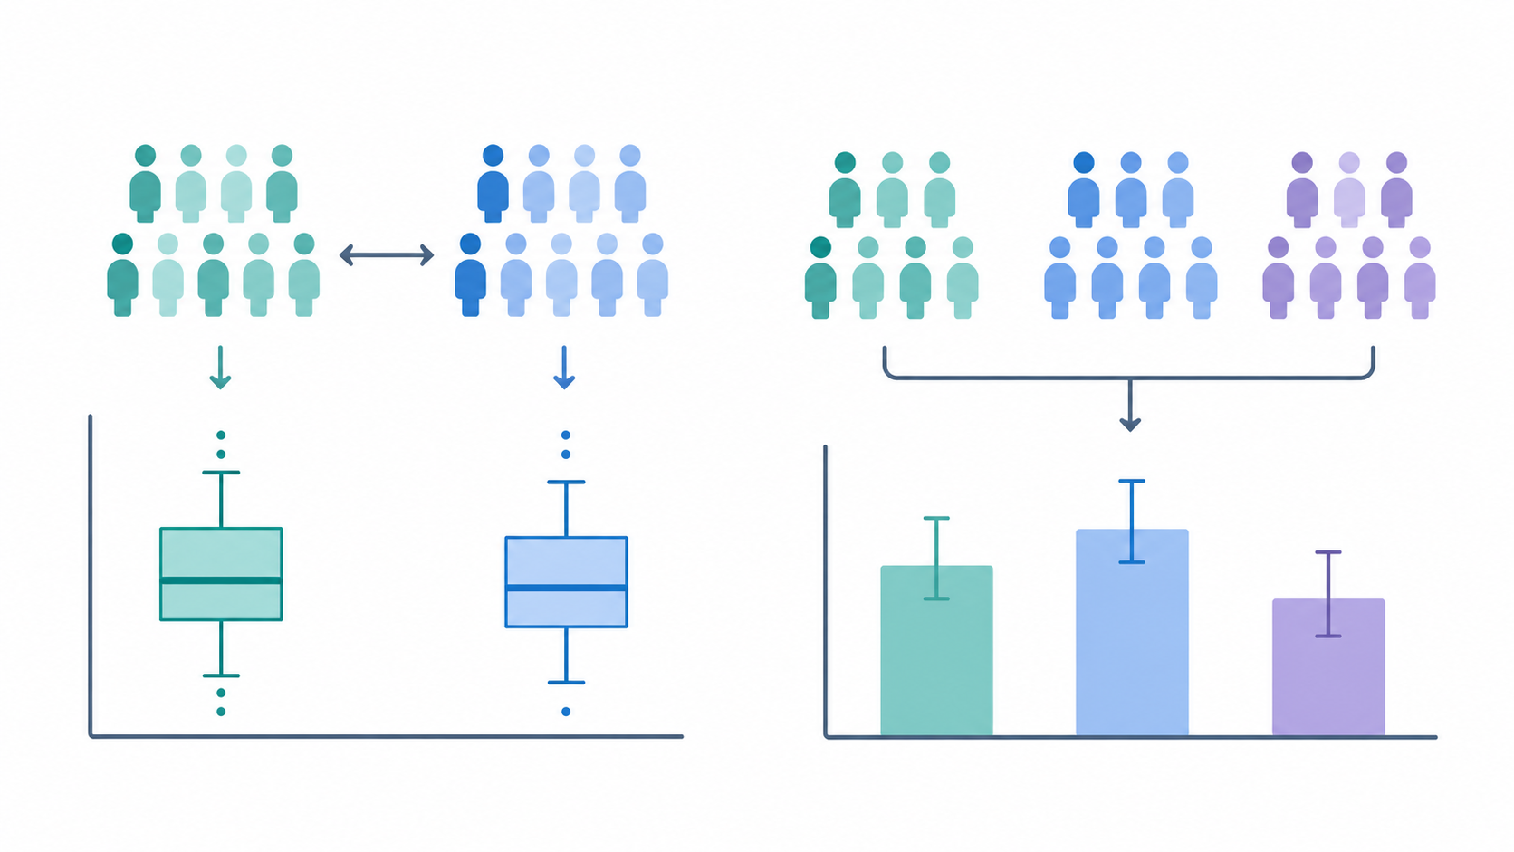
STATISTICAL TESTS
Part 4
Common tests
Learn the question, data type, menu route and simple interpretation.
Biostatistics & SPSS Workshop

Slide 29
One-sample t-test
?
Question
Ex
Example
S
SPSS menu
Is one sample mean different from a known value?
Is average pain score different from 5?
Analyze → Compare Means → One-Sample T Test
Data needed: one scale outcome variable.
STATISTICAL TESTS

Slide 30
Independent-samples t-test
?
Question
Ex
Example
Do two separate groups have different mean outcome values?
Compare mean plaque score between two treatment groups.
SPSS: Analyze → Compare Means → Independent-Samples T Test
STATISTICAL TESTS

Slide 31
Paired-samples t-test
?
Question
Ex
Example
Does the mean change when the same participants are measured twice?
Pain score before treatment vs pain score after treatment in the same participants.
Key idea: two readings are connected, not independent.
SPSS: Analyze → Compare Means → Paired-Samples T Test
STATISTICAL TESTS

Slide 32
ANOVA
?
Question
Ex
Example
Do three or more independent groups have different mean values?
Compare mean plaque score among three toothpaste groups.
If ANOVA is significant, use post-hoc tests to see which groups differ.
STATISTICAL TESTS

Slide 33
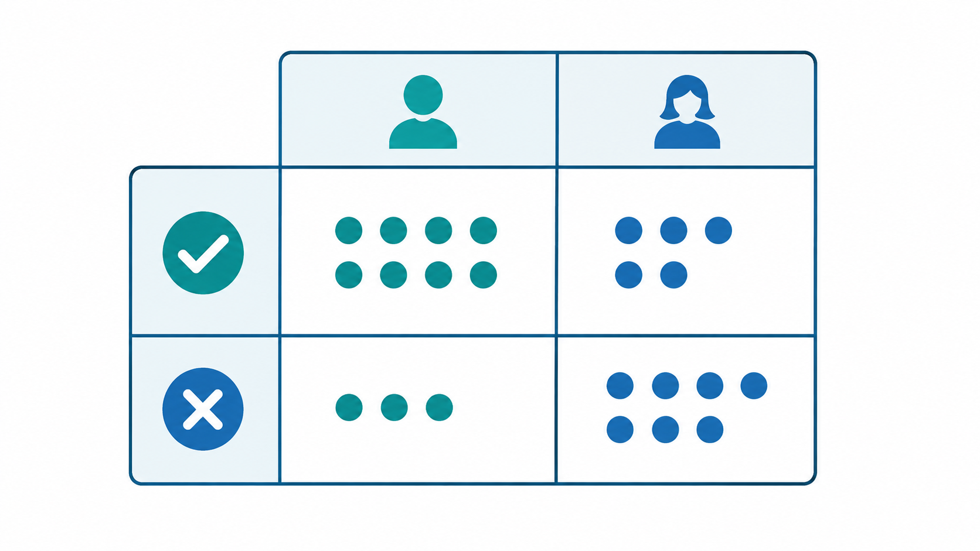
Chi-square test
?
Question
Are two categorical variables associated?
Ex
Example
Is treatment group associated with improvement: Yes/No?
SPSS: Analyze → Descriptive Statistics → Crosstabs → Chi-square
STATISTICAL TESTS

Slide 34

Regression
?
Question
Can one or more variables explain or predict an outcome?
Ex
Example
Can age, brushing frequency and baseline score predict final plaque score?
STATISTICAL TESTS

Slide 35
How to report results simply
1
Describe
2
Test
3
Conclude
Report mean ± SD or frequency (%).
Mention the statistical test used.
Write p-value and plain-language meaning.
Example: Mean pain score decreased from 6.1 ± 1.4 to 3.2 ± 1.1 after treatment (paired t-test, p < 0.001).
REPORTING

Slide 36
Common mistakes to avoid in SPSS
Entering categories as text when numeric codes are easier.
Choosing “Scale” for categorical data such as Yes/No.
Using independent t-test for before/after readings.
Ignoring missing values and outliers before analysis.
Reporting p-value without explaining what it means.
REPORTING

Slide 37
Hands-on activity
1
Step 1
2
Step 2
3
Step 3
Create variables in Variable View.
Enter 10 sample records in Data View.
Run frequencies and descriptives.
4
Step 4
5
Step 5
Choose a test using the decision table.
Write a one-line interpretation.
PRACTICE

Slide 38
Key take-home messages
Start with the research question, not the software menu.
Identify variable type before choosing statistics.
Use descriptive statistics before inferential tests.
Choose tests according to groups, outcome type and data structure.
Report results with both numbers and plain meaning.
SUMMARY

Slide 39
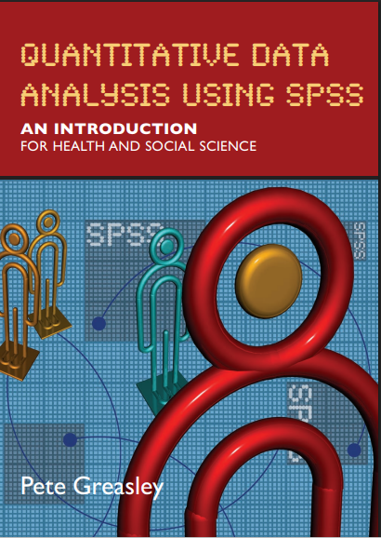
More study & reference material
↗
Kent State University Libraries: SPSS Recode Variables
Step-by-step guide for recoding old values into new categories in SPSS.
https://libguides.library.kent.edu/SPSS/RecodeVariables
B
Recommended book
Quantitative Data Analysis Using SPSS: An Introduction for Health and Social Science — Pete Greasley
Use these resources after the workshop to repeat SPSS commands, practice recoding, and revise basic analysis steps.
Beginner-friendly SPSS reading for basic data analysis practice.
REFERENCE MATERIAL

Slide 40
Thank you
Questions & Discussion
Safoorah Sabir

