Slide 1

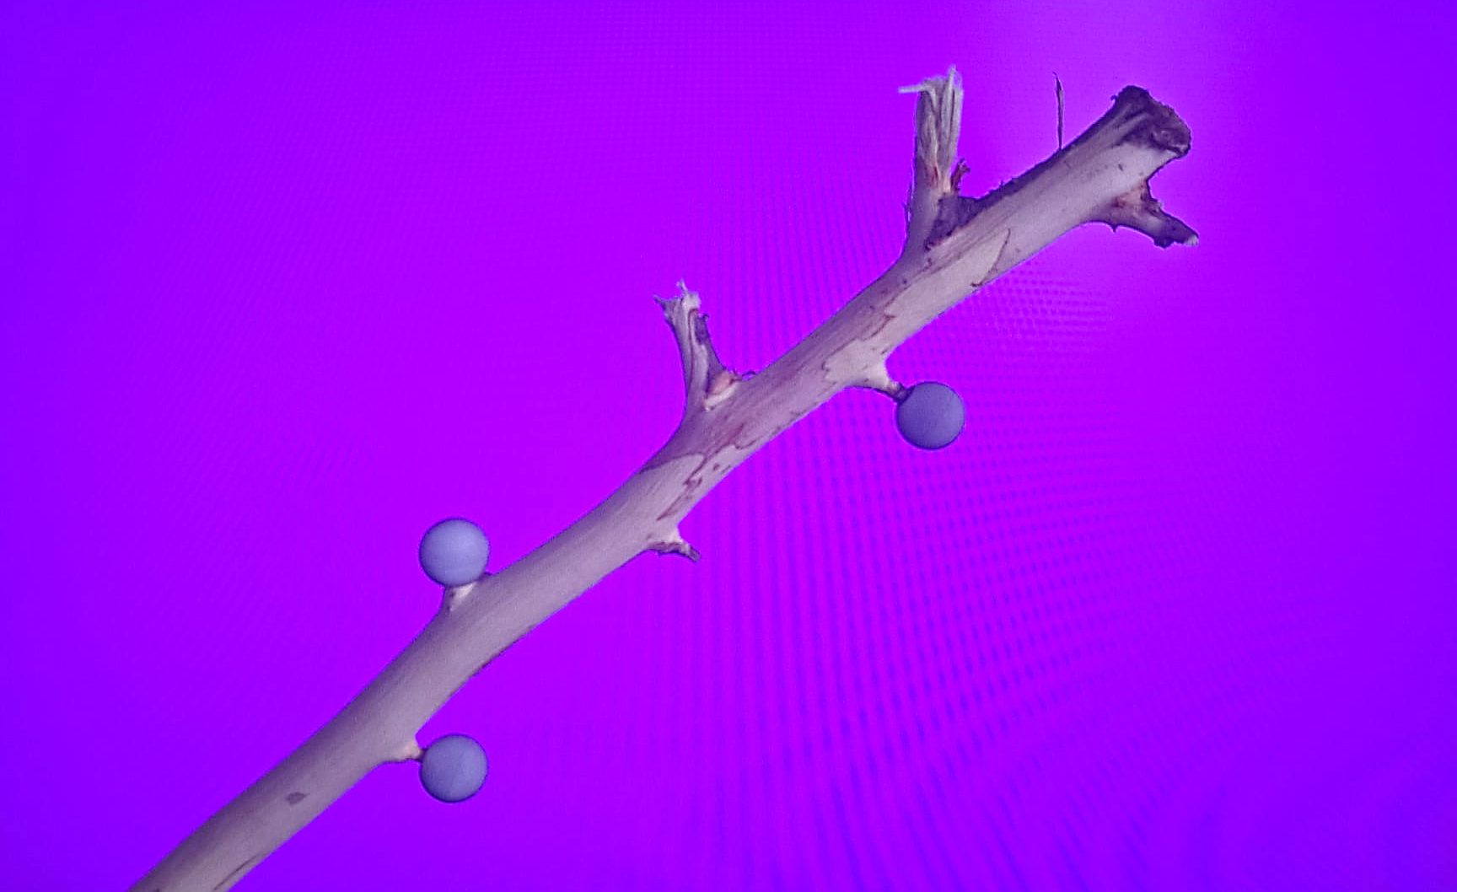
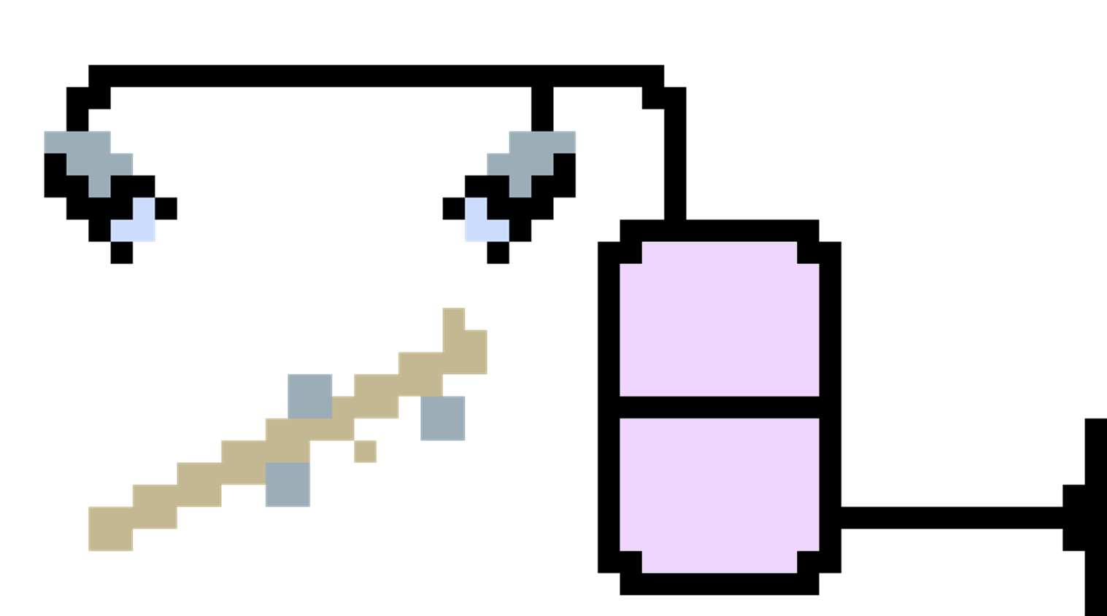
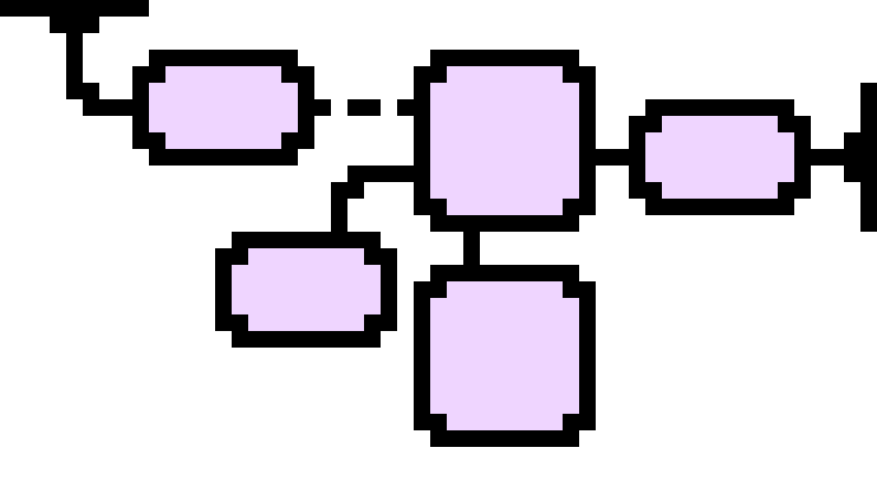
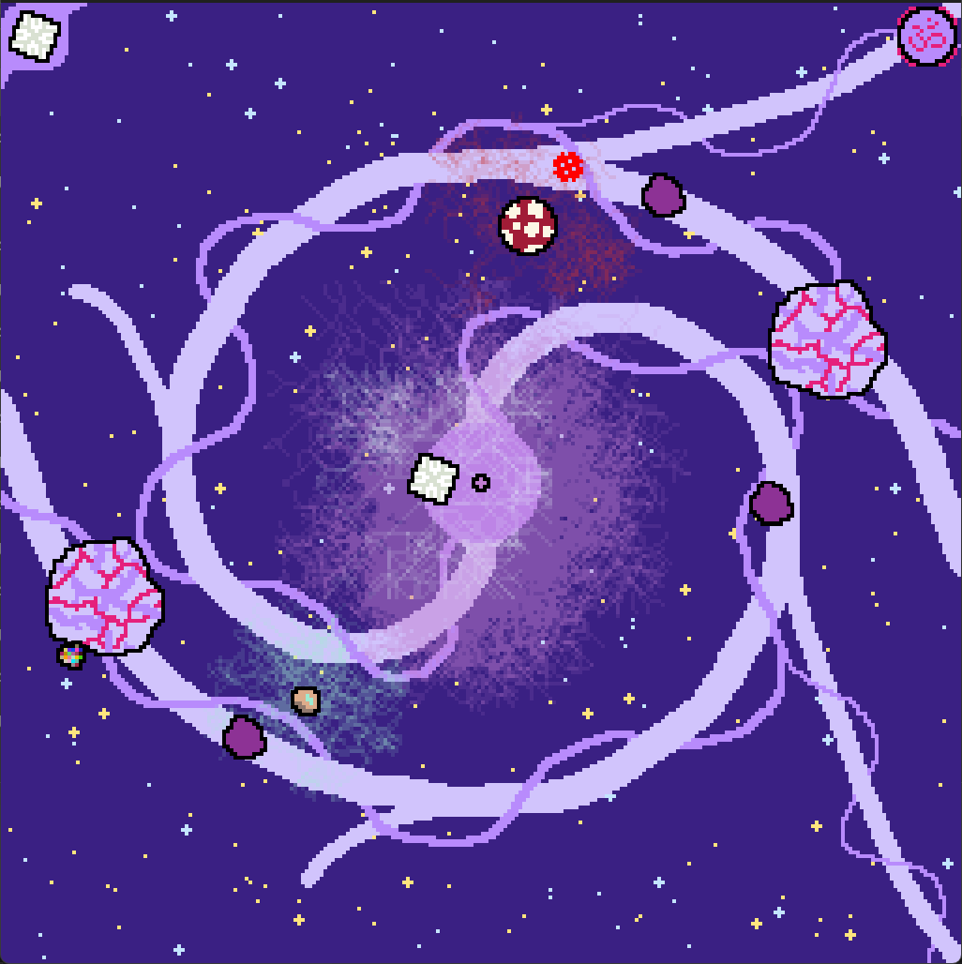
Tower Defence game with MoCap Technology
Autor: Portugaels Safwaan
Promotor: Dr. Prof. Kris Luyten
Introduction
Most games make players sit for hours.
Motion Capture can be a solution*.
My project has researched how.
*If money and space aren’t a problem
QDS
Cameras
QTM
2D
Fig. 1: Branch with Tracking Points
Per camera
MoCap
Branch
3D
Q-SDK
C++
Motion capture uses cameras to track reflective points in a 3D space.
Qualisys’s system was used:
Qualisys DHCP Server (QDS)
Qualisys Track Manger (QTM)
Qualisys_cpp_sdk (Q-SDK)
8 Miqus cameras
3 tracking points
Anything with trackers can be used for input: branch fits the natural theme (See Fig. 1)
This together forms a pipeline as seen in Fig. 2.
Calibration with a kit is needed for 3d tracking.
Tracking points
Fungods
Fig. 2: Pipeline from Tracking points to C++
Kingdom Fungi does not get enough attention
Fungi vs. Bacteria Tower Defense
Displayed on the ground with a projector
Use the branch to place and control the fungi
There are 6 fungi, all with different:
Attacks
Stats
Mycelium
C++ was used with:
SDL graphics (for flexibility)
Qualisys_cpp_sdk MoCap
Qualisys
MoCap
Engine
6DOF input
Links:
Input
Model
Output
SDL
Output
Level
Projector
Waves
Entity
Fungi
Bacteria
Spores
Fig. 3: High-level representation of the code
Final Remarks
Result is nearly to my expectations.
Fungods “engine” has a lot of potential.
Game design was the hardest part.
MoCap makes the game much more active.
Qualisys’s name is accurate.
Fig. 4: Active gameplay

