Slide 1
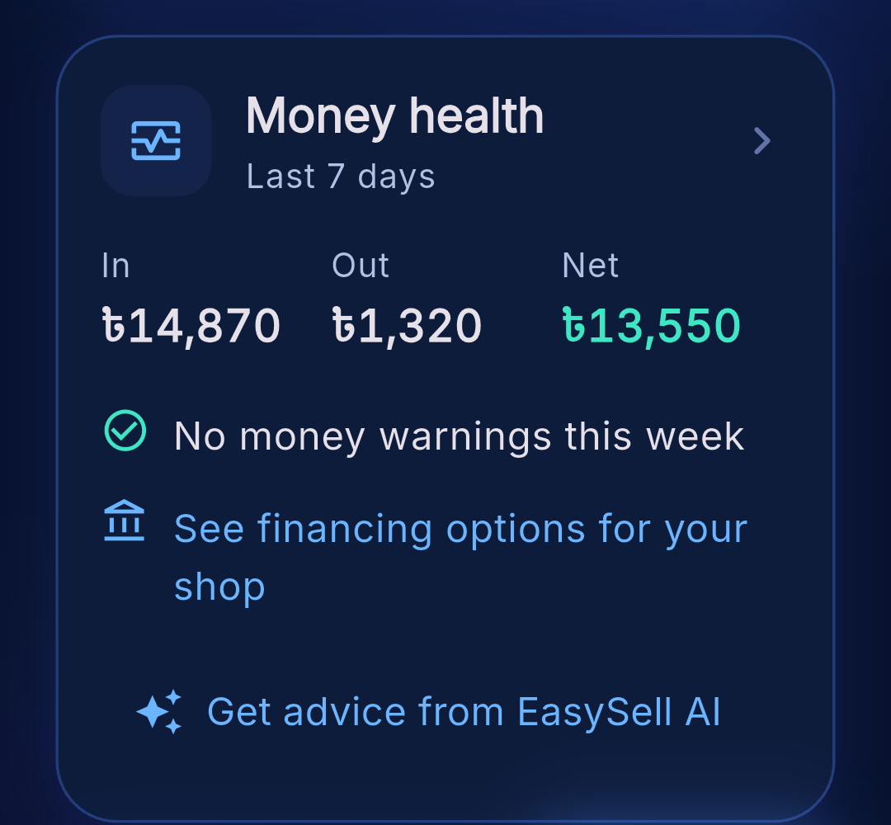
EasySell
TOPIC E · SME FINANCE COPILOT
The AI finance copilot for the world's neighbourhood shops
Sell by voice or camera. See every sale add up. Get warned before cash runs out. Get matched to finance.
Live screenshot: the Money health card
[Team name]
Notes:
Hello judges. We are [Team name], and this is EasySell, our entry for Topic E, the SME Finance Copilot. EasySell is an AI finance copilot for the small neighbourhood shops that sell most everyday goods in emerging markets: kiranas, warungs, sari-sari stores, dukas and corner shops. The shopkeeper sells by speaking or pointing the camera, and EasySell quietly turns every sale into real numbers: profit, cash flow and customer credit. Then it warns the owner before cash runs out and shows which loans the shop is ready for. What you see on the right is a live screenshot from the working app. In the next nine minutes: the problem, our solution, how it works, and the business plan.

Slide 2




Millions of shops run on memory and a paper notebook
21–26M
US$5.7T
34%
neighbourhood shops in the six markets we sized
small-business finance gap in emerging economies
of that gap is women-owned businesses (US$1.9T)
No real numbers
Cash trouble shows up too late
Owners rarely know true profit, cash stuck in stock, or credit owed by customers
Unpaid credit piles up and restocking drains the drawer before anyone notices
Locked out of finance
Typing apps don't stick
No records means no way to prove the shop is creditworthy
A busy counter and low typing comfort mean bookkeeping apps get abandoned
Sources: IFC–World Bank MSME Finance Gap (2025); BCG; USDA FAS; Jakarta Globe; ANPEC; industry estimates. Details in the business plan.
Notes:
Here is the problem. Across the six markets we sized, from India and Indonesia to Nigeria and Mexico, there are 21 to 26 million neighbourhood shops. Most run on memory and a paper notebook. Owners rarely know their real profit, how much cash is tied up in stock, or how much customers owe them. Cash problems show up too late: credit piles up, restocking drains the drawer, and the owner only notices when there is no money for the next delivery. And without records, a shop cannot prove it is creditworthy. That is part of a 5.7 trillion dollar financing gap for small businesses in emerging economies, a third of it for women-owned businesses. Existing apps need typing at a busy counter, so most get abandoned.

Slide 3





EasySell turns everyday selling into a finance copilot
1 Sell
2 Track
3 Warn
4 Finance
Speak or scan the sale. AI fills the cart; the owner confirms
Stock, profit and customer credit update in one safe step
Money health flags late payers, cash drain, rising credit, falling sales
Matches the shop to loans it is ready for, and says why
Rules decide, AI explains
Every number comes from the shop's own records. Gemini only turns it into plain advice in the owner's language, so it can never invent a figure.
Notes:
Our solution works in four steps. One: sell. The owner speaks the sale or points the camera at products, and Gemini fills the cart. Nothing is saved until the owner confirms. Two: track. Every sale updates stock, profit and customer credit together, in one database transaction, so the books always add up. Three: warn. Our Money health feature watches cash coming in and going out and flags problems early. Four: finance. EasySell matches the shop to the kinds of loans it is ready for, using its own sales history, and explains why. One principle runs through all of it: rules decide, AI explains. The numbers come from the shop's records; AI only puts them into plain words.

Slide 4
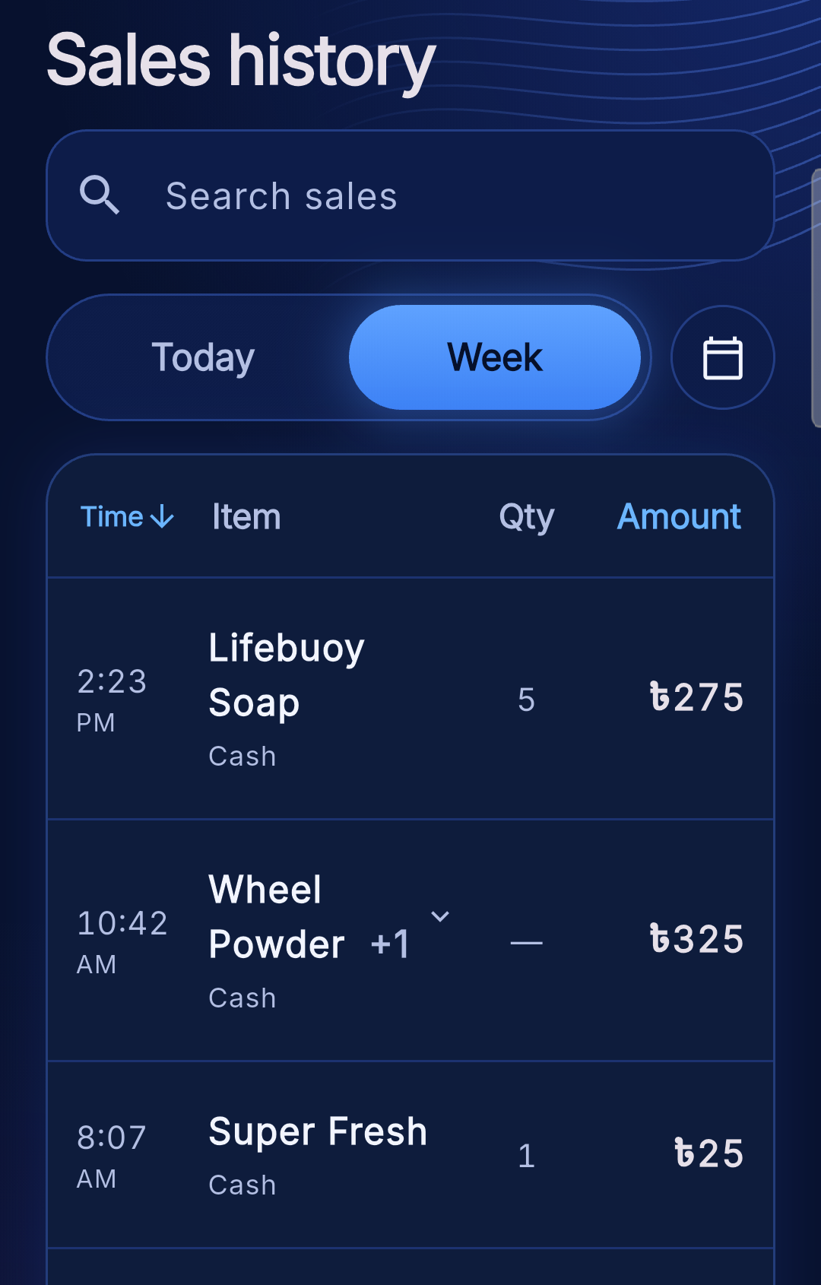


Selling at counter speed, with books that add up
Voice sale
Say the sale in your own words; Gemini turns it into cart lines
Camera scan
Point at products; AI matches them to the shop's own list
[Screenshot: voice sale or camera scan]
Checkout
Cash, Digital or Credit, with discounts; retry-safe, never recorded twice
Financial analysis
Sales history
Revenue, profit, margin, top sellers and searchable sales history
Notes:
This is what makes the data real: selling has to be faster than writing in a notebook. With voice sale, the owner just says what was sold, in their own words, and Gemini turns it into cart lines. With camera scan, they point the phone at products and the AI matches them to the shop's own product list. Checkout records how each sale was paid: cash, digital or credit. Every sale is saved in one safe step, and a lost network reply can never record the same sale twice. On top of that sits financial analysis: revenue, profit, margin, top sellers and a searchable sales history, which you can see on the right.

Slide 5
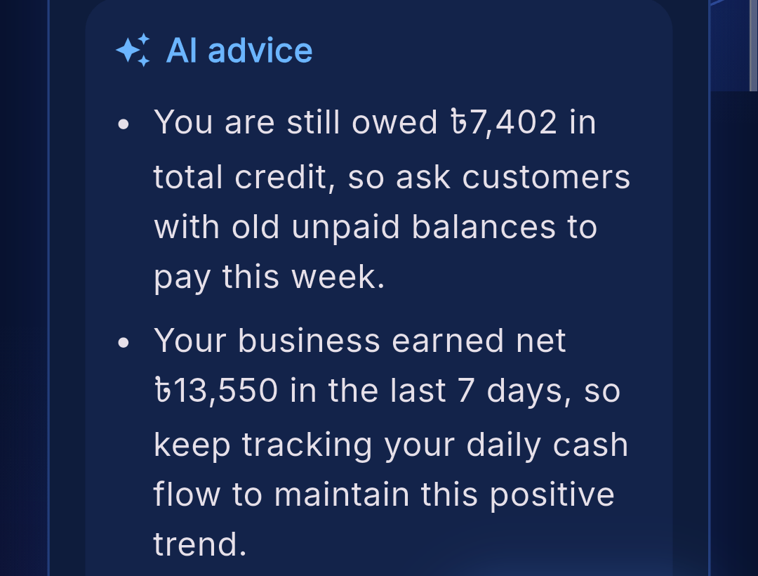




Money health warns the owner before cash runs out
Every week: money in (cash + digital sales + credit collected), money out (restocks), and net. Four automatic warnings:
A customer is 30+ days late paying
Restocks cost more than the money that came in
Credit owed rose 20%+ in a week
Sales fell 25%+ from the week before
Live screenshot: AI advice on the Money health card
One tap: AI advice in the owner's language
Only called on tap and cached for the day: about US$0.002 a tip
Notes:
Money health is our cash-flow management feature. Every week it shows the owner money in, which is cash and digital sales plus credit collected, money out, which is restocking, and the net. Then it raises four kinds of warnings: a customer more than 30 days late, restocks costing more than the money that came in, credit owed rising more than 20 percent in a week, and sales falling more than 25 percent. These thresholds are fixed rules, so a warning is always explainable. With one tap, Gemini turns the numbers into a few plain tips in the owner's own language, like asking customers with old balances to pay this week. It only runs on tap and is cached for the day, at about a fifth of a cent per tip.

Slide 6
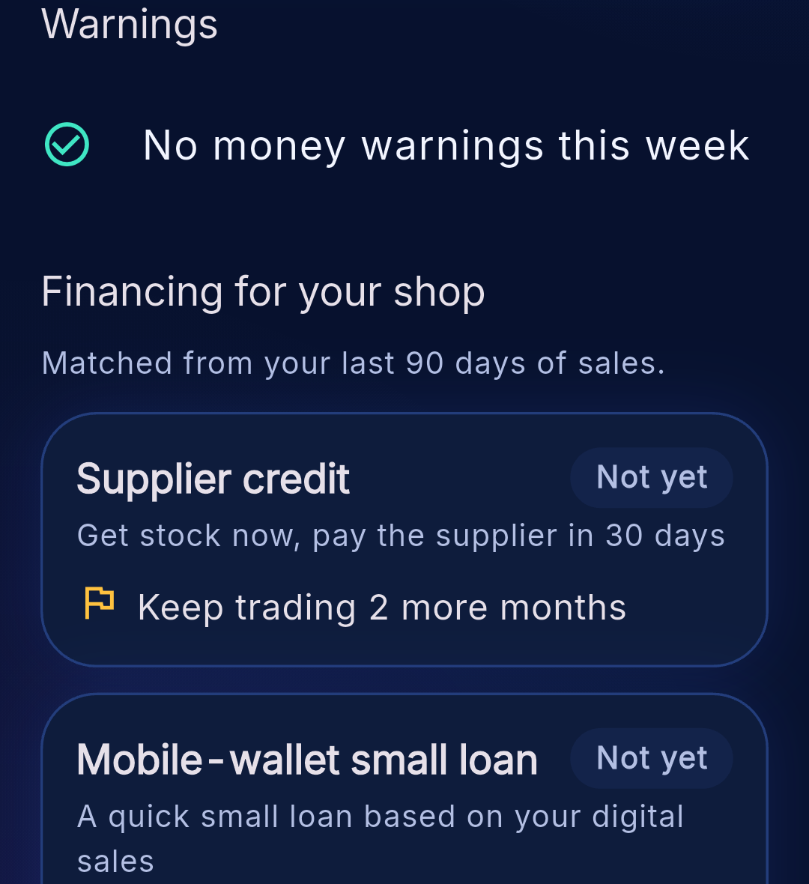

Financing matching shows which loans a shop is ready for
Example loan type | Fits when the shop has… | Shown amount
Supplier credit | 3+ months trading, restocks, sales in 8 of 12 weeks | ~1 month of restocks
Mobile-wallet small loan | 3+ months trading, 10%+ of sales digital | ~1 month of digital sales
Microfinance shop loan | 6+ months trading, sales in 10 of 12 weeks | ~1 month of sales
Bank SME loan | 12+ months, 10%+ margin, low credit owed | ~3 months of sales
Each one shows “Fits you” with the reason, or “Not yet” with what to do next (e.g. “Keep trading 2 more months”). Example loan types, not lender offers.
Financing screen
Topic E covered end to end
Financing-option matching
Cash-flow management with alerts
Business financial analysis
Notes:
This is financing-option matching. EasySell checks four example loan types, from small to large, against the shop's own last 90 days: how long it has been trading, how many weeks it made sales, its profit margin, how much of its sales are digital, and how much credit customers owe. Each option says Fits you, with the reason and a rough amount, or Not yet, with what to do to qualify, like keep trading two more months. These are example loan types, not real offers yet; real lender partners are on our roadmap. Together with Money health and the dashboard, this covers all three parts of Topic E: financing matching, cash-flow management with alerts, and business financial analysis.

Slide 7

Built to be trusted with a shop's money
Edge Functions
Gemini
707
19
Voice, scan and advice; AI key stays on the server
Understands and words; never decides
automated tests passing
database migrations
Phone app
Flutter · English + Bangla · any currency
3
0
Database (Supabase PostgreSQL)
Sale + stock in one transaction · prices frozen per sale · each shop sees only its own data
AI server functions
exploitable issues in our security review
Owner confirms every AI result before it's saved
No secret keys in the app; AI keys only on the server
Row Level Security on every table
A lost network reply never records a sale twice
Notes:
Here is how it works, and why a shopkeeper can trust it with their money. The Flutter app talks to two things. For AI, it calls our server functions, which hold the Gemini key, so no secret key ever ships in the app. For money, every sale goes into the database in one transaction: the sale and the stock change succeed together or not at all, prices are frozen on each sale, and a lost network reply can never record the same sale twice. Row Level Security means each shop only ever sees its own data. And the owner confirms every AI result before it is saved. This is a working app, not a mock-up: 707 automated tests pass, and our security review found no exploitable issues.

Slide 8
Bangladesh first, then the world's corner shops
Market size
Market entry
US$630M a year
Year 1
Bangladesh
21M+ shops × US$30 a year
Home market; national QR-payment push
Year 2
Philippines · Kenya
US$170–250M a year
Sari-sari e-wallet boom; M-Pesa
Our 6 target markets, smartphone-using shops
Year 3
Nigeria · Indonesia · Mexico
Gaps left by failed bookkeeping apps
25,000 paying shops
Later
India (via a partner)
Year-3 goal: under 0.5% of target markets
Largest, but crowded
Competition: Khatabook, OkCredit, Vyapar, BukuWarung and TallyKhata are typing-first. Kippa and BukuKas failed on bookkeeping alone, so our revenue path is finance from day one.
Notes:
Now the business plan. The market: across six markets we sized there are over 21 million neighbourhood shops; at 30 dollars a year that is a 630 million dollar subscription market, before any finance revenue. Our six target markets are worth 170 to 250 million dollars a year, and our year-three goal of 25,000 paying shops is under half a percent of that. We start in Bangladesh, our home market, where a national QR-payment push is moving shops online. In year two we add the Philippines and Kenya, then Nigeria, Indonesia and Mexico. India is the largest market but crowded, so we would enter through a partner. The big lesson from competitors: apps that only did bookkeeping, like Kippa and BukuKas, failed. Our revenue path is finance from day one.

Slide 9
Free records, paid AI, and fees from financing
Free
Smart plan
Financing fees
US$0
US$2.99 / month
Year 2+
Records, credit book, dashboard, Money health and financing matching
600 AI voice or camera sales a month, plus AI money advice
Lenders pay a fee when a matched shop takes a loan, with consent
US$1.48
profit per paying shop a month (59%), after AI, app-store fees and servers
Break-even at ~340 shops in year 1
Monthly profit by the end of year 3
Raising US$100k pre-seed
Launch in Bangladesh, open the Philippines and Kenya, cut AI cost, add offline selling. Plus introductions to lenders and distributors.
Notes:
How we make money. The free plan includes everything that builds a loan-ready record: the books, the credit book, Money health and financing matching. Those features are rule-based, so they cost us almost nothing to run, and every free shop enters our financing funnel. The Smart plan, at 2.99 dollars a month, unlocks AI voice and camera selling and AI advice, the only features that cost us per use. From year two, lenders pay us a referral fee when a matched shop takes a loan, with the owner's consent. Each paying shop leaves us about 1.48 dollars a month, a 59 percent margin. We plan to grow from 500 to 25,000 paying shops in three years and reach monthly profit by the end of year three. We are raising 100,000 dollars pre-seed.

Slide 10





What's next
Ask EasySell
Lender partners
Credit profile
Offline selling
New markets
Money questions in your own language
Turn matches into real applications
A shareable sales and repayment record
Sell without internet, sync later
New languages and currencies
Thank you
[Team name]
[Member names and roles]
EasySell: speak the sale, see the money, get ready for finance.
Notes:
What's next. First, Ask EasySell: owners asking money questions in their own language, like can I afford fifty bags of rice this week. Second, real lender partners, so a Fits you match becomes an actual loan application, with the owner's consent. Third, a shareable credit profile: a one-page sales and repayment record that a shopkeeper can show any lender. Fourth, offline selling with automatic sync, for shops with patchy internet. And fifth, new languages and currencies as we enter new markets. EasySell lets a shopkeeper speak the sale, see the money, and get ready for finance. Thank you. We are [Team name], and we would love your questions.

