Slide 1

Bangladesh Army University of Science and Technology Khulna
Personal Finance
Management System
A Java Swing GUI Application Demonstrating Object-Oriented Programming
Safwan Ahmad
ID: 1072420005101001 | Section CSE 4A
Course: OOP Language Sessional-II (CSE 220)
Submitted to: Rohul Amin, Lecturer, CSE
June 9, 2026
Page 1

Slide 2

OVERVIEW
Introduction & Objectives
Key Objectives
What Is It?
Build a working finance app with a Java Swing GUI
Demonstrate core OOP principles in practice
Apply encapsulation with private data
Add, delete, categorize & summarize entries
Save data to a file so it persists permanently
A simple desktop application with a clean graphical interface that records income and expenses, then automatically calculates the net balance. All data is saved to a file, so it stays safe even after the computer is turned off.
June 9, 2026
Page 2

Slide 3





CAPABILITIES
What the System Can Do
Cash In
Cash Out
Delete
Record an income entry with a name and amount
Record an expense entry with a name and amount
Remove a transaction; remaining ones auto-renumber
View Lists
Summary
Simple Exit
Show all Cash In or all Cash Out separately
Totals for income, expense, and the net balance
Close the program with a clean goodbye message
June 9, 2026
Page 3

Slide 4




DESIGN
System Architecture
Four classes, each with one clear responsibility — a clean separation of concerns.
→
→
→
Transaction.java
FinanceManager.java
FinanceGUI.java
Main.java
The data model
The brain
The GUI
Console (optional)
Holds one entry: serial number, name, amount, and type
Stores the list and runs the add, delete, filter & total logic
Swing window with cards, table & buttons; saves data to file
Original text-menu entry point, kept for terminal use
June 9, 2026
Page 4

Slide 5




OOP IN ACTION
Object-Oriented Concepts Applied
Class & Object
Encapsulation
Blueprints like Transaction become real objects with new
All fields are private, accessed only through methods
Constructor
Methods
Sets up each object's values the moment it is created
addCashIn(), deleteTransaction(), getters & setters
Object Interaction
Method Overriding
FinanceManager works with many Transaction objects
toString() controls how a transaction prints
June 9, 2026
Page 5

Slide 6
DEMO · STEP 1
The Main Menu
Personal Finance Manager
On Screen
PERSONAL FINANCE MANAGER
1. Cash In
2. Cash Out
3. Delete Transaction
4. All Cash In
5. All Cash Out
6. Show All Transactions
7. Exit
Enter your choice (1-7): _
Seven clear options
Menu repeats after each action
Pick a number to begin
June 9, 2026
Page 6

Slide 7
DEMO · OPTION 1
Adding Cash In
Personal Finance Manager
What Happens
Enter your choice (1-7): 1
--- CASH IN ---
Enter Name : Salary
Enter Amount : 5000
SUCCESS! Cash In added.
Serial Number: #1
User types name & amount
A new Transaction object is made
It is added to the list
A serial number is assigned
June 9, 2026
Page 7

Slide 8
DEMO · OPTION 2
Adding Cash Out
Personal Finance Manager
What Happens
Enter your choice (1-7): 2
--- CASH OUT ---
Enter Name : Groceries
Enter Amount : 1200
SUCCESS! Cash Out added.
Serial Number: #2
Same steps as Cash In
Type is stored as CASH OUT
Counts toward total expenses
June 9, 2026
Page 8

Slide 9
DEMO · OPTION 3
Deleting a Transaction
Personal Finance Manager
What Happens
Enter your choice (1-7): 3
--- DELETE TRANSACTION ---
Enter Serial Number: 1
SUCCESS! Transaction #1
has been deleted.
(Remaining items renumber
from 1 automatically)
Finds the matching serial
Removes it from the list
Renumbers what's left from 1
Shows an error if not found
June 9, 2026
Page 9

Slide 10
DEMO · OPTIONS 4 & 5
Viewing the Lists
Personal Finance Manager
What Happens
Enter your choice (1-7): 4
===== ALL CASH IN =====
[1] CASH IN | Salary | 5000.0
Enter your choice (1-7): 5
===== ALL CASH OUT =====
[2] CASH OUT | Groceries | 1200.0
Filters by transaction type
Option 4 shows only income
Option 5 shows only expenses
June 9, 2026
Page 10

Slide 11
DEMO · OPTION 6
The Full Summary
Personal Finance Manager
What Happens
Enter your choice (1-7): 6
===== ALL TRANSACTIONS =====
[1] CASH IN | Salary | 5000.0
[2] CASH OUT | Groceries | 1200.0
----------------------------
Total Cash In : 5000.0
Total Cash Out : 1200.0
Net Balance : 3800.0
Lists every transaction
Adds up income & expenses
Net = income − expenses
June 9, 2026
Page 11

Slide 12
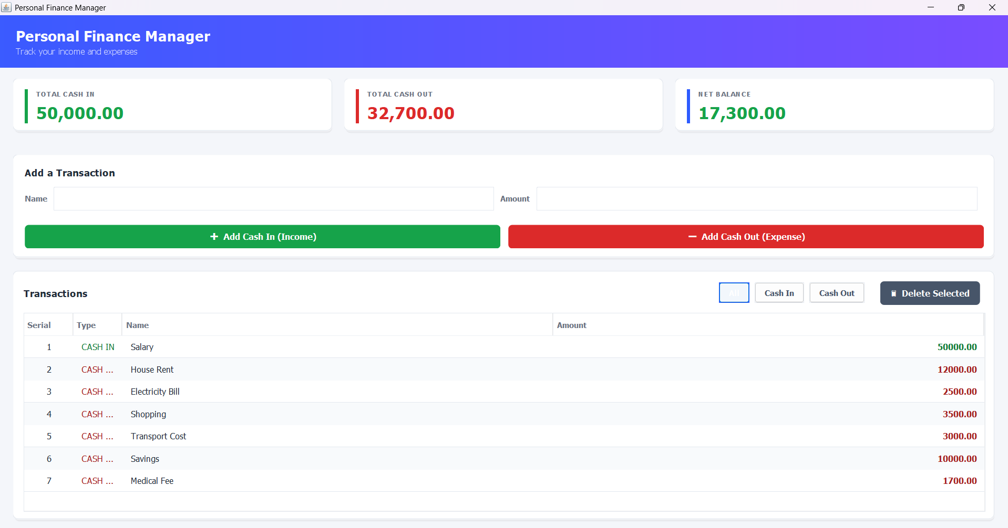
GUI Interface
June 9, 2026
Page 12

Slide 13
REFLECTION
Limitations & Future Work
Current Limitations
Future Improvements
No category or date for entries
Stores data in a plain text file, not a database
Single user, no login system
Move storage to a MySQL database
Add categories, dates & monthly reports
Multi-user support with secure login
June 9, 2026
Page 13

Slide 14
Conclusion
The project meets its goals — a practical finance tool that clearly demonstrates the core principles of Object-Oriented Programming through a clean, modular design.
Thank You
Safwan Ahmad | CSE 4A | OOP Sessional-II (CSE 220)
June 9, 2026
Page 14

