Slide 1
DATABHASE MANAGEMENT SYSTEM
Group: 01
Group Member:
1. Azfar Hossain (1631350)
2. Ahmad Sayeef Khan (1520139)
3. Avirup Mondol (1720672)
4. Shoptorshi Rahman (1720360)
5. Sajedur Rahman Shakil (1530855)

Slide 2
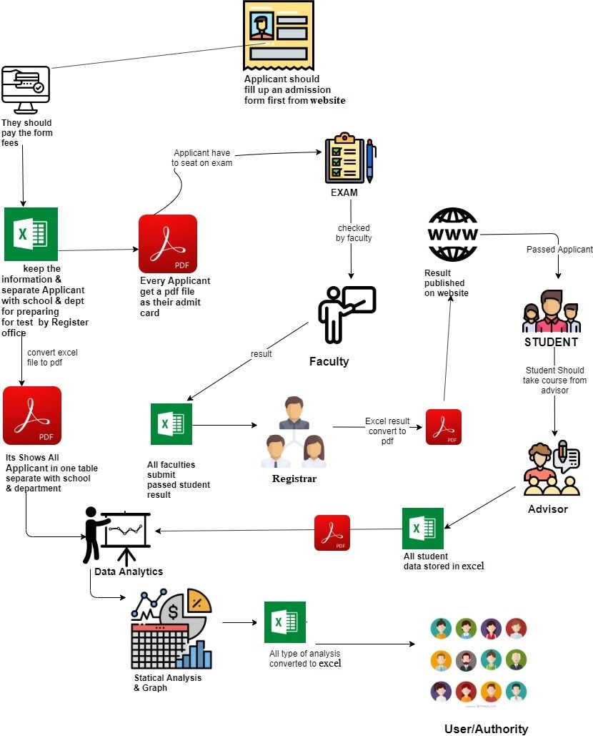
Existing Rich Picture

Slide 3
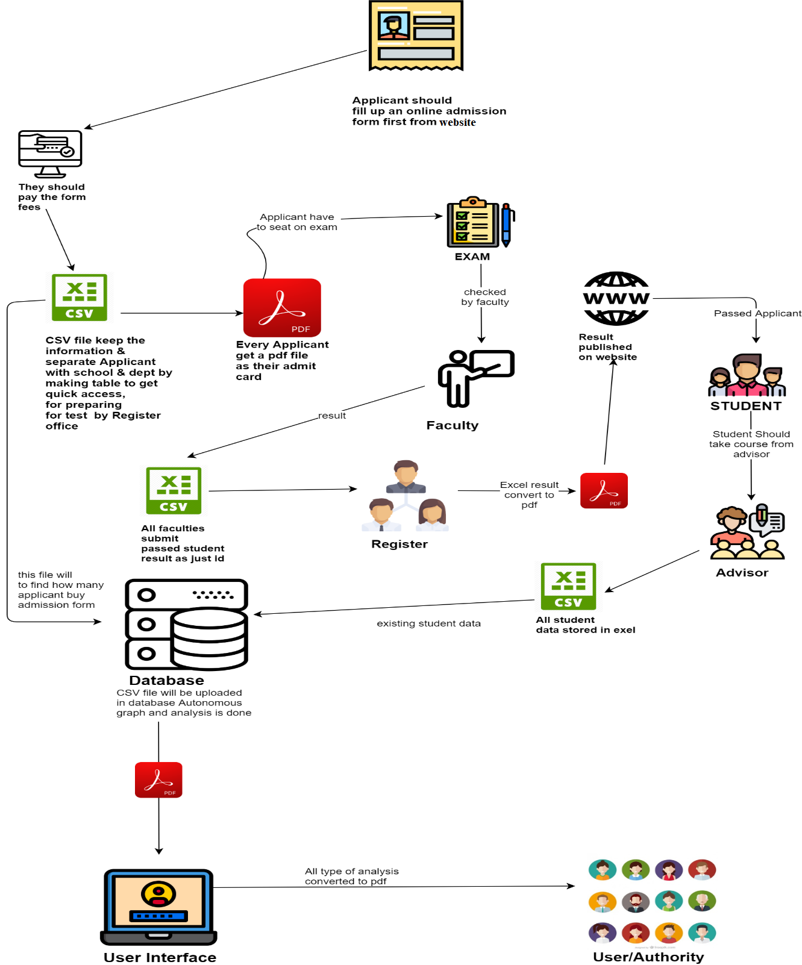
Proposed Rich Picture

Slide 4
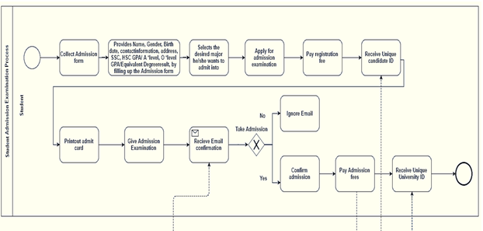
Existing BPMN

Slide 5
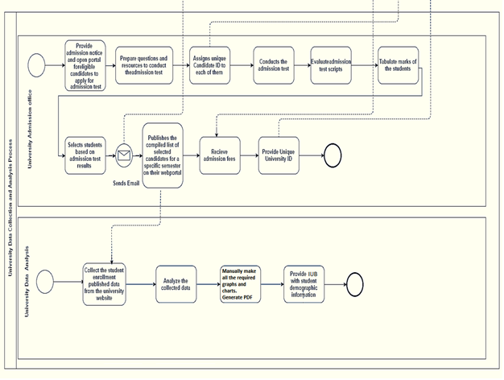
Existing BPMN(Cont.)

Slide 6
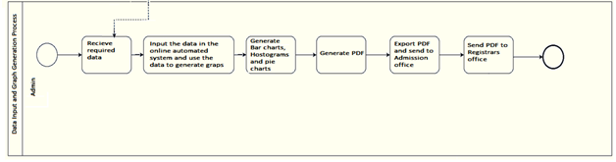
Proposed BPMN

Slide 7
PROCESS ALONG WITH SIX SYSTEM ELEMENTS:
Process | System Roles
 | Human | Non-computing Hardware | Computing Hardware | Software | Database | Communication & Network / Connectivity
Word to Excel conversion process | Analyst | Document | Computer | Office Excel | -- | --
Excel to Pdf conversion process | Analyst | -- | Computer | Office Excel | -- | --
Admission Result publication process | Registrar | -- | Utilizing computer to publishes the result | operating browser, university website | -- | Using internet to publish the results.

Slide 8
PROPOSED PROCESSES ALONG WITH SIX SYSTEM ELEMENTS:
 | System Roles
Process | Human | Non-computing Hardware | Computing Hardware | Software | Database | Communication & Network / Connectivity
Word to excel conversion process | Analyst | Document | Computer | Office Excel | -- | --
Csv to Pdf conversion process | Analyst | -- | Computer | Office Excel | -- | --
Admission result publication process | Registrar | -- | Utilizing computer to publishes the result | Operating browser, University website | -- | Using internet to publish the results.
Admission result downloading and calculation process | Policy maker | -- | Utilizing computer to download the result. | Operating browser, university website | Pile the information in Pdf. | Internet

Slide 9
Existing Problem And Analysis
Process | Stakeholders | Concerns (Problems) | Analysis (Reason of the Problem) | Proposed Solution
Policy Maker/Faculty convert Pdf file to excel format and generate graphical representation. | Policy Maker | The process is done manually for graphs which is not time efficient. | Autonomous System can do it faster and less effort. | By Utilizing Database and data processing system that can maximize the output and minimize time.
Human error | Policy Maker | May contain error. | Manual calculation done by humans can contain error. | Automation of all sorts of calculations needed in this entire process
Time consuming | Policy Maker | The manual process takes more time. | Policy maker may take more time to finish everything. | Automation system will be faster at doing things
Maintenance | Policy Maker | Harder to maintain/replace/correct information. | Things are done manually so the main thing must do again if anything must be modified. | Everything is done automatically and stored in database. Easier to maintain and modify as things are present in the automation system.

Slide 10
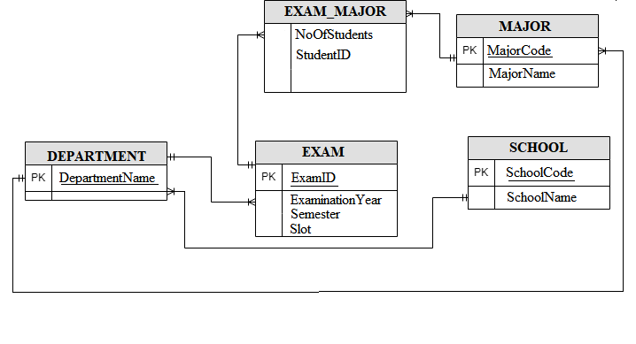
ERD (Entity Relationship Diagram)

Slide 11
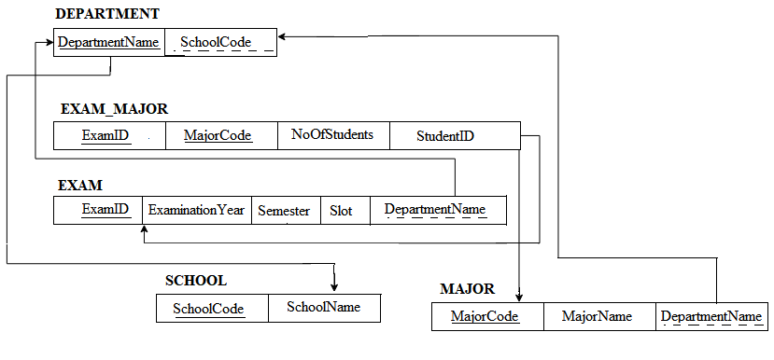
ERD To Relations

Slide 12
DATA DICTIONARY
Table_DEPARTMENT:
Name | Data Type | Size | Remark
DepartmentName | Varchar | 40 | DepartmentName is the primary key in this relation. This contains the Department Name. Example: " Computer Science and Engineering "
Table_EXAM:
Name | Data Type | Size | Remark
ExamID | Varchar | 40 | ExamID is the primary key in this relation. This contains the name of admission Test Taken. Example: "Exam ID 2000- 2016".
ExaminationYear | Year | yyyy | This contains year of admission. Example: “2015 or 2017”
Semester | Varchar | 20 | This contains during of four-month courses of the candidate. Example: “Summer” or “Fall”.
Slot | Varchar | 20 | This contains the slot number of examination. Example: “slot1” or “slot2”.

Slide 13
PROJECT PROTOTYPE

Slide 14
Usage Languages
HTLM
CSS
PHP
JAVASCRIPT
JASON
MySQL

Slide 15
APPLICATION FEATURE
LogIn SignUp with authentication
PDF & default google print Genarator of graph
Various Type Of Graph for various cases
Table Generator & Save File In various
Admin Input For Updating Data

Slide 16
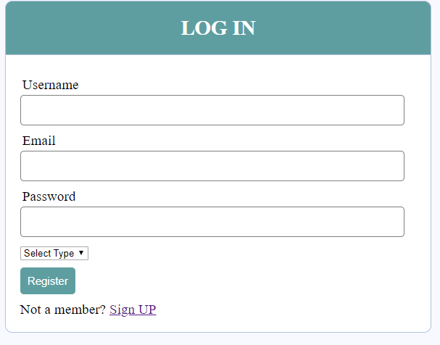
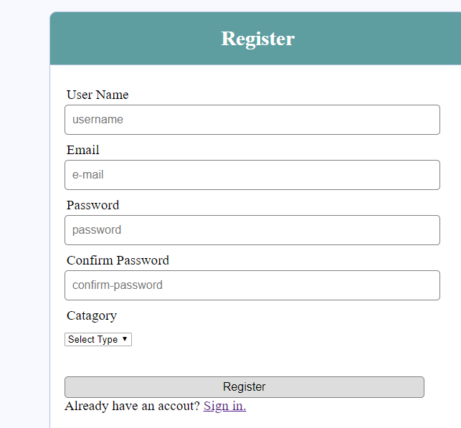

Slide 17
DataEntry Interface

Slide 18
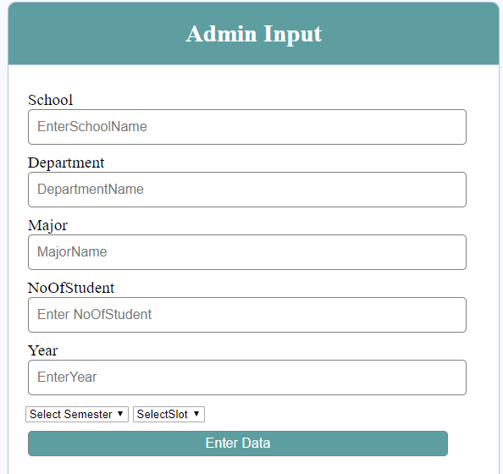

Slide 19
User Interface

Slide 20
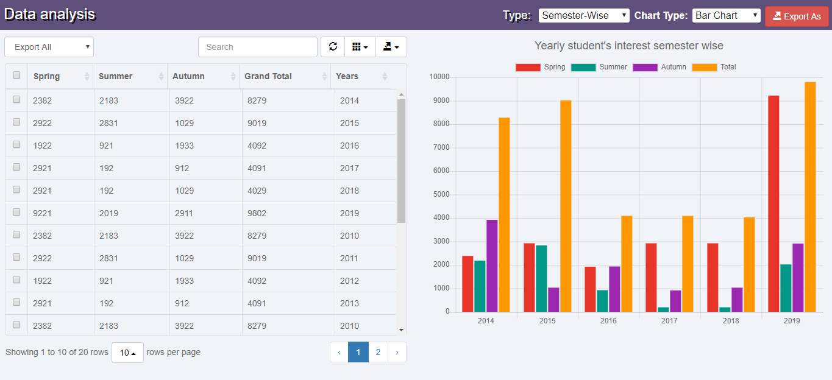

Slide 21
Print or PDF

Slide 22
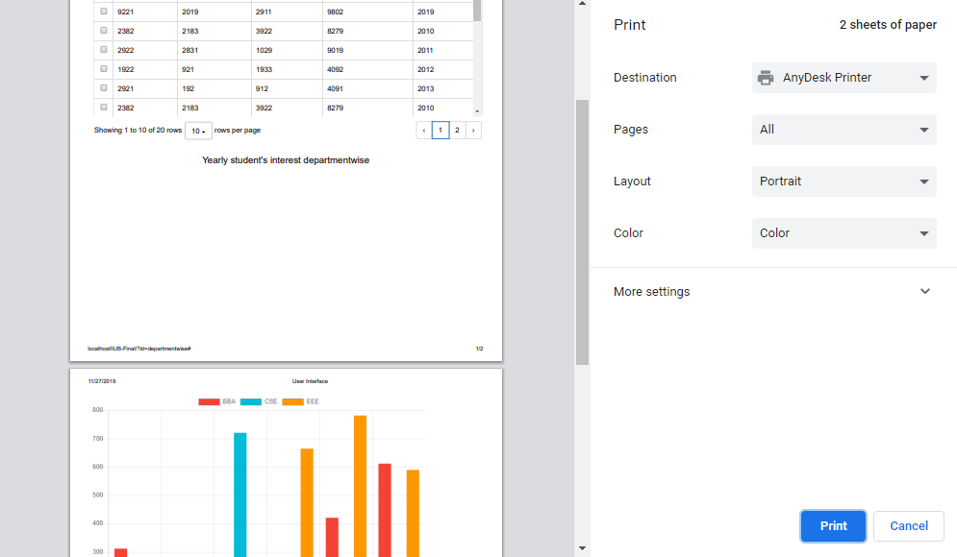
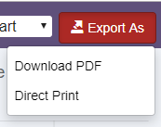

Slide 23
Table Genarate

Slide 24
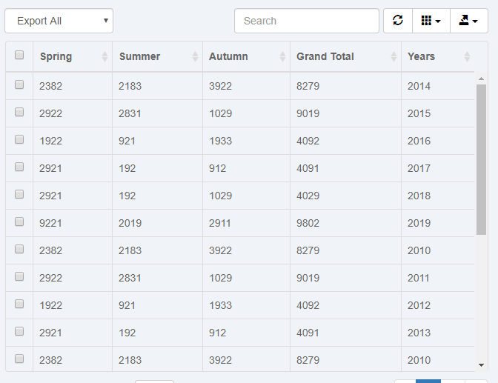

Slide 25
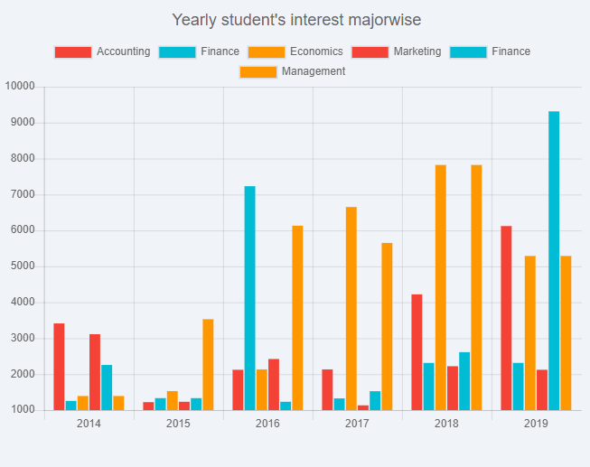

Slide 26
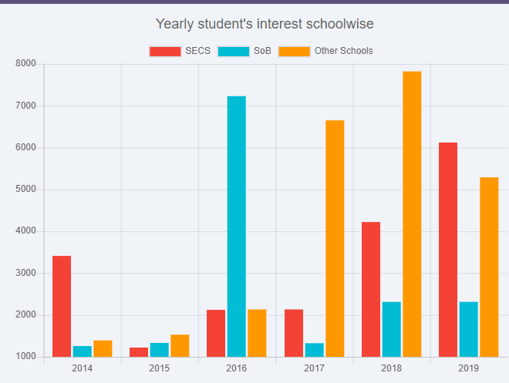

Slide 27
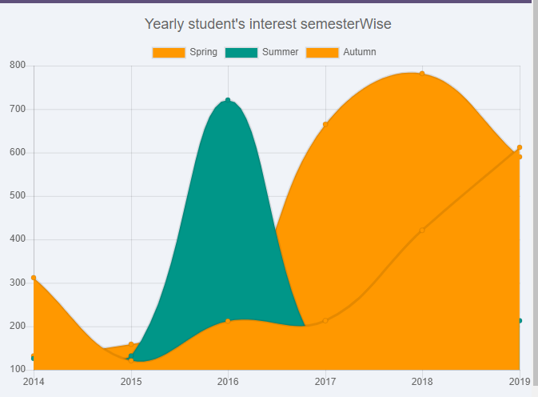

Slide 28
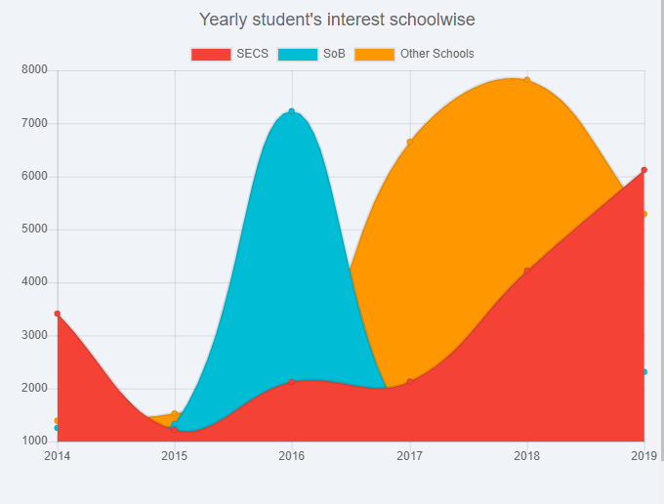

Slide 29
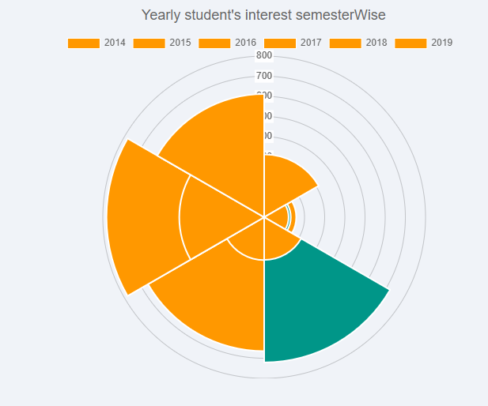
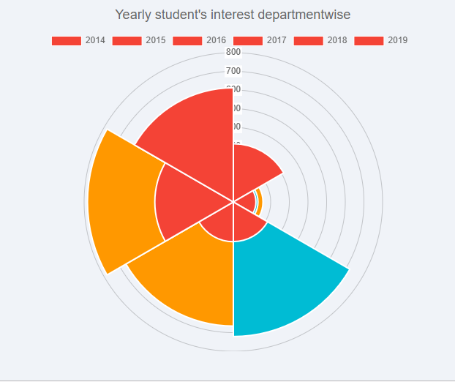
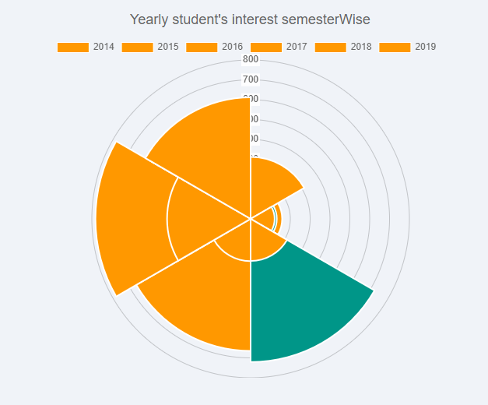

Slide 30
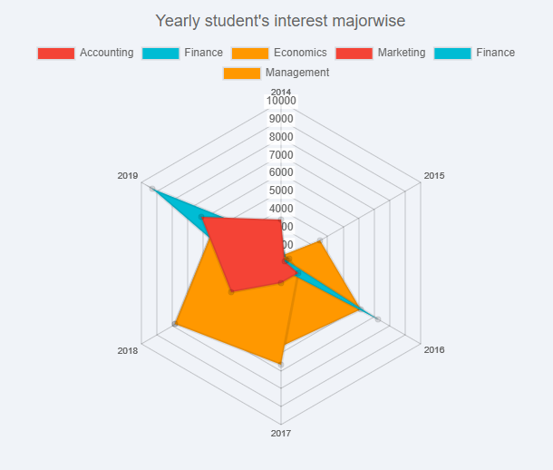
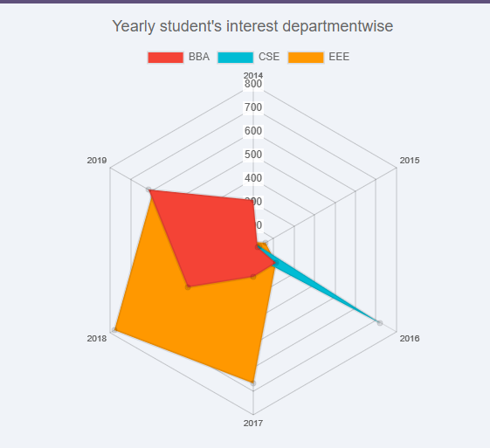

Slide 31
THANK YOU

Slide 32
Question?

