Slide 2
Introduction

Slide 3
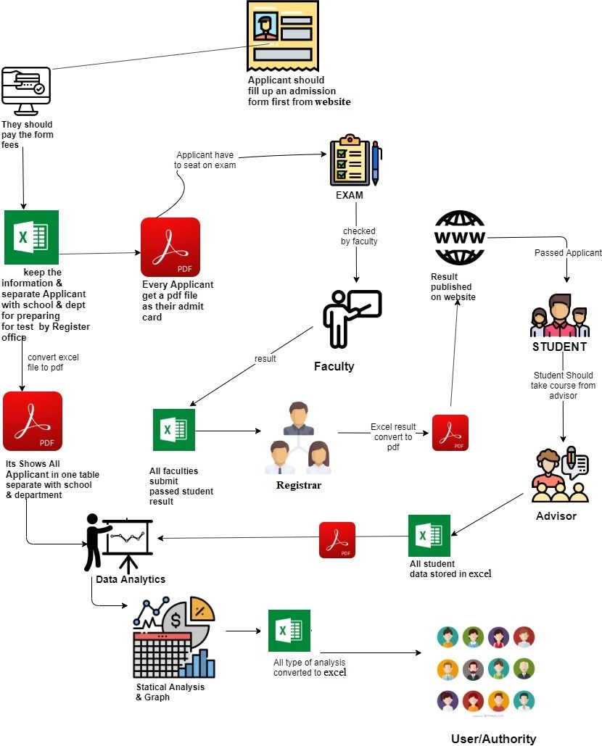
Existing System (with Rich Picture)

Slide 4
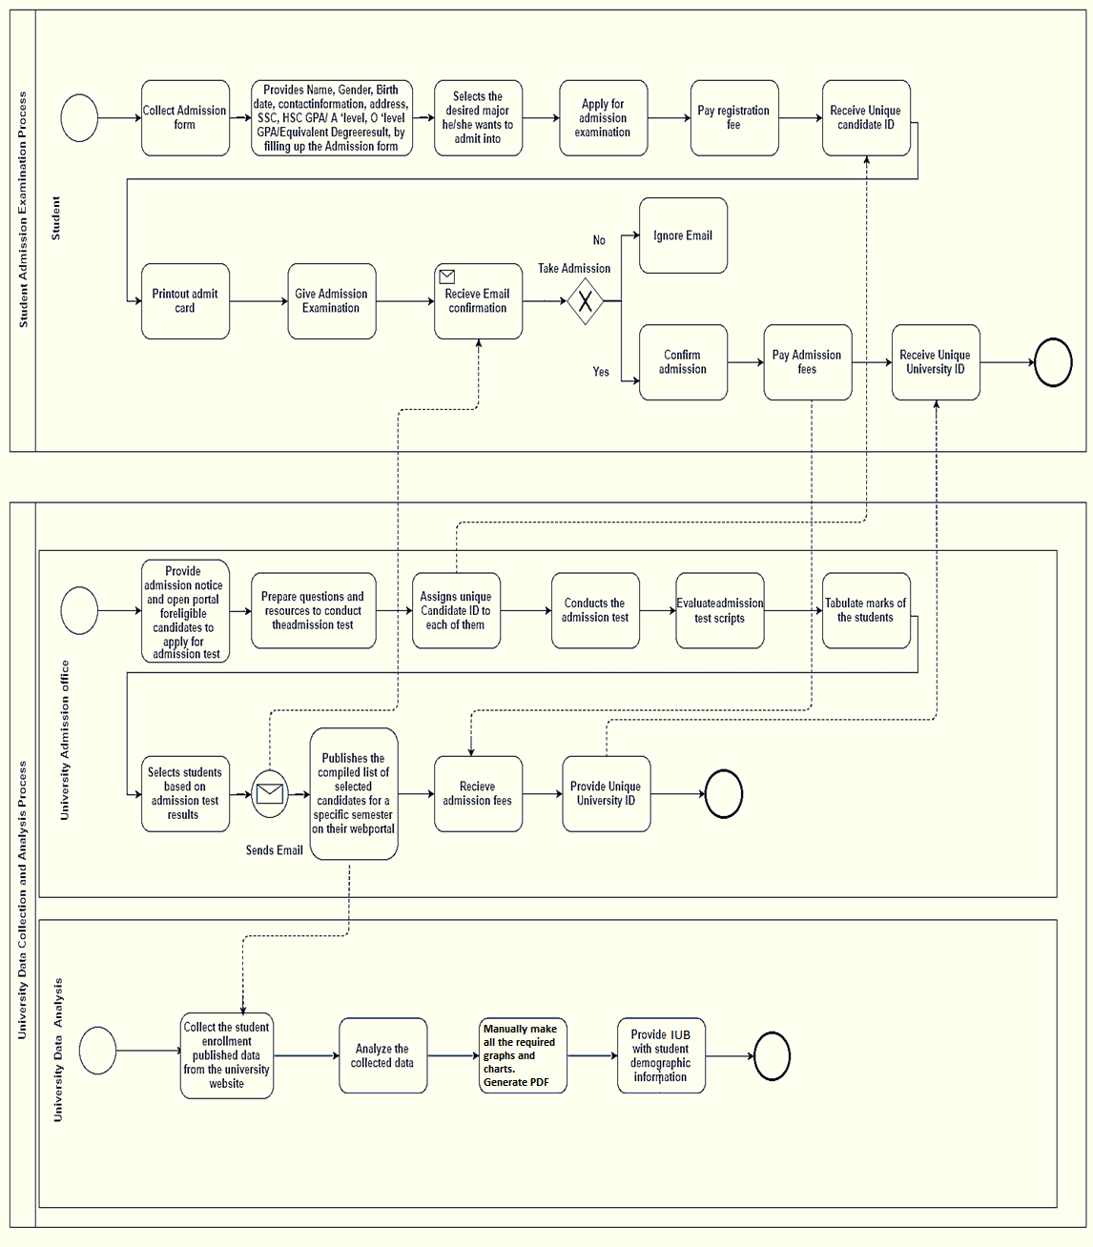
Existing BPMN 2.0

Slide 5
PROCESS ALONG WITH SIX SYSTEM ELEMENTS:
Process | System Roles
 | Human | Non-computing Hardware | Computing Hardware | Software | Database | Communication & Network / Connectivity
Word to Excel conversion process | Analyst | Document | Computer | Office Excel | -- | --
Excel to Pdf conversion process | Analyst | -- | Computer | Office Excel | -- | --
Admission Result publication process | Registrar | -- | Utilizing computer to publishes the result | operating browser, university website | -- | Using internet to publish the results.

Slide 6
Admission result downloading and calculation process | policy maker | -- | Utilizing computer to download the result. | Operating browser, university website | Pile the information in Pdf. | Internet
Website publication process | Registrar | -- | Utilizing computer to download the annual result. | Utilizing browser to publish the annual report. | -- | Internet
Necessary file conversion process | Policy maker | -- | Utilizing computer to convert data from PDF to Excel. | Operating Office Excel to convert the PDF. | Store in the Office Excel. | --

Slide 7
Existing Problem And Analysis
Process | Stakeholders | Concerns (Problems) | Analysis (Reason of the Problem) | Proposed Solution
Policy Maker/Faculty convert Pdf file to excel format and generate graphical representation. | Policy Maker | The process is done manually for graphs which is not time efficient. | Autonomous System can do it faster and less effort. | By Utilizing Database and data processing system that can maximize the output and minimize time.
Human error | Policy Maker | May contain error. | Manual calculation done by humans can contain error. | Automation of all sorts of calculations needed in this entire process
Time consuming | Policy Maker | The manual process takes more time. | Policy maker may take more time to finish everything. | Automation system will be faster at doing things
Maintenance | Policy Maker | Harder to maintain/replace/correct information. | Things are done manually so the main thing must do again if anything must be modified. | Everything is done automatically and stored in database. Easier to maintain and modify as things are present in the automation system.

Slide 8
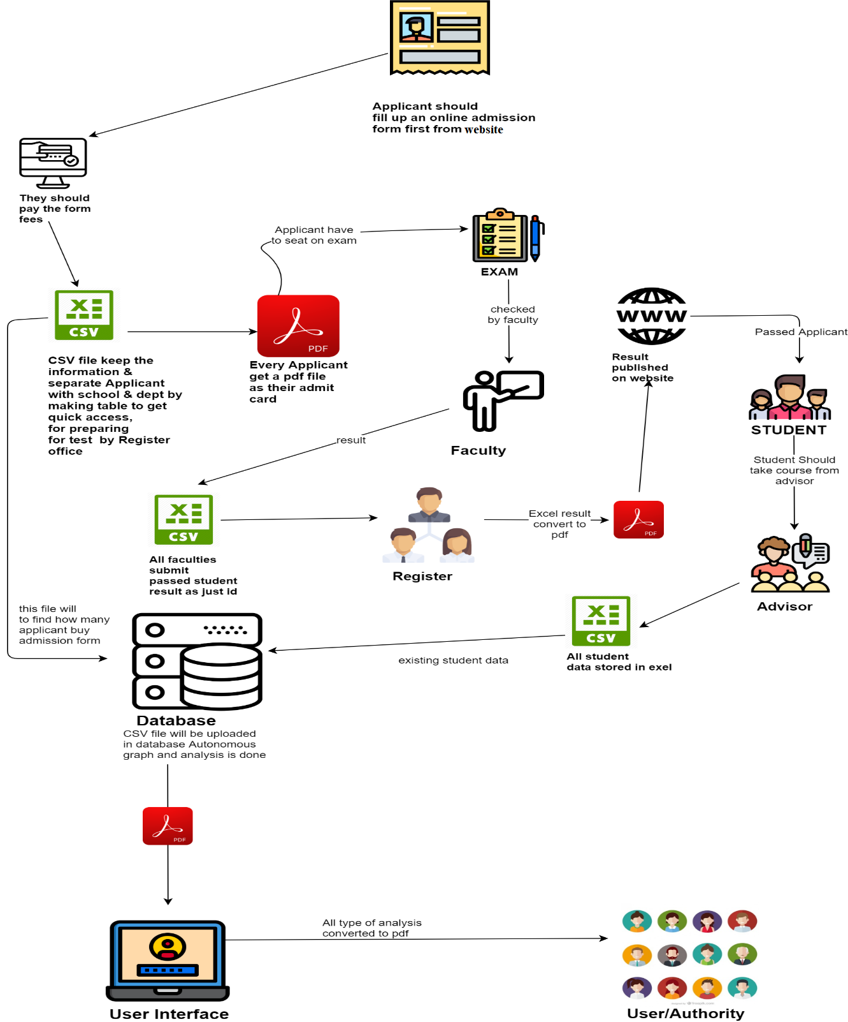
Proposed System(With Rich Picture)

Slide 9
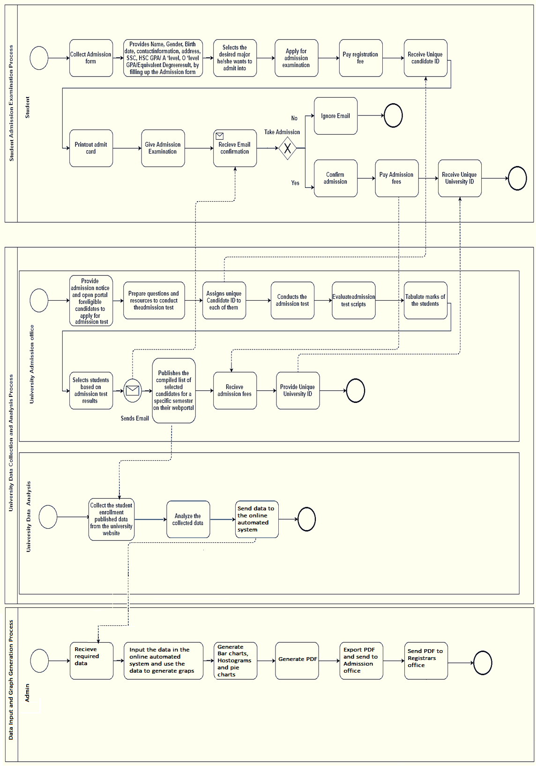
Proposed BPMN2.0

Slide 10
PROPOSED PROCESSES ALONG WITH SIX SYSTEM ELEMENTS:
 | System Roles
Process | Human | Non-computing Hardware | Computing Hardware | Software | Database | Communication & Network / Connectivity
Word to excel conversion process | Analyst | Document | Computer | Office Excel | -- | --
Csv to Pdf conversion process | Analyst | -- | Computer | Office Excel | -- | --
Admission result publication process | Registrar | -- | Utilizing computer to publishes the result | Operating browser, University website | -- | Using internet to publish the results.
Admission result downloading and calculation process | Policy maker | -- | Utilizing computer to download the result. | Operating browser, university website | Pile the information in Pdf. | Internet

Slide 11
Website publication process | Registrar | -- | Utilizing computer to publish the annual result. | Utilizing browser to publish the annual report. | Pile the result on their website. | Browser to publish the annual report.
Necessary file conversion process | Policy maker | -- | Utilizing computer to convert data from PDF to Excel. | Operating Office Excel to convert the PDF. | Store in the Office Excel. | --
CSV file data comparison and verification process | Policy maker | -- | Utilizing computer office CSV to create graph. | Operating on Office CSV. | Store in the Office CSV. | --
CSV file uploading process | Policy Maker | -- | Computer or laptop to upload the CSV. | -- | My SQL database. | --
Data Facing process | Automation system | -- | Database. | -- | My SQL database. | Website.

Slide 12
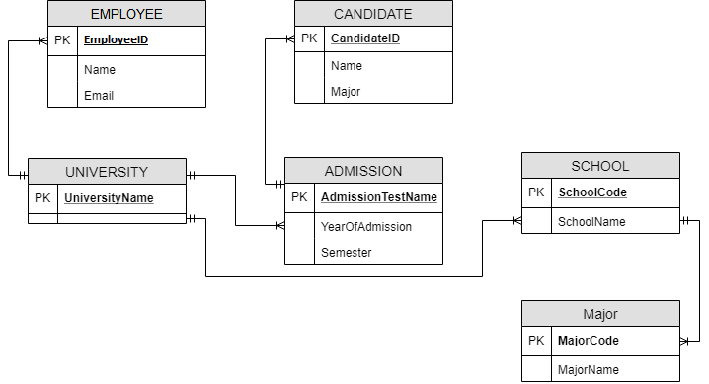
ERD (Entity Relationship Diagram)

Slide 13
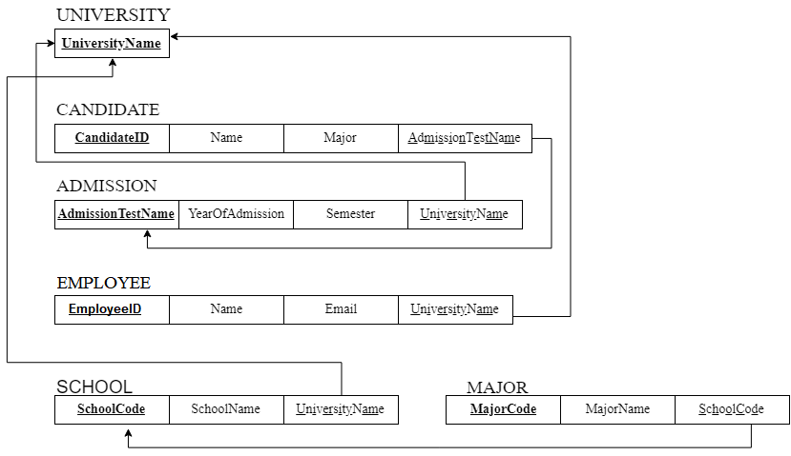
ERD To Relations

Slide 14
DATA DICTIONARY:
Table_DEPARTMENT:
Name | Data Type | Size | Remark
DepartmentName | Varchar | 40 | DepartmentName is the primary key in this relation. This contains the Department Name. Example: " Computer Science and Engineering "
Table_EXAM:
Name | Data Type | Size | Remark
ExamID | Varchar | 40 | ExamID is the primary key in this relation. This contains the name of admission Test Taken. Example: "Exam ID 2000- 2016".
ExaminationYear | Year | yyyy | This contains year of admission. Example: “2015 or 2017”
Semester | Varchar | 20 | This contains during of four-month courses of the candidate. Example: “Summer” or “Fall”.
Slot | Varchar | 20 | This contains the slot number of examination. Example: “slot1” or “slot2”.

Slide 15
DepartmentName | Varchar | 40 | This is the Foreign key in this relation from table1-Department. This contains the Department Name. Example: " Computer Science and Engineering "
Table_SCHOOL:
Name | Data Type | Size | Remark
SchoolCode | Varchar | 4 | SchoolCode is the primary key in this relation. This contains the School Code. Example: "SESM" or “SECS”
SchoolName | Varchar | 40 | This contains name of school. Example: “School of Environmental Science and Management”.
Table_MAJOR:
Name | Data Type | Size | Remark
MajorCode | Varchar | 10 | This is the primary key of this relation. This contain the major code of the student. Example: “CS” or “ECN” or “FIN”.
MajorName | Varchar | 40 | This contains School of the candidate. Example: “Computer Science” or “Economics”.

Slide 16
DepartmentName | Varchar | 40 | This is the Foreign key in this relation from table1-Department. This contains the Department Name. Example: " Computer Science and Engineering "
3.7.6 Table_EXAM_MAJOR:
Name | Data Type | Size | Remark
ExamID | Varchar | 40 | ExamID is the foreign key in this relation. This contains the name of admission Test Taken. Example: "Exam ID 2000- 2016".
MajorCode | Varchar | 10 | This is the foreign key of this relation. This contain the major code of the student. Example: “CS” or “ECN” or “FIN”.
NoOfStudents | Varchar | 40 | This contains the number of students. Example: “2000 students etc”
StudentID | Varchar | 40 | This contains the student ID. Example: 1620457

