Slide 1
Applying Machine Learning

Slide 2
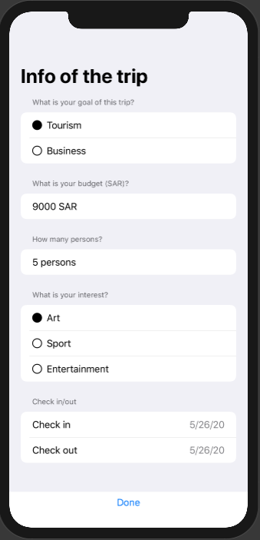
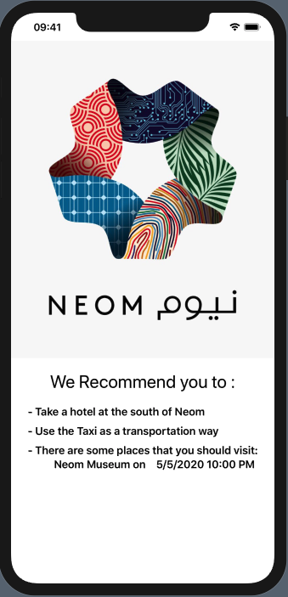
Recommendation System

Slide 3
Using KNN (K-Nearest Neighbors)
The dataset was created by the team.
We established some rules that simulate the reality.
We created the dataset based on that rules.
The dataset includes 500 rows, 7 columns (goal, budget, n_people, period, location, activity, transportation).
We add some noise data to weaken the restricted rules.
Assumptions:
1- Assuming the activities provided based on the interest of the visitor witch was ( Art ), (Museum A, Concert A, Photo Gallery), A represents the name of the activity

Slide 4
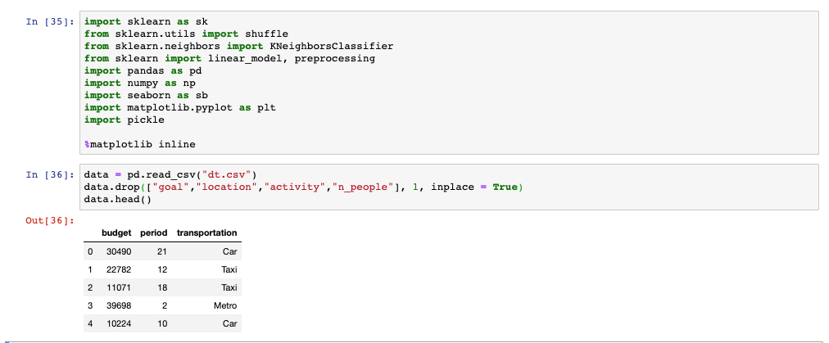
Recommend the best transportation way
Inputs :
1- period (number of days)
2- budget (SAR)
Output : Recommended transportation way (Taxi, Bus, Metro, Car)

Slide 5
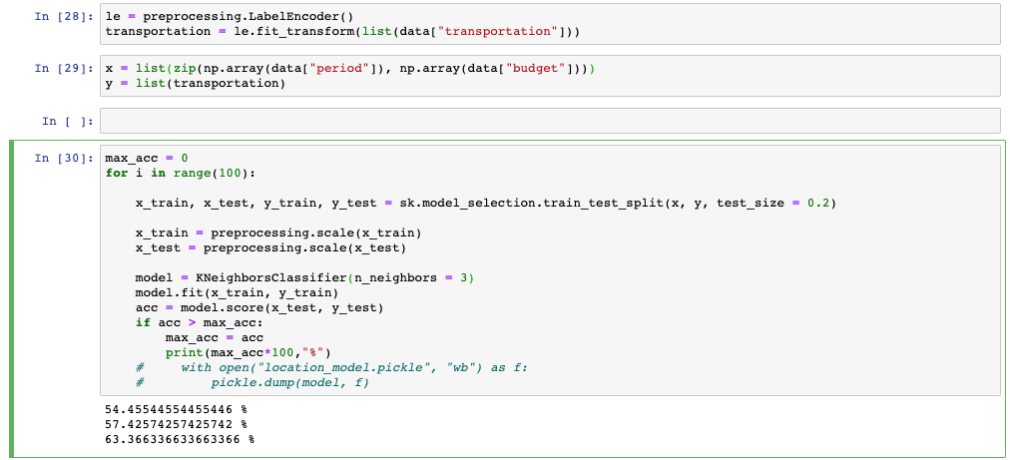

Slide 6
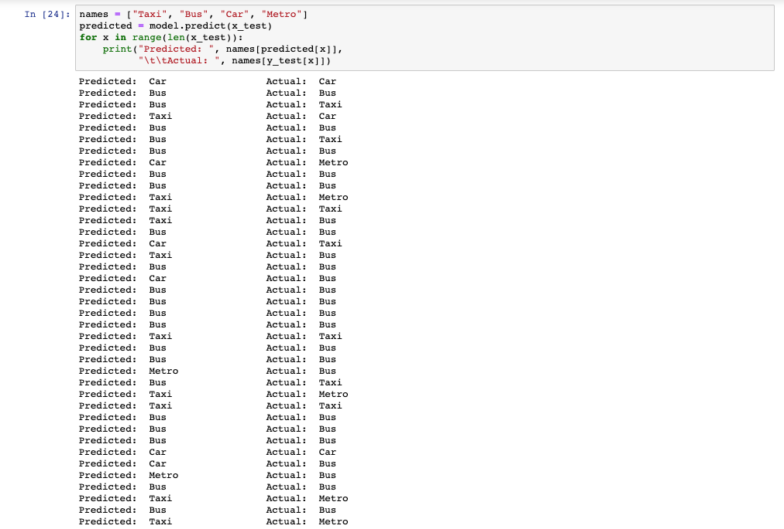

Slide 7
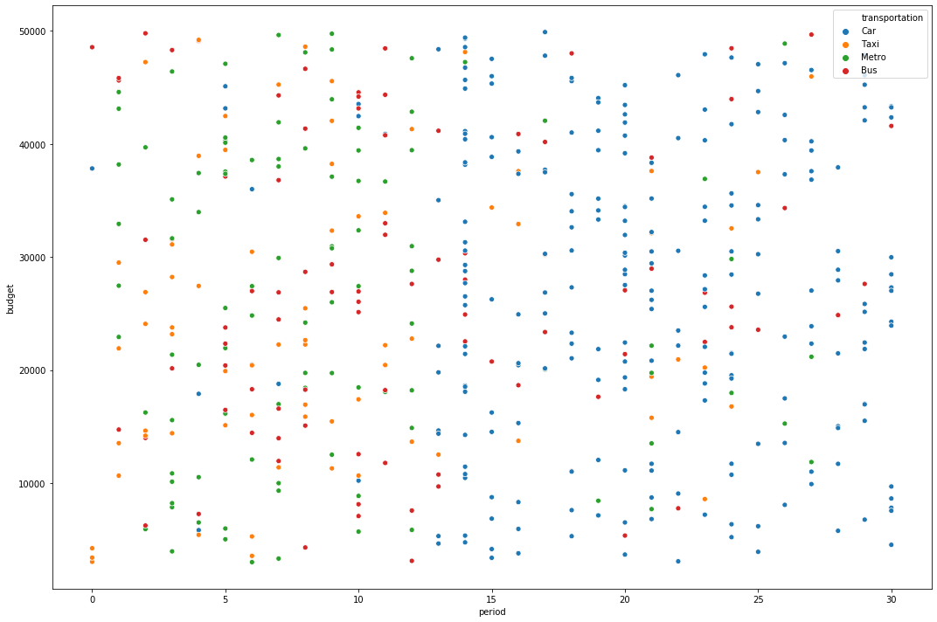

Slide 8
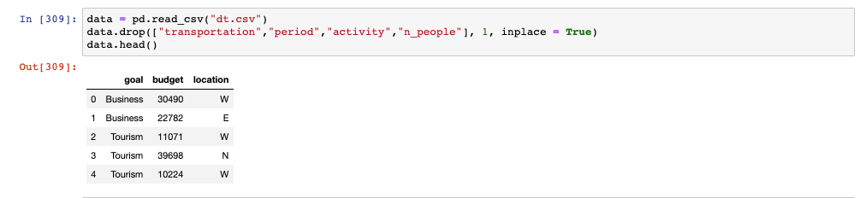
Recommend the best location
Inputs :
1- Goal (the goal of the trip)
2- budget (SAR)
Output : Recommended best location (North, South, East, West)

Slide 9
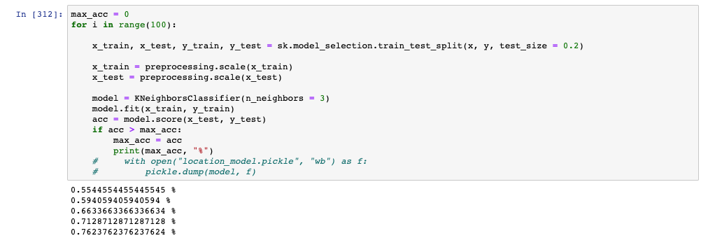

Slide 10
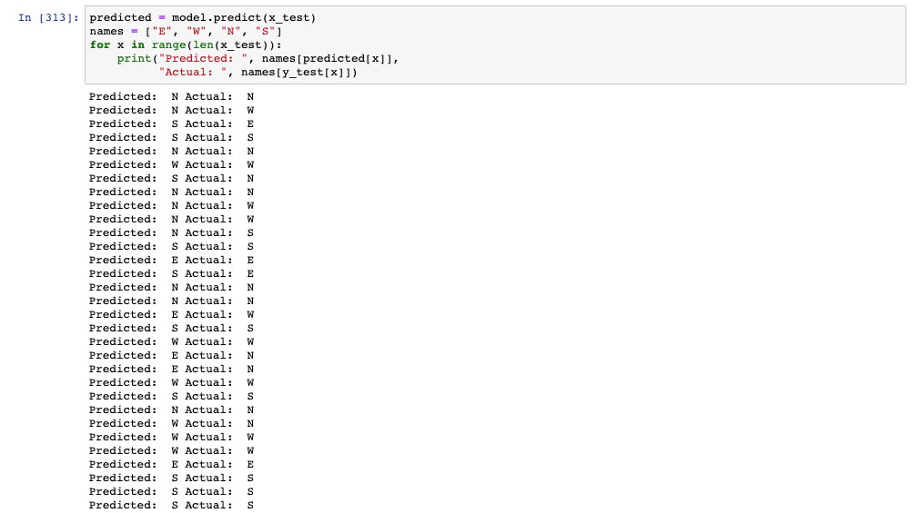

Slide 11
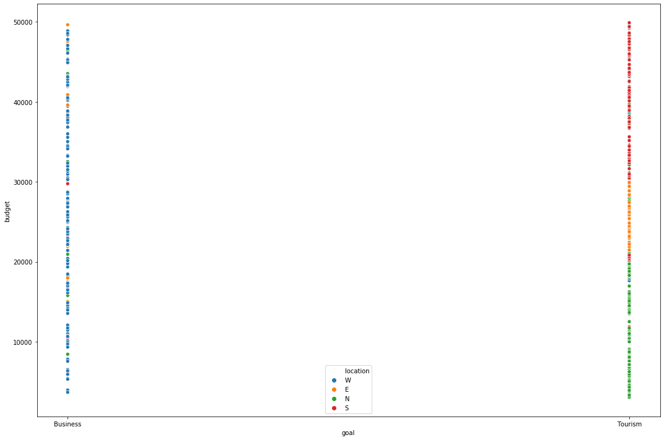

Slide 12
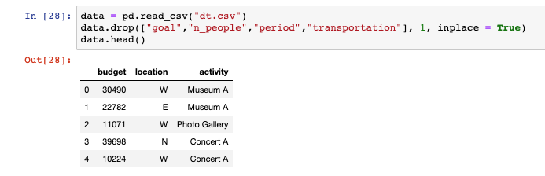
Predict the activity
Inputs :
1- location (E, N, S, W)
2- budget (SAR)
Output : Recommended best activity (Concert, Museum, Photo Gallery)

Slide 13
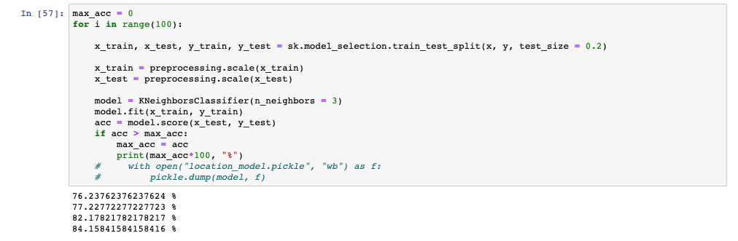

Slide 14
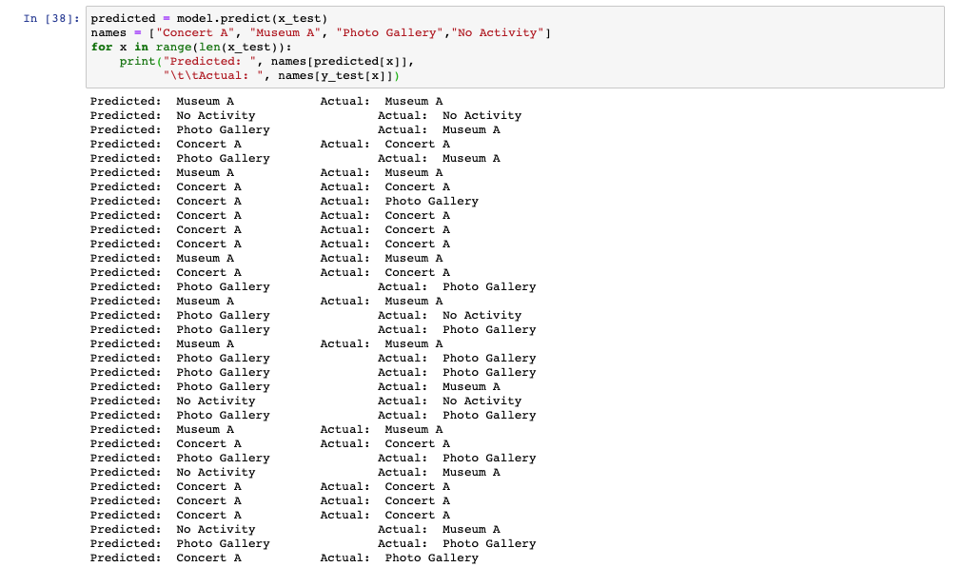

Slide 15
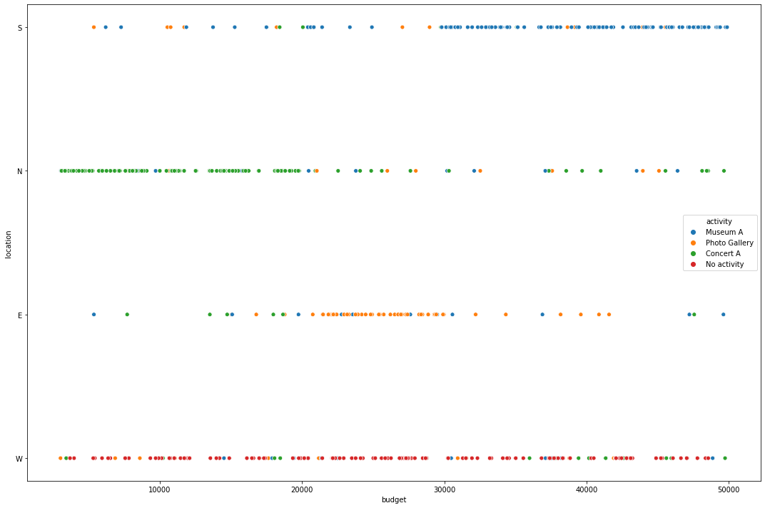

Slide 16
Thank you!
Fonts used: Roboto

