Slide 1
Infineon Hackathon Contest
Battery State of Charge (SoC) Monitoring System
Using Aurix™ Microcontroller
Presented By: Batmon 17
Sarvesh Nandanwar
Himani Deore
Vaishnavi Pawar
Safwan Sayyad

Slide 2
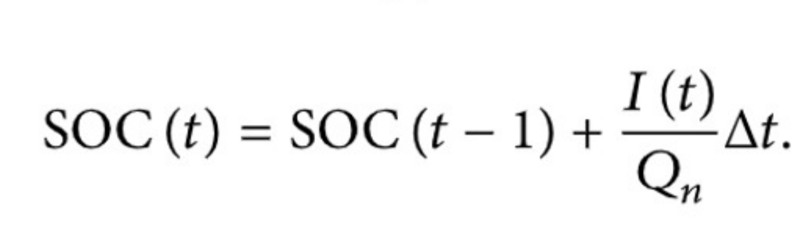
Approach Taken to Develop Battery SoC Monitor (AURIX™)
Identified initial build errors and warnings during project compilation
Traced primary error to ADC channel declaration commented out in EVADC configuration
ADC Configuration & Signal Validation
Verified ADC channel selection
Fixed bug where ADC was reading onboard potentiometer (Channel 0) instead of external input (AN1)
Coulomb Counting Formula

Slide 3
UART Communication Setup
Validated UART operation for real-time debugging and data monitoring
Confirmed successful communication at 115200 baud.
Assigned UART pins explicitly:
  RX → P14.1
  TX → P14.0
EVADC Sampling Logic Debugging
Observed incorrect ADC behavior due to non-incrementing sample counter
Identified commented increment statement in EVADC source file
Enabled continuous sampling by fixing sample count logic

Slide 4
Key Learnings – Battery SoC Monitor Using AURIX™
Battery & SoC Fundamentals
AURIX™ Microcontroller Learnings
Real-Time Embedded System Design
Software & Algorithm Insights
Debugging & Optimization Learnings
Safety & Automotive Perspective

Slide 5
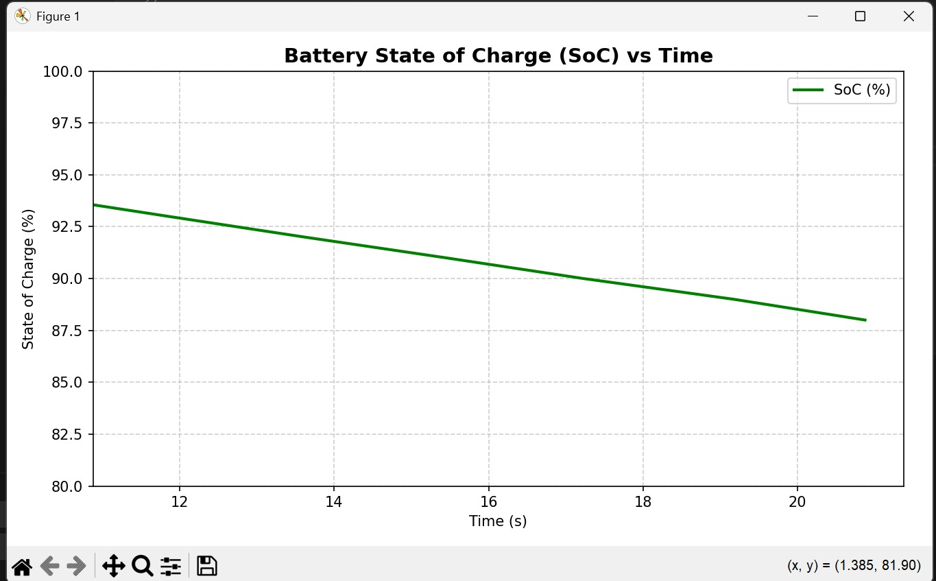
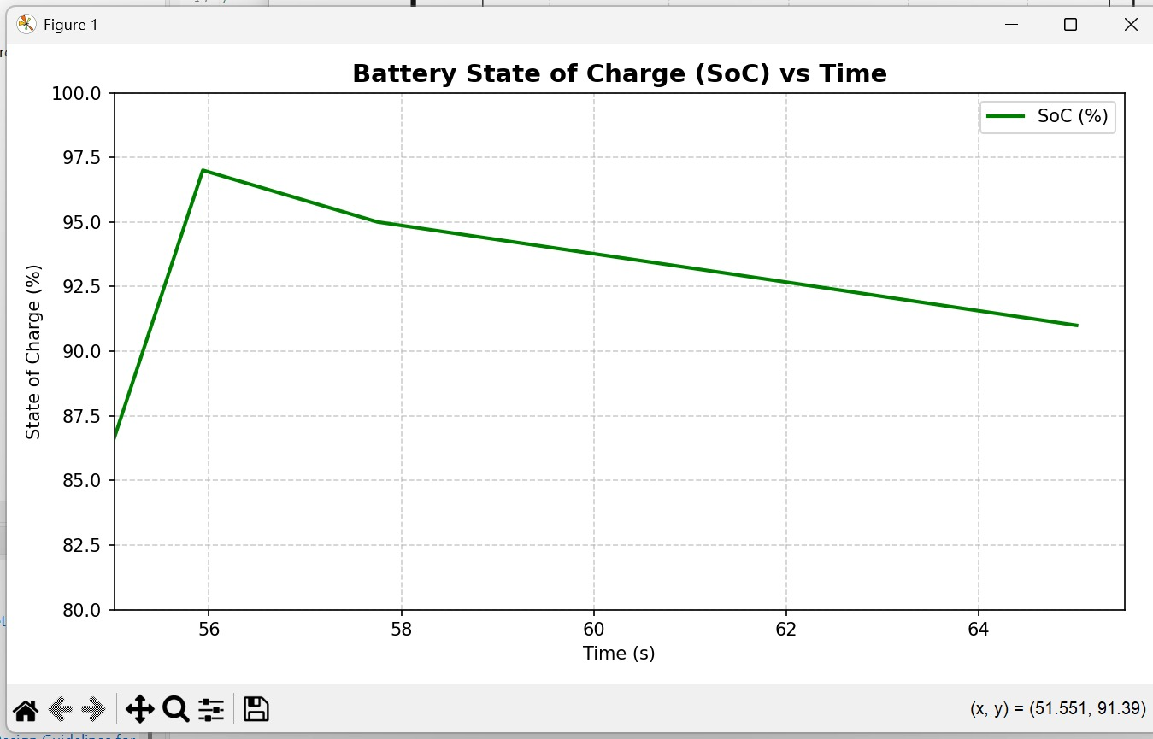
RESULTS:

