Slide 1

A Bullish Case for
By Ahmed Sajid

Slide 2
Bull Case Investment Thesis: Visa & Mastercard
Duopoly in a Massive, Growing Market
Visa and Mastercard dominate the global card payments network, benefiting from strong network effects and the ongoing global shift from cash to digital payments.
Asset-Light, Scalable Business Models
Their model generates high margins and free cash flow since they don't lend money or assume credit risk. Operating leverage allows volume growth to amplify earnings.
Global Expansion and Financial Inclusion
Both companies are investing in emerging markets and financial inclusion, unlocking long-term volume growth opportunities in underserved regions.
Diversification Beyond Core Payments
They are expanding into high-margin services like fraud prevention, tokenization, and data analytics, creating new recurring revenue streams.

Slide 3
Beneficiaries of E-Commerce and Cross-Border Travel
Growing e-commerce and recovering international travel drive higher transaction volumes, especially in high-margin cross-border segments.
Strong Balance Sheets and Shareholder Returns
Robust financials enable significant stock buybacks and dividend growth, appealing to long-term investors seeking reliability and compounding potential.
Technological Adaptability and Innovation
Rather than being disrupted, Visa and Mastercard are integrating with fintech's and exploring new technologies like crypto, real-time payments, and AI.

Slide 4
Duopoly in a Massive, Growing Market
Visa and Mastercard dominate the global card payments network with a combined ~80% market share outside of China.
This entrenched duopoly benefits from strong network effects — the more consumers and merchants use their services, the more valuable they become.
Visa's network effect is strong as more consumers using Visa cards attract more merchants, which in turn attracts more consumers. With over 3.6 billion cards and millions of merchants worldwide, its network is self-reinforcing.
The secular shift from cash to digital payments is still underway, especially in emerging markets, offering multi-decade tailwinds.
Asset-Light, Scalable Business Models
Neither company takes on credit risk (banks issue the cards and assume the lending risk). Instead, they collect fees on transaction volume.
Their high-margin, capital-efficient model yields substantial free cash flow and return on equity.
Both businesses have operating leverage — incremental volume growth results in outsized earnings growth.

Slide 5
Global Expansion and Financial Inclusion
Billions of people in emerging economies remain unbanked or underbanked.
Visa and Mastercard are deeply invested in financial inclusion initiatives, such as mobile-first solutions, real-time payments, and local partnerships.
Long-term, their presence in markets like India, Africa, and Southeast Asia could drive sustained volume growth.
Diversification Beyond Core Payments
Both companies are expanding into value-added services, such as:
  Cybersecurity and fraud prevention
  Tokenization and identity solutions
  Data analytics for financial institutions and merchants
These new verticals offer high-margin recurring revenue streams beyond traditional interchange and processing.

Slide 6
Beneficiaries of E-Commerce and Cross-Border Travel
The growth of global e-commerce directly boosts digital transaction volumes.
Visa and Mastercard also earn outsized fees from cross-border transactions, which are rebounding post-pandemic due to increased international travel and global economic recovery.
Strong Balance Sheets and Shareholder Returns
Both companies maintain fortress balance sheets, with little debt and robust cash flows.
Their consistent buybacks and dividend growth appeal to both growth and income investors.
Capital allocation discipline has been historically strong.
Technological Adaptability and Innovation
Contrary to being disrupted, both Visa and Mastercard are acquiring or partnering with fintech’s to stay relevant.
Investments in crypto rails, tokenized payments, real-time settlements, and AI suggest strong adaptability to evolving trends.
Their infrastructure is mission-critical, making them resilient even as new rails emerge.

Slide 7
High Switching Cost
Customers and merchants face high switching costs due to the hassle of changing payment processors, re- establishing merchant services, and the ubiquity of Mastercard’s acceptance.
Brand Identity
Mastercard's brand is synonymous with credit and debit card payments, symbolizing trust and reliability. Its brand strength is a competitive advantage, encouraging card issuance and merchant acceptance.
Intangible Assets
Mastercard holds numerous patents and licenses critical for payment processing. These assets protect its technology and services, maintaining a competitive edge in the payments industry.
Efficient Scale
Mastercard's efficient scale is evident as it handles billions of transactions with minimal incremental cost. Its infrastructure supports massive volumes, deterring potential competitors due to the high entry costs.
The 2nd Widest Moat
Mastercard has the 2nd biggest network and the 2nd widest moat in the payment processing industry.
The 2nd Most Dominant Player
Mastercard is the 2nd most dominant player in the Global Payment Processing industry.

Slide 8
Business Description
Mastercard Inc. (NYSE:MA) is a leading global payment solutions company that provides an array of services in support of credit, debit, mobile, web-based and contactless payments, and other related electronic payment programs to financial institutions and other entities.
The company's payment solutions include payment programs, marketing, product development, technology, processing, consulting and information services. It also provides worldwide transaction processing and other payment-related services, which include facilitating the authorization, clearing and settlement process of transactions, as well as processing cross-border and currency conversion transactions.
Mastercard has one reportable operating segment, Payment Solutions. The company manages and licenses payment card brands including MasterCard, Maestro and Cirrus.
The company was founded in November 1966 and is headquartered in Purchase, NY.
Mastercard went public through an IPO in 2006.
The company has a market cap of $510.001 billion and 35,300 employees.

Slide 9
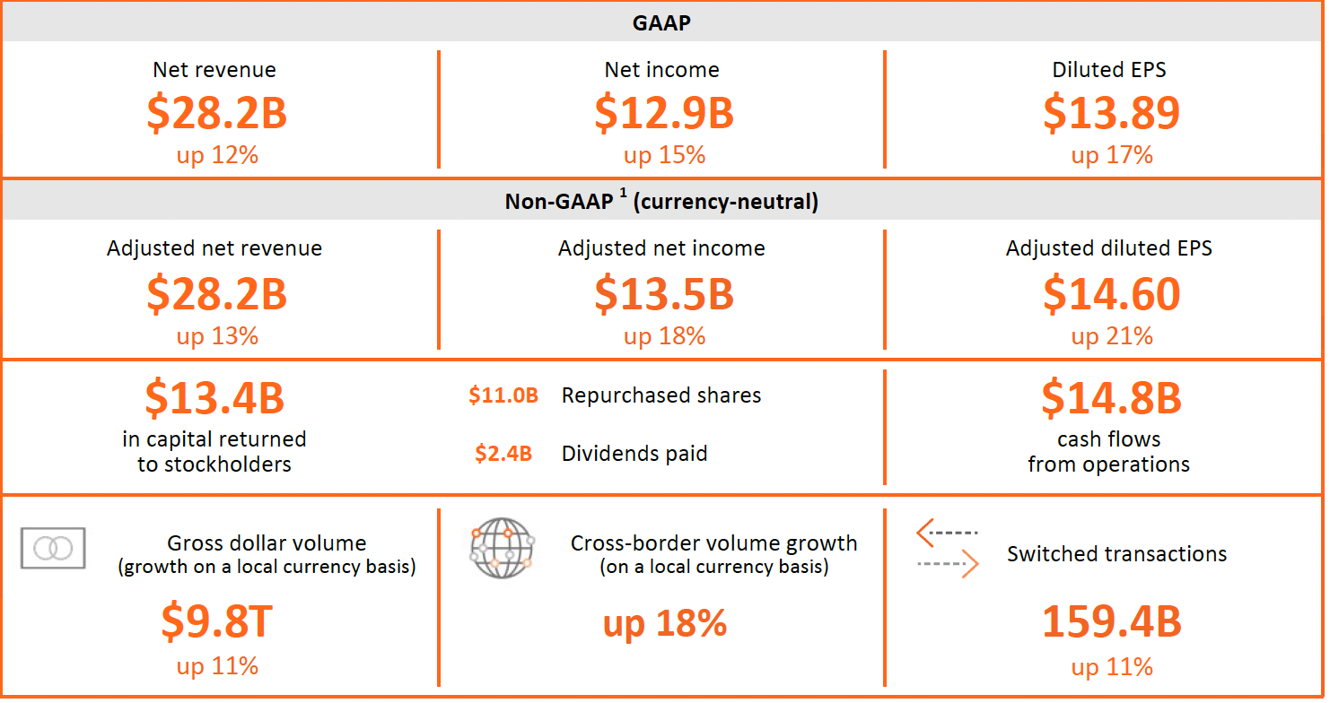
Mastercard 2024 Snapshot

Slide 10
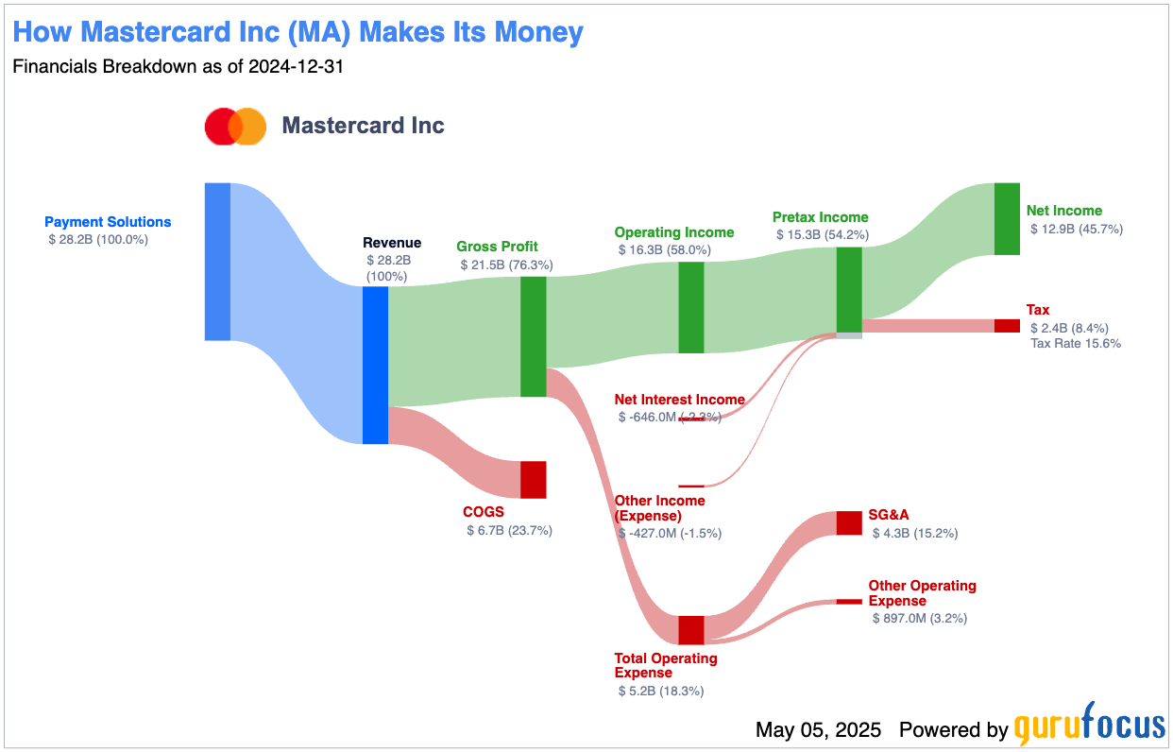

Slide 11
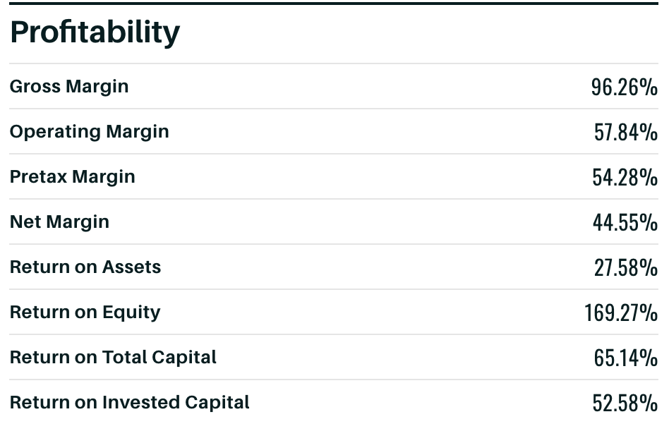

Slide 12
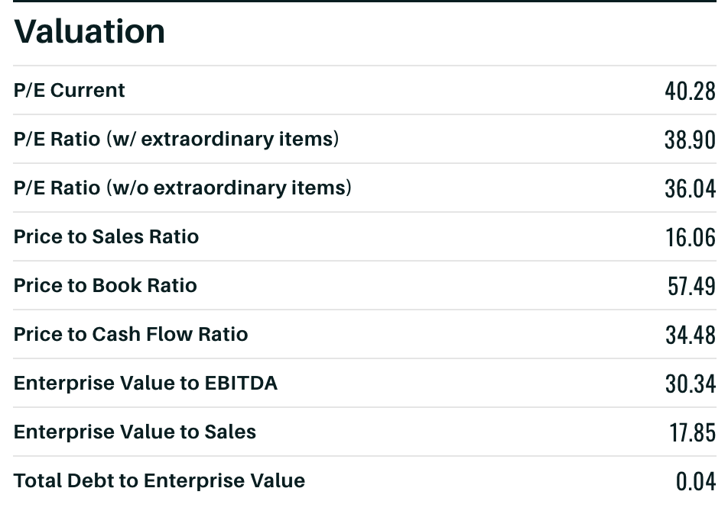

Slide 15
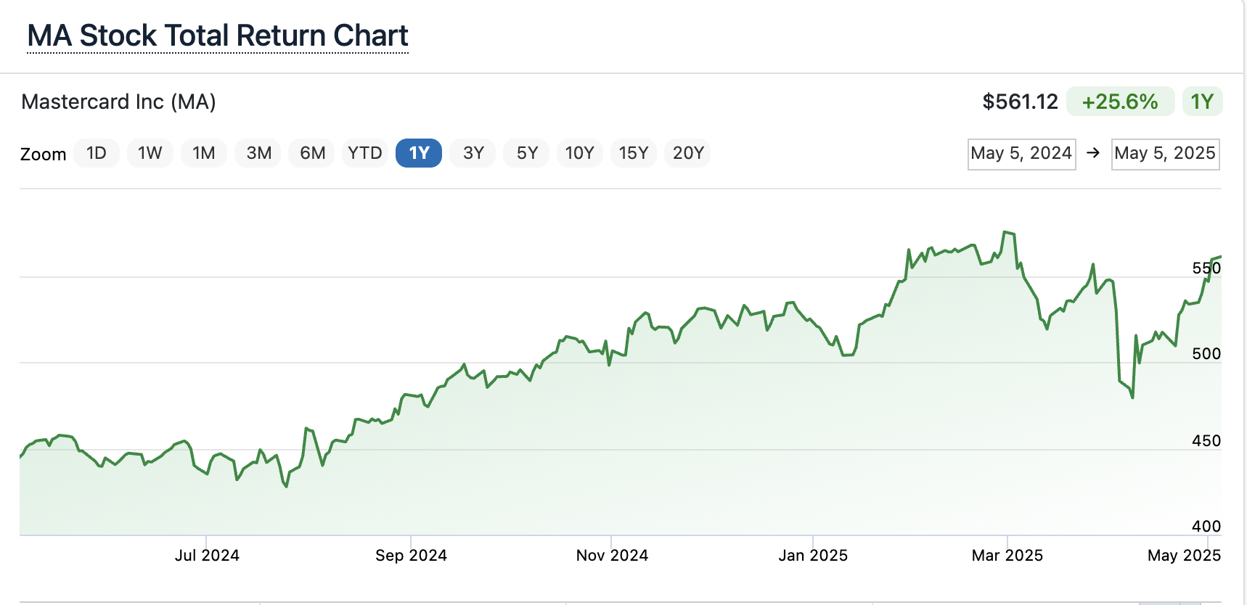

Slide 16
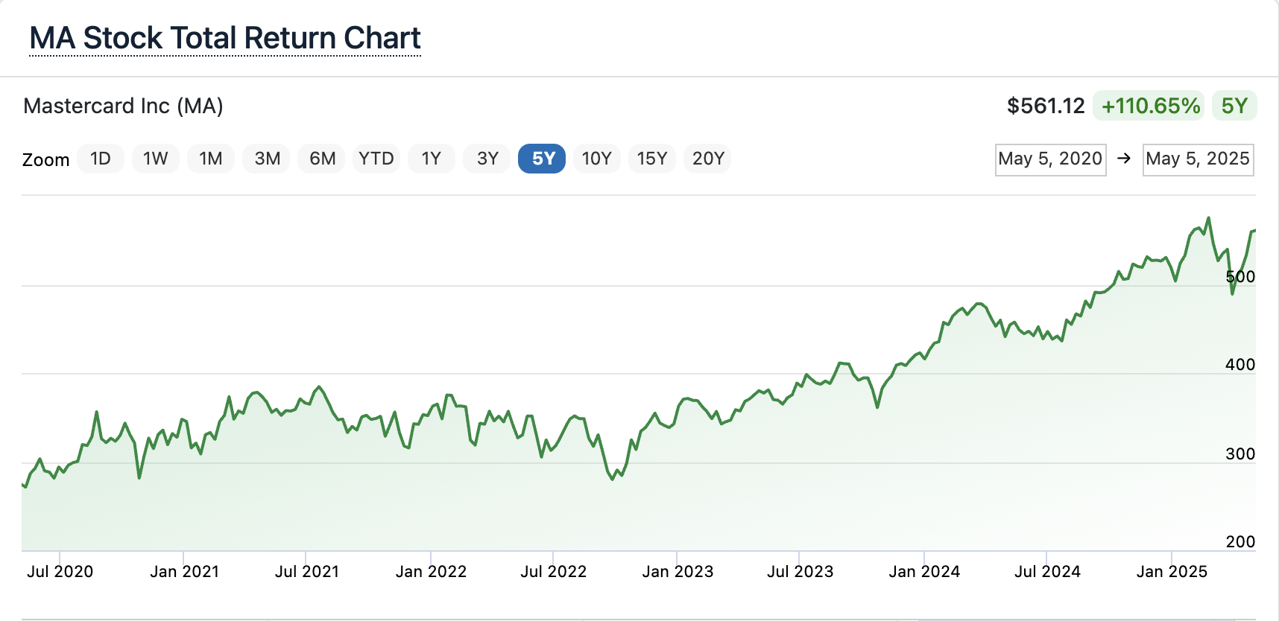

Slide 17
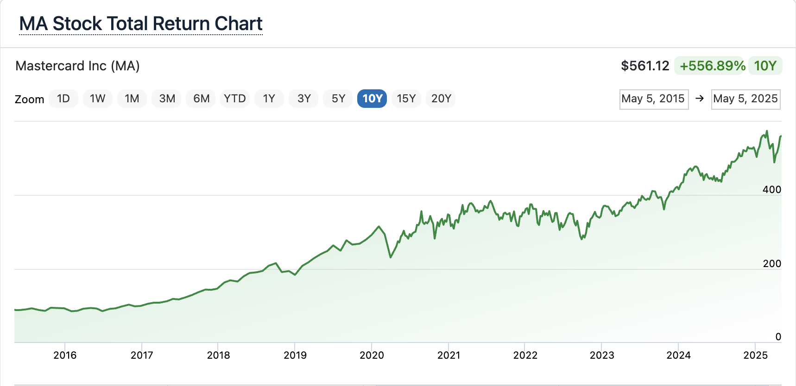

Slide 20
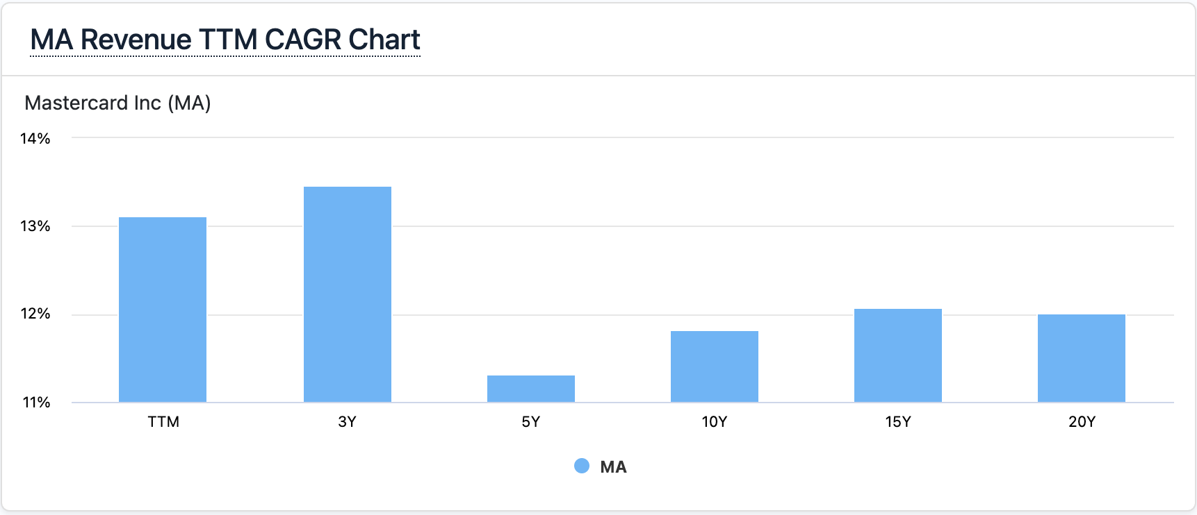
13.46%
12.08%
12.01%
11.82%
11.32%

Slide 23
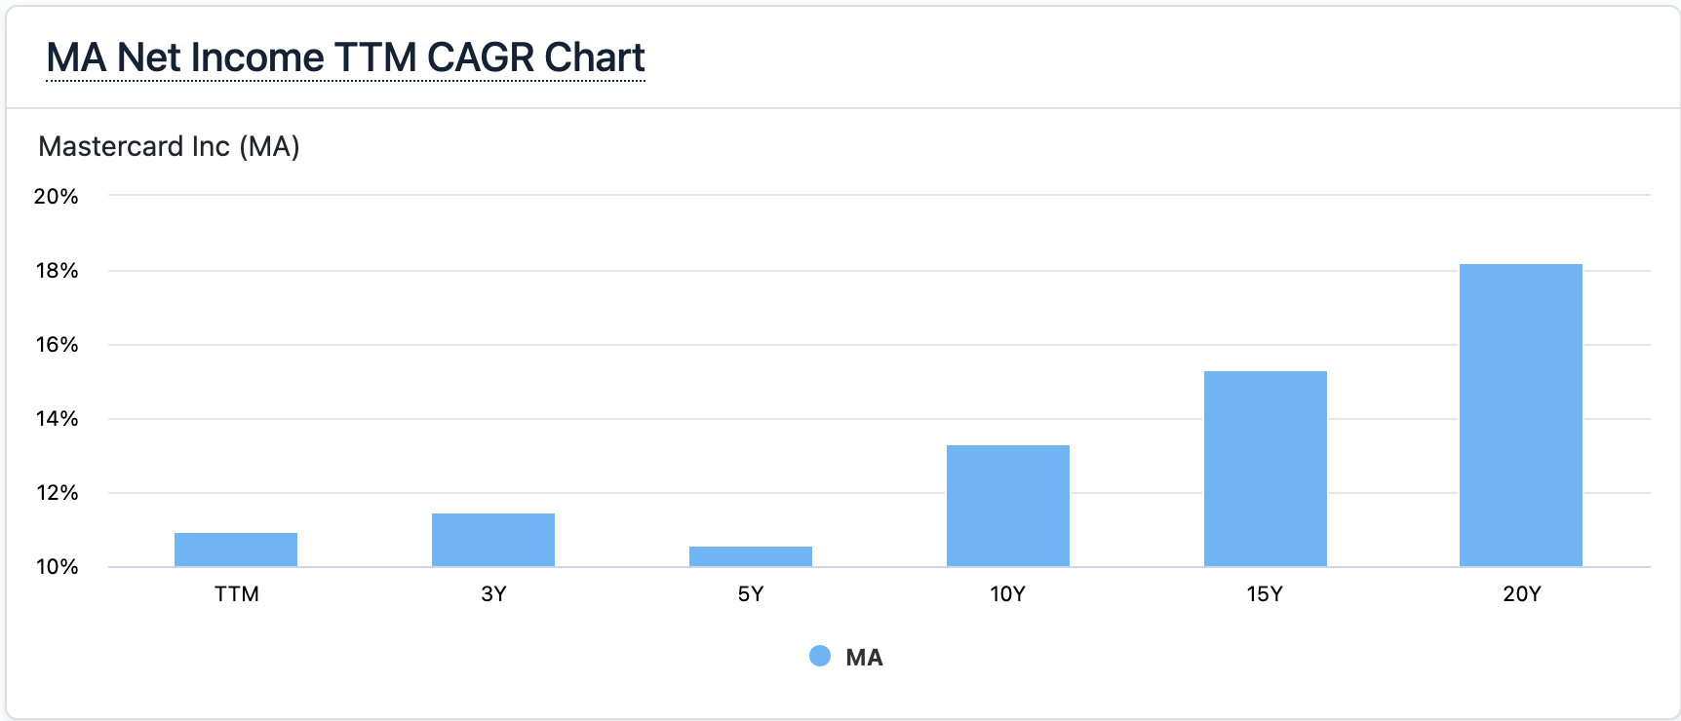
18.22%
15.30%
13.30%
11.47%
10.57%

Slide 26
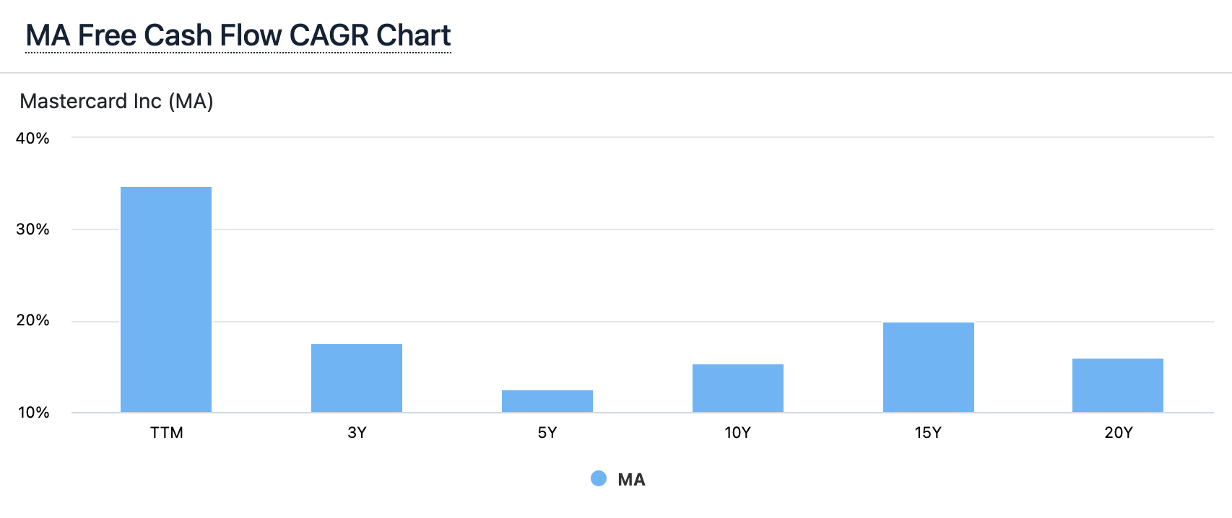
20.01%
17.51%
15.42%
16.07%
12.52%

Slide 27
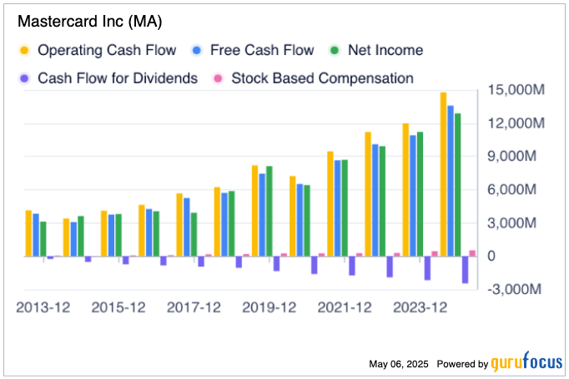

Slide 28
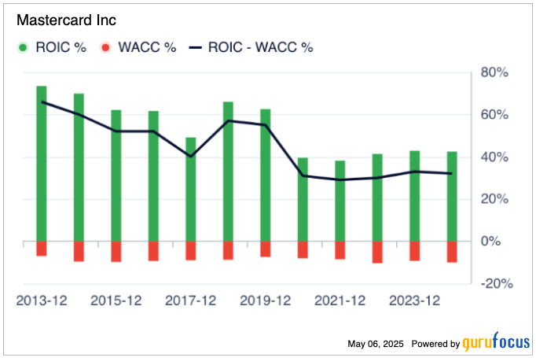

Slide 29
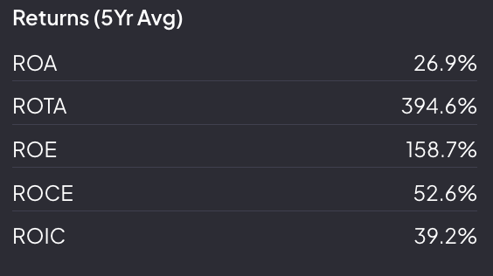

Slide 30
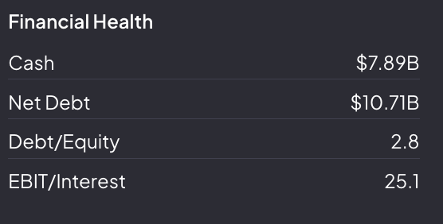

Slide 31
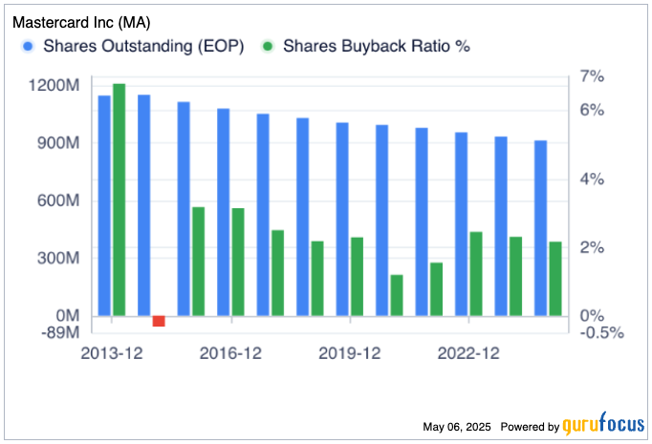

Slide 32
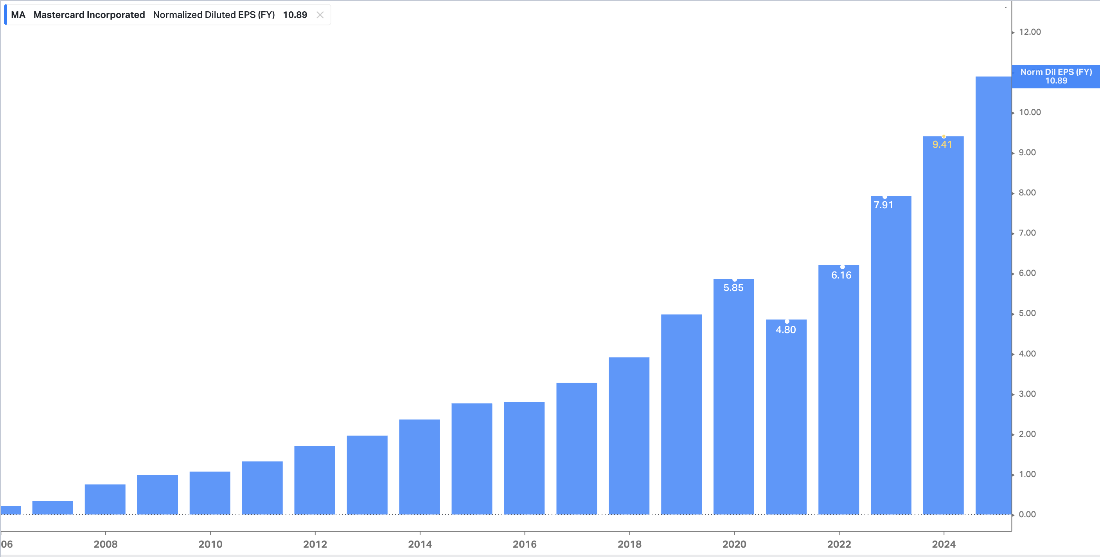

Slide 33
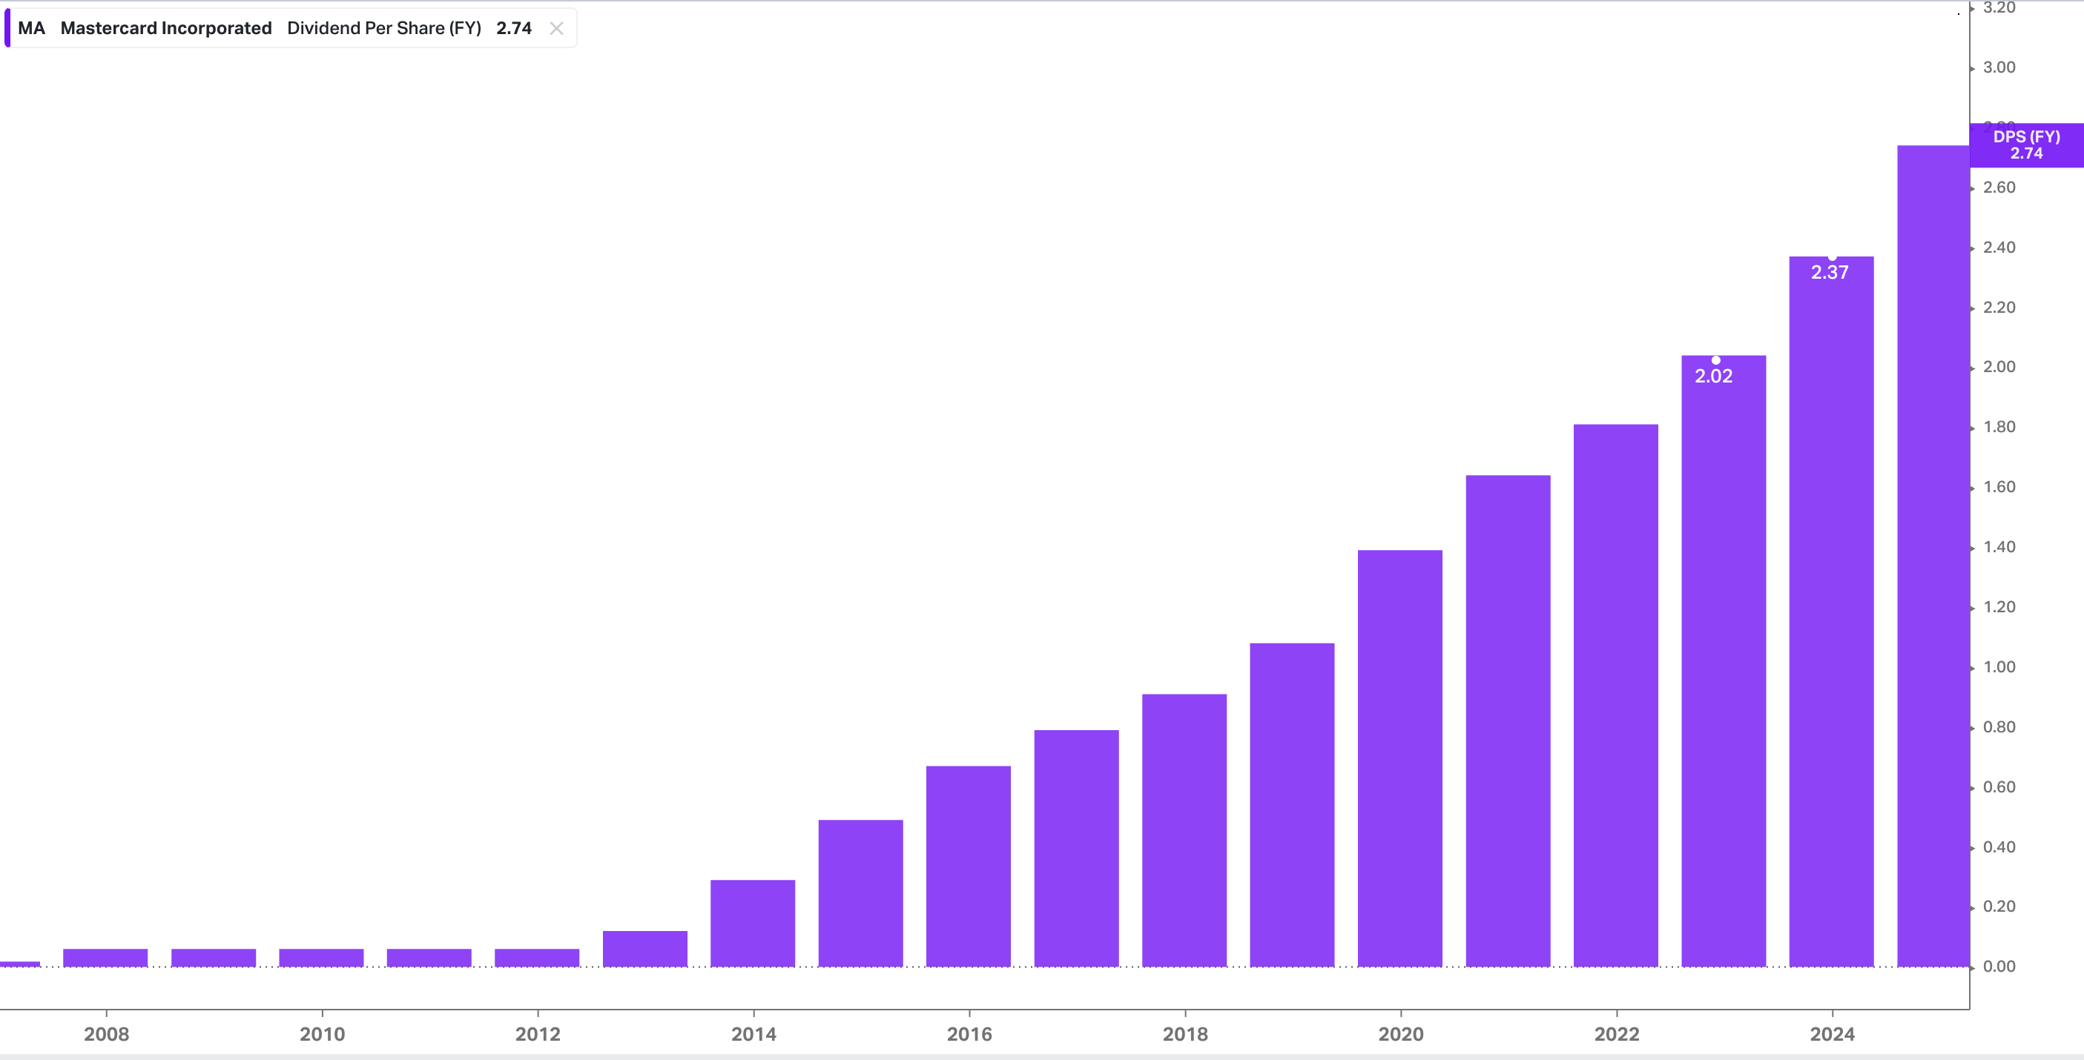

Slide 34
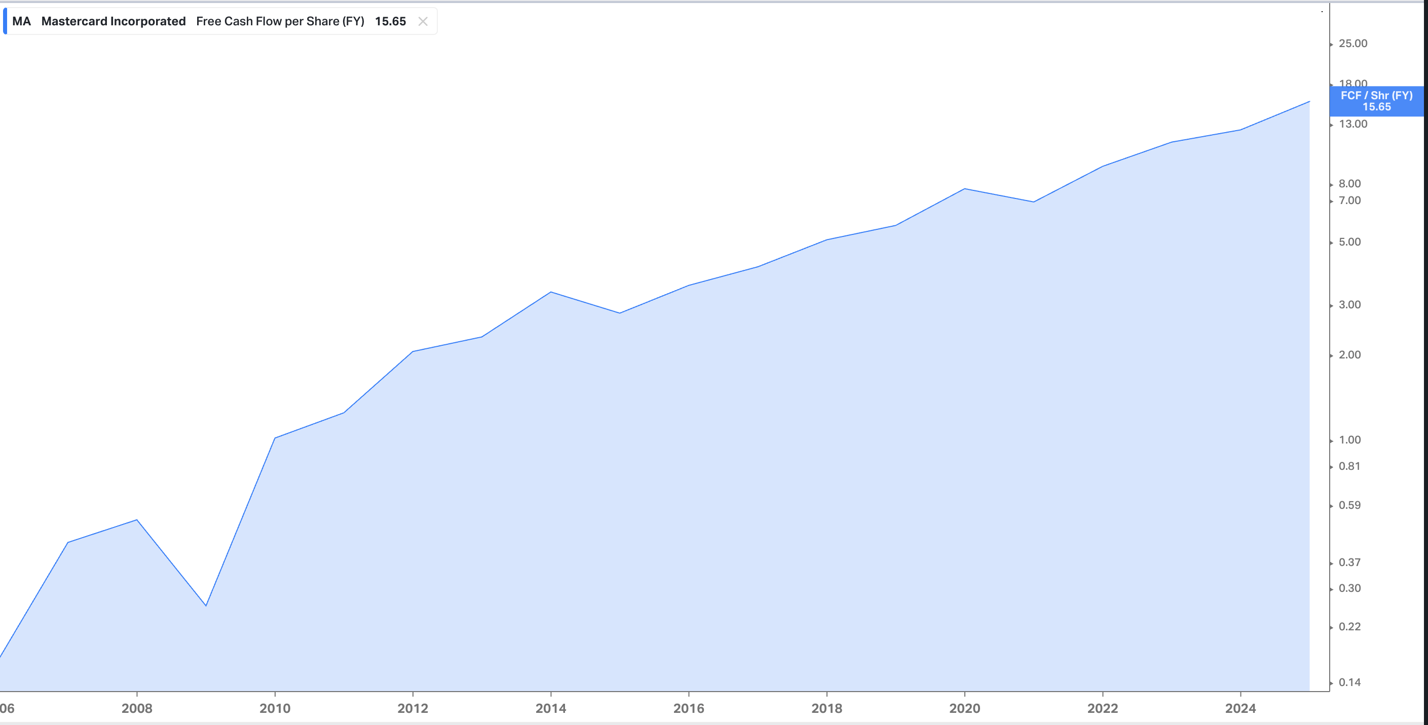

Slide 35
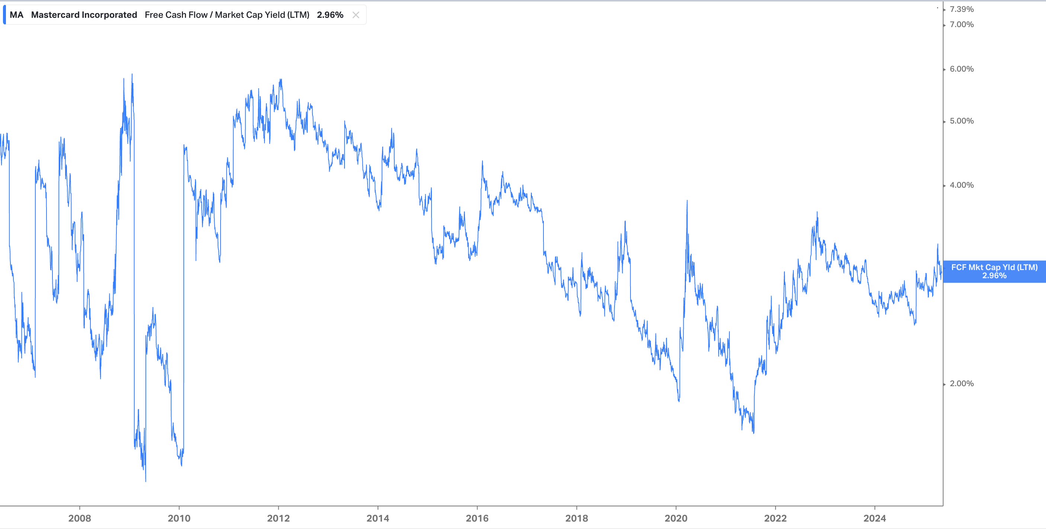

Slide 36
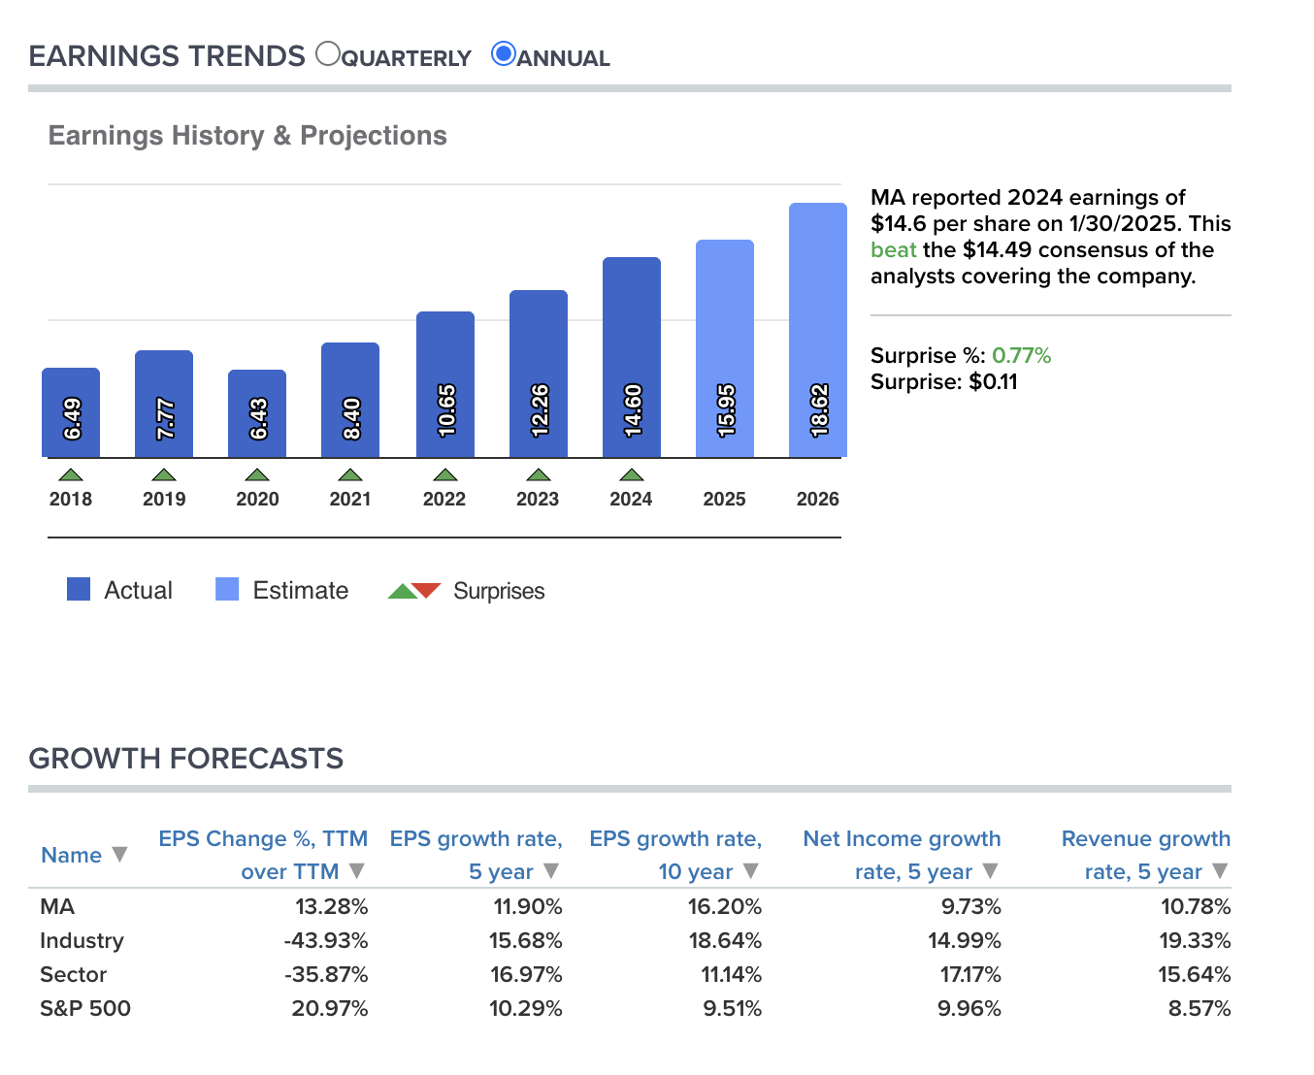

Slide 37
Mastercard Management Team
President and Chief Executive Officer: Michael Miebach is the president and CEO of of Mastercard since 2021. He was previously Chief Product Officer of Mastercard from 2016 to 2020. From 2010 to 2015, he was president of middle east and north Africa division at Mastercard. He held various executive positions at Barclays bank and Citigroup prior to joining Mastercard.
Chief Financial Officer: Sachin Mehra is CFO of Mastercard since April 2019. Prior to that he was chief financial operations officer from 2018 to 2019. He joined Mastercard in 2010 as corporate treasurer and remained in that role until 2013. He held various senior treasury and finance role at General Motors corporation prior to joining Mastercard.
President, Chief Technology Officer, Mastercard Technology: Edward McLaughlin has been CTO of Mastercard technology since May 2017. Prior to that he was Chief Information Officer from 2016 to 2017. Before that he was Chief Emerging Payments Officer from 2010 to 2015.
Chief Product Officer: John Lambert has been the Chief Product Officer since May 2024. Prior to that he was Chief Digital Officer from 2020 to 2024. He joined Mastercard in 2002 and was the Group Head, emerging payments Europe from 2002 to 2013.

Slide 38
Mastercard Mergers & Acquisitions
Recorded Future (December 2024)
Deal Value: $2.65 billion
Description: A Massachusetts-based cybersecurity firm specializing in AI-driven threat intelligence. Recorded Future provides real-time visibility into potential threats by analyzing a broad set of data sources. This acquisition enhances Mastercard's cybersecurity services, identity solutions, and real-time fraud scoring capabilities.
Minna Technologies (October 2024)
Deal Value: Undisclosed
Description: A Swedish company that allows users to manage subscription services within their banking applications. This acquisition supports Mastercard's efforts to provide consumers with more control over their financial lives.
Baffin Bay Networks (March 2023)
Deal Value: Undisclosed
Description: A Sweden-based cybersecurity platform offering cloud-based solutions such as threat intelligence and intrusion prevention. This acquisition bolsters Mastercard's cybersecurity infrastructure.

Slide 39
Dynamic Yield (December 2021)
Deal Value: Undisclosed
Description: A New York-based AI-powered platform that offers solutions such as customer data management and A/B testing. This acquisition enhances Mastercard's personalization capabilities for its clients.
Arcus Financial Intelligence (November 2021)
Deal Value: Undisclosed
Description: A New York-based fintech platform that provides solutions such as payment processing and financial data management. This acquisition supports Mastercard's efforts to expand its payment services in Latin America.
These acquisitions reflect Mastercard's strategic focus on enhancing its cybersecurity infrastructure, expanding digital services, and providing consumers with more control over their financial lives.

Slide 40
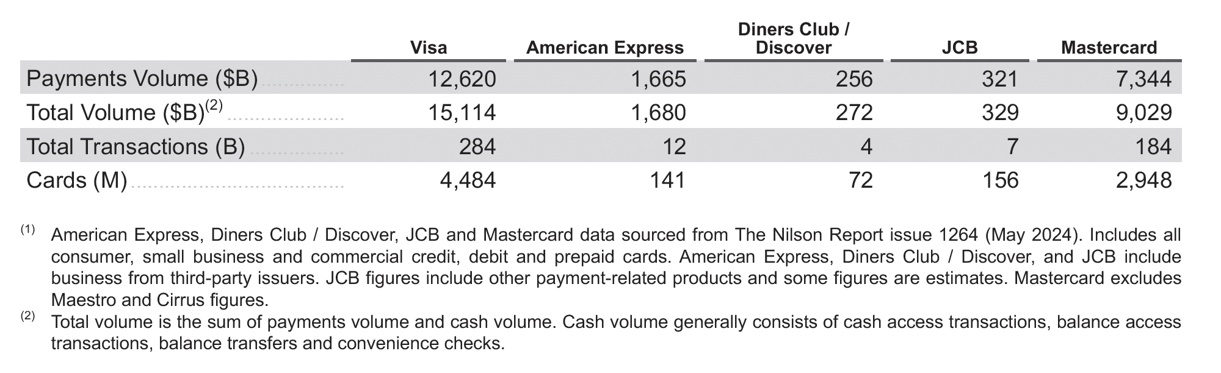
COMPETITION
The global payments industry continues to undergo dynamic and rapid change. Existing and emerging
competitors compete with Visa’s network and payment solutions for consumers and for participation by financial
institutions and merchants. Technology and innovation are shifting consumer habits and driving growth
opportunities in ecommerce, mobile payments, blockchain technology and digital currencies. These advances are
enabling new entrants, many of which depart from traditional network payment models.
Global or Multi-regional Networks: These networks typically offer a range of branded, general-purpose card
payment products that consumers can use at millions of merchant locations around the world. Examples include
American Express, Diners Club/Discover, JCB, Mastercard and UnionPay. These competitors may be more
concentrated in specific geographic regions, such as Discover in the U.S.,JCB in Japan and UnionPay in China.

Slide 41
RTP Networks: RTP networks have launched in at least 80 countries and continue to be driven by strong
government sponsorship and regulatory initiatives to enable and drive adoption (e.g., FedNow in the U.S., PIX
in Brazil and United Payments Interface (UPI) in India), increasing their position as an alternative to payment
card schemes. These networks primarily focus on domestic transactions, with adoption varying by use cases
and geographies. However, with linkages such as PayNow in Singapore and UPI in India, cross-border RTP
networks are advancing and will compete with our cross-border business. RTP networks can compete with
Mastercard on consumer payments and other payment flows (e.g., B2B and P2P) but can also be customers for
value-added services, such as risk management.
Alternative Payments Providers: These providers, such as closed commerce ecosystems, BNPL solutions and
cryptocurrency platforms, often have a primary focus of enabling payments through ecommerce and mobile
Channels.
Central Bank Digital Currencies:. The Bahamas was the first country to launch a nationwide Central Bank Digital
Currency (CBDC), named the Sand Dollar, in 2020. Following this, Nigeria also rolled out its eNaira in the same year.
In April 2020, China became the first major economy to pilot its digital currency, the e-CNY or Digital Yuan. India
has introduced the e-Rupee. The digital currency was initially rolled out in phases, with pilot projects for wholesale
and retail use in 2022 and 2023.

Slide 42
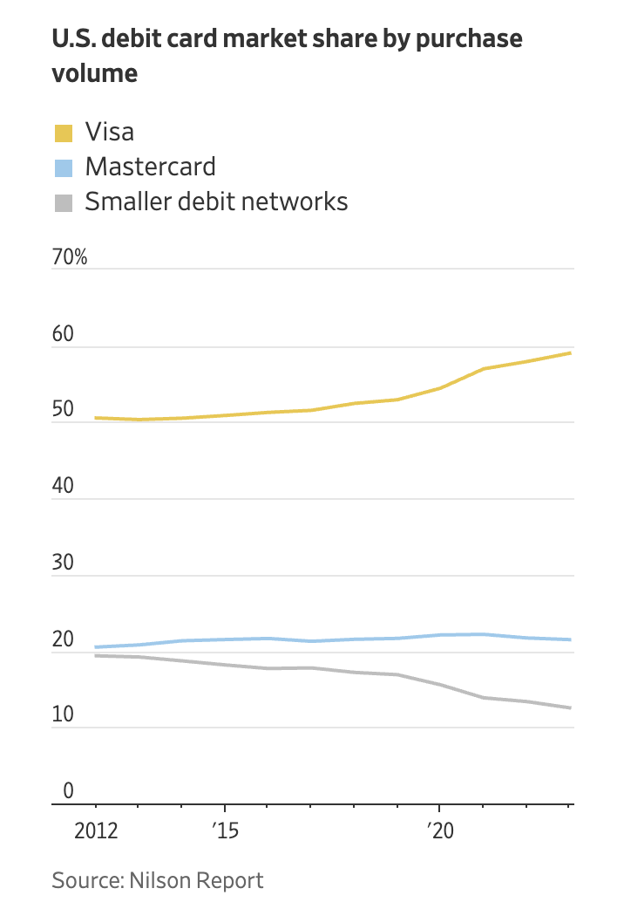
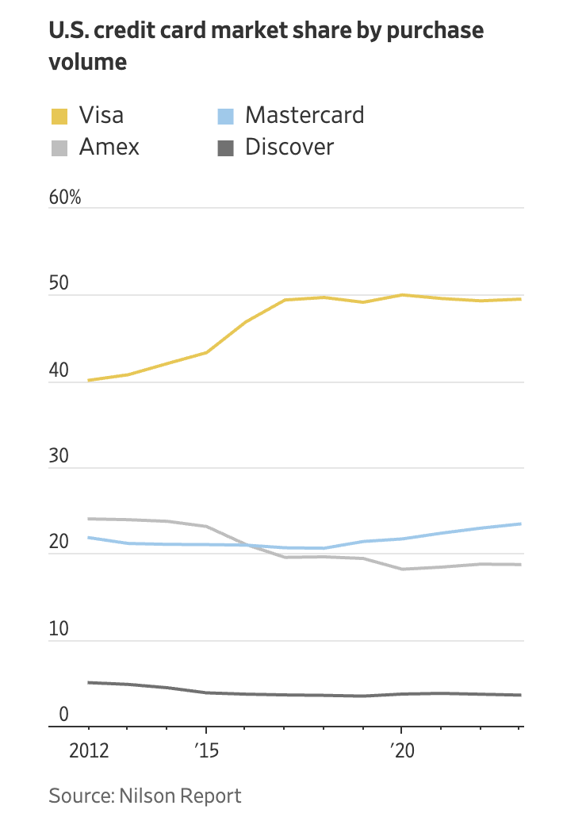

Slide 43
The Payment Card Landscape
There were 17.45 billion credit, debit, and prepaid cards in circulation worldwide as of the end of 2023.
UnionPay cards made up 56% of total cards, Visa composed 25%, Mastercard made up 17%, and American Express held slightly less than 1%. Discover comprised less than half a percent.
Global purchase volume by credit card brand in 2023:
UnionPay credit: $6.9 trillion, 35%
Visa credit: $6.3 trillion, 32%
Mastercard credit: $4 trillion, 21%
American Express credit: $1.7 trillion, 9%
JCB credit: $320 billion, 2%
Discover credit: $256 billion, 1%

Slide 44
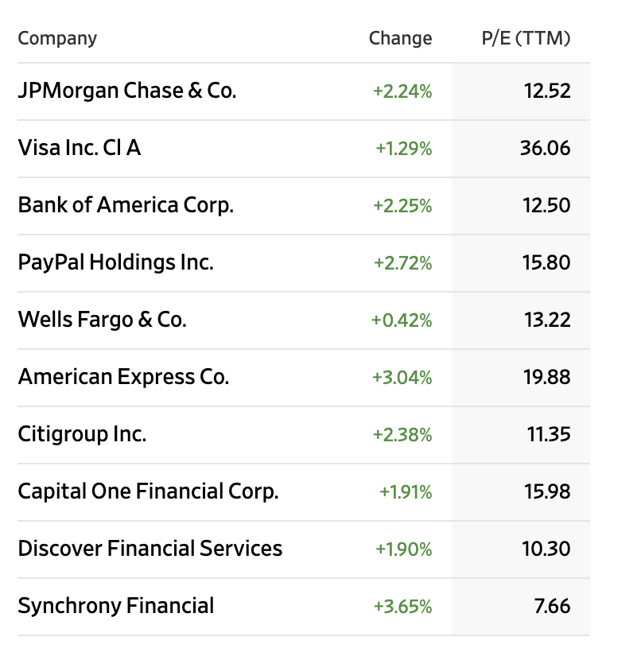
PEER COMPETITORS

Slide 45
Risks
Mastercard faces structural, competitive, and regulatory headwinds that may constrain growth, compress margins, and erode its competitive moat. As the global payment's ecosystem evolves, Mastercard’s traditional revenue model—based heavily on interchange fees and transaction volumes—faces disruption from digital wallets, real-time payment networks, and regulatory pressure. The company's high valuation amplifies downside risk if growth slows or sentiment shifts.
Disintermediation by Fintech and Big Tech
Threat from real-time payments (RTP): Governments and central banks globally (e.g., FedNow in the U.S., UPI in India) are rolling out instant payment systems that bypass card networks, reducing Mastercard's relevance in domestic transactions.
Digital wallets and closed-loop systems: Players like Apple Pay, PayPal, Square, and emerging super apps (e.g., in Asia) are creating ecosystems that can route payments outside traditional card rails.
Direct bank-to-bank transfers may gain traction due to lower fees and faster settlement.

Slide 46
Regulatory Risk and Interchange Fee Pressure
Global scrutiny of interchange fees: Mastercard faces growing regulatory scrutiny, particularly in the EU and increasingly in the U.S., where legislators are targeting credit card fee structures as anti-competitive and inflationary.
Potential caps or restructuring of fees could impair Mastercard’s core revenue streams.
Legal risks: Ongoing and future antitrust lawsuits may result in fines, settlements, or structural business changes.
Macroeconomic Sensitivity
Consumer spending exposure: Mastercard’s revenue is tied directly to consumer and business spending volume. A recession or economic slowdown could meaningfully hurt transaction growth.
Currency headwinds: As a global company, Mastercard’s earnings are sensitive to foreign exchange fluctuations, particularly if the U.S. dollar strengthens.

Slide 47
Slowing Growth and Market Saturation
Mature markets: In key markets like the U.S. and Western Europe, card penetration is already high, limiting further expansion opportunities.
Emerging markets: Although promising, these markets pose geopolitical, currency, and regulatory risks that could impair Mastercard’s ability to grow reliably.
Cannibalization risk: As Mastercard pushes into new products (e.g., buy now pay later, open banking), it may cannibalize its core high-margin businesses.
High Valuation and Limited Margin for Error
Premium multiple: Mastercard trades at a high forward P/E and EV/EBITDA multiple relative to both payment peers and the broader market.
Growth expectations baked in: Any deceleration in cross-border growth, fintech partnerships, or innovation uptake could trigger multiple compression.
Buybacks as a crutch: The company has relied on share repurchases to support EPS growth—unsustainable if revenue slows.

Slide 48
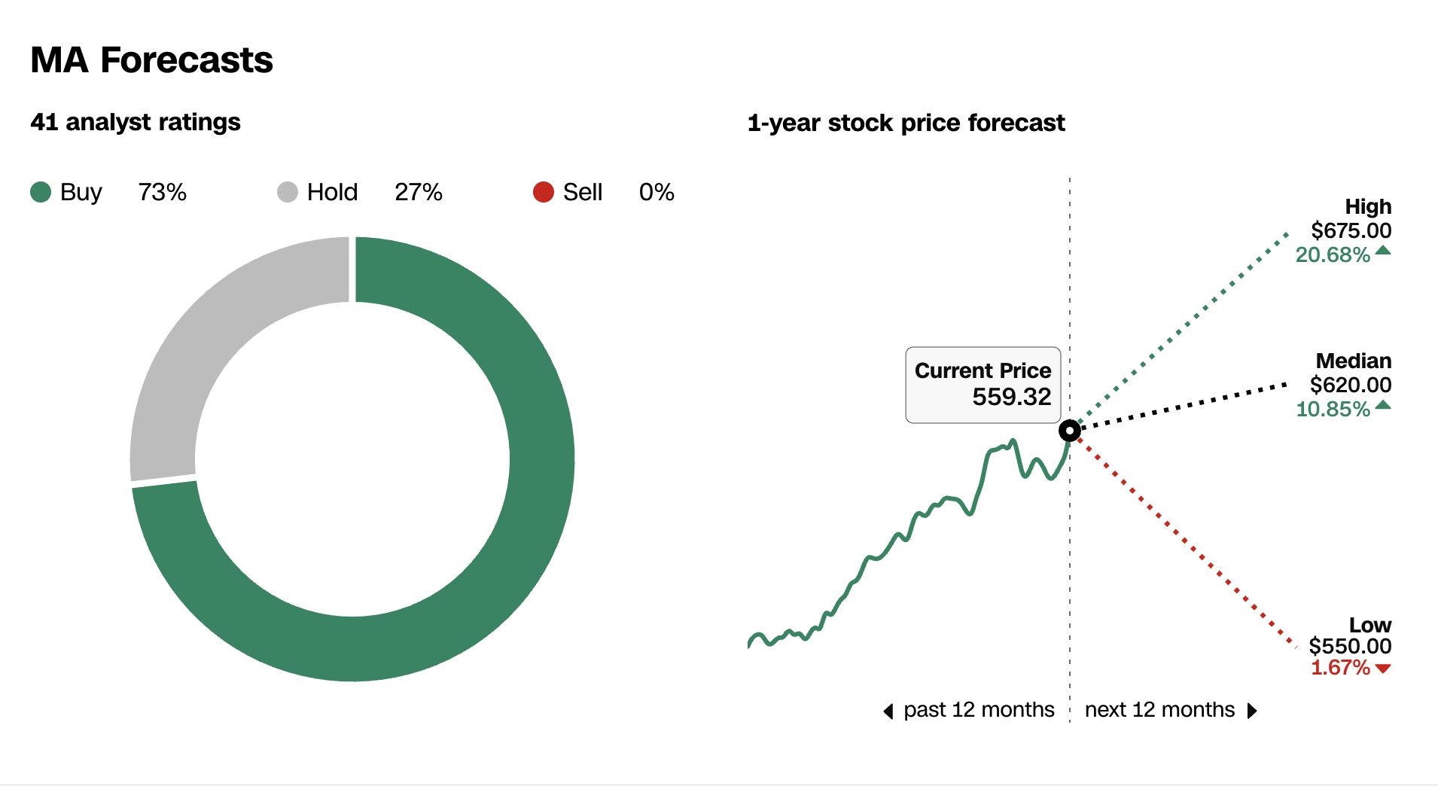

Slide 49
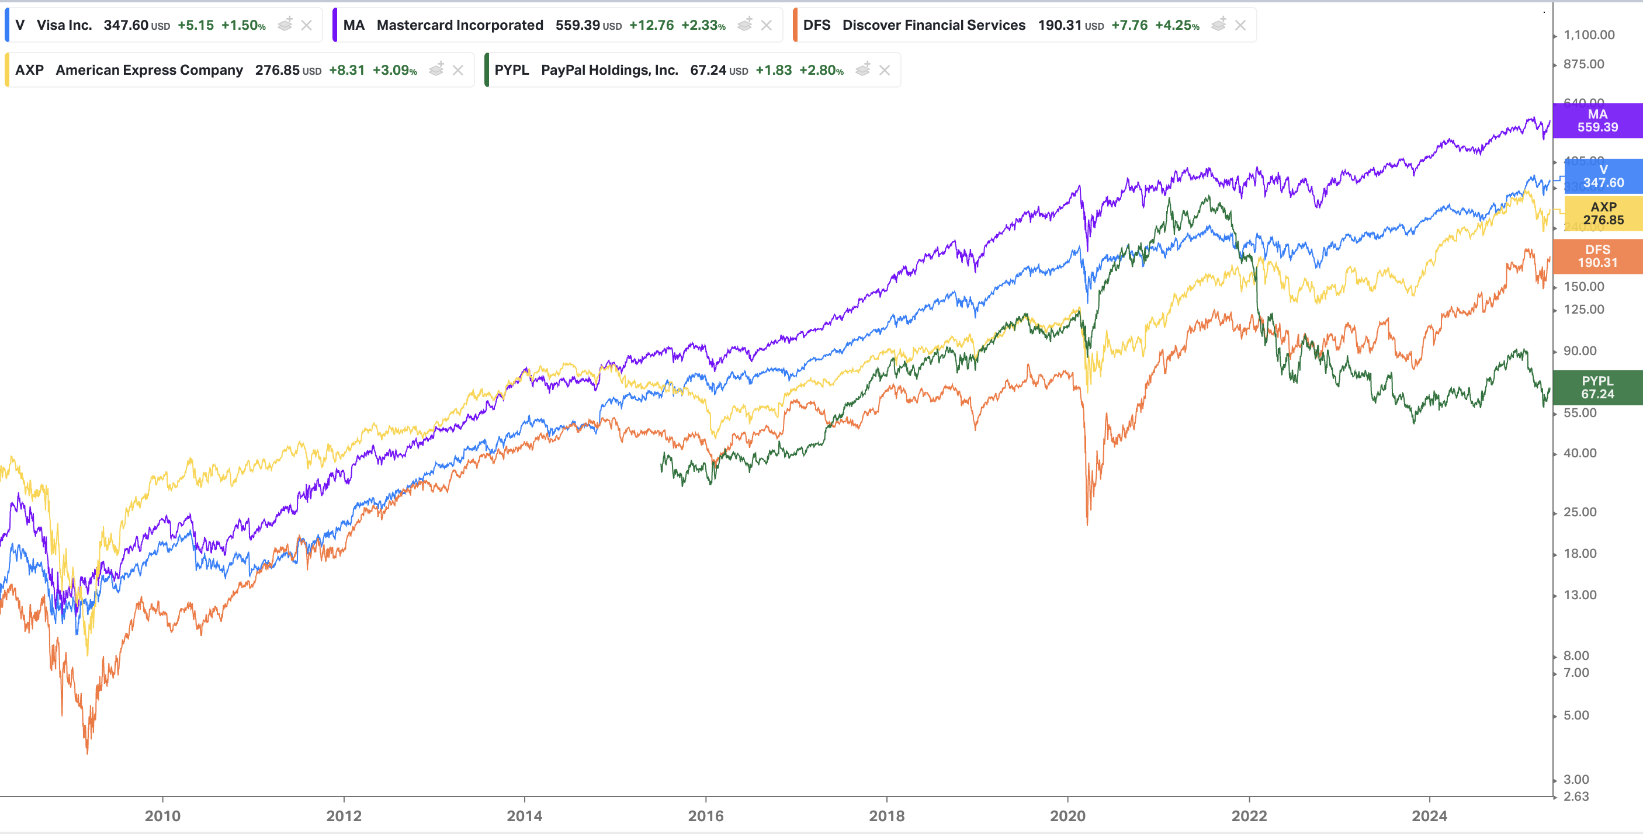

Slide 50
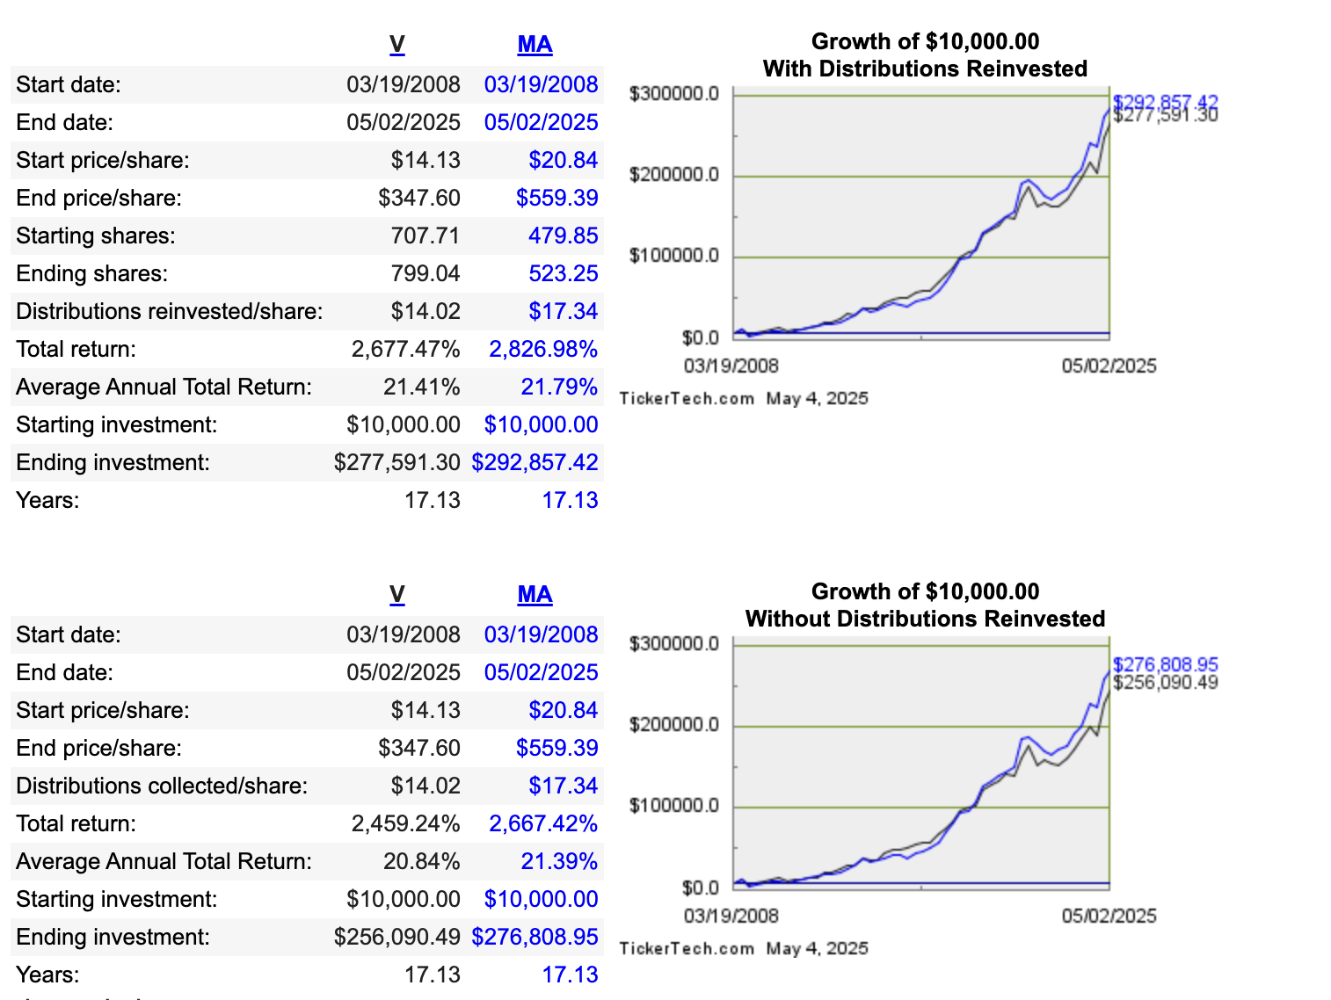

Slide 51
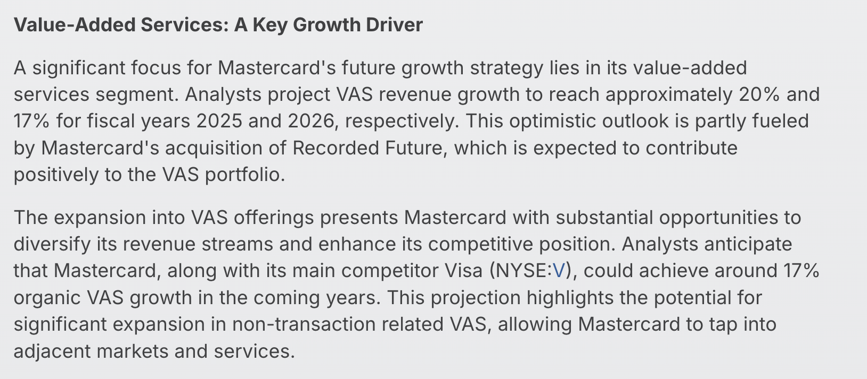
Mastercard Growth Drivers

Slide 52
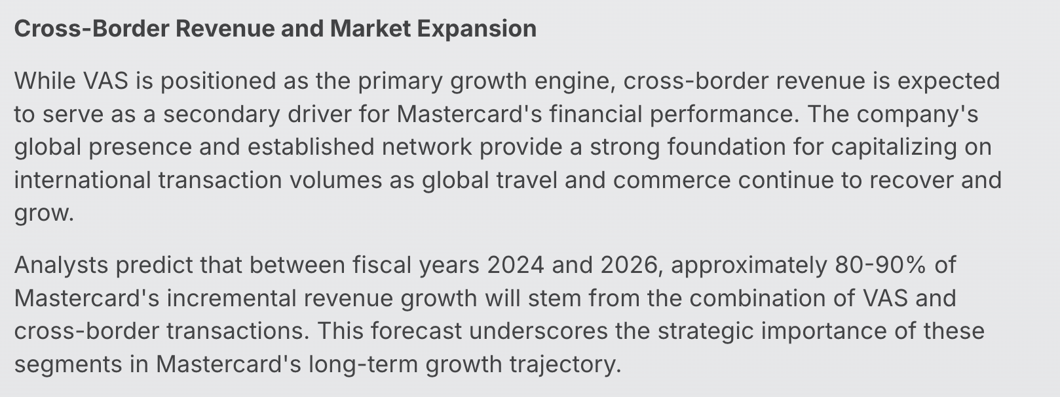

Slide 53
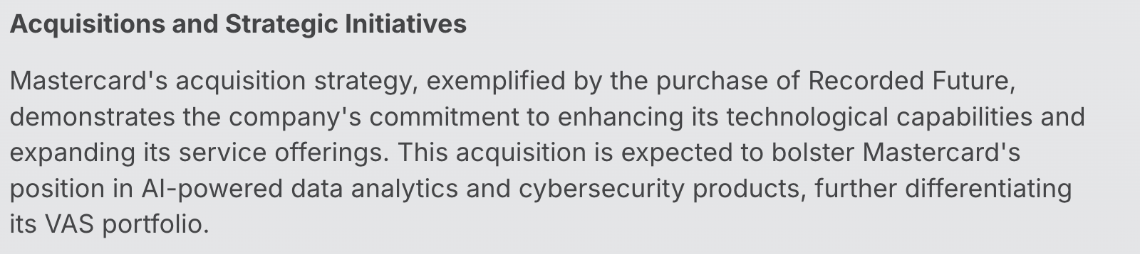
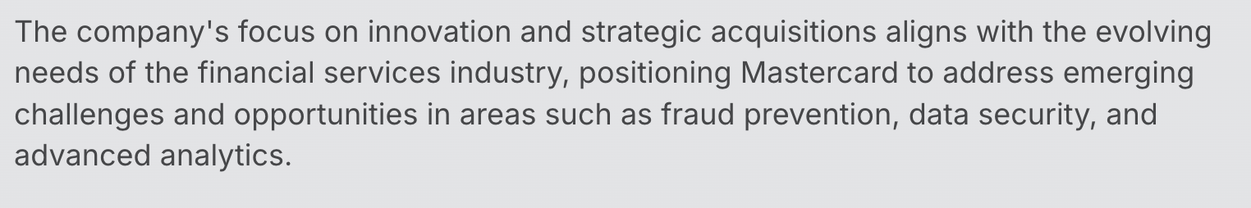

Slide 54
THESIS SUMMARY
Dominant Market Position in Global Payments
Mastercard is one of the two largest global payment networks (alongside Visa), operating a duopoly with massive scale and brand recognition. Its secure, fast, and reliable infrastructure underpins trillions of dollars in annual transaction volume, creating a powerful network effect that is difficult to replicate.
Secular Tailwinds in Digital Payments
The global transition from cash to digital payments continues to accelerate, driven by e-commerce, contactless payments, fintech adoption, and financial inclusion initiatives. Mastercard is a key enabler of this trend, positioning it to benefit from sustained, long-term volume growth globally—especially in emerging markets.
High Operating Leverage & Strong Margins
Mastercard’s business model—charging fees on volume rather than bearing credit risk—produces robust profit margins and free cash flow. As volume grows, the company scales efficiently, turning incremental revenue into substantial operating profit.
Strategic Expansion into High-Growth Adjacent Markets
Mastercard is investing in value-added services, open banking, cybersecurity, real-time payments and B2B transactions. These initiatives diversify revenue streams and expand its total addressable market beyond traditional card payments.

Slide 55
Shareholder-Friendly Capital Allocation
The company has a consistent track record of returning capital via share buybacks and dividends while maintaining investment in innovation and growth. Its strong balance sheet and cash flow generation support this balanced approach.
Resilience and Pricing Power
Mastercard’s entrenched role in the financial system provides pricing power and resilience against macroeconomic volatility. Even during economic downturns, transaction volumes tied to everyday spending remain relatively stable.
Exposure to Global Economic Growth and Inflation Hedge
As a toll-taker on global commerce, Mastercard benefits from GDP growth, consumption trends, and inflation (since its fees are tied to transaction value). This makes it a potential inflation hedge in investor portfolios.
Mastercard has shown excellent performance over the last 17 years with an average annual return of ~21% outperforming most peer competitors and both S&P500 and NASDAQ100 Index.
Mastercard also possess vast amounts of payment transaction data placing it in an ideal position to integrate AI models easily.

