Slide 1
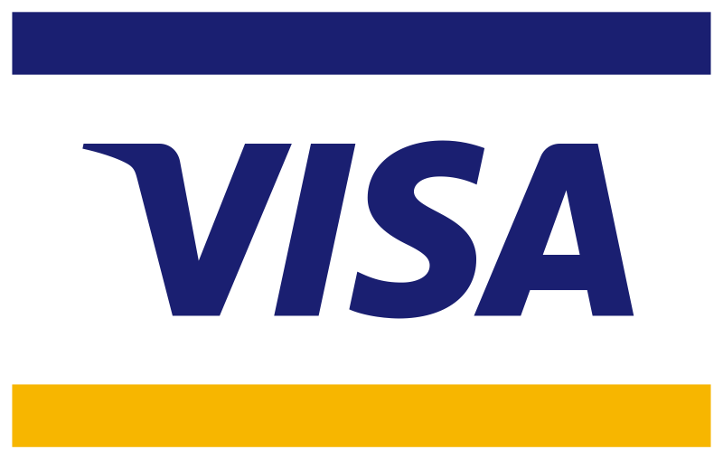
A Bullish Case for
By Ahmed Sajid

Slide 2
Bull Case Investment Thesis: Visa & Mastercard
Duopoly in a Massive, Growing Market
Visa and Mastercard dominate the global card payments network, benefiting from strong network effects and the ongoing global shift from cash to digital payments.
Asset-Light, Scalable Business Models
Their model generates high margins and free cash flow since they don't lend money or assume credit risk. Operating leverage allows volume growth to amplify earnings.
Global Expansion and Financial Inclusion
Both companies are investing in emerging markets and financial inclusion, unlocking long-term volume growth opportunities in underserved regions.
Diversification Beyond Core Payments
They are expanding into high-margin services like fraud prevention, tokenization, and data analytics, creating new recurring revenue streams.

Slide 3
Beneficiaries of E-Commerce and Cross-Border Travel
Growing e-commerce and recovering international travel drive higher transaction volumes, especially in high-margin cross-border segments.
Strong Balance Sheets and Shareholder Returns
Robust financials enable significant stock buybacks and dividend growth, appealing to long-term investors seeking reliability and compounding potential.
Technological Adaptability and Innovation
Rather than being disrupted, Visa and Mastercard are integrating with fintech's and exploring new technologies like crypto, real-time payments, and AI.

Slide 4
Duopoly in a Massive, Growing Market
Visa and Mastercard dominate the global card payments network with a combined ~80% market share outside of China.
This entrenched duopoly benefits from strong network effects — the more consumers and merchants use their services, the more valuable they become.
Visa's network effect is strong as more consumers using Visa cards attract more merchants, which in turn attracts more consumers. With over 3.6 billion cards and millions of merchants worldwide, its network is self-reinforcing.
The secular shift from cash to digital payments is still underway, especially in emerging markets, offering multi-decade tailwinds.
Asset-Light, Scalable Business Models
Neither company takes on credit risk (banks issue the cards and assume the lending risk). Instead, they collect fees on transaction volume.
Their high-margin, capital-efficient model yields substantial free cash flow and return on equity.
Both businesses have operating leverage — incremental volume growth results in outsized earnings growth.

Slide 5
Global Expansion and Financial Inclusion
Billions of people in emerging economies remain unbanked or underbanked.
Visa and Mastercard are deeply invested in financial inclusion initiatives, such as mobile-first solutions, real-time payments, and local partnerships.
Long-term, their presence in markets like India, Africa, and Southeast Asia could drive sustained volume growth.
Diversification Beyond Core Payments
Both companies are expanding into value-added services, such as:
  Cybersecurity and fraud prevention
  Tokenization and identity solutions
  Data analytics for financial institutions and merchants
These new verticals offer high-margin recurring revenue streams beyond traditional interchange and processing.

Slide 6
Beneficiaries of E-Commerce and Cross-Border Travel
The growth of global e-commerce directly boosts digital transaction volumes.
Visa and Mastercard also earn outsized fees from cross-border transactions, which are rebounding post-pandemic due to increased international travel and global economic recovery.
Strong Balance Sheets and Shareholder Returns
Both companies maintain fortress balance sheets, with little debt and robust cash flows.
Their consistent buybacks and dividend growth appeal to both growth and income investors.
Capital allocation discipline has been historically strong.
Technological Adaptability and Innovation
Contrary to being disrupted, both Visa and Mastercard are acquiring or partnering with fintech’s to stay relevant.
Investments in crypto rails, tokenized payments, real-time settlements, and AI suggest strong adaptability to evolving trends.
Their infrastructure is mission-critical, making them resilient even as new rails emerge.

Slide 7
High Switching Cost
Customers and merchants face high switching costs due to the hassle of changing payment processors, re- establishing merchant services, and the ubiquity of Visa’s acceptance.
Brand Identity
Visa's brand is synonymous with credit and debit card payments, symbolizing trust and reliability. Its brand strength is a competitive advantage, encouraging card issuance and merchant acceptance.
Intangible Assets
Visa holds numerous patents and licenses critical for payment processing. These assets protect its technology and services, maintaining a competitive edge in the payments industry.
Efficient Scale
Visa's efficient scale is evident as it handles billions of transactions with minimal incremental cost. Its infrastructure supports massive volumes, deterring potential competitors due to the high entry costs.
Wide Moat
Visa has the biggest network and the widest moat in the payment processing industry.
Dominant Player
Visa is the most dominant player in the Global Payment Processing industry

Slide 8
Business Description
Visa Inc. (NYSE:V) is a global payments technology company. It facilitates global commerce and money movement across more than 200 countries and territories among a global set of consumers, merchants, financial institutions and government entities through technologies.
It operates through the Payment Services segment. It provides transaction processing services (primarily authorization, clearing and settlement) to its financial institution and merchant clients through VisaNet, its proprietary advanced transaction processing network.
It offers a range of Visa-branded payment products that its clients, including nearly 14,500 financial institutions, use to develop and offer payment solutions or services, including credit, debit, prepaid and cash access programs for individual, business and government account holders.
It also provides value-added services to its clients, including issuing solutions, acceptance solutions, risk and identity solutions, open banking solutions and advisory services.
Visa was founded in 1958 by Bank of America as the BankAmericard credit card program. It was renamed Visa in 1976. It went public through an IPO in 2008.
Visa is headquartered in San Francisco, California.
Visa has a market cap of $676.07 billion.

Slide 9
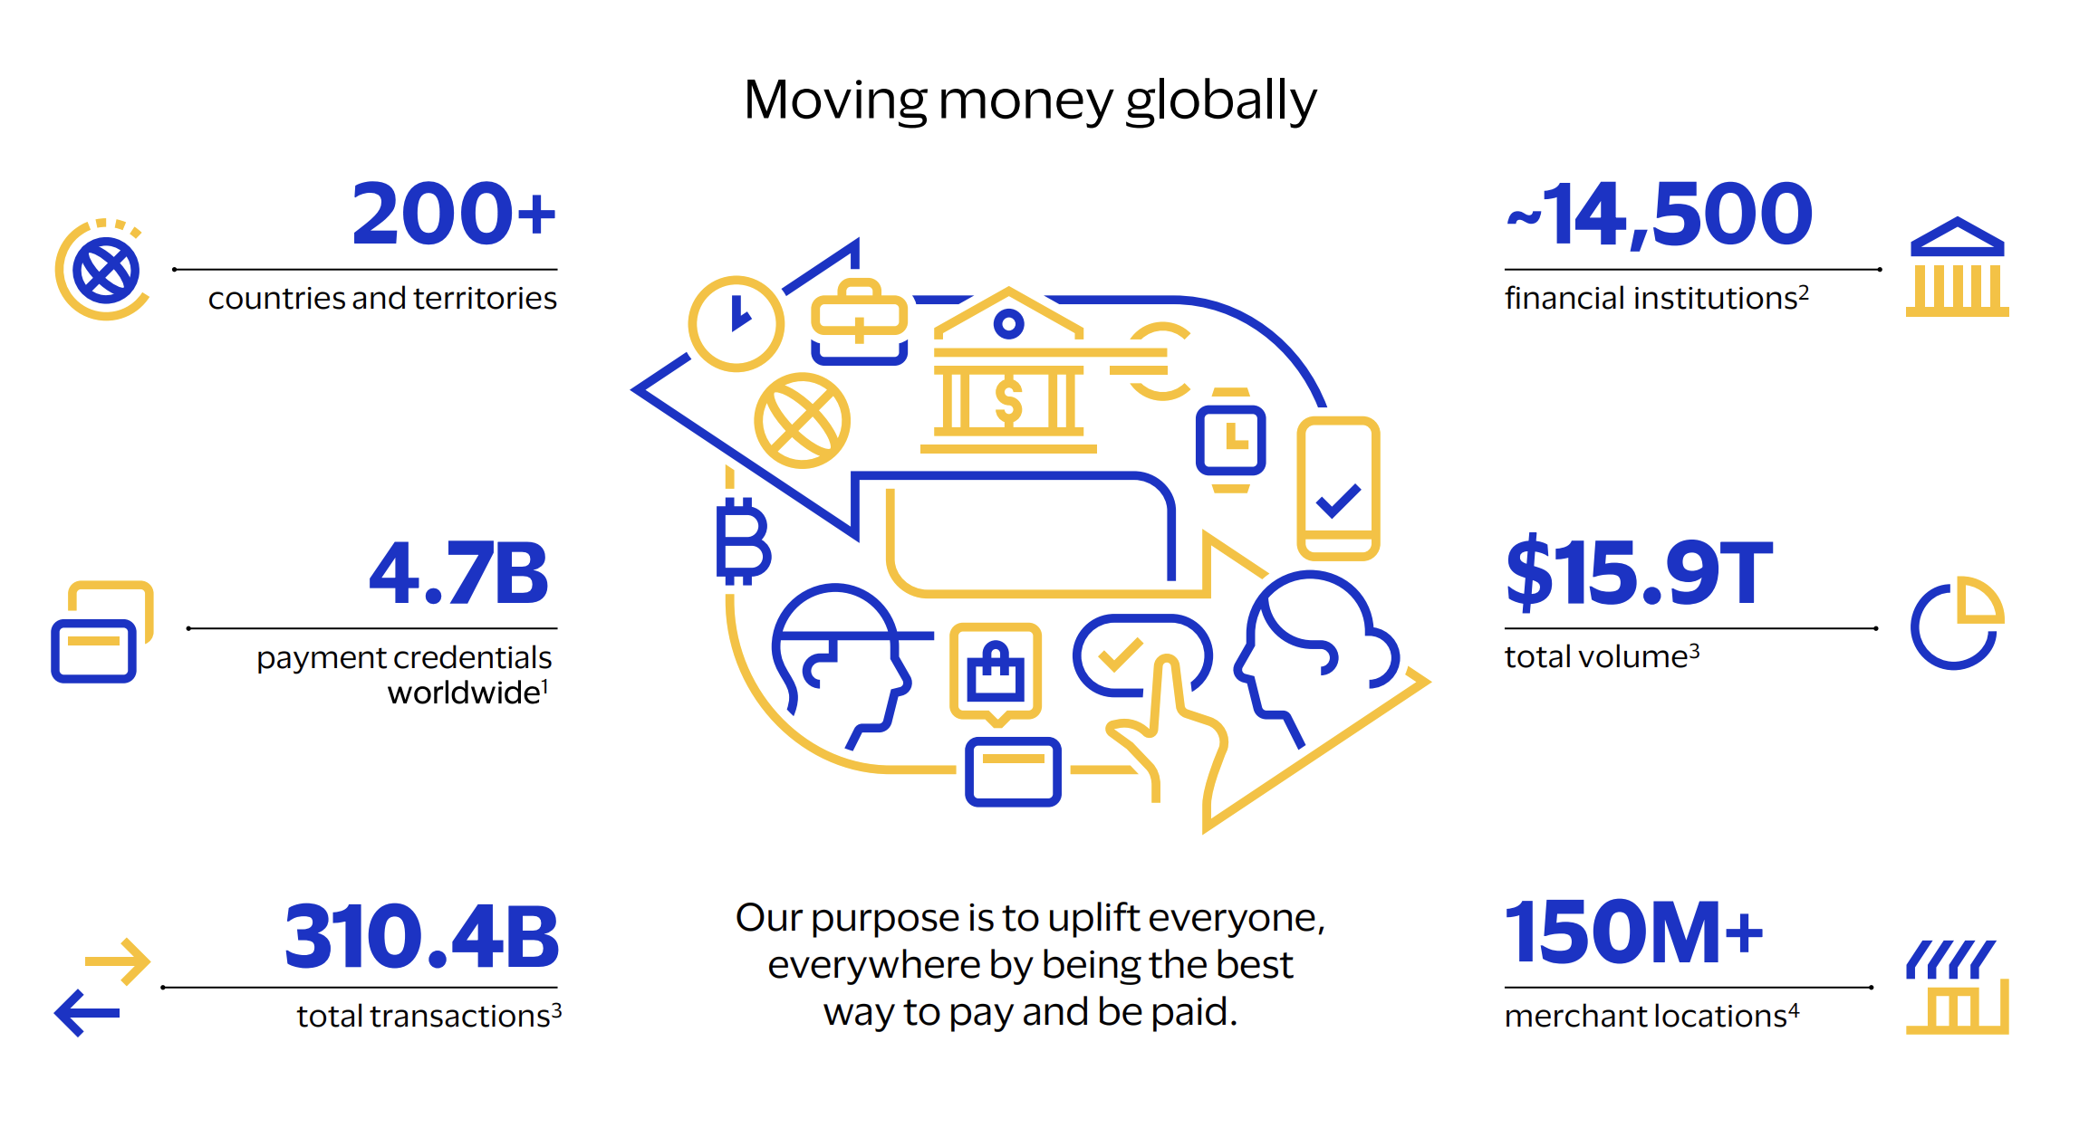
VISA Factsheet

Slide 10
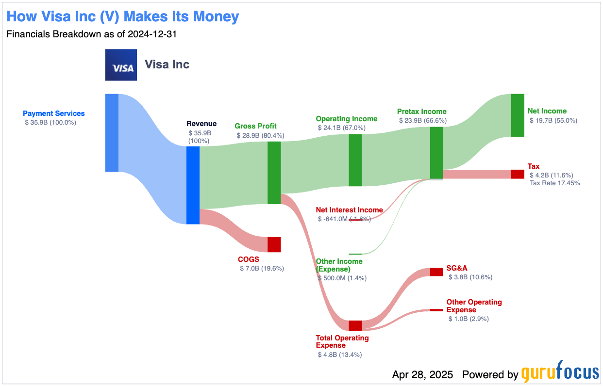

Slide 11
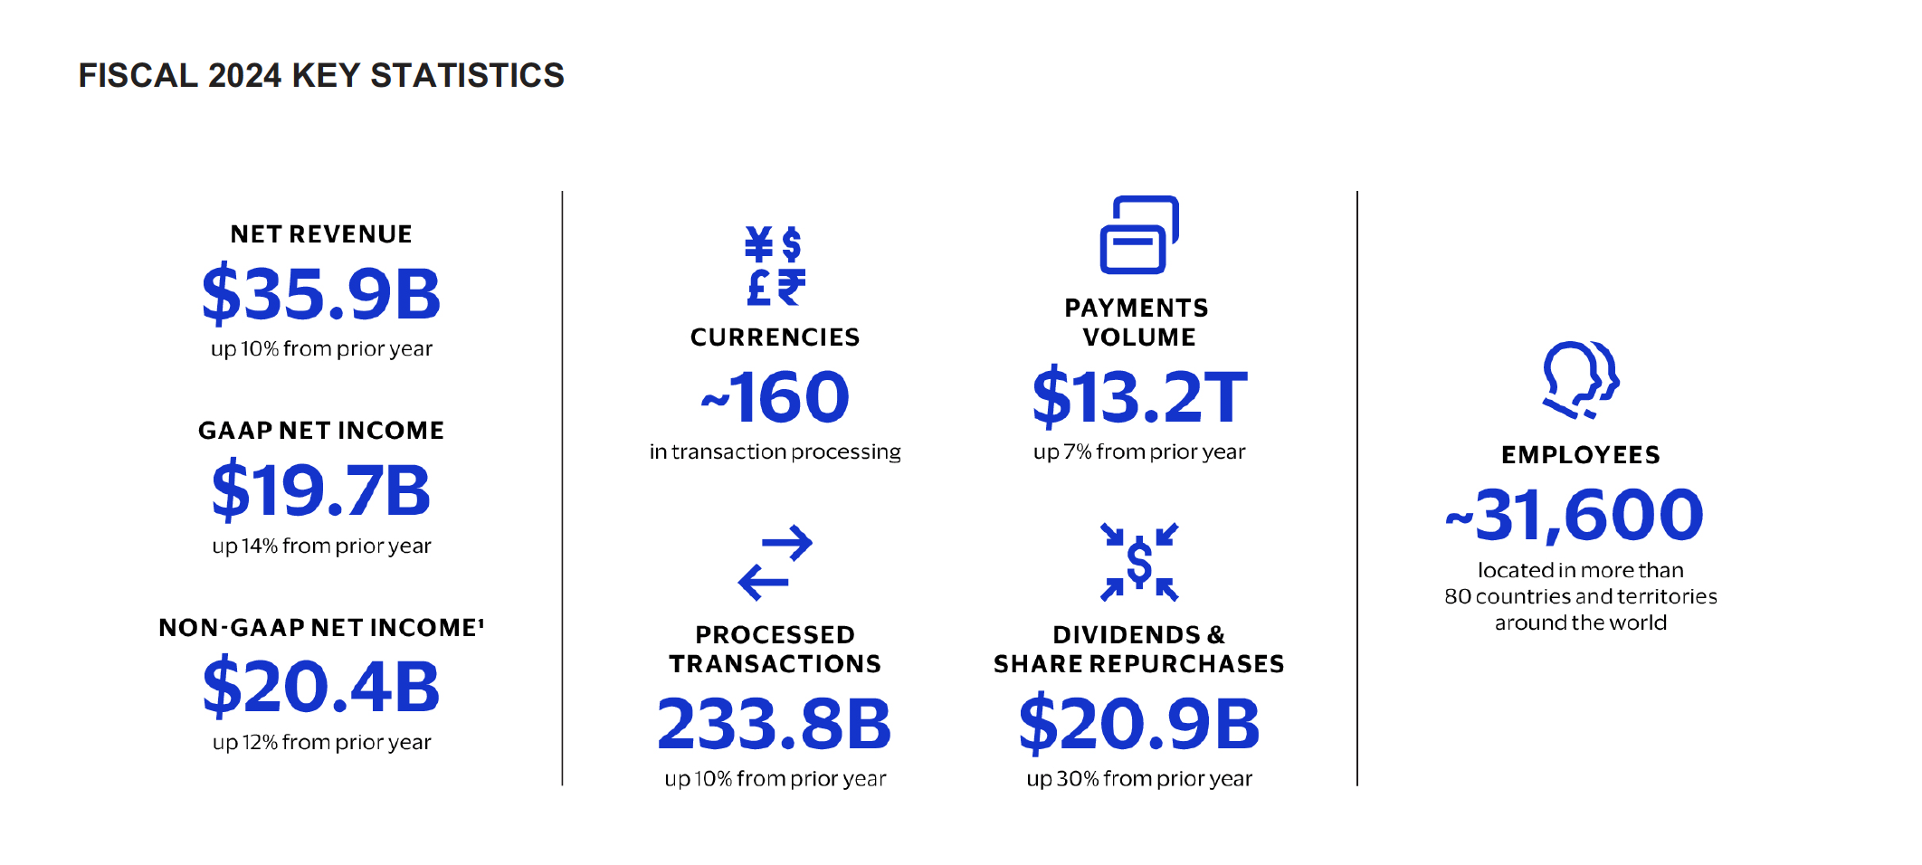

Slide 12
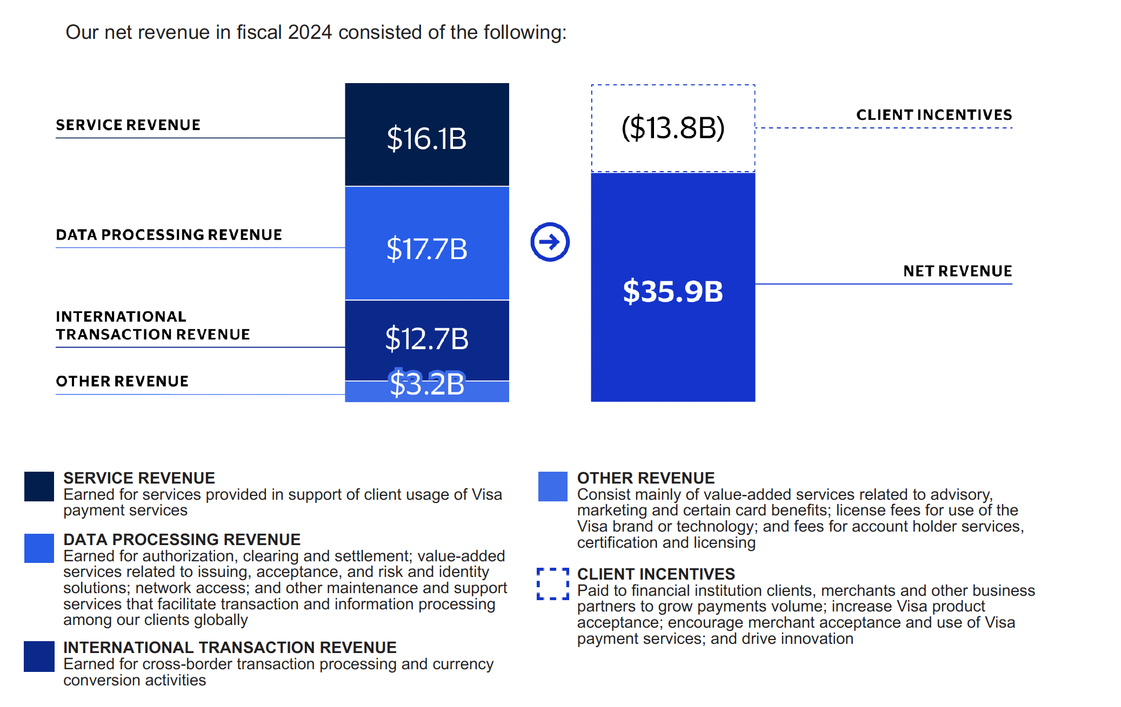
Revenue Breakdown

Slide 13
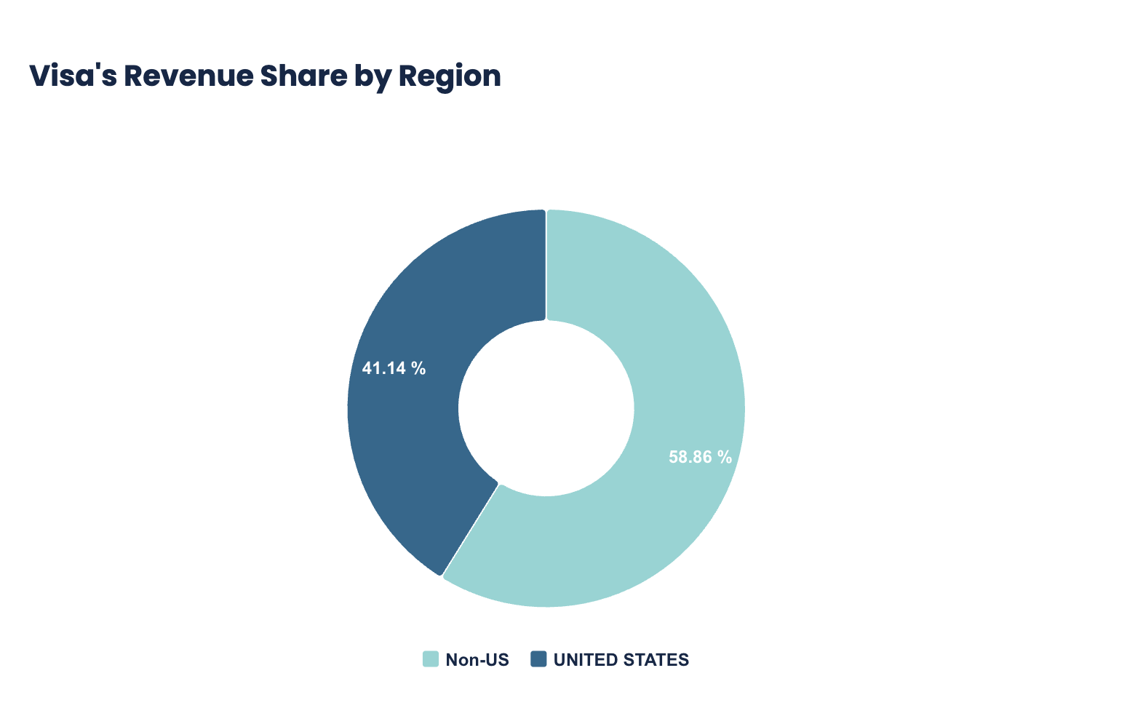

Slide 14
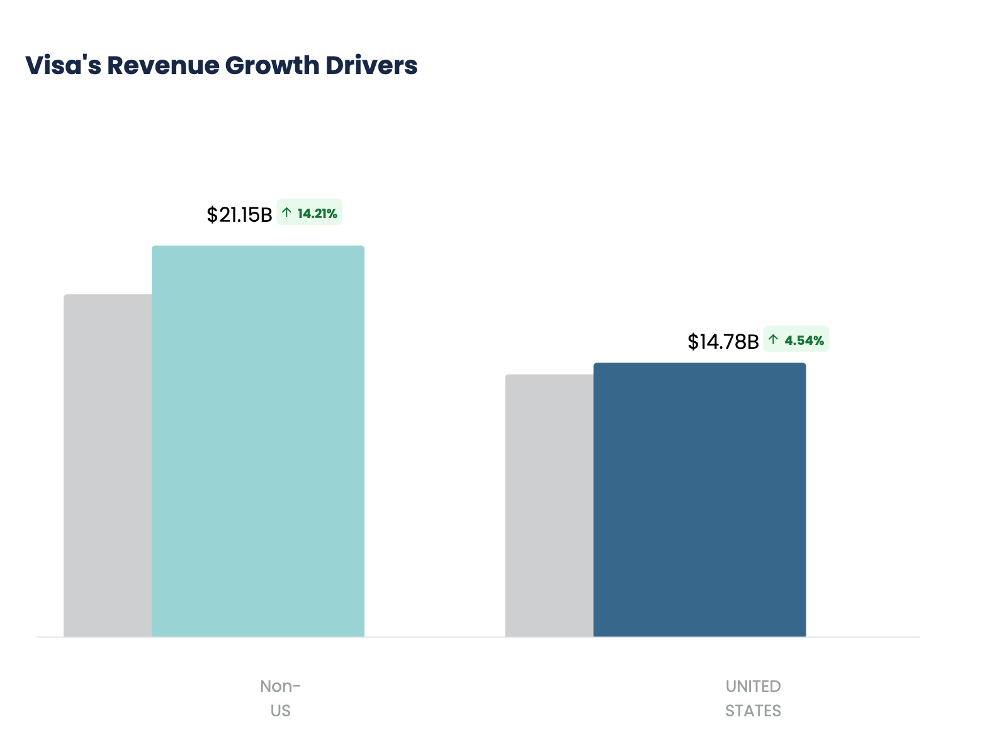

Slide 15
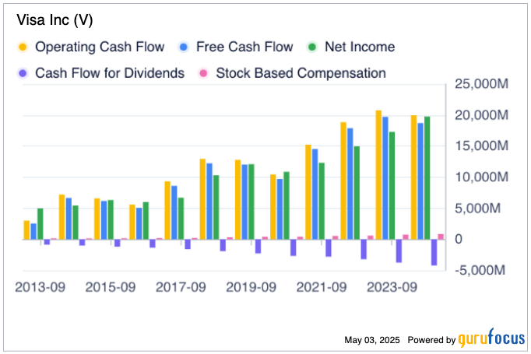

Slide 16
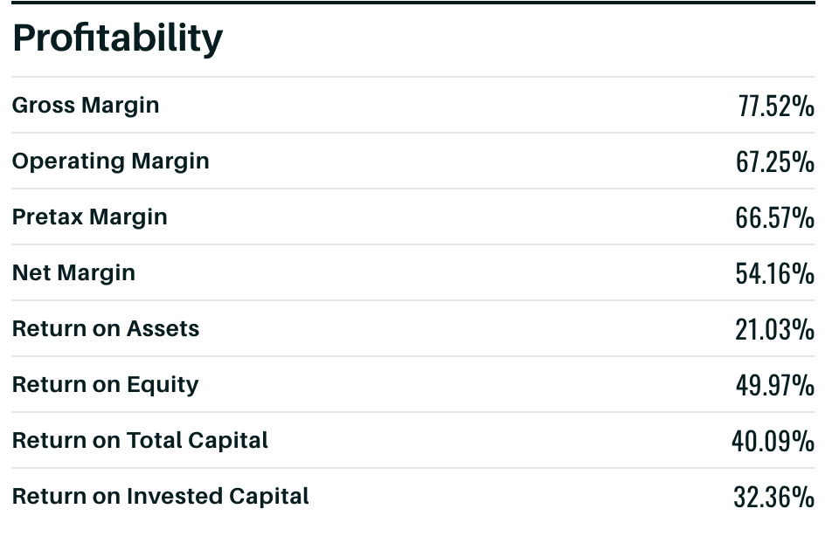

Slide 17
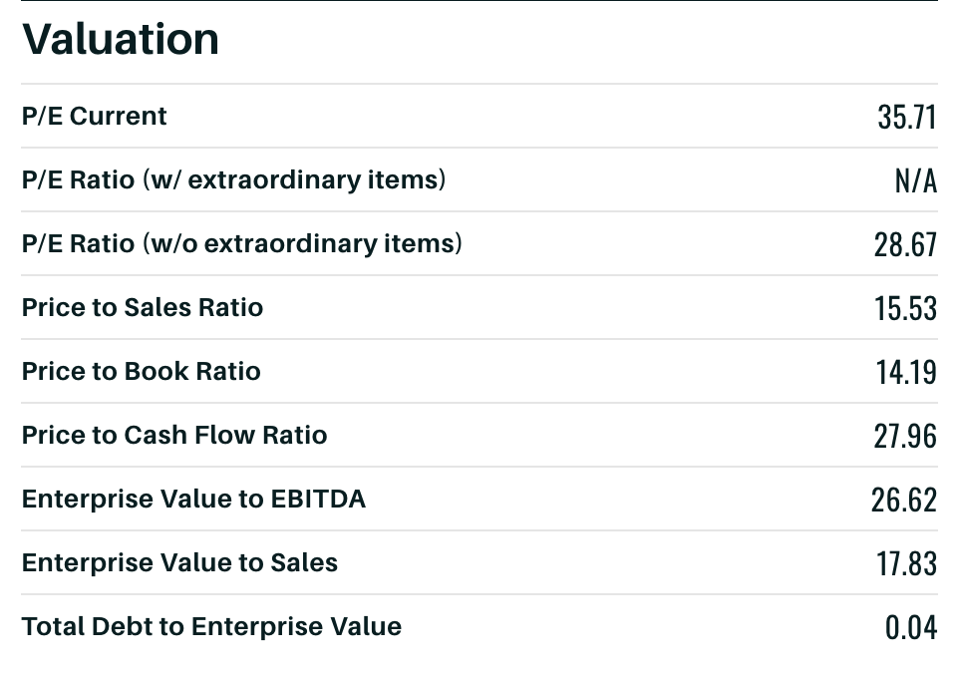

Slide 18
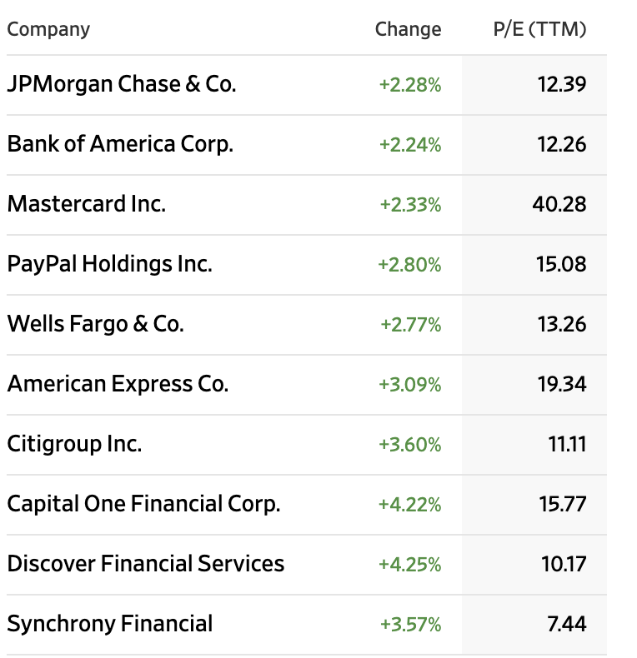
PEER COMPETITORS

Slide 19
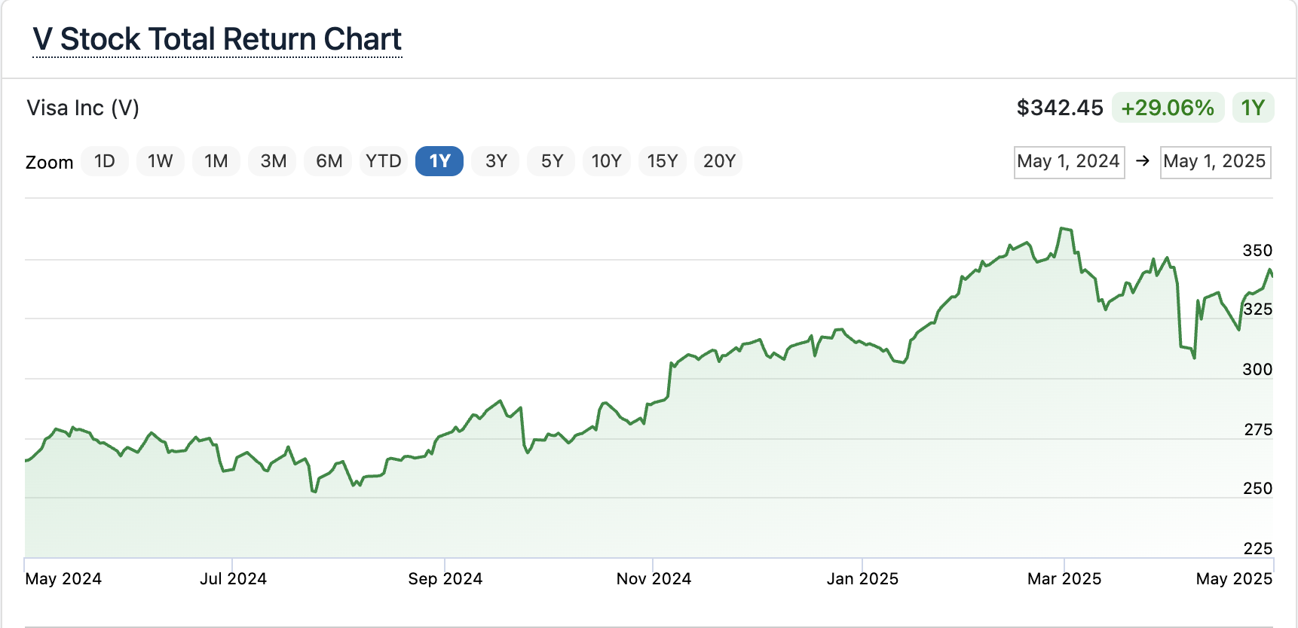

Slide 20
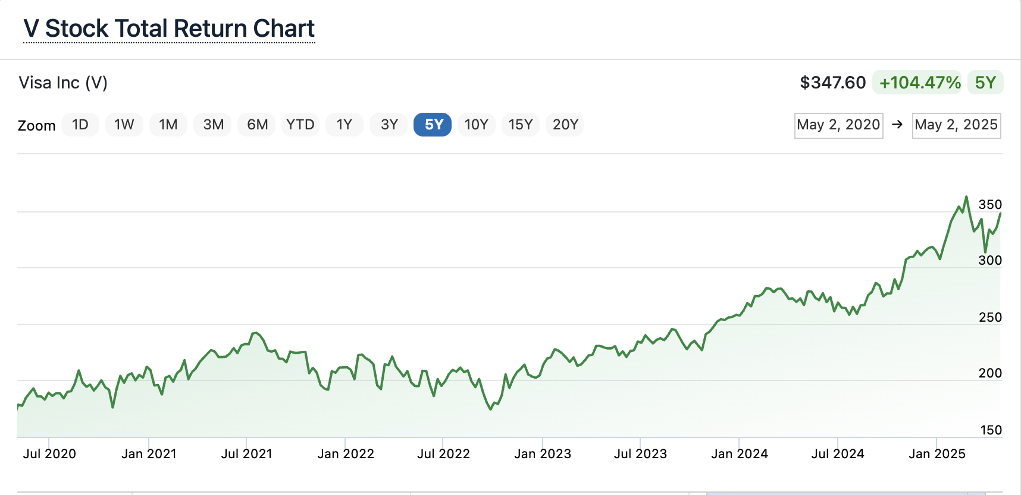

Slide 21
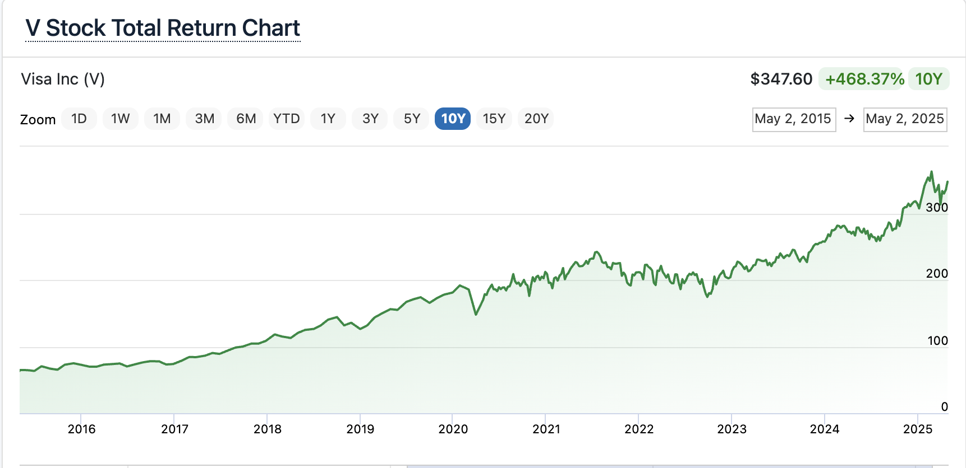

Slide 24
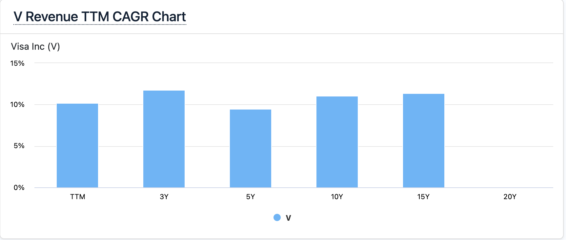
11.77%
11.05%
11.40%
9.51%

Slide 27
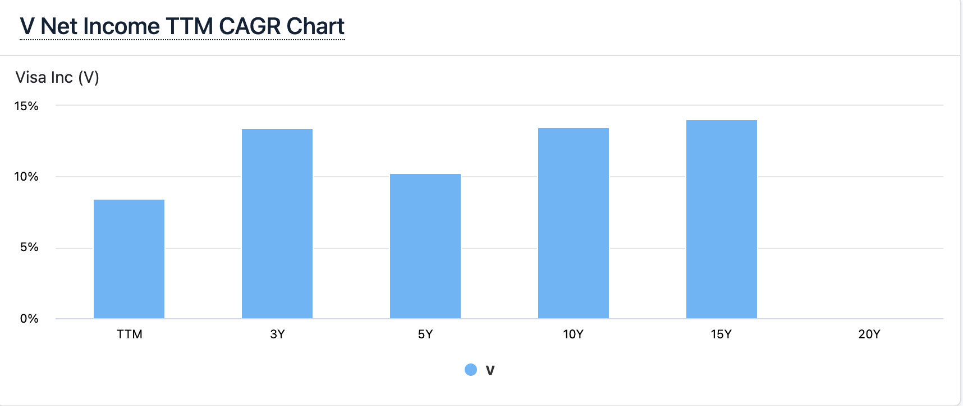
13.49%
14.08%
13.43%
10.29%

Slide 30
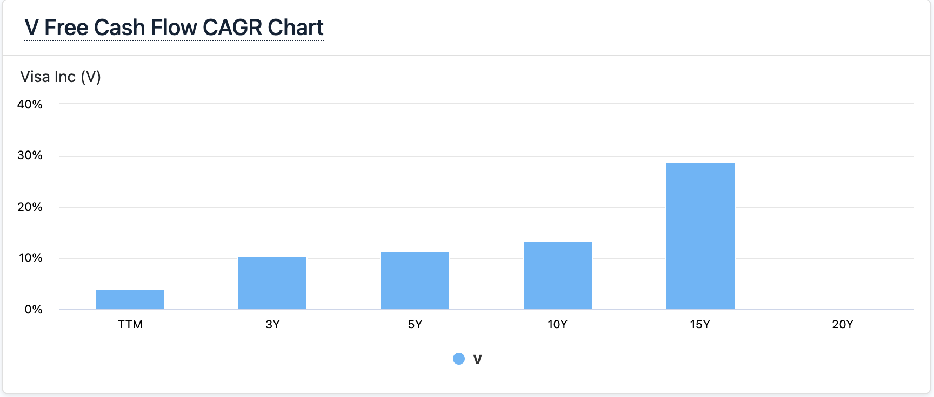
28.58%
11.46%
13.19%
10.30%

Slide 31
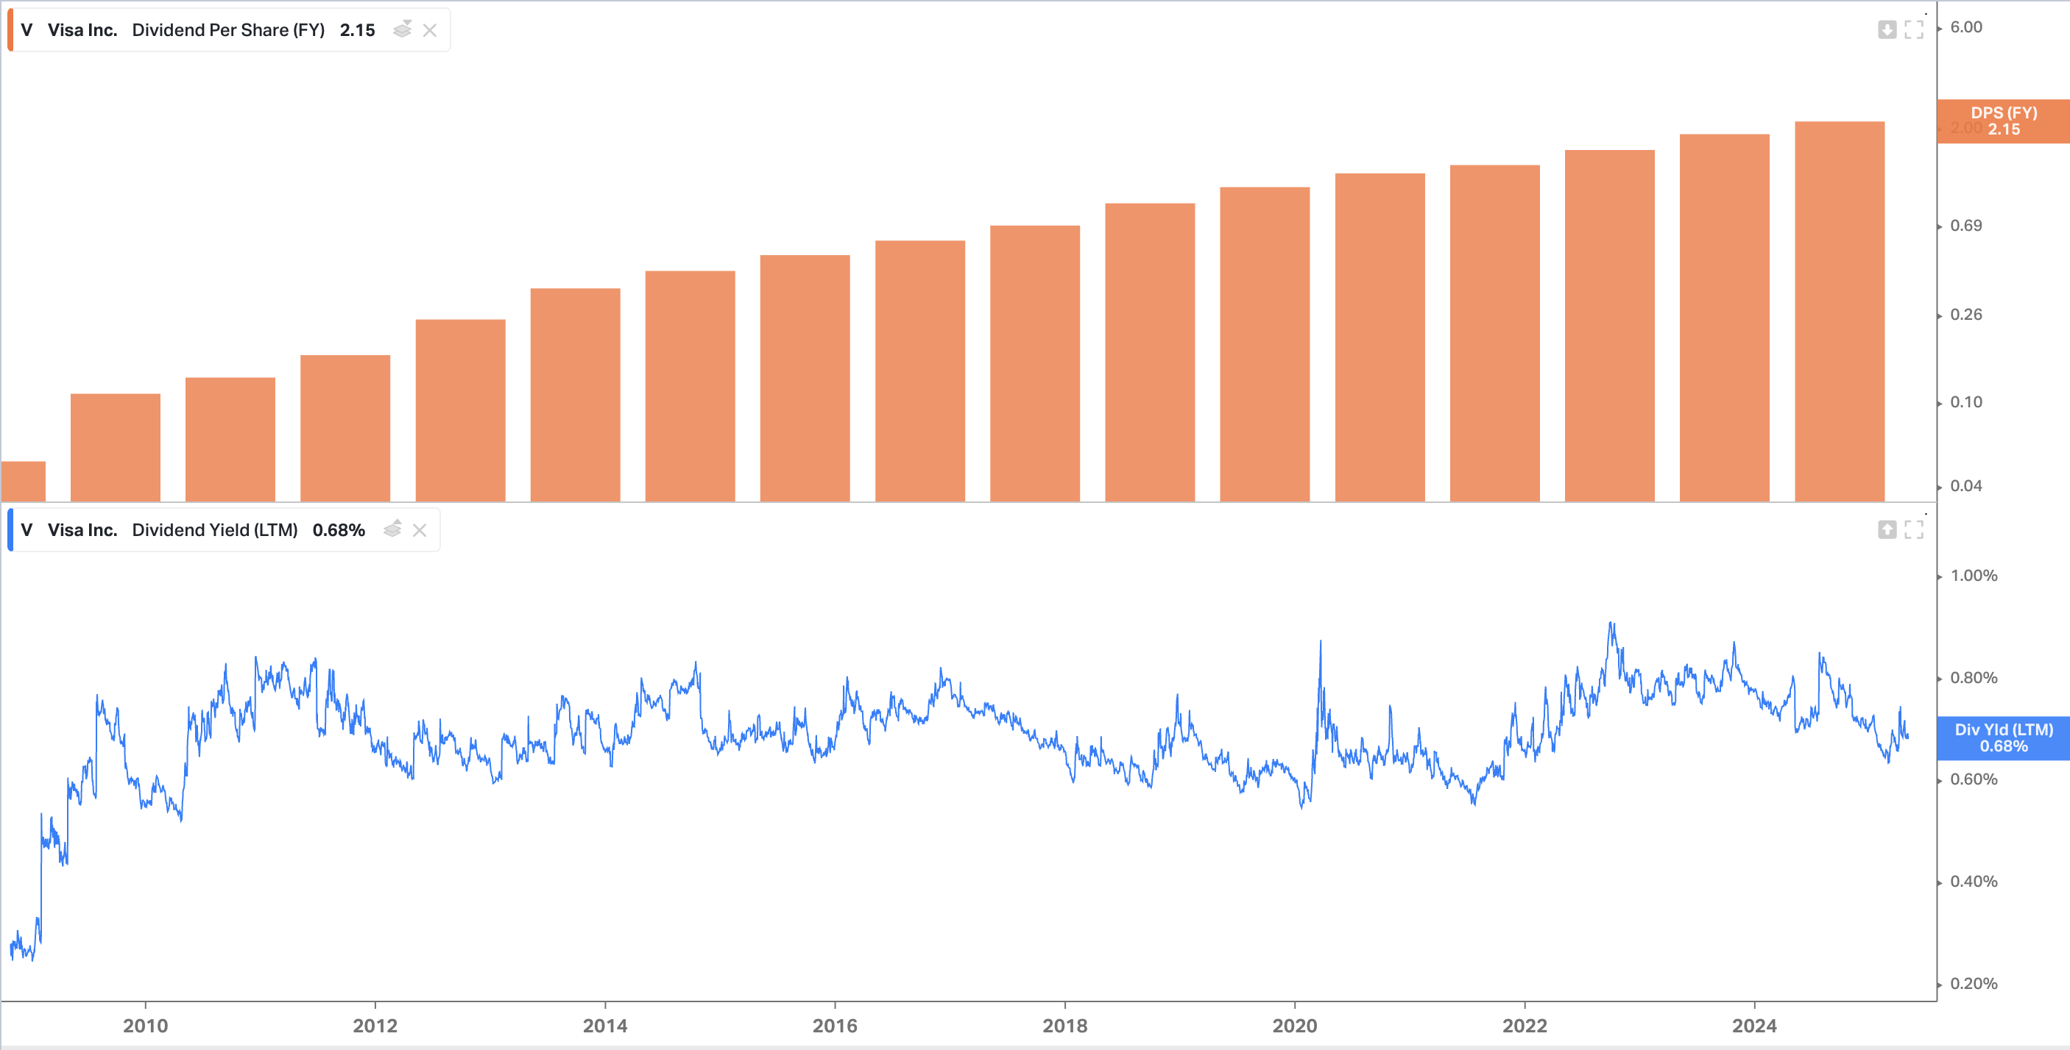

Slide 32
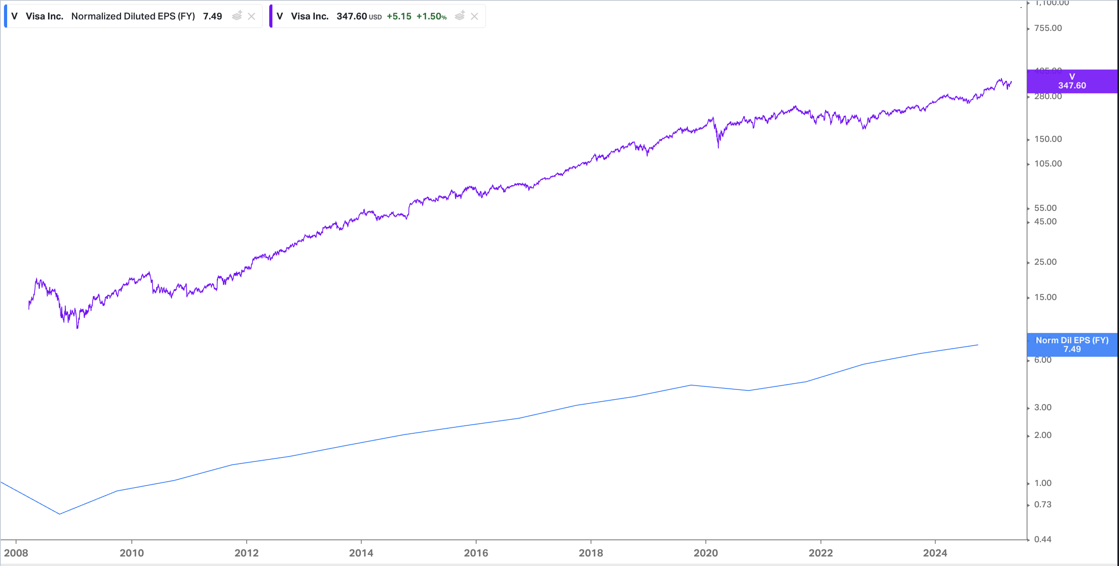

Slide 33
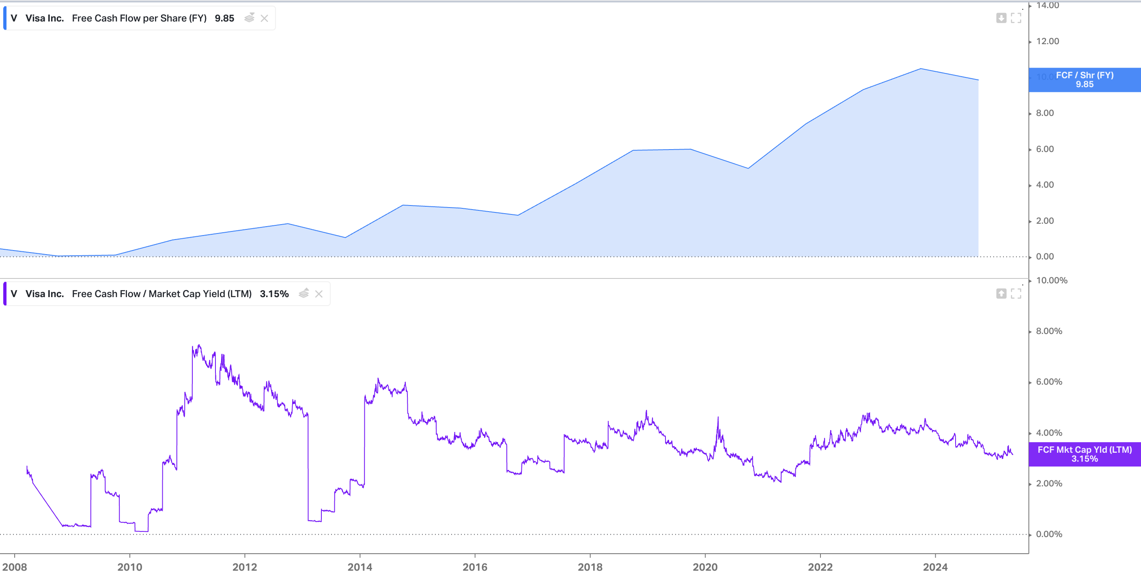

Slide 34
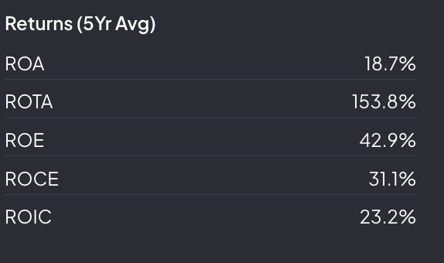

Slide 35
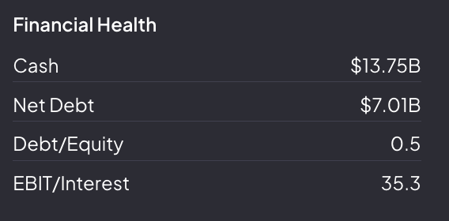

Slide 36
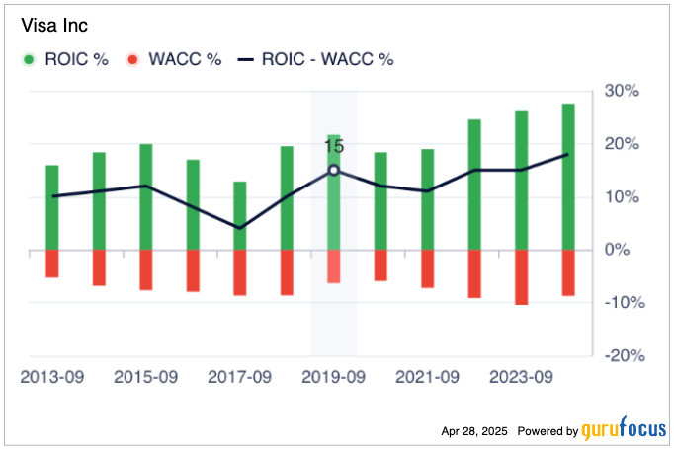

Slide 37
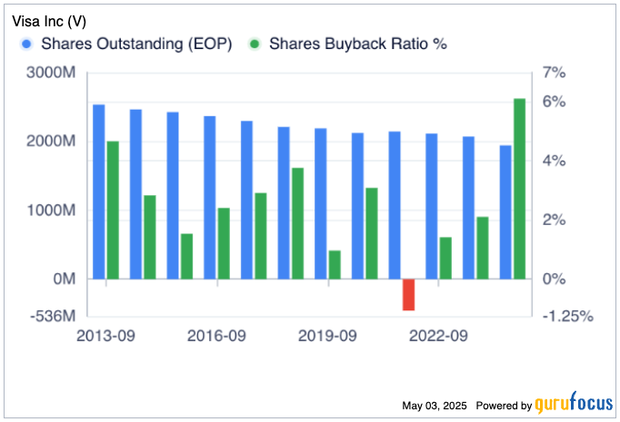

Slide 38
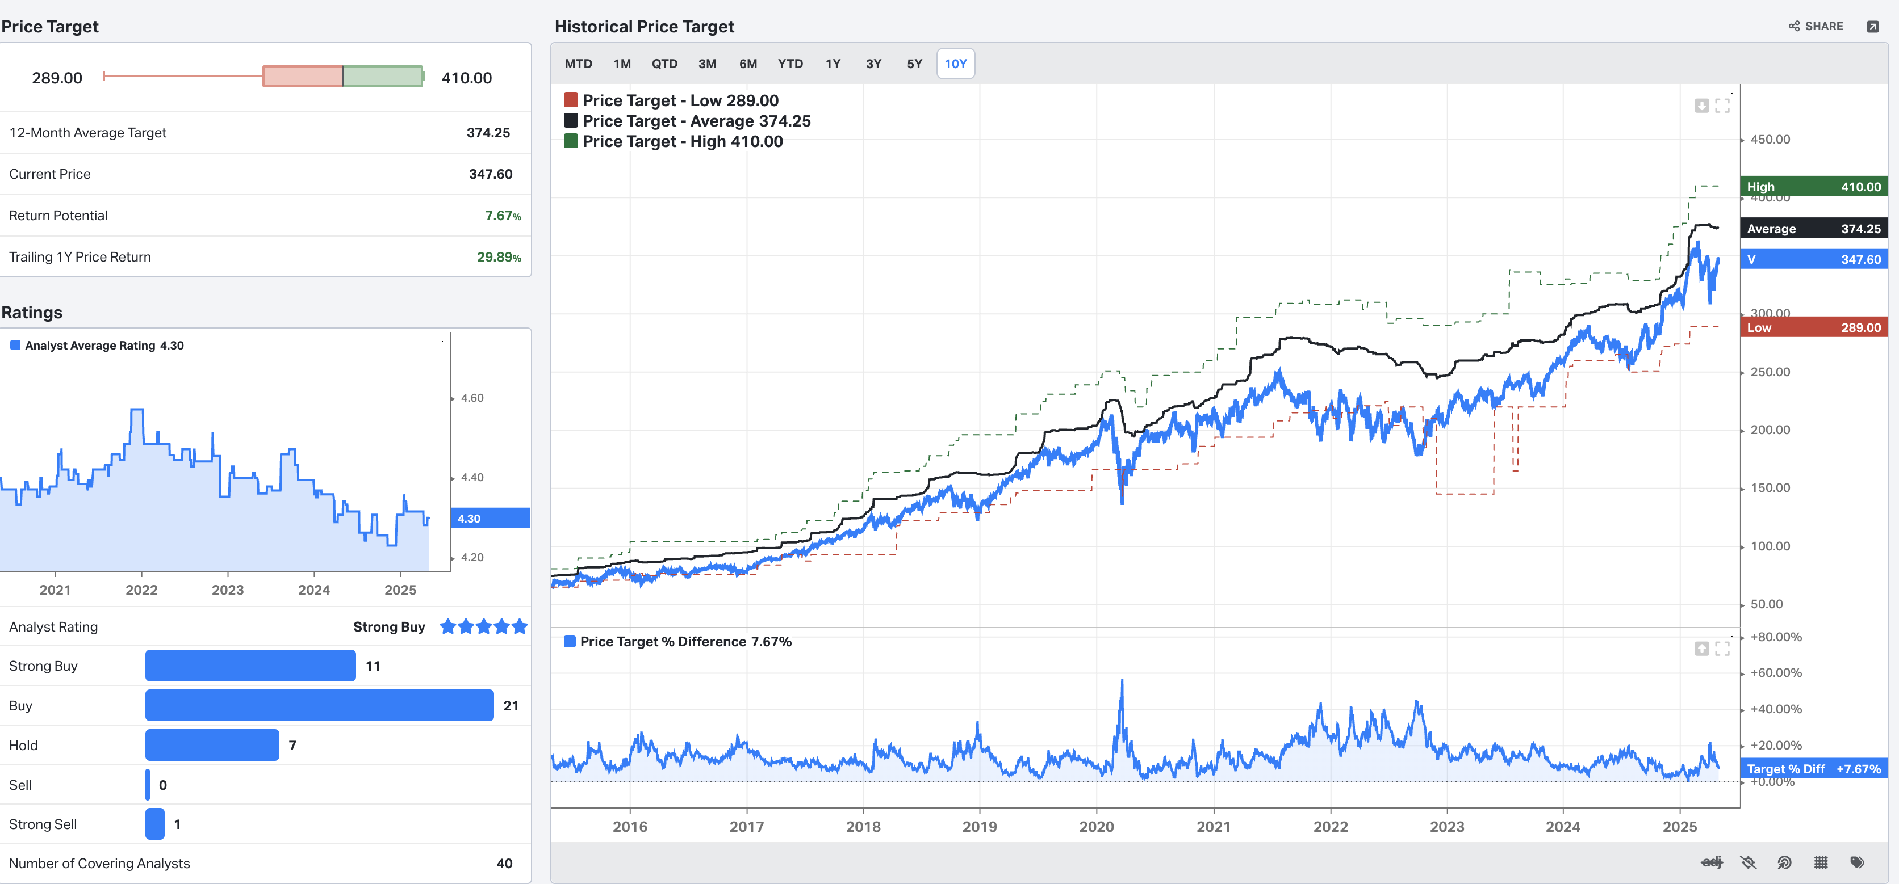

Slide 39
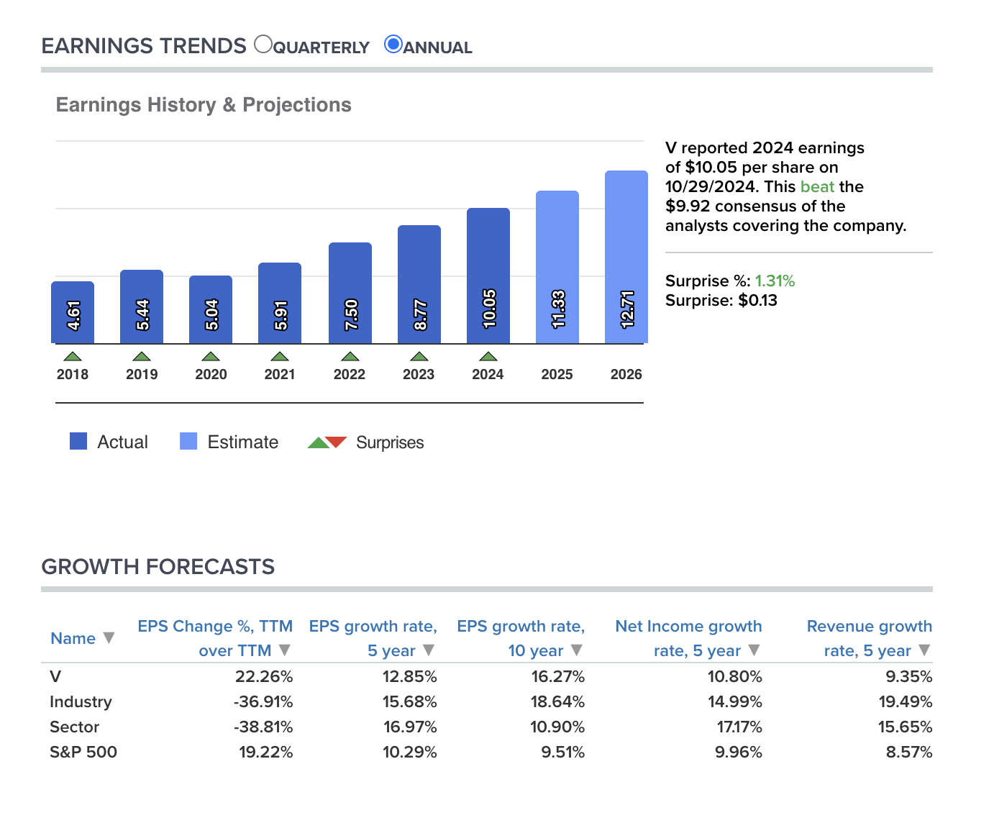

Slide 40
VISA Management Team
Chief Executive Officer: Ryan McInerney has been with Visa since June of 2013 and serves as Chief Executive Officer. Prior to assuming the role of CEO in February 2023, he was President, responsible for Visa’s global business Prior to joining Visa, Mr. McInerney served as Chief Executive Officer of consumer banking for JPMorgan Chase.
Chief Product and Strategy Officer: Jack Forestell joined Visa in 2014. He has served as Group President, Value Added Services and Global Head of Merchant & Acquirer Solutions and Global Head of Products and Solutions. Before joining Visa, Mr. Forestell spent 12 years at Capital One, most recently as Head of Capital One Digital.
Chief Financial Officer: Chris Suh is the Chief Financial Officer at Visa. In his role, he oversees Visa’s financial strategies, planning and reporting, in addition to all finance operations and investor relations. Mr. Suh joined Visa in July 2023 from Electronic Arts, where he served as Chief Financial Officer. From 1996 to 2022, Mr. Suh held senior finance roles at Microsoft, including serving as Chief Financial Officer of the Cloud + AI division from 2018 to 2022, and Head of Investor Relations from 2013 to 2018.
President of Technology: Rajat Taneja is President of Technology for Visa, responsible for the company's technology innovation and investment strategy, product engineering, global IT and operations infrastructure. He joined Visa in November 2013. Prior to joining Visa, Mr. Taneja was Executive Vice President and Chief Technology Officer of Electronic Arts Inc., from October 2011 until November 2013.
Charlotte Hogg is Executive Vice President and Chief Executive Officer for Visa’s European operations. She joined Visa in 2017, bringing with her more than 25 years of experience in financial services, bank operations and management consulting. Prior to joining Visa, Ms. Hogg served as Chief Operating Officer for the Bank of England from 2013 to 2017.

Slide 41
Visa Mergers & Acquisitions
Featurespace Limited
Date: September 2024
Deal Value: Undisclosed
Description: Featurespace is a UK-based behavioral analytics platform specializing in financial crime risk management and anti-money laundering solutions. This acquisition enhances Visa's fraud prevention capabilities.
Prosa (Para Promocion y Operacion S.A. de C.V.)
Date: December 2023
Deal Value: Undisclosed
Description: Prosa is a leading payments processor in Mexico. Visa acquired a majority interest to accelerate the adoption of secure and innovative digital payments in the country.
Pismo
Date: January 2024
Deal Value: $1 billion
Description: Pismo is a Brazil-based cloud-native issuer processing and core banking platform. This acquisition allows Visa to offer core banking and card-issuer processing capabilities across all product types via cloud-native APIs.

Slide 42
Tink AB
Date: March 2022
Deal Value: $2.1 billion
Description: Tink is a Sweden-based open banking platform that enables financial institutions, fintech's, and merchants to develop data-driven financial services. This acquisition enhances Visa’s capabilities in providing open banking solutions.
Currencycloud
Date: July 2021
Deal Value: $963 million
Description: Currencycloud is a UK-based fintech platform that offers solutions such as currency exchange, money transfer, and virtual account management for banks and FX brokers. This acquisition expands Visa's cross-border payment capabilities.
Visa Europe
Date: Jun 2016
Deal Value: €21.2 billion
Description: Visa acquired Visa Europe to integrate its regional operations and strengthen its global network.

Slide 43
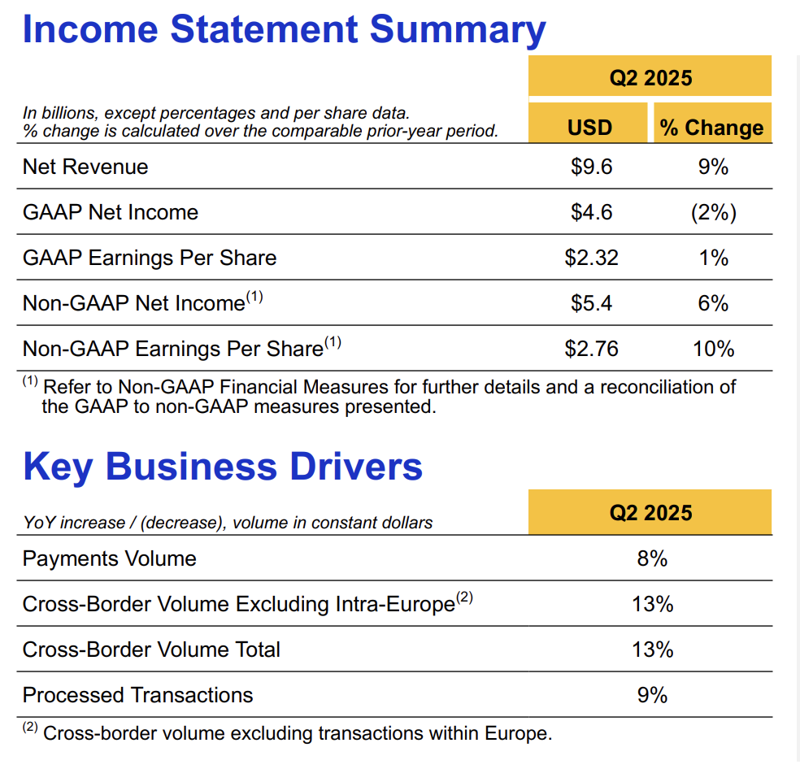
The board of directors authorized a new $30.0B multi-year share repurchase program.
Share repurchases and dividends of $5.6B

Slide 44
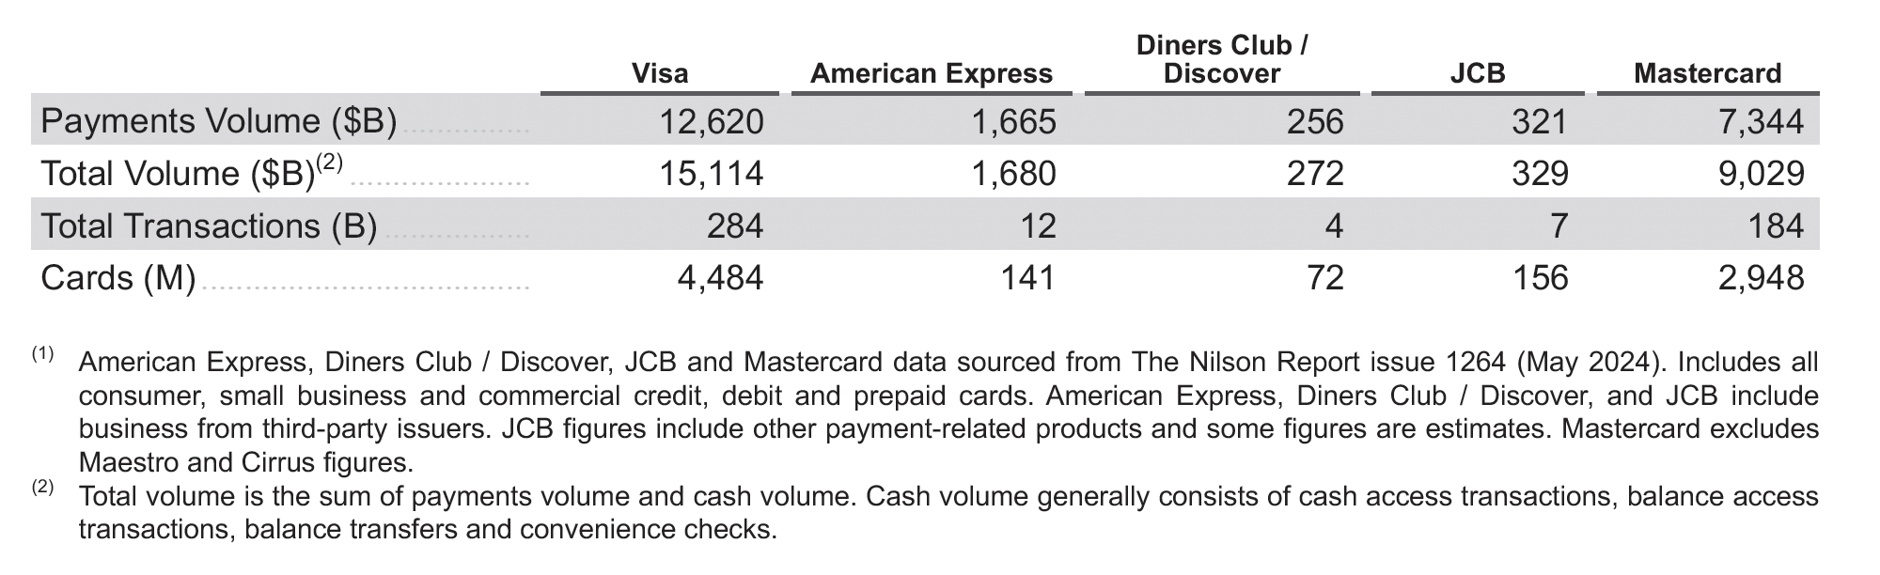
COMPETITION
The global payments industry continues to undergo dynamic and rapid change. Existing and
emerging competitors compete with Visa’s network and payment solutions for consumers and for
participation by financial institutions and merchants. Technology and innovation are shifting consumer
habits and driving growth opportunities in ecommerce, mobile payments, blockchain technology and
digital currencies. These advances are enabling new entrants, many of which depart from
traditional network payment models.
Global or Multi-regional Networks: These networks typically offer a range of branded, general
purpose card payment products that consumers can use at millions of merchant locations around the
world. Examples include American Express, Diners Club/Discover, JCB, Mastercard and
UnionPay. These competitors may be more concentrated in specific geographic regions, such as
Discover in the U.S.,JCB in Japan and UnionPay in China.

Slide 45
RTP Networks: RTP networks have launched in at least 80 countries and continue to be driven by strong
government sponsorship and regulatory initiatives to enable and drive adoption (e.g., FedNow in the U.S., PIX
in Brazil and United Payments Interface (UPI) in India), increasing their position as an alternative to payment
card schemes. These networks primarily focus on domestic transactions, with adoption varying by use cases
and geographies. However, with linkages such as PayNow in Singapore and UPI in India, cross-border RTP
networks are advancing and will compete with our cross-border business. RTP networks can compete with Visa
on consumer payments and other payment flows (e.g., B2B and P2P) but can also be customers for value-added
services, such as risk management.
Alternative Payments Providers: These providers, such as closed commerce ecosystems, BNPL solutions and
cryptocurrency platforms, often have a primary focus of enabling payments through ecommerce and mobile
Channels.
Central Bank Digital Currencies:. The Bahamas was the first country to launch a nationwide Central Bank Digital
Currency (CBDC), named the Sand Dollar, in 2020. Following this, Nigeria also rolled out its eNaira in the same year. In
April 2020, China became the first major economy to pilot its digital currency, the e-CNY or Digital Yuan. India has
introduced the e-Rupee. The digital currency was initially rolled out in phases, with pilot projects for wholesale and
retail use in 2022 and 2023.

Slide 46
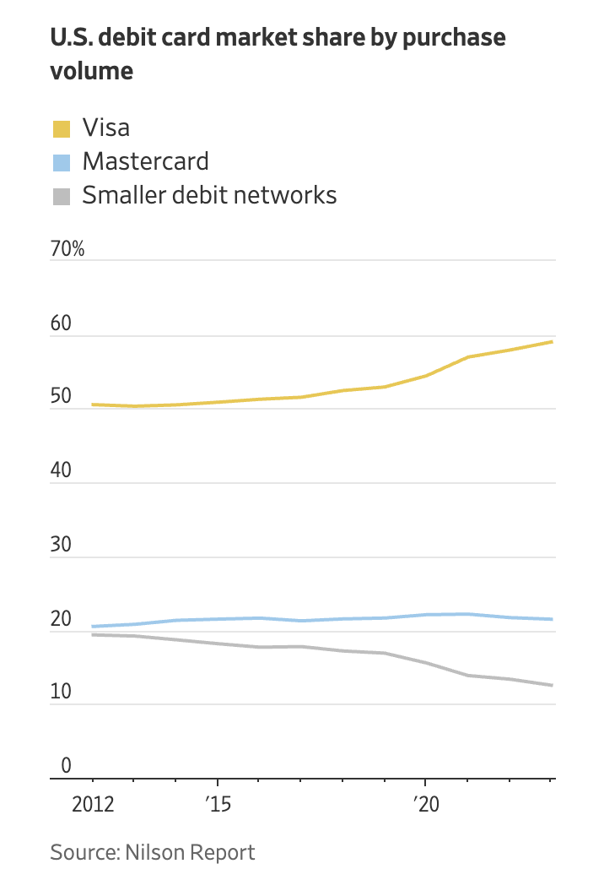
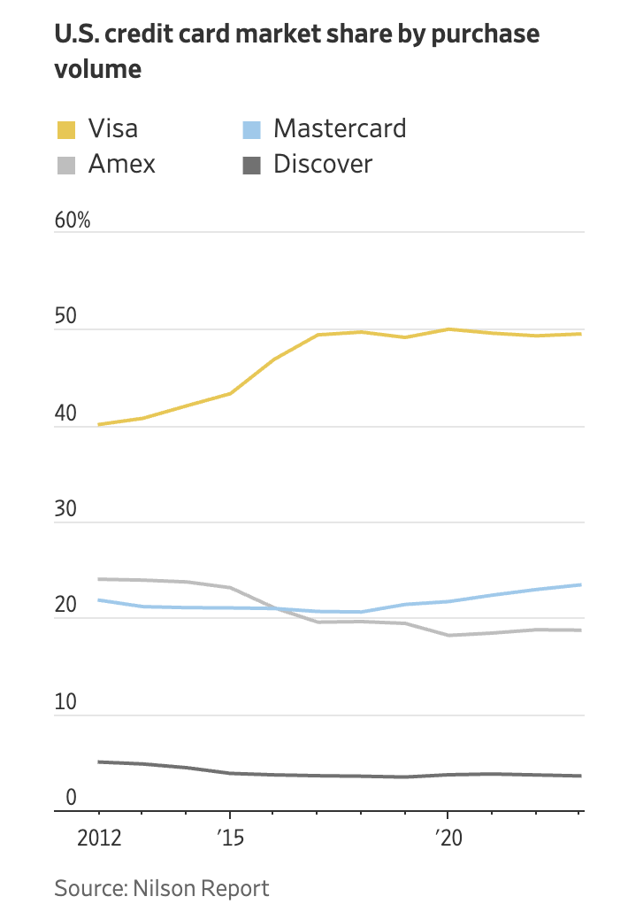

Slide 47
The Payment Card Landscape
There were 17.45 billion credit, debit, and prepaid cards in circulation worldwide as of the end of 2023.
UnionPay cards made up 56% of total cards, Visa composed 25%, Mastercard made up 17%, and American Express held slightly less than 1%. Discover comprised less than half a percent.
Global purchase volume by credit card brand in 2023:
UnionPay credit: $6.9 trillion, 35%
Visa credit: $6.3 trillion, 32%
Mastercard credit: $4 trillion, 21%
American Express credit: $1.7 trillion, 9%
JCB credit: $320 billion, 2%
Discover credit: $256 billion, 1%

Slide 48
Risks
Regulatory Pressure and Antitrust Risk
Visa operates in a heavily scrutinized industry. Governments and regulators across the globe have shown increasing hostility toward perceived monopolistic behavior in the payment's ecosystem. Key risks include:
Fee caps and interchange regulation: Proposed legislation in the U.S. (e.g., the Credit Card Competition Act) could force Visa to allow competing networks on its cards, potentially lowering its interchange revenue and diminishing its competitive moat.
European regulation: The EU has historically capped interchange fees and may further restrict Visa's pricing power, particularly for cross-border transactions.
Antitrust scrutiny: Visa’s dominant market share in credit card processing makes it a target for antitrust litigation and regulatory action, especially as governments focus more on digital competition.

Slide 49
Threat of Disruption from Fintech and Real-Time Payments
Visa’s traditional model of charging fees for routing card transactions faces long-term existential risk from:
Fintech disruptors (e.g., Block, Stripe, Adyen): These platforms are building merchant ecosystems that bypass legacy card rails or minimize card usage.
Real-time payment networks (e.g., FedNow, UPI in India): Governments are promoting cheaper, faster alternatives that could erode Visa’s value proposition, especially in emerging markets.
Decentralized finance (DeFi): Although nascent, blockchain-based payment protocols could disintermediate Visa over time, especially for international and peer-to-peer transfers.
Dependency on Consumer Spending and Economic Cyclicality
Visa’s revenues are closely tied to transaction volumes, particularly discretionary consumer spending. In a slowing macro environment:
Recession or stagflation scenarios could reduce spending volumes.
Higher interest rates and household debt could pressure consumers to reduce credit usage.
A shift from credit to debit—often seen in downturns—may erode Visa’s more lucrative credit card revenue streams.

Slide 50
Slower International Growth and FX Headwinds
While international markets have historically been a growth driver, Visa faces several challenges abroad:
Currency volatility and FX translation risks may weigh on earnings reported in USD.
In some regions (e.g., China), local competitors like UnionPay are favored by governments, limiting Visa’s expansion.
Emerging markets are increasingly adopting alternative payment methods, including digital wallets, QR code systems, and government-backed platforms that may marginalize Visa.
Valuation Risk
Visa trades at a premium multiple relative to the broader market and even many fintech peers. Risks include:
Multiple compression: In a rising rate or risk-off environment, high-multiple stocks often underperform.
Growth expectations baked into current valuations may not materialize** if any of the above headwinds intensify.
Investors may rotate toward newer, high-growth fintech platforms with greater perceived upside.

Slide 51
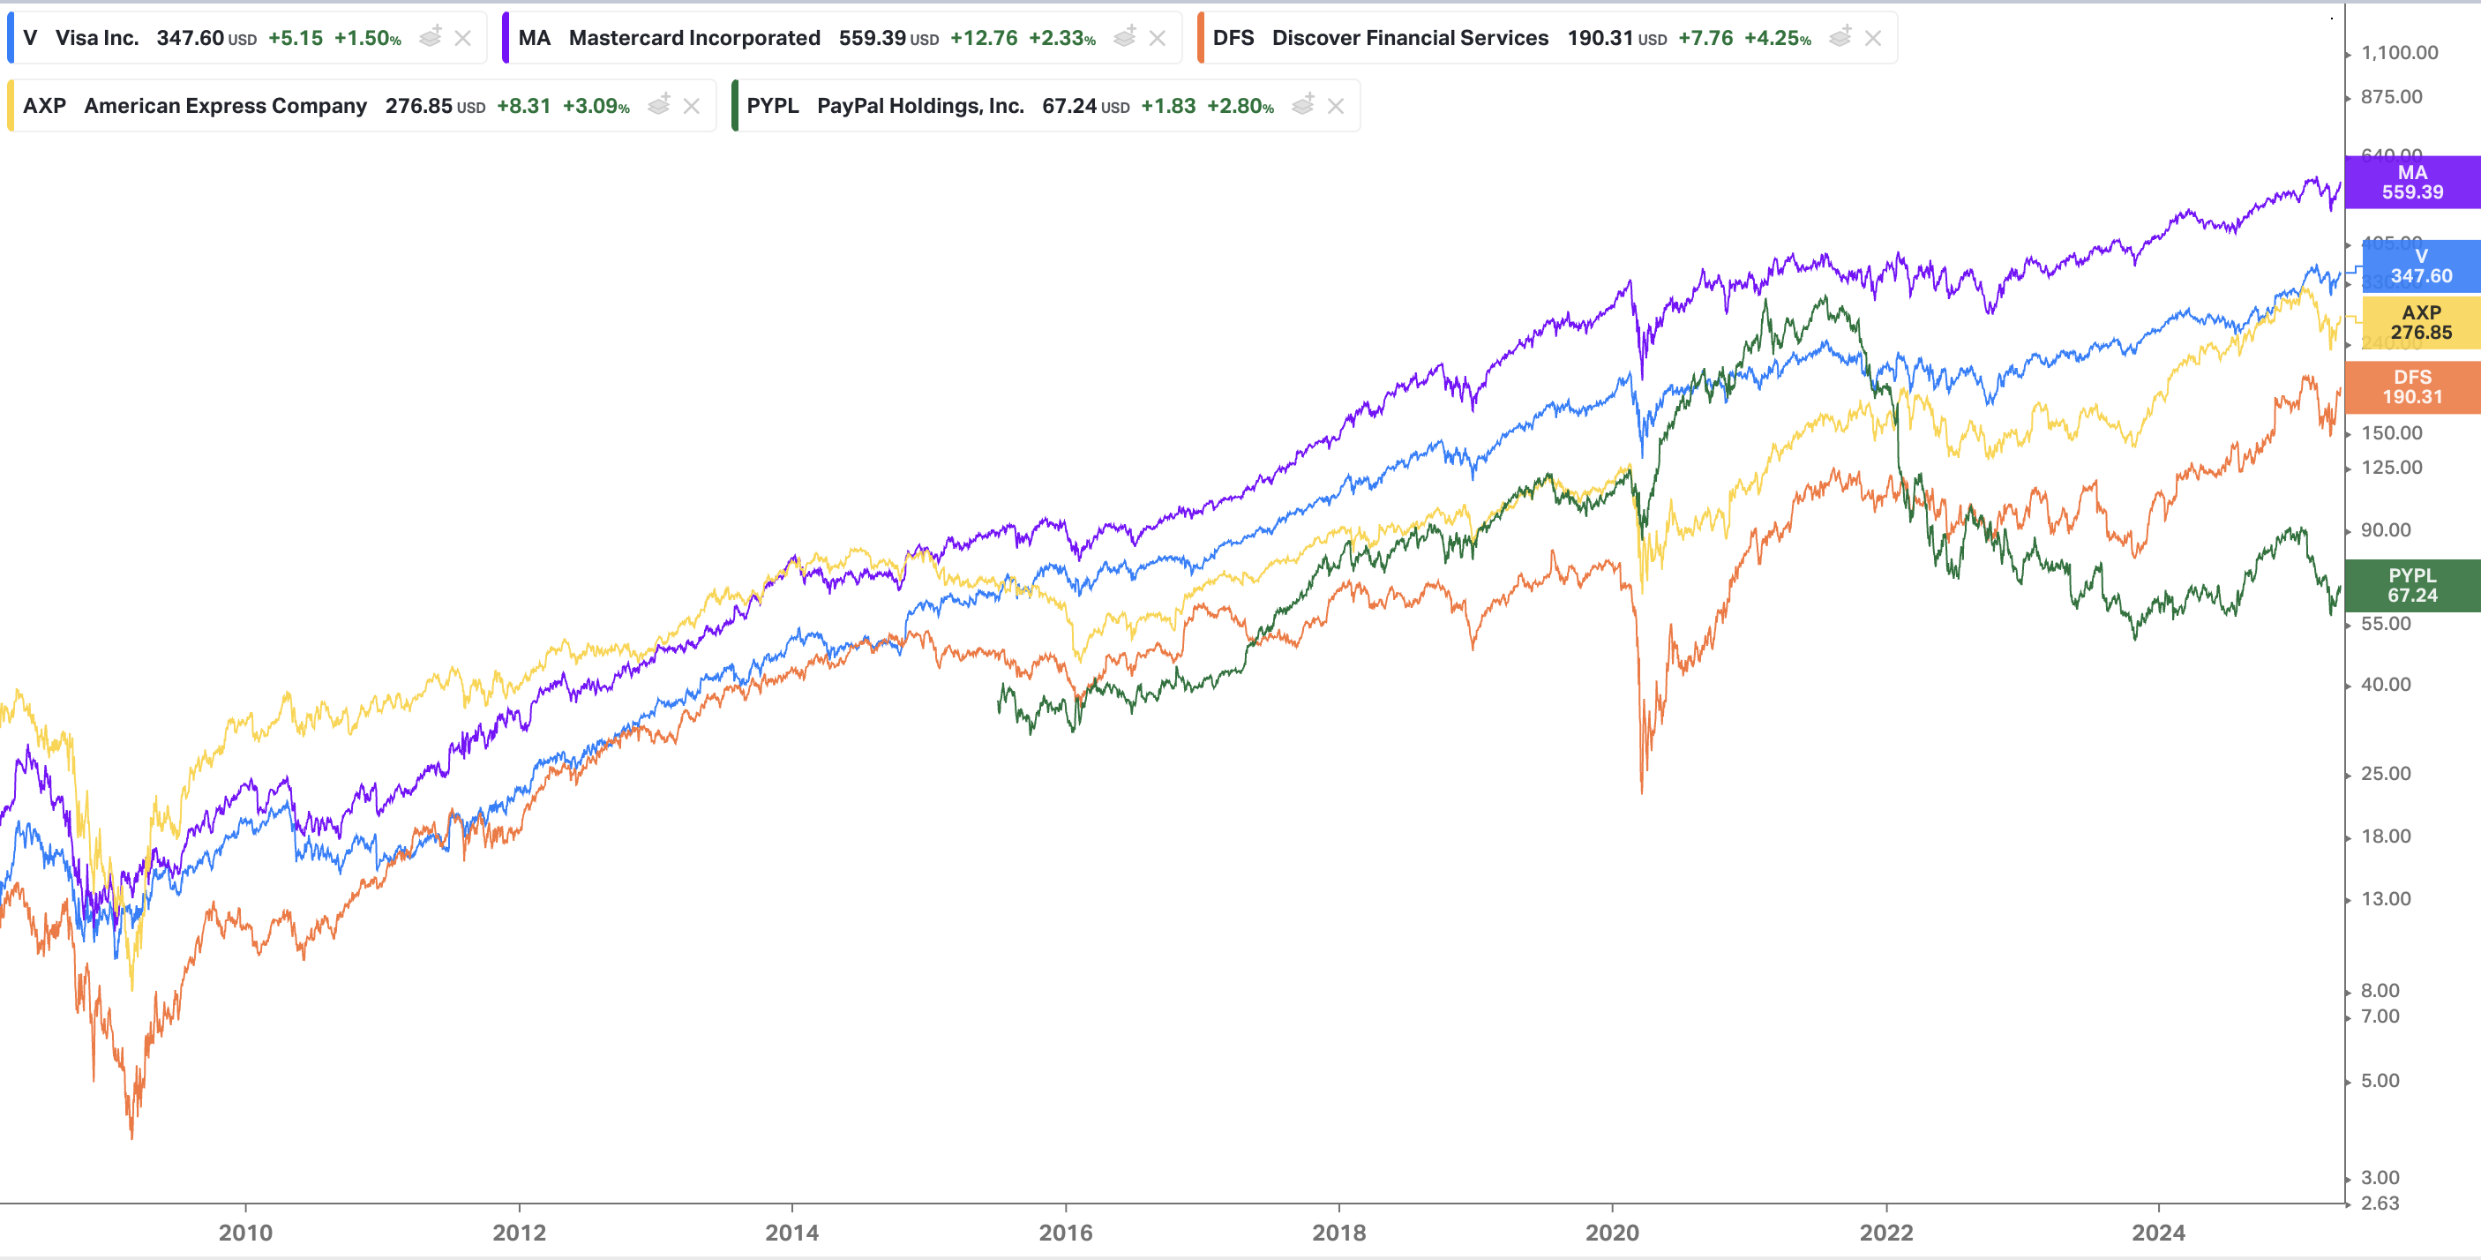

Slide 52
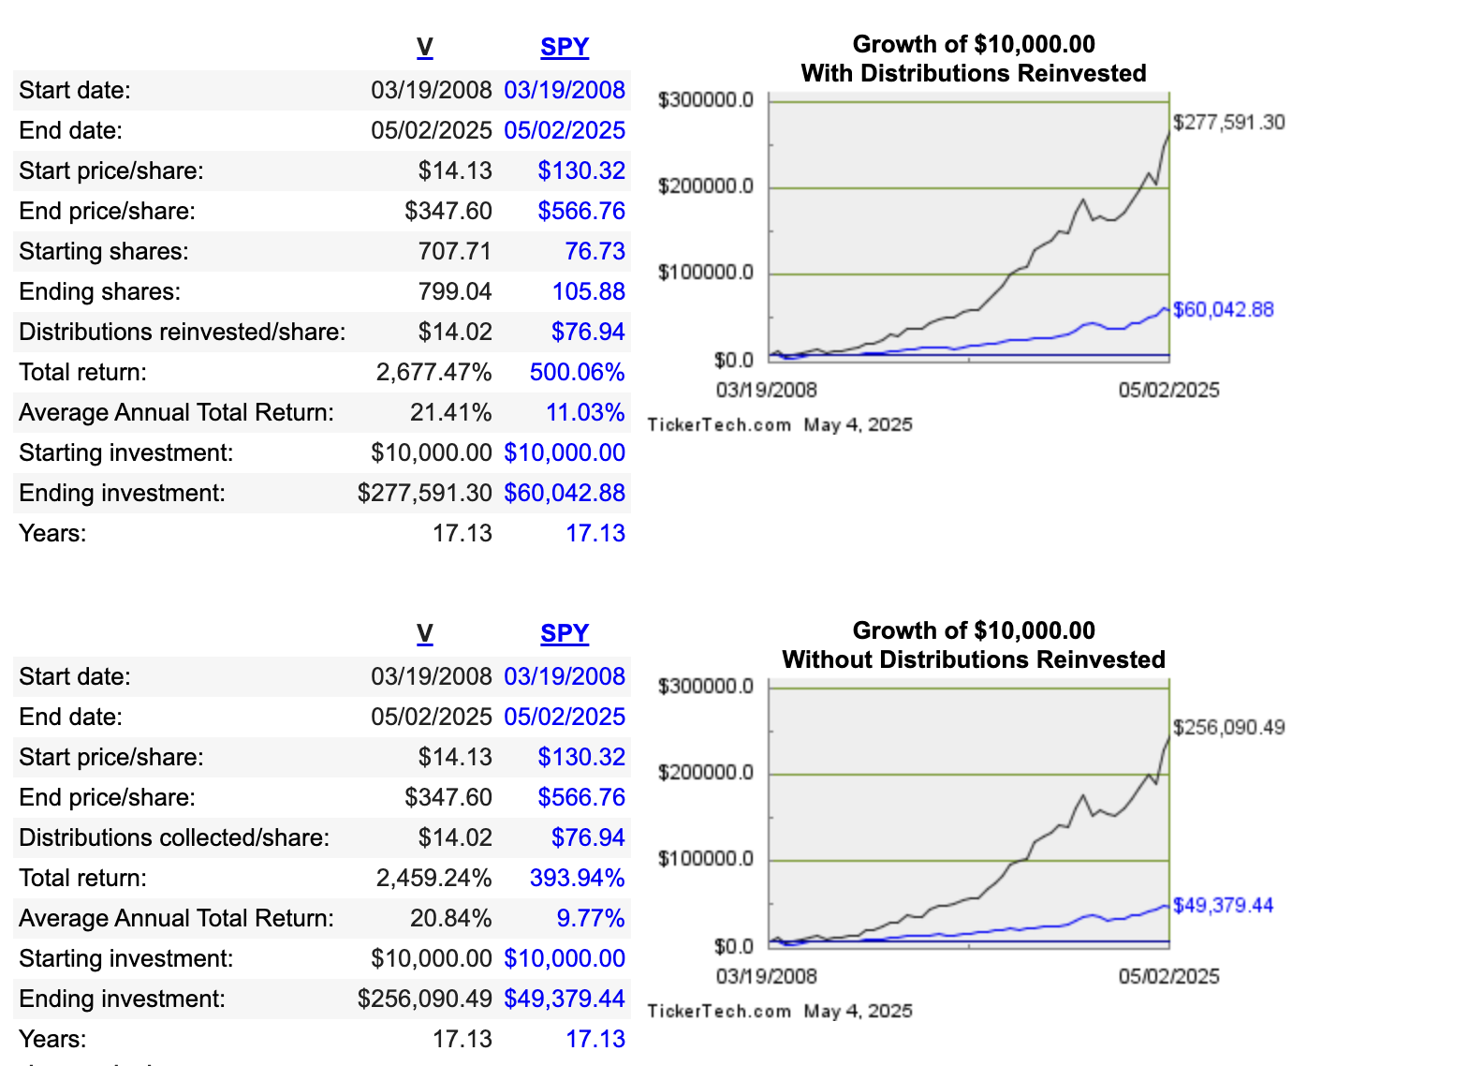

Slide 53
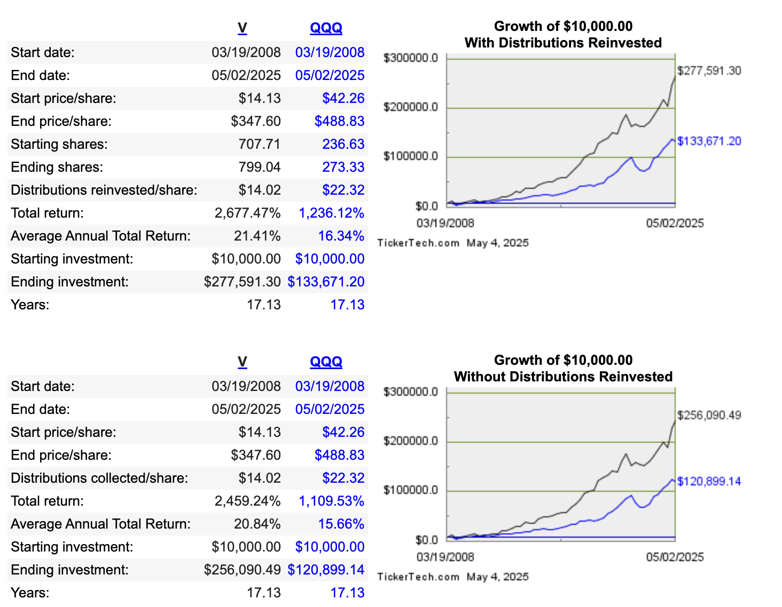

Slide 54
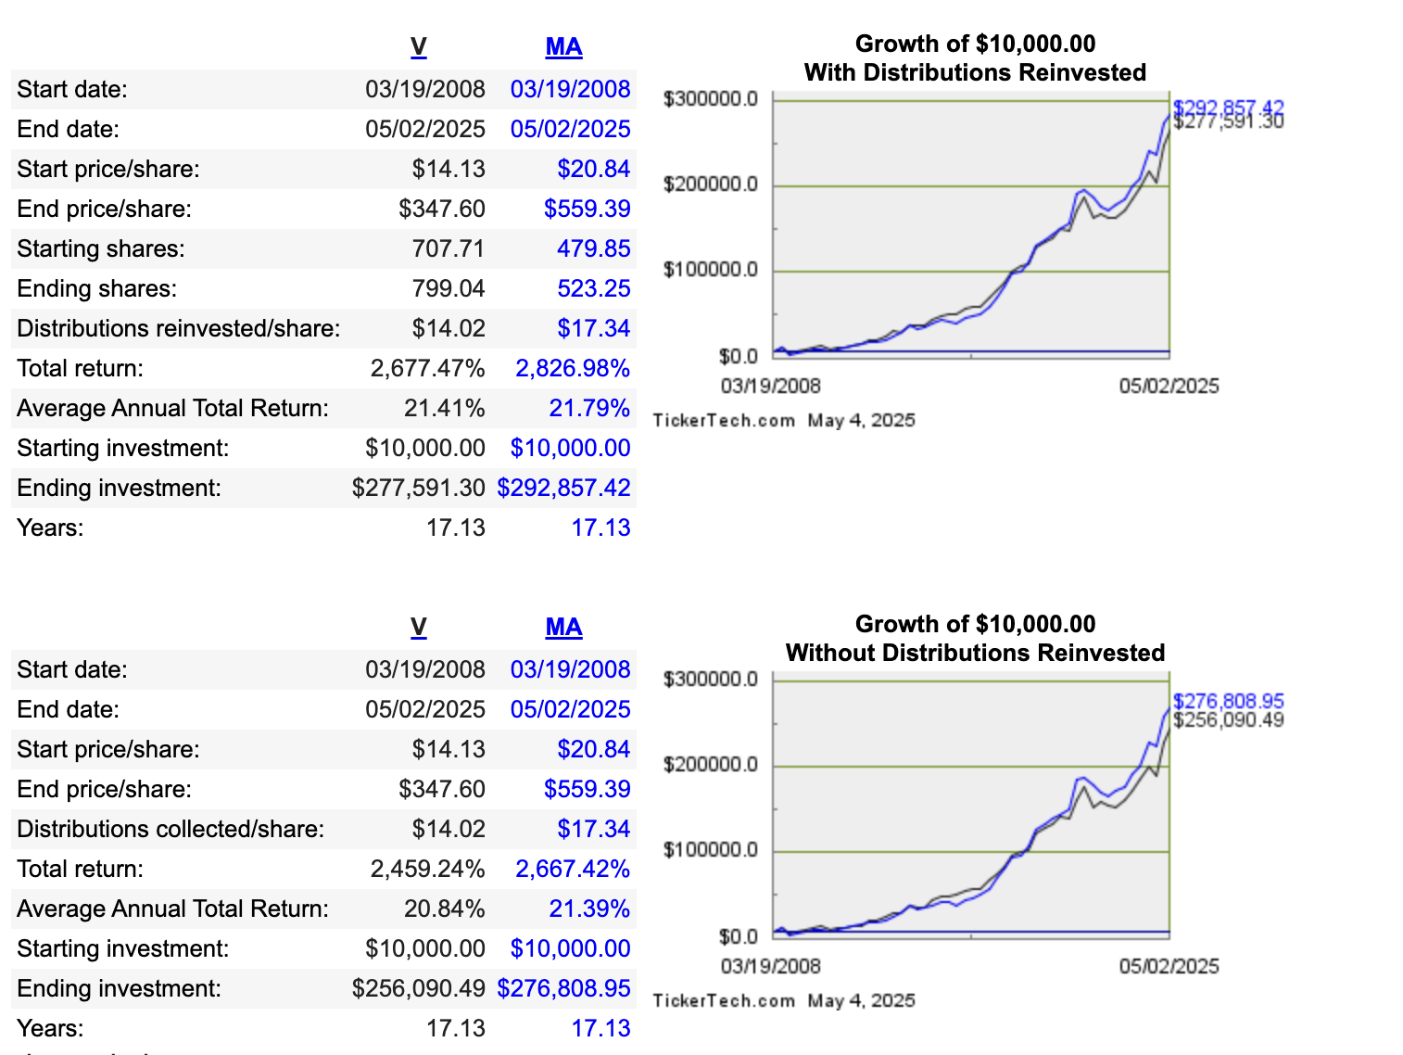

Slide 55
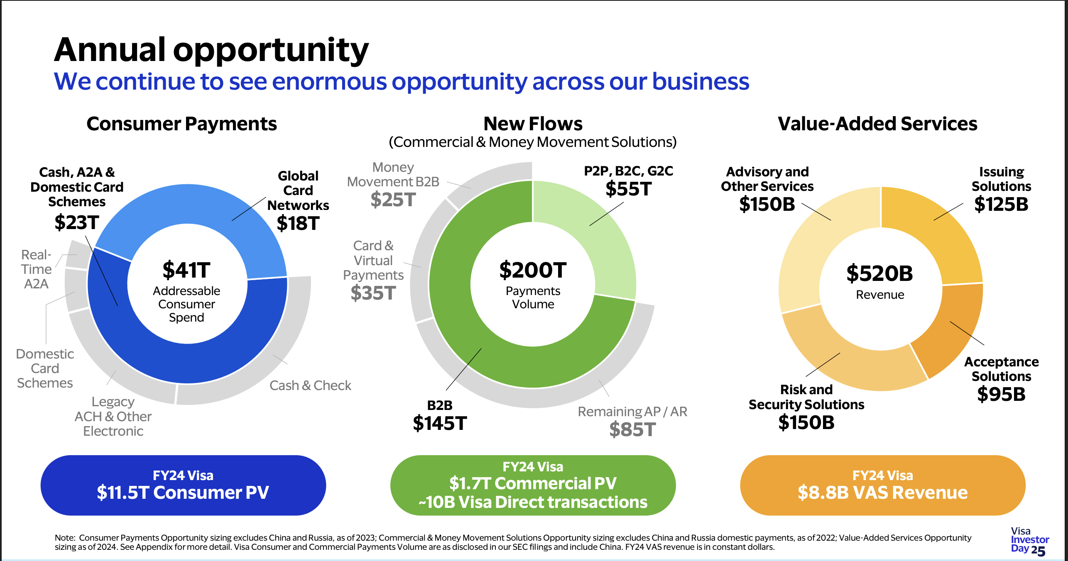

Slide 56
THESIS SUMMARY
Global Leader in Payment Processing
Visa operates the world’s largest electronic payment network, facilitating over $14 trillion in annual payment volume. Its unmatched scale, brand strength, and global reach form a powerful moat that is difficult for competitors to breach.
Highly Scalable and Profitable Business Model
Visa doesn’t take on credit risk but earns fees on payment volume, making its model capital-light and highly scalable. This results in exceptional operating margins (60%+) and strong free cash flow, fueling reinvestment and shareholder returns.
Tailwinds from Cash-to-Digital Shift
Visa is a direct beneficiary of the multi-decade trend away from cash toward digital payments, driven by e-commerce growth, mobile wallets, financial inclusion, and rising consumer spending. These tailwinds support long-term volume and revenue expansion.
Strategic Expansion Beyond Cards
Visa is aggressively expanding into new areas—real-time payments (Visa Direct), B2B payments, fintech partnerships, open banking, and digital identity—broadening its total addressable market and reinforcing its long-term relevance.

Slide 57
Strong Balance Sheet and Shareholder Returns
With little debt and consistently high free cash flow, Visa is well-positioned to invest in innovation while returning capital via dividends and aggressive buybacks. Its financial strength adds to its appeal in both growth and defensive portfolios.
Robust Network Effects and Pricing Power
Visa’s two-sided network (consumers and merchants) creates strong network effects that deter new entrants. Its essential role in global commerce gives it meaningful pricing power and resilience against competitive and macroeconomic pressures.
Beneficiary of Global Economic Growth and Inflation
Because its revenue is tied to transaction values, Visa benefits from higher spending and inflation, serving as a natural hedge in inflationary environments and a proxy for global consumer and business activity.
Visa has shown excellent performance over the last 17 years with an average annual return of ~21% outperforming most peer competitors and both S&P500 and NASDAQ100 Index.
Visa also possess vast amounts of payment transaction data placing it in an ideal position to integrate AI models easily.

