Slide 1

WEEK 3 CHALLENGE
TEAM 4

Slide 2

PROBLEM STATEMENT

Slide 3

DATA ANALYSIS
11 csv files in "Northwind" Database
Different types of data – Boolean, float , datetime
11 files with highest 2154 rows & lowest 4 rows
There are 21 Null values in Shipped date column in orders table

Slide 4
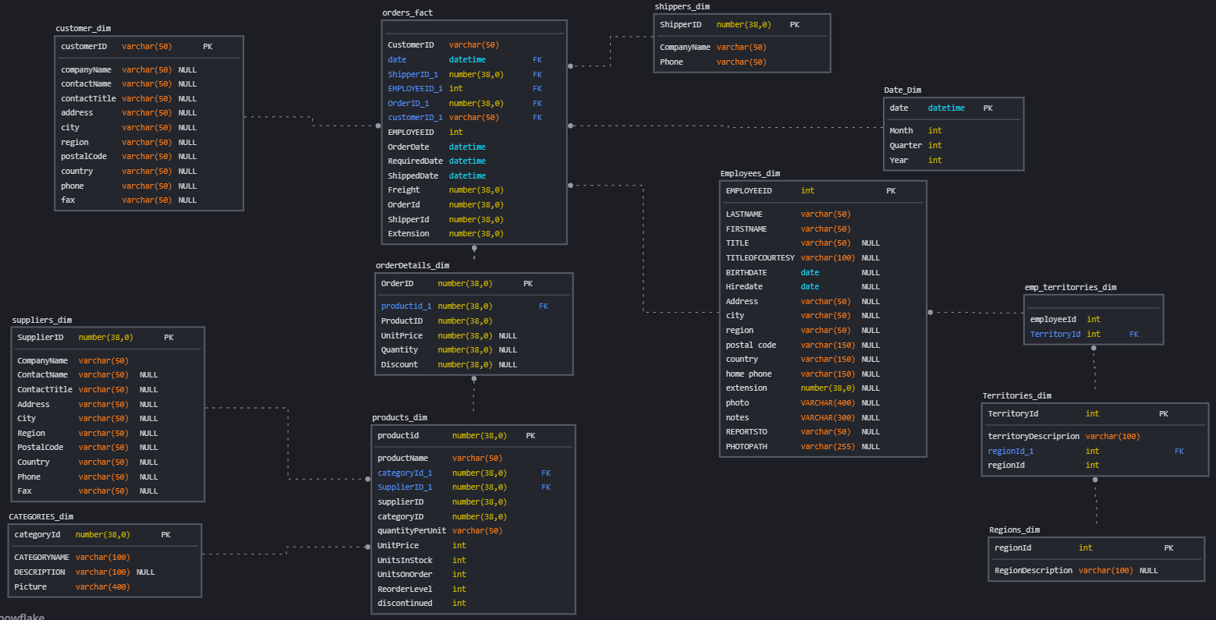
Dimensional Modeling

Slide 5
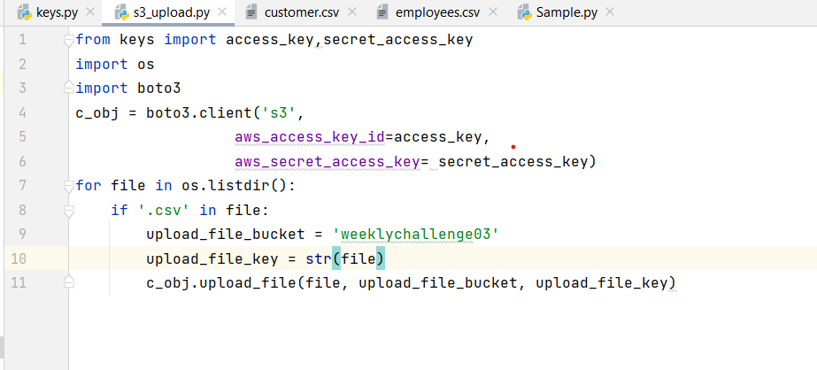

Slide 6
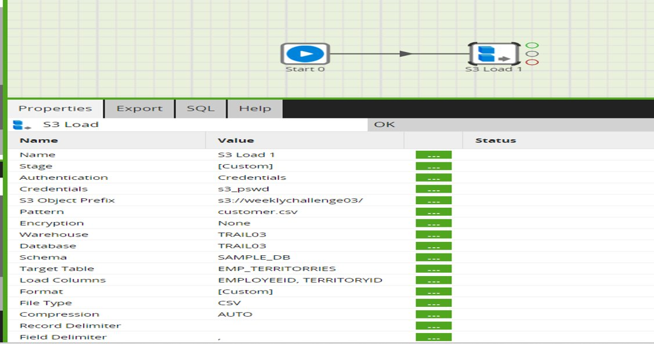
S3 TO Snowflake

Slide 7
Implement J.I.T.(Just in time): A Japanese model to manage deliveries.
Customer retention.
Employee incentive Program.
Optimize supply chain management.
Optimize delivery time.
Business Requirements

Slide 8
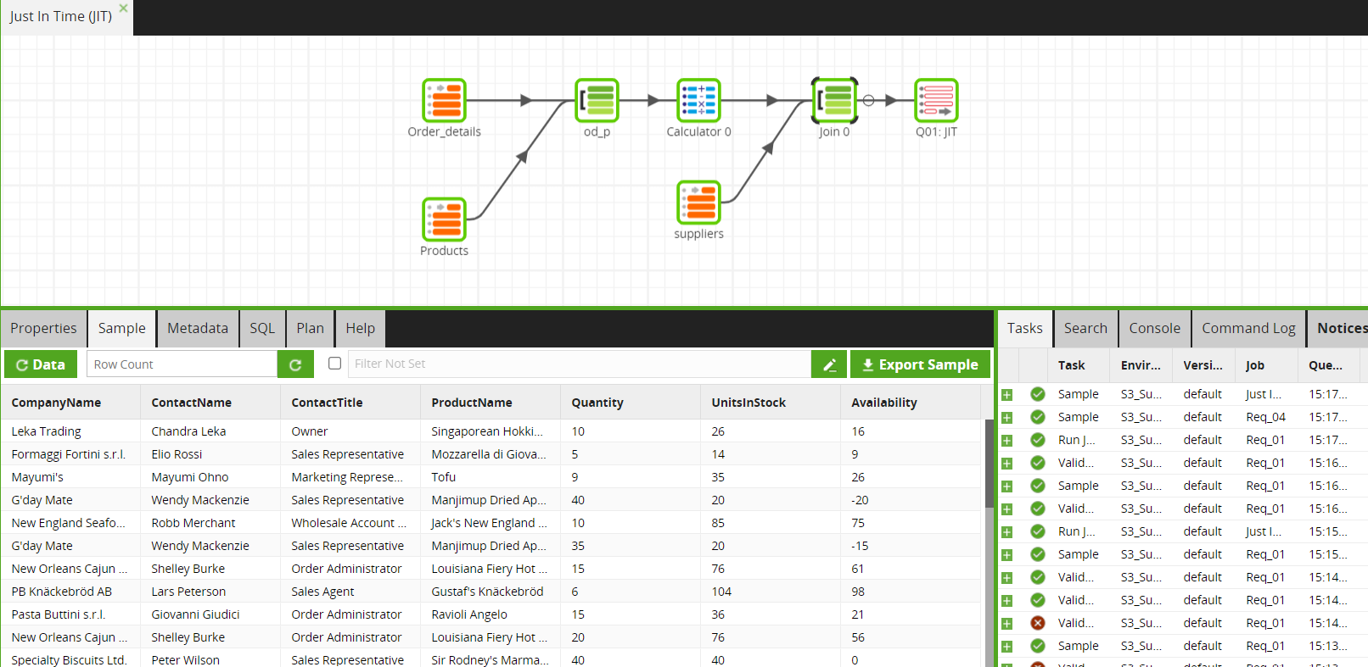
Implementation of J.I.T.(Just In Time)

Slide 9
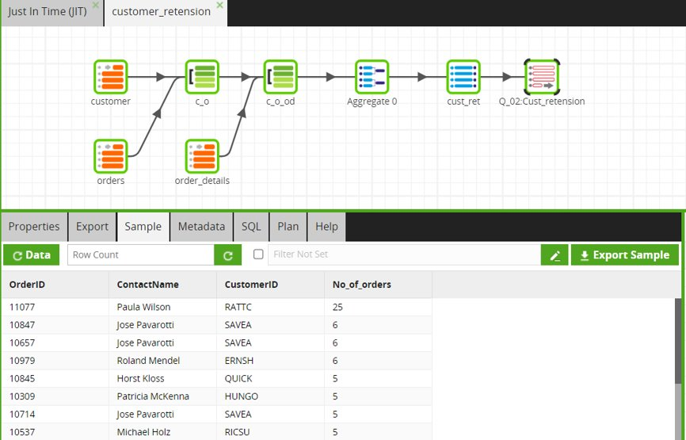
Customer Retension

Slide 10
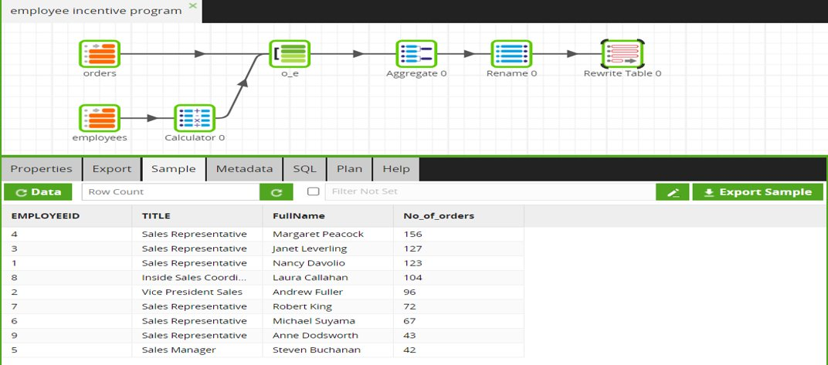
Employee Incentive Program

Slide 11
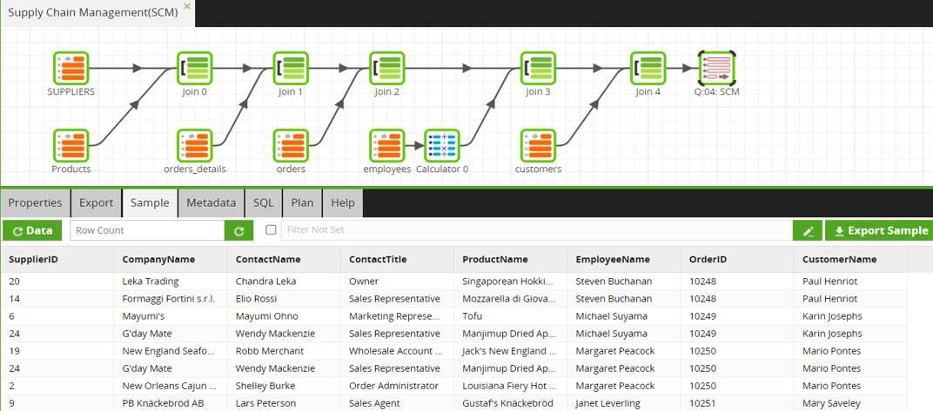
Supply Chain Management(SCM)

Slide 12
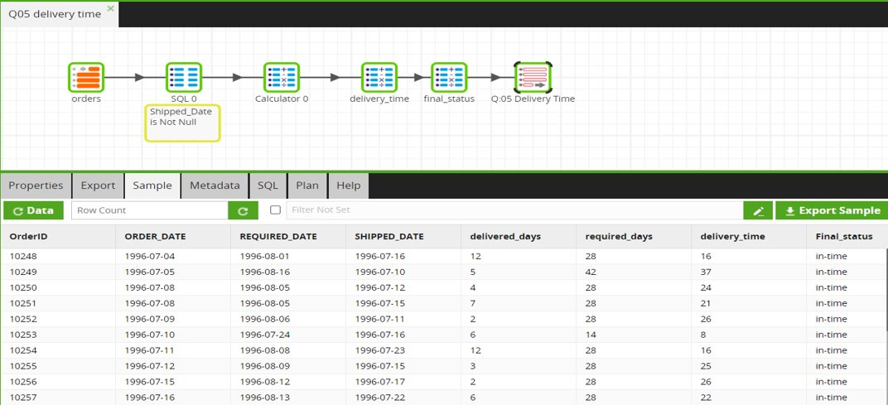
Delivery Time

Slide 13
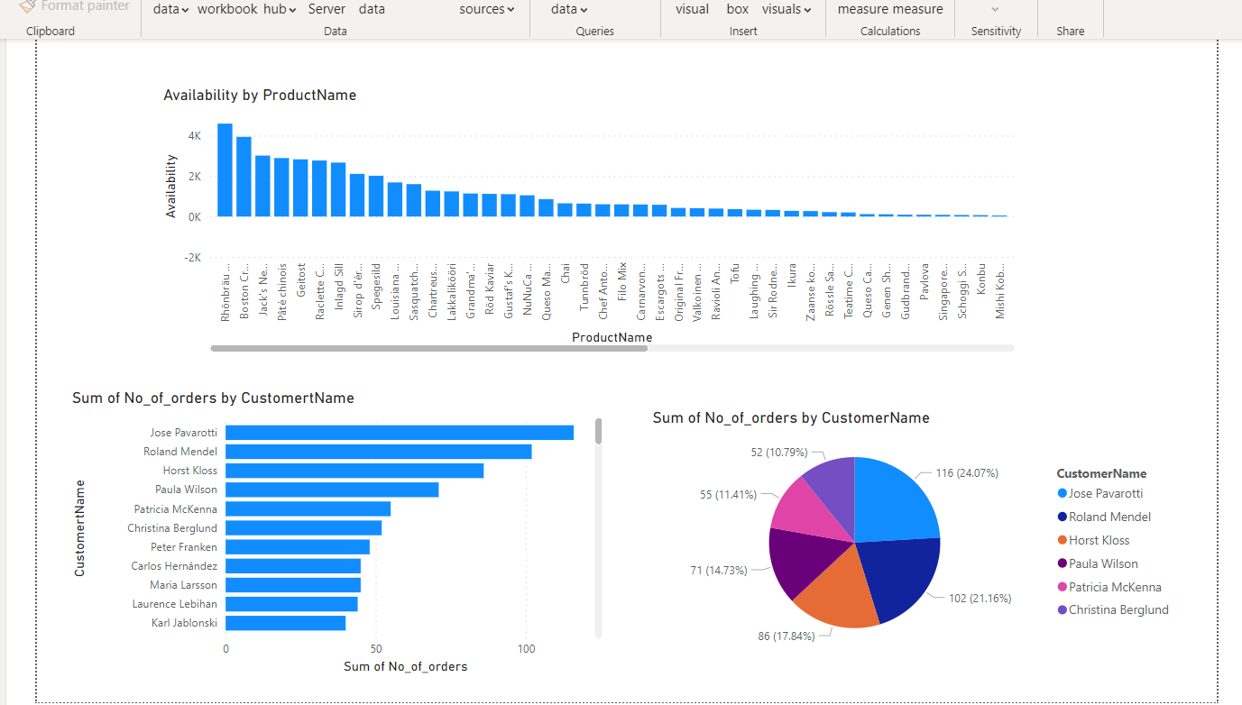

Slide 14
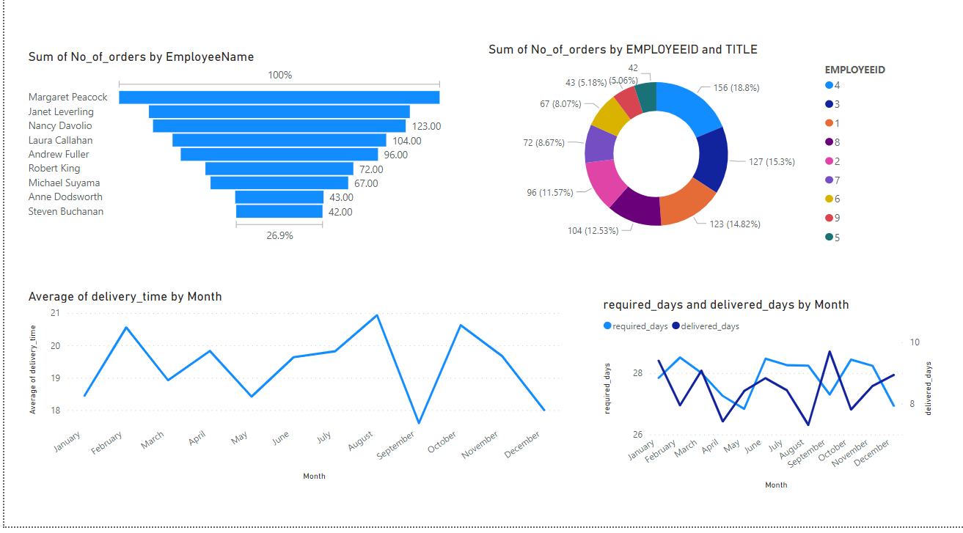

Slide 15
THANK YOU

