Slide 1

TEAM-04

Slide 2
Analysis:
We performed this task using pandas.
Used read_csv () function to read the data.
The dataset contains information about the seasons, episodes, scenes, and lines of the series.
There are 7 columns in the given dataset.
We have observed there are some not null values in column 7 of the dataset.

Slide 3
Design:
DataFrame.nunique(axis=0, dropna=True) : This function return Series with number of distinct observations over requested axis.
DataFrame.groupby(by="column") : It is used for grouping the data according to the categories and apply a function to the categories.
DataFrame.sum() : Return the sum of the values over the requested axis.
DataFrame.count() : It returns count of non-null values of each row or column.
lambda arguments: expression : An anonymous function which we can pass in instantly without defining a name or anything like a full traditional function ( def keyword).
Str.split() is used to split the string based on delimiter or seperator default delimiter is whitespace & returns the list as output.

Slide 4
Coding:
As per the requirement, We filtered the Michael records using contains function and we used nunique() function.
Used group by with nunique() function to determine the number of episodes in each season, sum() function for total sum.
Appiled "count()" function to find the number of lines.
Appiled split() in the lambda function with len() to find the number of words for the column name "line".
Used notnull() to know the not-null records & split() in the lambda function with len() to find the number of words for the column name "Unamed: 6".
Performed sum of the words of both columns for total number of words.
https://colab.research.google.com/drive/1b7_uTvbvbyRMgRPEiOU5f3Q06YtUuWfL#scrollTo=8n6ZD4J-YhGZ

Slide 5
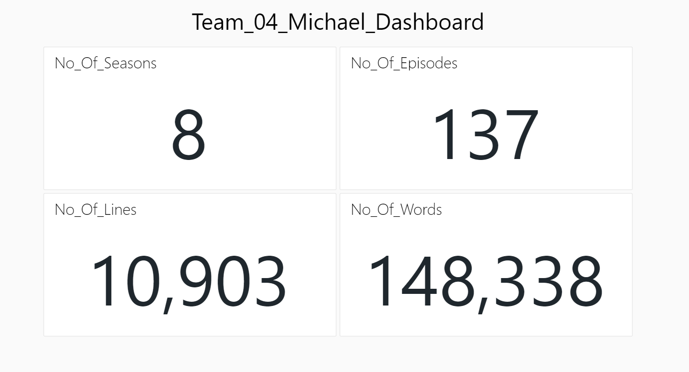
Dashboard

Slide 6
Thank you

