Slide 1

WEEK 2 CHALLENGE
TEAM 4

Slide 2

PROBLEM STATEMENT

Slide 3

DATA ANALYSIS
5 files with highest 2155 and lowest 25 rows
Different types of data – Boolean, float , date
Single quotes in Csv file
Special characters
Phone no and fax is varchar

Slide 4
DIFFERENT APPROACHES
IICS
PANDAS
ORACLE
MySql
Snowflake

Slide 5
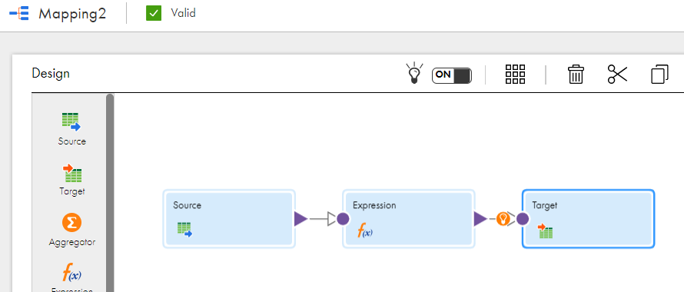
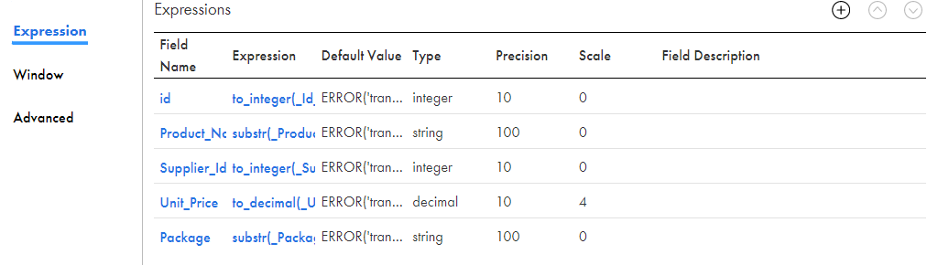
Substr (Column_Name, 2, length( Column_Name)-2)

Slide 6
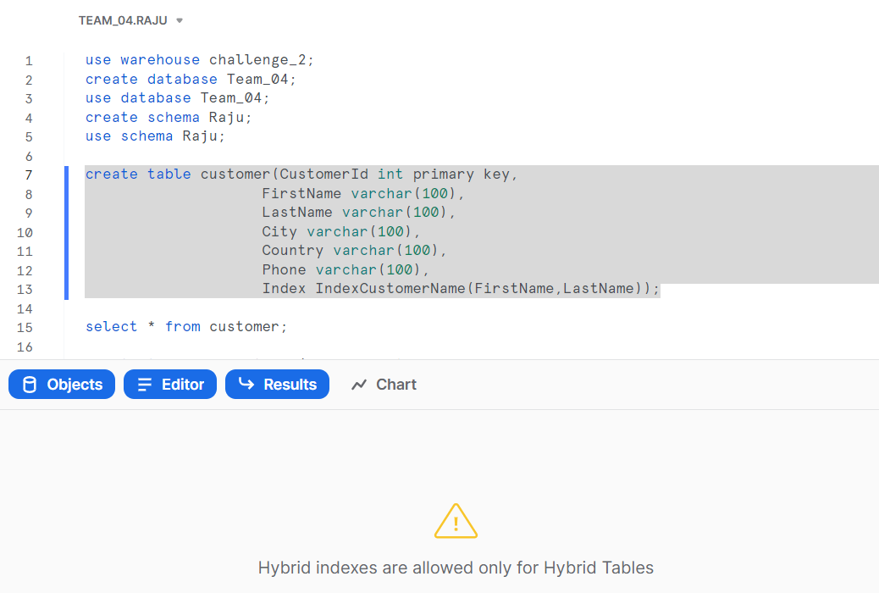

Slide 7
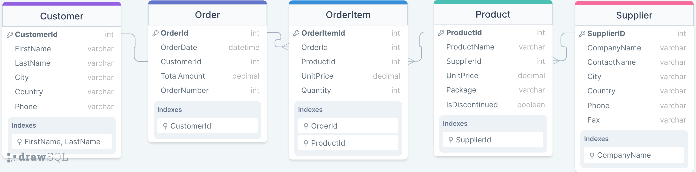
ER Model

Slide 8
CREATE TABLE
create database week_challenge_02;
use week_challenge_02;
create table customer(CustomerId int primary key,
FirstName varchar(100),
LastName varchar(100),
City varchar(100),
Country varchar(100),
Phone varchar(100),
Index IndexCustomerName(FirstName,LastName)):
create table Order_table(OrderId int primary key,
OrderDate datetime,
CustomerId int,
TotalAmount decimal(10,4),
OrderNumber int,
foreign key (CustomerId) references customer(CustomerId),
Index IndexOrderCustomerId(CustomerId));

Slide 9
create table Supplier(SupplierId int primary key,
CompanyName varchar(100),
ContactName varchar(100),
City varchar(100),
Country varchar(100),
Phone varchar(100),
Fax varchar(100),
Index IndexSupplierName(CompanyName));
create table Product(ProductId int primary key,
ProductName varchar(100),
SupplierId int,
UnitPrice Decimal(10,3),
Package varchar(100),
IsDiscontinued boolean,
foreign key (SupplierId) references Supplier(SupplierId),
Index IndexProductSupplierId(SupplierId));
create table OrderItem(OrderItemId int primary key,
OrderId int,
ProductId int ,
UnitPrice Decimal(10,3),
Quantity int,
foreign key (OrderId) references Order_table(OrderId),
foreign key (ProductId) references Product(ProductId),
Index IndexOrderItemOrderId(OrderId),
Index IndexOrderItemProductId(ProductId));

Slide 10
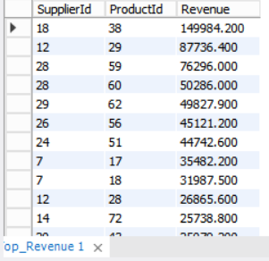
Q2
Create view Top_Revenue as SELECT Product.SupplierId,OrderItem.ProductId, sum(OrderItem.UNITPRICE*OrderItem.QUANTITY) as Revenue
FROM Product INNER JOIN OrderItem
ON Product.ProductId=OrderItem.ProductId group by SupplierId,OrderItem.ProductId order by 3 desc;
Select * from Top_Revenue;
The company wants to identify suppliers who are responsible for the highest revenue. This data would have to be regularly accessed. Create a view which has the following

Slide 11
Q3
A:
select max(CustomerId)+1 from customer;
SELECT @CustIdVariable := MAX(CustomerId)+1 from customer;
INSERT INTO customer(CustomerId,FirstName,LastName,City,Country,Phone)
VALUES (@CustIdVariable,'Tyrion','Lannister',"King's Landing",'Us','(60) 12345’);
B:
select @OrdID_var:=Max(OrderId)+1 from order_table;
select @Cid_var:=Max(CustomerId)+1 from order_table;
select @OrdNum_var:=Max(OrderNumber)+1 from order_table;
insert into order_table (OrderId,OrderDate,CustomerId,TotalAmount,OrderNumber)
values (@OrdId_var,sysdate(),@Cid_var,1000.23,@OrdNum_var);
update order_table set TotalAmount=2000.34 where customerid=92;
select * from order_table where customerid=92;
Write SQL transactions for the following activities:
a. Adding a new customer to the database.
b. Updating a new order into the database.

Slide 12
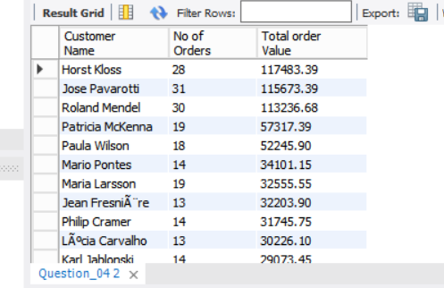
Q4
create view Question_04 as SELECT concat(customer.FirstName,' ',customer.LastName) as 'Customer Name',count(order_table.OrderId) as "No of Orders",round(sum(order_table.TotalAmount),2) as "Total order Value" from customer inner join
order_table on customer.CustomerId=order_table.CustomerId group by order_table.CustomerId having sum(order_table.TotalAmount)>5000 order by 3 desc;
Vision International ltd. also intends to send out promotional offers to customers who have placed orders amounting to more than 5000. Identify the names of these customers.

Slide 13
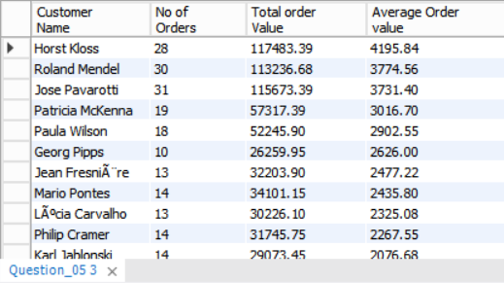
Q5
create view Question_05 as SELECT concat(customer.FirstName,' ',customer.LastName) as 'Customer Name',count(order_table.OrderId) as "No of Orders",round(sum(order_table.TotalAmount),2) as "Total order Value" ,round(avg(order_table.TotalAmount),2) as "Average Order value" from customer inner join
order_table on customer.CustomerId= order_table.CustomerId group by order_table.CustomerId having count(order_table.OrderId)>=10 and avg(order_table.TotalAmount)>1000 order by 4 desc;
Identify those customers who are responsible for at least 10 orders with the 'average order value' being greater than 1000.

Slide 14
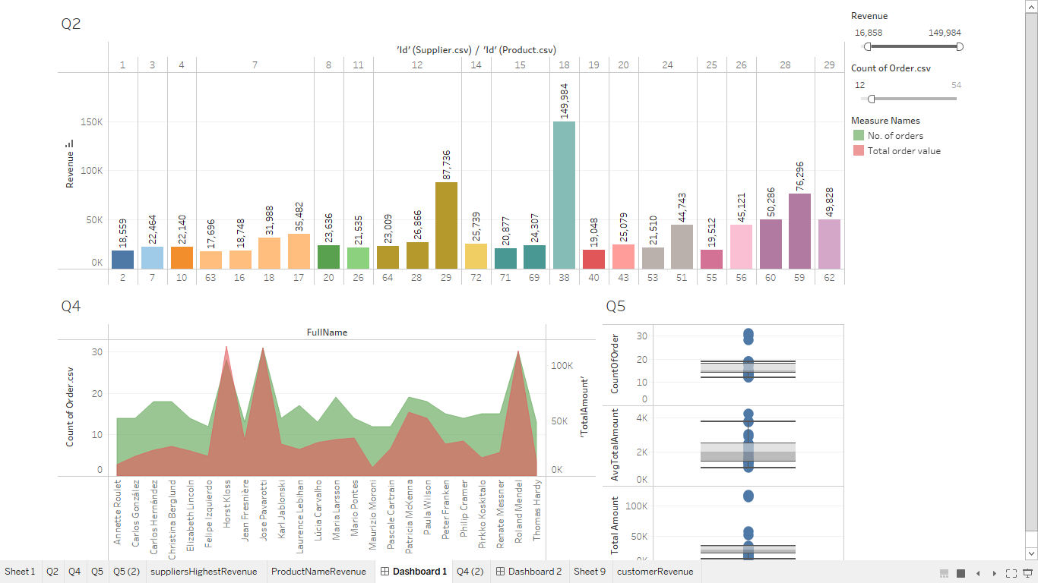

Slide 15
THANK YOU

