Slide 1



DEPARTMENT OF
Computer Science
INNOVATION
Mid Review Internship Presentation
TEACHING
LIFE
TIME
Presented by
Piyush Songara
PROGRAM
Under the guidance of
THINK
BUILD
KNOWLEDGE
Faculty Internship guide:-Megha Garg
Industrial guide:-Balveer Bajiya
BROTHERHOOD
INFORMATION
2025-2026

Slide 2
Contents
INNOVATION
Company / Project Profile
TEACHING
LIFE
Internship Role
TIME
Project Introduction
PROGRAM
Work Evidence and Metrics
Roles and Responsibilities
THINK
BUILD
Tools Used
KNOWLEDGE
Methodology
Outcomes and Learning
BROTHERHOOD
Conclusion
INFORMATION

Slide 3
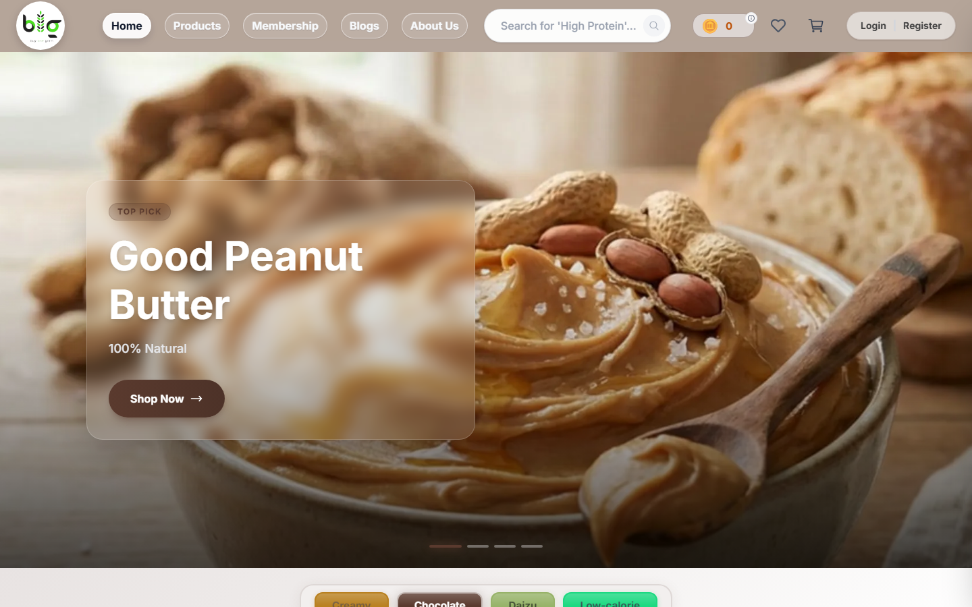
01 Cover
Frontend Developer Internship Report
BogEcom - Buy
One Gram
Piyush Songara - B.Tech Computer Science
Internship Guide: Faculty & Industry Mentor - Duration: January - April 2026
INTERNSHIP REPORT
FRONTEND DEVELOPMENT
E-COMMERCE PLATFORM

Slide 4
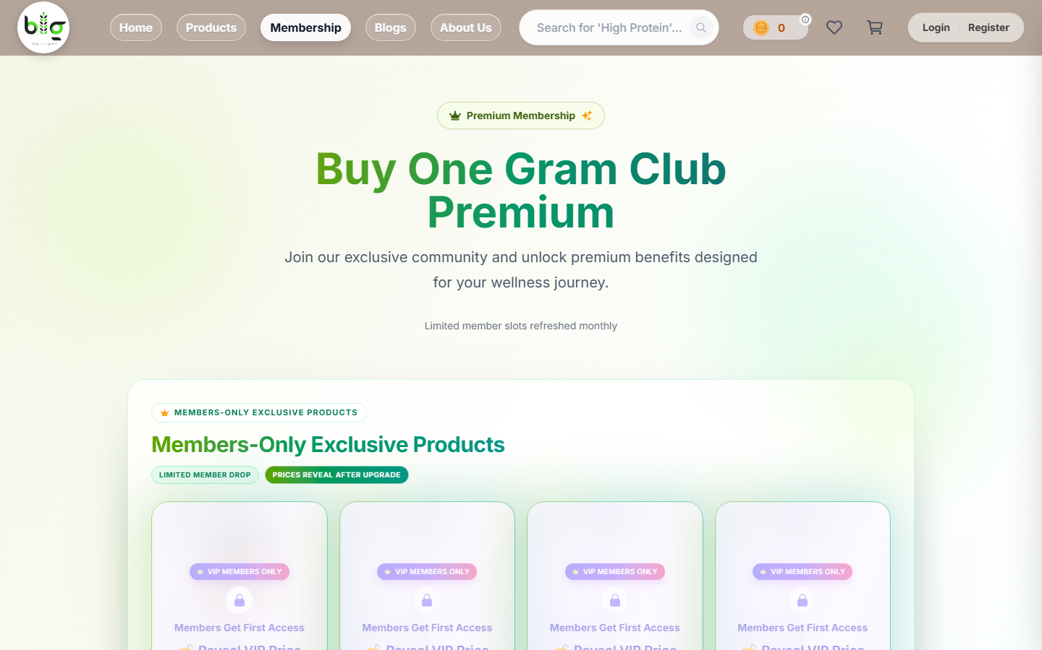
02 Overview
Abstract & Overview
This presentation documents a structured internship on BogEcom (Buy One Gram), a live ecommerce platform. My role covered end-to-end UI implementation, state management, production fixes, API-linked behavior, and delivery support across client and admin portals.
Role
1
Frontend Developer Intern with full product exposure from day one
Platform
2
Dual-portal ecommerce system with client storefront, admin dashboard, and connected APIs
Key Contributions
3
UI components, checkout flows, state management, API integration, bug fixes
Duration
4
January 2026 - April 2026, including latest updates up to April 21

Slide 5
03 Context
Objective & Platform Context
A real product internship focused on delivering production-ready ecommerce experiences across client and admin portals.
Internship Objective
About BogEcom (Buy One Gram)
Bridge academic knowledge with real-world software engineering by contributing to a live, production-grade ecommerce product.
Understand frontend architecture at scale.
Deliver features under real product constraints.
Collaborate using Git, APIs, and shared code patterns.
BogEcom is a dual-portal ecommerce platform serving both customers and internal administrators.
Client Portal: product browsing, cart, checkout, order tracking.
Admin Portal: inventory, pricing, orders, user management.
Backend: RESTful APIs feeding both portals and linked business workflows.

Slide 6
04 Stack
Technology Stack
The project used a modern JavaScript ecosystem focused on frontend performance, developer velocity, and live ecommerce reliability.
1
2
3
4
Next.js & React
JavaScript (ES6+)
Context API
Git & APIs
Server-rendered and client-side UI architecture for storefront and admin experiences
Async logic, reusable components, array methods, event handling, and app flow control
Shared global state for cart, settings, wishlist, theme, and related frontend behaviors
Version control, collaboration, RESTful integration, payment flow support, and production fixes
Project Architecture
BogEcom follows a connected product architecture where frontend portals communicate with API and business logic layers serving both customers and administrators.
BogEcom
Core Platform
Client Portal
Admin Portal
Next.js storefront: product pages, cart, checkout, account, membership, orders
Dashboard, orders, settings, combos, analytics, shipping, support workflows

Slide 7
05 Timeline
Monthly Progress Timeline
Growth followed a deliberate ramp-up from onboarding and exploration to independent feature ownership by the final sprint.
January - Foundation
February - Building
March - Deepening
April - Ownership
Onboarding, codebase exploration, environment setup, first UI contributions
Page development, Context API integration, cart and product listing features
Checkout flow, admin panel work, API integration, complex pricing logic
End-to-end feature delivery, regression testing, bug fixes, deployment support
1
2
3
4
Key Responsibilities & Contributions
Core Responsibilities
Major Contribution Areas
-> Page Development - product listing, detail, cart, checkout pages
-> UI Components - reusable blocks across both portals
-> State Management - cart, settings, wishlist, theme behavior
-> Admin Features - inventory, order management, analytics support
-> API Integration - client endpoints and linked backend behavior
Storefront: customer-facing product discovery and purchase journey
UI Components: modular reusable blocks for consistency
State Management: shared patterns powering cart and settings
Admin Portal: internal tools for catalog and order operations
Checkout Flow: end-to-end purchase experience with validation

Slide 8
Testing, Validation & Deployment
06 Execution
Quality assurance and deployment readiness were treated as integral to every sprint, not as an afterthought.
1
Manual & Flow-Based Testing
2
Regression Awareness
3
Deployment & Stability Support
Executed structured manual test cases across product browsing, cart operations, checkout completion, and admin workflows.
Maintained awareness of regression risk when modifying shared components and linked business logic.
Contributed to release readiness by fixing bugs, resolving edge cases, and iterating quickly on reported issues.
Work Evidence & Metrics
Quantifiable output across the internship reflects consistent, high-volume contribution to a live production codebase.
75
351
Git Commits
Files Modified
Consistent, incremental commits across the internship duration
Spanning pages, components, utilities, server logic, and styles
75K+
4+
Lines Added
Months Active
Reflecting substantial feature delivery and iterative UI construction
January through April with ongoing latest updates included
These metrics represent direct contributions to a live ecommerce platform. The report has been updated with latest work through April 21, 2026.

Slide 9
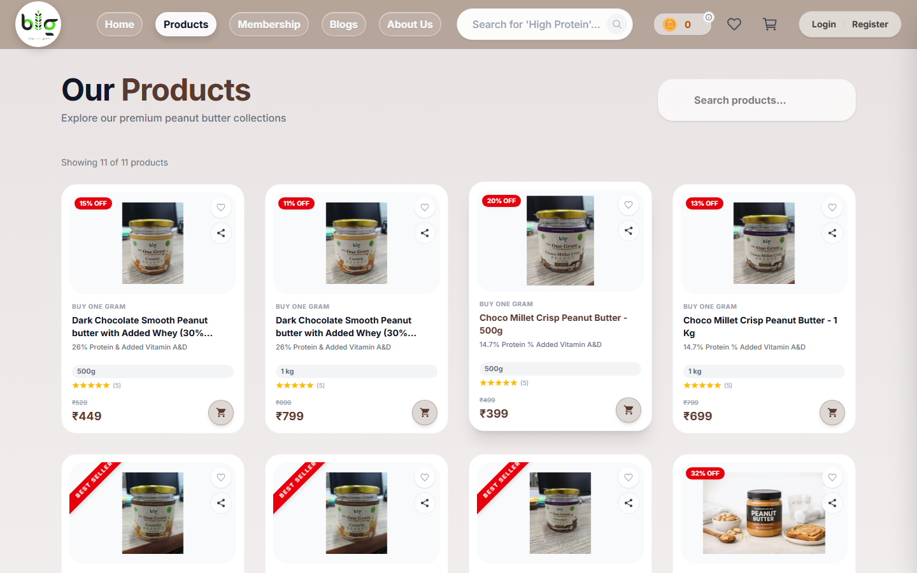
07 Live Screens
Live Implementation Screens I
Representative live-site screens showing how implemented work appears in the deployed product experience.
Home Page on Live Site
Products Listing on Live Site

Slide 10
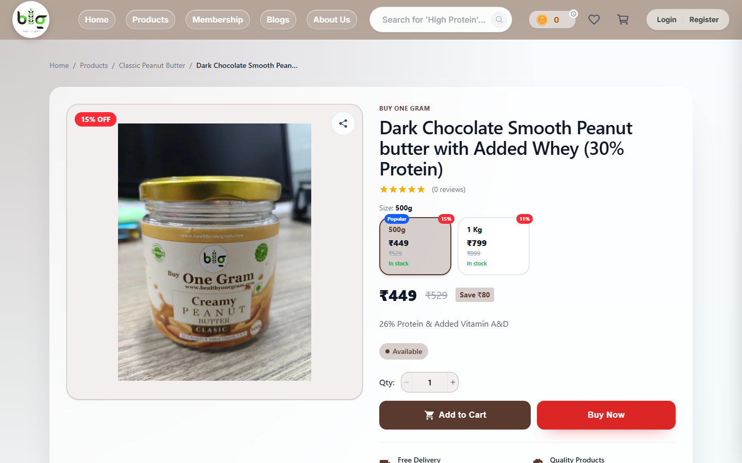
07 Live Screens
Live Implementation Screens II
Representative live-site screens showing how implemented work appears in the deployed product experience.
Product Detail Page on Live Site
Membership Page on Live Site

Slide 11
Challenges, Learning & Conclusion
09 Close
Learning Outcomes
Challenges Faced
+
!
Codebase Complexity: navigating a large existing system with shared components and business logic
Pricing Logic: implementing dynamic calculations with discounts, taxes, variants, and combos
Regression Risk: ensuring changes in shared modules did not break connected flows
Multi-Portal Coordination: balancing client polish, admin behavior, and server-linked correctness
Release Pressure: fixing production-impacting issues while maintaining visual consistency
Technical: deeper expertise in React, Next.js, Context API, and API integration patterns
Product Thinking: understood how frontend decisions impact user experience and business outcomes
Collaboration: improved confidence in working safely inside an active multi-author repository
Closing Reflection
>
This internship gave me real exposure to product-scale frontend engineering. My contribution spanned UI, logic, integration, testing, and delivery support, making the experience a strong bridge between academic learning and professional software work.

