Slide 1
Task Management Flutter App with Back4App
Prepared by:
Sagar Mahapatra (2023tm93671)

Slide 2
Project Overview
This project is a Flutter-based mobile application that integrates with Back4App (Parse Server) to manage user authentication and task data via cloud storage.
The app allows users to:
Sign Up and Log In using email and password
Persist user sessions securely using Back4App's built-in session management
Create, Read, Update, and Delete (CRUD) task records
Filter tasks by status (All, Pending, In Progress, Completed)
Log out from their account securely via a drawer-based logout option

Slide 3
Project Overview
Key Components:
Flutter (Frontend): UI design, navigation, form handling, and API integration Back4App (Backend): User authentication and database operations using Parse SDK
Parse SDK: Handles all interaction with the Back4App server including login, session, and object management
Highlights:
Clean and responsive UI with Material Design components
Form validation for both login/signup and task creation
Effective error handling with SnackBars and field-level validation
Modular code with separation of concerns for services and UI
Code is ready for GitHub/GitLab upload and academic evaluation

Slide 4
Features
User Authentication:
Sign Up, Login, Session Management
CRUD Operations:
Add, View, Update, Delete tasks
UI/UX:
Modern design, Drawer with logout, Filtering, Validation

Slide 5
Architecture of the Solution
1. Frontend: Flutter (Client-Side)
Built using the Flutter SDK and Dart programming language.
Handles:
UI Rendering: Login, signup, task lists, forms, filters, dialogs
User Input Validation: Ensures data (like email, password, task fields) is correct before submission
Navigation & Session Flow: Transitions between login, task pages, and logout
State Management: StatefulWidgets and internal state for forms and task filtering

Slide 6
Architecture of the Solution
2. Backend: Back4App (Parse Server)
Hosted on Back4App, using a Parse Server instance.
Manages:
User Accounts: Registration, login, session tokens
Task Data (CRUD): Stores and serves task records (title, description, due date, status, owner)
Session Persistence: Uses ParseUser.currentUser() to keep users logged in across sessions

Slide 7
Flow Summary
User launches the app → sees Login or is auto-logged in
On login/signup → session token is saved and user navigates to task list
Tasks are queried using Parse SDK based on user ownership
CRUD operations update the cloud database in real time
Logout clears session and returns the user to login screen

Slide 8
User Authentication
Sign Up (Registration)
The user enters their username, email, and password.
The app calls: ParseUser().signUp()
Back4App Creates a new user object in the. generates a session token
Stores the user credentials securely in the cloud
If successful, a confirmation is shown and the user is directed to the login screen.
.

Slide 9
User Authentication
Login
The user enters email/username and password
The app calls: ParseUser().login()
Back4App: Verifies credentials against the stored
Returns a session token if successful
The app stores this session allowing the user to remain logged in.

Slide 10
User Authentication
Session Management
When the app starts, it checks for an existing logged-in user: ParseUser.currentUser()
If a user is found, they are automatically redirected to the main screen (task list).
This allows persistent login sessions across app launches.
Logout
The user can log out from the app, which calls: ParseUser().logout()
This invalidates the current session token and removes the local user session,
forcing re-authentication.

Slide 11
Tools & Frameworks
Flutter (Frontend)
Dart (Programming Language)
Back4App (Backend as a Service)
Parse SDK for Flutter
GitHub for version control

Slide 12
Key Challenges & Solutions
Session Handling: Handled with ParseUser.currentUser()
Error Handling: User-friendly SnackBars
Task Filtering: Dynamic dropdown + fetch

Slide 13
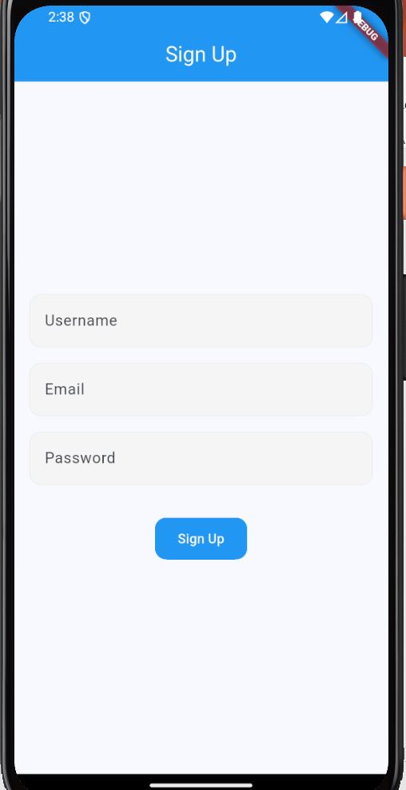
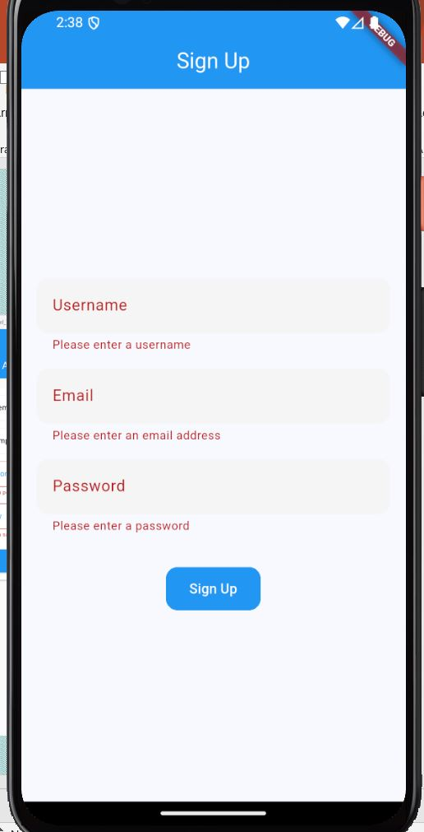
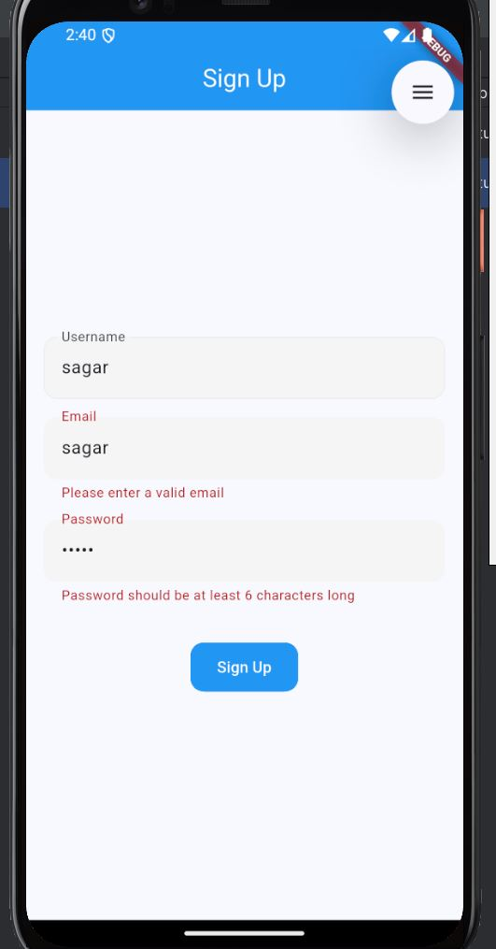
Sign Up Screenshots

Slide 14
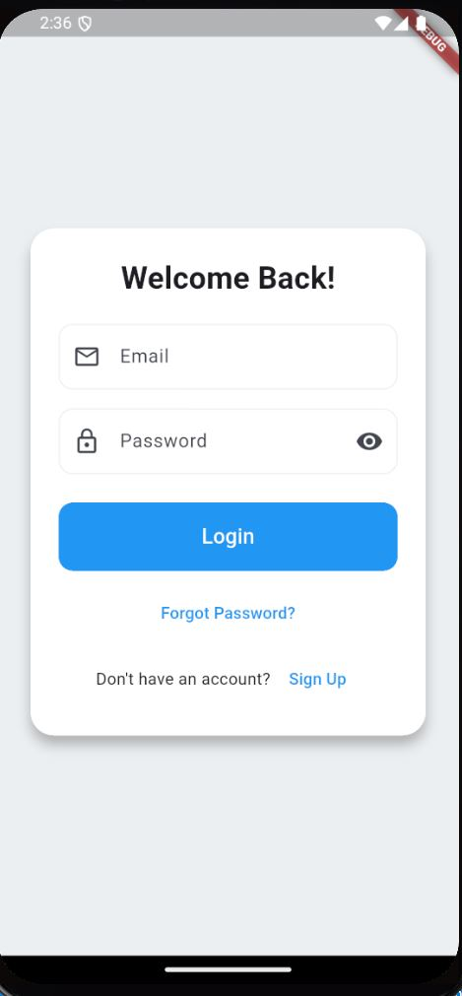
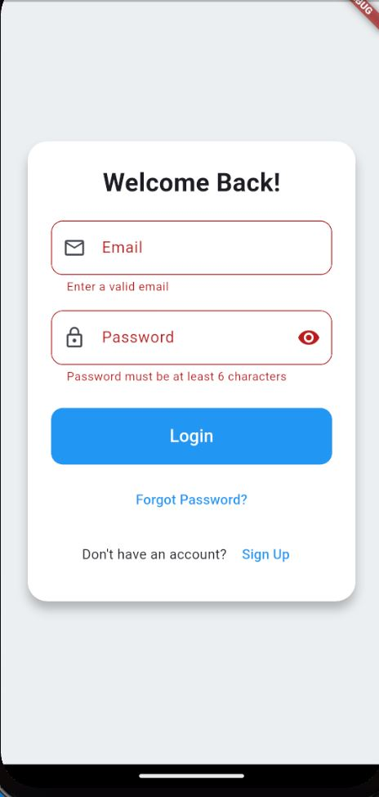
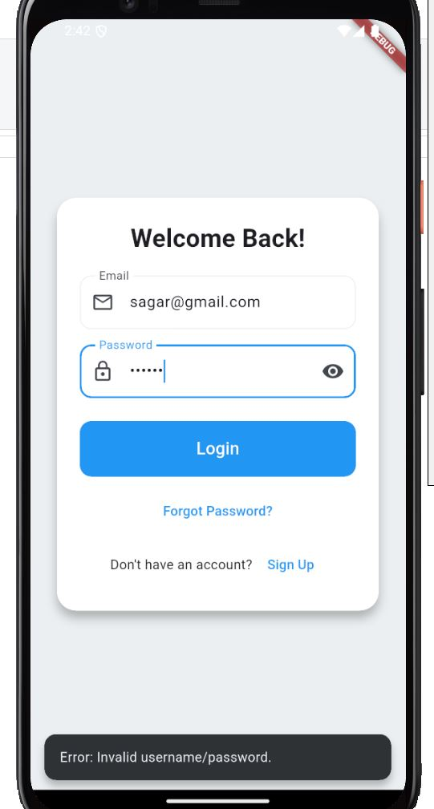
Log-in Screenshots

Slide 15
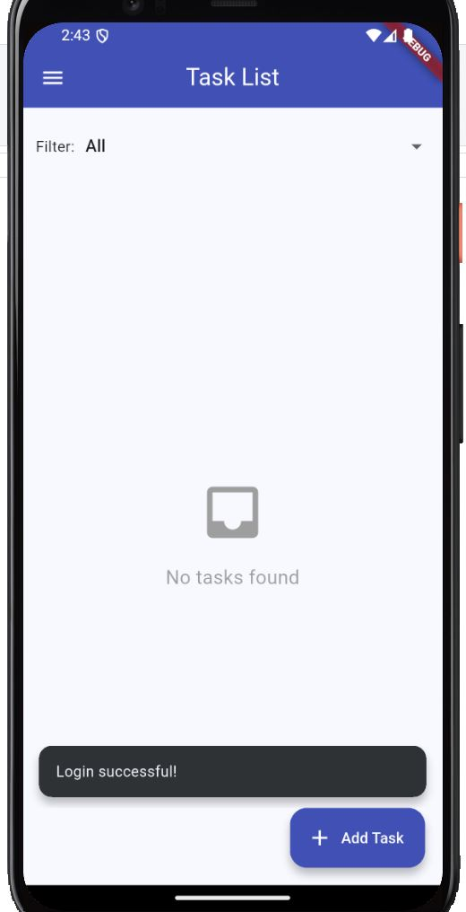
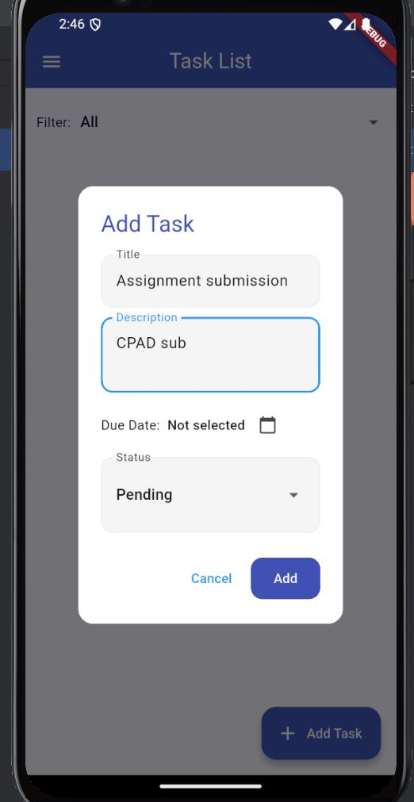
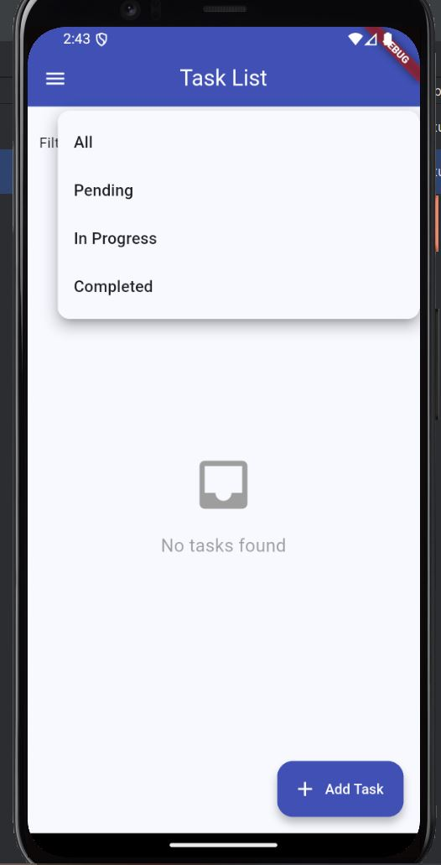
My Task Screenshots

Slide 16
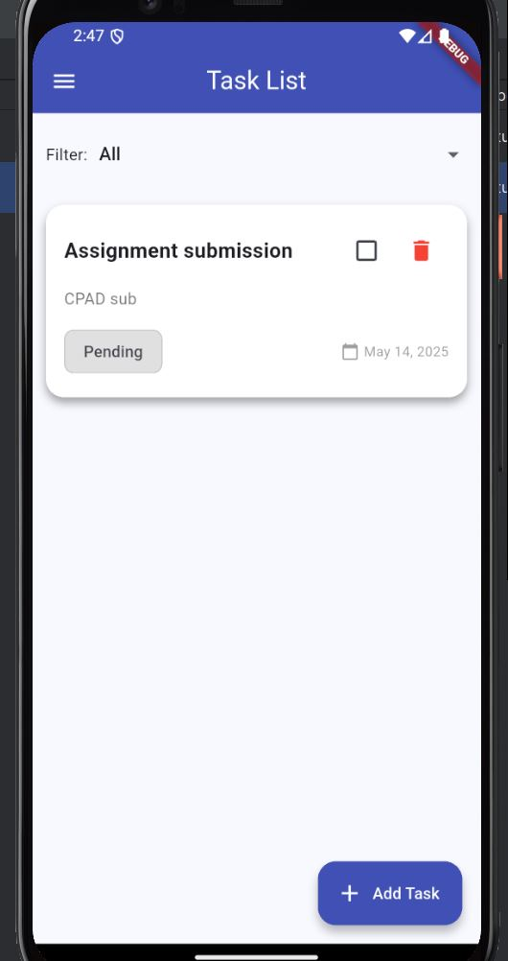
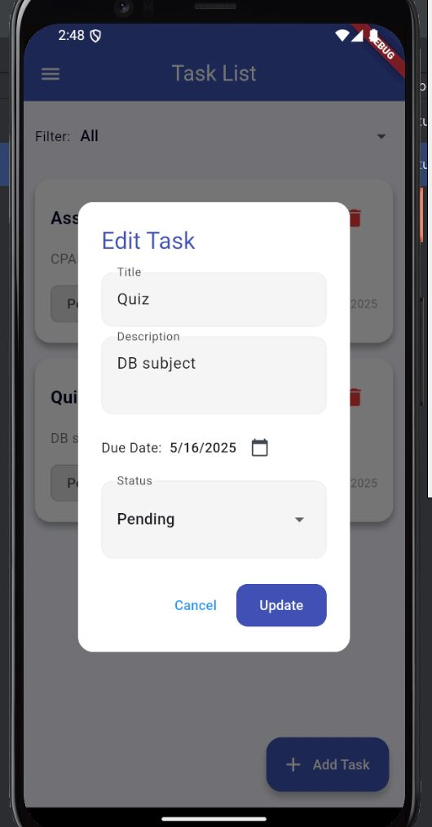
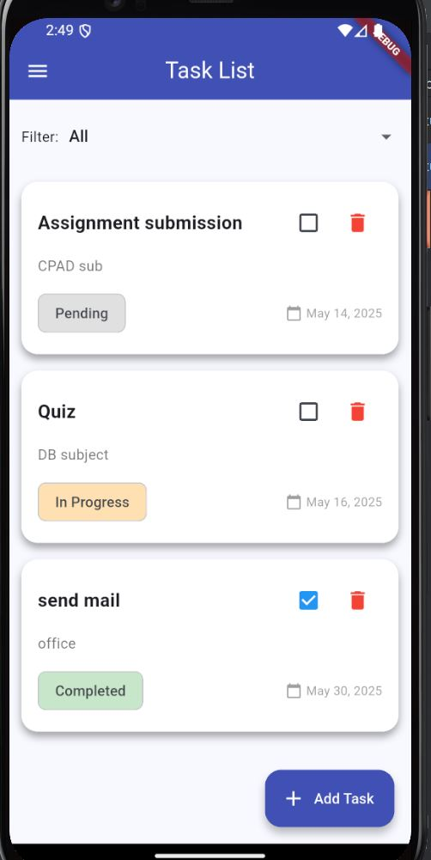
My Task Screenshots

Slide 17
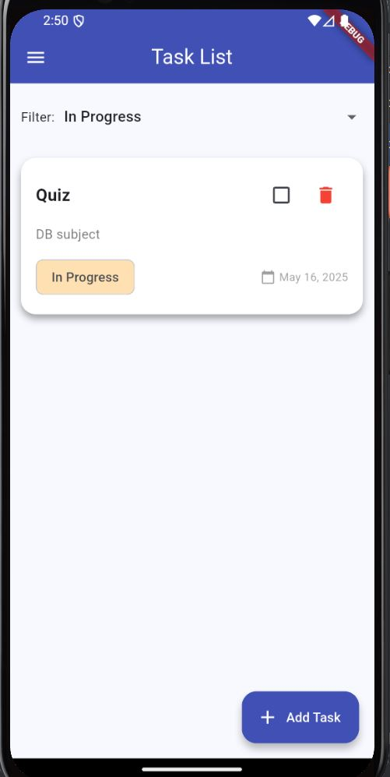
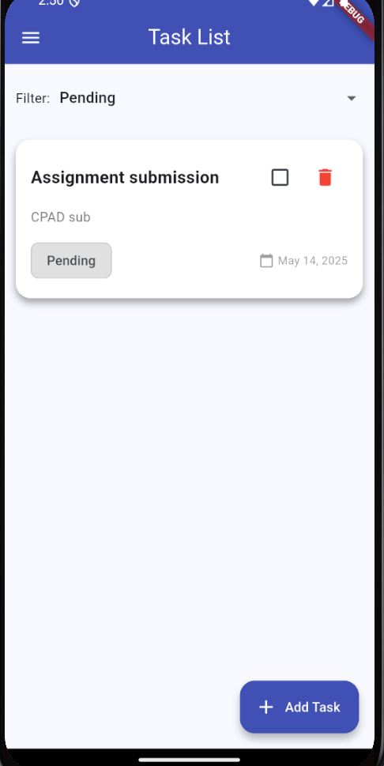
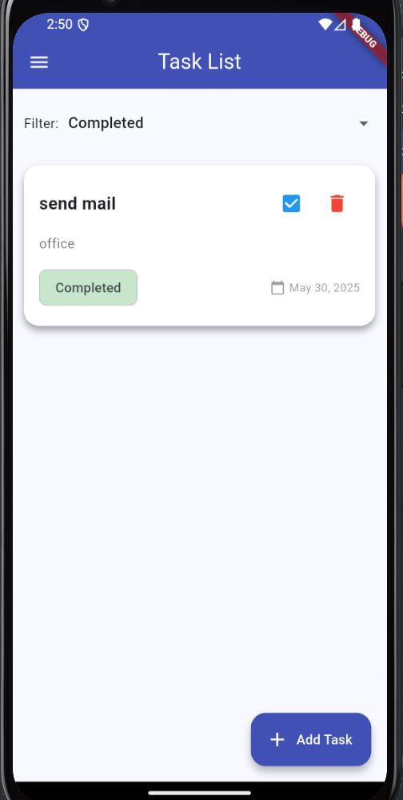
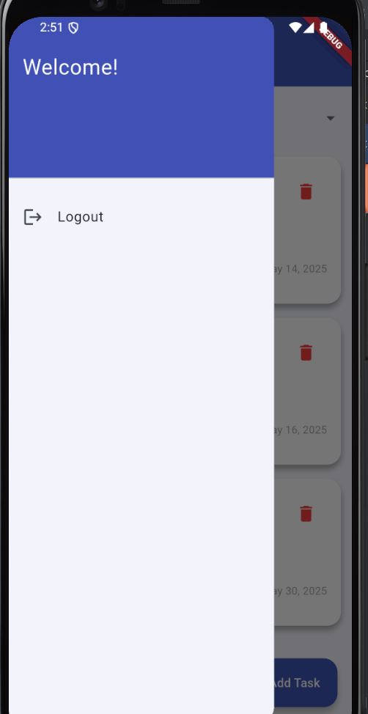
My Task Screenshots

Slide 18
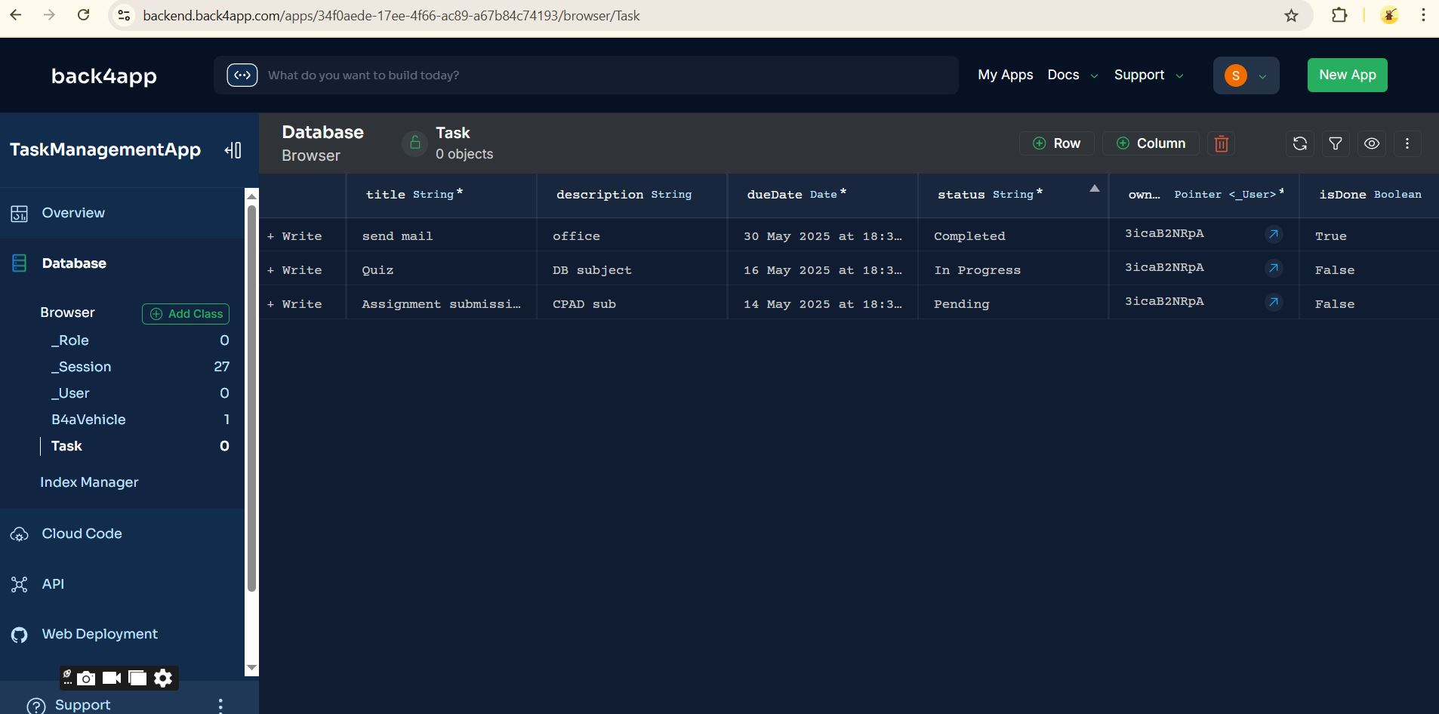
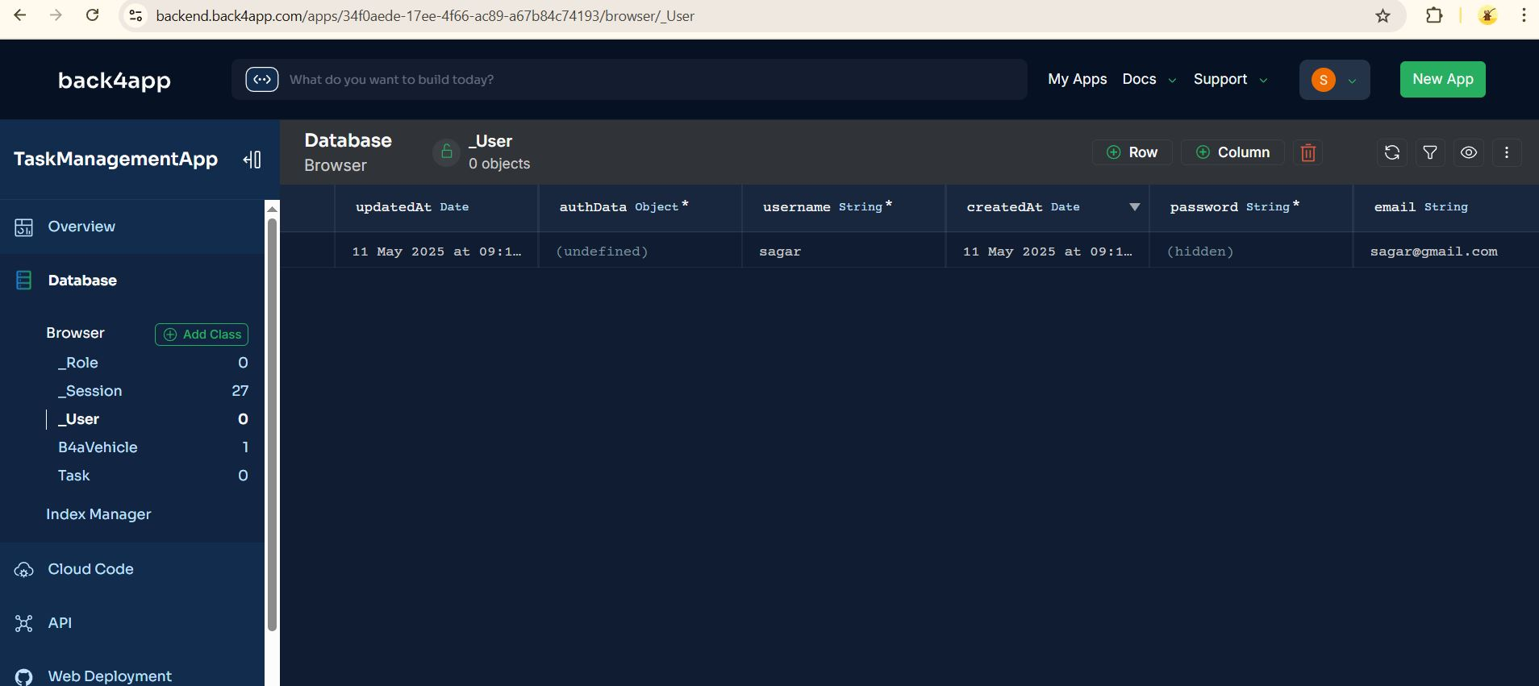
Back4App DB Screenshots

Slide 19
Links
Repo link: Github
Demo video link: YouTube

Slide 20
Thank you
Prepared by:
Sagar Mahapatra (2023TM93671)

