Slide 1

Programming Pokemons Team: CodeMonks
Gaurav Misra | CMPE-202 Section 3
Nitinkumar Gove | CMPE-202 Section 4
Sagar Mane | CMPE-202 Section 4
Sushant Vairagade | CMPE-202 Section 4
Saurabh Gedam | CMPE-202 Section 4

Slide 2
UI Wireframes

Slide 3
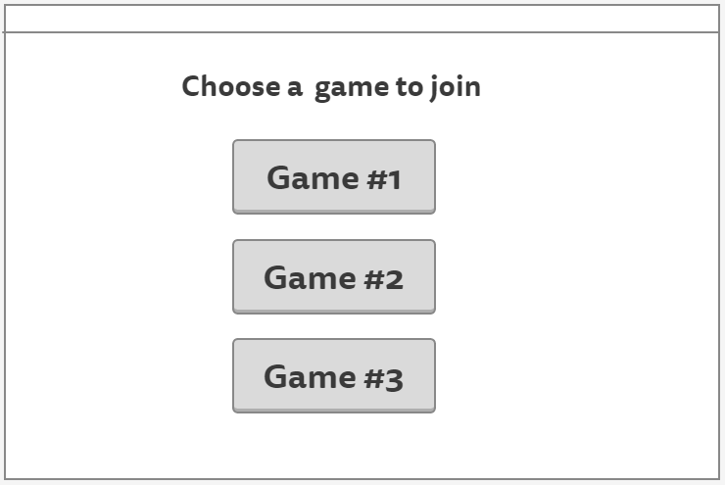

Slide 4
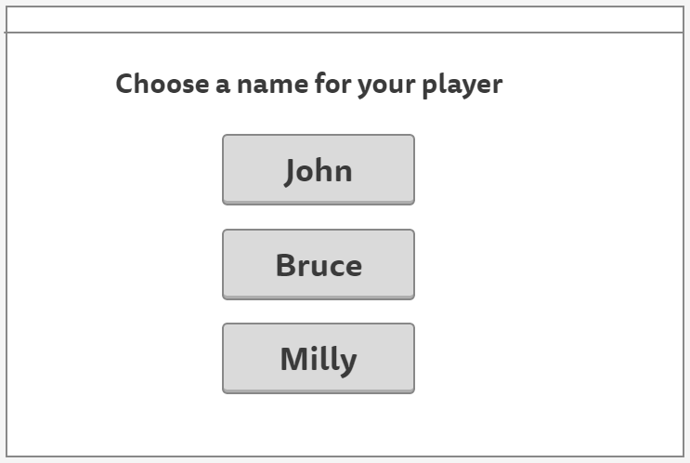

Slide 5
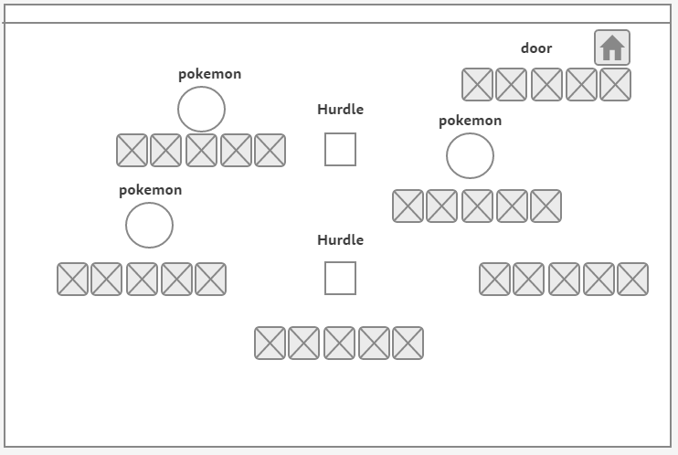

Slide 6
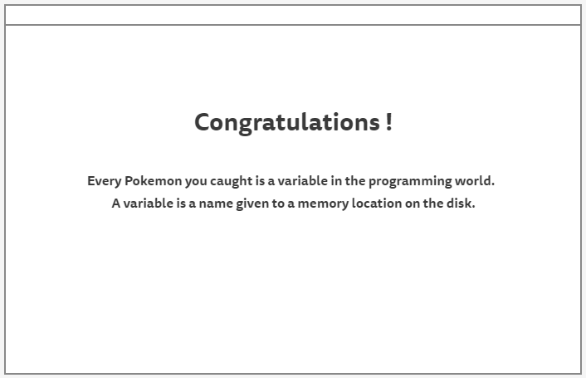

Slide 7
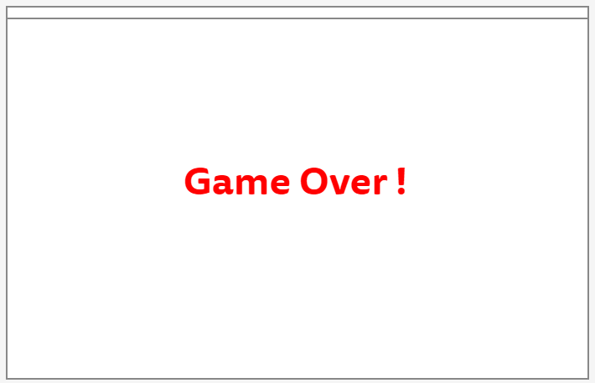

Slide 8
Activity Diagram

Slide 9
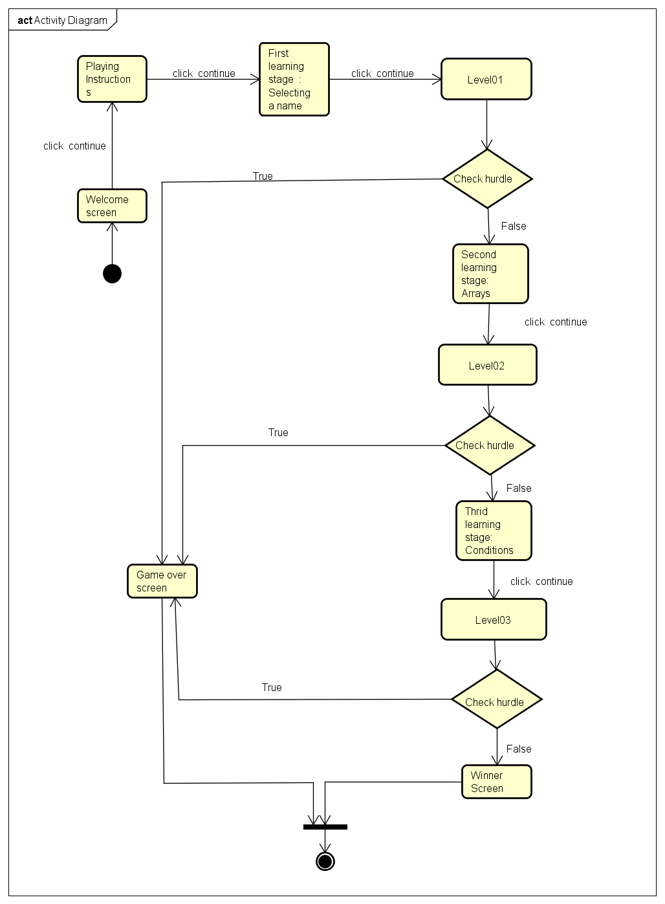

Slide 10
Sequence Diagram

Slide 11
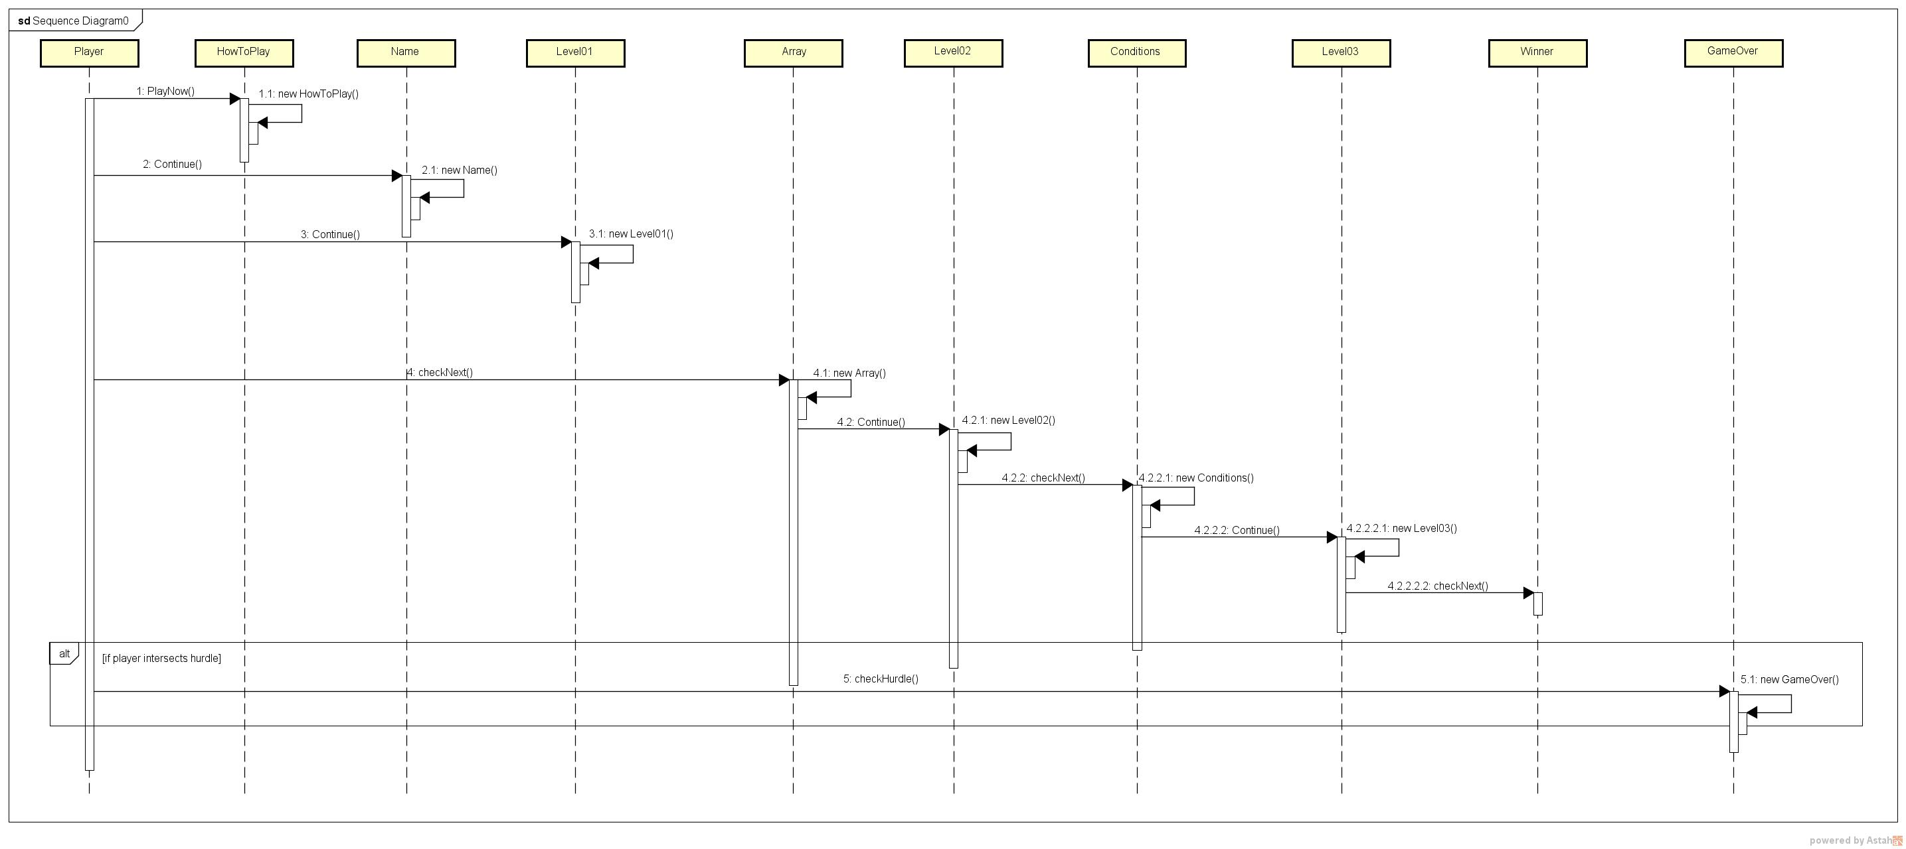

Slide 12
Use Case

Slide 13
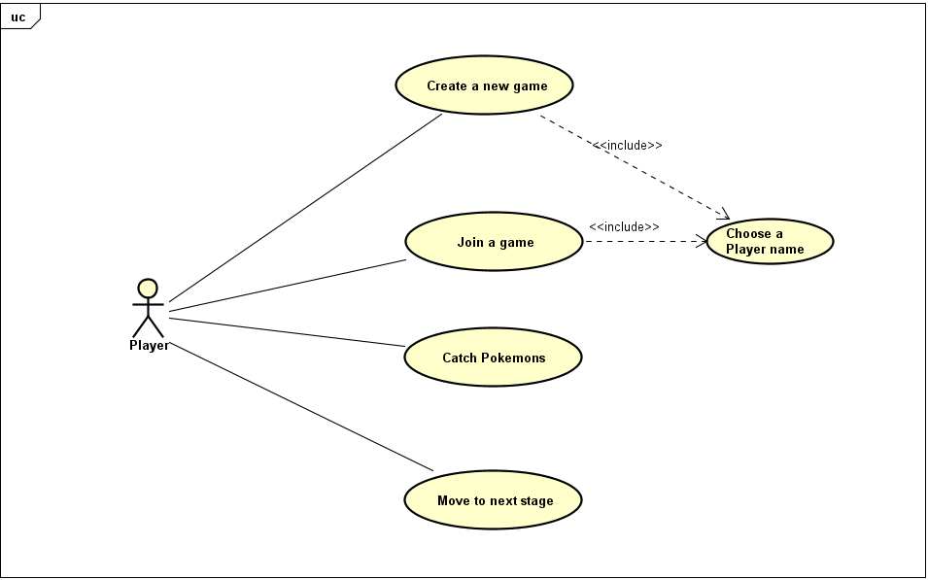

Slide 14
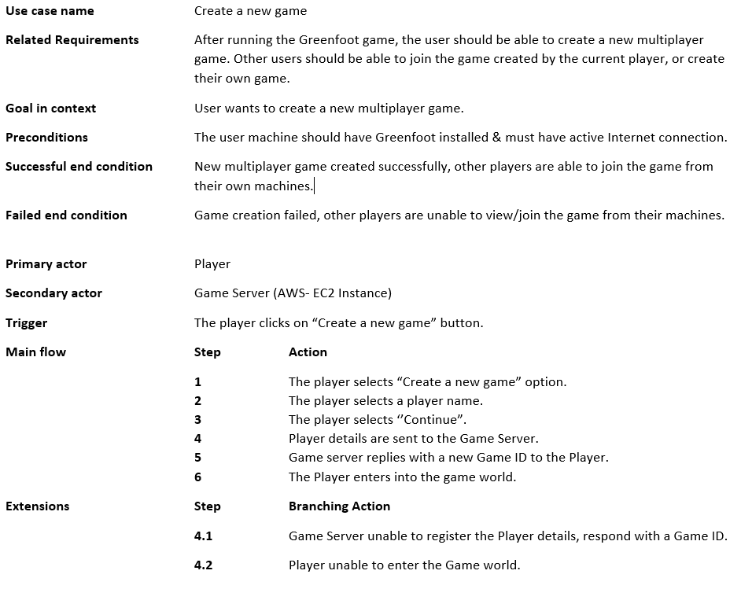

Slide 15
User Story

Slide 16
Story: Player joins an existing game. As a Player, I want to join a game created by another Player so that I can play alongside existing players without creating a new game.
Scenario 1: Player selects an existing game and enters the game world.
Given a player who selects the option of joining an existing game
And the player has chosen a player name from the available names
When the player chooses to continue and enter into the game world
Then the player should enter into the first stage of the game world.
Scenario 2: Player tries to join a game when none is available
Given a player who wants to join an existing game
And the player wants to view available game sessions
When the player chooses “Join Game” and tries to view any available game sessions
Then the player is not presented with any game session.

Slide 17
Scenario 3: Player tries to join a game having 4 players
Given a player who selects the option of joining an existing game.
And the player can view the available game sessions
When the player chooses “Continue” after choosing a game session
Then the player is presented with “The game has already 4 players” message.
Scenario 4: Player tries to join a game in case of a lost connection.
Given a player who wants to join an existing game.
And the player has lost network connection
When the player chooses any option available on screen
Then the player is presented with an error message.
Scenario 5: Player selects an existing game but cannot enter the game world.
Given a player who selects the option of joining an existing game
And the player has chosen a player name from the available names
When the player chooses to continue and enter into the game world
Then the game server is unable to add the player to the selected game instance.

Slide 18
You got to catch them all!
Stay away from us!!

Slide 19
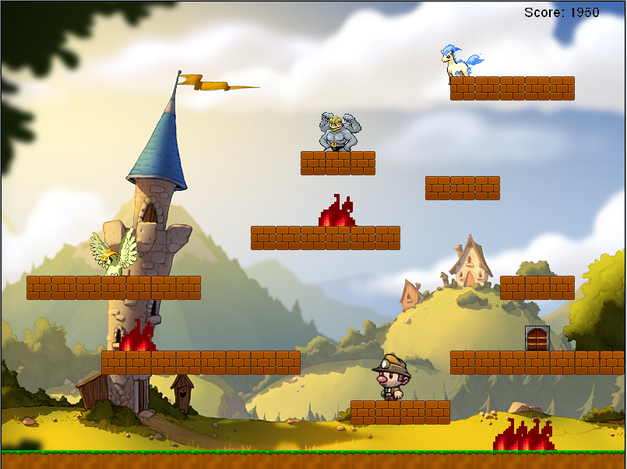
The door takes you to the next stage

Slide 20
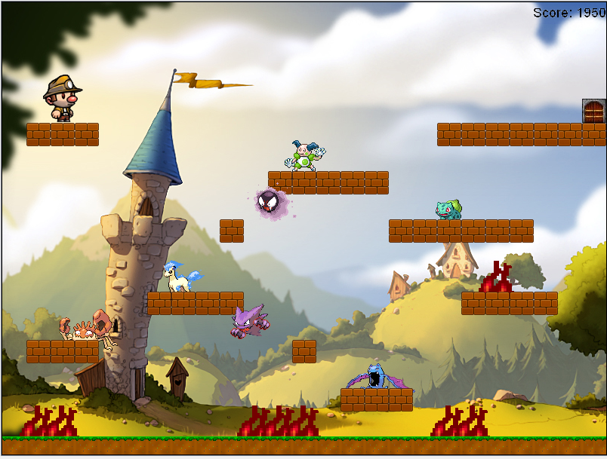

Slide 21
