Slide 1

Group No. 112
Pulkit Dhirana 11911052
Shivam Gupta 11911074
E-KAKSHA(E-Classroom)

Slide 2

An Initiative towards Online Commencement of exam

Slide 3
Introduction
As we all know that the current pandemic situation has affected all our life’s badly, specially to the future generation of our nation i.e. our young and dynamic brain students. Although commencement of online classes has helped very much to continue the education system.
But all schools, colleges and universities is still lacking a secure system for conduction online exam . Students uses various unfair means during online exams.
So as a Software developer we have developed an application for conduction of online exam in fair manner. We have tried to reduce the uses of unfair as much as possible.

Slide 4
Project Objective
This project provides a common platform for all the teachers and students to interact in a user friendly manner.
Primary objective of this project is to provide a platform where teachers can arrange online exams where no unfair means are used by students while conducting exams.
Secondly this app will automatically check the answer sheet of students from the answer key and maintain performance records of all students. It will also notify the results to the students when teacher’s allow the app.
Moreover, on this app teachers can post any information and can give assignments also.

Slide 5
Methodology and Outcomes
The basic idea of our app is to use the face recognition system to track the students live during the exam. Our app will recognize students face during the exam and also track how many people are seeing the screen . So if our app detected more than one face or the detected face doesn’t match to students then the screen will becomes invisible.
Outcomes
Conduction of online exams.
Check answers sheet of MCQs type question and maintain records of result.
Teachers can give and collect the Assignments.
Gives teachers and students a common platforms to interact with social distancing.

Slide 6
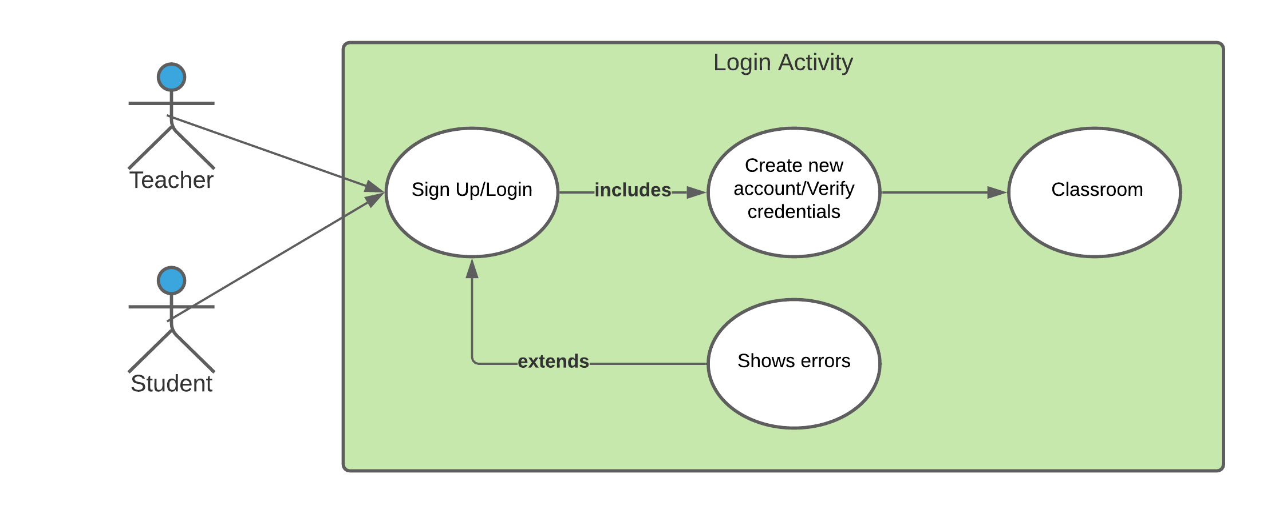
Login Activity diagram
This activity shows how the teachers and students will enter in our app.

Slide 7
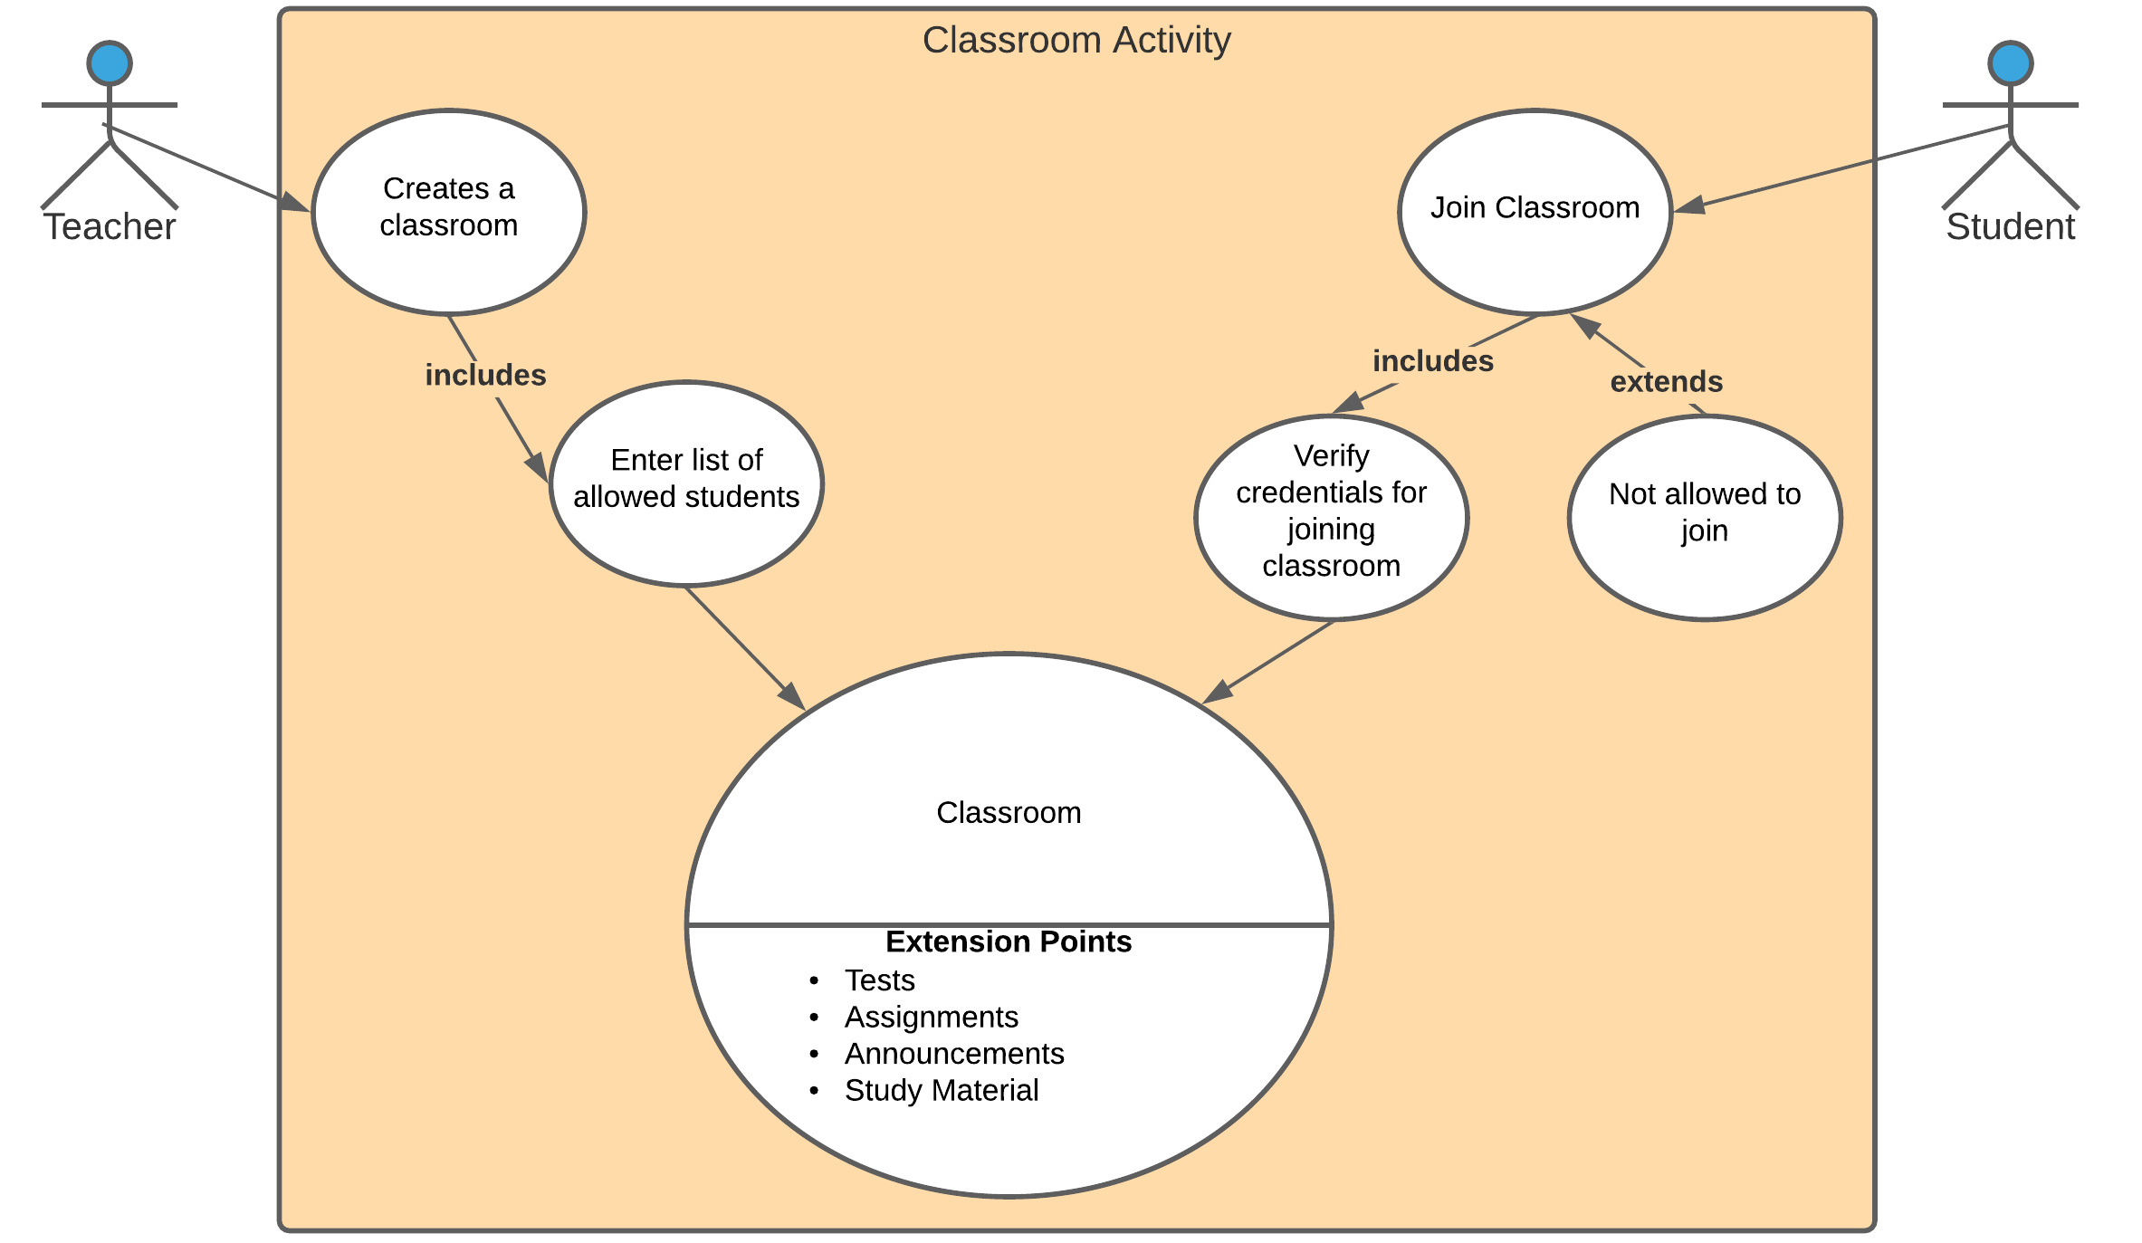
Classroom Activity diagram
This activity shows how the teachers and students will interact in our app.

Slide 8
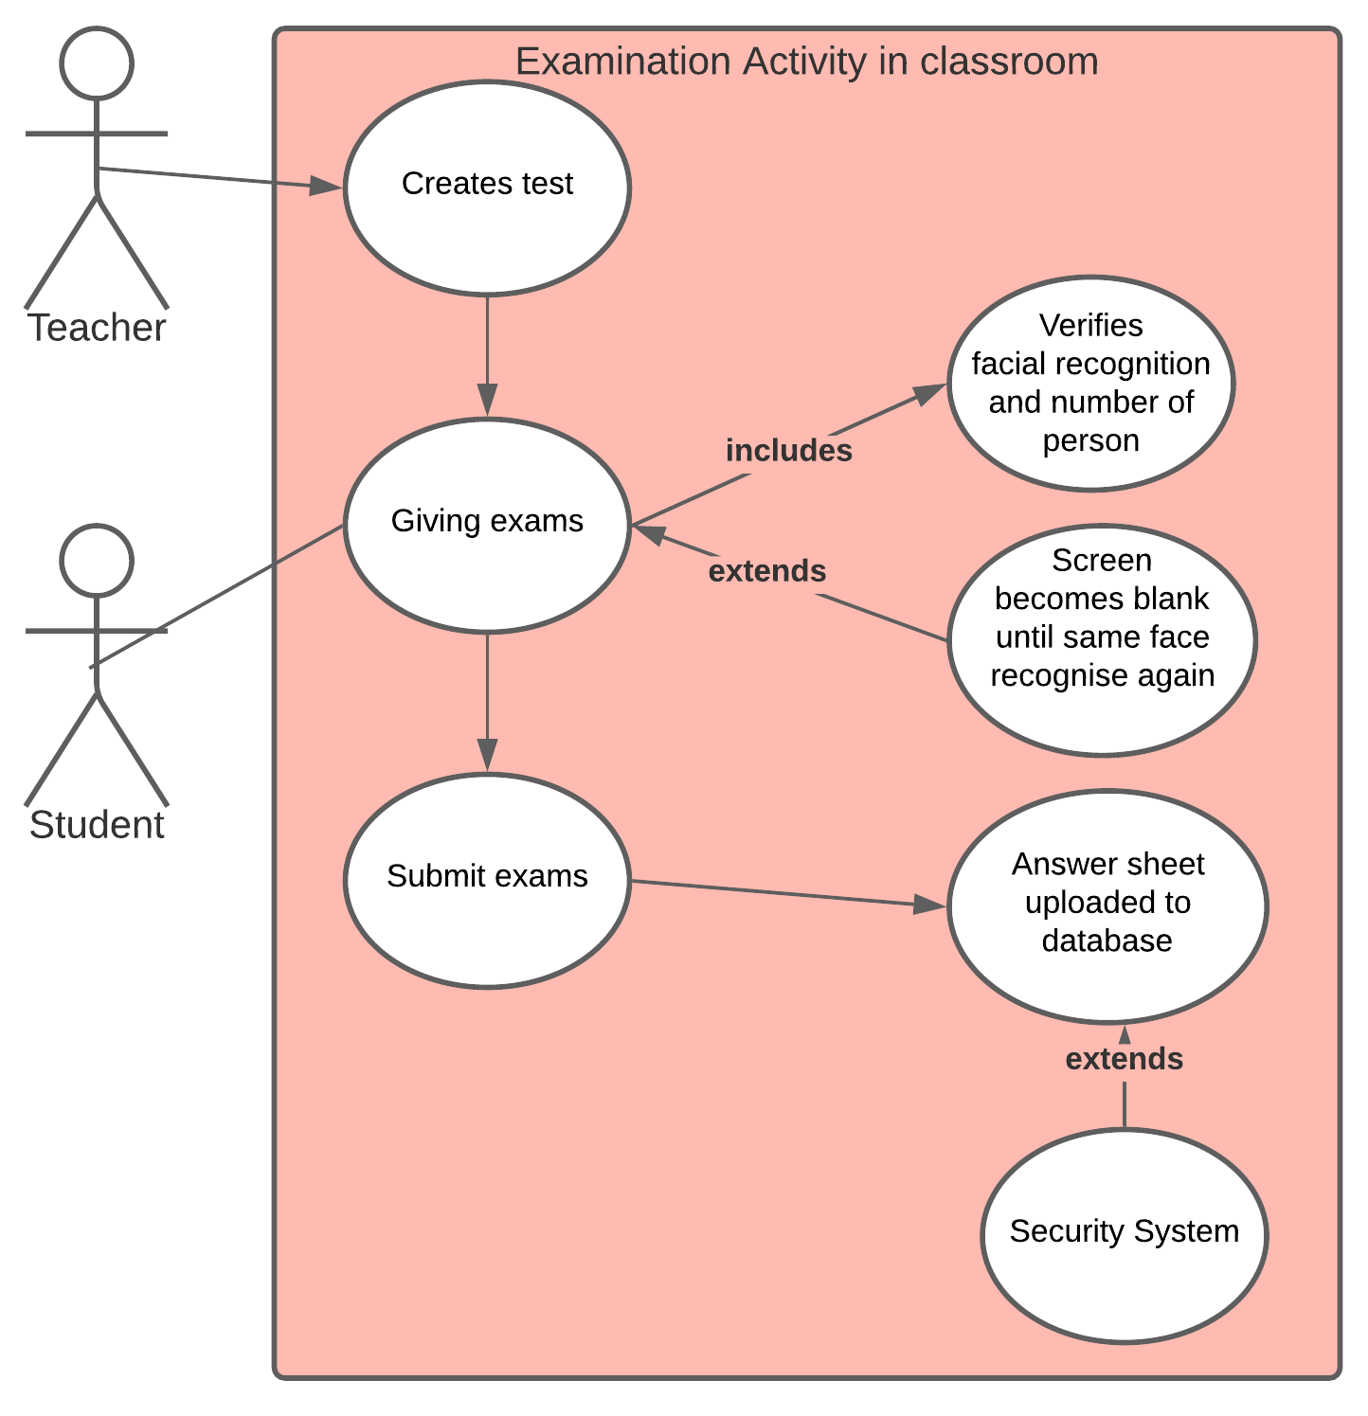
Examination Activity diagram
This activity shows how the student will give exams.

Slide 9
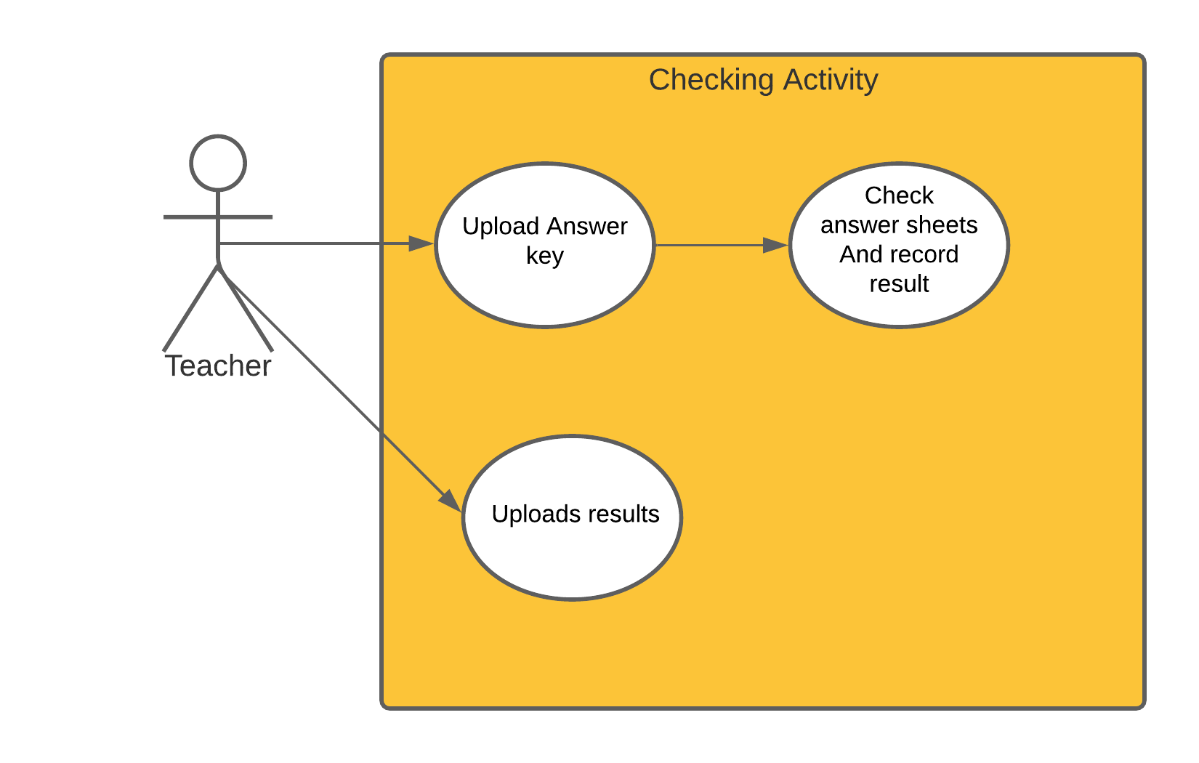
Checking Activity diagram
This activity shows how the teachers will upload the answer key’s and then our app will check all the answer sheets and record the results.

Slide 10
Class Diagram
In this section we will present the class diagram which we are going to use in our project. ​The purpose of class diagrams is to model the static view of an application. Given below is the example of class diagram.

Slide 11
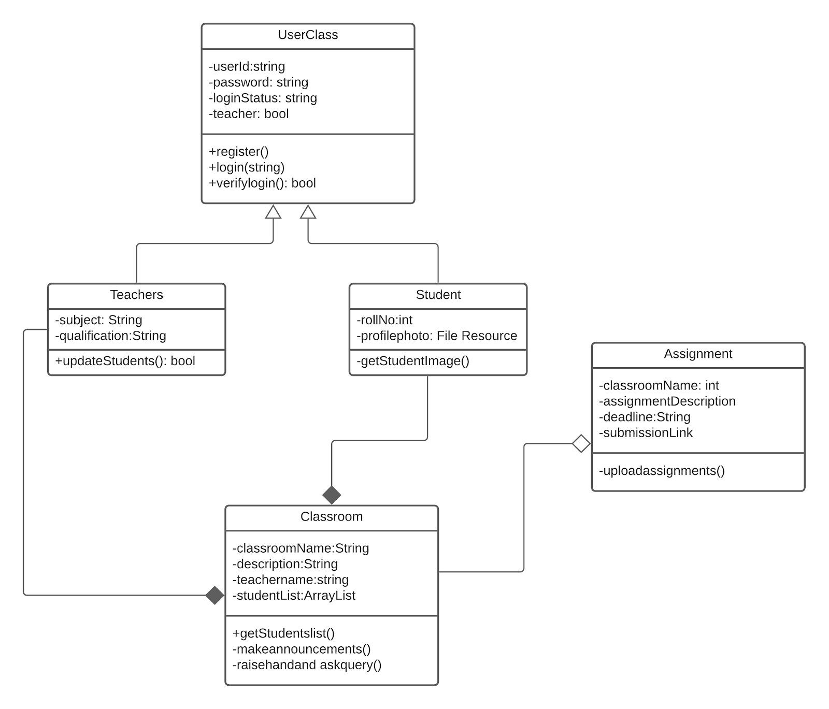
This is how a class diagram looks.

Slide 12
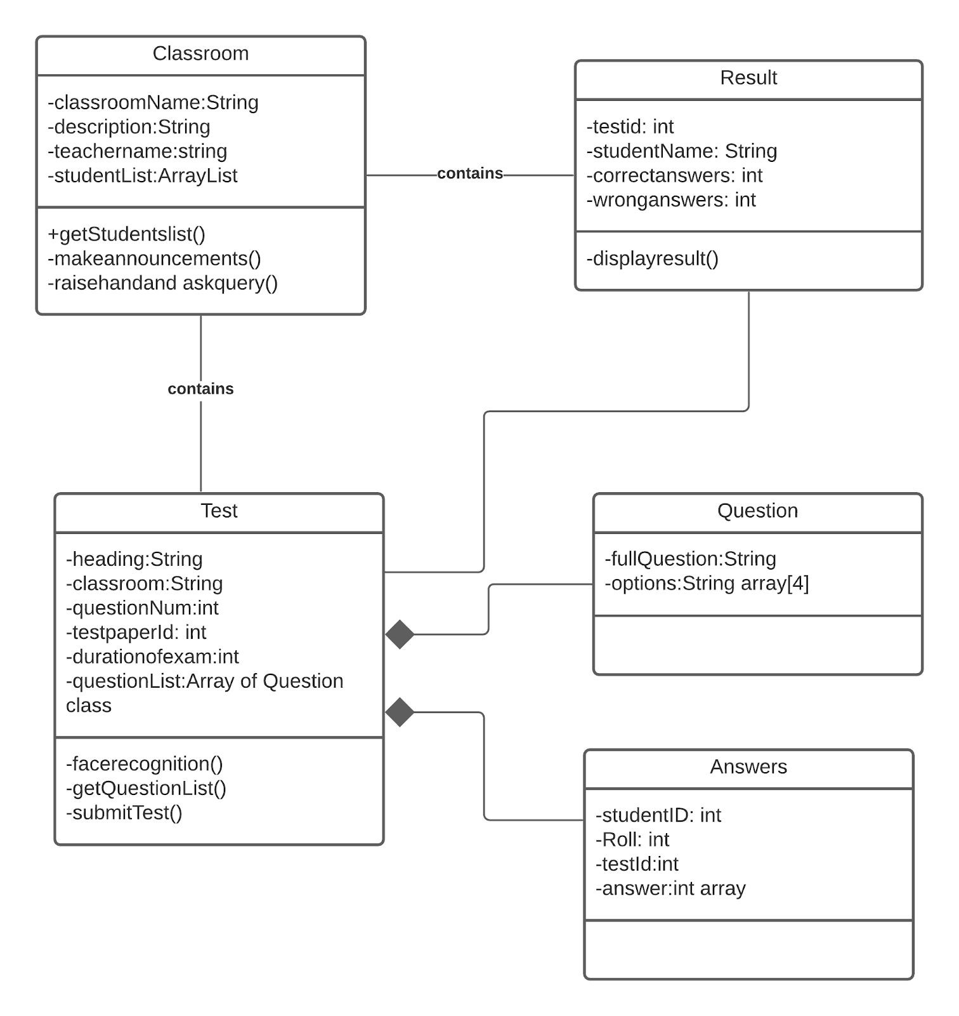

Slide 13
Summary
In this chapter we have presented the basic ideology of the projects ​E-Kaksha ​. The various challenges which we are facing and various obstacles which we have to overcome in making this project . This project will give the teachers an easy platform to conduct exams, evaluate results and maintain records.

