Slide 1

COVID-19 HANDLING:
India vs USA
By:
SAGAR SAINI
CSE
11911076

Slide 2
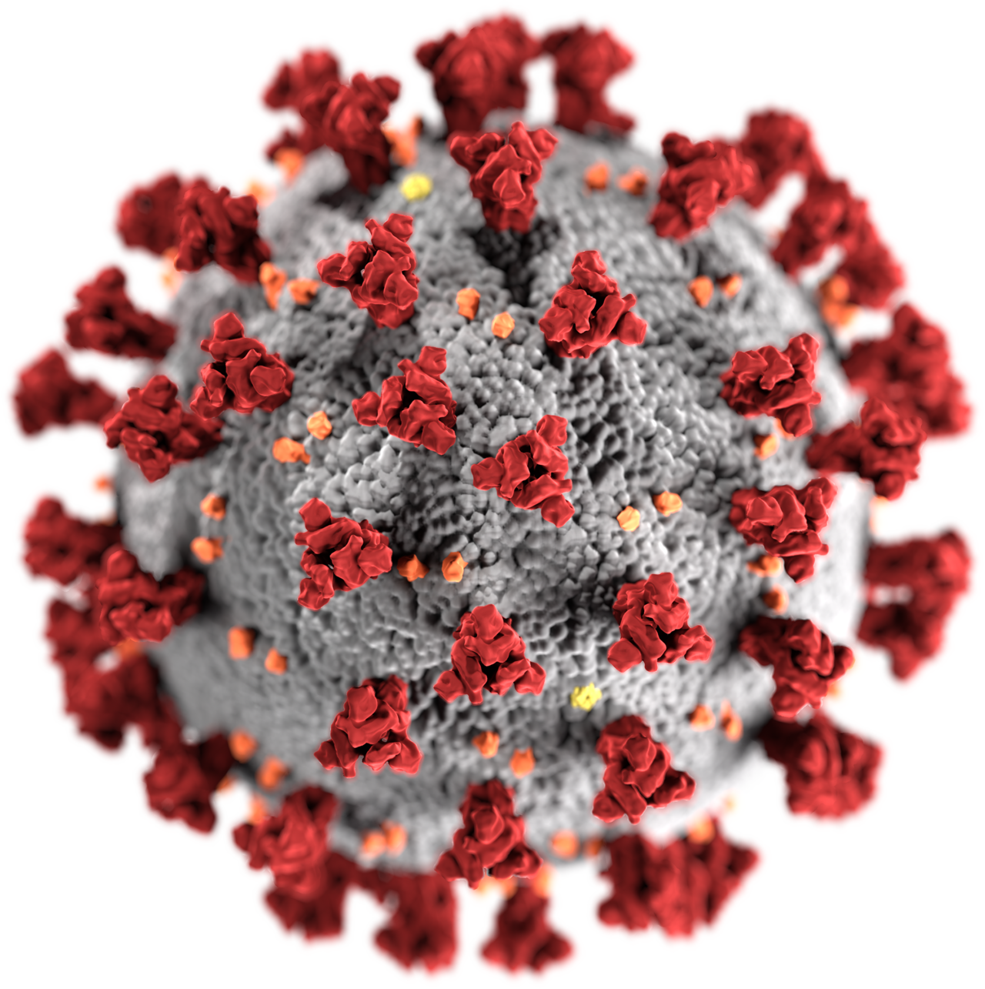
Why it named as COVID-19 ?
The disease was first identified in December 2019 in Wuhan,China.
The Virus responsible for this disease
is Corona Virus. (Informal name)
So, COVID-19 Stands for
COronaVIrus Disease 2019

Slide 3

Ranking of India & USA
in terms of healthcare.
According to a Lancet study,
The score for India's healthcare access and quality was 41.2 (up from 24.7 in 1990), placing it 145th out of 195 countries.
The score for the USA's healthcare access and quality was 88.7 points, placing it 29th out of 195 countries.

Slide 4
Covid-19 Testing Statistics
Country | Date | Tests | Positive | +ve % age | Test per million | Positive per million
India | 24/04/20 | 579,957 | 24,506 | 4.2 | 429 | 18
USA | 24/04/20 | 4,888,198 | 890,816 | 18.2 | 14,892 | 2,714
Source:
Wikipedia

Slide 5
USA is on the top of list of countries conducting highest no of Covid-19 Testing.
India is on the 12th position in this list till 24 April.
Some positive things for India are
* India is having low positive/tested percentage.
* India is on the 12th position in the list, although India’s healthcare rank is above 100.

Slide 6
Protective Measures taken by India
India began Thermal Screening of passengers arriving from China on 21th Jan and later it extended for passengers from other countries.
In March, Govt assigned different ministries the task of availability of essential material as per their department.
India started evacuating Indians from other countries and asked them to be quarantined for 14 days.

Slide 7
G.O.I. closed passenger traffic from all neighbouring countries on 16 March and made screening of all international passengers compulsory.
On 16 March, G.O.I. declared nationwide lock down of school and colleges and exams were postponed.
Aarogya Setu, a COVID-19 tracking mobile app was launched.
On 24th March, PM Narendra Modi announced a complete nationwide lockdown till 14 april and on 14 April, PM extended it till 3 may.
Govt focused on increasing labs and authorised private lab on 17th March to test for the virus

Slide 8
COVID-19 Cases Trends in India
Date | Total Cases | Active Cases | Recovered | Deaths
30/01/2020 | 1 | 1 | 0 | 0
29/02/2020 | 3 | 0 | 3 | 0
06/03/2020 | 31 | 28 | 3 | 0
15/03/2020 | 112 | 97 | 13 | 2
25/03/2020 | 657 | 603 | 43 | 11
02/04/2020 | 2,545 | 2,285 | 191 | 69
07/04/2020 | 5,349 | 4,719 | 469 | 161
13/04/2020 | 10,453 | 8,897 | 1198 | 358
18/04/2020 | 15,724 | 12,737 | 2,466 | 521
24/04/2020 | 24,447 | 18,171 | 5,496 | 780
Source:
COVID-19_INDIA

Slide 9
Protective Measure taken by USA
USA banned foreign nationals arriving from China on 31 Jan
In March, the govt started to use the Defence Production Act to direct industries to produce medical equipment.
The first usage of the D.P. Act to direct industry came on March 27, when Trump ordered General Motors to make ventilators.

Slide 10
On March 16, the White house advised against any gathering of more than 10.
In late March, Lockdown announced in some states of USA over a period of time.
By April 22, school building had been ordered to be closed.
By April 20, USA had processed more than 4 million tests

Slide 11
COVID-19 Cases Trends in USA
Date | Total Cases | Currently Infected | Deaths
15/02/2020 | 15 | 12 | 0
29/02/2020 | 68 | 60 | 1
11/03/2020 | 1,301 | 1,248 | 38
17/03/2020 | 6,357 | 6,129 | 121
21/03/2020 | 24,418 | 23,870 | 374
27/03/2020 | 1,05,217 | 1,00,548 | 2,110
01/04/2020 | 2,20,295 | 2,04,966 | 6,394
10/04/2020 | 5,09,604 | 4,60,252 | 22,038
17/04/2020 | 7,14,822 | 6,16,864 | 37,448
24/04/2020 | 9,25,232 | 7,62,607 | 52,193
Source:
Worldometers

Slide 12

Conclusion
India had faced situation wisely, though, India is having limited resources .
India should increase the no of daily testings.
There should b restriction
in USA atleast till Corona Virus cases growth rate gets controlled.
What’s your Opinion ?

Slide 13

Thank you !

