Slide 1
Bank-Data-X: “Centralized Data Warehouse and ML Solution for Banking Analytics"
Done By
Sagar s Salvi

Slide 2
Problem Statement
Our client, a bank, has various data sources, that contain valuable data. However, the data is not well-organized, making it challenging to analyze and gain insights. Additionally, the client wants to use the data to create machine learning models to improve their business processes and provide better services to their customers.

Slide 3
Solution
Organized Data: By extracting and transforming data from various sources into a centralized data warehouse, the bank can have a more organized and consistent data set to analyze.
Analysis and Reporting: With a centralized data warehouse, the bank can easily perform analysis and generate reports to gain insights into their customer behavior.
Machine Learning Model: By using the data warehouse, we can develop and deploy a machine learning model that can help the bank predict which customers are likely to purchase a term deposit.
Improved Decision-Making: With organized and analyzed data, the bank can make informed decisions about their marketing and sales strategies, leading to better business outcomes.

Slide 4
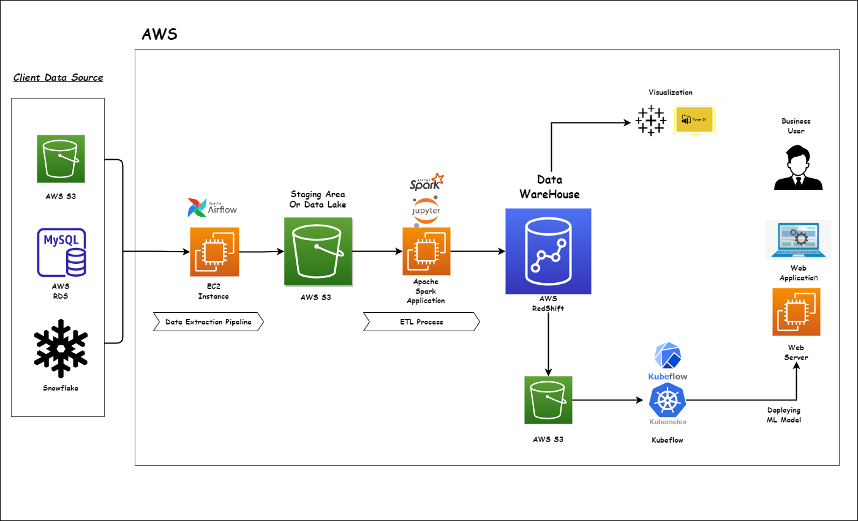
Architecture

Slide 5
Services & Tools
AWS Cloud Services :- EC2 Instance, IAM, S3 Bucket, RDS Database, Redshift Cluster, SNS, Sagemaker
Containerization-Orchestration Tool :- Docker, Kubernetes
Visualization Tools :- Tableau or Power Bi
MLOps Tool :- Kubeflow
Programming Language :- Python
Machine Learning - Scikit Learn
Apache spark
Apache Airflow
Jupyter Notebook

