Slide 1

Project Title -Seasonal Agriculture Performance Analysis
[Student Name SAGAR LINKA]
[College Name- WORLD COLLEGE OF TECHNOLOGY AND MANAGEMENT ]
AICTE STU ID : STU6a440d0bdd22b1782844683
VOIS AICTE BATCH: BATCH 1 |2026-2027

Slide 2

PROBLEM STATEMENT
Agricultural performance varies across seasons due to changes in environmental conditions, farming practices, resource availability and market conditions. However, raw agricultural data does not clearly show how performance changes across seasons. This project analyzes the agricultural dataset to identify seasonal patterns, trends, relationships and variations in yield, production, resource usage and economic performance.

Slide 3
Project Description The Seasonal Agriculture Performance Analysis project focuses on understanding how agricultural performance changes across different seasons.The project involves: * Exploring and understanding the agricultural dataset * Cleaning and preparing the data * Comparing agricultural performance across seasons * Analysing crop yield and production * Studying resource usage and water efficiency * Examining environmental factors such as rainfall and temperature * Analysing economic performance such as revenue and profit * Creating visualizations to identify meaningful patterns * Developing data-driven insights and recommendations

Slide 4

WHO ARE THE END USERS?
Farmers
Agricultural planners
Agricultural analysts
Government and agricultural departments
Researchers
Farm management organizations
Data analyst

Slide 5

Technology Used
1- Programming Language : Python
2- Platform : Google Colab
3- Libraries:
Pandas
NumPy
Matplotlib
Seaborn
4- Techniques : Data Cleaning
Exploratory Data Analysis (EDA)
Statistical Analysis
Correlation Analysis
Data Visualization
Comparative Analysis

Slide 6
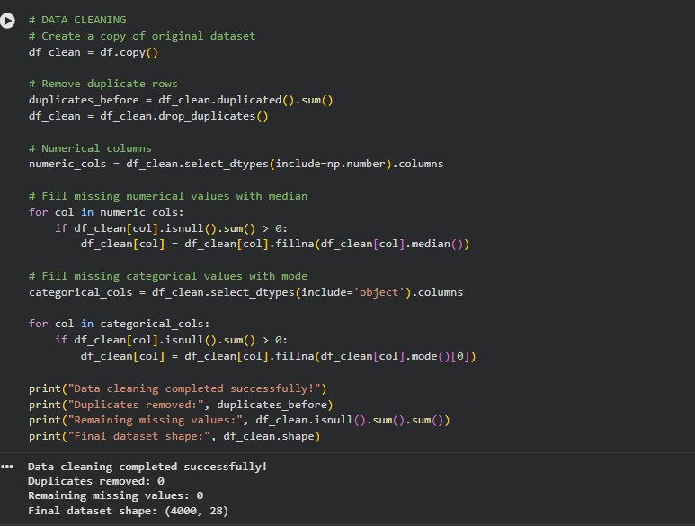
RESULTS
DATA PREPARATION & CLEANING
• Dataset contains 4,000 records and 28 variables.
• Dataset includes crop, season, farm area and environmental parameters.
• Missing values were identified in selected numerical variables.
• Missing numerical values were handled using median imputation.
• Missing categorical values were handled using mode imputation.
• Duplicate records were checked and removed where present.
• The cleaned dataset was used for further analysis and visualization.

Slide 7
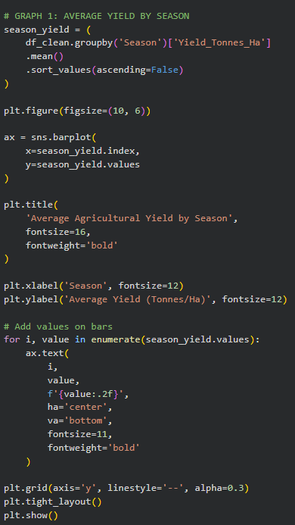
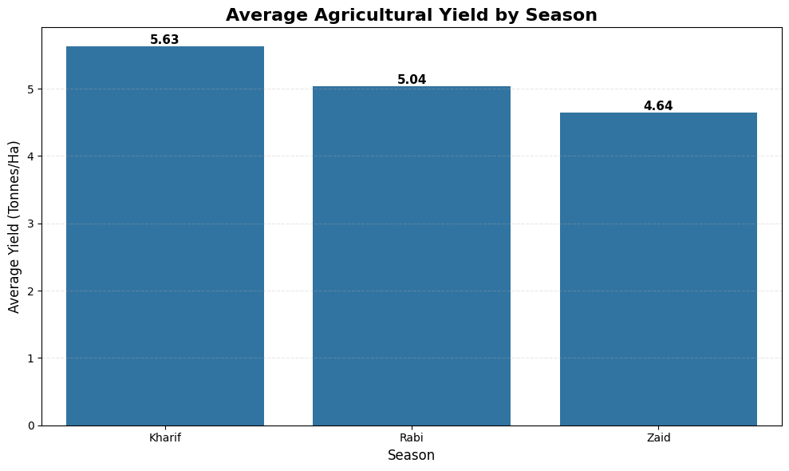
RESULTS
AVERAGE AGRICULTURAL YEILD BY SEASON
KEY FINDINGS
• Kharif recorded the highest average yield at 5.63 tonnes/ha.
• Zaid recorded the lowest average yield among the analysed seasons.
• Seasonal conditions influence agricultural productivity.

Slide 8
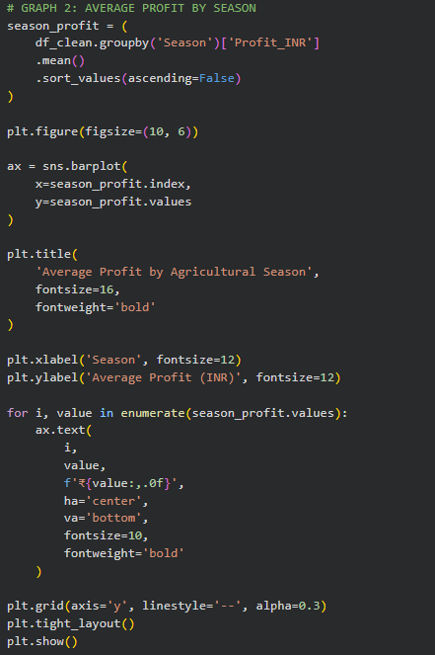
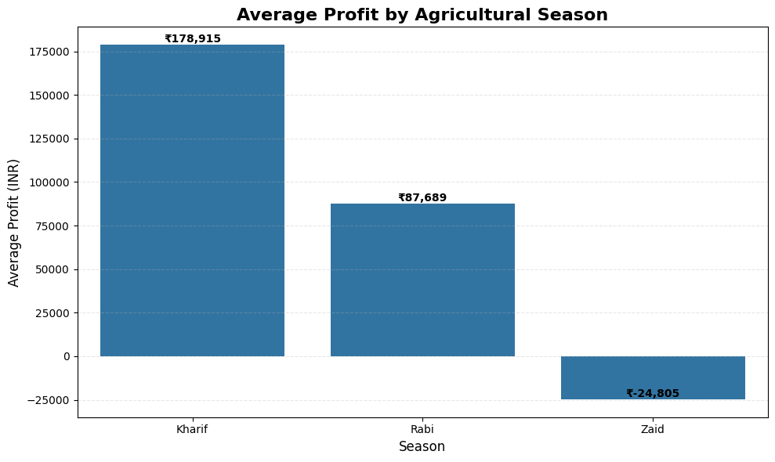
RESULTS
AVERAGE PROFIT BY SEASON
KEY FINDINGS
• Kharif recorded the highest average profit at approximately
₹178,915.
• Rabi showed moderate average profitability.
• Zaid recorded negative average profitability of approximately
₹24,805 loss.
• Seasonal planning should consider both yield and economic returns.

Slide 9
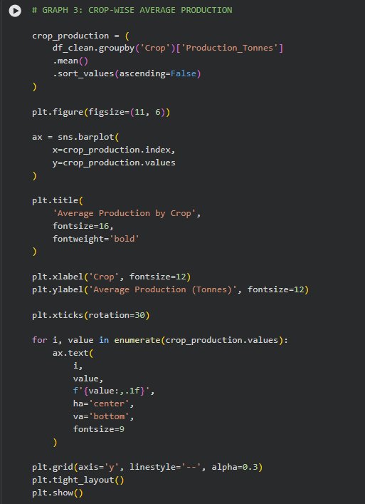
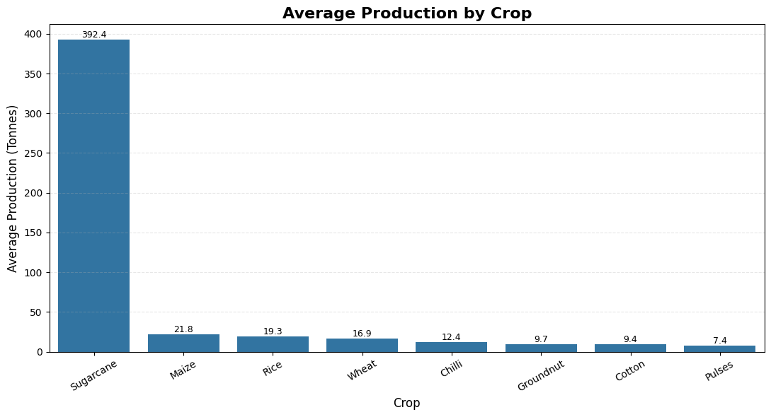
RESULTS
CROP-WISE AGRICULTURAL PERFORMANCE
KEY FINDING
• Sugarcane recorded the highest average yield among
the analysed crops.
• Crop performance varies significantly across different crops.
• Crop selection should consider both yield and profitability.

Slide 10
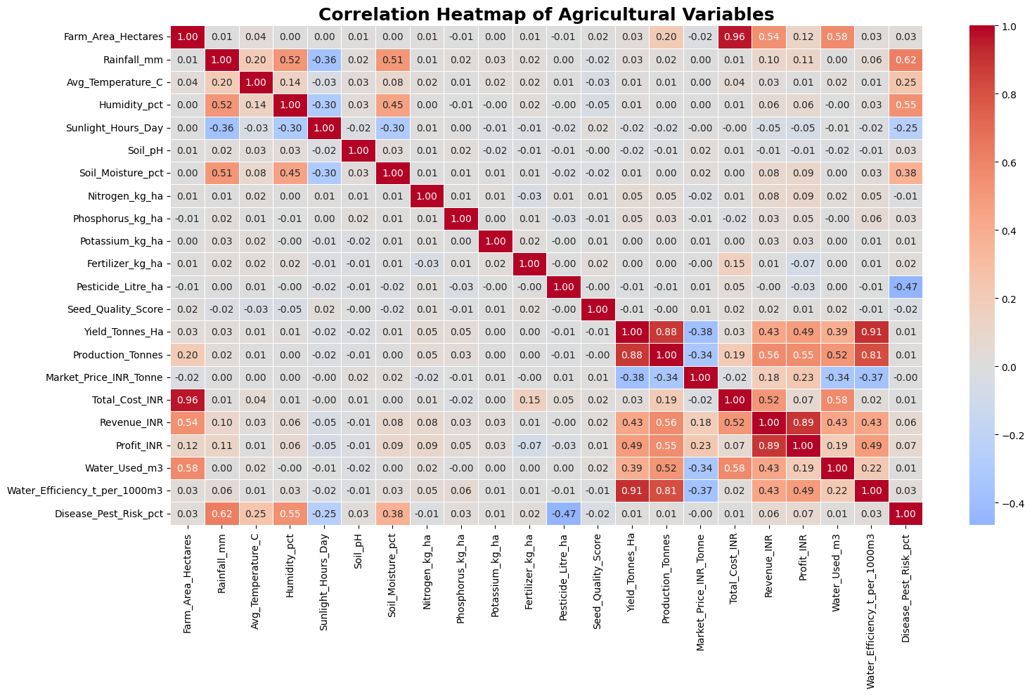
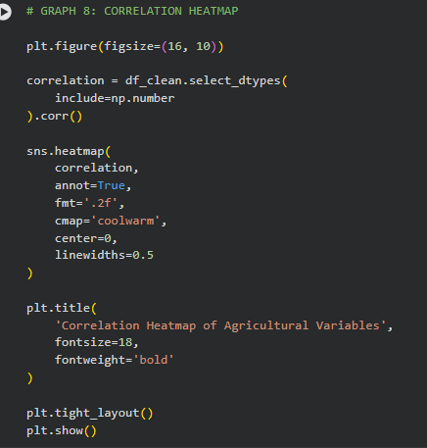
RESULTS
KEY FINDINGS
Water efficiency shows a strong positive relationship with yield.
Production has a strong positive relationship with yield.
Profit and revenue show moderate positive relationships with yield.
Correlation analysis helps identify important relationships between agricultural variables.
CORRELATION ANALYSIS

Slide 11
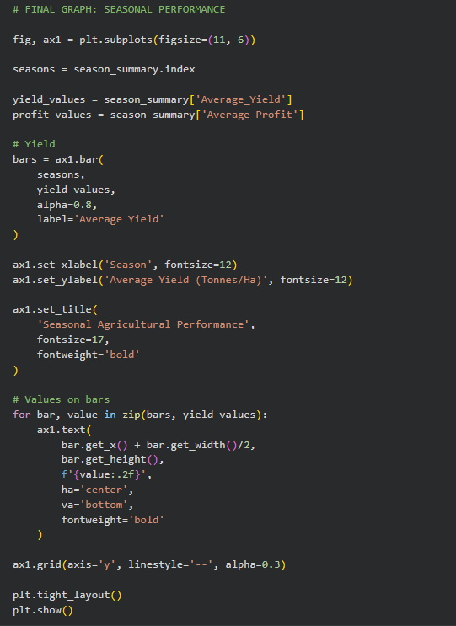
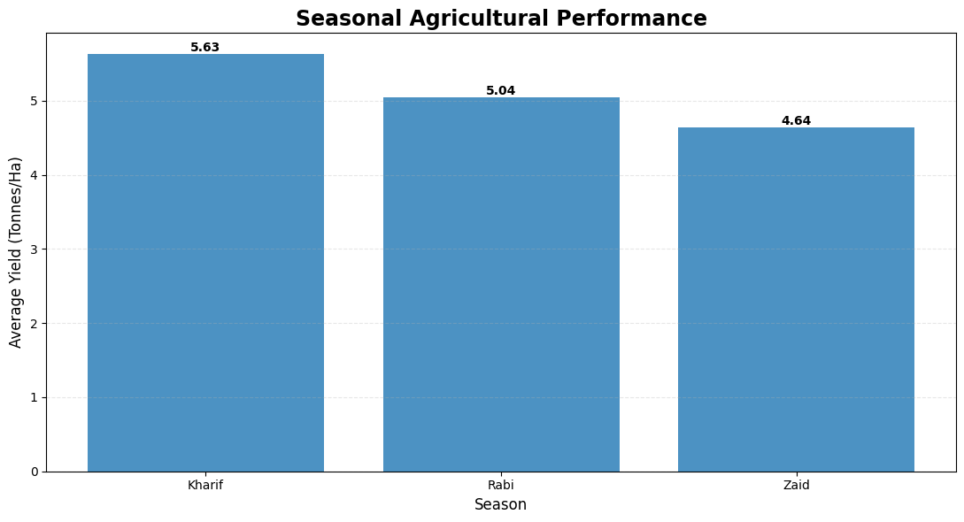
RESULTS
SEASONAL PERFORMANCE COMPARISON
KEY FINDINGS
Kharif shows the strongest overall seasonal performance.
Rabi shows moderate performance.
Zaid records comparatively lower performance.
Seasonal comparison helps support better agricultural planning.

Slide 12
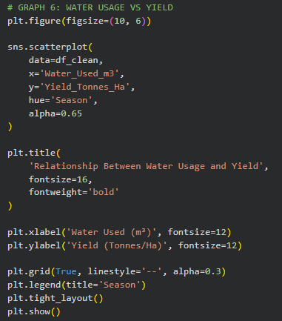
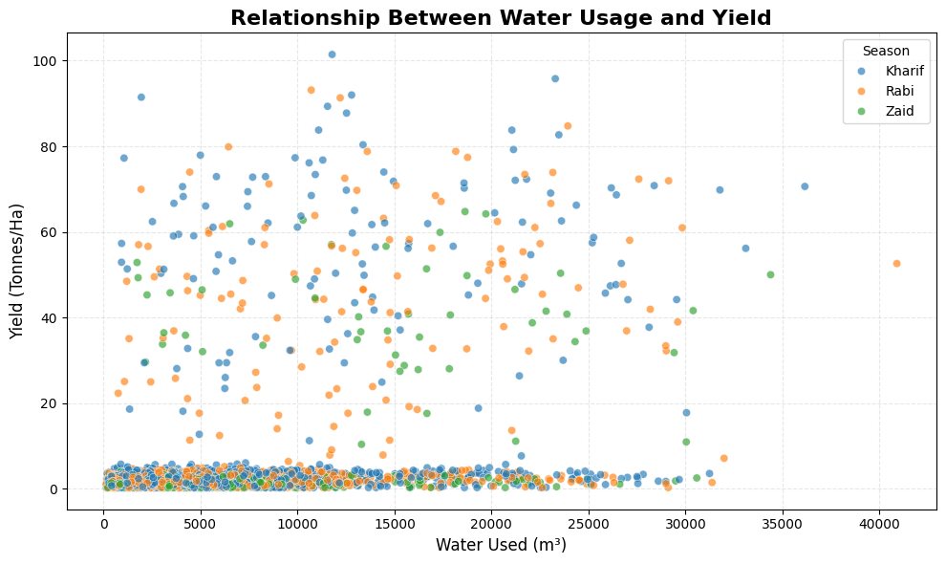
RESULTS
WATER USAGE & YEILD RELATIONSHIP
KEY FINDINGS
Water usage shows a positive relationship with agricultural yield.
The relationship varies across different seasons.
Water efficiency is an important factor in understanding yield performance.
Efficient water management can support better agricultural outcomes.

Slide 13
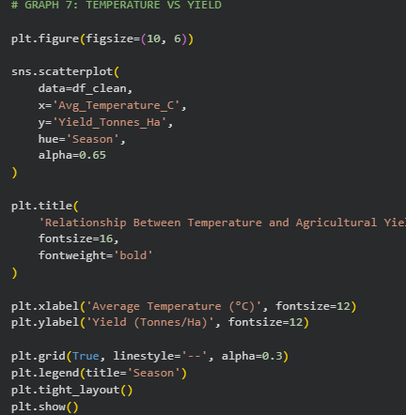
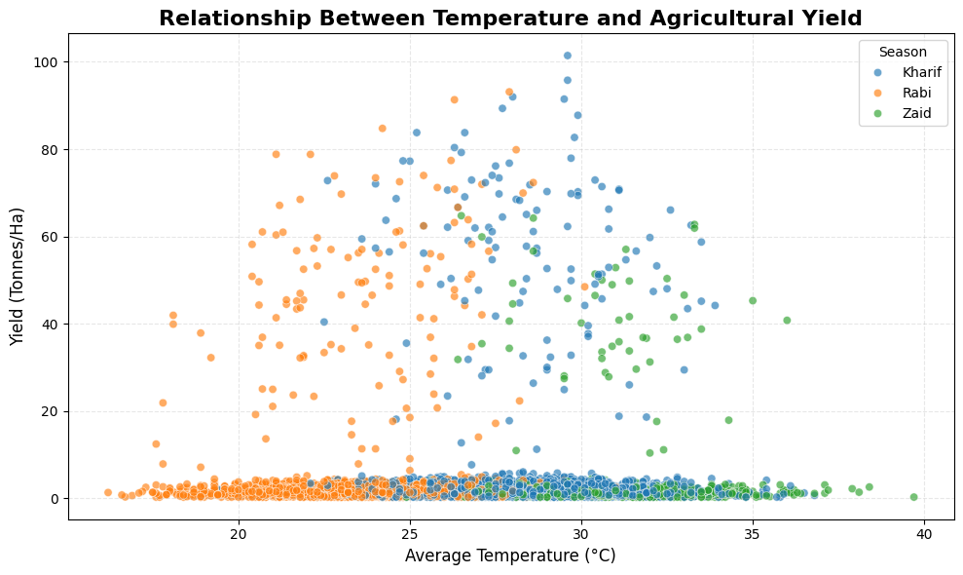
RESULT
TEMPERATURE & YEILD ANALYSIS
KEY FINDINGS
Yield varies across different temperature conditions.
Seasonal differences can be observed in the relationship.
Environmental conditions are important factors in agricultural performance.
Temperature analysis helps identify patterns affecting crop yield.

Slide 14
Future scope
Develop predictive models for crop yield forecasting.
Include real-time weather and environmental data.
Build interactive dashboards for agricultural monitoring.
Extend analysis to more regions and crop varieties.
Apply advanced machine learning techniques for better predictions.

Slide 15
GitHub Link
https://github.com/Sagar-drexx/Seasonal-Agricultural-performance-analysis

Slide 16

VOIS Course completion certificate - Course name- Data Visualization

Slide 17
Thank you
.
.

