Slide 1

DEPARTMENT OF COMPUTER SCIENCE & ENGINEERING(DATA SCIENCE)
“NyxTrace – ML-Powered Money-Laundering Detection & Intelligence”
COURSE NAME : MINI PROJECT
COURSE CODE:22CDS48
Presentation by,
SAGAR
[USN]
Under the Guidance of ,
[Guide Name]
[Designation]

Slide 2
Agenda
Introduction
Literature survey / Existing system
Limitations of Existing System
Problem Definition
Proposed system
Objectives
Design modules
Algorithm / Flow chart
Conclusion

Slide 3
Introduction
Domain: Financial crime analytics – Anti-Money Laundering (AML) using machine learning and graph analysis
Terminologies: layering, fan-in / fan-out, cycles, illicit vs. licit transactions, risk score, explainability
Big picture: Transactions → ML detection → transaction graph → route tracing → risk score → investigation report
Relevance: institutions process enormous transaction volumes; suspicious flows and hidden networks are hard to spot manually
Application: AML analysts, banks, crypto-exchange compliance teams and financial-crime investigators

Slide 4
Literature Survey / Existing Systems
Literature considered
[1] Weber et al. (2019) – Elliptic dataset; GCN and Random Forest baselines for Bitcoin AML
[2] Elmougy & Liu (2023) – Elliptic++: transaction-level and wallet-level graphs
[3] Altman et al. (2023) – realistic synthetic AML transactions with labelled laundering patterns
[4] XGBoost (2016) and [5] SHAP (2017) – gradient-boosted detection and model explainability
Existing systems
Rule-based transaction monitoring: fixed thresholds followed by manual alert review
Supervised classifiers / GCN baselines: label transactions but offer no route tracing or investigation dashboard

Slide 5
Limitations of Existing Systems
Fixed-threshold rules cause many false alerts and miss evolving laundering behaviour
Transactions are judged in isolation; the surrounding account network is ignored
Multi-hop routes through intermediary accounts are hard to trace
Black-box scores give analysts and regulators no reason for a flag
Little interactive tooling; investigation summaries are written manually
Scope of improvement: combine ML, graph analysis, risk scoring, explainability and a dashboard in one pipeline

Slide 6
Problem Definition
Financial institutions process enormous transaction volumes, making it difficult to identify suspicious activity and trace potentially illicit funds across interconnected accounts
Traditional detection systems struggle to uncover complex transaction networks and hidden money-flow patterns, and give analysts little insight into why a transaction is flagged

Slide 7
Objectives
Objective 1 – Collect and preprocess transaction datasets (Elliptic++, IBM AMLSim) and analyse transaction patterns
Objective 2 – Apply machine learning to classify potentially illicit transactions
Objective 3 – Build a transaction graph, trace multi-hop money routes and detect layering, fan-in / fan-out and cycles
Objective 4 – Assign risk scores and explain the factors behind each flag
Objective 5 – Develop an interactive dashboard to upload datasets, explore flagged transactions, visualise networks and generate investigation summaries

Slide 8
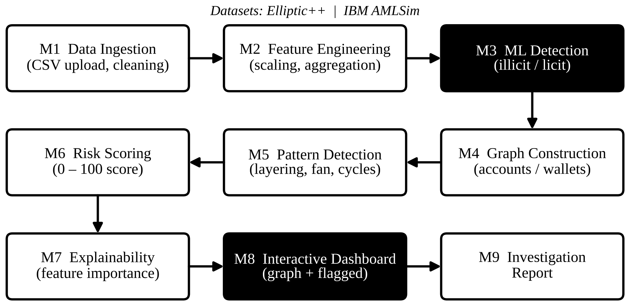
Design Modules – Overall Flow

Slide 9
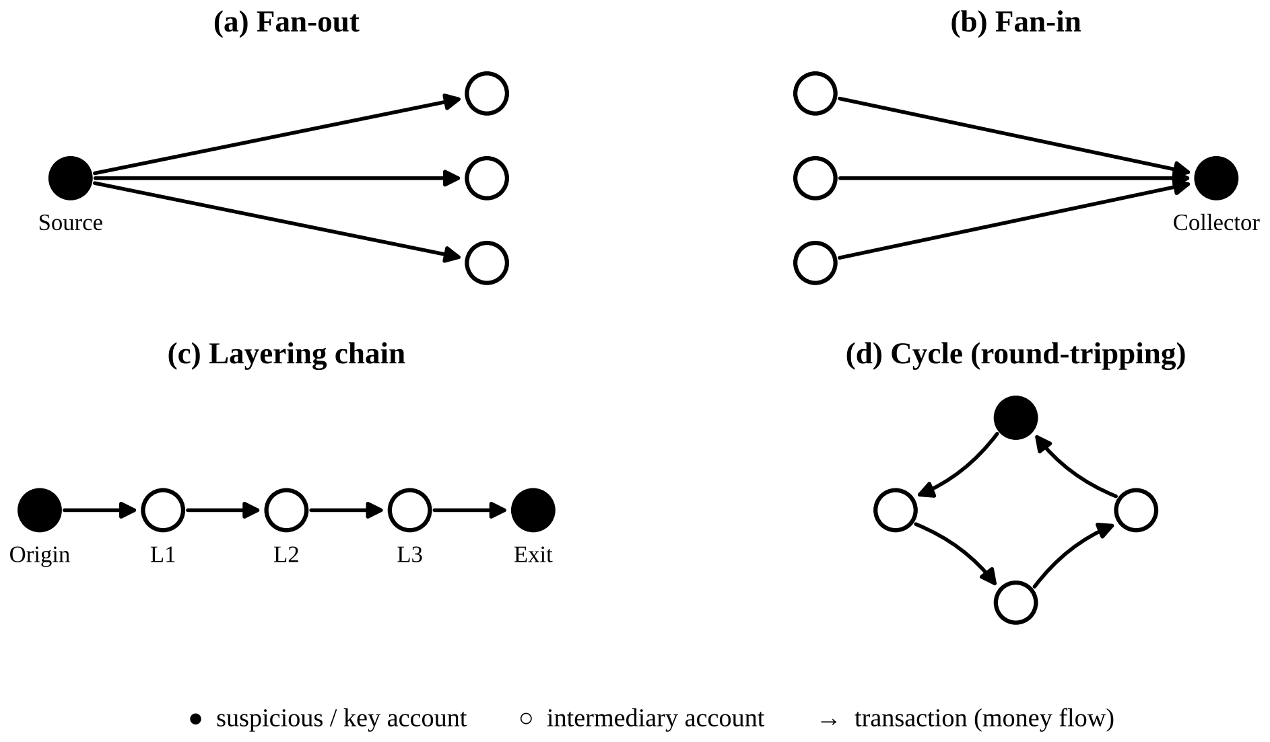
Design Modules – Pattern Detection

Slide 10
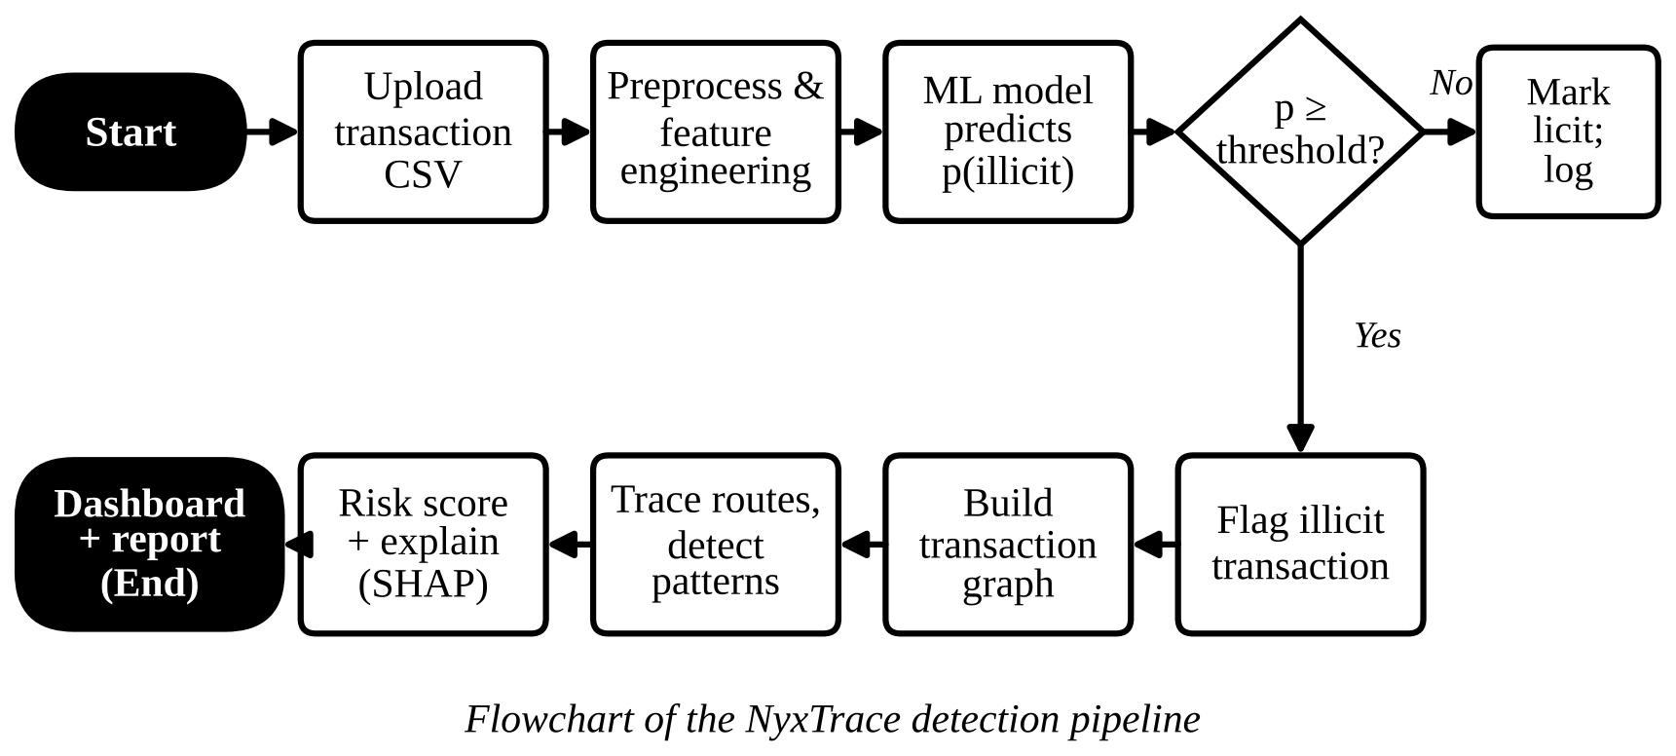
Algorithm / Flowchart

Slide 11
Algorithm – Pseudocode
Input: transaction CSV T, trained model M, threshold θ
Load T; clean missing values; scale / aggregate features X
p ← M.predict_proba(X); flag transaction i if p[i] ≥ θ
Build directed graph G(V, E): nodes = accounts / wallets, edges = transactions
For each flagged transaction, run BFS / DFS (k hops) upstream and downstream to get candidate routes
Detect patterns: fan-out, fan-in (degree ≥ d), layering chains and cycles
Risk(v) ← normalised w1·p + w2·pattern score + w3·proximity to illicit nodes (0–100)
Explain each flag with SHAP feature contributions
Output ranked suspicious networks, routes and an investigation summary to the dashboard

Slide 12
Conclusion
NyxTrace turns raw transaction data into interpretable intelligence for financial-crime investigation and risk assessment
Combines ML detection, graph-based route tracing, risk scoring and explainability in one interactive dashboard
Elliptic++ labels (4,545 illicit and 42,019 licit transactions) allow the prototype to show real detection results
Presented as an ML-based research prototype; it flags suspicious activity and cannot prove criminal money laundering
Future scope: graph neural networks, near real-time scoring, additional datasets

Slide 13
References
[1] M. Weber et al., “Anti-Money Laundering in Bitcoin: Experimenting with Graph Convolutional Networks for Financial Forensics,” KDD Workshop on Anomaly Detection in Finance, 2019.
[2] Y. Elmougy and L. Liu, “Demystifying Fraudulent Transactions and Illicit Nodes in the Bitcoin Network for Financial Forensics,” ACM KDD, 2023.
[3] E. Altman et al., “Realistic Synthetic Financial Transactions for Anti-Money Laundering Models,” NeurIPS Datasets and Benchmarks, 2023.
[4] T. Chen and C. Guestrin, “XGBoost: A Scalable Tree Boosting System,” ACM KDD, 2016.
[5] S. Lundberg and S.-I. Lee, “A Unified Approach to Interpreting Model Predictions,” NeurIPS, 2017.
[6] Web: github.com/git-disl/EllipticPlusPlus (Elliptic++) and github.com/IBM/AMLSim (IBM AMLSim)

Slide 14
Thank you
Queries ?

