Slide 1
AI Resume Analyzer
Attractive Mini Project Presentation
Developed by Sagar Kumar (B.Tech CSE)

Slide 2
Abstract
AI-based Resume Analyzer built using Python and Flask.
Automatically extracts skills from resumes.
Recommends suitable job roles and missing skills.

Slide 3
Problem Statement
Manual resume screening is time-consuming.
HR teams face difficulty in shortlisting candidates.
Need for automated and intelligent resume analysis.

Slide 4
Objectives
Automate resume analysis process.
Extract technical skills from resumes.
Recommend best job role.
Identify missing skills.

Slide 5
System Architecture
User uploads resume (PDF).
Flask web application processes resume.
AI logic extracts skills.
System displays job role and missing skills.

Slide 6
Technologies Used
Python
Flask
HTML & CSS
AI Logic (Keyword Matching)
PDF Processing

Slide 7
Modules
Resume Upload Module
Skill Extraction Module
Job Role Recommendation Module
Result Display Module

Slide 8
Output Screenshots
Server Running (CMD)
Home Page – Resume Upload
Analysis Result Page
→ Screenshots inserted during presentation

Slide 9
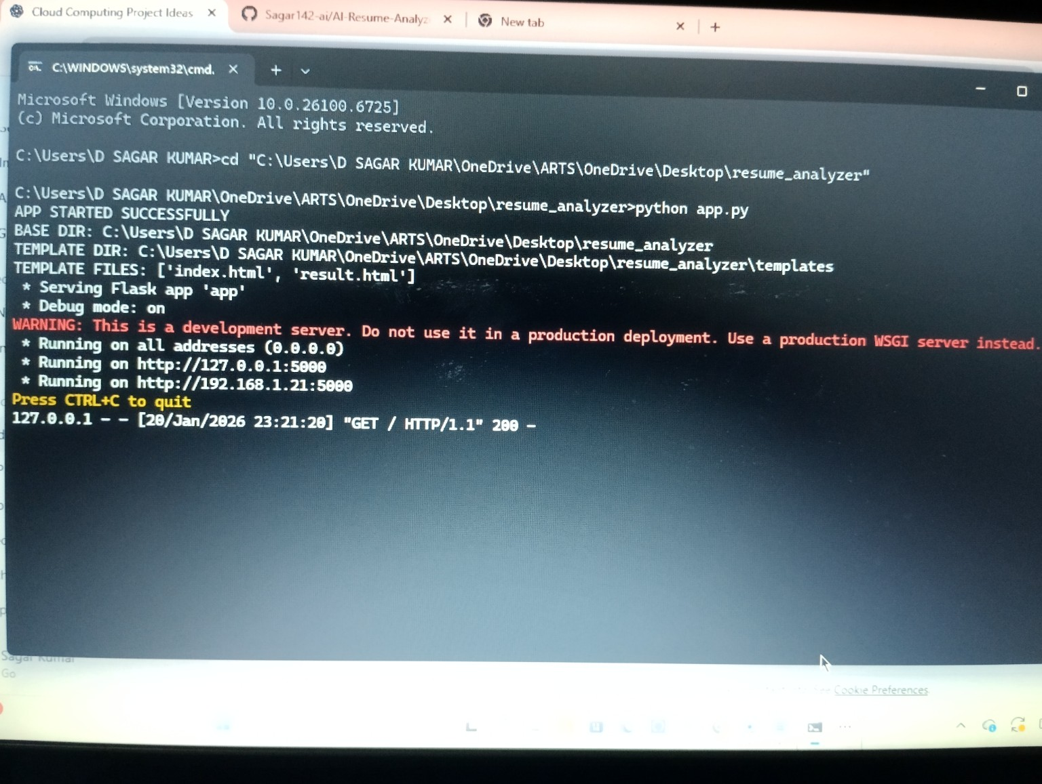
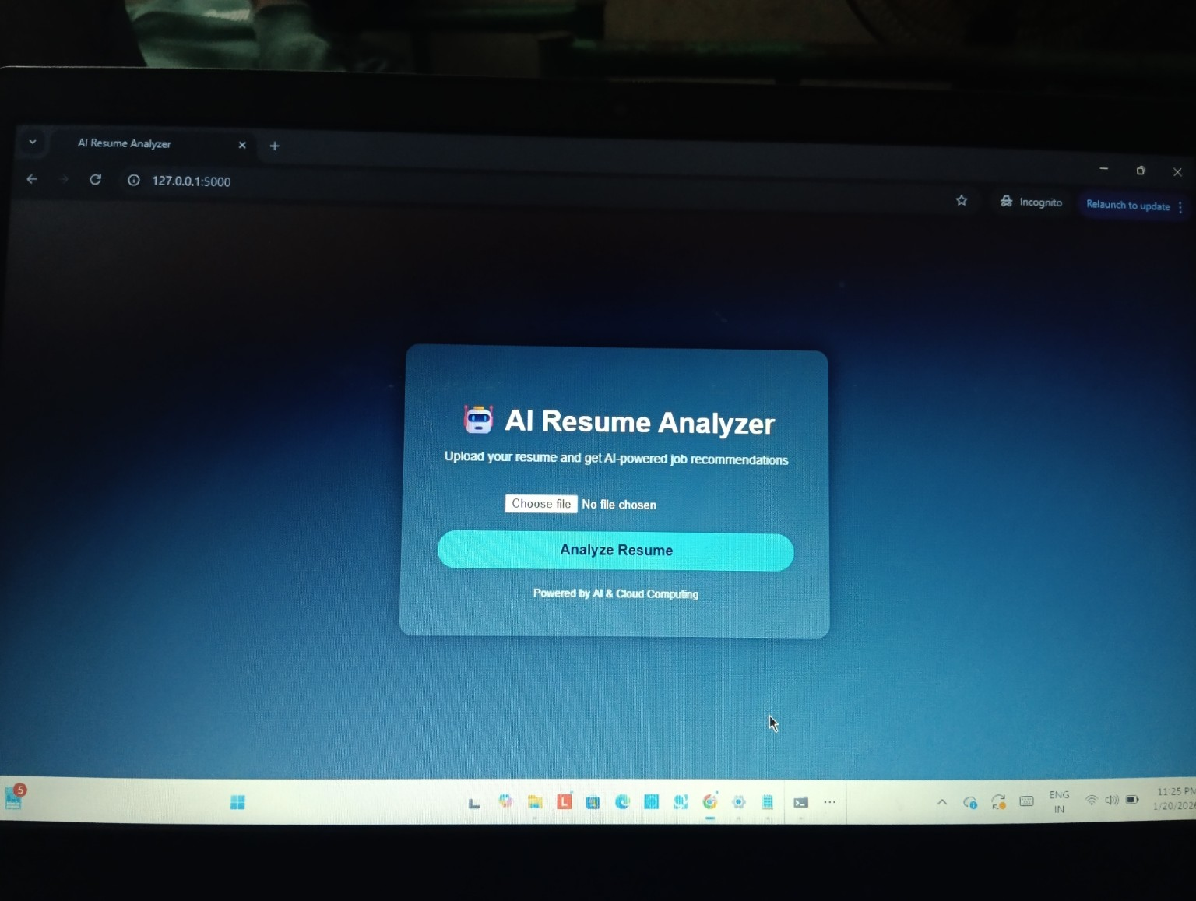
Server running HOMEPAGE

Slide 10
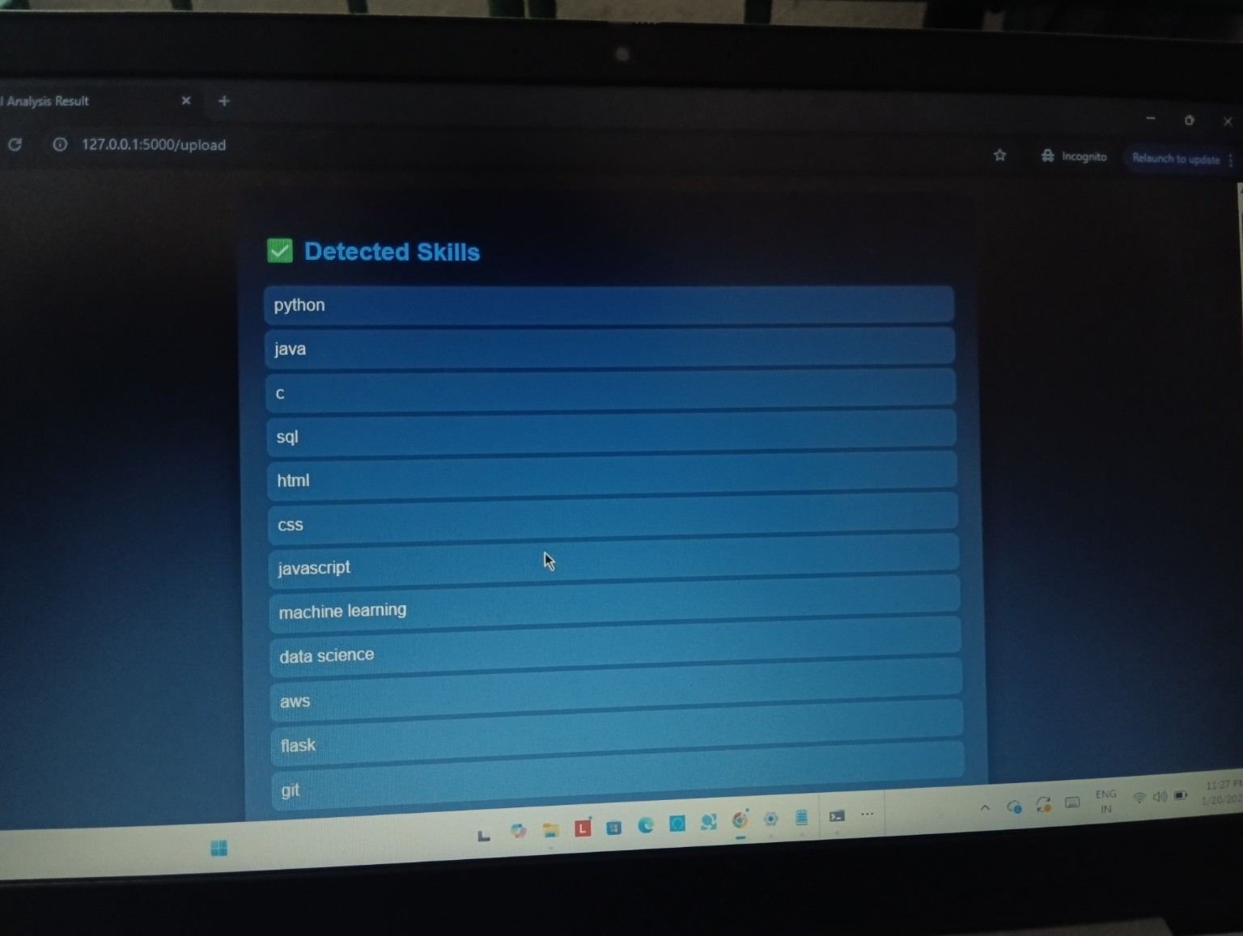
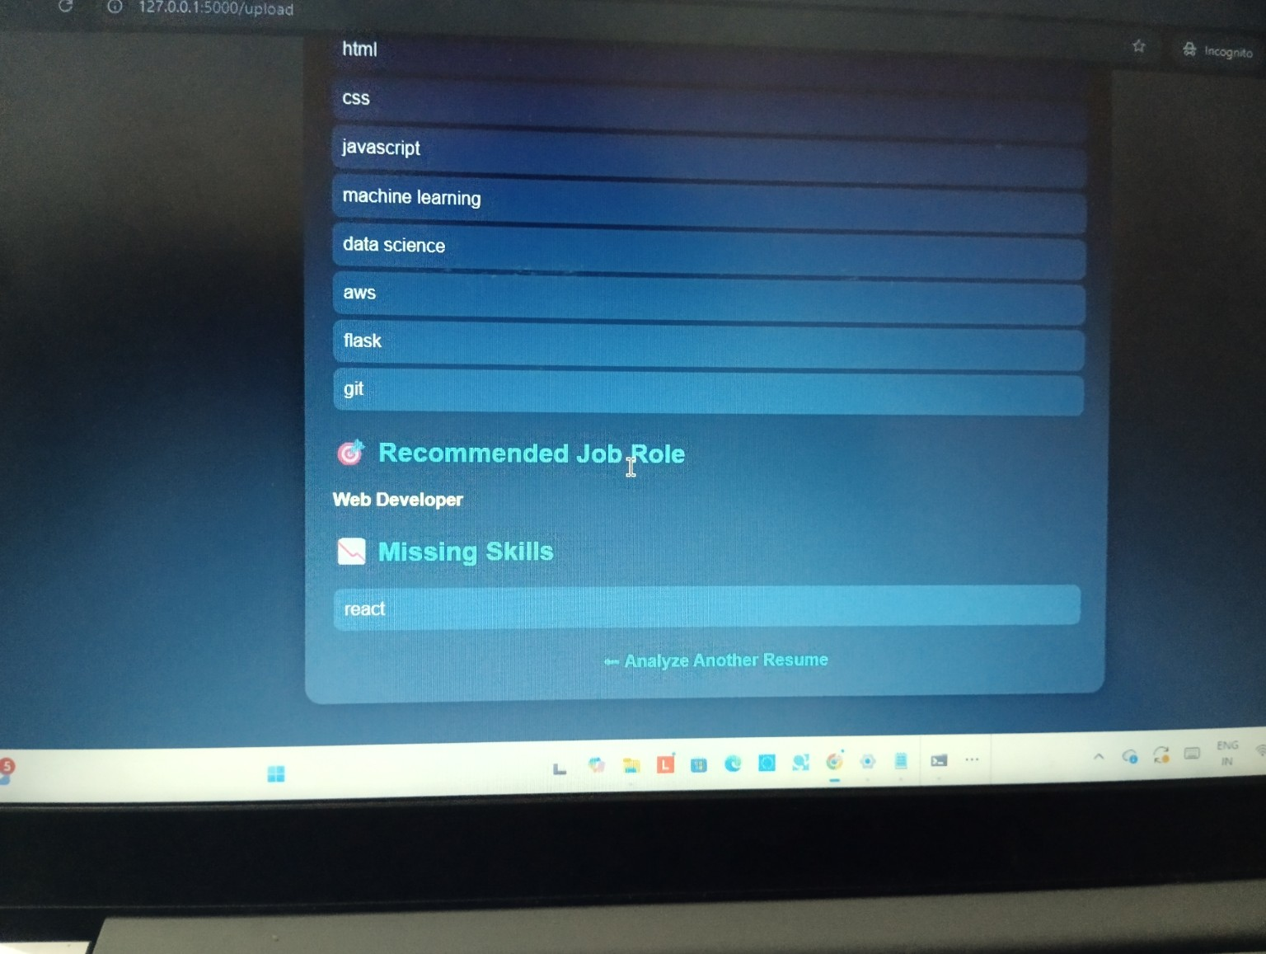
RESULT PAGES

Slide 11
Future Scope
Cloud storage using AWS S3.
Machine Learning-based resume ranking.
Database integration.
User authentication.

Slide 12
Conclusion
Project successfully analyzes resumes using AI.
Provides accurate job recommendations.
Improves efficiency of resume screening process.

