Slide 1


Neural
Nexus
PLUGIN
Hot Swappable
SME PLUGIN
Sagar Shukla
Atharva Sayankar
Nikhil Tale
Pranav Patil
COEP Technological University, Pune

Slide 2

Neural
Nexus
Page 02
Understanding the
Problem
LLMs are powerful but unreliable in critical domains. They can hallucinate facts, ignore expert reasoning workflows, and provide answers without verified sources. In areas like healthcare, finance, and cloud architecture, such inaccuracies can lead to serious consequences. There is a need for a structured middleware layer that enforces domain-specific reasoning and ensures responses are grounded in verified sources.

Slide 3
Neural
Nexus
Page 03
Core LLM
  Hallucination of facts
  Unclear domain understanding
Challenges
  Lack of confidence validation
  No modular expert control
5. No gaurenteed source-of -truth
  Generic responses

Slide 4


USER INPUT
DOMAIN Router
Regex / LLM / Embedding
Page 04
DNA Capsule
RAG + Decision Trees + Guardrails
HYDE Query
Workflow
HYBRID RETRIEVAL
(BM25, ChromaDB, RRF)
CROSS-ENCODER RERANKER
GUARDRAILS
Expert LLM Call
EXPERT RESPONSE
Citations, Domain, Confidence

Slide 5
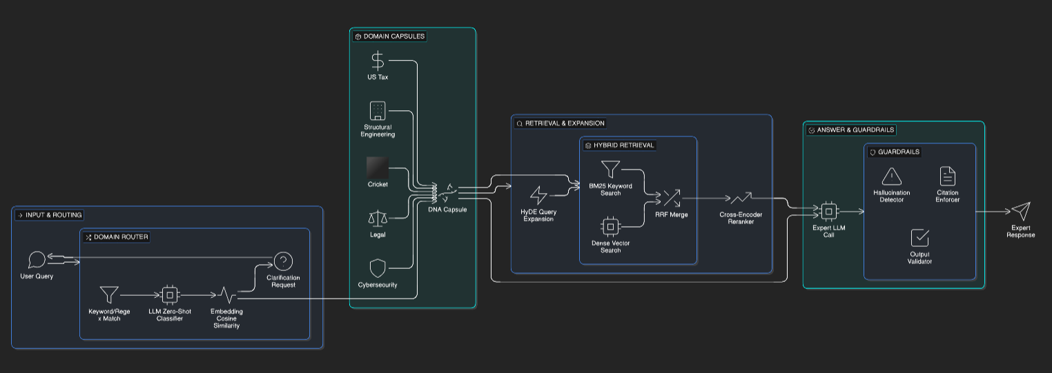
Neural
Nexus
Page 05
Architecture

Slide 6
Neural
Nexus
Page 06
Types of
AGENTS
Routing Agent
Retrieval Agent
Reasoning Agent
Validation Agent
Compliance Agent
Risk Agent

Slide 7
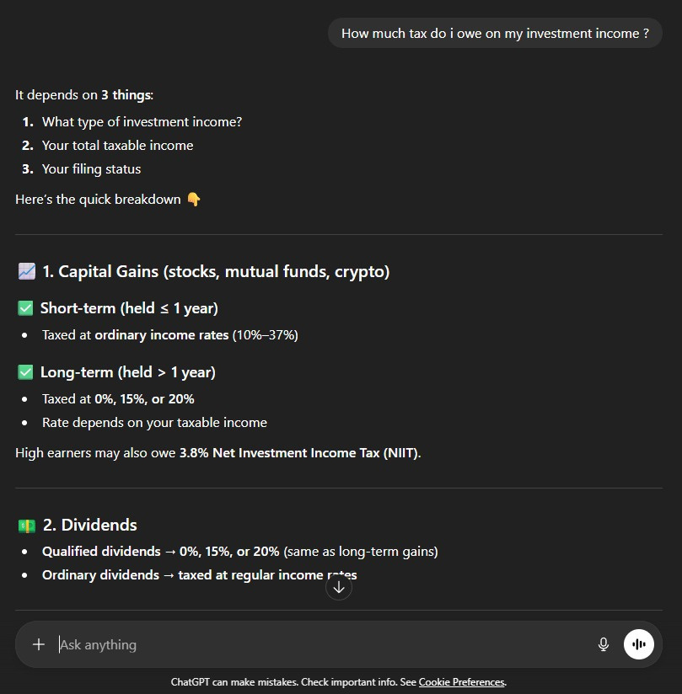
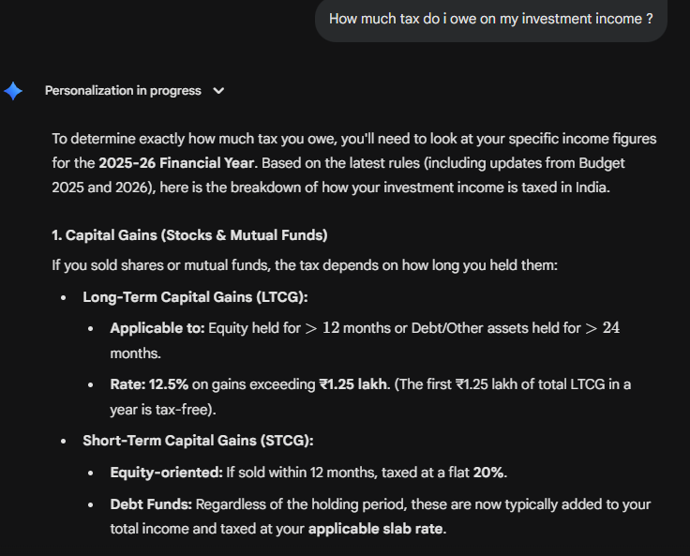
Neural
Nexus
Page 07
Results
QUESTION = How much tax do i owe on my investment income ?
GPT`s answer
GEMINI`s answer

Slide 8
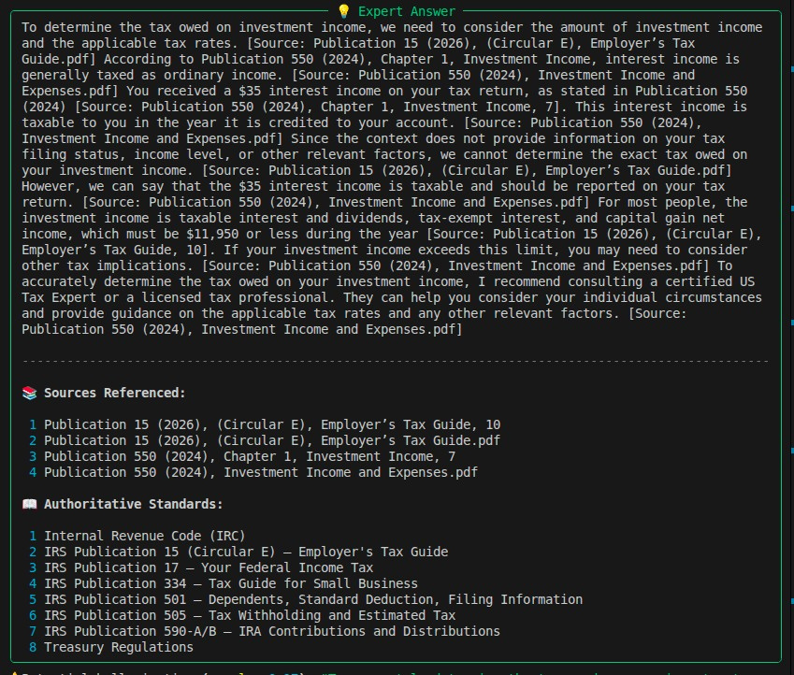
Neural
Nexus
Page 08
Results
QUESTION = How much tax do i owe on my investment income ?
SME`s answer

Slide 9
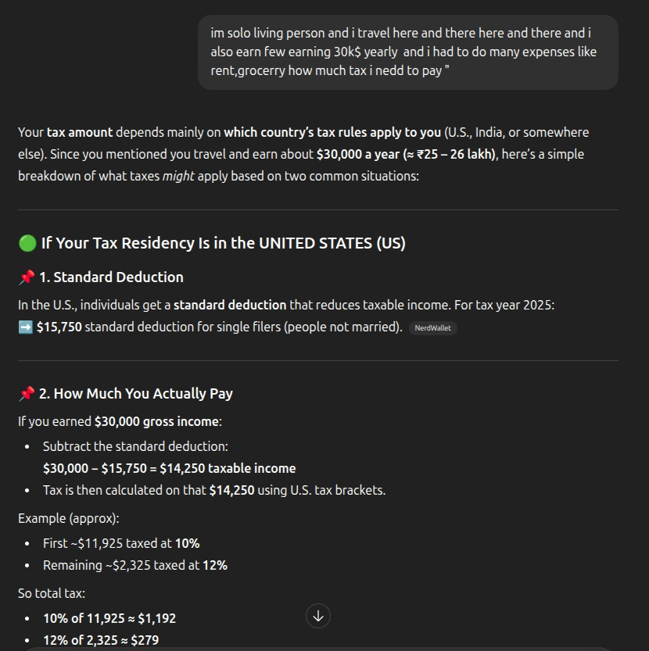
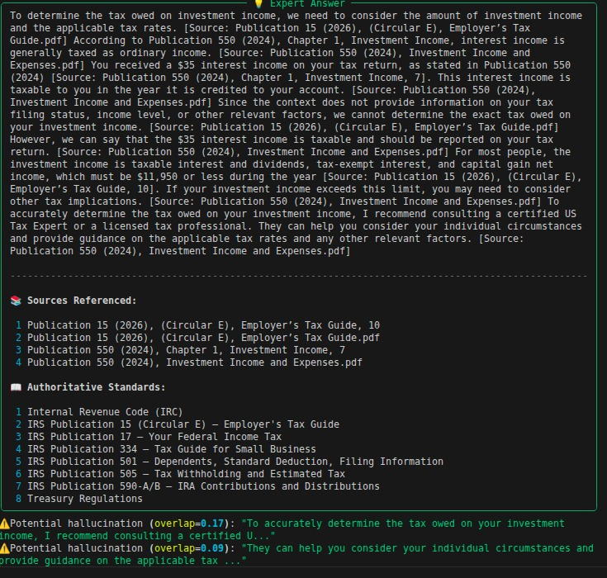
Neural
Nexus
Page 09
Results
Ambiguous QUESTION = Im solo living person and i travel here and there and i also earn few earning 30k$ yearly and i had to do many expense like rent, grocery, how much tax i need to pay
GPT`s answer
SME ‘ s answer

Slide 10
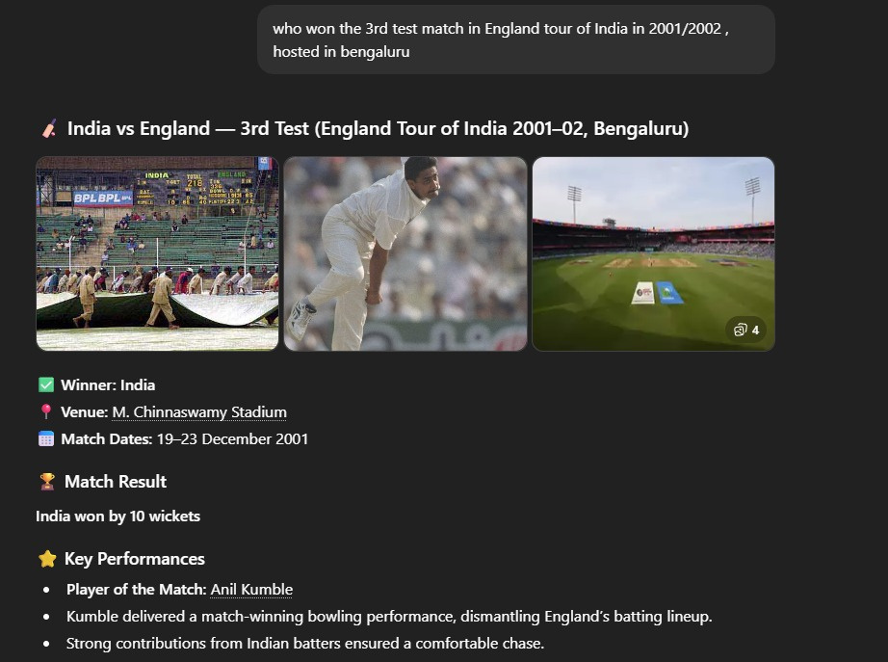
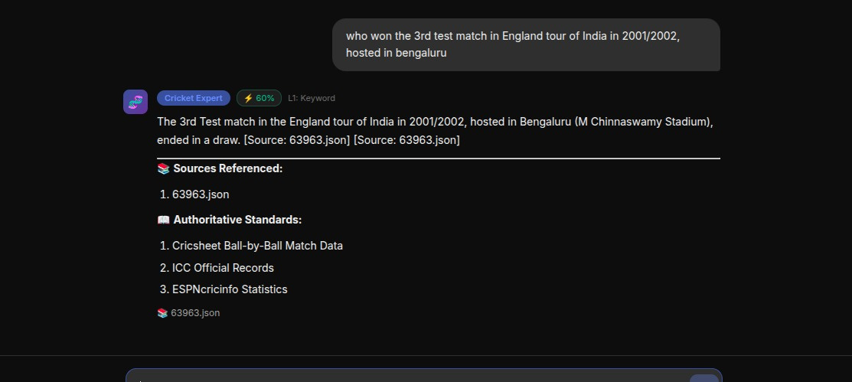
Neural
Nexus
Page 10
Results
Question : who won the 3rd test match in England tour of India in 2001/2002, hosted in bengaluru
GPT`s answer
SME`s answer

Slide 11
Neural
Nexus
Page 11
Without SME:
Our
  Non-Specific explanation
  Random / No citations
  No verification
  No hallucination detection
SME Plugin
With SME:
  Domain detected (Taxes/ Cricket)
  Structured reasoning path
  Retrieved references
  Hallucination flagged
  Citation enforcement
  Confidence score shown

Slide 12

Neural
Nexus
Page 12
Importance of
SME
Domain Expertise
Source-of-Truth
Reliability in High-Stakes Domains
Reduced Hallucination
Confidence Validation
Structured Responses

Slide 13
Neural
Nexus
Page 13
Let’s Discuss Business
“Chatbots that talk” to “ Agents that do”
Who & Why ?
Customer Segment
The why ?
Why buy from us ?
B2B SaaS companies
Their users want specialized features (e.g., a "Legal Assistant" in a CRM).
Why They don't want to build a new model. They just "plug in" SME module.
Engineering Audit
Reviewing 500+ blueprints or tax filings manually is slow and error-prone.
Source of Truth citations and Decision Trees reduce their liability.
Healthcare & Medical Systems
Clinical workflows require domain-safe decision support rather than generic AI responses.
Reduces unsafe AI outputs while maintaining explainable medical reasoning.

Slide 14
Neural
Nexus
Page 14
Thank You

