Slide 1

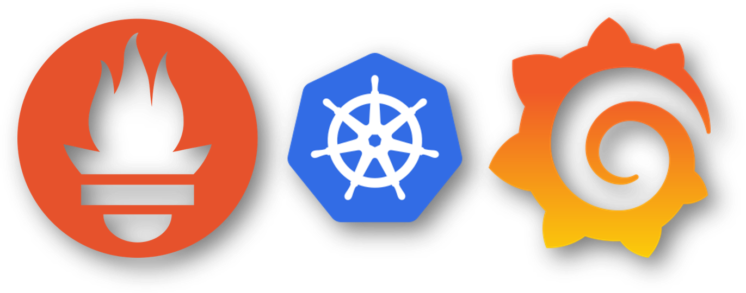
Monitor Kubernetes cluster using Prometheus & Grafana
Sagar Utekar
VMWare Software India PVT. LTD.

Slide 2
What’s on the Agenda ?
Kubernetes Cluster Monitoring
The Four Golden Signals
System Architecture
Components
Demo

Slide 3
Kubernetes Cluster Monitoring
WHAT ?
Collecting, processing, aggregating and displaying real time quantitative data about a system, such as query counts and types, error counts and types, processing times and server lifetimes, CPU & memory usage, health of the cluster components.
WHY ?
Your Kubernetes cluster is up and running. Does it mean your work is done ? Avoid calls at 3 AM.
Analyzing long-term trends
Comparing over time or experiment groups
Alerting
Building dashboards
Debugging
HOW ?
https://github.com/Sagar2366/kubernetes-monitoring/blob/main/README.md

Slide 4
The Four Golden Signals
Latency
Time it takes to service a request.
It’s important to track error latency, as opposed to just filtering out errors.
Traffic
Measure of how much demand is being placed on your system – req/sec, transactions/sec.
Errors
The rate of requests that fail, either explicitly or implicitly.
Saturation
How full your service is.
Having utilization target is essential.
Predictions of impeding saturation, such as “database will fill in 4 hours”
If you measure all four golden signals and page a human when one signal is problematic, your service will be at least decently covered by monitoring.

Slide 5
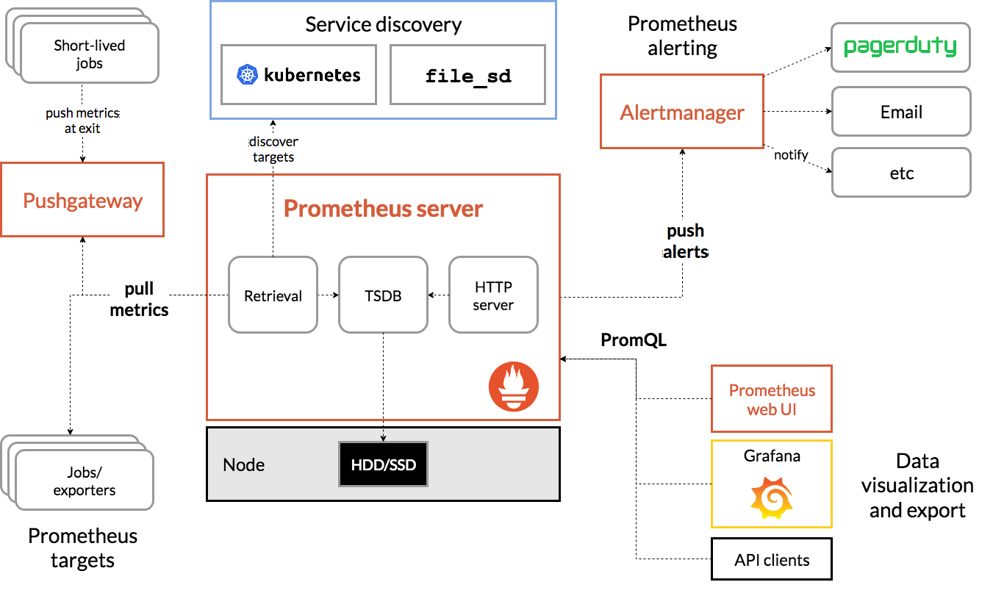
System Architecture

Slide 6
System Components
Kubernetes
Kubernetes (also known as k8s) is an Open-source container orchestration platform that automates many of the manual processes involved in deploying, managing, and scaling containerized applications.
Helm
Package manager for Kubernetes.
Allows us to streamline installation and management of Kubernetes applications.
Prometheus
Open-source systems monitoring and alerting toolkit.
Collects and stores the metrics as time series data.
Provides out-of-box monitoring capabilities for container orchestration platforms such as Kubernetes.
Grafana
Open-source analytics and interactive visualization web application.
Provides charts, graphs and alerts for the web when connected to supported data services.
Allows us to query, visualize, alert on and understand our metrics, no matter where they are stored. Some supported data sources in addition to Prometheus are AWS CloudWatch, Azure Monitor, PostgreSQL, Elasticsearch and many more.

Slide 7
Conclusion
Design your monitoring system with an eye toward simplicity. In choosing what to monitor, keep the following guidelines in mind :
The rules that catch real incidents most often should be as simple, predictable and reliable as possible.
Data collection, aggregation and alerting configuration that is rarely exercised should be up for removal.
Signals that are collected, but not exposed in any prebaked dashboards nor used by any alert, are candidates for removal.
A healthy monitoring and alerting is simple and easy to reason about. It focuses primarily on symptoms for paging, reserving cause-oriented heuristics to serve as aids to debugging problems.

