Slide 1


Monitor Kubernetes cluster using Prometheus & Grafana
Sagar Utekar
VMWare Software India PVT. LTD.

Slide 2
What’s on the Agenda ?
Kubernetes Cluster Monitoring
The Four Golden Signals
System Architecture
Components
Demo

Slide 3
Prometheus Monitoring
WHAT ?
Prometheus is a leading Open-Source monitoring solution with alerting capabilities.
It scrapes HTTP endpoints of targets to gather, organize and store scraped metrics into time series DB.
When specified condition met it can trigger alerts and send notification via Email, PagerDuty or slack, etc.

Slide 4
Why we need monitoring ?
WHY ?
Need a way to have a visibility and consistent monitoring in highly dynamic containerized environment without that we will have no idea what is happening, what has caused the issue and what is not working.
Instead of manually trying to troubleshoot across multiple components. It will help exactly pinpoint directly to the root cause – help to save time, effort and money.
With Prometheus everything is automated. It's constantly monitor and looking out for any issues real time and may even identify a potential issue before it happens, so you can prevent it.
HOW ?
https://github.com/Sagar2366/kubernetes-monitoring/blob/main/README.md

Slide 5
Kubernetes Cluster Monitoring
WHAT ?
Collecting, processing, aggregating and displaying real time quantitative data about a system, such as query counts and types, error counts and types, processing times and server lifetimes, CPU & memory usage, health of the cluster components.
WHY ?
Your Kubernetes cluster is up and running. Does it mean your work is done ? Avoid calls at 3 AM.
Analyzing long-term trends
Comparing over time or experiment groups
Alerting
Building dashboards
Debugging
HOW ?
https://github.com/Sagar2366/kubernetes-monitoring/blob/main/README.md

Slide 6
The Four Golden Signals
Latency
Time it takes to service a request.
It’s important to track error latency, as opposed to just filtering out errors.
Traffic
Measure of how much demand is being placed on your system – req/sec, transactions/sec.
Errors
The rate of requests that fail, either explicitly or implicitly.
Saturation
How full your service is.
Having utilization target is essential.
Predictions of impeding saturation, such as “database will fill in 4 hours”
If you measure all four golden signals and page a human when one signal is problematic, your service will be at least decently covered by monitoring.

Slide 7
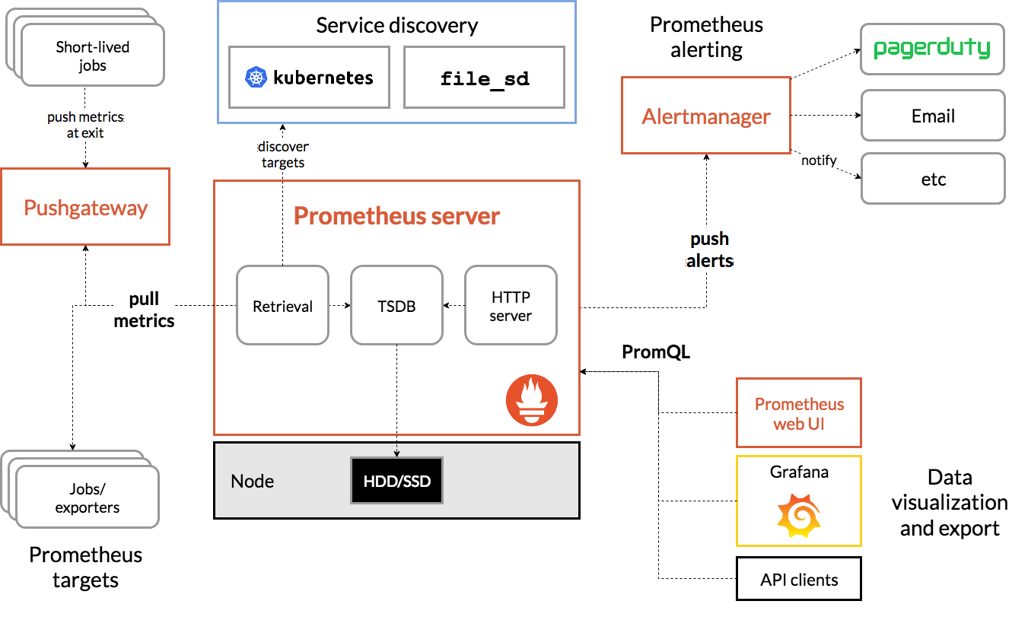
System Architecture

Slide 8
System Components
Prometheus Server
Is the main component which does the actual monitoring of scraping and storing time series data.
Data Retrieval
Pulls metrics from /metrics endpoint of registered targets. Metrics should be in correct format which Prometheus can understand.
Target can be Linux/windows server, Apache server, Kubernetes cluster, Database, etc.
Metrics examples – CPU, Memory/disk usage, Request count, exceptions count, etc.
Exporters
Exporters help in collecting metrics from third-party systems which do not expose /metrics endpoint by default, convert metrics in Prometheus metrics format and expose them on /metrics endpoint.
Pushgateway
Pushgateway exists to allow ephemeral and batch jobs to expose their metrics to Prometheus. Since these kinds of jobs may not exist long enough to be scraped, they can instead push their metrics to a Pushgateway. The Pushgateway then exposes these metrics to Prometheus. The Pushgateway is explicitly not an aggregator, but rather a metrics cache
Alertmanager
The Alertmanager handles alerts sent by Prometheus server
Takes care of deduplicating, grouping and routing them to the correct receiver integration – email, PD, Slack

Slide 9
Metrics
Prometheus can collect metrics that were emitted by applications and servers as time series data - these are very simple sets of data that include a timestamp, label and the measurement itself. The Prometheus data model provides four core metrics :
Counter : A value that increases, like a request or error count
Gauge : Values the increase or decrease, like memory size
Histogram : A sample of observations, like request duration or response size
Summary : Like a histogram, but also provides the total count of observations.
To expose these metrics, applications can expose an HTTP endpoint under /metrics instead of implementing it yourself.

Slide 10
Tools used in demo
Kubernetes
Kubernetes (also known as k8s) is an Open-source container orchestration platform that automates many of the manual processes involved in deploying, managing, and scaling containerized applications.
Helm
Package manager for Kubernetes.
Allows us to streamline installation and management of Kubernetes applications.
Prometheus
Open-source systems monitoring and alerting toolkit.
Collects and stores the metrics as time series data.
Provides out-of-box monitoring capabilities for container orchestration platforms such as Kubernetes.
Grafana
Open-source analytics and interactive visualization web application.
Provides charts, graphs and alerts for the web when connected to supported data services.
Allows us to query, visualize, alert on and understand our metrics, no matter where they are stored. Some supported data sources in addition to Prometheus are AWS CloudWatch, Azure Monitor, PostgreSQL, Elasticsearch and many more.

Slide 11
Conclusion
Design your monitoring system with an eye toward simplicity. In choosing what to monitor, keep the following guidelines in mind :
The rules that catch real incidents most often should be as simple, predictable and reliable as possible.
Data collection, aggregation and alerting configuration that is rarely exercised should be up for removal.
Signals that are collected, but not exposed in any prebaked dashboards nor used by any alert, are candidates for removal.
A healthy monitoring and alerting is simple and easy to reason about. It focuses primarily on symptoms for paging, reserving cause-oriented heuristics to serve as aids to debugging problems.

