Slide 1
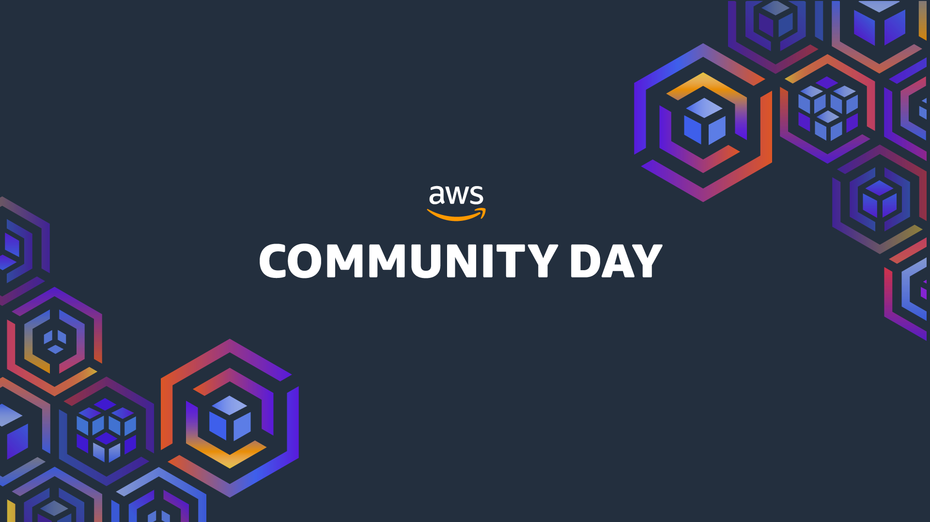
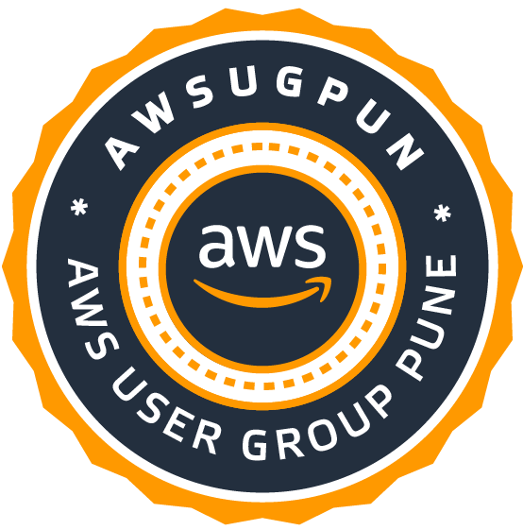
Pune
2022
Notes:
1

Slide 2
Pune 2022
Simplifying K8S setup on AWS using KOPS
Sagar Utekar | December 10, 2022

Slide 3
Pune 2022
About Me
Sagar is working as Site Reliability Engineer at VMWare Software India PVT. LTD.
Open-Source Enthusiast, A firm believer in the power of community education.
Google Summer Of Code Admin, Mentor, Mentee 2022 @PEcAn Project
CKS | CKA | CKAD | Terraform Certified
Mentored 5000+ students & professionals across India for career guidance, Job Search, Open Source, Cloud Native

Slide 4
Pune 2022
Agenda
Kubernetes, KOPS, EKS overview
System Architecture
Activities needed to get production ready k8s in AWS
Setup k8s Cluster in AWS using KOPS
SSH access to clusters
Upgrading clusters
Deciding best solution for your use case

Slide 5
Pune 2022
Kubernetes, KOPS, EKS overview
Kubernetes is an open source, container orchestration platform. Applications packaged as Docker images can be easily deployed, scaled, and managed in a Kubernetes cluster.
Kops, short for Kubernetes Operations, is a set of tools for installing, operating, and deleting Kubernetes clusters in the cloud. A rolling upgrade of an older version of Kubernetes to a new version can also be performed.
Amazon EKS is a managed Kubernetes service to run Kubernetes in the AWS cloud and on-premises data centres. In the cloud, Amazon EKS automatically manages the availability and scalability of the Kubernetes control plane node.

Slide 6
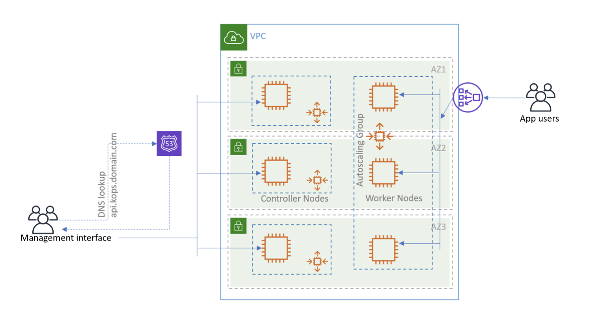
Pune 2022
System Architecture - KOPS

Slide 7
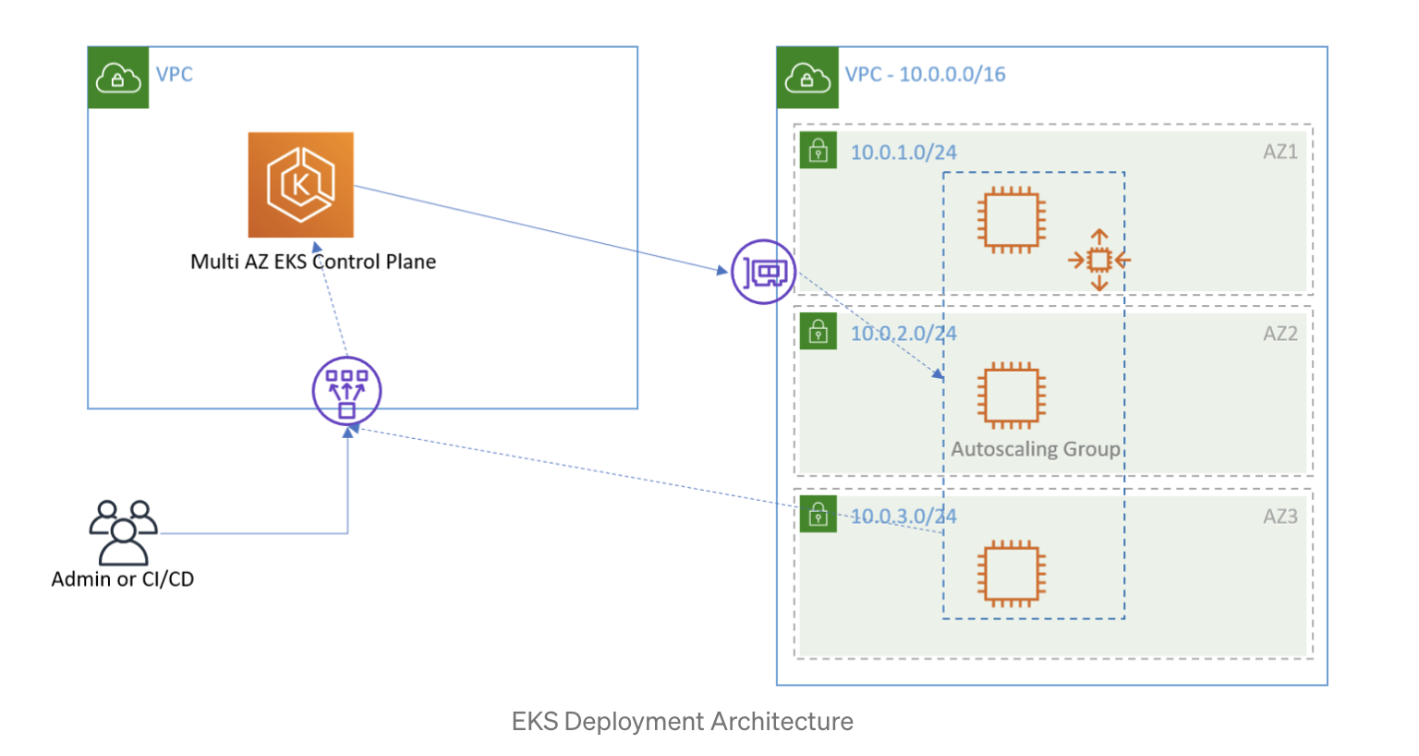
Pune 2022
System Architecture - EKS

Slide 8
Activities needed to get a production ready K8S in AWS

Slide 9
Pune 2022
What’s included for setup
Area | KOPS | EKS
Etcd | Included (Master) | Included
Networking | NA | AWS Support
DNS | Partially (Requires third party domain) | Included
Monitoring | NA | Included
Logging | NA | Included
Storage | NA | Included
Load Balancing | Included | Included

Slide 10
Pune 2022
Who’s responsible when it breaks ?
Area | KOPS | EKS
Control plane | Community Support | EKS
Networking | “” | AWS Support
Cert manager | ”” | Community Support
Monitoring | ”” | AWS Support
Logging | “” | “”
Storage | “” | “”
Load Balancing | “” | “”

Slide 11
Setup K8S cluster in AWS using KOPS

Slide 12
SSH access to K8S cluster

Slide 13
Upgrade K8S cluster

Slide 14
Decide what’s best for your use case

Slide 15
Questions & Answers

Slide 16

Pune 2022
Connect with me
https://www.linkedin.com/in/sagar-utekar/
https://twitter.com/me_sagar_utekar
https://github.com/Sagar2366

