Slide 1
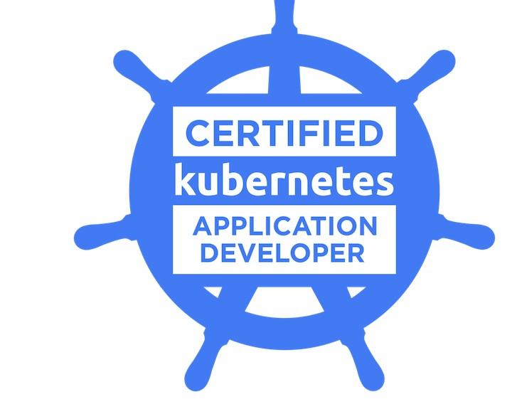
ACE CKAD in first go
SAGAR UTEKAR
VMWare Software India PVT. LTD.

Slide 2

About me
Working as MTS3 Site Reliability Engineer at VMWare Software India PVT. LTD.
Open-Source Enthusiast, A firm believer in the power of community education.
Google Summer Of Code Admin since 2018, Mentor, Mentee 2022 @PEcAn Project
GSoD, GSSoC, Github Externship, SIH mentor
CKS | CKA | CKAD | EX180 | Prometheus | Terraform Certified
Mentored 5000+ students & professionals across India for career guidance, Job Search, Open Source, Cloud Native

Slide 3
Agenda
What is CKAD ?
Who should take the CKAD exam ?
How to register for the exam ?
CKAD Curriculum
Exam preparation tips
Helpful tips and tricks during Exam
Resources
Kubectl cheatsheet
Example questions

Slide 4
What is CKAD?
Due to the rapid growth of Kubernetes, The Cloud Native Computing Foundation (CNCF) launched the public availability of the Certified Kubernetes Application Developer (CKAD) exam last May 2018 expanding the training opportunities to application developers.
This training allows application developers to have the necessary knowledge and skill-set to build cloud-native applications for Kubernetes. This in turn provides the confidence to hiring managers to obtain professionals with high proficiency with the technology.
This certification certifies that candidates can design, build and deploy cloud-native applications for Kubernetes.
It is a 2-hour online performance based exam where you must debug issues, create Kubernetes resources, and deploy them within the cluster.
Candidates who register for the Certified Kubernetes Application Developer (CKAD) exam will have 2 attempts (per exam registration) to an exam simulator, provided by Killer.sh.
The exam is based on Kubernetes v1.26 and will be always aligned with the most recent K8s minor version
For the CKAD Exam, a score of 66% or above must be earned to pass.

Slide 5
Who should take the exam?
The majority of modern software applications are now served via containerized deployments. Since more companies are now embracing this technology and integrating containers into their workflow at a fast rate, application developers will need to learn how these containers work in order to keep up with the trend.
Kubernetes is one of the most used orchestration tools for containers and one of the important skills that companies require now.
This certification is for Kubernetes engineers, cloud engineers and other IT professionals responsible for building, deploying, and configuring cloud native applications with Kubernetes.
Individuals who passed CKAD certify that they have the necessary skills needed in order to design, build, configure and deploy applications to Kubernetes.
Aside from these, they will also be able to demonstrate the ability the perform monitoring of the application deployed in Kubernetes if it is functioning correctly as well as be able to troubleshoot in the event of any issue occurring.

Slide 6
Register for CKAD exam
Once you have made up your mind to get certified, you can register and buy the exam voucher from Linux Foundation. You can schedule the exam within one year from the date of purchase.
Even if you could not make it on the first attempt, you get to reappear once without additional cost as the exam voucher includes one free retake.
CKAD - https://training.linuxfoundation.org/certification/certified-kubernetes-application-developer-ckad/
How to get 65-100% discount coupon codes ?
Cyber Monday sale
Black Friday sale
Linux Foundation flash sales
Kodekloud exam challenges
Kubecon giveaways
CNCF Events
Subscribe to Linux Foundation newsletter - https://training.linuxfoundation.org/resources/newsletter/

Slide 7
CKAD Curriculum
Application Design and Build 20%
Define, build and modify container images
Understand Jobs and CronJobs
Understand multi-container Pod design patterns (e.g. sidecar, init and others)
Utilize persistent and ephemeral volumes
Application Deployment 20%
Use Kubernetes primitives to implement common deployment strategies (e.g. blue/green or canary)
Understand Deployments and how to perform rolling updates
Use the Helm package manager to deploy existing packages
Application Observability and Maintenance 15%
Understand API deprecations
Implement probes and health checks
Use provided tools to monitor Kubernetes applications
Utilize container logs
Debugging in Kubernetes

Slide 8
CKAD Curriculum
Application Environment, Configuration and Security 25%
Discover and use resources that extend Kubernetes (CRD)
Understand authentication, authorization and admission control
Understanding and defining resource requirements, limits and quotas
Understand ConfigMaps
Create & consume Secrets
Understand ServiceAccounts
Understand SecurityContexts
Services and Networking 20%
Demonstrate basic understanding of NetworkPolicies
Provide and troubleshoot access to applications via services
Use Ingress rules to expose applications

Slide 9
Exam preparation tips
Remember to test your mic and webcam, which you need to turn on during exam. If you are using USB webcam, make sure the system can detect.
Use killer.sh environment before attempting the real exam.
Give a lot of practice exams, identify your weak topics and spend more time on those.
While giving practice exams, try to wrap up 15 minutes before the deadline – it will give you additional time to revise the solutions.
Most people don’t even use an alias. So no need to overwhelm yourself with an alias for everything.
Don’t give the exam on the last day. The idea is to give it in a pressure-free environment.
Get very familiar and comfortable with the Official Kubernetes Documentation
Improve your text editing skills with vim or nano
Master your kubectl imperative commands.

Slide 10
Tips & tricks for during exam
On exam day, keep an alternative internet source handy in case of Wi-Fi internet goes down.
Testing Room – for the test, you need to prepare a room. This room should be well-lit, private, and quiet.
If any particular question is going to take more than 6-7 mins to solve, flag/mark it to solve for later and come back once you solve the rest.
Use Imperative Commands as much as possible.
At the time of the exam, you shouldn’t have anything on the table other than your system.
Take backup of resource yamls before doing any changes.
Use the browser within the VM to access the following documentation:
https://kubernetes.io/docs/
https://kubernetes.io/blog
https://helm.sh/docs
8. Never give up when you do not have an idea on any of the exam questions. Search through the Kubernetes.io pages by typing some keywords and searching. On this website, you could get lucky with discovering some right answers or hints.

Slide 11
Tips & tricks for during exam
9. Manage your time well – avoid awkward questions. In other words, save your time and do not waste time on any questionable items. You can spend the remaining time you have on these difficult questions. However, it would be best if you endeavoured to attempt all the easy questions first. To pass the exam, you do not have to beat everything. Passing the exam requires scores of at least 66% in the CKAD.
10. Always Check context & namespace
11. Always verify the resources you created or updated.
12. In case task requires to ssh to node, make sure to switch back to base node before attempting the next question
13. If namespace is not explicitely specified, consider the default namespace to solve the question
14. Use kubectl describe/logs to verify the answers
15. Delete resources forcefully without waiting by using –grace-period=0 –force

Slide 12
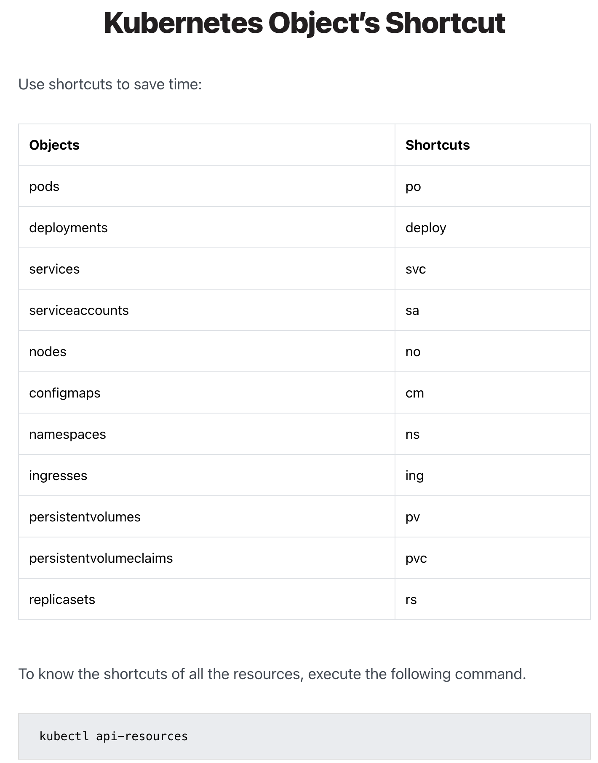
Tips & tricks for during exam

Slide 13
Resources
KodeKloud Kubernetes Basics is a great course for anyone who does not even know the K about Kubernetes. An absolute beginners course that starts with the basics of Kubernetes, its architecture and different components, setting up Kubernetes in the local environment, and covers some basic Kubernetes resources like Pods, Deployment, and Replicaset. You will also get access to hands-on lab sessions to practice.
CKAD with tests by Mumshad Mannambeth is one of the best courses which covers all domains and provides good clarity on each topic required to clear CKAD. Apart from that it also provides a hands-on lab and access to mock tests.
Kubernetes doc is the official documentation and the best resource to get insights on various concepts and their application. Although the amount of content is vast you could still filter out the important ones.
To crack this exam, you need to practice a lot. This post by Bhargav Bachina contains 150 practice questions along with detailed answers.
This GitHub repo is another good resource for practice with regular updates(topics included in the latest curriculum).
You can also explore and play around KillerCoda
Along with the exam, you also get 2 practice sessions of Killer.sh. This is a simulator of the actual exam but more difficult. Scoring well in killer.sh, will give you the confidence to appear and excel in the CKAD exam.

Slide 14
Kubectl cheatsheet
https://kubernetes.io/docs/reference/kubectl/cheatsheet/
https://www.altoros.com/wp-content/uploads/pdf/Kubernetes-Kubectl-CLI-Cheat-Sheet.pdf
https://github.com/linuxacademy/content-cka-podofminerva/blob/master/kubernetes-cheat-sheet.sh

Slide 15

Community Links
Docker Pune Slack - https://lnkd.in/dyV7VDK6
Docker Pune LinkedIn group - https://lnkd.in/dDZdJRV7
Docker Pune meet-up group - https://lnkd.in/dJhqR8Cj
CNCF Pune meetup group - https://community.cncf.io/pune/

Slide 16




CONNECT WITH ME
https://www.linkedin.com/in/sagar-utekar/
https://twitter.com/me_sagar_utekar
https://github.com/Sagar2366

Slide 17

Thank You

