Slide 1
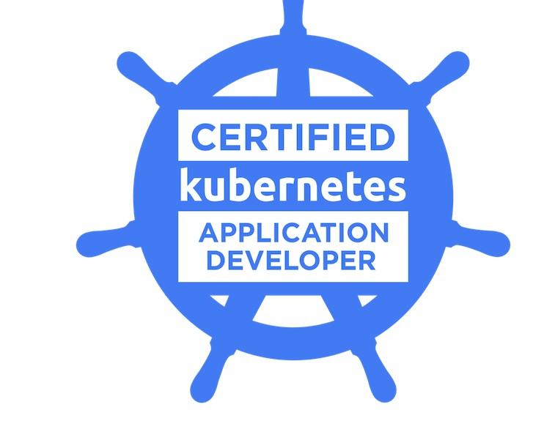
ACE CKAD in first go
SAGAR UTEKAR
VMWare Software India PVT. LTD.

Slide 2
About me
Working as MTS3 Site Reliability Engineer at VMWare Software India PVT. LTD.
Open-Source Enthusiast, A firm believer in the power of community education.
Google Summer Of Code Admin since 2018, Mentor, Mentee 2022 @PEcAn Project
GSoD, GSSoC, Github Externship, SIH mentor
CKS | CKA | CKAD | EX180 | Prometheus | Terraform Certified
Mentored 5000+ students & professionals across India for career guidance, Job Search, Open Source, Cloud Native

Slide 3
What’s on the Agenda ?
What is CKAD ?
Who should take the CKAD exam ?
How to register for the exam ?
CKAD Curriculum
Exam preparation tips
Helpful tips and tricks during Exam
Resources
Kubectl cheatsheet
Example questions

Slide 4
What is CKAD?
Source code that is made available to public
Decentralized and collaborative
Allow anyone to study, modify, enhance or re-engineer a program’s code and distribute under a permissive license

Slide 5
ROLES IN TYPICAL OPEN-SOURCE PROJECT
Author/Owner
Maintainers
Contributors
Community Members/Users

Slide 6
How to chose an open-source project
Project with License file and following Open-Source guidelines
Project, community, Maintainers are active
Availability of Good First Open issues
PRs getting merged actively, Issues getting closed
Active discussions, meetings in community forums
Appreciating environment

Slide 7

Community Links
Docker Pune Slack - https://lnkd.in/dyV7VDK6 Docker Pune LinkedIn group - https://lnkd.in/dDZdJRV7
Docker Pune meet-up group - https://lnkd.in/dJhqR8Cj
CNCF Pune meetup group - https://community.cncf.io/pune/
PEcAN Project Slack - https://pecanproject.github.io/contact.html
The Palisadoes Foundation Slack - https://www.palisadoes.org/slack/

Slide 8




CONNECT WITH ME
https://www.linkedin.com/in/sagar-utekar/
https://twitter.com/me_sagar_utekar
https://github.com/Sagar2366

Slide 9
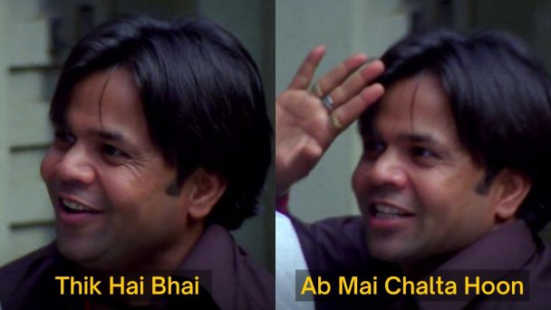
Thank You

