Slide 1
BartPho Model
Huỳnh Nguyễn Huy Anh – 51900723
Liễu Thanh Lâm - C1900015

Slide 2
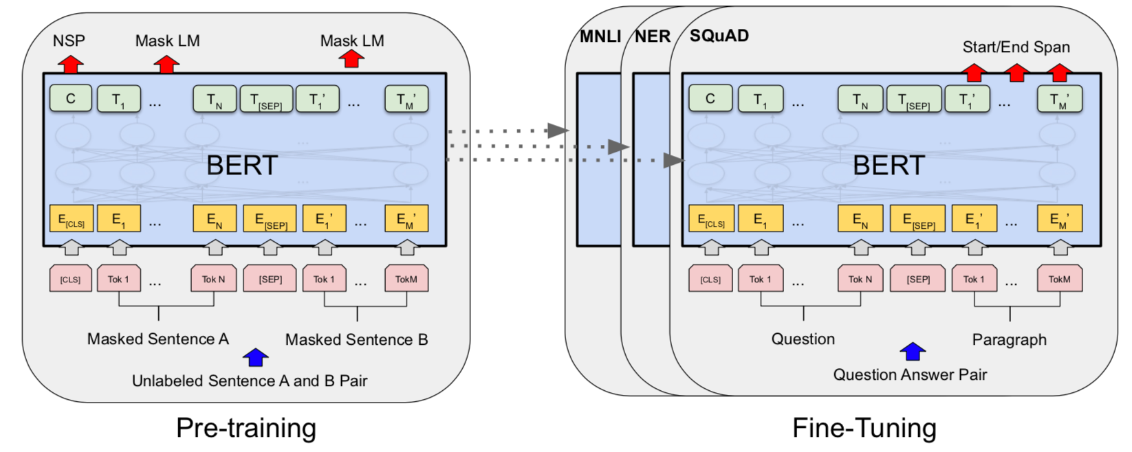
Motivation
Pretrained language MODEL(Bert and ITs VARIANT)
A bidirectionality nature
pretrained sequence-to-sequence (seq2seq) models(e.g. BART and T5) for Vietnamese

Slide 3
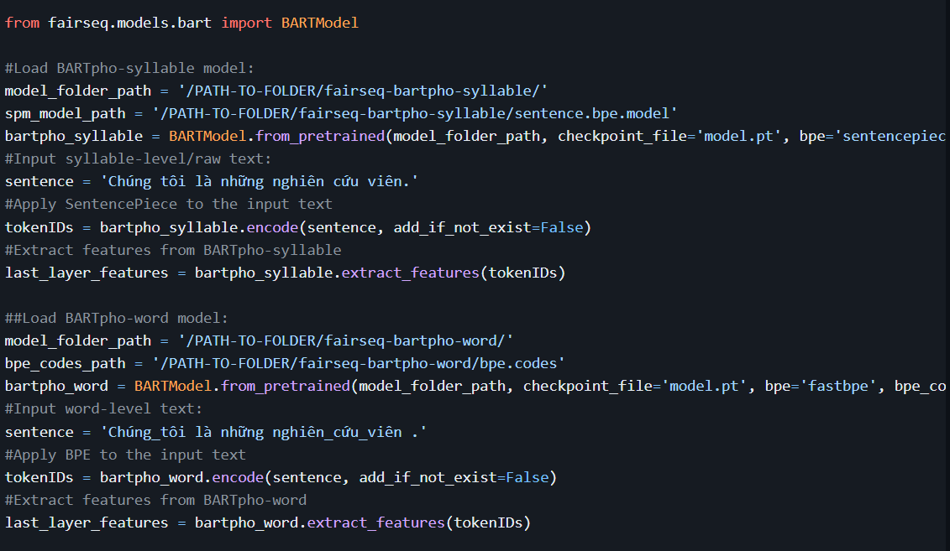

Motivation
2 version: $BARTpho_{syllable}$ and $BARTpho_{word}$

Slide 4

Architecture
The standard architecture Transformer with the GeLU activation function
two types of noise in the noising function: text infilling and sentence permutation:
Text infilling: sample text spans from a Poisson distribution and replace each span with a single special mask token.
Sentence permutation: consecutive sentences are grouped to generate sentence blocks of 512 tokens, and sentences in each block are then shuffled in random order
2 stage of pretrained:
corrupting the input text with an arbitrary noising function
learning to reconstruct the original text

Slide 5
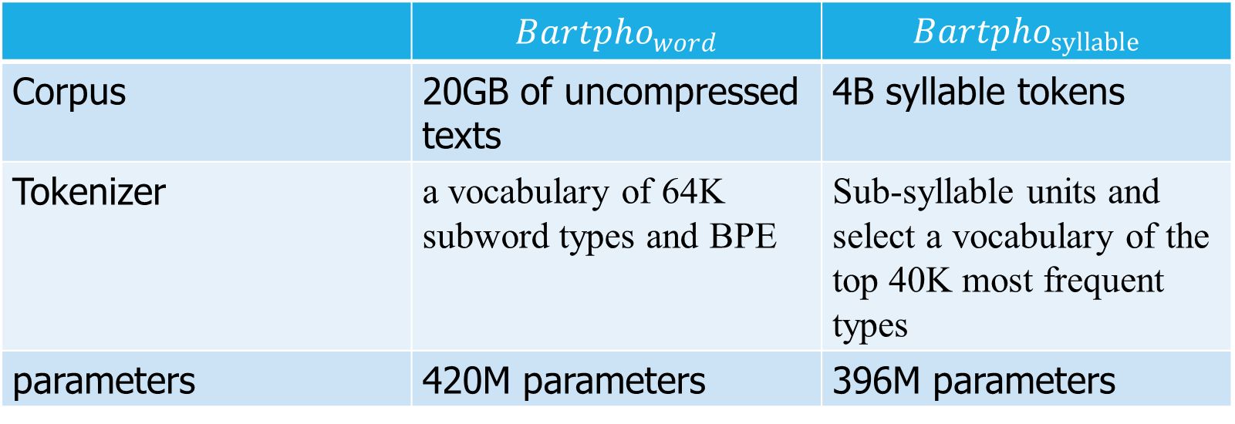
Training Data
 | $$Bartpho_{word}$$ | $$Bartpho_{syllable}$$
Corpus | 20GB of uncompressed texts | 4B syllable tokens
Tokenizer | a vocabulary of 64K subword types and BPE | Sub-syllable units and select a vocabulary of the top 40K most frequent types
parameters | 420M parameters | 396M parameters

Slide 6
Optimization
Adam with batch size 512 sequce blocks across 8 A100 GPUs(40GB) and a peak learning rate of 0.0001
The learning rate is warmed up for 1.5 epochs

Slide 7
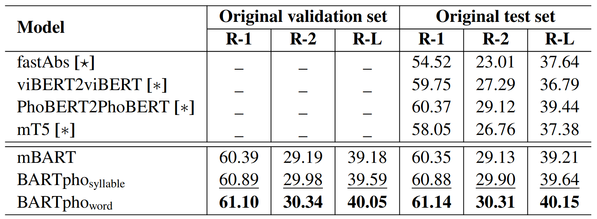
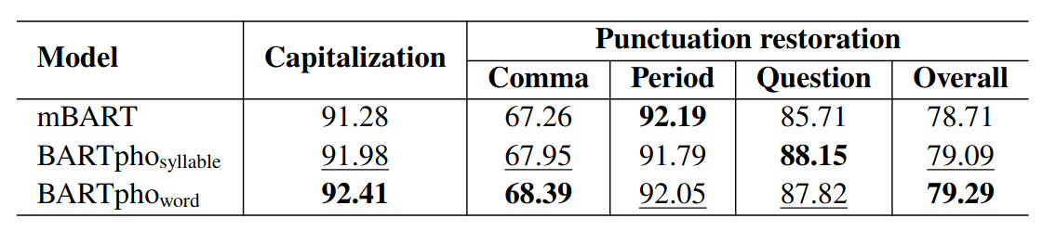
Evaluate models and result

Slide 8
Thank you

