Slide 1
MedRAG: Bridging the Post-Training Knowledge Gap in Efficient LLMs

Slide 2
Agenda
1
Title Slide (The Challenge)
2
The Core Problem (Motivation)
3
Solution & Novelty (The MedRAG Difference)
4
The MedRAG Pipeline (Methodology Diagram)
5
Performance Metrics (Quantitative Results)
6
Conclusion and Future Work
7
Implications for AI in Healthcare
8
Q&A Session

Slide 3
MedRAG: Bridging the Post-Training Knowledge Gap in Efficient LLMs
A Hybrid RAG Pipeline for Current AI+Healthcare Research Intelligence (2023–2025)
Integrated Research Intelligence: Research intelligence systems play a pivotal role in accelerating scientific discovery, yet there is a notable scarcity of solutions that provide integrated, up-to-date, and cross-domain analysis tailored for specialized fields such as AI and healthcare. MedRAG addresses this gap by offering a comprehensive framework that synthesizes diverse research insights.
  Resource-Efficient Hybrid Architecture: MedRAG is built on a resource-efficient hybrid Retrieval-Augmented Generation (RAG) pipeline, meticulously designed to empower researchers. It leverages a curated vector store containing 100,000 multi-source AI and healthcare research papers published between 2023 and 2025, ensuring that users have access to the most relevant and current information.
  Multi-Stage Processing: The architecture of MedRAG employs a multi-stage processing approach, utilizing a FAISS index for real-time evidence retrieval, Flan-T5-Large as a Fusion-in-Decoder synthesizer, and the Gemma-2B model for narrative enhancement. This layered methodology enhances the quality and relevance of generated responses to complex research queries.
  Quantitative Validation and Safety: Quantitative benchmarks demonstrate that MedRAG achieves a remarkable 22.9% improvement in overall quality scores compared to the FiD-only baseline. Additionally, the integrated Medical Validator Agent ensures responsible AI practices, achieving an impressive safety score of 0.71 out of 1.0, thereby reinforcing the system's reliability in sensitive healthcare contexts.
Notes:
Welcome to the presentation on MedRAG, a pioneering approach designed to bridge the knowledge gap in large language models (LLMs) post-training. Today, we will explore how our hybrid retrieval-augmented generation (RAG) pipeline can enhance AI applications in healthcare research from 2023 to 2025. My name is [Your Name], and I am affiliated with the Department of Computer Science at [University/Institution Name]. Let's dive into the challenges we face in this domain. Research intelligence systems are crucial for accelerating discovery, yet few solutions exist that offer integrated, current, and cross-domain analysis for specialized fields like AI and healthcare. MedRAG is introduced as a resource-efficient hybrid RAG pipeline designed to empower researchers and tackle the complexities of cross-domain scientific inquiry. It is grounded in a meticulously curated vector store of 100,000 multi-source AI and healthcare research papers published between 2023 and 2025. The system employs a multi-stage approach, utilizing a FAISS index for up-to-date evidence, Flan-T5-Large as a Fusion-in-Decoder synthesizer, and the resource-efficient Gemma-2B model for final narrative enhancement. Quantitative benchmarks validate the effectiveness of this hybrid approach, showing a significant 22.9% improvement in overall quality score over the FiD-only baseline in answering complex research queries. Furthermore, the integrated Medical Validator Agent ensures responsible AI practices, maintaining an average safety score of 0.71 out of 1.0. MedRAG validates RAG as the definitive, scalable strategy for deploying scientifically current LLM capabilities and advancing cross-domain research intelligence.

Slide 4



The Core Problem (Motivation)
Understanding the Challenges in LLMs
Knowledge Obsolescence
LLMs like Gemma-2B are limited by static knowledge cutoffs, rendering them less effective in rapidly evolving fields such as healthcare.
Resource Constraints
The financial and computational costs associated with continuous fine-tuning and retraining of large foundational models can be prohibitive for many organizations.
Cross-Domain Complexity
Synthesizing knowledge across diverse scientific domains presents significant challenges, often leading to gaps in understanding and application.
Notes:
The core problems we face in leveraging LLMs for healthcare research are multifaceted. First, knowledge obsolescence is a significant issue, as models like Gemma-2B are constrained by their training data, which can quickly become outdated. Second, the resource constraints associated with continuous fine-tuning and training of large foundational models can limit accessibility for many researchers. Lastly, the complexity of synthesizing knowledge across various scientific domains complicates the effective application of AI in healthcare, leading to potential gaps in research and practice.

Slide 5



Solution & Novelty (The MedRAG Difference)
Introducing MedRAG: A New Paradigm
MedRAG: The Hybrid RAG Architecture
MedRAG combines retrieval and generation techniques to effectively address the knowledge gap in LLMs, ensuring up-to-date and relevant information is utilized.
Custom Data Injection
By integrating a corpus of 100,000 papers from 2023 to 2025, MedRAG ensures that the latest AI and healthcare research is readily available for model training.
Model Chaining for Efficiency
This approach decouples tasks across three specialized models, optimizing resource utilization and enhancing overall system performance.
Notes:
The MedRAG solution introduces a hybrid architecture that effectively bridges the knowledge gap in LLMs. By combining retrieval and generation techniques, we ensure that our models utilize the most current and relevant information. A key innovation is our custom data injection, which incorporates a vast corpus of 100,000 papers from 2023 to 2025, providing a rich foundation for training. Additionally, our model chaining strategy decouples tasks across three specialized models, optimizing resource use and enhancing performance.

Slide 6



The MedRAG Pipeline (Methodology Diagram)
Understanding the Architecture and Key Steps
Architecture Overview
The MedRAG pipeline consists of FAISS for efficient document retrieval, followed by FiD synthesis and Gemma enhancement for output generation.
Key Steps in the Process
The pipeline includes retrieval, synthesis, generation, and validation of outputs, ensuring a comprehensive approach to knowledge integration.
User Query Integration
User queries are embedded into the FAISS system for precise document retrieval, enhancing the relevance of the generated outputs.
Notes:
The MedRAG pipeline is designed with a clear architecture that facilitates efficient knowledge integration. It begins with FAISS, a powerful tool for document retrieval, followed by FiD synthesis and Gemma enhancement to generate high-quality outputs. The key steps in this process include retrieval, synthesis, generation, and validation, ensuring that we comprehensively address the knowledge gap. Importantly, user queries are embedded into the FAISS system, allowing for precise document retrieval and enhancing the relevance of our outputs.

Slide 7
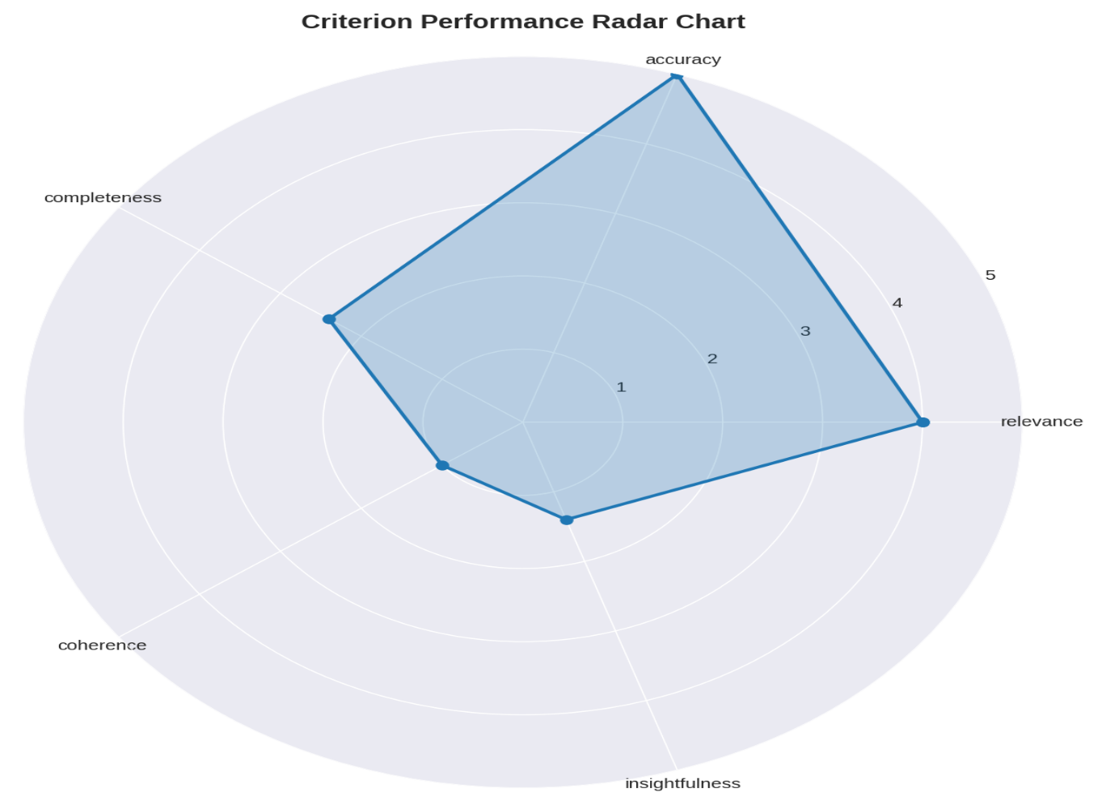
Performance Metrics (Quantitative Results)
Evaluating the Effectiveness of MedRAG
Quantitative Results: The validation process demonstrates significant performance uplift, showcasing the effectiveness of the MedRAG approach.
  Quality Gain of +22.9%: The enhancement layer of MedRAG contributes to a notable quality gain, improving the relevance and accuracy of generated outputs.
  Performance Comparison Table: A comparative analysis of baseline models versus the full MedRAG implementation, illustrating the advantages of our approach.
Notes:
In terms of performance metrics, our validation process reveals a significant uplift in effectiveness, underscoring the advantages of the MedRAG approach. Notably, we observe a quality gain of +22.9% attributable to the enhancement layer, which markedly improves the relevance and accuracy of the generated outputs. Additionally, we will present a performance comparison table that juxtaposes baseline models with the full MedRAG implementation, clearly illustrating the benefits of our innovative approach.

Slide 8
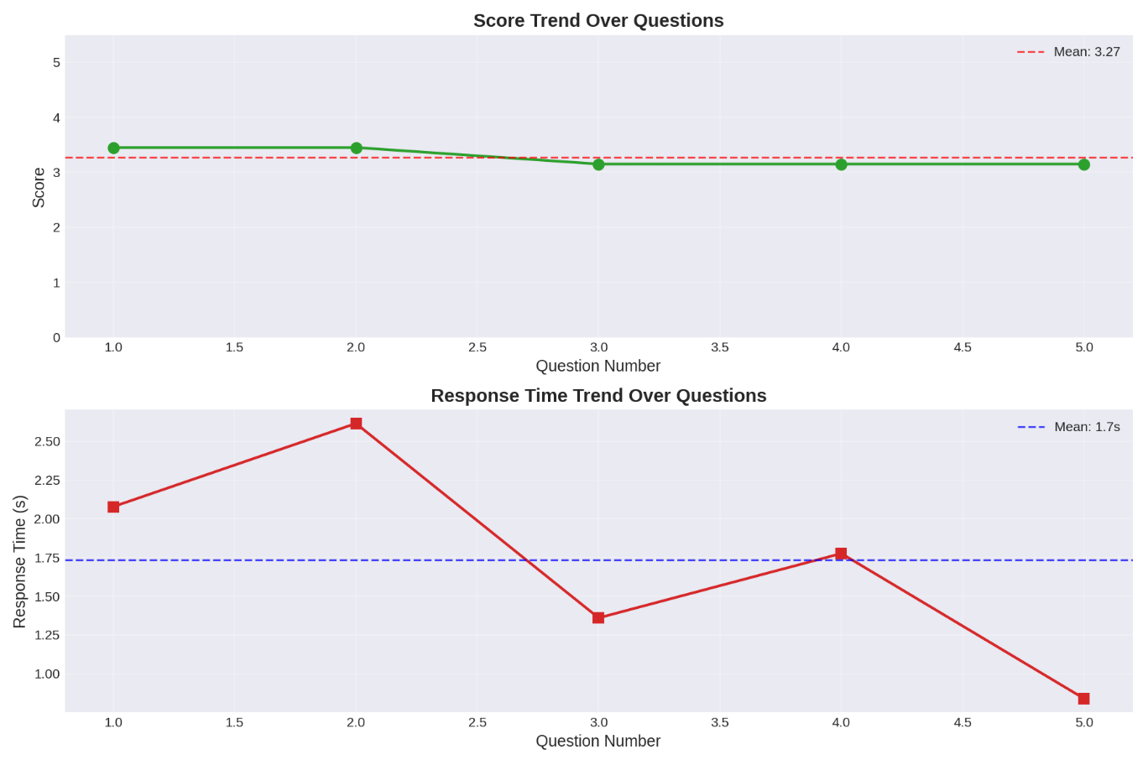
Conclusion and Future Work
Summarizing MedRAG's Impact and Next Steps
Conclusion: Resource-Efficient Strategy: MedRAG represents a strategic advancement in deploying current LLM capabilities, addressing critical knowledge gaps in healthcare research.
  Future Work Directions: Future initiatives will focus on multimodal RAG, dynamic latency control, and enhancing trust and explainability mechanisms in AI systems.
Notes:
In conclusion, MedRAG stands as a resource-efficient strategy for deploying the capabilities of current LLMs, effectively addressing the critical knowledge gaps in healthcare research. Looking ahead, our future work will explore several exciting directions, including the integration of multimodal RAG, the implementation of dynamic latency control, and the enhancement of trust and explainability mechanisms within AI systems.

Slide 9


Implications for AI in Healthcare
Exploring the Future of AI Applications
Potential Impact of MedRAG
MedRAG has the potential to revolutionize AI applications in healthcare, enhancing the speed and accuracy of research outcomes.
Enhancing Research Efficiency
By providing timely and relevant information, MedRAG can significantly improve the efficiency of healthcare research processes.
Long-Term Benefits for Professionals
The long-term implications of MedRAG include improved decision-making and patient outcomes for healthcare professionals and researchers alike.
Notes:
The implications of MedRAG for AI in healthcare are profound. This innovative approach has the potential to revolutionize how AI applications are utilized in the field, significantly enhancing the speed and accuracy of research outcomes. By providing timely and relevant information, MedRAG can improve research efficiency, ultimately leading to better decision-making and patient outcomes for healthcare professionals and researchers alike.

Slide 10
Q&amp;A Session
Engaging with the Audience
Notes:
Now, I would like to open the floor for questions and discussions. Your feedback on the MedRAG approach and its applications is invaluable, and I look forward to engaging with you on this exciting topic.

