Slide 1
RedCrow
~ a study supporting crowdfunding
Team – Alpha
Arvind Pawar
Mihir Gandhi
Rajesh Ranjan
Sagar Ashok Daswani
Trupti Khodke
ALY6980
Project Study Report

Slide 2
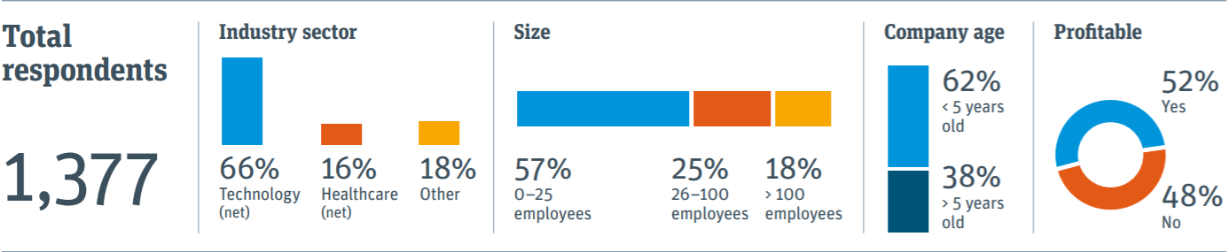
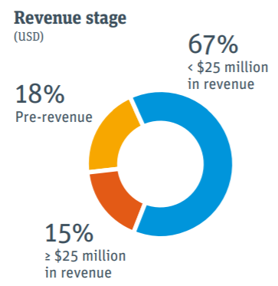
2019 Outlook – Startup Executives
Notes:
(2020). Retrieved 22 June 2020, from https://www.svb.com/globalassets/library/uploadedfiles/content/trends_and_insights/reports/startup_outlook_report/us/svb-suo-us-report-2019.pdf

Slide 3
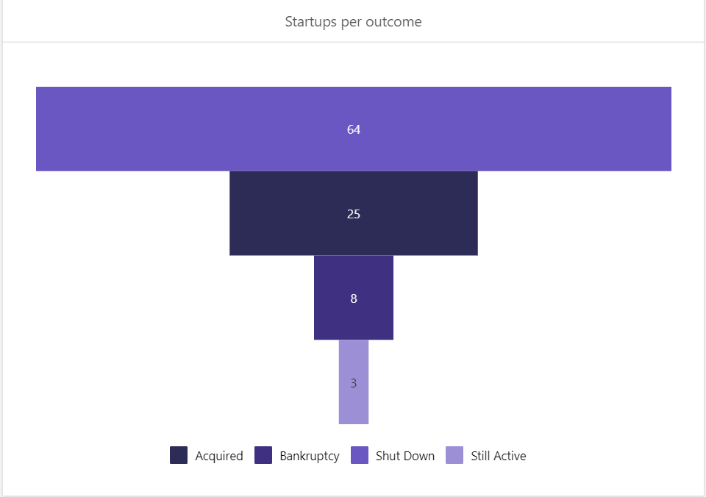
Important Startup failure statistics
90% Startups fails

Slide 4
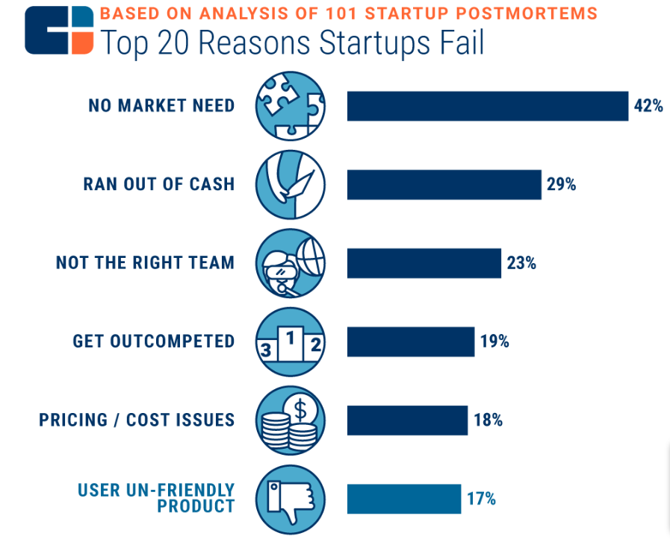
Top reasons of Failure
Funds
Business
Notes:
Why Startups Fail: Top 20 Reasons l CB Insights. (2019). Retrieved 21 June 2020, from https://www.cbinsights.com/research/startup-failure-reasons-top/

Slide 5
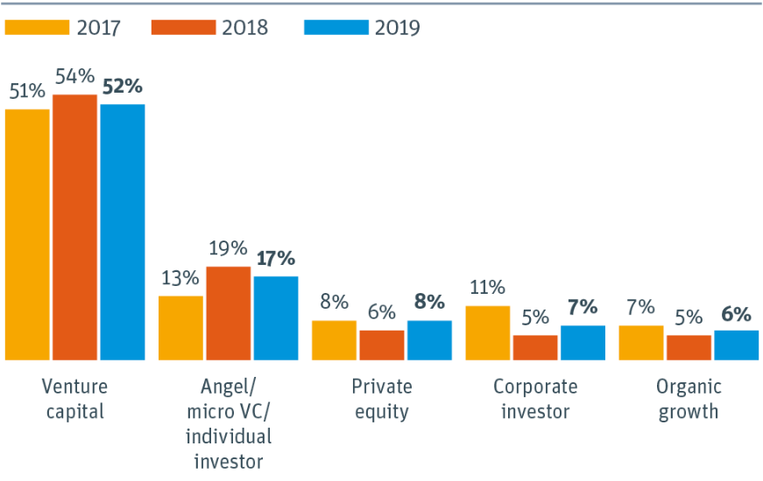
Recent Funding Pattern
Notes:
2019 Startup Outlook US Report | Silicon Valley Bank. (2020). Retrieved 21 June 2020, from https://www.svb.com/startup-outlook-report-2019/us#funding

Slide 6
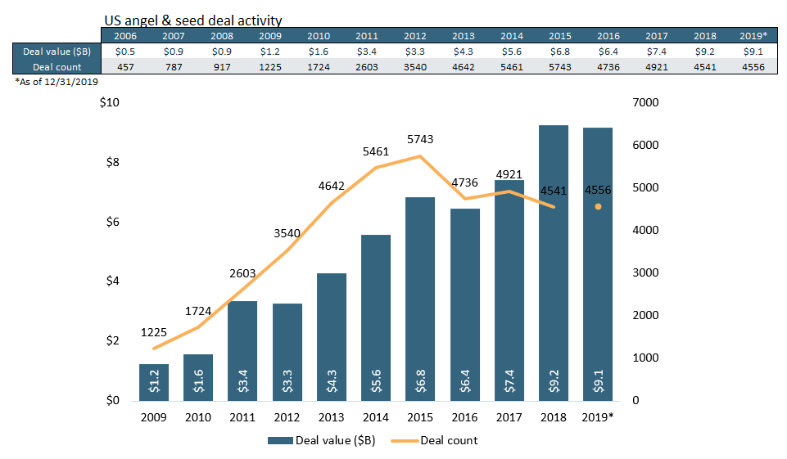
Angle And Seed Funding (2009-2019)

Slide 7
Life - Cycle
Successful Stage
Project Delivery
Reward
Trust
Optimal Funding
Operating Condition

Slide 8
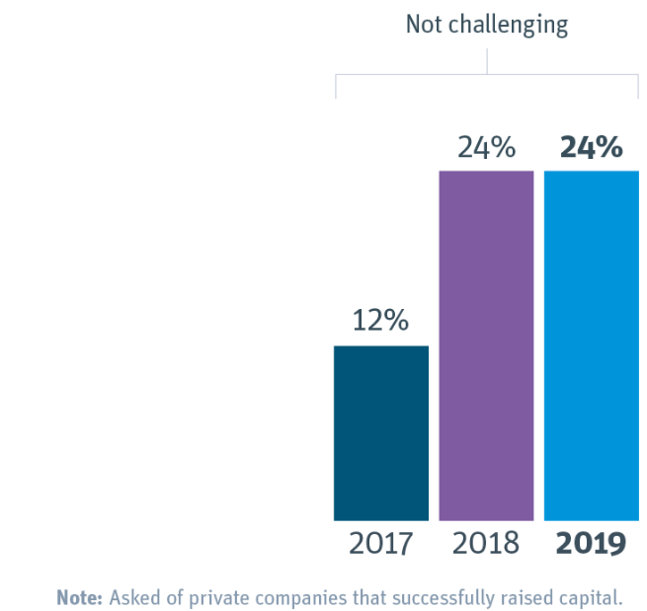
Funding Challenge dominance
Challenges
Realistic Goal Amount
Time required for funding round
Design Rewards for diverse stakeholders
Notes:
2019 Startup Outlook US Report | Silicon Valley Bank. (2020). Retrieved 21 June 2020, from https://www.svb.com/startup-outlook-report-2019/us#funding

Slide 9
Bad news continues…
9% of Kickstarters with NO rewards
8% of dollars pledged went to FAILED projects
90% of startup companies funded will not make it to initial public offering (IPO).
7% of backers did not get a chosen reward
35% of backers agreed or agreed strongly that – NO reward on time.

Slide 10
The PROBLEM
Startup
Build Trust- Brand with no prior credibility
Investor
Performance Opacity- Don’t see the project
Trust- Money to be used for PROMISSED project
Platforms
Trust- on Startups
Appropriate and continuous Cash-Flow for operation
Optimal amount for funding
Startup evolution for each stages
Startup funding performance for Seed and Series A

Slide 11
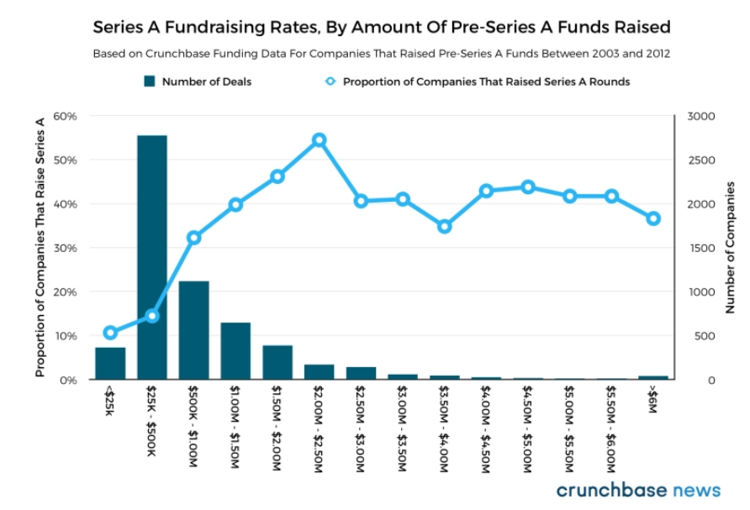
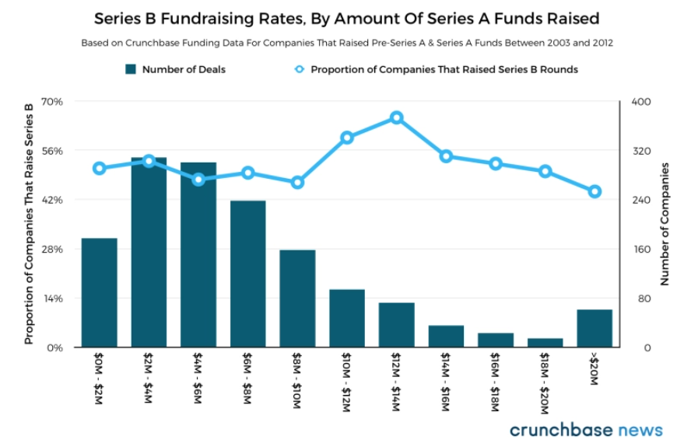
Startup establishment with funding evolution
Seed or Pre-series – 2 m (avg)
Series A – 12 m (avg)

Slide 12
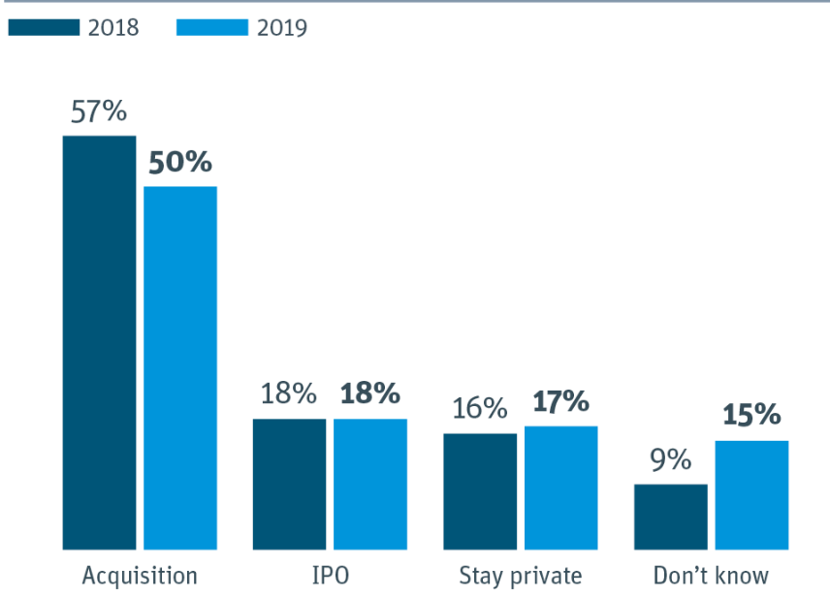
Aspiration for ultimate stand
Notes:
2019 Startup Outlook US Report | Silicon Valley Bank. (2020). Retrieved 21 June 2020, from https://www.svb.com/startup-outlook-report-2019/us#funding

Slide 13
Proposed SOLUTION
STARTUP’s operating and funding performance
Success Prediction
Operating (IPO, Acquired, Self-Operating) or Close
How region is effecting the success probability
With the help of DOMAIN and funding pattern
Stage Prediction
Estimate if startup will reach to 2m bar for SEED round
Estimate if startup will reach to 12m limit for Series A round
SOCIAL presence influence on stage evolution (2m/12m)

Slide 14
Quick review – Solutions to support the problem
Stage evolution : startups movement from Seed to Stage A
Support hypothesis of SOUND association between funding stage with digital & social presence
Probability of startups to establish Seed and Series A funding position
Trust : estimate the position of startups
Can help startups to predict their prospect based on historical analysis
Investors to get confidence on startups and associated domain

Slide 15
Project goal & outcome
success & stage evolution prediction for startups
Startup
OPERTIONAL - Probability of startup
Stage Evolution of startup
RedCrow
Success prediction for startup on
crowdfunding
Survival Analysis of startups

Slide 16
High Level project approach
Startup Success
Startup Survival
Seed Funding
Series A Funding
Startup Final Stage
Analysis
Features
Processing
Startup
Investment
Social Media

Slide 17
Impediment
Startup data
Open source data platforms – not up-to-date
Small number of new startups
Social Media Metric
Unpredictable Social platform alias name and Startup name
Time consuming process

Slide 18
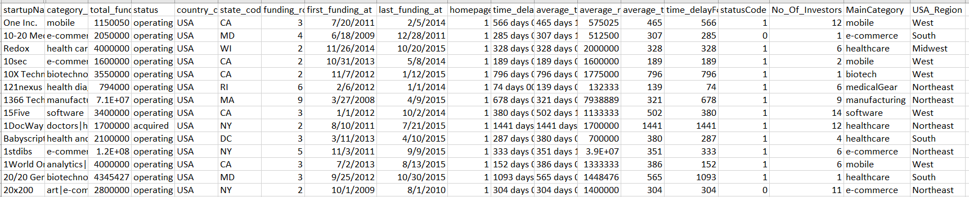
Data Preparation- for Operating classification
Startup
Investments
Final Dataset
Funding Round

Slide 19
Feature processing for Operating classification
Features
Outcome
Status (Operating, IPO, Acquired, Close)
Status Code ( 0- Close, 1- Operating)
total_funding
funding_rounds
first_funding_at
last_funding_at
homepage_url_code – (0- No, 1- yes)
time_delayFor_first_round
average_time_delay_rounds
average_raised_usd
average_time_delay_rounds_number
time_delayFor_first_round_number
No_Of_Investors
MainCategory (Top 10 market category)
USA_Region – (Based on state code)

Slide 20
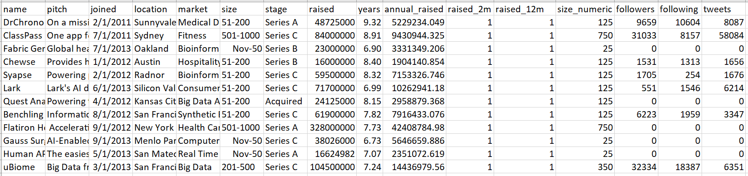
Data Preparation- for Funding prediction
Web Scrape Startups
Startup list
Scrape Twitter details
Final Integrated Dataset

Slide 21
Feature processing for Seed and Series Funding
Features
Outcome
Raise 2m (0- No, 1- Yes)
Raise 12m( 0- No, 1- Yes)
years
Location
Market
Size_numeric
Stage
Raised (amount $)
Annual Raised($)
Followers

Slide 22
High level Data Analysis Flow – Stage Evolution
Obtain Startup data from Crunchbase
Train
Final Model
Tune
Final Training Dataset
Pre-processing
Define Hypothesis
Validate Hypothesis
Integrated dataset (Startup, Twitter)
Test Dataset
Crowdfunding stage prediction
Extract Twitter attributes for identified startups

Slide 23
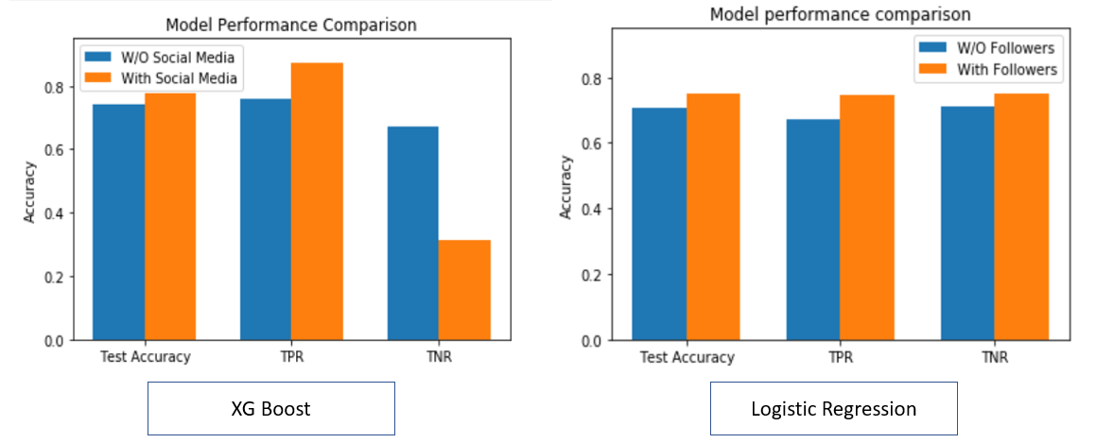
Key Observation – Follower impact on Seed funding

Slide 24
Key Insights – Seed Stage Evolution
Age and Size of startup – top most deciding factor for reaching 2m goal.
Highest growing market domains to reach 2m stage – cutting-edge technologies (- Big data, Predictive analytics)
Twitter followers- add 5% extra likelihood of reaching seed goal
startups with <15 people – approx 93% of probability to NOT pass through 2m goal
Approx 3.5 years old, Seattle based Startups with <15 people – 100% probability to achieve 2m goal
Seed
- 2m
Major correlated features: Size, Years, location (Austin, Seattle), Big Data Analytics, Predictive Analytics

Slide 25
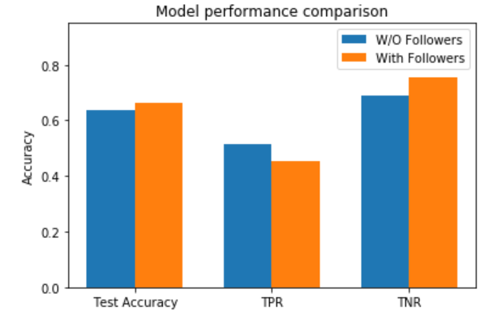
Key Observation – Follower impact on Series A

Slide 26
Key Insights – Series A Stage Evolution
Size & SF, Seattle location – top most deciding factor for reaching 12m goal
Highest growing market domains to achieve target –Big data, Predictive analytics, Healthcare IT
Twitter followers- add 4% extra likelihood of reaching seed goal
4 – 5.5 years old SF based Startup with >15 people – 90% probability to reach goal
2-4 years old Seattle based startups with <15 people – 75% chances of completing the set goals
Series A
- 12m
Major correlated features: Size, Location (San Francisco, Seattle), Big Data Analytics, Years

Slide 27
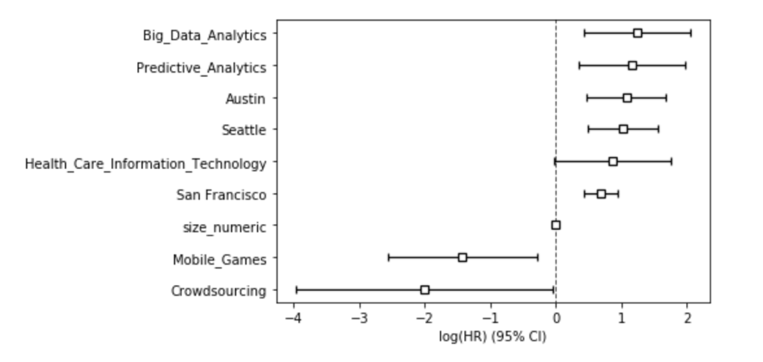
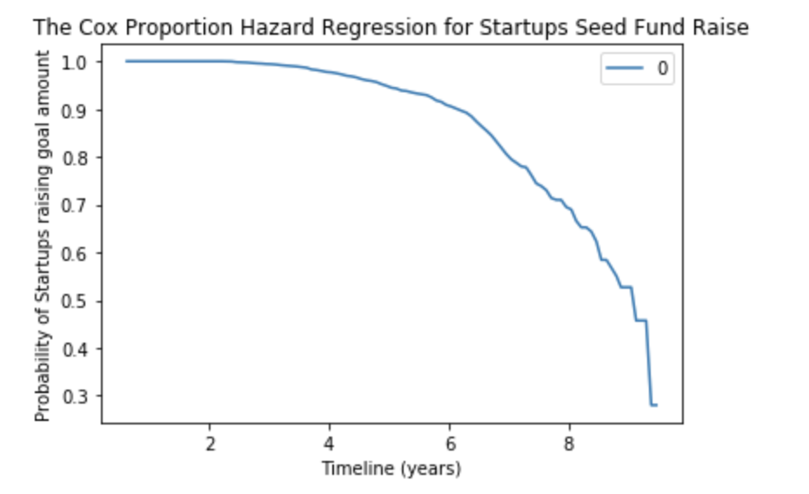
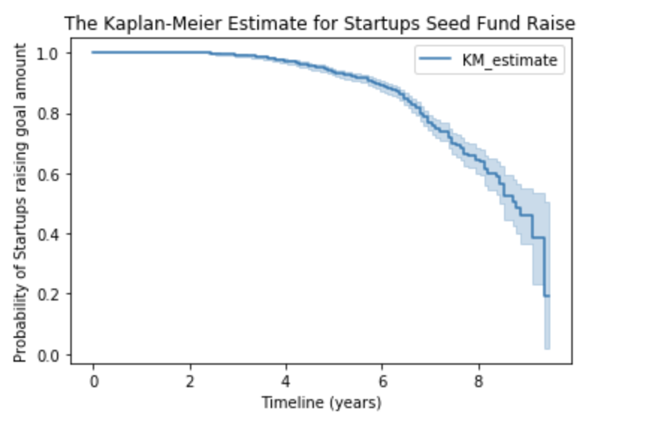
Survival Analysis
Observation – The highest probability of reaching 2m goals is during early 4 years.

Slide 28
Descriptive Insights – Startup Operation
~ 30% unicorns are closed - in a sample of 9500 startups (2005-2015).
10% of Bio-tech & healthcare startups closed even with ~5B total market funding.
Highest yearly funding was associated with software market in last 10 years.
Way-Area dominance- most of companies are situated in CA followed by NY and TX
mobile commerce has highest number of initiatives followed by SaaS systems
Operating or Closed

Slide 29
Predictive Insights – Startup Operation
Top deciding factors - market category, investors, funding rounds
Higher funding attributes (rounds, investors, total & avg) leads to higher probability of survival.
Higher funding delay (avg delay in first funding, avg delta b/w rounds) leads to lower probability of success.
Operating or Closed

Slide 30
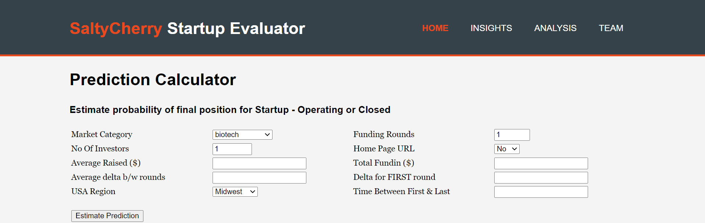
Show time

Slide 31
Conclusion – Seed and Series A
Data Quality and Quantity
Quality : Data extraction approach from Angle list provided new startups with present position
Quantity : very less (~4000) current startup records with current Seed and Series A stage.
Only “twitter- follower” metric increases the probability of reaching Seed (2m) and Series A (12m) goal.
New startups (<4 years old) have higher chances of achieving Seed goals.
Modern technologies – Big Data, Predictive Analytics, Healthcare IT are major market categories to achieve Seed/Series A goals.
Scope to explore- other key indicators (Engagement rate, No of @Mentions, Click ratio, post score, sentiment score etc…)

Slide 32
Conclusion – Operating prediction
Data Quality and Quantity
Quality : Historical data from Kaggle provides OLD startups, investors and funding details from (1990-2015).
Quantity : sufficient number of OLD startup records with past investment and funding account.
Market category and Funding amount appears as major deciding factor for Startups operation.
Historical Funding patterns
Delta between first and last funding
Duration between Startup start date and first funding
Average delay between funding rounds
Future Scope : Social presence impact on startup’s operation

Slide 33
Low-level application Flow
HTML UI to enter user I/P
HTML UI for predicted O/P
Feature evaluation
Feature selection
Model Development
Model Evaluation
Data preprocessing
I/P
round
USD
I/P convert
I/P process
O/P
survival
Process
Final Integrated Dataset
Model File
Pickle engine of prediction model
Flask Web app

Slide 34
References
2019 Startup Outlook US Report | Silicon Valley Bank. (2020). Retrieved 21 June 2020, from https://www.svb.com/startup-outlook-report-2019/us#funding
106 Must-Know Startup Statistics for 2020 - Embroker. (2020). Retrieved 21 June 2020, from https://www.embroker.com/blog/startup-statistics/
The Ultimate Startup Failure Rate Report [2020]. (2020). Retrieved 21 June 2020, from https://www.failory.com/blog/startup-failure-rate
8 Challenges You Could Face Crowdfunding Your Next Project - ReadWrite. (2013). Retrieved 22 June 2020, from https://readwrite.com/2013/12/16/crowdfunding-challenges-entrepreneurs/
Why Startups Fail: Top 20 Reasons l CB Insights. (2019). Retrieved 21 June 2020, from https://www.cbinsights.com/research/startup-failure-reasons-top/
Snider, J. (2015), “Strategies for sustaining small businesses in US healthcare Industry”, Walden university. Retrieved from https://pdfs.semanticscholar.org/c6d2/9d5fd95d02ee4c72d1944185836ceeef58c3.pdf?_ga=2.19300986.318645954.1586443441-1236334836.1586443441
All in the Numbers: How to Measure Your Start-up's Success. (2020). The Muse. Retrieved 20 April 2020, from https://www.themuse.com/advice/all-in-the-numbers-how-to-measure-your-startups-success
Wiltens, R. (2020). Top 5 Challenges of a Crowdfunding Campaign. Home.invesdor.com. Retrieved 20 April 2020, from https://home.invesdor.com/en/blog/2016/7/28/top-5-challenges-of-a-crowdfunding-campaign

Slide 35
Capstone- RedCrow
~ a study supporting crowdfunding
Q&A
Team – Alpha
Arvind Pawar
Mihir Gandhi
Rajesh Ranjan
Sagar Ashok Daswani
Trupti Khodke

