Slide 1
Notes:
Welcome to Shinchan’s Clue Club. This is an evidence-first mystery game built around a Digital Dark Spot: when important details are scattered, changed, or missing, can you show what the records support?

Slide 2
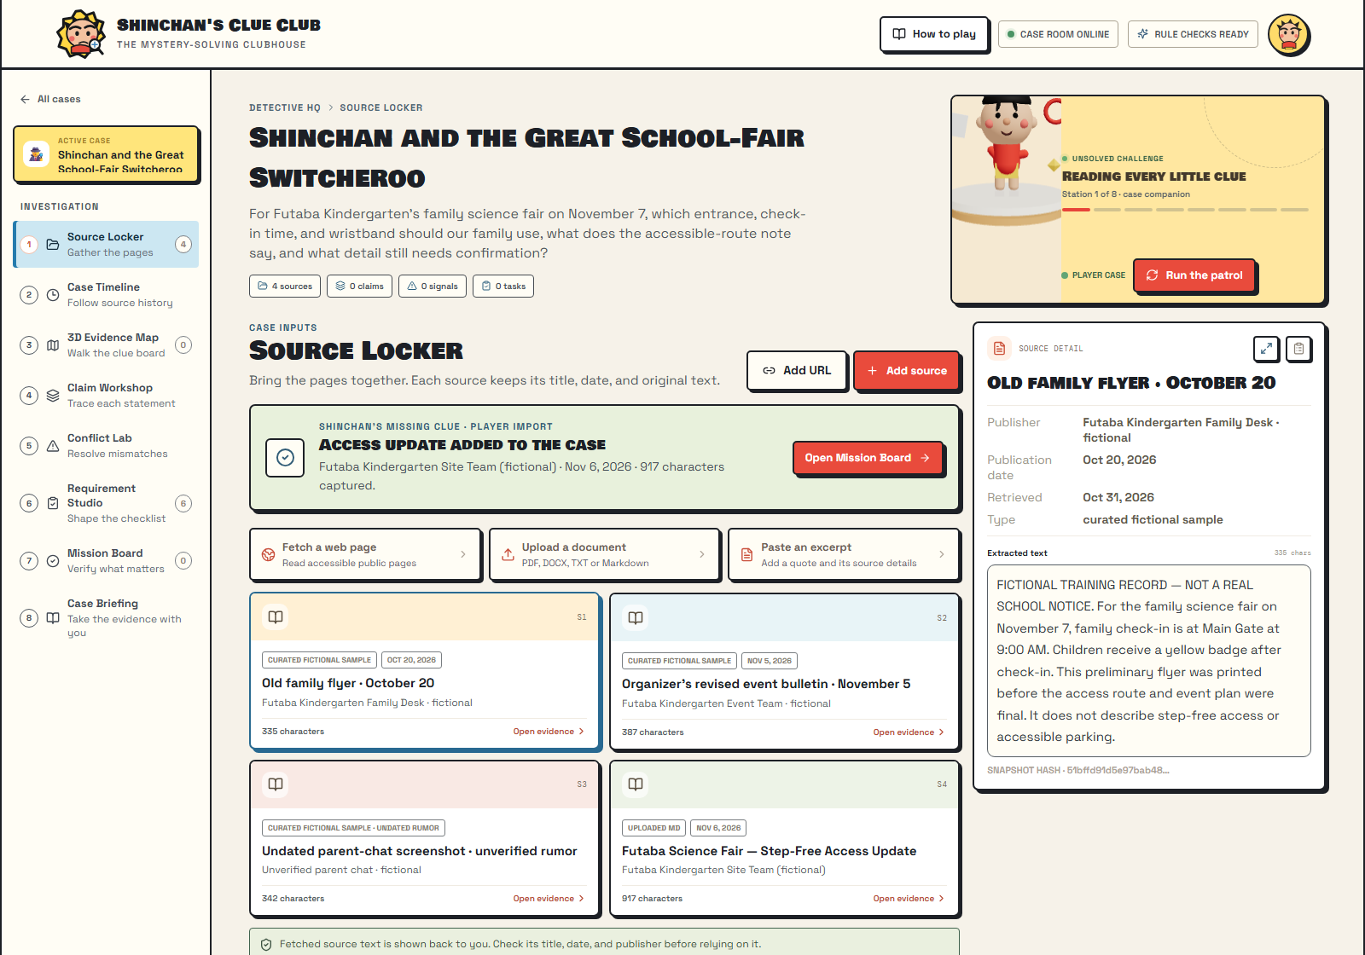
01 · SOURCE LOCKER
Four records.
One missing detail.
An outdated flyer, a revised bulletin and an unverified rumor disagree. Shinchan’s access update joins the case with its date and publisher intact.
2 / 8
Notes:
Our judge challenge begins with three conflicting school-fair records: an older flyer, a revised organizer bulletin and an unverified parent-chat rumor. The player imports Shinchan’s fictional step-free access note. The locker preserves its title, publisher, date and original text.

Slide 3
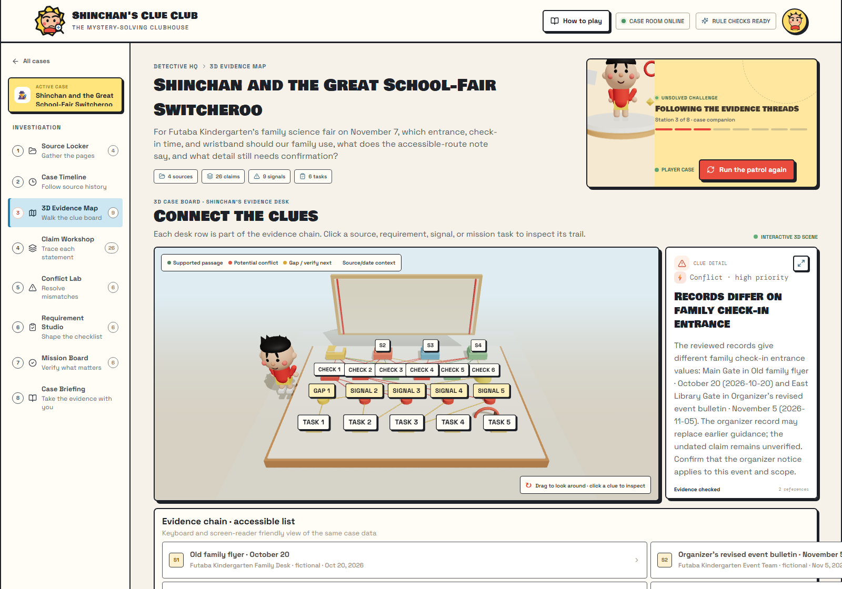
02 · 3D EVIDENCE MAP
Every clue has
a trail.
Sources connect to checks, conflicts and next actions. Select a 3D clue to inspect the exact passage behind it.
3 / 8
Notes:
Run the patrol and the case becomes a living 3D evidence map. Sources, requirements, conflicts and next actions connect on Shinchan’s clue desk. Select a node to inspect its source trail, then rotate the board to explore how the clues relate.

Slide 4
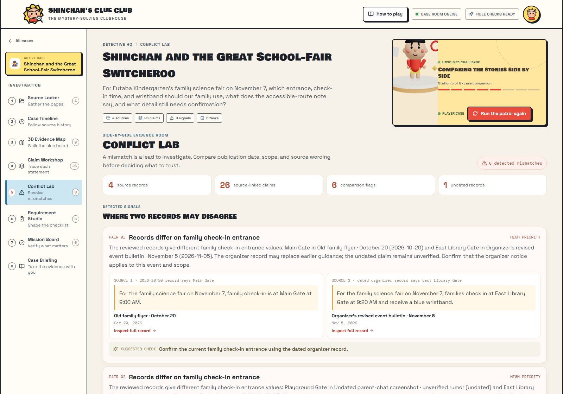
03 · CONFLICT LAB
Compare the
actual records.
The old flyer says Main Gate at 9:00. The newer bulletin says East Library Gate at 9:20 and explicitly replaces it. The rumor remains unverified.
4 / 8
Notes:
In Conflict Lab, the player compares the exact passages. The old flyer says Main Gate at nine. The newer organizer notice says East Library Gate at nine twenty and states that it replaces the old flyer. The undated rumor stays unverified.

Slide 5
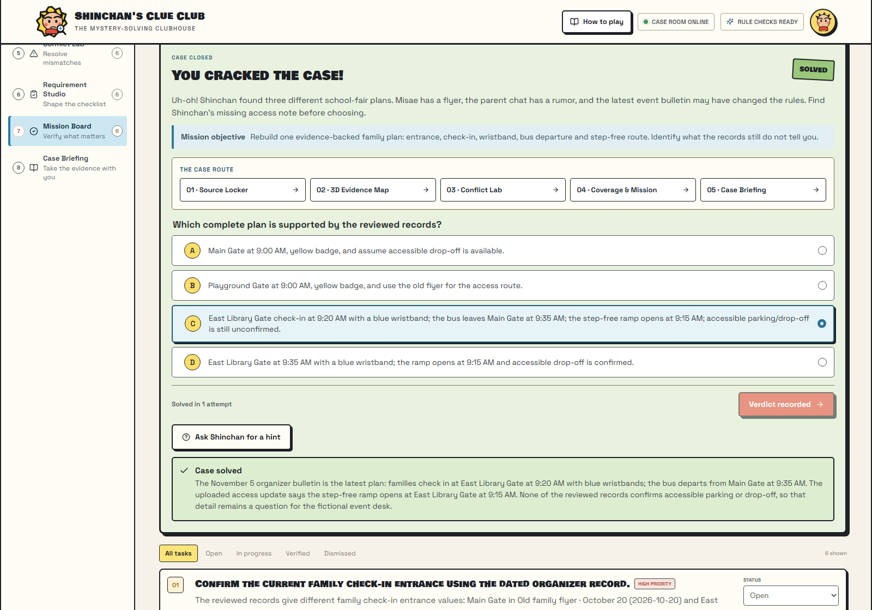
04 · PLAYER VERDICT
The player
solves the case.
The verdict is the player’s choice, checked against the records. A correct answer reveals the evidence-backed explanation.
5 / 8
Notes:
Now Shinchan asks for the full plan. The player chooses an answer, and the verdict is checked against the case records. Get it right and the case is marked solved, with the reasoning and source evidence still visible.

Slide 6
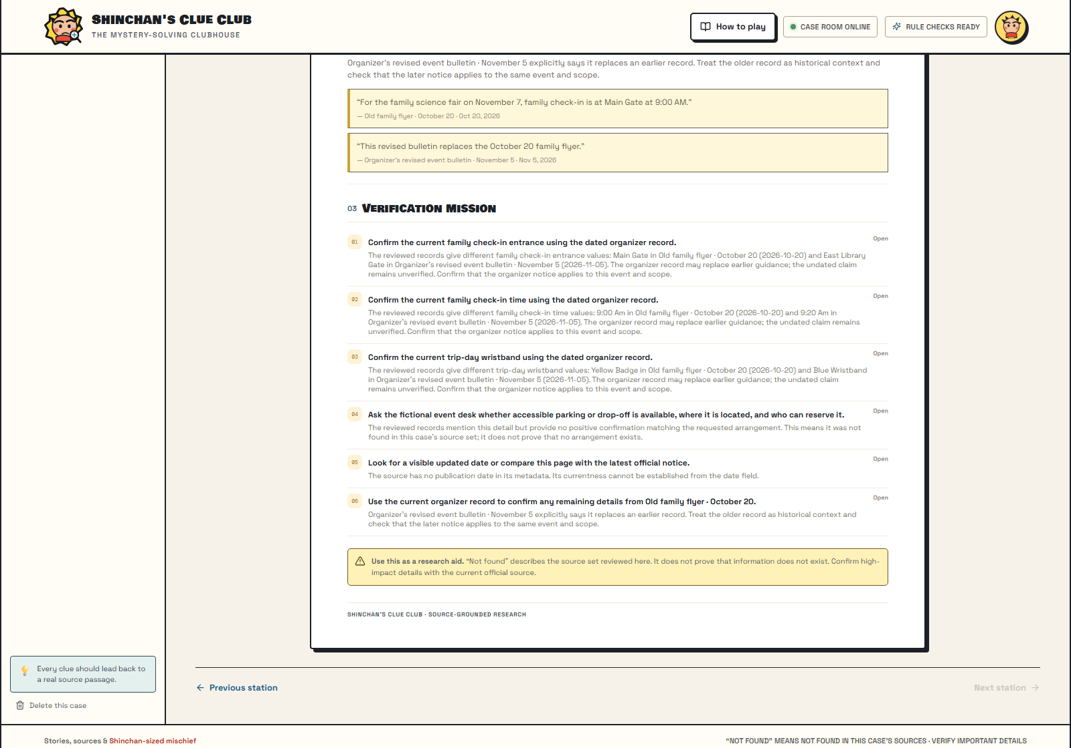
05 · CASE BRIEFING
Unknown means
unknown.
The briefing carries the evidence into a shareable report. Accessible drop-off stays unconfirmed because none of the reviewed records answers it.
6 / 8
Notes:
The briefing exports the findings and next checks as a shareable Markdown file. Accessible parking and drop-off remain unconfirmed because none of the reviewed records answers that question. The app never treats missing evidence as proof.

Slide 7
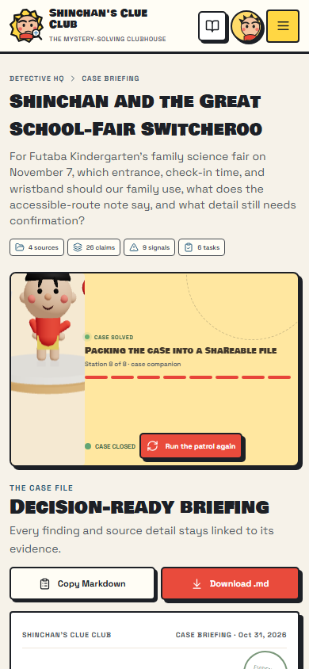
06 · MOBILE CASE FILE
The case fits
your pocket.
The mobile briefing keeps the evidence and open checks visible in a narrow layout, ready to review wherever the detective is.
7 / 8
Notes:
The evidence stays readable on a phone too. The mobile case file keeps the source trail and remaining verification tasks together, so the player can review the result wherever the investigation continues.

Slide 8
SHINCHAN'S CLUE CLUB
Follow the clue.
Check the source.
Solve the gap.
github.com/Sagar44-Github/Shinchan-s-Clue-Club-Digital-Dark-Spot-Detective
8 / 8
Notes:
Shinchan’s Clue Club. Think like Shinchan. Build like a Devenger. Follow the clue. Check the source. Solve the gap.

