Slide 1
MODULE - 1

Slide 2
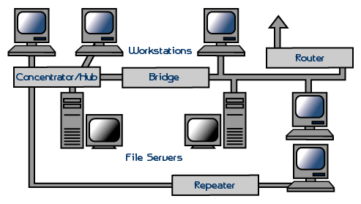

Slide 3


What is a Network?
A network consists of two or more computers that are linked in order to:
  Share resources (such as printers and CD-ROMs)
  Exchange files
  Allow electronic communications

Slide 4

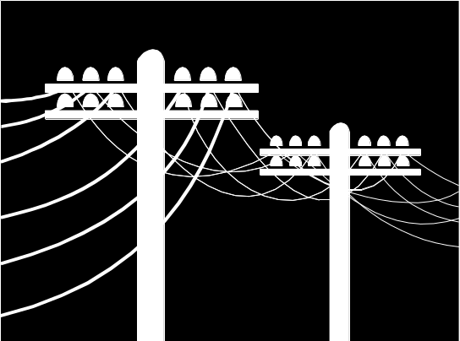
How are they linked?
Computers on a network may be linked through:
  Cables,
  Telephone lines,
  Radio waves, Satellites
  Wireless technologies

Slide 5
The two Basic types of Networks include:
Local Area Networks (LAN)
Wide Area Networks (WAN)
LAN
WAN

Slide 6
Local Area Networks
LANs are confined to a relatively small area such as a school or a building.
LANs usually have one computer designated as the file server.
Other computers are connected to the network by cables connecting network interface cards in each computer.

Slide 7


Wide Area Networks
WANs connect larger areas, such as whole states, or even the world.
Transoceanic cables and satellites are used to connect WANs

Slide 8
Basic Network Types
System area network (SAN)
  same room (meters)
  300 MB/s Cray T3E
Local area network (LAN)
  same bldg or campus (km)
  10 Mb/s Ethernet
  100 Mb/s Fast Ethernet
  100 Mb/s FDDI
  150 Mb/s OC-3 ATM
  622 Mb/s OC-12 ATM
Metropolitan area network (MAN)
  same city (10’s of km)
  800 Mb/s Gigabit Nectar
Wide area network (WAN)
  nationwide or worldwide (1000’s of kilometers)
  telephone system
  1.544 Mb/s T1 carrier
  44.736 Mb/s T3 carrier
  Global Internet

Slide 9
Example | Interprocessor Distance | Processors located in same
Local Area Network | 10 m | Room
 | 100 m | Building
 | 1 km | Campus
Metropolitan Area Network | 10 km | City
Wide Area Network | 100 km | Country
 | 1000 km | Continent
Internet | 10,000 km | Planet

Slide 10

Network Hardware
Network hardware includes:
  Computers
  Peripherals, Cables
  Interface cards and
  Other equipment needed to perform data processing and communications within the network

Slide 11
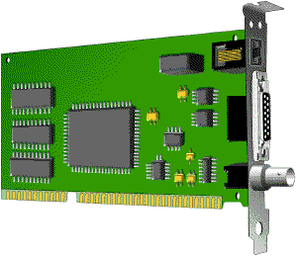
Network interface cards
The network interface card (NIC) provides the physical connection between the network and the computer workstation.
Most NICs are internal with the card fitting into an expansion slot in the computer.
Three common network interface connections are Ethernet cards, Local Talk connectors and Token Ring cards

Slide 12
Ethernet cards
The most common Network Interface Cards are Ethernet cards
They contain connections for either coaxial or twisted pair cables, or both
Co-axial cable
Twisted pair cable

Slide 13
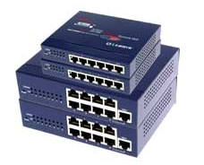
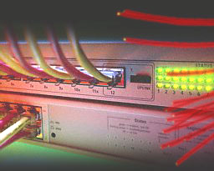
Concentrators / Hubs
A concentrator is a device that provides a central connection point for cables from workstations, servers and peripherals
Hubs are multi-slot concentrators

Slide 14
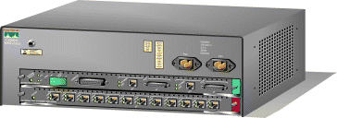
Switches
While hubs provide an easy way to scale up and shorten the distance that the packets must travel to get from one node to another, they do not break up the actual network into discrete segments. That is where switches come in.

Slide 15
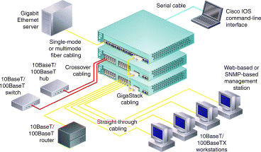
Switches (continued)
A vital difference between a hub and a switch is that all the nodes connected to a hub share the bandwidth among themselves, while a device connected to a switch port has the full bandwidth all to itself.
Think of a switch as a ‘clever’ hub

Slide 16
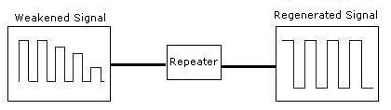
Repeaters
A signal loses strength as it passes along a cable, so it is often necessary to boost the signal with a device called a repeater
A repeater might be a separate device, or might be part of a concentrator

Slide 17
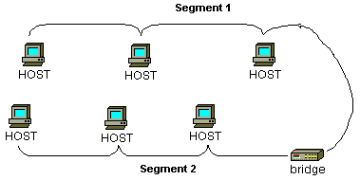
Bridges
A bridge is a device that allows you to segment a large network into two smaller, more efficient networks

Slide 18
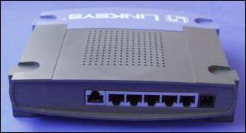
Routers
A router translates information from one network to another
The router directs traffic to prevent “head-on” collisions
If you have a LAN that you want to connect to the Internet, you will need a router to serve as the translator between information on your LAN and the Internet

Slide 19
Gateways
Gateways make communication possible between different architectures and environments.
They repackage and convert data going from one environment to another so that each environment can understand the other's environment data.
A gateway links two systems that do not use the same:
- Communication protocols
- Data formatting structures
- Languages
- Architecture

Slide 20
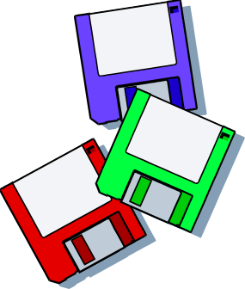
Network Operating Software
Network operating systems co-ordinate the activities of multiple computers across a network
The two major types of network OS are:
  Peer-to-peer
  Client/server

Slide 21

Peer to peer network OS
In peer to peer network OS, there is no file server or central management source; all computers are considered equal
Peer to peer networks are design primarily for small to medium LANS
e.g.AppleShare, Windows

Slide 22
Client/Server network OS
Client/server network OS centralize functions and applications in one or more dedicated file servers.
The file server provides access to resources and provides security
e.g. Novelle Netware, Windows NT Server

Slide 23
Topology
The physical topology of a network refers to the configuration of cables, computers and other peripherals.
The main types of network topologies are:
  Linear Bus
  Star
  Ring
  Tree or Hybrid

Slide 24


Linear Bus
A linear bus topology consists of a main run of cable with a terminator at each end. All servers workstations and peripherals are connected to the linear cable.

Slide 25
Star
A star network is designed with each node (file server, workstation, peripheral) connected directly to a central network hub or server

Slide 26
Ring
A ring network is one where all workstations and other devices are connected in a continuous loop. There is no central server.

Slide 27
Tree or hybrid
A tree or hybrid topology combines characteristics of linear bus and star and/or ring topologies.
It consists of groups of star-configured workstations connected to a linear bus backbone cable.

Slide 28

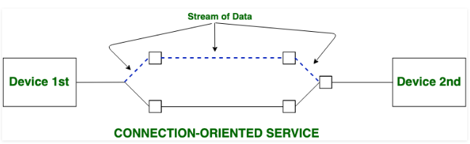
Connection Oriented Service/Network

Slide 29
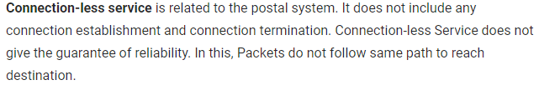
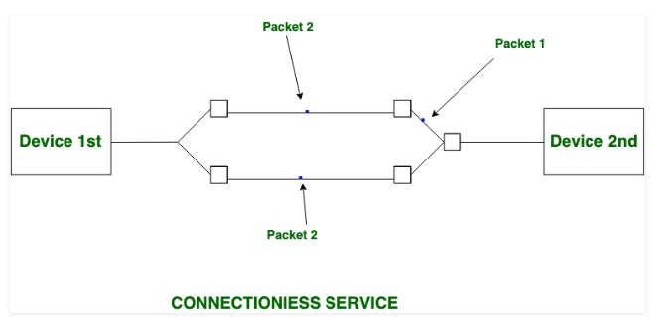
Connectionless Service/Network

Slide 30
Protocol, Services, Interface
A protocol is a set of rules that governs the communications between computers on a network.
These rules include guidelines that regulate the method of access, types of cabling and speed of data transfer.
A service is a set of primitives (operations) that a layer provides to the layer above it.
An interface refers to the connecting point between two adjacent entities.
Protocols communicate using interfaces which define primitive operations.

Slide 31
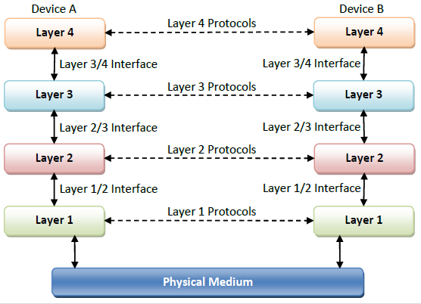
Protocol Hierarchy

Slide 32

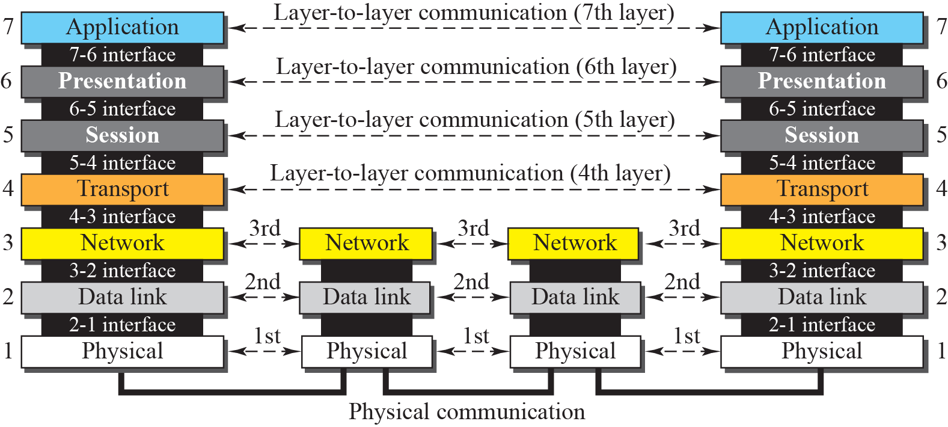

Slide 33
Design Issues for Layers
Reliability : Network channels and components may be unreliable, resulting in loss of bits while data transfer. So, an important design issue is to make sure that the information transferred is not distorted.
Scalability : Networks sizes are continually increasing leading to congestion. Also, when new technologies are applied to the added components, it may lead to incompatibility issues. Hence, the design should be done so that the networks are scalable and can accommodate such additions and alterations.
Addressing : At a particular time, innumerable messages are being transferred between large numbers of computers. So, a naming or addressing system should exist so that each layer can identify the sender and receivers of each message.
Error Control : Unreliable channels introduce a number of errors in the data streams that are communicated. So, the layers need to agree upon common error detection and error correction methods so as to protect data packets while they are transferred.

Slide 34
Design Issues for Layers
Flow Control : If the rate at which data is produced by the sender is higher than the rate at which data is received by the receiver, there are chances of overflowing the receiver. So, a proper flow control mechanism needs to be implemented.
Resource Allocation : Computer networks provide services in the form of network resources to the end users. The main design issue is to allocate and de-allocate resources to processes, optimal usage of the resources.
Statistical Multiplexing : It is not feasible to allocate a dedicated path for each message while it is being transferred from the source to the destination. So, the data channel needs to be multiplexed, so as to allocate a fraction of the bandwidth or time to each host.
Routing : There may be multiple paths from the source to the destination. Routing involves choosing an optimal path among all possible paths, in terms of cost and time. There are several routing algorithms that are used in network systems.

Slide 35
Design Issues for Layers
Security (Confidentiality & Integrity) : A major factor of data communication is to defend it against threats like eavesdropping and surreptitious alteration of messages. So, there should be adequate mechanisms to prevent unauthorized access to data through authentication and cryptography.
Mechanisms that provide confidentiality defend against threats like eavesdropping. Mechanisms for integrity prevent faulty changes to messages.

Slide 36
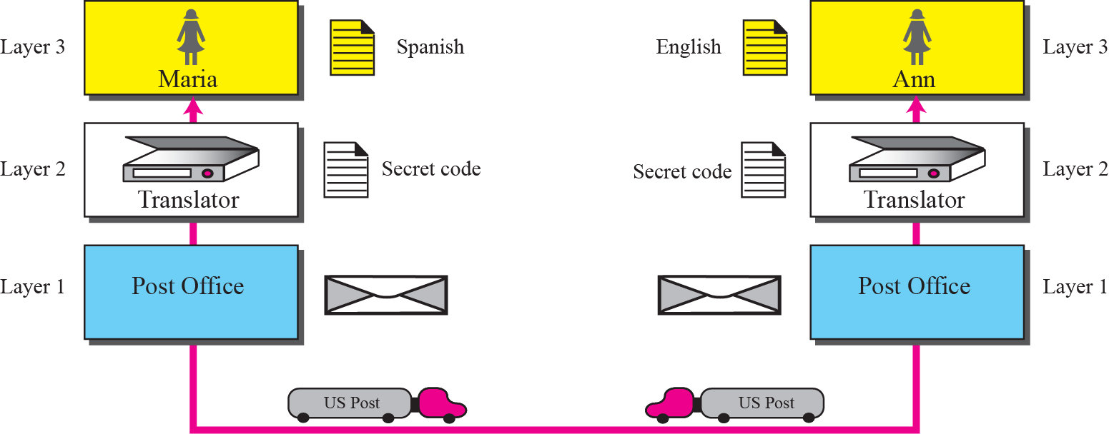
Example :

Slide 37
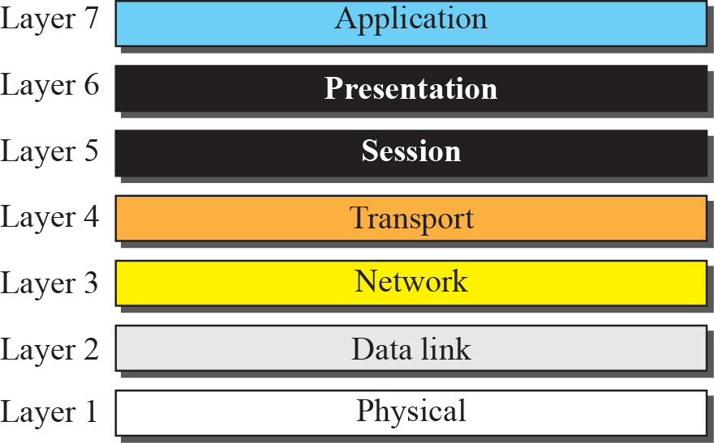
The OSI model
(Open System Interconnection)

Slide 38

Note
The unit of communication at the physical layer is a bit.
The unit of communication at the data link layer is a frame.
The unit of communication at the network layer is a datagram.
The unit of communication at the transport layer is a segment, user datagram, or a packet, depending on the specific protocol used in this layer.
The unit of communication at the application layer is a message.

Slide 39
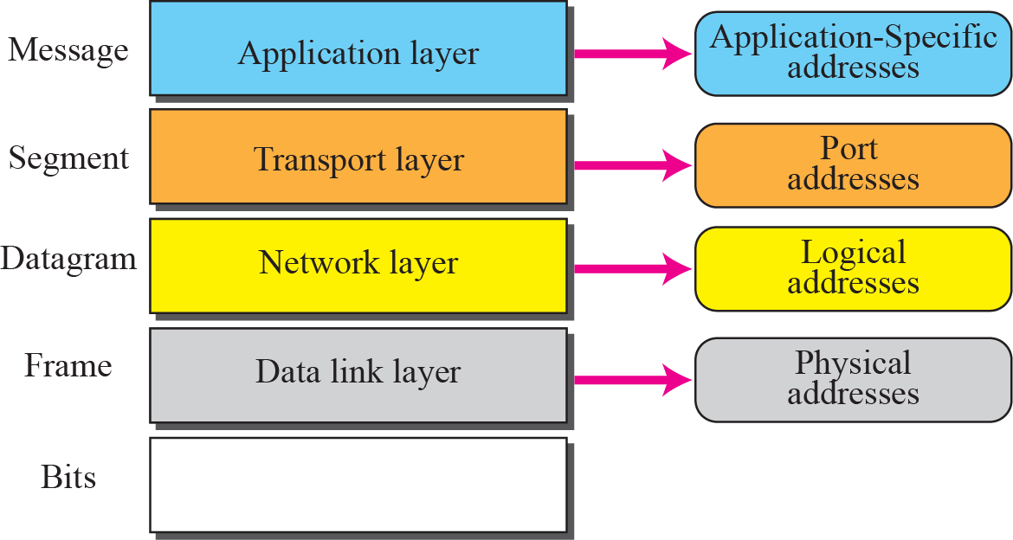
Addresses in the TCP/IP (Transport Control protocol / Internet Protocol) suite :

Slide 40
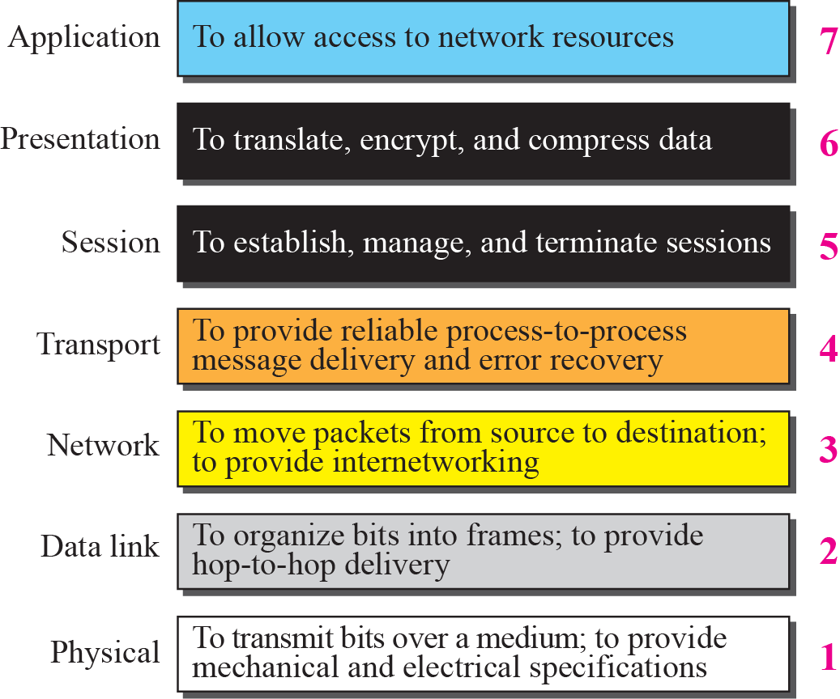
Summary of OSI Layers :

Slide 41
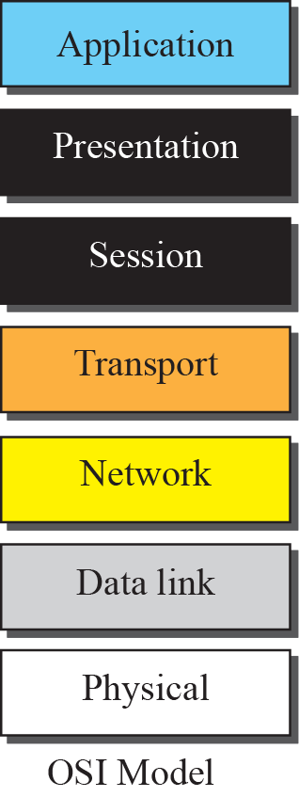
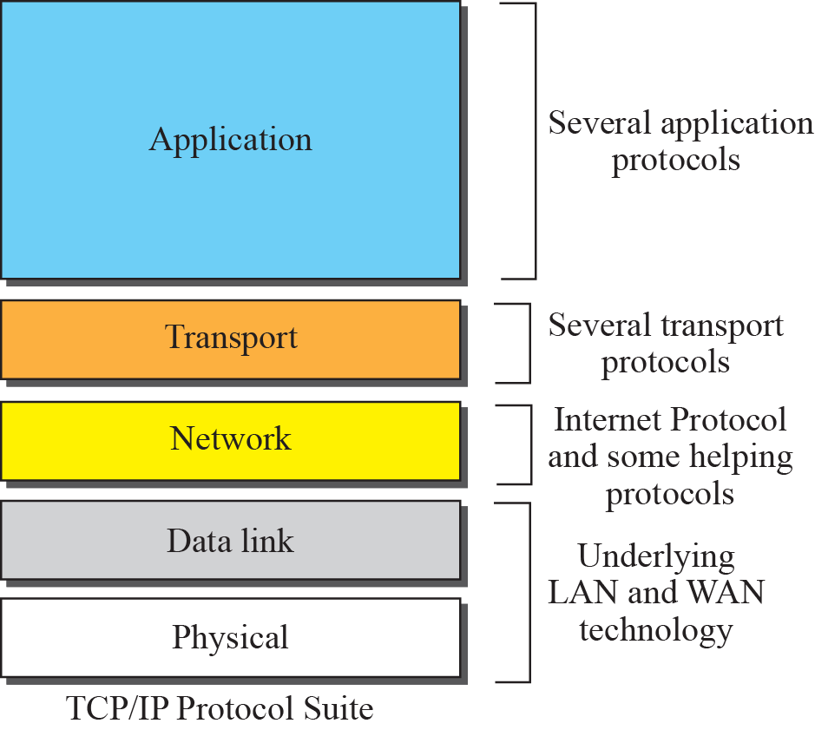
OSI and TCP/IP model

Slide 42
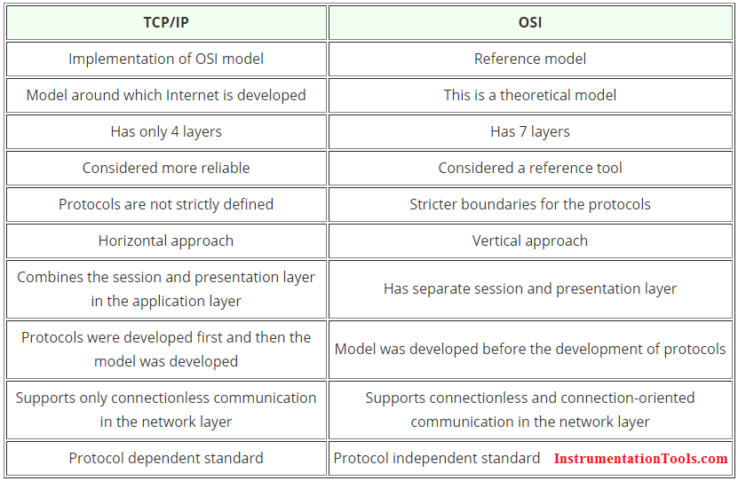
Comparison : OSI model & TCP-IP model

Slide 43
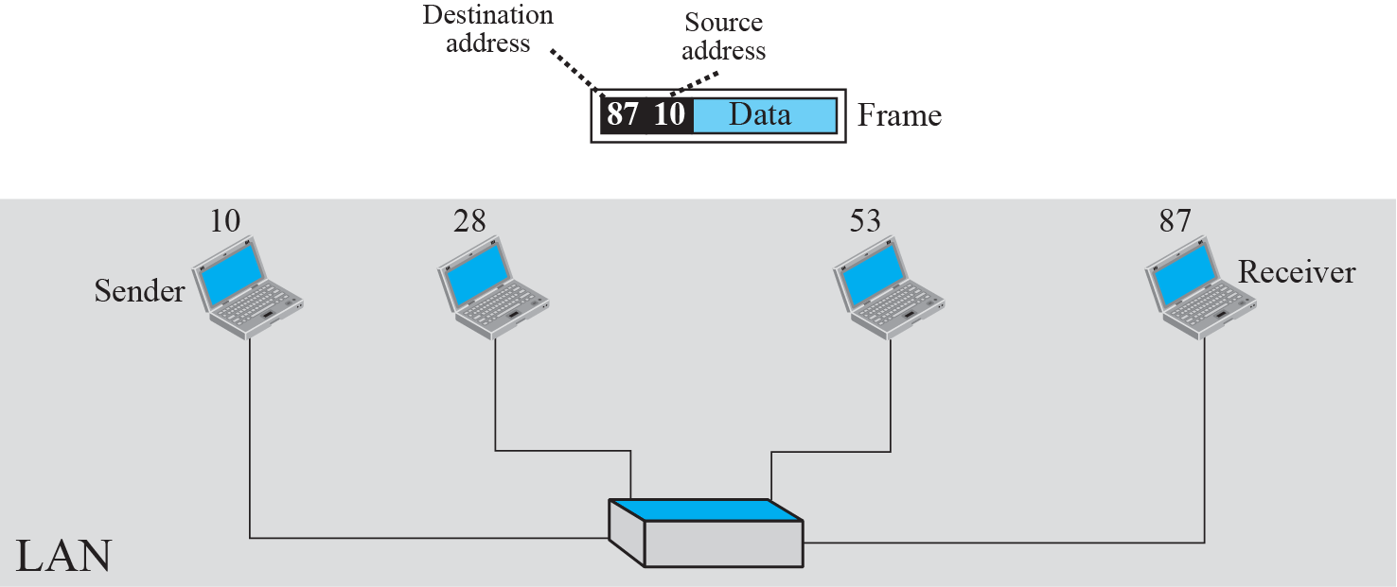
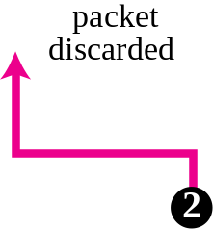
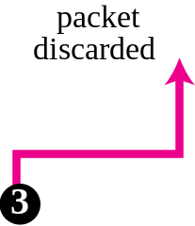
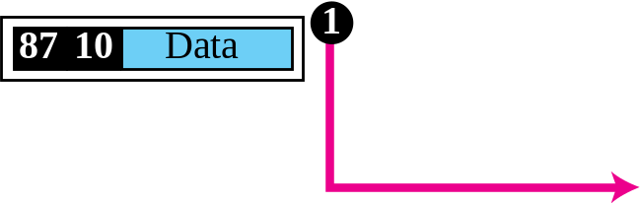
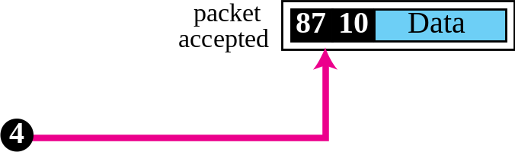
Example : physical addresses

Slide 44
END

