Slide 1
MODULE - 2
Prepared By : Ms. Arti K. Gore-Sabale

Slide 2

Transmission Media
Transmission Media and Physical Layer

Slide 3

Classes of Transmission Media

Slide 4
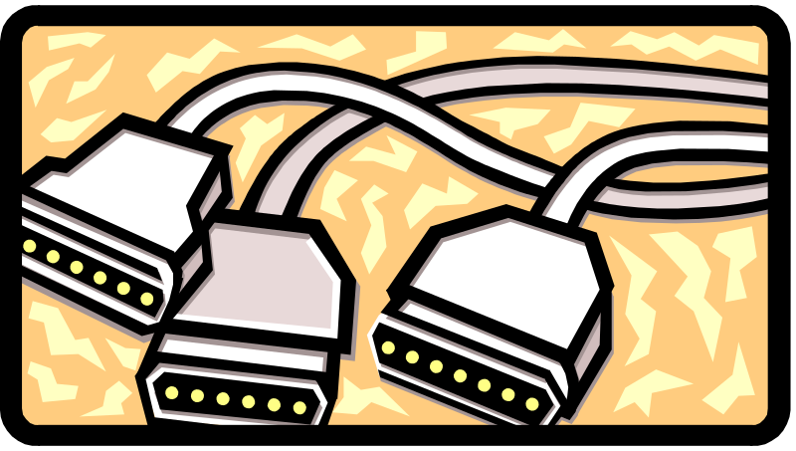
Cabling
Network cabling is the medium through which information usually moves from one network device to another.
There are several different types of cable commonly used in LANS.
Some networks use a variety of cable types within the one network.

Slide 5
Twisted Pair Cable
Transmission Characteristics
Analog - needs amplifiers every 5km to 6km
Digital - can use either analog or digital signals
  needs a repeater every 2-3km
Limited distance & Limited bandwidth (1MHz)
Limited data rate (100MHz)
Susceptible to interference and noise

Slide 6
Unshielded Twisted Pair (UTP) Cable
Twisted pair cables come in two varieties: shielded and unshielded. Unshielded (UTP) is the most popular.
Shielded twisted pair is used only in environments
where there may be electrical interference.

Slide 7
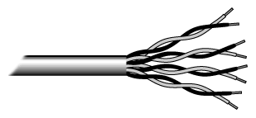
UTP (continued)
UTP has four pairs of wires inside the jacket
Each pair is twisted with a different number of twists per inch to help eliminate interference from adjacent pairs.

Slide 8
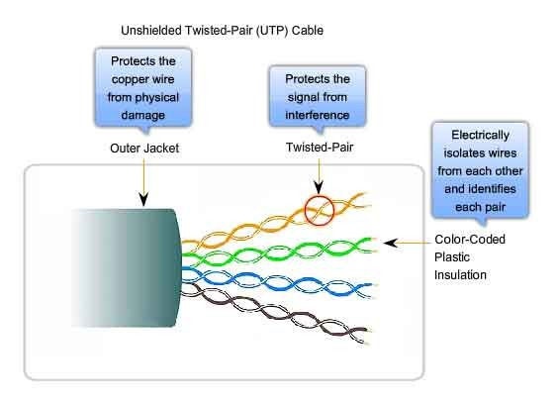
UTP (continued)

Slide 9
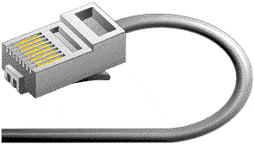
UTP Connector
The standard connector for UTP cabling is an RJ-45. It looks like a telephone style connection.
Applications:
  Telephone lines connecting subscribers to the central office
  DSL lines
  LAN – 10Base-T &
  100Base-T

Slide 10

Coaxial cable
Coaxial cable has a single copper conductor at its centre with a plastic layer between the centre conductor & the braided metal shield.
Although coaxial cabling is difficult to install, it is highly resistant to signal interference.

Slide 11

Coaxial cable connectors
The most common type of connector used with coaxial cables is the BNC connector.

Slide 12
Coaxial Cable
Transmission Characteristics
Superior frequency characteristics to TP.
Performance limited by attenuation & noise
Analog signals
  - amplifiers every few km
  - closer if higher frequency
  - up to 500MHz
Digital signals
  - repeater every 1km
  - closer for higher data rates

Slide 13
Coaxial Cable Applications
Most versatile medium
Television distribution
Long distance telephone transmission
Can carry 10,000 voice calls simultaneously
Short distance computer systems links
Local area networks

Slide 14
Differences Between Coaxial Cable and Twisted Pair
Coaxial cables are generally used for cable television and internet connections.
Twisted pair cables are usually used for telephone connections.
Coaxial cables support greater cable lengths.
Twisted pair cables are thinner and less expensive.
Coaxial cables are better shielded from crosstalk.
Twisted pair cables provide high transmission rates.

Slide 15

Fiber Optic Cable
Fiber optic cabling consists of a center glass core surrounded by several layers of protective materials
It transmits light rather than electronic signals.
It is the standard for connecting networks between buildings, due to its immunity to the effects of moisture and light.

Slide 16
Fiber Optic (continued)
Fiber optic cable has the ability to transmit signals over much longer distances than coaxial or twisted pair.
It can also carry information at vastly greater speeds.
Fiber optic cable is more difficult to install than other cabling.

Slide 17
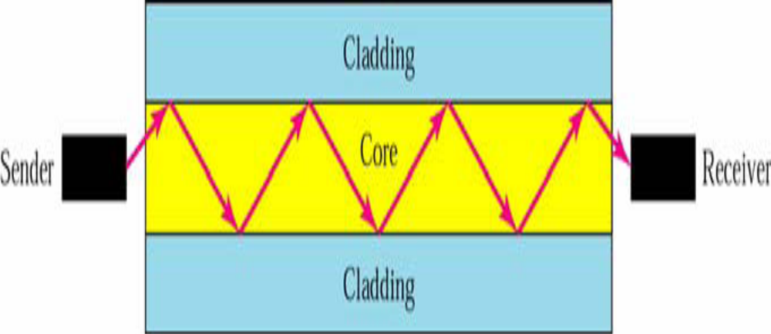
Optical Fiber
Uses reflection to guide light through a channel
Core is of glass or plastic surrounded by Cladding
Cladding is of less dense glass or plastic

Slide 18
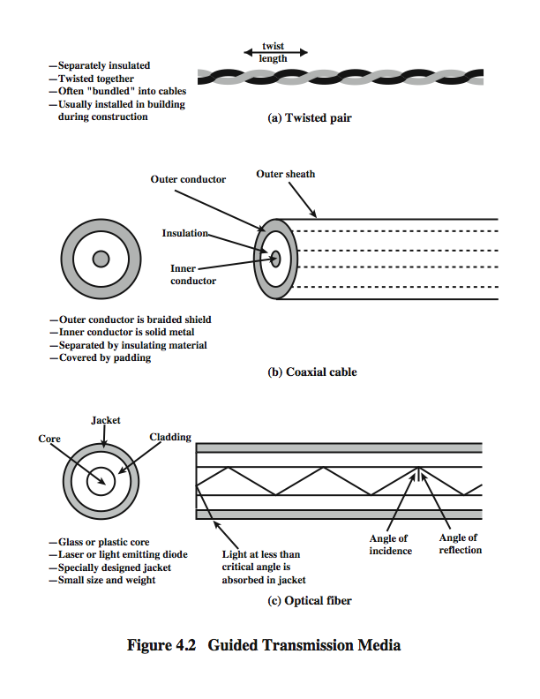

Optical Fiber Connector
Notes:
An optical fiber is a thin (2 to 125 µm), flexible medium capable of guiding an optical ray. Various glasses and plastics can be used to make optical fibers. An optical fiber cable has a cylindrical shape and consists of three concentric sections: the core, the cladding, and the jacket (Stallings DCC8e Figure 4.2c). The core is the innermost section and consists of one or more very thin strands, or fibers, made of glass or plastic; the core has a diameter in the range of 8 to 50 µm. Each fiber is surrounded by its own cladding, a glass or plastic coating that has optical properties different from those of the core and a diameter of 125 µm. The interface between the core and cladding acts as a reflector to confine light that would otherwise escape the core. The outermost layer, surrounding one or a bundle of cladded fibers, is the jacket. The jacket is composed of plastic and other material layered to protect against moisture, abrasion, crushing, and other environmental dangers.
Optical fiber already enjoys considerable use in long-distance telecommunications, and its use in military applications is growing. The continuing improvements in performance and decline in prices, together with the inherent advantages of optical fiber, have made it increasingly attractive for local area networking. Five basic categories of application have become important for optical fiber: Long-haul trunks, Metropolitan trunks, Rural exchange trunks, Subscriber loops & Local area networks.

Slide 19
Optical Fiber
Transmission Characteristics
Uses total internal reflection to transmit light
  effectively acts as wave guide for 10¹⁴ to 10¹⁵ Hz
Can use several different light sources
  Light Emitting Diode (LED)
    cheaper, wider operating temp range, lasts longer
  Injection Laser Diode (ILD)
    more efficient, has greater data rate
Notes:
Optical fiber transmits a signal-encoded beam of light by means of total internal reflection. Total internal reflection can occur in any transparent medium that has a higher index of refraction than the surrounding medium. In effect, the optical fiber acts as a waveguide for frequencies in the range of about 10¹⁴ to 10¹⁵ Hertz; this covers portions of the infrared and visible spectra.
Two different types of light source are used in fiber optic systems: the light-emitting diode (LED) and the injection laser diode (ILD). Both are semiconductor devices that emit a beam of light when a voltage is applied. The LED is less costly, operates over a greater temperature range, and has a longer operational life. The ILD, which operates on the laser principle, is more efficient and can sustain greater data rates.
There is a relationship among the wavelength employed, the type of transmission, and the achievable data rate. Both single mode and multimode can support several different wavelengths of light and can employ laser or LED light sources.

Slide 20
Optical Fiber Cable
Applications:
  Backbone networks – SONET
  Cable TV – backbone
  LAN
    100Base-FX network (Fast Ethernet)
    100Base-X

Slide 21
Frequency Spectrum
twisted pair
coax cable
optical transmission
1 Mm
300 Hz
10 km
30 kHz
100 m
3 MHz
1 m
300 MHz
10 mm
30 GHz
100 μm
3 THz
1 μm
300 THz
VLF
LF
MF
HF
VHF
UHF
SHF
EHF
infrared
visible light
UV
VLF = Very Low Frequency UHF = Ultra High Frequency
LF = Low Frequency SHF = Super High Frequency
MF = Medium Frequency EHF = Extra High Frequency
HF = High Frequency UV = Ultraviolet Light
VHF = Very High Frequency
Notes:
Universität Karlsruhe
Institut für Telematik
Mobilkommunikation
SS 1998
Prof. Dr. Dr. h.c. G. Krüger
E. Dorner / Dr. J. Schiller

Slide 22
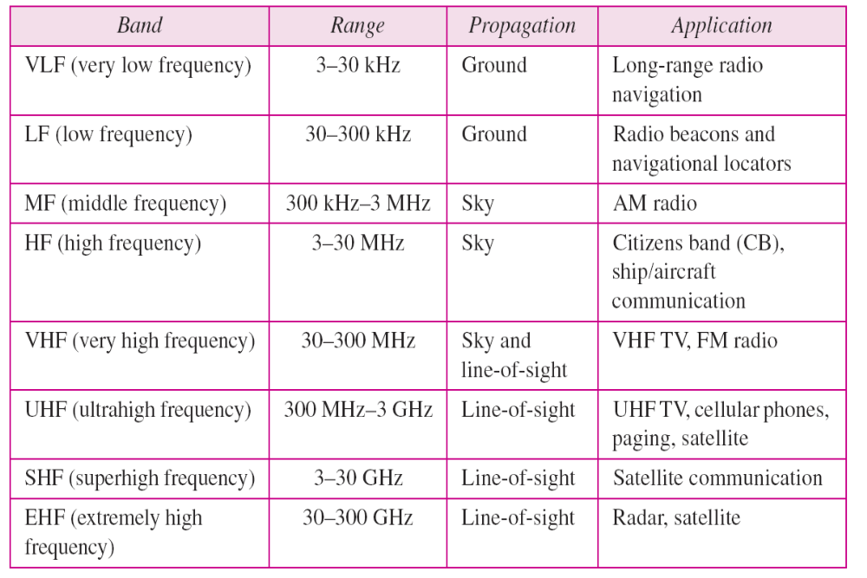
Bands

Slide 23
Comparison of Media
Medium Cost Speed Atten Interfere Security
UTP Low 1-100M High High Low
STP Medium 1-150M High Medium Low
Coax Medium 1M–1G Medium Medium Low
Fibre High 10M–2G Low Low High
Radio Medium 1-10M Varies High Low
Microwv High 1M–10G Varies High Medium
Satellite High 1 M–10G Varies High Medium
Cellular High 9.6–19.2K Low Medium Low

Slide 24
Circuit Switched & Packet Switched Networks
Circuit switched networks are connection-oriented networks. Here, a dedicated route is established between the source and the destination and the entire message is transferred through it.
Packet switched networks are connectionless networks.

Slide 25
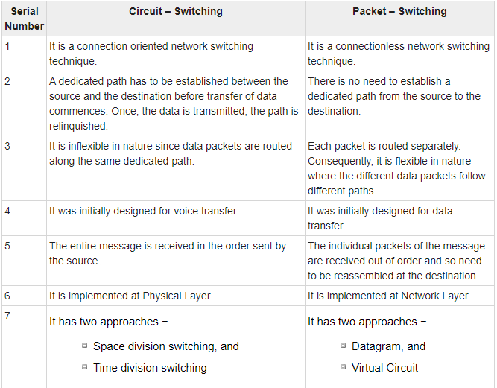

Slide 26
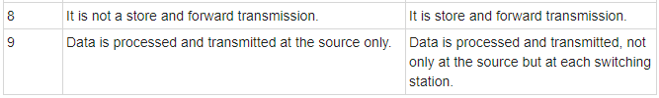
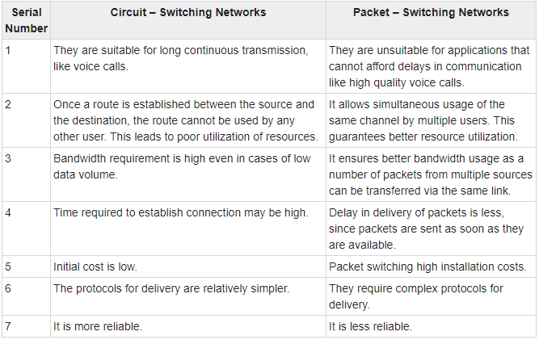

Slide 27
END

