Slide 1
Explore Zomato Restaurant Data of Ahmedabad City
Sagar Tarasariya
B.Tech CSE Student
Nirma University, Ahmedabad

Slide 2
Introduction
Ahmedabad is located near the banks of the Sabarmati River, 25 km (16 mi), from the capital of Gujarat, Gandhinagar, also known as its twin city. Ahmedabad has emerged as an important economic and industrial hub in India.
And also Ahmedabad is very much famous for Food all over Gujarat.
There are many restaurants in Ahmedabad City, each belonging to different categories like Chinese, Italian, North Indian, French, etc.
So as part of this project, we will list and visualize all major parts of Ahmedabad, Gujarat.

Slide 3
Objectives
Questions that can be asked using the above mentioned datasets:
Q: which places are have best restaurant in Ahmedabad?
Q: Which Restaurant have most outlets in Ahmedabad city?
Q: Top Quick Bites restaurant in Ahmedabad?
Q: Top Casual Dining Restaurants in Ahmedabad?
Q: Which place are suitable for edible person in Ahmedabad city?
Q: What are the best Chinese restaurant in Bodakdev?
Q: How many Restaurant Accepting Digital Payment in Ahmedabad?

Slide 4
Dataset
For this project we need the following data:
Ahmedabad restaurants data that contains list Locality, Restaurant name, rating along with their latitude and longitude.
Data source: Zomato Indian Restaurant kaggel dataset
Description: This data set contains the required information. And we will use this data set to explore various locality of Ahmedabad city.
Nearby places in each locality of Ahmedabad city.
Data source: Foursquare API
Description: By using this API we will get all the venues in each neighborhood.

Slide 5
Approach
Collect the Ahmedabad city data from Zomato kaggel dataset
Using Foursquare API we will find all venues for each neighborhood.
Filter out all venues that are nearby by locality.
Using aggregative rating for each restaurant to find the best places.
Visualize the Ranking of neighborhoods using folium library(python)

Slide 6
RESULT

Slide 7
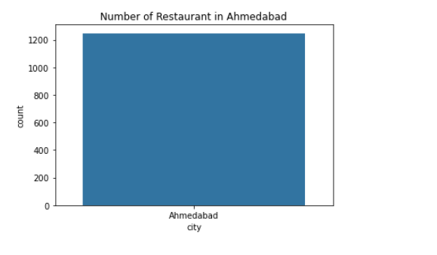

Slide 8
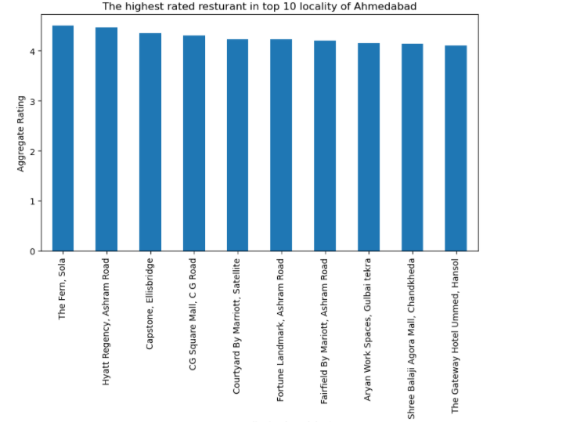

Slide 9
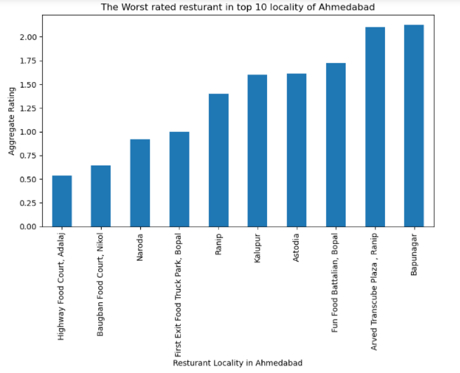

Slide 10
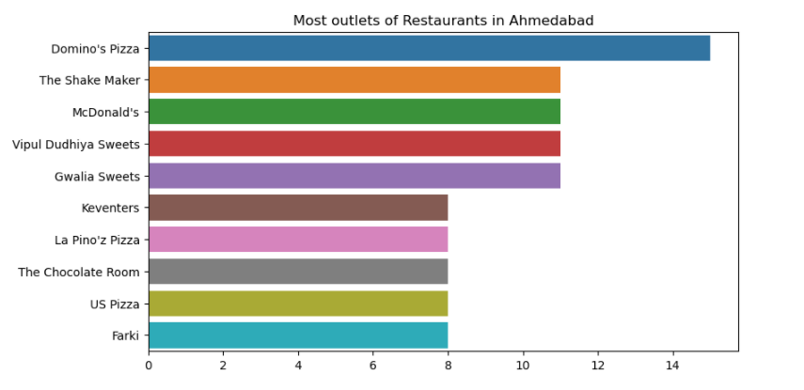

Slide 11
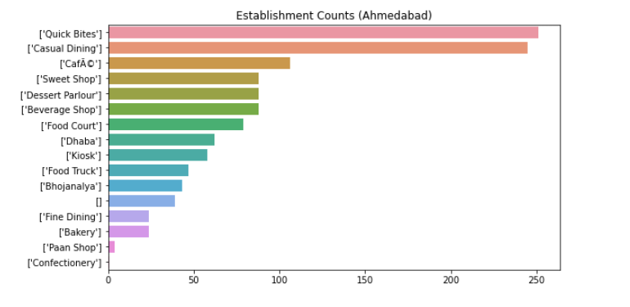

Slide 12
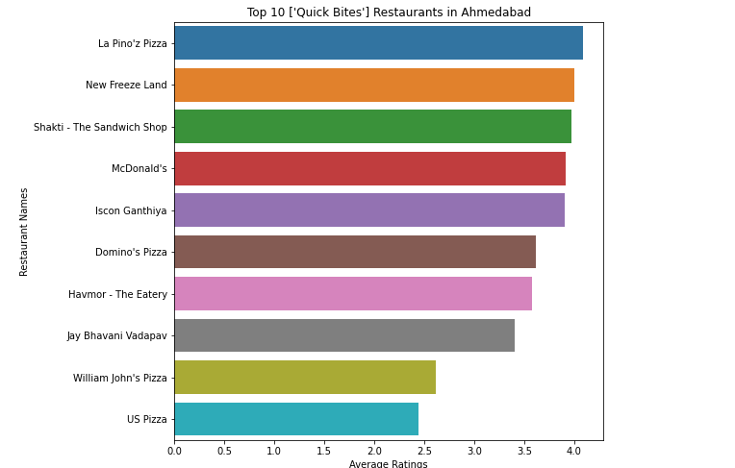

Slide 13
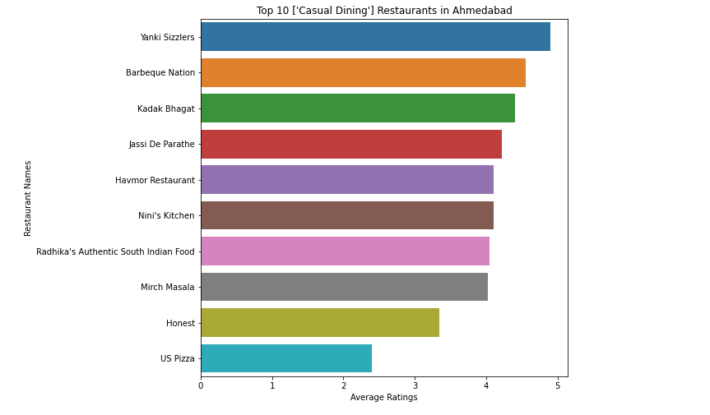

Slide 14
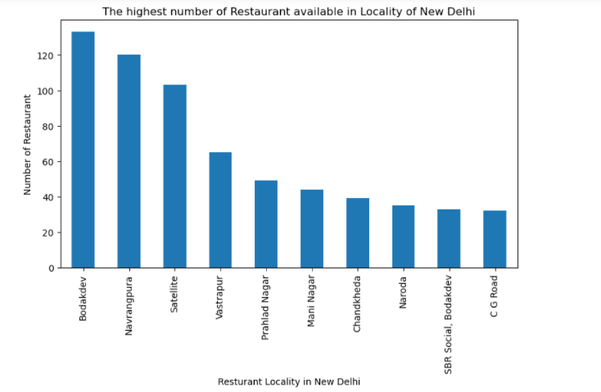

Slide 15
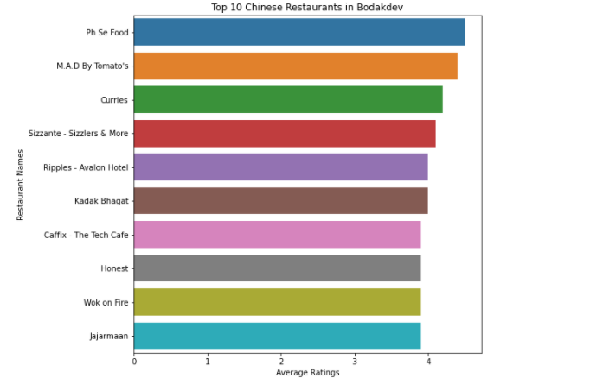

Slide 16
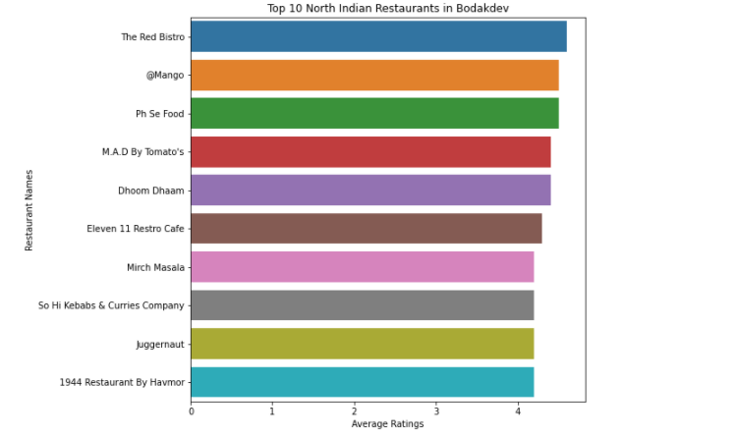

Slide 17
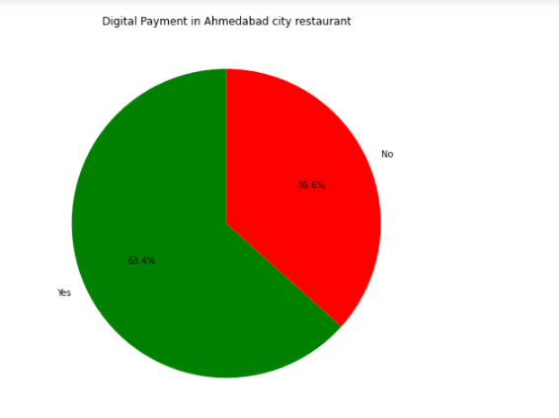

Slide 18
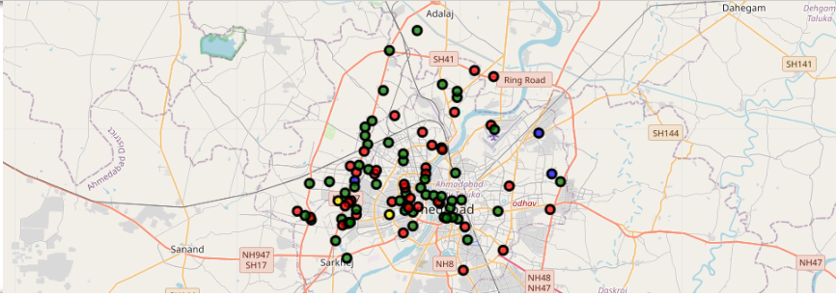
Folium Map

Slide 19
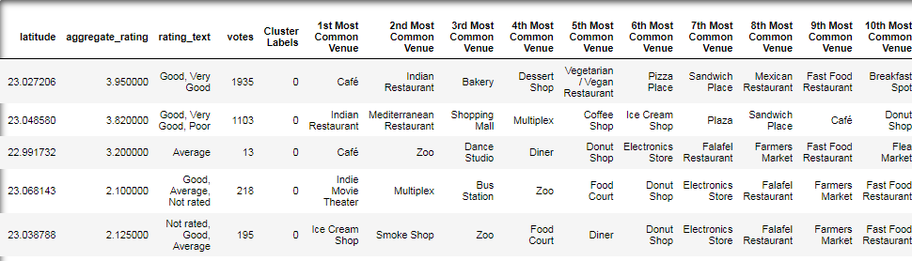
Cluster-1

Slide 20
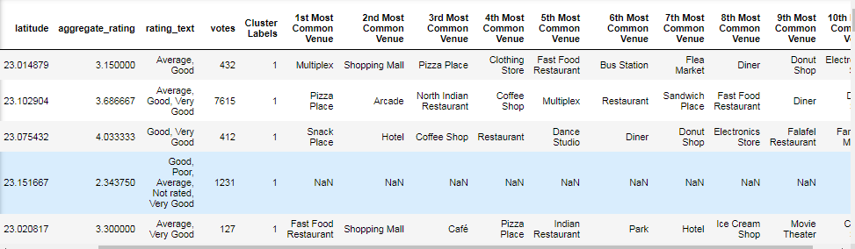
Cluster-2

Slide 21
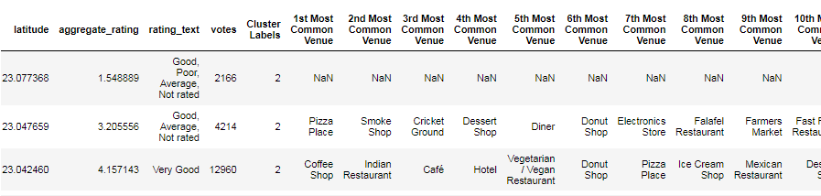
Cluster-3

Slide 22
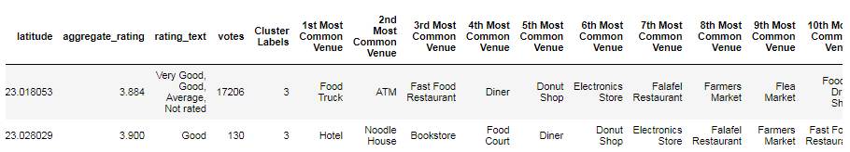
Cluster-4

Slide 23
Conclusion
Sola, Ashram road, Ellisbridge, C G Road, satellite, Gulbai tekra and Hansoi are the best places which have 4+ ratings restaurant.
La Pino’z Pizza is no. 1 Quick bite restaurant in Ahmedabad
Yanki Sizzlers, Barbeque Nation etc. are the best Dining Restaurant in Ahmedabad
Ph Se Food is the best Chinese Restaurant in Bodakdev
63.4% restaurant are accepting digital payment but 36.6% are not accepting Digital payment

