Slide 1
END-TO-END DATA SCIENCE PROJECT
FINANCIAL FRAUD
DETECTION
Using Machine Learning
Empowering Financial Security through Predictive Analytics
Presented by: Sagar Wagh | Data Science Project
PYTHON • SCIKIT-LEARN • XGBOOST • SMOTENC • STREAMLIT

Slide 2
01 / BUSINESS CONTEXT
The challenge: detecting rare fraudulent transactions
Fraud detection is an imbalanced classification problem: fraudulent transactions are rare, but missing them can be costly.
39,221
560
38,661
Transaction records in the supplied dataset
Potentially fraudulent records (1.43%)
Legitimate records (98.57%)
Business objective: classify a transaction as legitimate or potentially fraudulent.
Model output: fraud probability and a threshold-based class prediction.
Key challenge: balance fraud detection (Recall) with false alerts (Precision).
FINANCIAL FRAUD DETECTION • MACHINE LEARNING
02

Slide 3
02 / PROJECT APPROACH
Project objectives & end-to-end workflow
01
02
03
04
05
Understand & validate
Explore & engineer
Prepare & balance
Train & compare
Evaluate & deploy
→
→
→
→
Dataset profiling, quality checks and cleaning
EDA, statistics, feature engineering and selection
Leakage checks, preprocessing and SMOTENC
Five classifiers, validation threshold tuning
Independent test evaluation, Joblib and Streamlit
Notebook implementation: Steps 1–24, followed by the final project summary.
FINANCIAL FRAUD DETECTION • MACHINE LEARNING
03

Slide 4
03 / DATA UNDERSTANDING
Dataset overview
39,221
8
1
Binary classification
Rows / transaction records
Original columns
Target variable: label
0 = Legitimate | 1 = Potentially Fraudulent
Feature | Meaning
accountAgeDays | Account age in days
numItems | Number of items
localTime | Transaction time-related value
paymentMethod | Payment method category
paymentMethodAgeDays | Age of linked payment method
isWeekend | Weekend indicator
Category | Transaction category
label | Target: 0 legitimate / 1 fraud
FINANCIAL FRAUD DETECTION • MACHINE LEARNING
04

Slide 5
04 / DATA QUALITY
Data validation & cleaning
Checked dataset dimensions, column names, data types and target labels.
Reviewed missing values, duplicate records and categorical inconsistencies.
Inspected target distribution before model development.
Investigated suspicious target-aligned feature patterns before final modelling.
Removed leakage-prone account-age features and derived variables from the reduced feature set.
Why leakage checks matter
A model can appear highly accurate if it learns information that would not be available or valid at prediction time.
Final approach
Use reduced features and a fresh train / validation / test split for final evaluation.
Validation principle
Keep resampling and preprocessing fitted on training data only.
FINANCIAL FRAUD DETECTION • MACHINE LEARNING
05

Slide 6
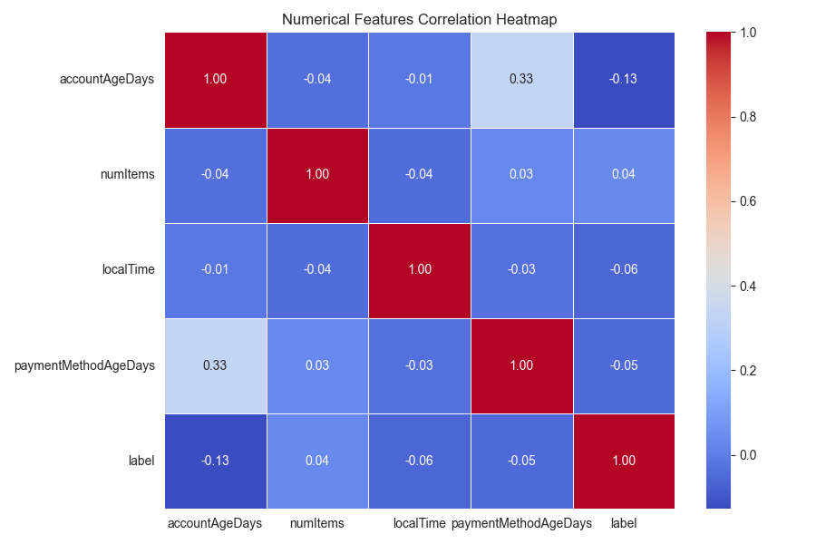
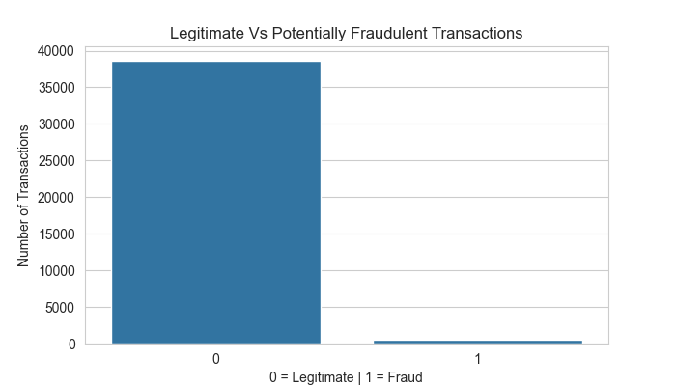
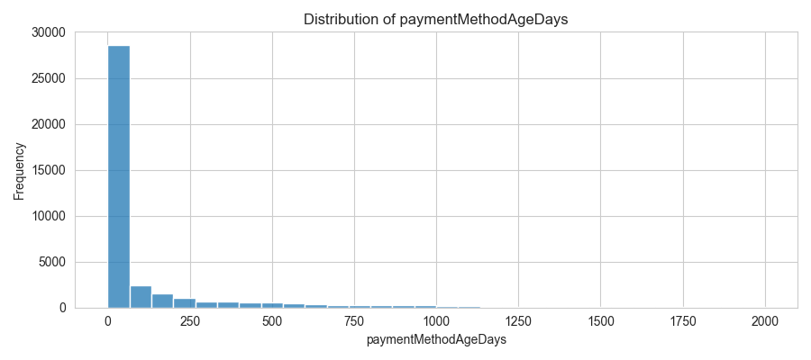
05 / EDA & VISUAL INSIGHTS
Exploratory data analysis
EDA examined target balance, numerical distributions, categorical patterns and relationships between features.
Target distribution
Numerical feature distributions
Correlation overview
FINANCIAL FRAUD DETECTION • MACHINE LEARNING
06

Slide 7
06 / CLASS IMBALANCE
Target distribution & class imbalance
98.57%
1.43%
Legitimate transactions
Potentially fraudulent
Why this matters
Accuracy alone can be misleading when one class dominates.
Precision and Recall are important for assessing fraud alerts.
SMOTENC was applied to the training data in the final workflow.
FINANCIAL FRAUD DETECTION • MACHINE LEARNING
07

Slide 8
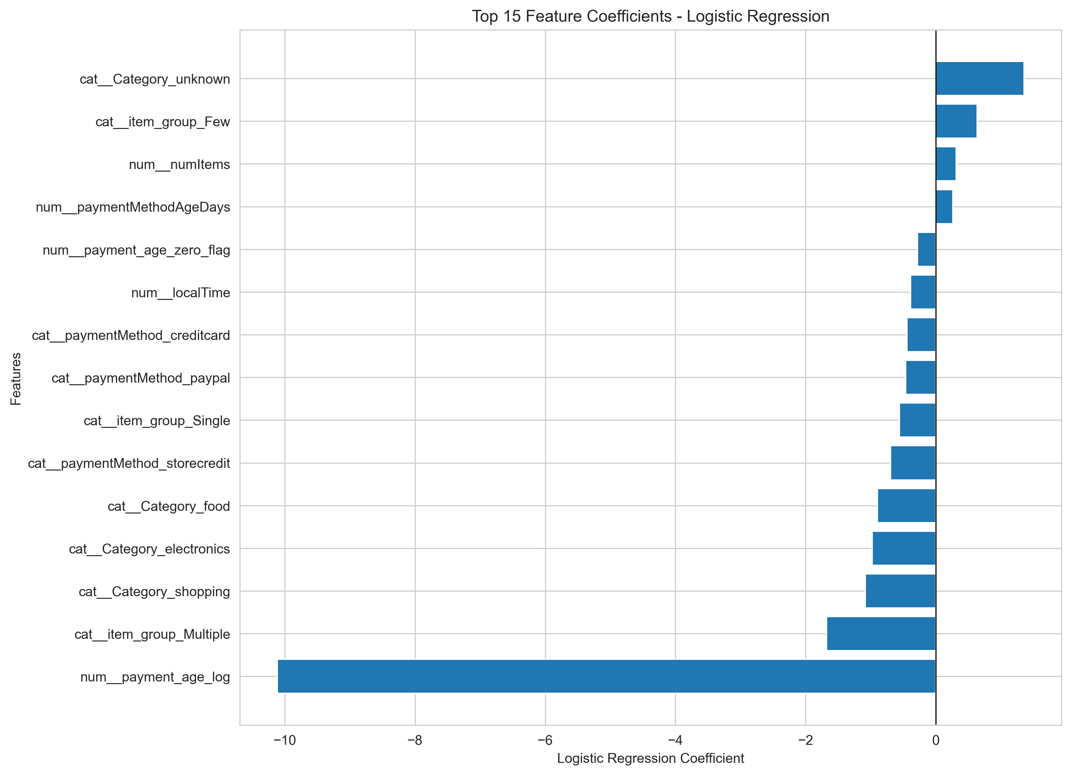
07 / FEATURE DESIGN
Feature engineering & feature reduction
Engineered features
Leakage investigation
Log-transformed payment age, payment-age zero flag and item grouping.
Account-age related features and derived variables were removed from the reduced model inputs.
Final reduced input features
5 numerical features
3 categorical features
numItems
localTime
paymentMethodAgeDays
payment_age_log
payment_age_zero_flag
paymentMethod
Category
item_group
Logistic Regression coefficients (top features)
FINANCIAL FRAUD DETECTION • MACHINE LEARNING
08

Slide 9
08 / MODEL PREPARATION
Preprocessing, splitting & SMOTENC
Dataset partition | Records | Fraud cases
Training | 23,360 | 323
Validation | 7,964 | 124
Final test | 7,897 | 113
Training-only resampling
SMOTENC was fitted on training data only; validation and test sets were kept separate.
Resampled training set
34,555 records: 23,037 legitimate and 11,518 fraud examples.
Preprocessing pipeline
NUMERIC: MEDIAN IMPUTATION + STANDARD SCALING
CATEGORICAL: UNKNOWN IMPUTATION + ONE-HOT
StratifiedGroupKFold created group-aware, stratified train / validation / test partitions; identical feature combinations were kept in the same group.
FINANCIAL FRAUD DETECTION • MACHINE LEARNING
09

Slide 10
09 / MODEL DEVELOPMENT
Machine learning models developed
01
Logistic Regression
Linear classification baseline
02
Decision Tree
Rule-based non-linear classifier
03
Random Forest
Ensemble of decision trees
04
Random Forest + SMOTENC
Tree ensemble with resampled training data
05
XGBoost
Gradient-boosted decision trees
A baseline model was also implemented as a reference point.
FINANCIAL FRAUD DETECTION • MACHINE LEARNING
10

Slide 11
10 / RESULTS
Final model performance — independent test set
Model | Accuracy | Precision | Recall | F1 | ROC-AUC | PR-AUC | Threshold
Logistic Regression | 97.18% | 14.29% | 19.47% | 16.48% | 84.19% | 9.92% | 0.88
Decision Tree | 98.19% | 15.91% | 6.19% | 8.92% | 73.51% | 6.52% | 0.95
Random Forest | 54.30% | 2.65% | 86.73% | 5.15% | 72.89% | 2.51% | 0.09
RF + SMOTENC | 98.08% | 11.76% | 5.31% | 7.32% | 75.41% | 4.31% | 0.78
XGBoost | 97.45% | 10.00% | 9.73% | 9.87% | 74.79% | 4.98% | 0.86
Best F1 / ROC-AUC / PR-AUC
Important trade-off
Logistic Regression ranked highest on these three metrics.
Decision Tree had higher Precision; Random Forest had higher Recall but many false positives.
Metrics are from Step 21, using validation-selected thresholds applied to the final test set.
FINANCIAL FRAUD DETECTION • MACHINE LEARNING
11

Slide 12
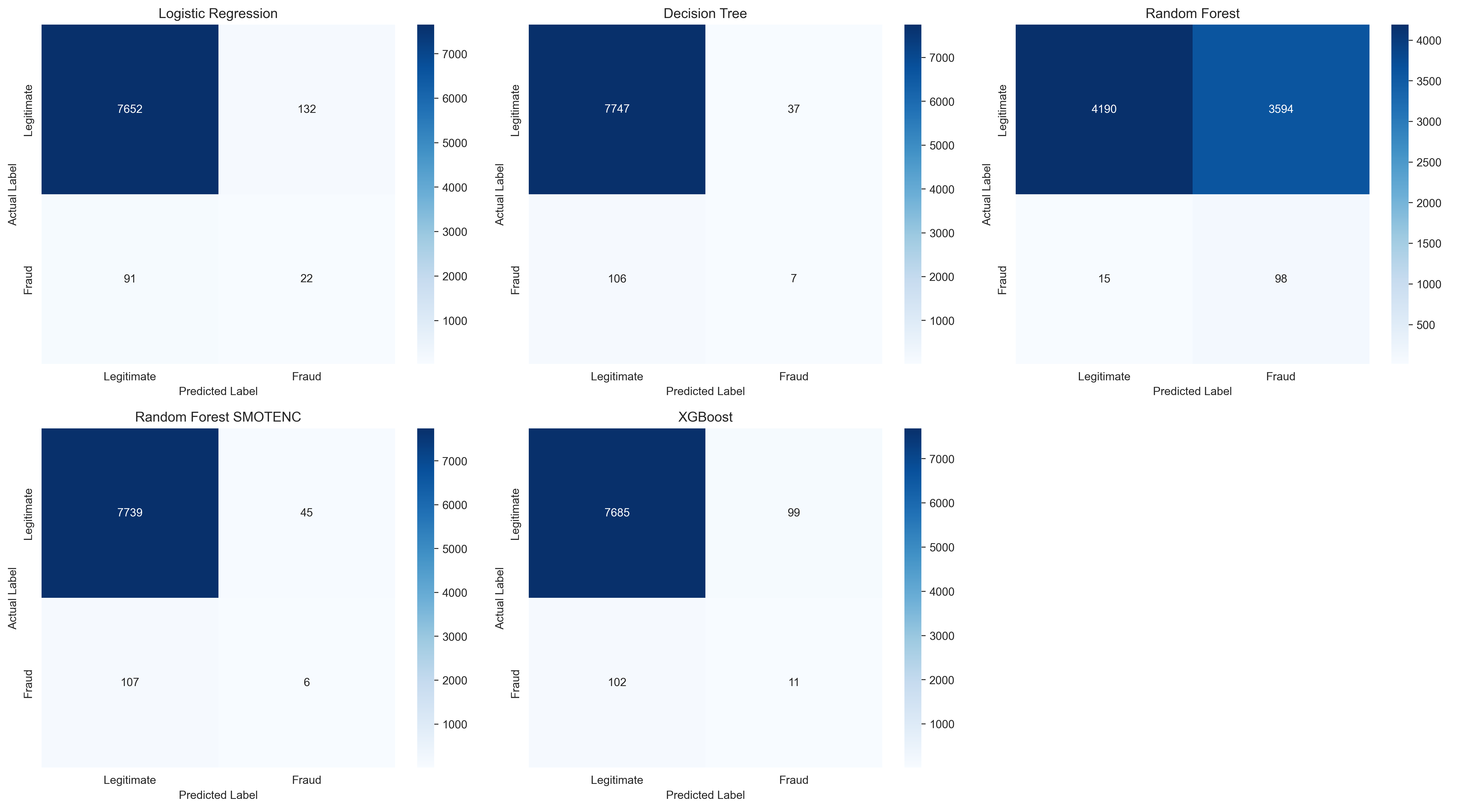
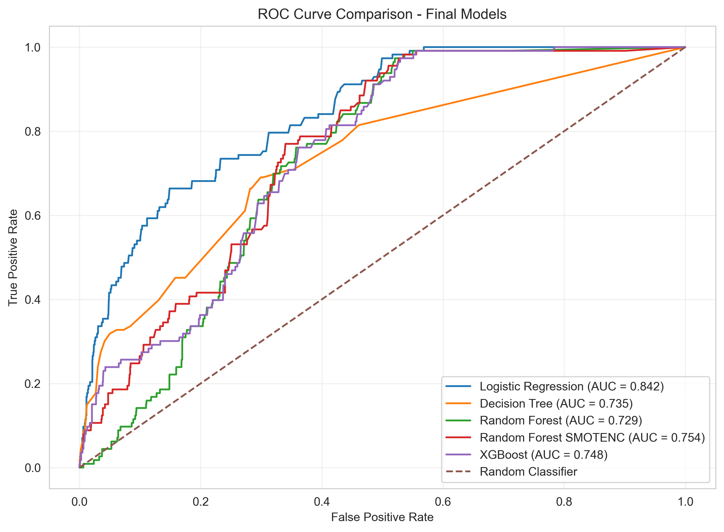
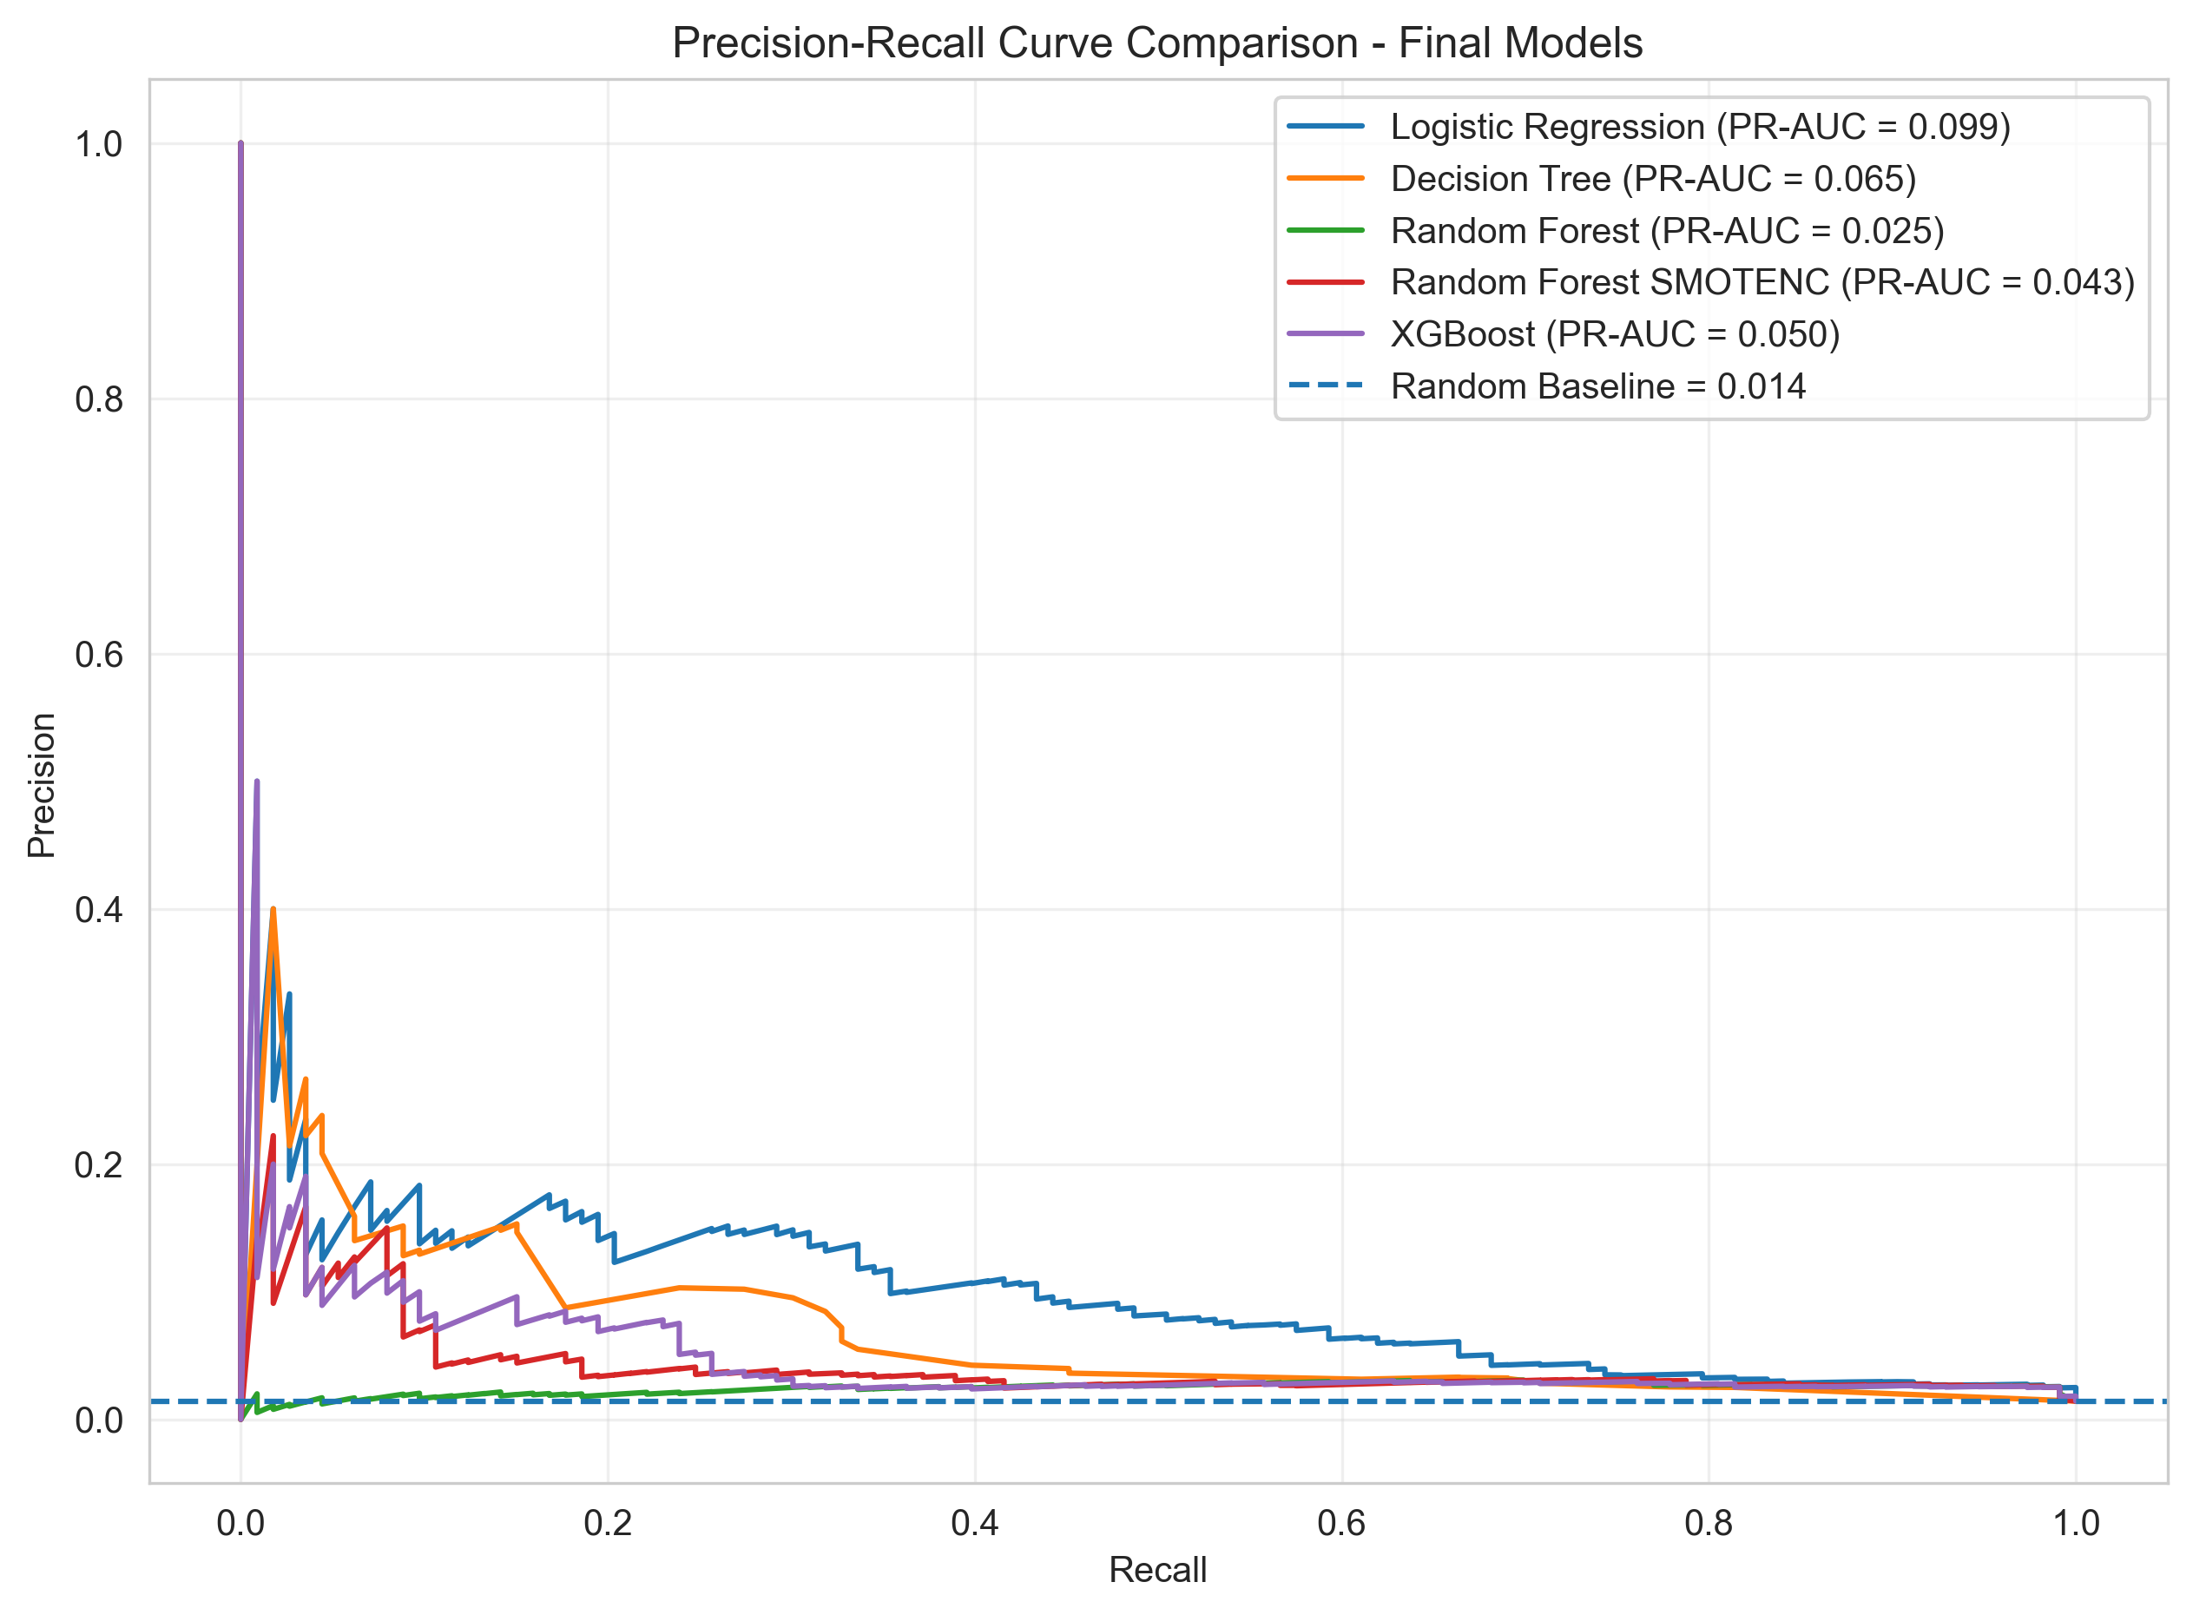
11 / MODEL EVALUATION
Evaluation visuals & selected model
Logistic Regression — confusion matrix
TN 7,652 | FP 132 | FN 91 | TP 22
Interpretation
ROC-AUC 84.19%; Recall 19.47% — further recall improvement is needed.
FINANCIAL FRAUD DETECTION • MACHINE LEARNING
12

Slide 13
12 / DEPLOYMENT PROTOTYPE
Streamlit application & prediction workflow
Machine Learning-Based Financial Fraud Detection
Application capabilities
MODEL INFORMATION
Loads the saved Logistic Regression pipeline and threshold using Joblib.
Accepts transaction attributes through Streamlit input controls.
Recreates the engineered model features before prediction.
Displays fraud probability and threshold-based classification.
Recommends manual review for transactions flagged as fraudulent.
Algorithm
Threshold
Status
Logistic Regression
0.88
Loaded Successfully
TRANSACTION INPUTS
Number of Items
Local Time
Payment Method Age (Days)
Payment Method
Transaction Category
ANALYZE TRANSACTION
Deployment status
Illustrative layout based on the supplied app.py — not a live application screenshot.
Interactive prototype; predictions are experimental.
FINANCIAL FRAUD DETECTION • MACHINE LEARNING
13

Slide 14
13 / CRITICAL REVIEW
Limitations & future improvements
CURRENT LIMITATIONS
FUTURE SCOPE
Highly imbalanced dataset; fraud is only 1.43% of records.
Selected model Recall is 19.47%, so many fraud cases remain undetected.
Precision is 14.29%, so false alerts remain substantial.
No transaction identifier and no external real-world validation.
Predictions are experimental, not confirmed fraud decisions.
Collect more representative transaction data.
Improve Recall while controlling false positives.
Explore cost-sensitive learning and probability calibration.
Monitor model drift and validate on unseen data.
Add secure API integration and human-review alerts.
FINANCIAL FRAUD DETECTION • MACHINE LEARNING
14

Slide 15
PROJECT TAKEAWAY
From raw transaction data
to an interactive fraud
prediction prototype.
KEY RESULT
16.48%
F1-Score
Logistic Regression • Test set
The project demonstrates data validation, EDA, feature engineering, leakage investigation, imbalanced learning, model comparison, threshold tuning and Streamlit integration.
THANK YOU
Questions & Discussion
Financial Fraud Detection Using Machine Learning

