Slide 1


Slide 2


Complaint Management system
Second Year Project Synopsis
Submitted by
ROLL | NAME
2301010312 | Sagar (Idea & design)
2301010314 | Shivansh (Frontend )
2301010317 | Devesh Sharma (UI & UX)
2301010339 | Yash Singh (Backend)
Industry Mentor: Mr. Bharat
Faculty Mentor: Ms. Ruchika Bhakhar
Notes:
New Courses replaced with New Programmes

Slide 3

Problem Statement
In many organizations, users face difficulties in registering complaints due to non-intuitive systems and lack of support.
Most systems lack voice input, tracking functionality, or user guidance features.
Our solution simplifies the process, supports voice and written input, and improves transparency through complaint tracking and admin notifications.
Notes:
New Courses replaced with New Programmes

Slide 4
Key Objectives
Enable users to submit complaints through a form or voice recording.
Automatically notify the admin via email when a complaint is registered.
Generate a unique complaint ID for tracking status (Pending/Completed/Deleted).
Integrate a chatbot to guide users on how to register complaints.
Provide a review page where users can give feedback on the service.
Display customer's complaint location on a map when clicking the city name.
Notes:
New Courses replaced with New Programmes

Slide 5
Project Architecture
System Flow:
User submits complaint (form/voice).
Complaint data stored in MySQL via Express.js backend.
Unique ID generated and shared with the user.
Email notification sent to the admin.
User can track complaint using the ID.
Chatbot available for assistance.
Review page captures customer feedback.
Clicking city name in complaint record opens map with user location.
Notes:
New Courses replaced with New Programmes

Slide 6
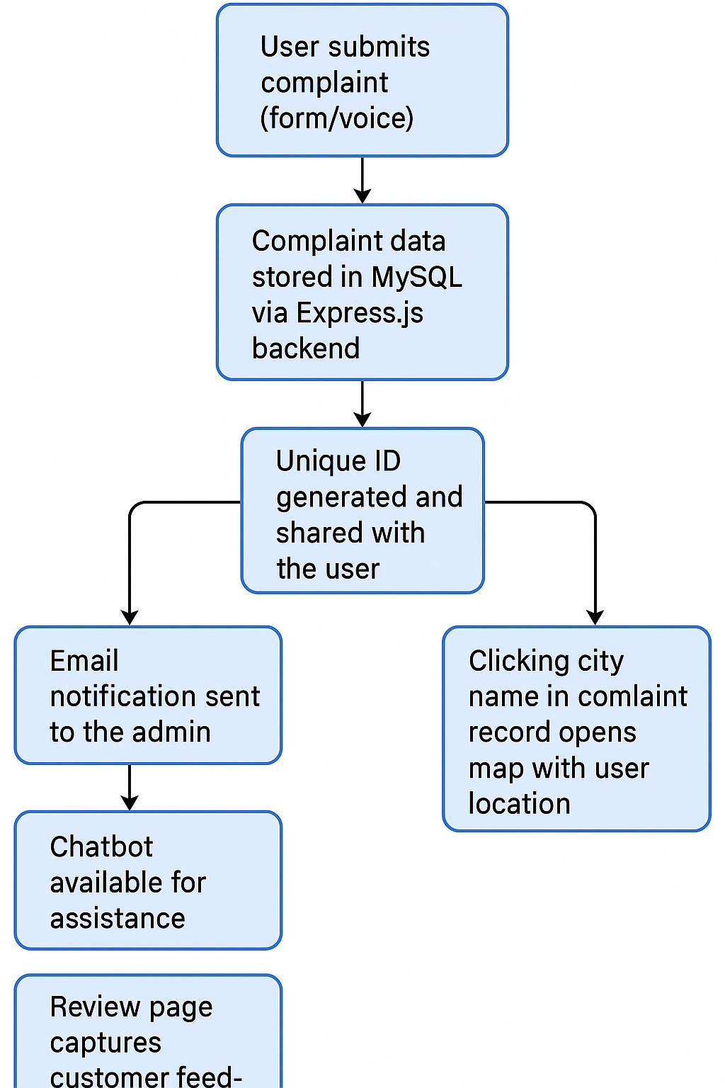
Flow Chart of Steps
Notes:
New Courses replaced with New Programmes

Slide 7
Frontend Development
Technologies Used:
HTML, CSS, JavaScript
React.js for component-based UIDesign Principles:
Responsive design (mobile & desktop)
Easy navigation & accessibility
Intuitive forms and interactions
Notes:
New Courses replaced with New Programmes

Slide 8
Backend Development
Technologies Used:
Node.js with Express.js
MySQL for database managementServer-Side Logic:
Routes for complaint submission, tracking, and status updates
Email service integration (e.g., Nodemailer) for admin notifications
Voice file storage and form validation
Notes:
New Courses replaced with New Programmes

Slide 9
UX/UI Design
Tools Used:
Figma for wireframes and UI planning
Design Rationale:
Focus on simplicity and clarity
Large call-to-action buttons
Clear instructions and chatbot for help
Notes:
New Courses replaced with New Programmes

Slide 10
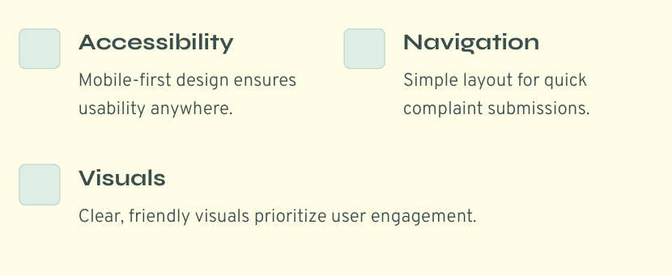
User Interface (UI) Mockup
Notes:
New Courses replaced with New Programmes

Slide 11
Key Features
Complaint Form: Written & voice input
Voice Recording: Stored and linked to complaints
Admin Notification: Real-time email alerts
Complaint Tracker: ID-based status checking
Chatbot: Instant guidance for users
Review System: Star rating and written reviews
Interactive Map: Clicking city name displays user's complaint location on a map
Notes:
New Courses replaced with New Programmes

Slide 12
Project Demonstration
Walkthrough:
Submit a complaint using text and voice
View confirmation with unique ID
Check email notification sent to admin
Use chatbot to ask "How to register a complaint?"
Submit a review
Click on city name to view user location on map
Highlight how each feature solves real-world issues

Slide 13
Conclusion & Future Scope
What We Learned:
Integration of frontend and backend with database
Voice recording and file handling
Real-time email communication
Chatbot and UX planning
Geolocation integration with maps
Future Improvements:
AI-powered chatbot for dynamic help
Complaint status auto-update based on admin input
Mobile app version
User login and complaint history

Slide 14
THANK YOU

