Slide 1
Gastrointestinal disease detection using ResNet50 on Hyper-kvasir dataset
Group 10
Dev Patel-AU2040056
Meet Patel-AU2040010
Manthan Patel-AU2040123
Sagar Bajaj -AU2040252

Slide 2
Introduction
2
Deep learning has shown great promise in automating medical diagnoses and providing accurate predictions for various medical imaging tasks.
Our project aims to develop an automated system for detecting gastrointestinal diseases using ResNet50 on the hyper-kvasir dataset.
Deep learning can potentially improve disease diagnosis accuracy by detecting subtle patterns and features in medical images that may be difficult for humans to see, reducing the risk of misdiagnosis.

Slide 3
3
Elaborating Problem Statement
The project aims to develop an automated system for detecting gastrointestinal diseases.
The system will utilize ResNet50, a state-of-the-art deep learning model, for disease detection.
The hyper-kvasir dataset, which consists of high-quality images of the gastrointestinal tract captured during endoscopic procedures, will be used for training the system.
The system will be trained to classify images into normal and abnormal categories and identify specific diseases.
The use of deep learning methods can potentially enhance the accuracy of disease diagnosis and reduce the risk of misdiagnosis.
The system has the potential to significantly improve the efficiency of diagnosis and treatment, leading to better health outcomes for patients.
Overall, the implementation of ResNet50 on the hyper-kvasir dataset shows promising results in detecting gastrointestinal diseases, and further improvements can be made by optimizing the hyperparameters and experimenting with other deep-learning architectures.

Slide 4
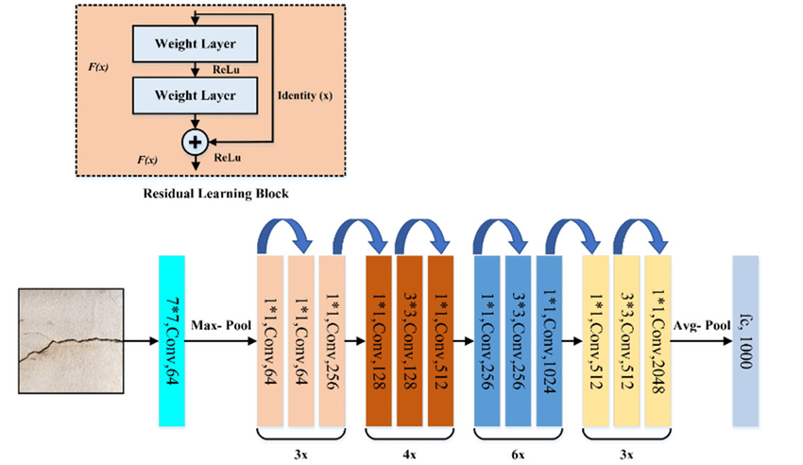
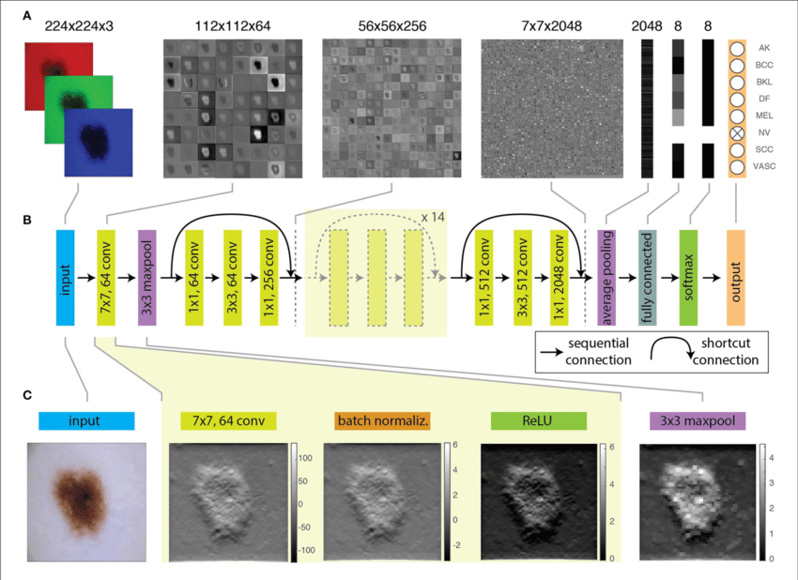
ResNet-50
4
Residual Network solves the problem of degradation by limiting vanishing gradients.
Skip connection enables deeper layers to learn an identity function of the previous layers which mitigates the multiplication of gradients by intermediate layers.
ResNet-50 architecture was adopted from ResNet-34 and introduced 3 layer bottleneck block for faster computation.
It consists of a 7*7,64 kernels, a max pooling layer, 48 internal convolution layers divided into four segments with residual connections and an average pooling layer fully connected with 1024 neurons using softmax activation function.
Each convolution layer is followed by a batch normalization layer and a ReLU activation function
Figure 1
Figure 2

Slide 5
Approach
5
1
Image Resizing
B
E
2
Image Pre-processing
Image
Pre-processing
Video Classification
D
3
Train Data Sets
Image Augmentation
C
4
Split the dataset into train and test sets
Image Augmentation
5
Fine tuning and implementation of the pre-trained model on Image Data Sets
A
Image Resizing
6
Improving the model
7
Video Classification
D
R
E
A
M

Slide 6

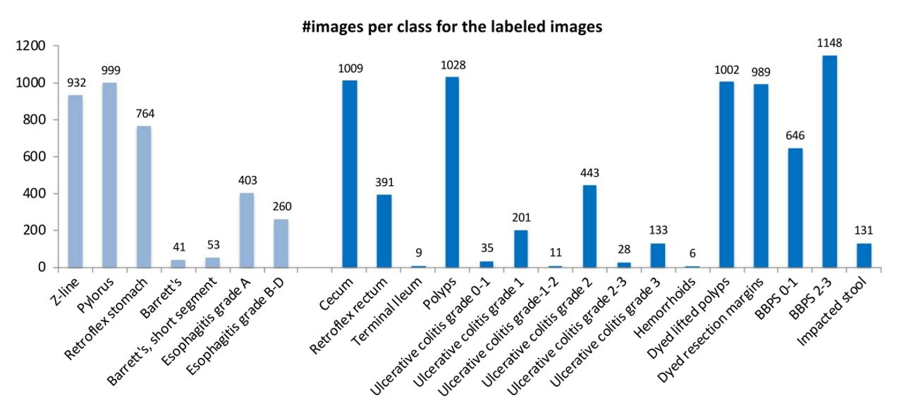
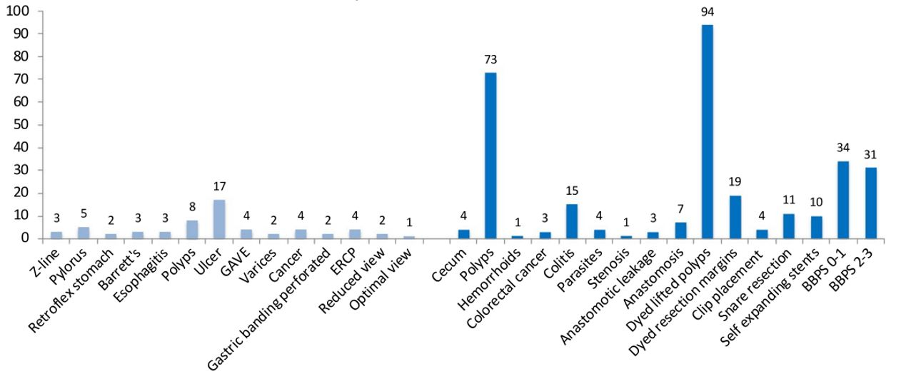
Graphs
6
Graph after Images Per Class
.
Graph after Video Classification
.

Slide 7
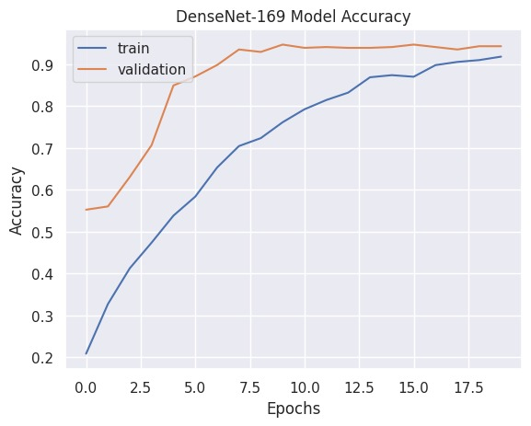
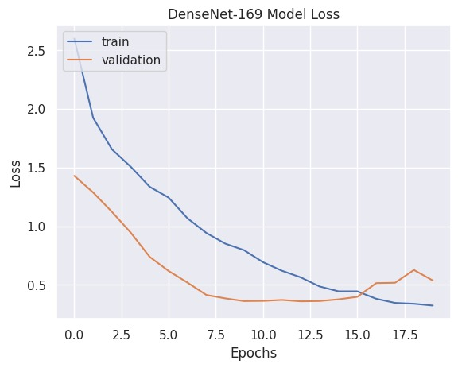
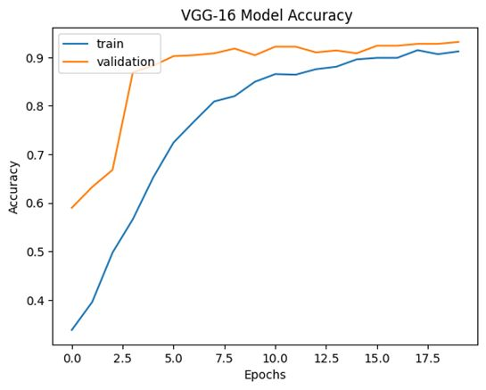
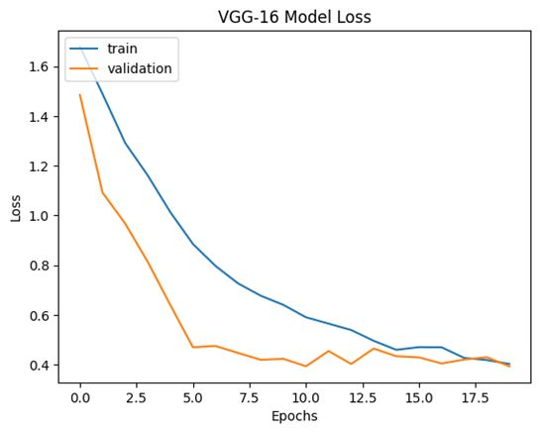
Graphs
7
DenseNet-169 Model
.
VGG-16 Model
.

Slide 8
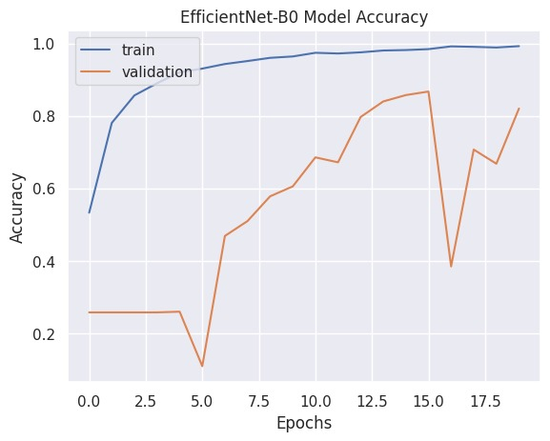
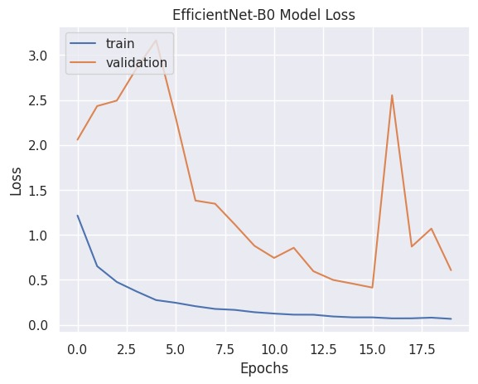
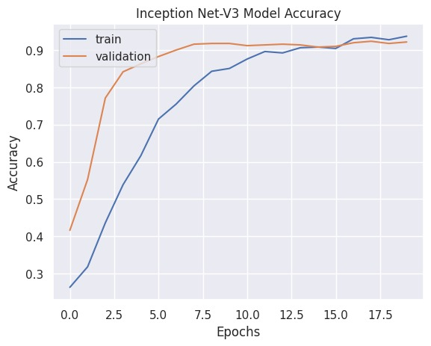
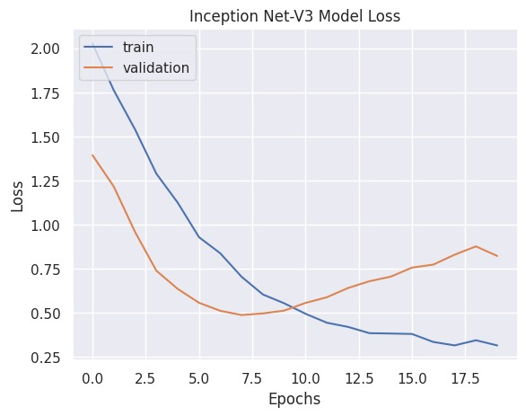
Graphs
8
EfficientNet-B0 Model
.
Inception Net-V3 Model
.

Slide 9
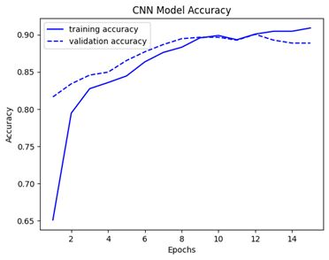
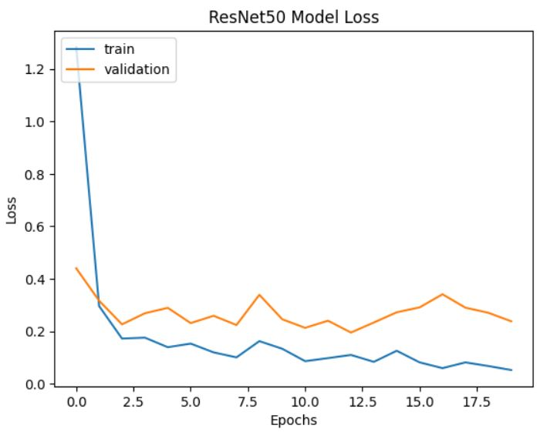
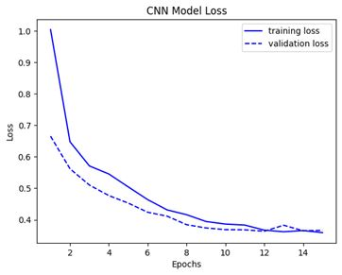
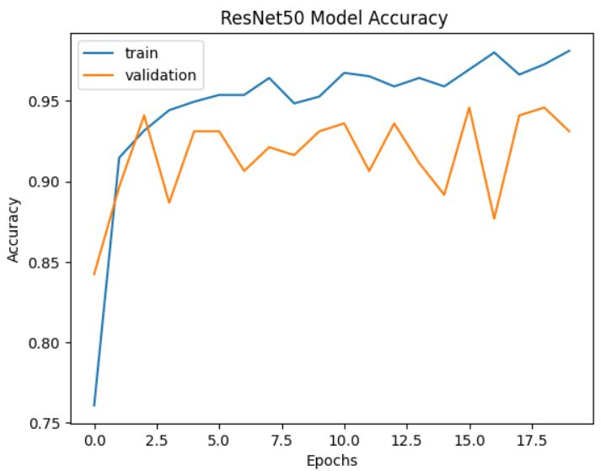
Graphs
9
CNN Model
.
ResNet-50 Model
.

Slide 10
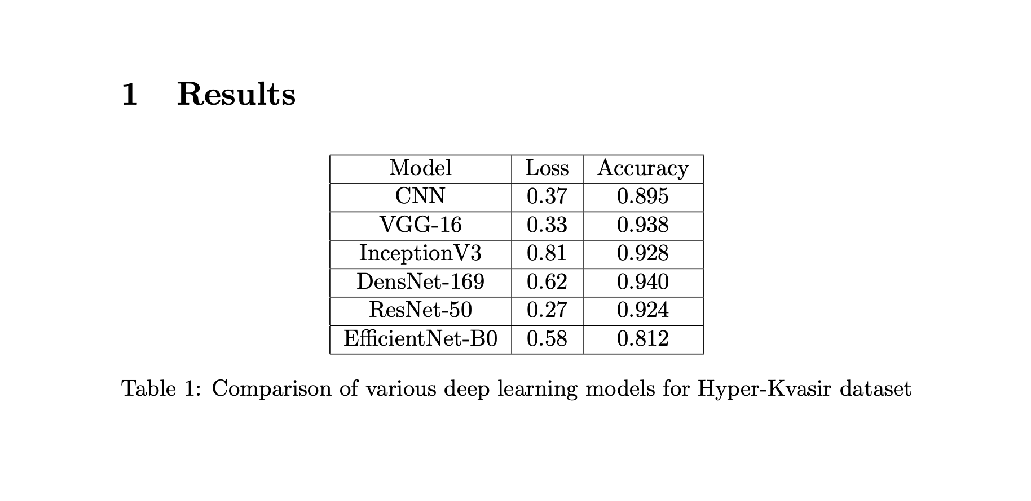
10
Video Classification and Implementation
1) Video Pre-Processing
2) Feature Extraction
3) Classification

Slide 11
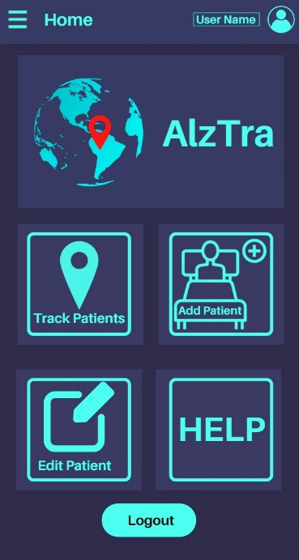
Conclusion
11
The implementation of the ResNet50 deep learning architecture was demonstrated for the detection of gastrointestinal diseases using the Hyper-Kvasir dataset.
The implementation involved data preprocessing, fine-tuning the pre-trained ResNet50 model, and training the model using the Adam optimizer.
Further improvements could be made by optimizing the hyperparameters and exploring other deep learning architectures.

Slide 12
12
Role of each group member
DEv
-ResNet-50 Implementation and Video Classification
Meet
-Fine-Tuning and ResNet-50 Implementation
Manthan
-Image Pre-Processing and Image Augmentation
Sagar
-Researches and compiles information on pre-trained models like VGG, ResNet, and Inception.

Slide 13
References
13
[1] G. Eason, B. Noble, and I. N. Sneddon, “On certain integrals of Lipschitz-Hankel type involving products of Bessel functions,” Phil. Trans. Roy. Soc. London, vol. A247, pp. 529–551, April 1955. (references)
[2] S. (n.d.). GitHub - simula/hyper-kvasir: GitHub repository for the Hyper-Kvasir dataset. GitHub. https://github.com/simula/hyper-kvasir
[3] Borgli, H., Thambawita, V., Smedsrud, P. H., Hicks, S. A., Kwon, G., Eskeland, S. L., Randel, K. R., Pogorelov, K., Lux, M., Nguyen, D. K., Johansen, D., Griwodz, C., Stensland, H. K., Garcia-Ceja, E., Schmidt, P., Hammer, H. L., Riegler, M., Halvorsen, P., & De Lange, T. (2020). HyperKvasir, a comprehensive multi-class image and video dataset for gastrointestinal endoscopy. Scientific Data, 7(1). https://doi.org/10.1038/s41597-020-00622-y
[4] He, K., Zhang, X., Ren, S., & Sun, J. (2015). Deep Residual Learning for Image Recognition. ArXiv (Cornell University). https://doi.org/10.48550/arxiv.1512.03385
[5] Dwivedi, P. (2021, December 7). Understanding and Coding a ResNet in Keras - Towards Data Science. Medium. https://towardsdatascience.com/understanding-and-coding-a-resnet-in-keras-446d7ff84d33
[6] Bengio, Y., Simard, P. Y., & Frasconi, P. (1994). Learning long-term dependencies with gradient descent is difficult. IEEE Transactions on Neural Networks, 5(2), 157–166. https://doi.org/10.1109/72.279181

Slide 14
Thanks for Seeing our Presentation
Hope you liked it.......

