Slide 1
Gastrointestinal disease detection using ResNet50 on Hyper-kvasir dataset
fantastic four
Dev Patel-AU2040056
Meet Patel-AU2040010
Manthan Patel-AU2040123
Sagar Bajaj-AU2040252

Slide 2
Elaborating Problem Statement
Introduction The advancement of deep learning techniques has shown promising results in automating the diagnosis process and providing accurate predictions for various medical imaging tasks. In this project, we aim to develop an automated gastrointestinal disease detection system using ResNet50, a deep neural network architecture, on the hyper-kvasir dataset.
I
Problem Statement In this project, we aim to develop an automated system for GI disease detection using ResNet50, a state-of-the-art deep learning model, on the hyper-kvasir dataset, which consists of high-quality images of the GI tract captured during endoscopic procedures. The system will be trained to classify images into normal and abnormal categories and further identify specific diseases
P

Slide 3
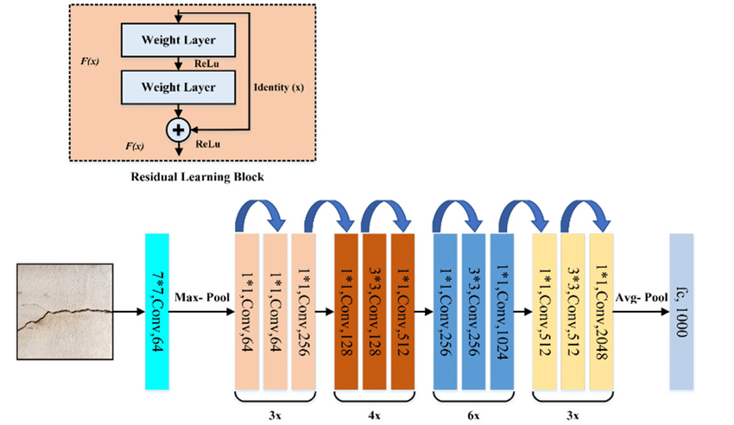
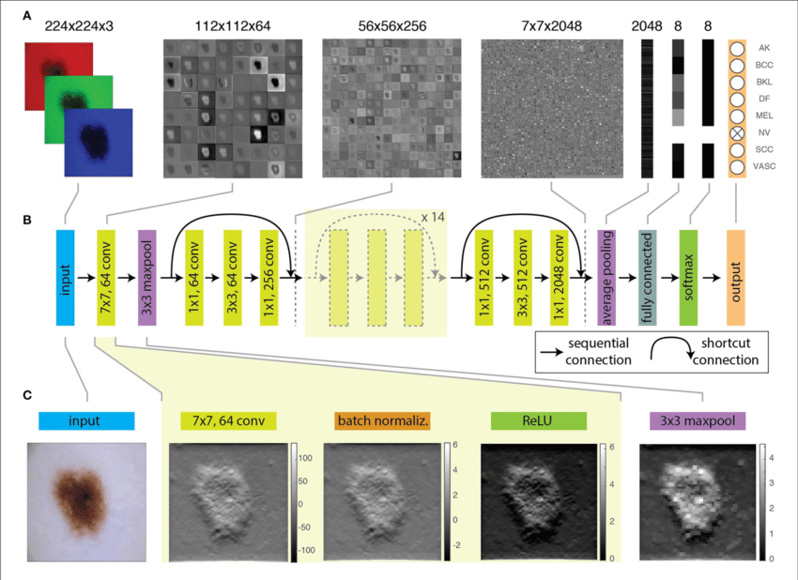
ResNet-50
Residual Network solves the problem of degradation by limiting vanishing gradients.
Skip connection enables deeper layers to learn an identity function of the previous layers which mitigates the multiplication of gradients by intermediate layers.
ResNet-50 architecture was adopted from ResNet-34 and introduced 3 layer bottleneck block for faster computation.
It consists of a 7*7,64 kernels, a max pooling layer, 48 internal convolution layers divided into four segments with residual connections and an average pooling layer fully connected with 1024 neurons using softmax activation function.
Each convolution layer is followed by a batch normalization layer and a ReLU activation function

Slide 4
Approach and Implementation
1
Image Resizing
B
2
E
Image Pre-processing
Image
Pre-processing
Final implementation
D
3
Train Data Sets
Image Augmentation
C
4
Split the dataset into train and test sets
Image Augmentation
5
Fine tuning and initial implementation of the pre-trained model
A
6
Image Resizing
Improving the model
7
Final implementation and analysis of the outputs
D
R
E
A
M

Slide 5
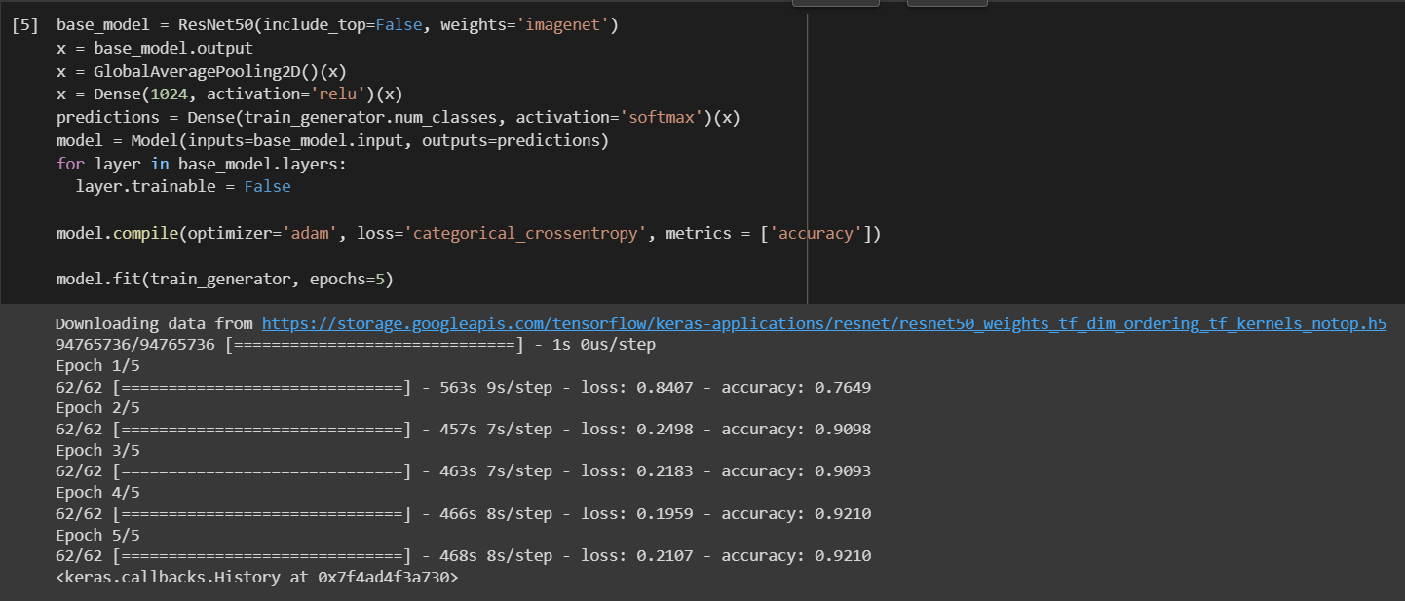
Initial Results

Slide 6
6
Role of each group member & Future Work
-Researches and compiles information on different image pre-processing techniques such as normalization, resizing, and denoising.
-Evaluates the performance of different image pre-processing techniques and selects the most appropriate ones for the project.
DEv
Future Work
1. Improve the image pre-processing
2. Improve the model by fine tuning
3. Final implementations
-Evaluates the performance of different image augmentation techniques and selects the most appropriate ones for the project.
-Implements the selected augmentation techniques on the pre-processed dataset and compares the results with the original images.
Meet
-Researches and compiles information on different pre-trained models such as VGG, ResNet, and Inception.
-Evaluates the performance of different pre-trained models and selects the most appropriate one for the project.
Sagar
-Evaluates the performance of different fine-tuning techniques and selects the most appropriate ones for the project.
-Implements the selected fine-tuning techniques on the pre-trained model and evaluates its performance.
Manthan

Slide 7
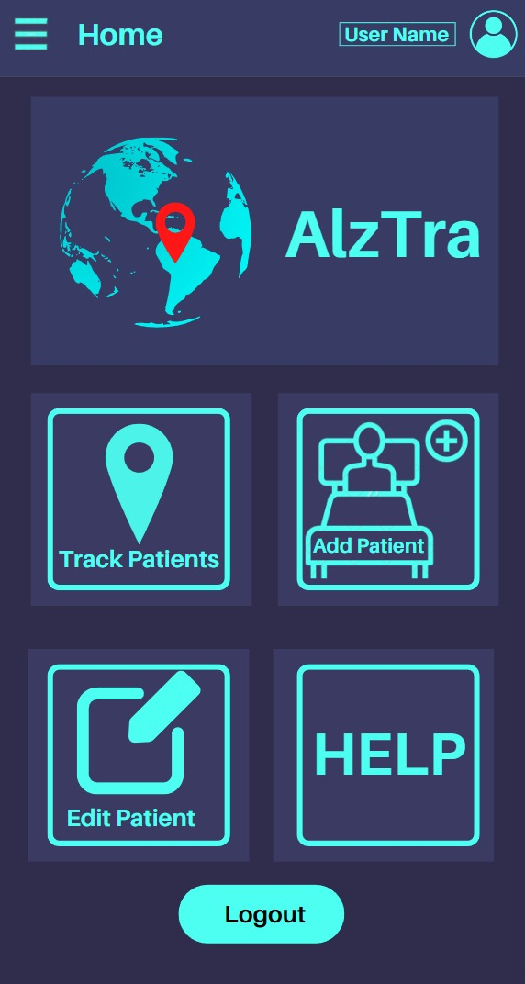
References
https://philarchive.org/archive/DHECOA
https://www.sciencedirect.com/science/article/pii/S2090447922002532
https://datasets.simula.no/hyper-kvasir/
https://www.researchgate.net/publication/338090796_HyperKvasir_A_Comprehensive_MultiClass_Image_and_Video_Dataset_for_Gastrointestinal_Endoscopy

Slide 8
Thanks for Seeing our Presentation
Hope you liked it.......

