Slide 1

Graduate Admission Prediction
Team 4:
Dhiab Aldhaheri
Dhruv Talwar
Sagar Bansal

Slide 2
Introduction of Data
Data Source:
https://www.kaggle.com/mohansacharya/graduate-admissions#Admission_Predict_Ver1.1.csv
Independent Variables:
Quantitative variables: GRE score, TOEFL score, SOP strength, LOR strength and CGPA.
Qualitative variables: Research Experience, University rating
Dependent variable: Chances of admit
Data Characteristics:
GRE Score - ranges from 260 to 340, integer data type.
TOEFL Score - ranges from 0 to 120, integer data type.
SOP strength - ranges from 1 to 5, decimal data type.
LOR strength - ranges from 1 to 5, decimal data type.
CGPA - maximum 10, decimal data type.
Research Experience – 0 or 1.
University Rating - ranges from 1 to 5.
Number of observations: 400
Total features: 7

Slide 3
Model Prediction Precision
Prediction = lm(`Chance of Admit`~ 0 + LOR + CGPA +log(`GRE Score`*`University Rating`)).
Multiple variable Regression Analysis
Regression through the origin
Our model was able to predict 98% of the observed variation in the chances of admission of students

Slide 4
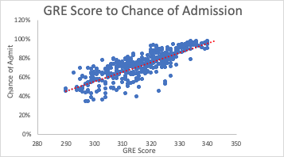
Building The Model
Clear linear relation between GRE SCORE and Chance of Admission
Correlation of 0.8026105
Most Graduate School require GRE to admit students which justifies the correlation we see.

Slide 5
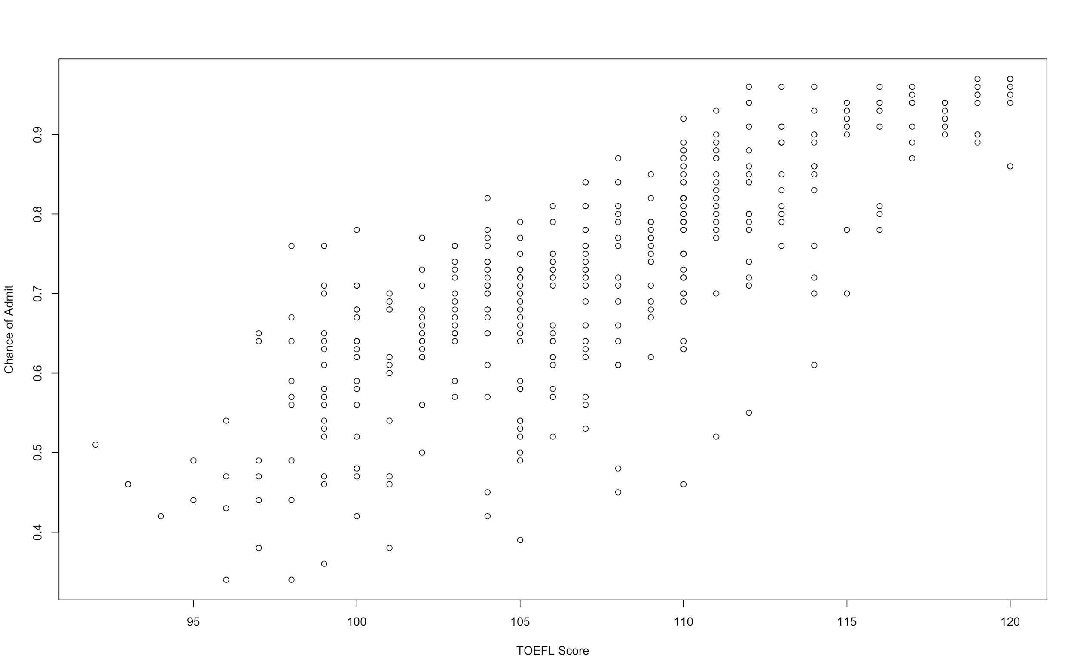
Building the Model
Clear linear relation between the variables.
Correlation of 0.79
Drop this variable ? Why?

Slide 6
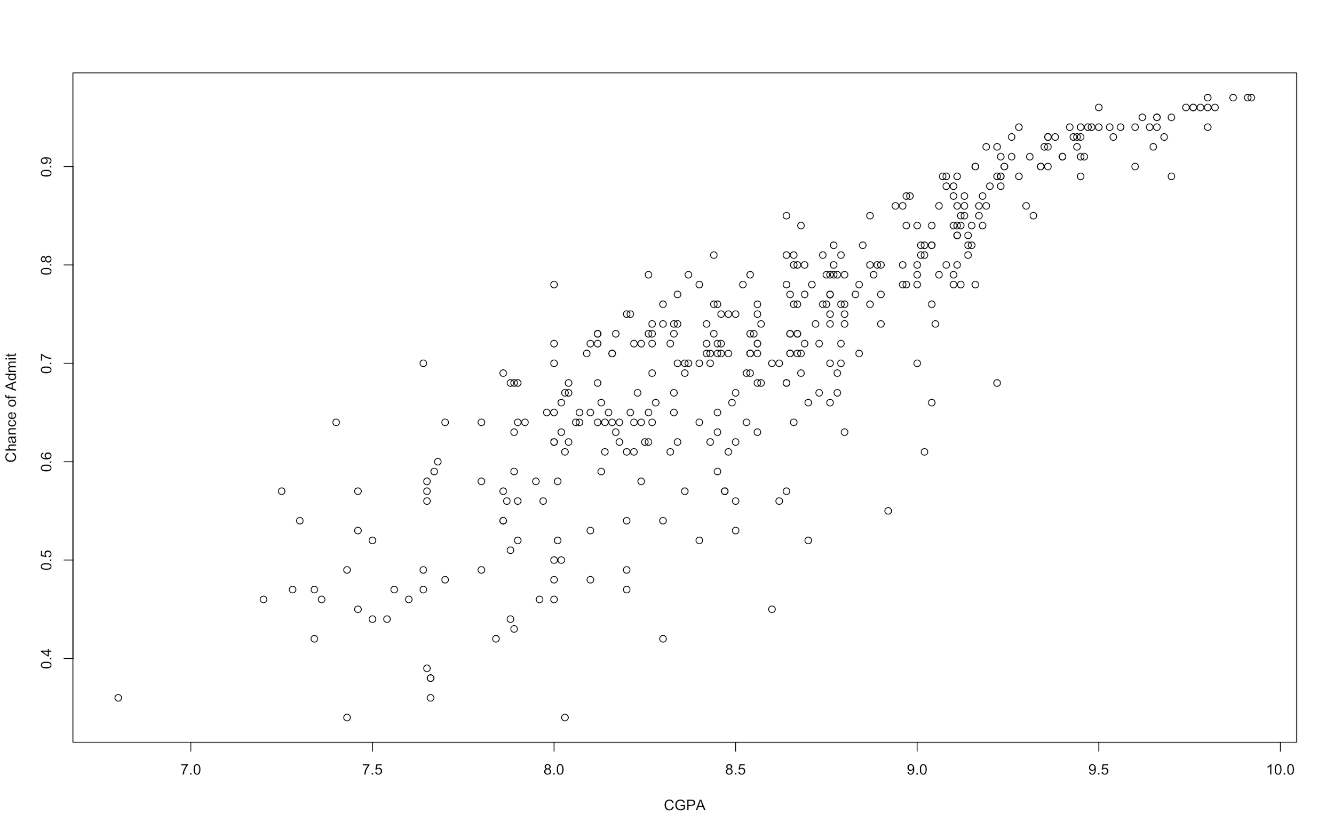
Building the Model
Highest correlated variable to the Chances of Admission 0.88
Clear Linear Relation
We see a trend in the higher CGPA students
For example, “We require students to have a CGPA > 9.0

Slide 7
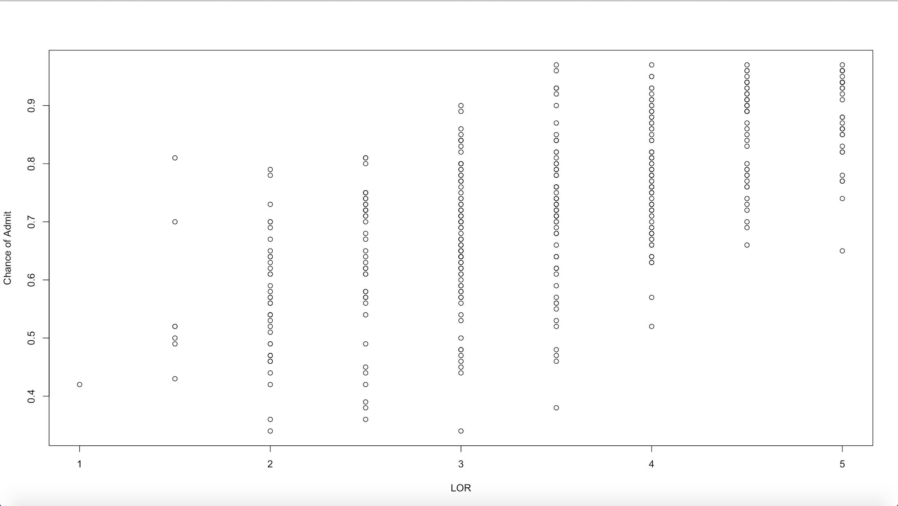
Building the Model
LOR letter of Recommendation
0.67 correlation
Highly useful predictor for our model

Slide 8
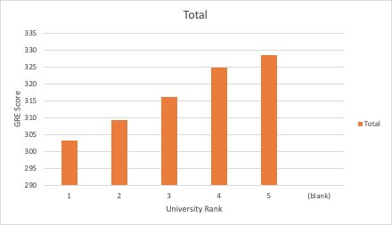
Interaction Term
The higher the University Rating the higher the required GRE Score to achieve higher rates of Admission.
Therefore, it made sense for us to add an interaction term.
(University Rating * GRE Score)

Slide 9
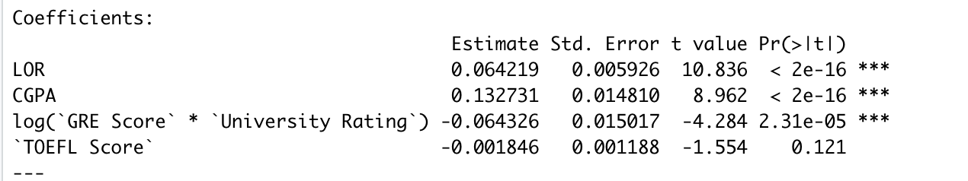
Dropping TOEFL Score
Since this is graduate admissions, from our experience of applying to GRAD school we were not required to submit a TOEFL Score
Moreover, Hypothesis testing proved it not as a useful predictor of our model.
H0: β₄ = 0
HA: β₄ ≠ 0

Slide 10
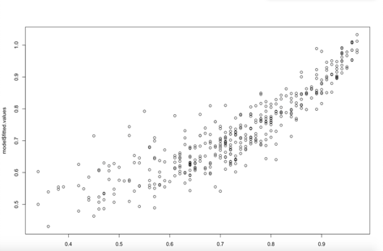
Heteroscedasticity (Model Assumptions)
Model precisely predicts for higher Chances of Admission 80% and higher.
Predicted errors have higher impacts on lower chances of admission
How ambitious the student seems to the recruiter
Uncaptured factors that contribute highly to the chances of admission
Admission has a threshold for high scoring students
Students with lower scores will be assessed on factors only the recruiter knows. eg: Legacy students, Donating Families.
Recruiters decision differ from one another

Slide 11
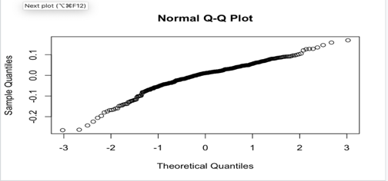
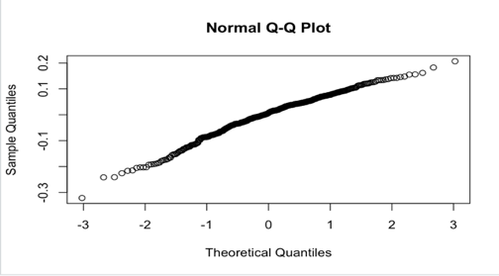
Distribution of errors (log term)

Slide 12
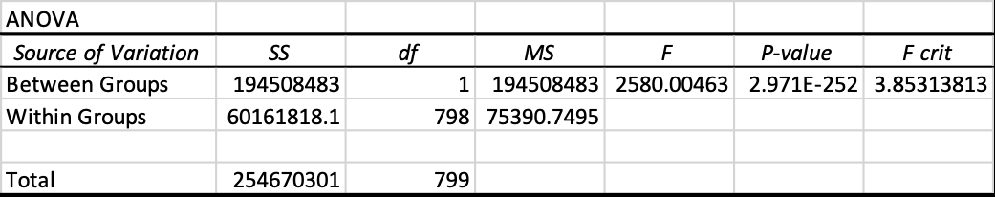
Let us hypothesize the Interaction?
Let us create a new term University Rating*GRE to conclude that when higher the GRE, better the chances of admit to a higher ranking university.
We will proceed with the Hypothesis Testing to reach a conclusion
For Hypothesis Testing, we will first define a Null & Alternate Hypothesis
H₀ = Interaction between UR & GRE <= 0
H_{a} = Interaction between UR & GRE > 0
For this hypothesis, we will use α = 0.05 = Significance Level

Slide 13
ANOVA!
H₀ = Interaction between UR & GRE <= 0
H_{a} = Interaction between UR & GRE > 0
For this hypothesis, we will use α = 0.05 = Significance Level
Since p-value < α, we will reject the null hypothesis.
This implies that when it comes to model the ‘Chance of Admission’, there exists some interaction between University Rating & GRE Score
Which further explains that higher the GRE Score, more will be the ‘Chance of Admission’ to a higher ranking university.

Slide 14
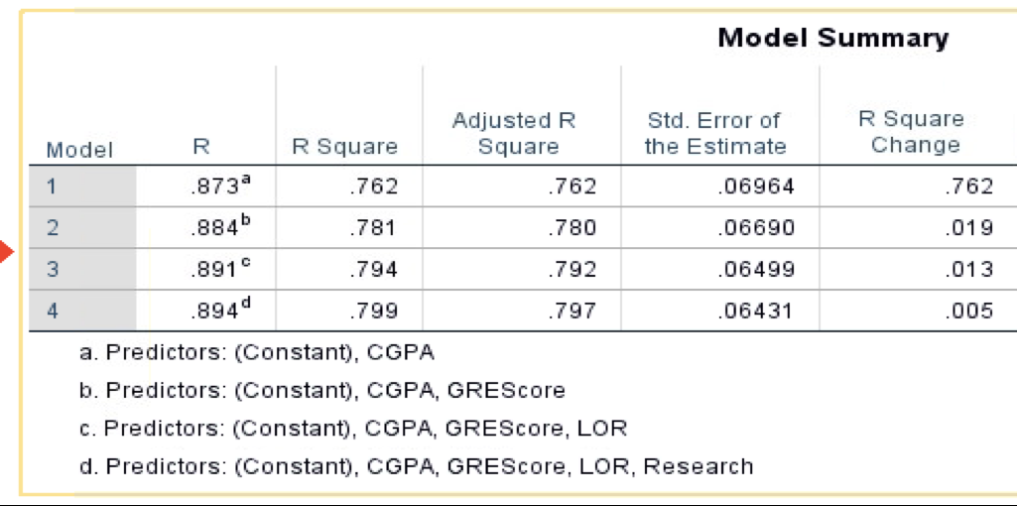
Exploring the Variables!
Stepwise analysis is a process of fitting regression model in which the choice of predictive model is carried out by an automatic process.
CGPA, GRE Score, LOR, Research came out to be the most important independent variables which we can use to create a model.
These 4 factors together explain ~80% of the variability in model.

Slide 15
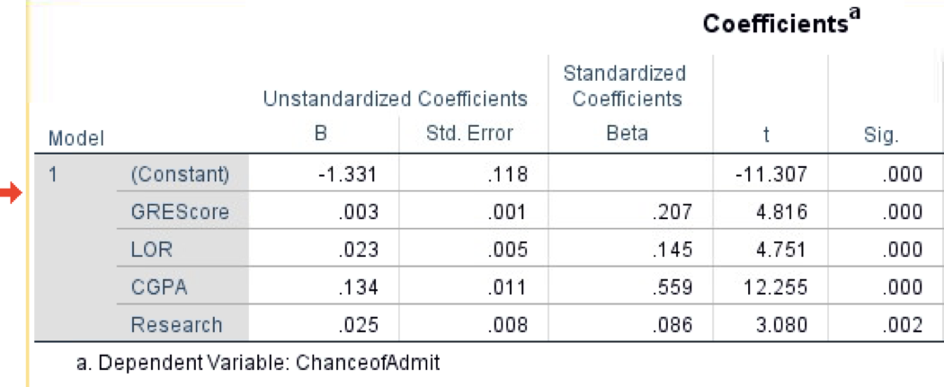
Exploring the Variables!
All the four independent factors have a positive relationship with Chances of Admission
CGPA remains the most important factor to decide on the chances of admission followed by GRE Score, LOR and Research respectively.
Chance of Admit = 0.134*CGPA + 0.003*GRE + 0.023*LOR + 0.025*Research

Slide 16
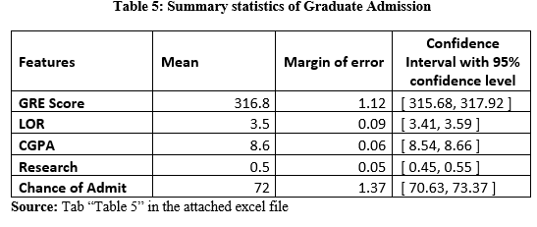
Confidence Interval
Interpretations:
GRE Score:
At 5% significance level, we can say that the average population value of the GRE Score will lie in between 315.68 and 317.92.

Slide 17
LOR:
At 5% significance level, we can say that the average population value of the LOR will lie in between 3.41 and 3.59.
CGPA:
At 5% significance level, we can say that the average population value of the CGPA will lie in between 8.54 and 8.66.
Research:
At 5% significance level, we can say that the average population value of the Research will lie in between 0.45 and 0.55.
Chance of Admit:
At 5% significance level, we can say that the average population value of our target variable (Chance of Admit) will lie in between 70.63% and 73.37%.
We noted that on average the mean of chance of admit varies between 70.63% and 73.37%. This is very important because the range is significantly far from 50% i.e., many more than half of the students have a good chance to get an admit from the university they apply and they actually get it. This information can also be used by the future applicants as a motivation to apply and expect to get an admit.

Slide 18
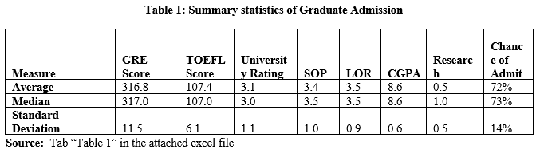
Descriptive Statistics:
We can see that the average of the GRE, TOEFL score and CGPA is considerably more than the possible mid value i.e., 300, 60 and 5.0, respectively.
The median and mean values are very close to each other for all of the features except Research.
Standard deviation is relatively more for GRE and TOEFL score compared to all other features.

Slide 19
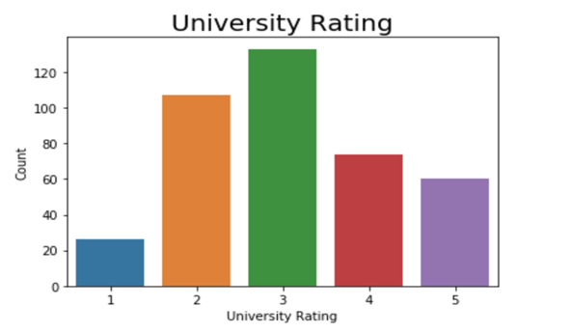
Histogram: University Rating
Universities with rating three gets the maximum number of student applications. We will explore more into the three and five rated universities and the typical student profiles needed.

Slide 20
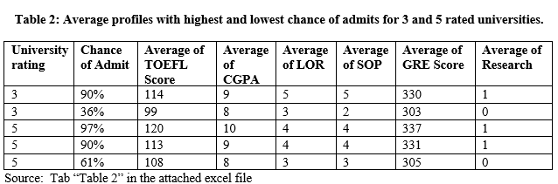
Typical student profiles for 90% chance of admit matches for 3 and 5 rated universities.
When the student has no prior research experience, the chance of admit gets hugely affected.

Slide 21
Conclusion:
Based on the above findings, or the analysis that we have done/presented, we can write the infer the below mentioned info:
We are 95% confident that the mean of all chance of admits lies between 70.63% and 73.37% i.e, many more than half of the students who apply get an admit.
Using ANOVA, we concluded that higher the GRE Score, more are the chances of a student getting admitted to a high university ranking!
CGPA, GRE Score, LOR, and Research comes out to be the most important factors on which the chances of admission depend.
Since all of these have a positive relationship with the Chance of Admission, higher the independent factors, more will be the Chance of Admission.

Slide 22

Time
For
Some
Questions

