Slide 1
Information Security Chapter 1&2 BS-CS-VI VVEEK-02 & 03 Lectures

Slide 2
C.I.A. triangle or Security Objectives
Confidentiality
“Preserving authorized restriction on information access and disclosure, including means for protecting personal privacy and proprietary information.”
Integrity
“Guarding against improper information modification or destruction, and includes ensuring information non-repudiation and authenticity.”
Availability
“Ensuring timely and reliable access and use of information.”
- 2 -

Slide 3
CIA TRIAD (Video)
https://www.youtube.com/watch?v=rwigKjEsdTc
- 3 -

Slide 4
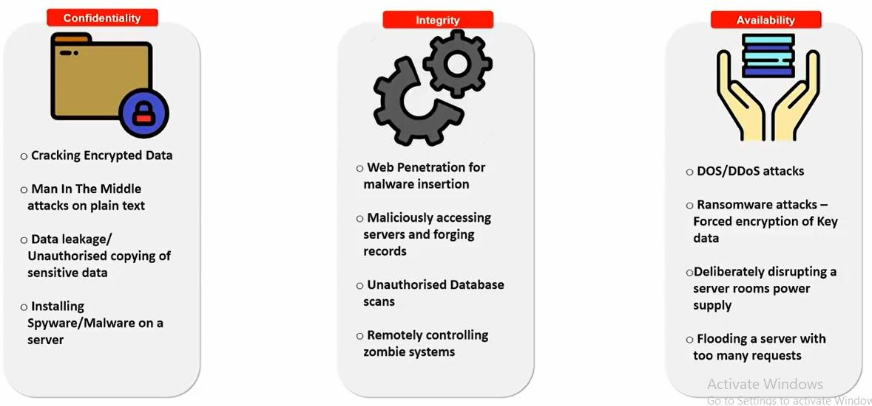
Attacks on CIA
4

Slide 5
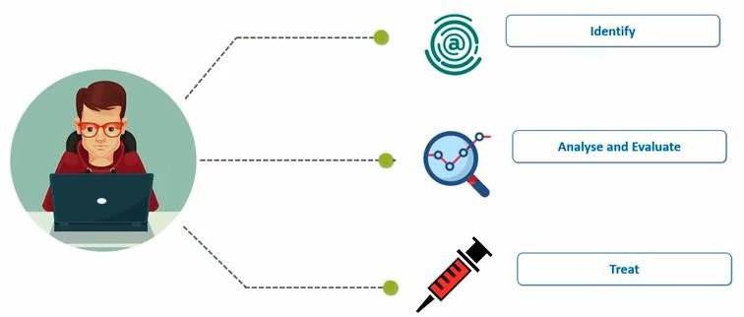
Steps to Fix a Crime
5

Slide 6
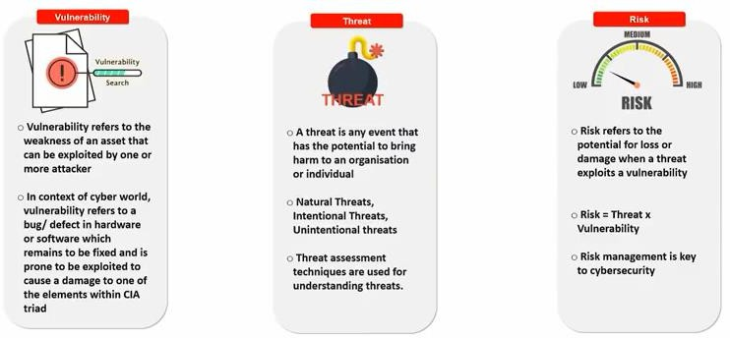
Vulnerability, Threat & Risk
6

Slide 7
How Seriously Should You Take Threats to Network Security?
Which group do you belong to?
“No one is coming after my computer.”
“The sky is falling!”
Middle ground.
© 2012 by Pearson Education, Inc.
Chapter 1 Introduction to Computer Security
7

Slide 8
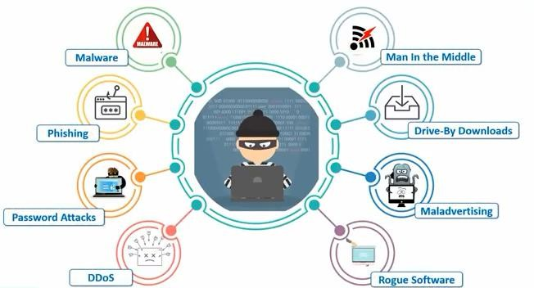
Cyber Attacks
39

Slide 9
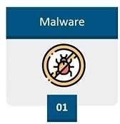
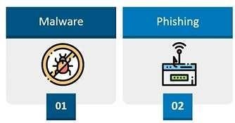
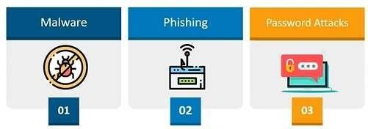
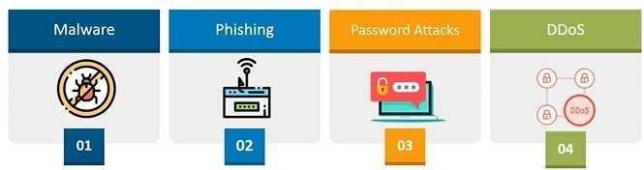
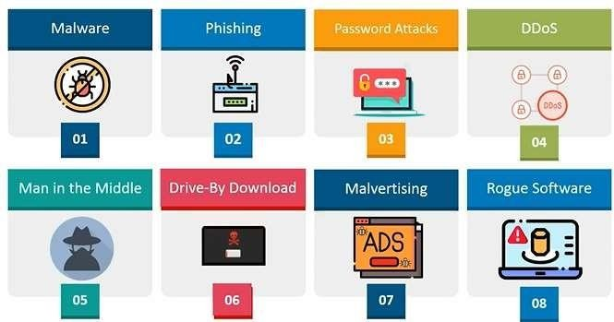
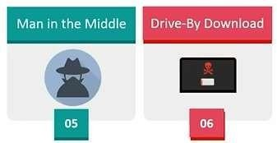
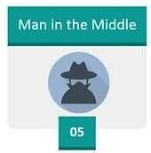
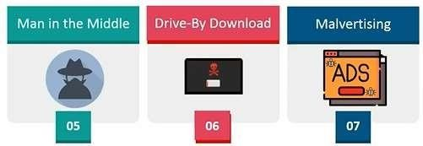
Types of Attacks

Slide 10
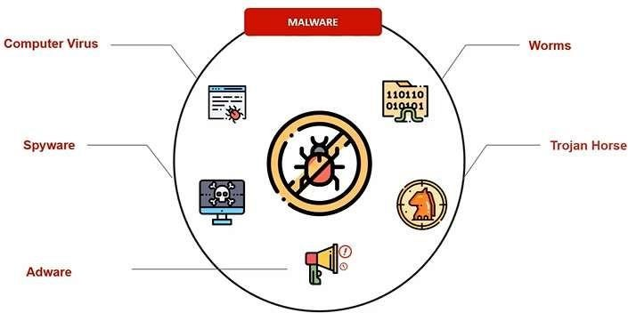
Malware

Slide 11
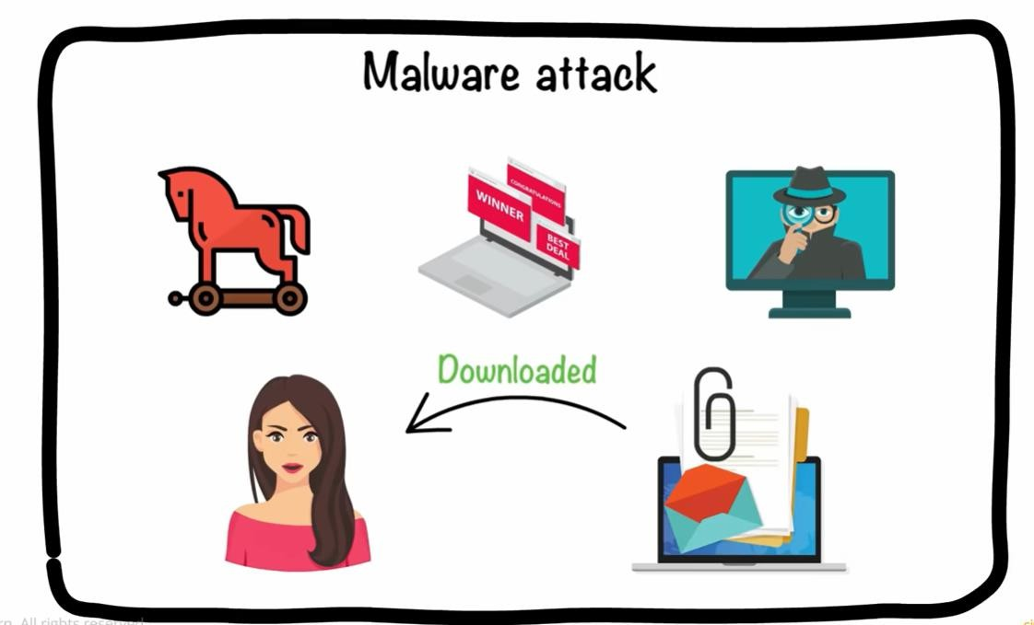

Slide 12
Malware
Spyware
The most rapidly growing types of malware
Cookies
Key logger
© 2012 by Pearson Education, Inc.
Chapter 1 Introduction to Computer Security
43

Slide 13
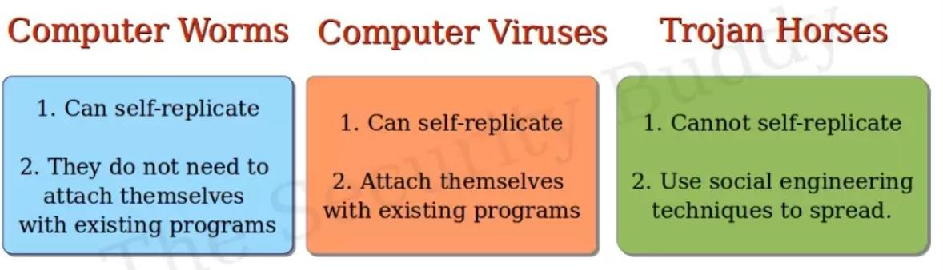

Slide 14
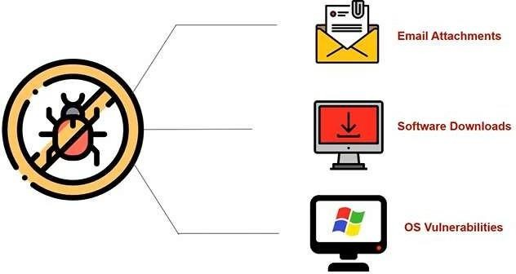
How Malware

Slide 15
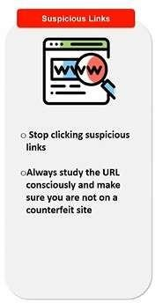
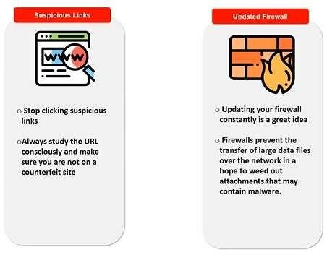
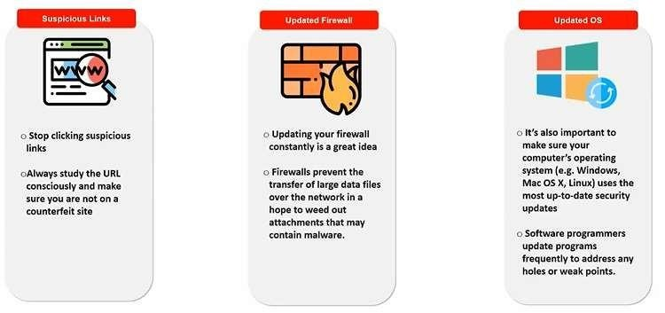
How to Stop?

Slide 16
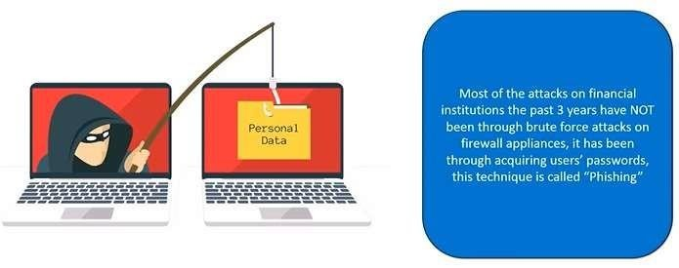
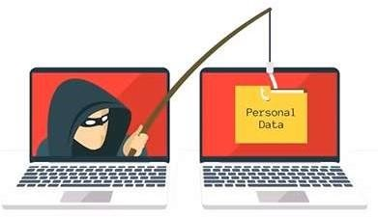
Phishing Attack

Slide 17
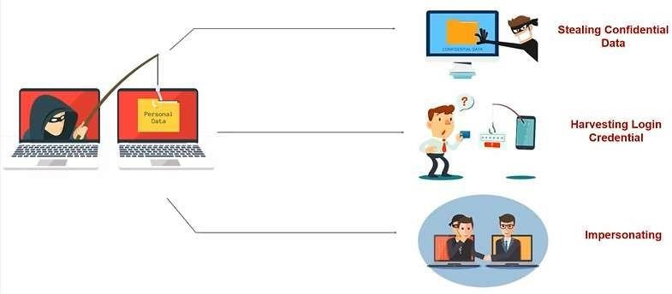
What is Phishing used for?
40

Slide 18
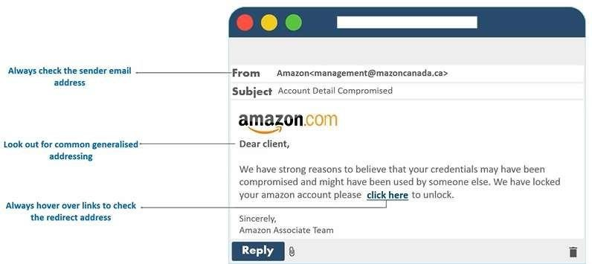
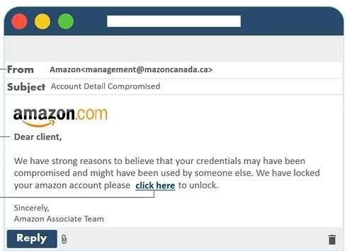
Phishing Awareness

Slide 19
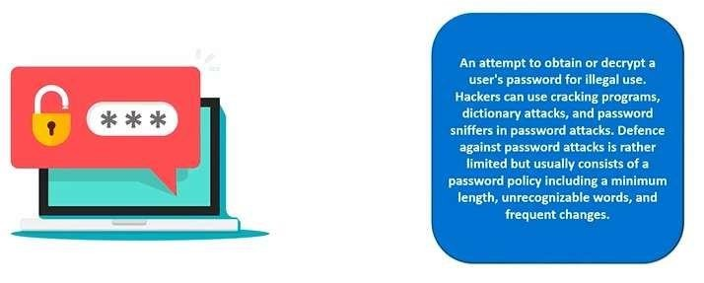
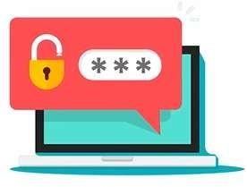
Password Attacks

Slide 20
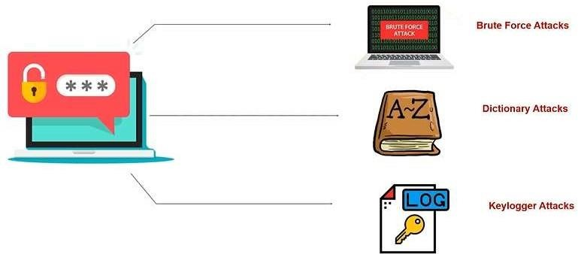
Types of Password Attacks

Slide 21
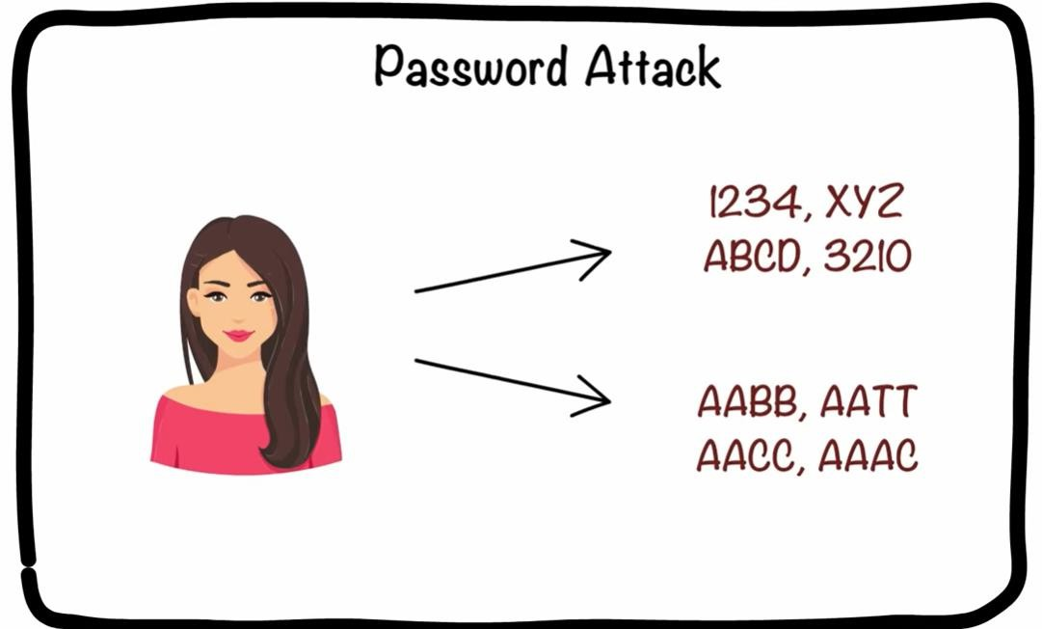

Slide 22
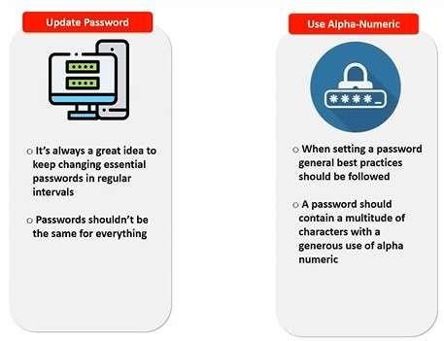
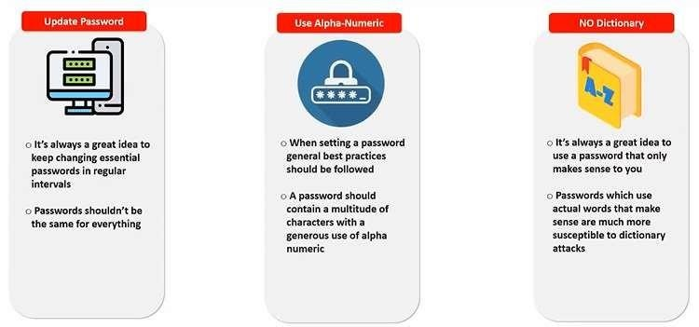
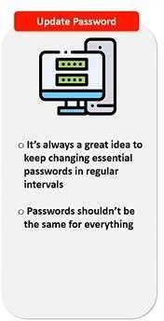
Stop Password Attacks

Slide 23
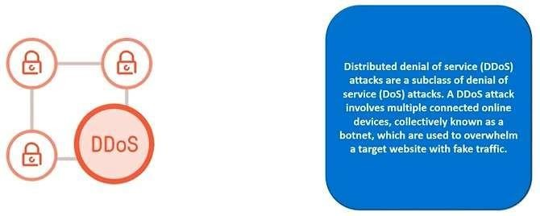
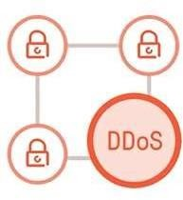
Distributed Denial of Services (DDoS)

Slide 24

Denial of Service Attacks
The attacker does not intrude into the system but just blocks access by authorized users.
© 2012 by Pearson Education, Inc.
Chapter 1 Introduction to Computer Security
55

Slide 25
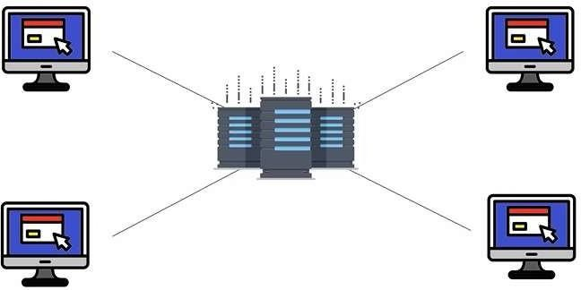
Packet Flood

Slide 26
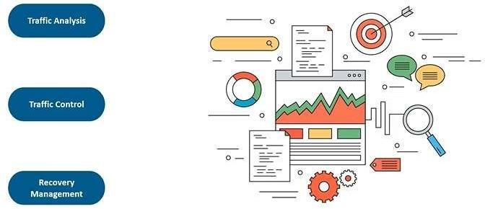
Prevention

Slide 27
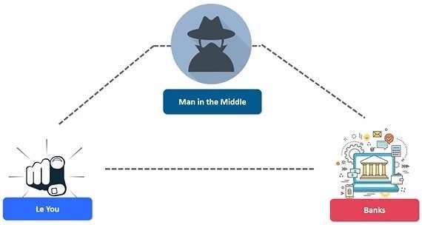
Man in the Middle

Slide 28
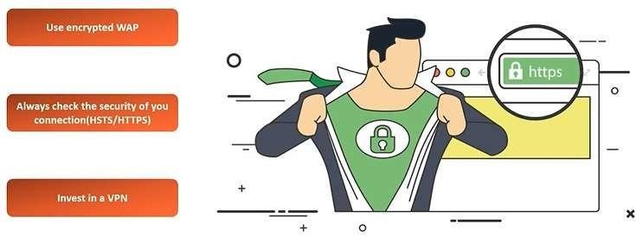
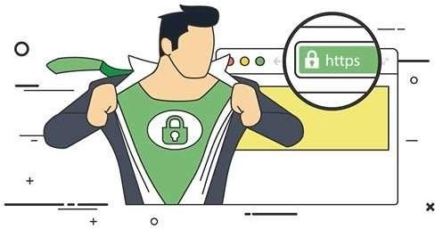
Prevent MITM

Slide 29
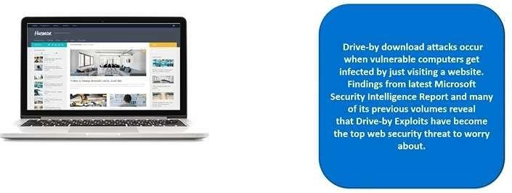
Drive-by Download
50

Slide 30
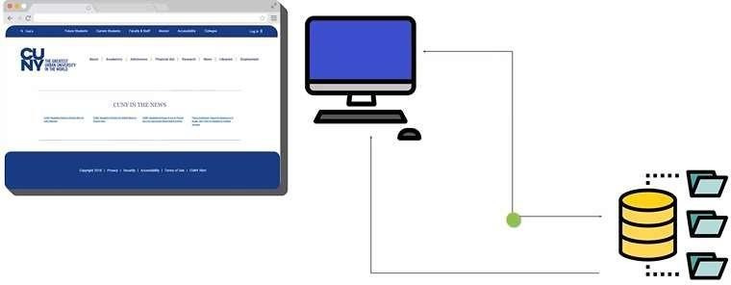
How it work?

Slide 31
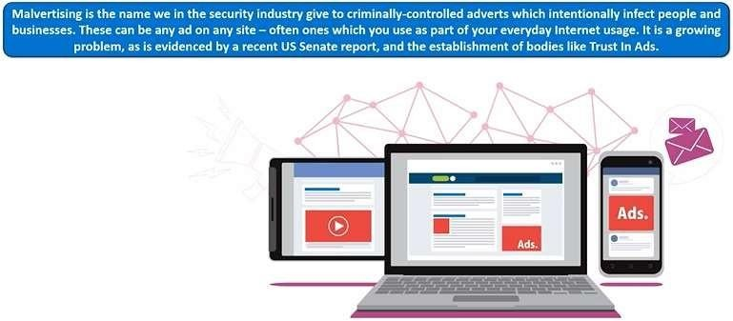
Malvertising

Slide 32
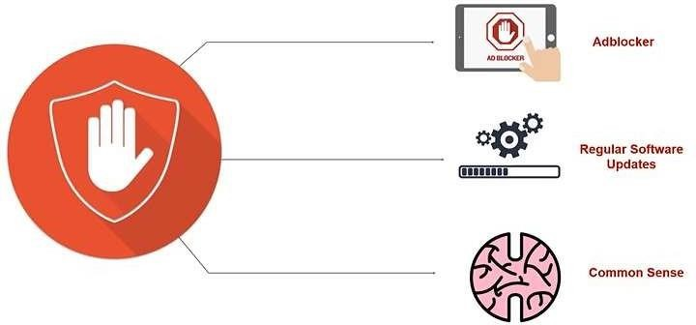
Prevention

Slide 33
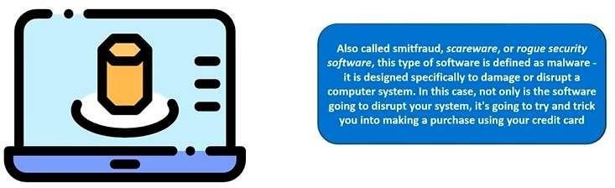
Rogue Software

Slide 34
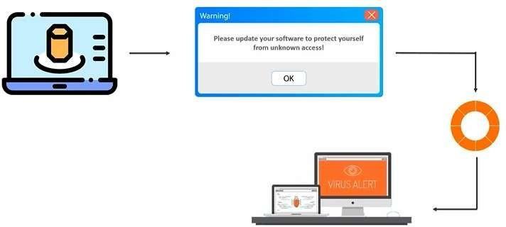
Propagation

Slide 35
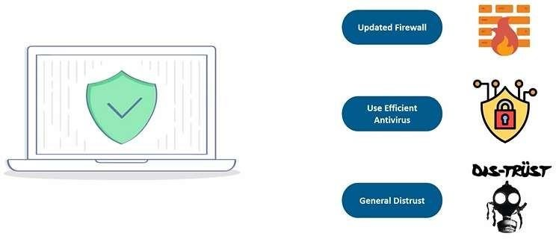
Prevention

Slide 36
Web Attacks
The attacker attempts to breach a web application. Common attacks of this type are SQL injection
© 2012 by Pearson Education, Inc.
Chapter 1 Introduction to Computer Security
67

Slide 37
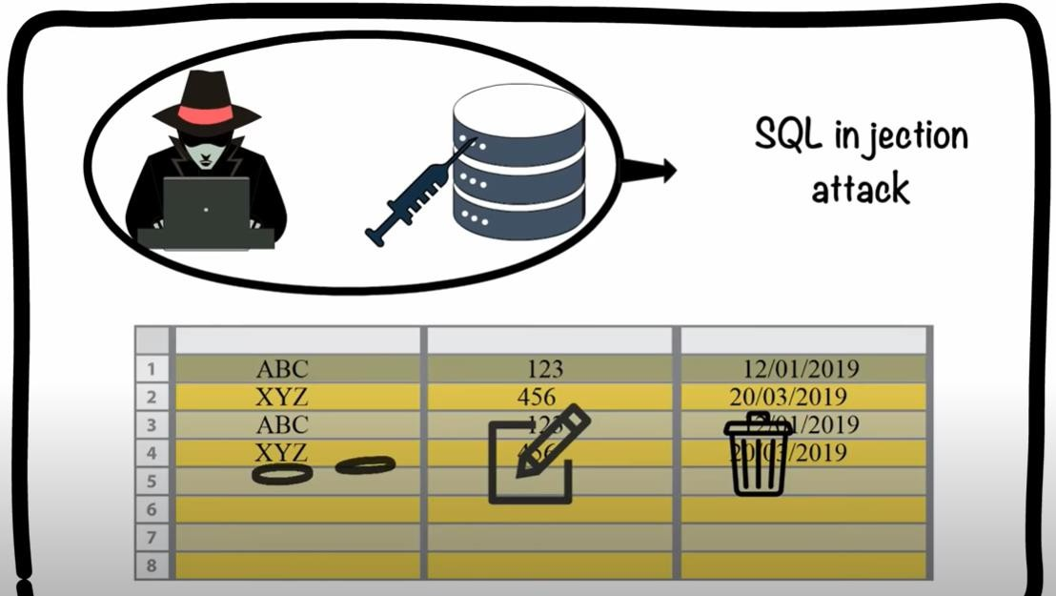
© 2012 by Pearson Education, Inc.
Chapter 1 Introduction to Computer Security

Slide 38
Session Hijacking
This is a complex attack that involves actually taking over an authenticated session.
© 2012 by Pearson Education, Inc.
Chapter 1 Introduction to Computer Security
38

Slide 39
DNS Poisoning
This involves altering DNS records on a DNS server to redirect client traffic to malicious websites, usually for identity theft.
© 2012 by Pearson Education, Inc.
Chapter 1 Introduction to Computer Security
39

Slide 40
Cyber Crime?
????
Cybercrime, or computer-oriented crime, is a crime that involves a computer and a network. The computer may have been used source of a crime, or it may be the target.

Slide 41
Classification of Cyber Crimes
Insider Attack:
Person with authorized system access
Dissatisfied or unhappy inside employees or contractors
Motive could be revenge or greed
Well aware of the policies, processes, IT architecture and weakness of the security system
Comparatively easy for a insider attacker to steel sensitive information, crash the network, etc.
Could be prevented by using IDS/IPS
External Attack:
Hired by an insider or an external entity to the organization
Organization not only faces financial loss but also the loss of reputation
Attackers usually scan and gathering information
Keeps regular eye on the log and carefully analyzing these firewall logs
IDS/IPS can also protect from external attackers

Slide 42
Classification of Cyber Crimes (Cont.)
Cyber attacks can also be classified as:
Unstructured attacks
Generally person who don't have any predefined motives to perform the cyber attack
Try to test a tool readily available over the internet
Structure attacks:
Performed by highly skilled and experienced people
Motives of these attacks are clear in their mind
Access to sophisticated tools and technologies to gain access to other networks without being noticed
Expertise to develop or modify the existing tools to satisfy their purpose
Usually performed by professional criminals, by a country on other rival countries, politicians to damage the image of the rival person or the country, terrorists, rival companies, etc.
60

Slide 43
Reasons for Commission of Cyber Crimes
Money:
People are motivated towards committing cyber crime is to make quick and easy money.
Revenge:
Take revenge with other person/organization/society/caste or religion
Defaming its reputation or bringing economical or physical loss.
This comes under the category of cyber terrorism.
Fun:
The amateur do cyber crime for fun.
Recognition:
It is considered to be pride if someone hack the highly secured networks
Anonymity:
Anonymity that a cyber space provide motivates the person to commit cyber crime
Cyber Espionage:
At times the government itself is involved in cyber trespassing to keep eye on other person/network/country

Slide 44
Kinds of Cyber Crimes
Cyber Stalking
Stalking, harassing, threatening someone, or defame a person
The behavior includes false accusations, threats, sexual exploitation to minors, monitoring, etc.
Child Pornography
Possessing image or video of a minor (under 18), engaged in sexual conduct.
Forgery and Counterfeiting
Produce counterfeit which matches the original document
Not possible to judge the authenticity of the document
Software Piracy and Crime related to IPRs:
An illegal reproduction and distribution
Cyber Terrorism
Use of computer resources to intimidate or force government, the civilian population or any segment thereof in furtherance of political or social objectives
Phishing
Acquiring personal and sensitive information of an individual via email
Vishing (voice phishing), Smishing
■

Slide 45
Kinds of Cyber Crimes (Cont.)
Computer Vandalism
Physical destroying computing resources using physical force or malicious code
Computer Hacking
Modifying computer hardware and software to accomplish a goal
Simply demonstrations of the technical ability, to sealing, modifying or destroying information for social, economic or political reasons

Slide 46
Kinds of Cyber Crimes (Cont.)
Creating and distributing viruses over internet
Spreading of an virus can cause business and financial loss
Spamming
Sending of unsolicited and commercial bulk message
Spams not only irritate the recipients and overload the network but also waste the time and occupy the valuable memory space
Cross Site Scripting
Injecting a malicious client side script into a trusted website
Malicious script gets access to the cookies and other sensitive information and sent to remote servers
Online Auction Fraud
Online auction fraud schemes which often lead to either overpayment of the product or the item is never delivered
Cyber Squatting
Reserving the domain names of someone else's trademark
Sell it afterwards at higher price
■

Slide 47

Basic Security Terminology
People:
Hackers
White hats
Black hats
Gray hats
Script kiddies
Ethical hackers/Sneakers
© 2012 by Pearson Education, Inc.
Chapter 1 Introduction to Computer Security
47

Slide 48
Basic Security Terminology (cont.)
Devices
Firewall
Filters network traffic
Proxy server
Disguises IP address of internal host
Intrusion Detection System
Monitors traffic, looking for attempted attacks
© 2012 by Pearson Education, Inc.
Chapter 1 Introduction to Computer Security
48

Slide 49
Basic Security Terminology (cont.)
Activities
Authentication
Auditing
© 2012 by Pearson Education, Inc.
Chapter 1 Introduction to Computer Security
49

Slide 50
Network Security Paradigms
How will you protect your network?
CIA Triangle
Least Privileges
Perimeter security approach
Layered security approach
Proactive versus reactive
Hybrid security method
© 2012 by Pearson Education, Inc.
Chapter 1 Introduction to Computer Security
50

Slide 51
How Do Legal Issues Impact Network Security?
The Computer Security Act of 1987
OMB Circular A-130
See www.alw.nih.gov/Security/FIRST/papers/ legal/statelaw.txt for state computer laws
Health Insurance Portability and Accountability Act of 1996, HIPAA
© 2012 by Pearson Education, Inc.
Chapter 1 Introduction to Computer Security
51

Slide 52
Online Security Resources
CERT
www.cert.org
Microsoft Security Advisor
www.microsoft.com/security/default.mspx
F-Secure
www.f-secure.com
SANS
www.sans.org
© 2012 by Pearson Education, Inc.
Chapter 1 Introduction to Computer Security
52

Slide 53
Summary
Network security is a constantly changing field.
You need three levels of knowledge.
Take the courses necessary to learn the basic techniques.
Learn your enterprise system intimately, with all its strengths and vulnerabilities.
Keep current in the ever-changing world of threats and exploits.
© 2012 by Pearson Education, Inc.
Chapter 1 Introduction to Computer Security
53

